Slide 1

Vehicle Insurance Fraudulent Claim Detection
UMBC Data Science Capstone Project
Dr. Chaojie (Jay) Wang
By – Lokesh Chava (YJ56814)

Slide 2
Introduction
Insurance Fraud bumps up to millions of dollars every year for insurance companies.
It is very essential to have a fraud detection system in place to avoid fraudulent claims
With the help of such system in hand we can identifying fraudulent requests for insurance claims and avoid frauds, also preserving right claims.
Fraudulent claims introduce additional risk to insurance portfolios.
By detecting and preventing fraud, insurance companies can better manage their risk exposure and maintain the financial health of the organization.

Slide 3
Data
Source: https://www.kaggle.com/datasets/khusheekapoor/vehicle-insurance-fraud-detection
Size: 3.69MB
Data Shape: 15420 Rows and 30 Columns
The dataset is an automobile insurance dataset “car claims”, which is publicly available and is provided by Angoss Knowledge Seeker. It has 15420 samples, of which 14497 are legitimate and 923 fraudulent.
This dataset contains columns like make, year, accident area, etc. and there are of integer, Object and String datatypes.

Slide 4
Target Variable: “FraudFound” is one of the features which labels weather a given entry is a fraudulent claim or not. It is of object type which contains either “yes” or “No” values in it.
Predictor Variables: Make, DriverRating, AgeOfPolicyholder, AgeOfVehicle, PastNumberOfClaims, NumberOfSuppliments, Year, VehiclePrice are the features that we will be using as predictor variables.

Slide 5
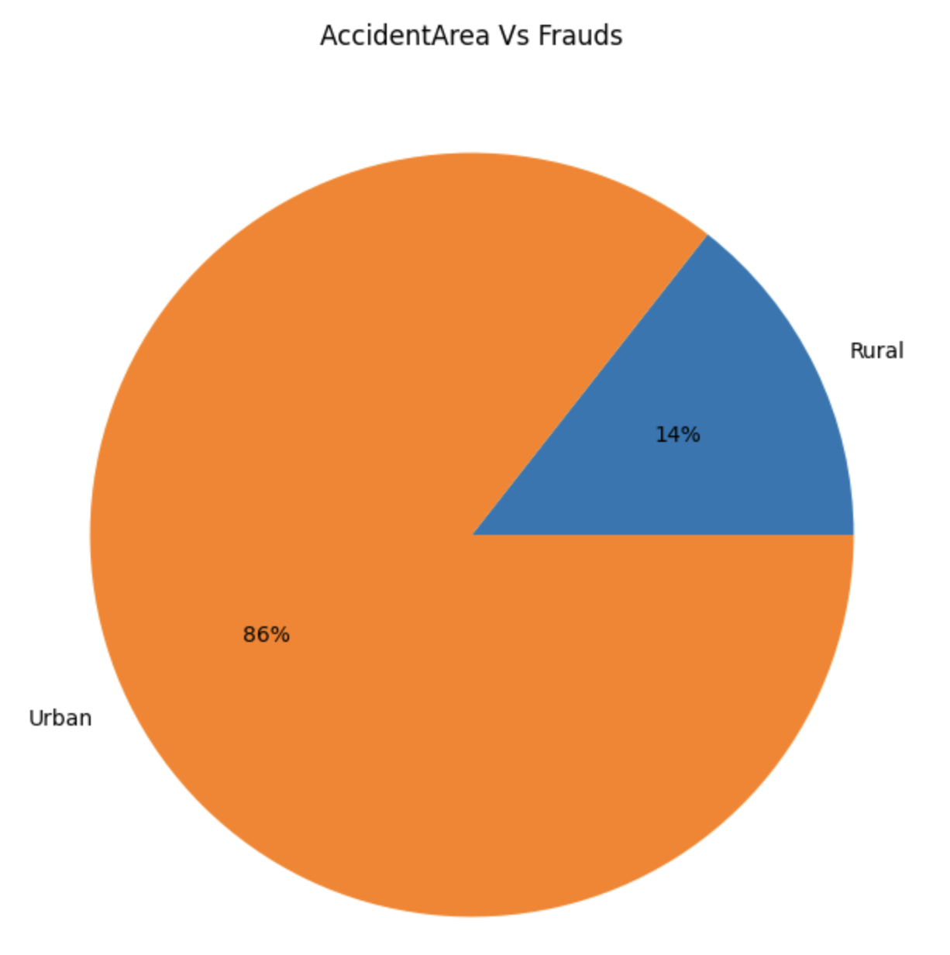
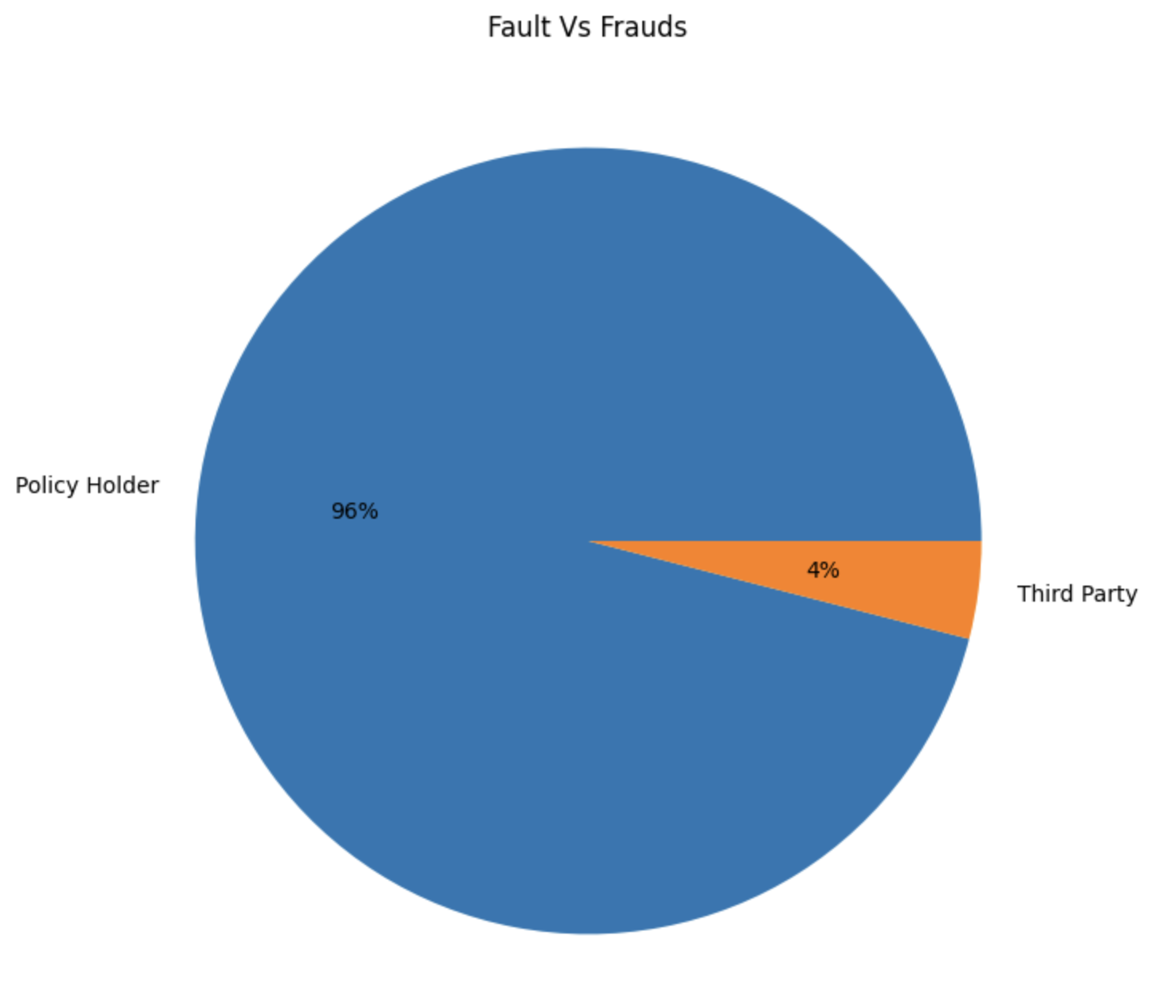
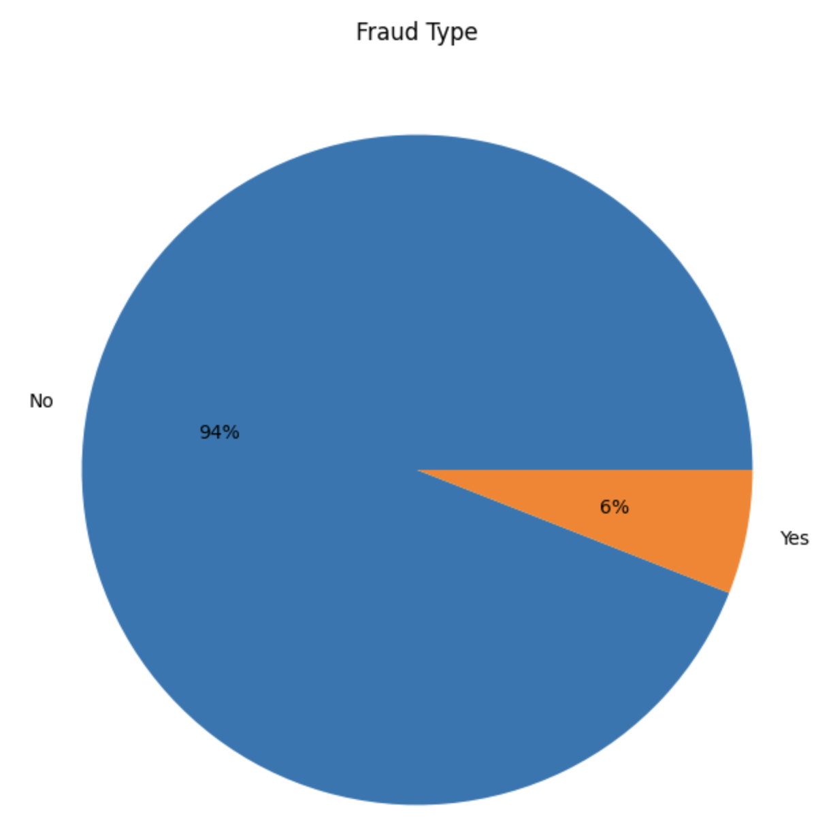
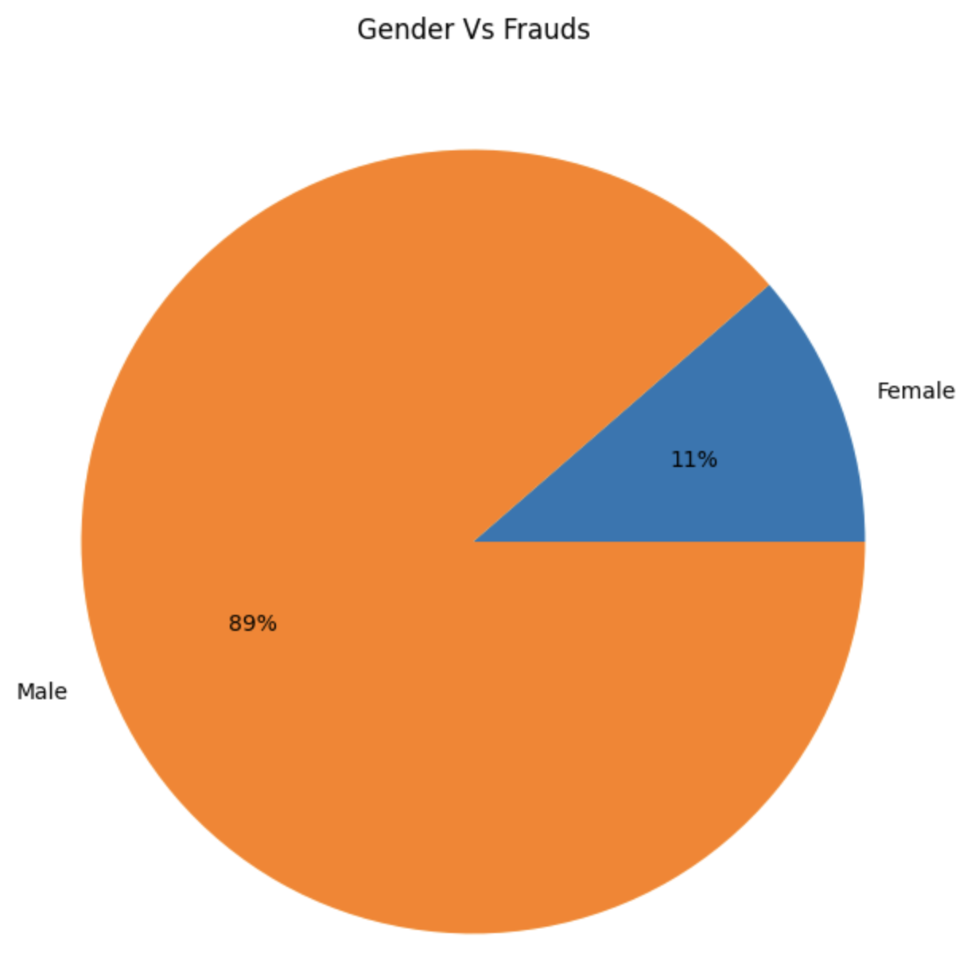
Explorative Data Analysis

Slide 6
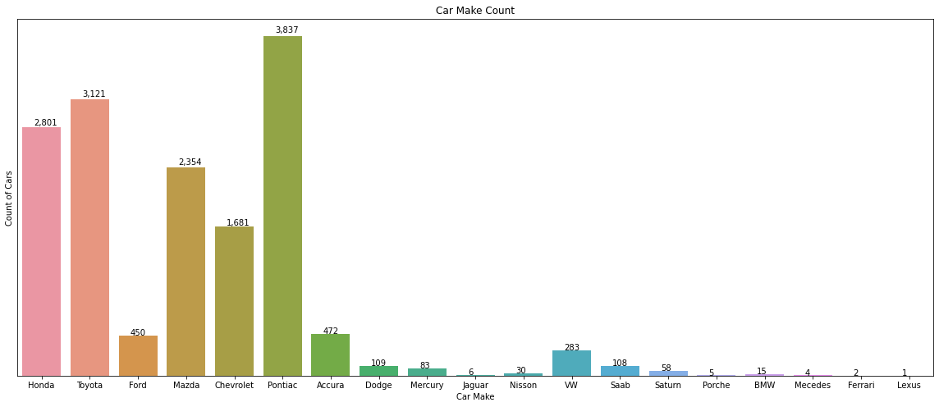
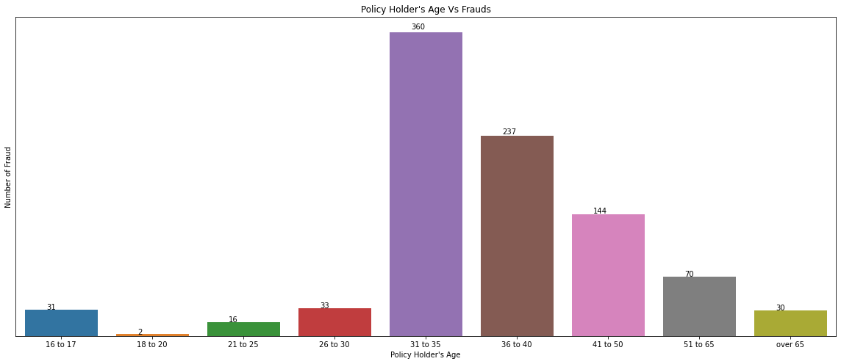
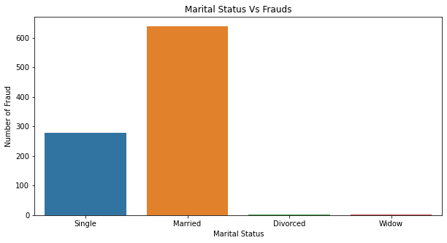
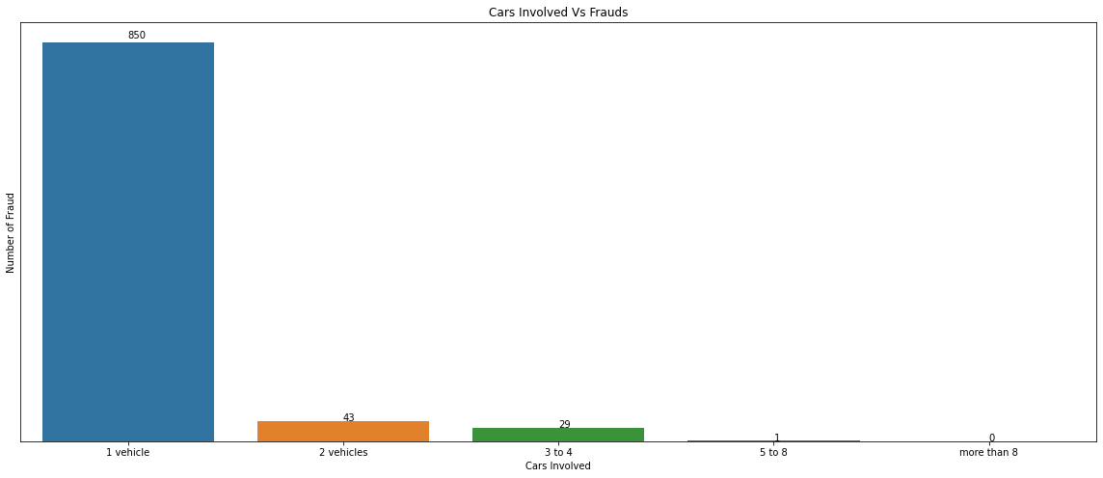

Slide 7
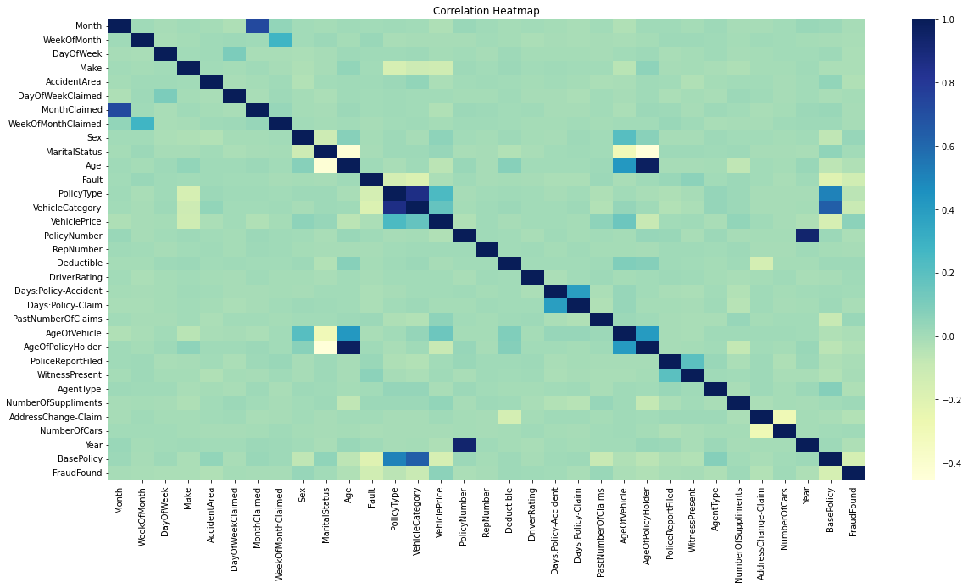
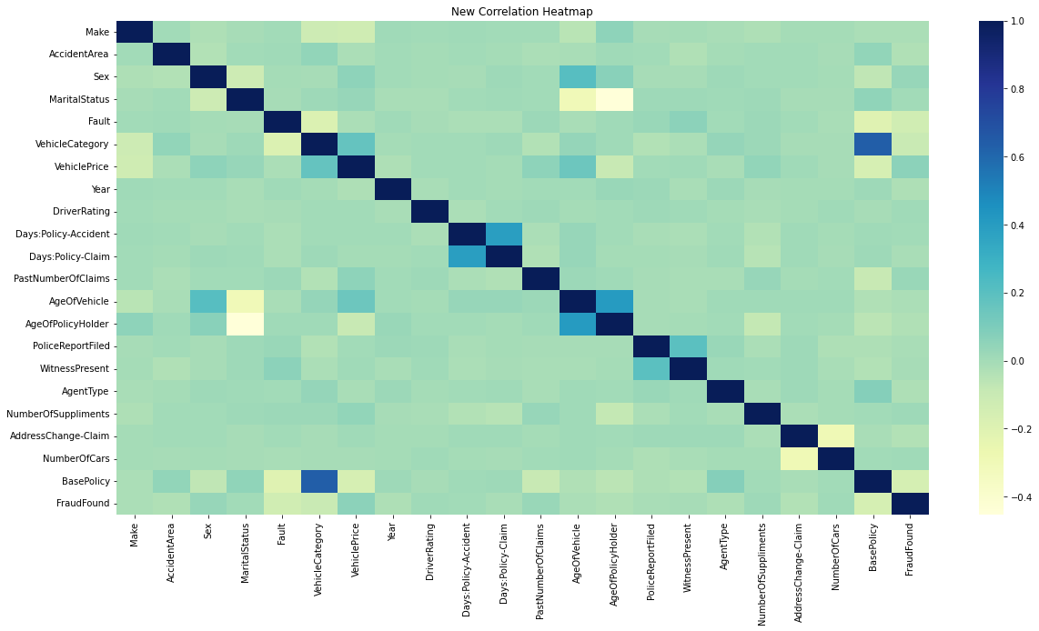
Correlation for all Features
Correlation for selected features

Slide 8
Data Preparation
Features selection based on correlation matrix with respect to the target variable
Encoding the features using LabelEncoder
Splitting the data using train_test_split
Balancing using under sampling and over sampling
Feature importance

Slide 9
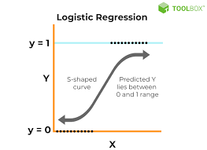
Logistic Regression Model
It is mainly used to check the association of independent variables with (categorical or continuous) with a binary variable
It is easy to set up and use
Model training by up-sampling the minor classes and down sampling the major classes
Down Sampling Accuracy: 0.75
Up Sampling Accuracy: 0.73

Slide 10
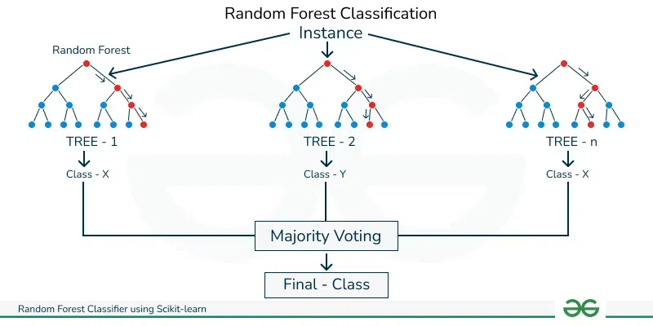
Random Forest Classifier
It is an ensemble learning method for classification, regression and other tasks that operates by constructing a multitude of decision trees at training time.
Because of its complexity and being an ensemble model, it is prone to overfitting and other issues that other traditional decision tree models faces.
Model training by up-sampling the minor classes and down sampling the major classes
Down Sampling Accuracy: 0.77
Up Sampling Accuracy: 0.98

Slide 11
Cat Boost Model
It is a gradient boot model which involves adding decision trees to minimize errors.
It is designed for regression and classification problems having huge number of features.
It requires no encoding for the data
Implementation of Symmetric weighted Quantile Sketch(SWQS) algorithm to handle missing values.
It work excellent with default parameters as it hyper-tune itself through internal cross validation.
It also works best with imbalanced classes.
Model accuracy: 0.82

Slide 12
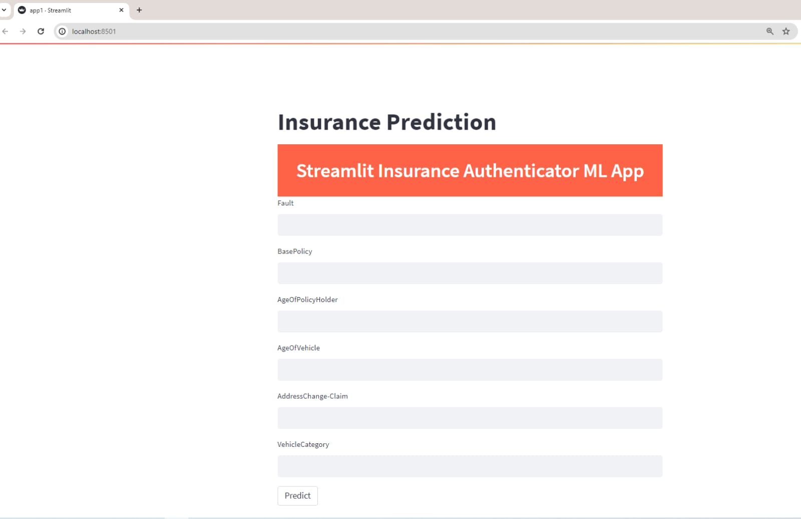
Model Deployment
Application Interface
The Streamlit Application enables us to deploy a machine learning model and use it to predict fraudulent insurances cases based on user inputs.
The app takes "Fault","BasePolicy","AgeOfPolicyHolder","AgeOfVehicle","AddressChange-Claim","VehicleCategory” as inputs and gives “Yes”, ”No” representing Fraud or not fraud as output.

Slide 13




Thank You

