Slide 1

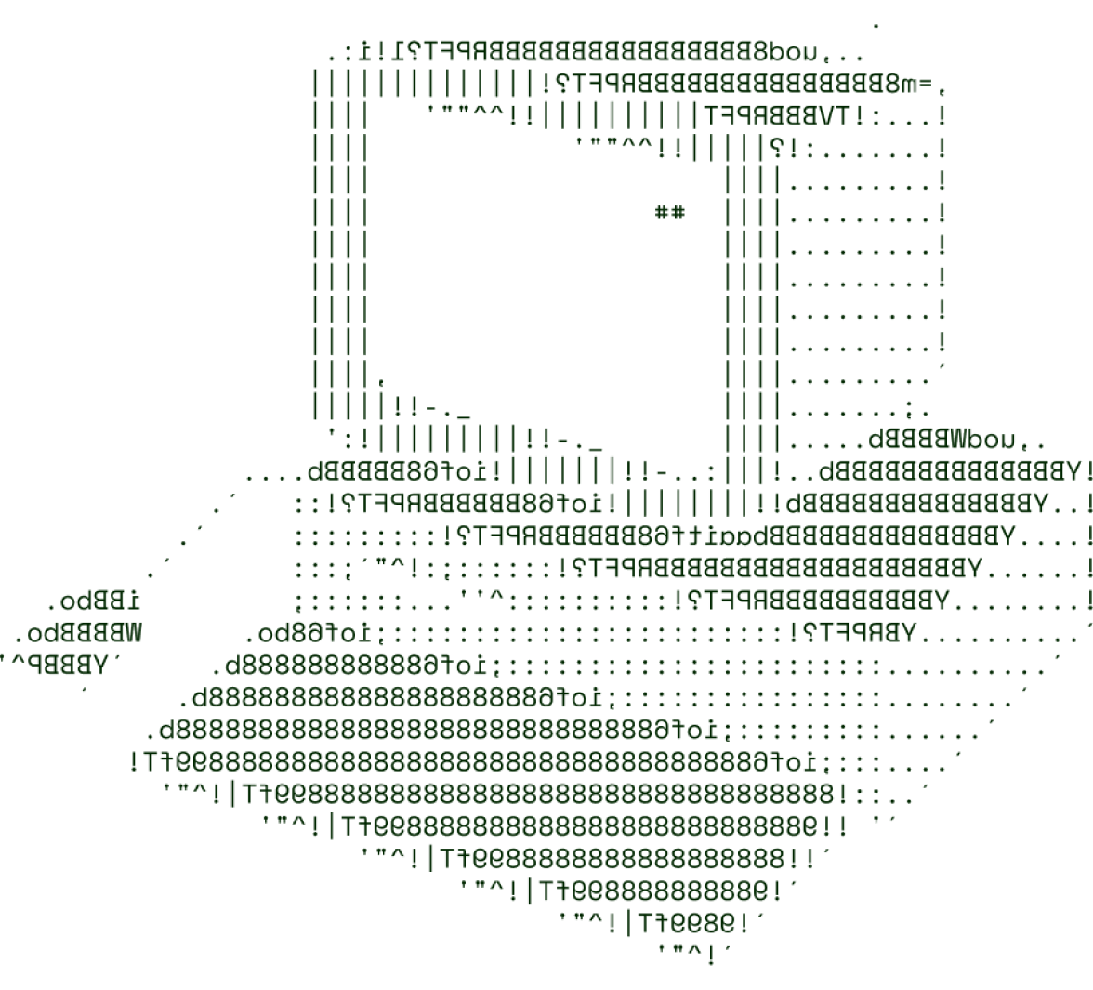

Agriculture for Tech & Rural Development
Farmotech

Slide 2

Our solution focuses on integrating cutting-edge technology into rural agriculture, addressing the critical issue of resource depletion and low productivity in rural areas. It leverages IoT, AI, and Blockchain to create a data-driven ecosystem that improves farming practices, boosts efficiency, and ensures transparency in the supply chain.
How It Addresses the Problem: The primary issues in rural agriculture are the lack of modern tools, water scarcity, soil degradation, and poor market access. Our solution uses:
Precision agriculture tools like IoT sensors to monitor soil health and automate irrigation.
Drones for precision spraying, reducing chemical overuse.
Blockchain for fair trade and transparent market access, cutting out middlemen.
Mobile apps that give farmers real-time data on weather, crop prices, and pest management.
Innovation and Uniqueness:
Data-driven farming: Leveraging AI to predict crop health and optimize resources.
Low-cost hardware: Utilizing affordable IoT devices and solar-powered tools for rural areas.
Blockchain integration: Ensuring supply chain transparency and fair pricing for rural farmers.
Key Features and Benefits:
Real-time data analytics for soil and crop monitoring.
Automated irrigation systems that conserve water.
E-commerce integration to help farmers directly reach buyers.
Blockchain for secure transactions, reducing exploitation by middlemen.
Mobile app for on-the-go access to market trends and farming tips.

Slide 3
TECH STACK
Frontend Technologies:
React for dynamic UI and real-time data rendering.
Bootstrap for responsive, mobile-friendly design.
Backend Technologies:
Node.js (with Express) for scalable and fast API development.
Django for secure and data-driven applications.
Database:
MongoDB for handling large datasets of real-time IoT sensor data.
PostgreSQL for transaction-heavy applications like blockchain integration.
Other Tools/Services:
AWS (Amazon Web Services) for cloud hosting and scaling.
Docker for containerization, ensuring the solution is portable and scalable.
Firebase for real-time database integration for mobile applications.
Git for version control and team collaboration.

Slide 4
SCALABILITY AND FUTURE SCOPE
Handling Increased Load:
The system is designed with microservices architecture, ensuring that different components (e.g., data analytics, blockchain, and irrigation systems) work independently and scale as needed.
Using cloud services (AWS) allows for elastic scaling, ensuring the system can handle increased traffic, users, and data.
Load balancing ensures equal distribution of traffic across servers to avoid overload.
Architecture Considerations:
Serverless computing (AWS Lambda) can be implemented for specific event-based tasks like sensor data collection and processing.
Database partitioning and sharding can ensure efficient data management as the user base grows.
Technologies Supporting Scalability:
Microservices: Each component of the system is built as a service, which can be independently deployed and scaled.
Containerization with Docker: Ensures that the application can be replicated and scaled across multiple environments with ease.
Kubernetes: Used for orchestration, managing containers across clusters for even greater scalability.
Additional Functionalities:
AI-driven prediction models for crop yields based on historical data.
Drone-based automated crop spraying for precision pest control.
Smart contract integration using Blockchain to automatically execute fair transactions.

Slide 5
FEASIBILITY
Potential Challenges and Risks:
Initial Adoption Resistance: Farmers in rural areas might resist new technologies.
Connectivity Issues: Rural areas often lack the infrastructure for stable internet access, limiting real-time data transmission.
High Initial Costs: Even with affordable IoT solutions, some farmers might find it difficult to afford the technology upfront.
Strategies for Overcoming These Challenges:
Education and Training: Offering workshops and demonstrations to help farmers understand the benefits of adopting these technologies.
Offline Functionality: Building a system that works offline and syncs data when internet connectivity is restored.
Government and NGO Partnerships: Collaborating with local governments and non-profits to subsidize costs and provide low-interest loans to farmers.
Scalable Pricing Models: Providing low-cost versions of IoT devices and expanding as adoption increases.

Slide 6

>Team Details

Slide 7




CHAVALI LOKESH
M.N. TANISHK REDDY
Software Developer
Software Developer
P DHEERAJ
K BALACHANDRA
Software Developer
Software Developer

Slide 8

Thanks

