Slide 1

Interfacing GSM module with LPC1768
Submitted by
Lokesh Chinthakuntla
(C0749681)

Slide 2
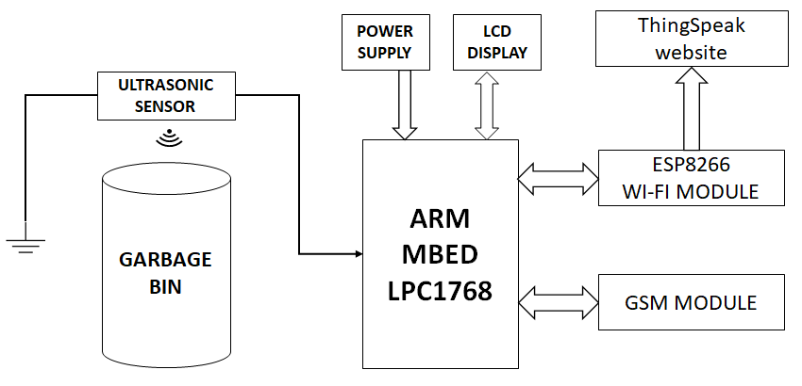
Block diagram

Slide 3
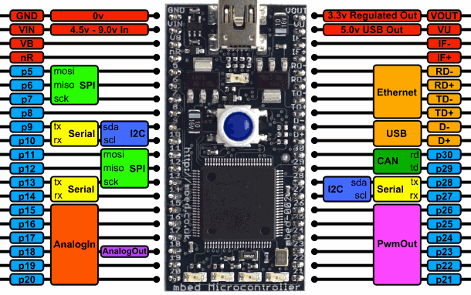
LPC1768 Pinout

Slide 4
Interface GSM with microcontroller.
GSM (Global System for Mobile Communication)
The GSM is communicating the microcontroller with mobile phones through UART. To communicate over UART , we just need three basic signals which are namely, RXD (receive), TXD (transmit), GND (common ground).
The transmit signal of serial port of microcontroller is connected with transmit signal (TxD) of the serial interface of GSM Modem while receive signal of microcontroller serial port is connected with receive signal (RxD) of serial interface of GSM Modem.

Slide 5
Hardware requirements :
LPC1768 micro-controller
GSM Module
Jumper wires
Bread board
Li-ion battery

Slide 6
Mbed online compiler
The IDE includes a full code editor including syntax highlighting, standard editor keyboard shortcuts, undo/redo, cut/copy/paste, tabs, block/line comment, and even a code auto-formater
Pre-configured compile engine that "just works", delivering .bin binary file to save to mbed microcontroller
Publish, fork, push and pull code in collaboration-enabled environment
Import programs from online catalogue of published programs

Slide 7
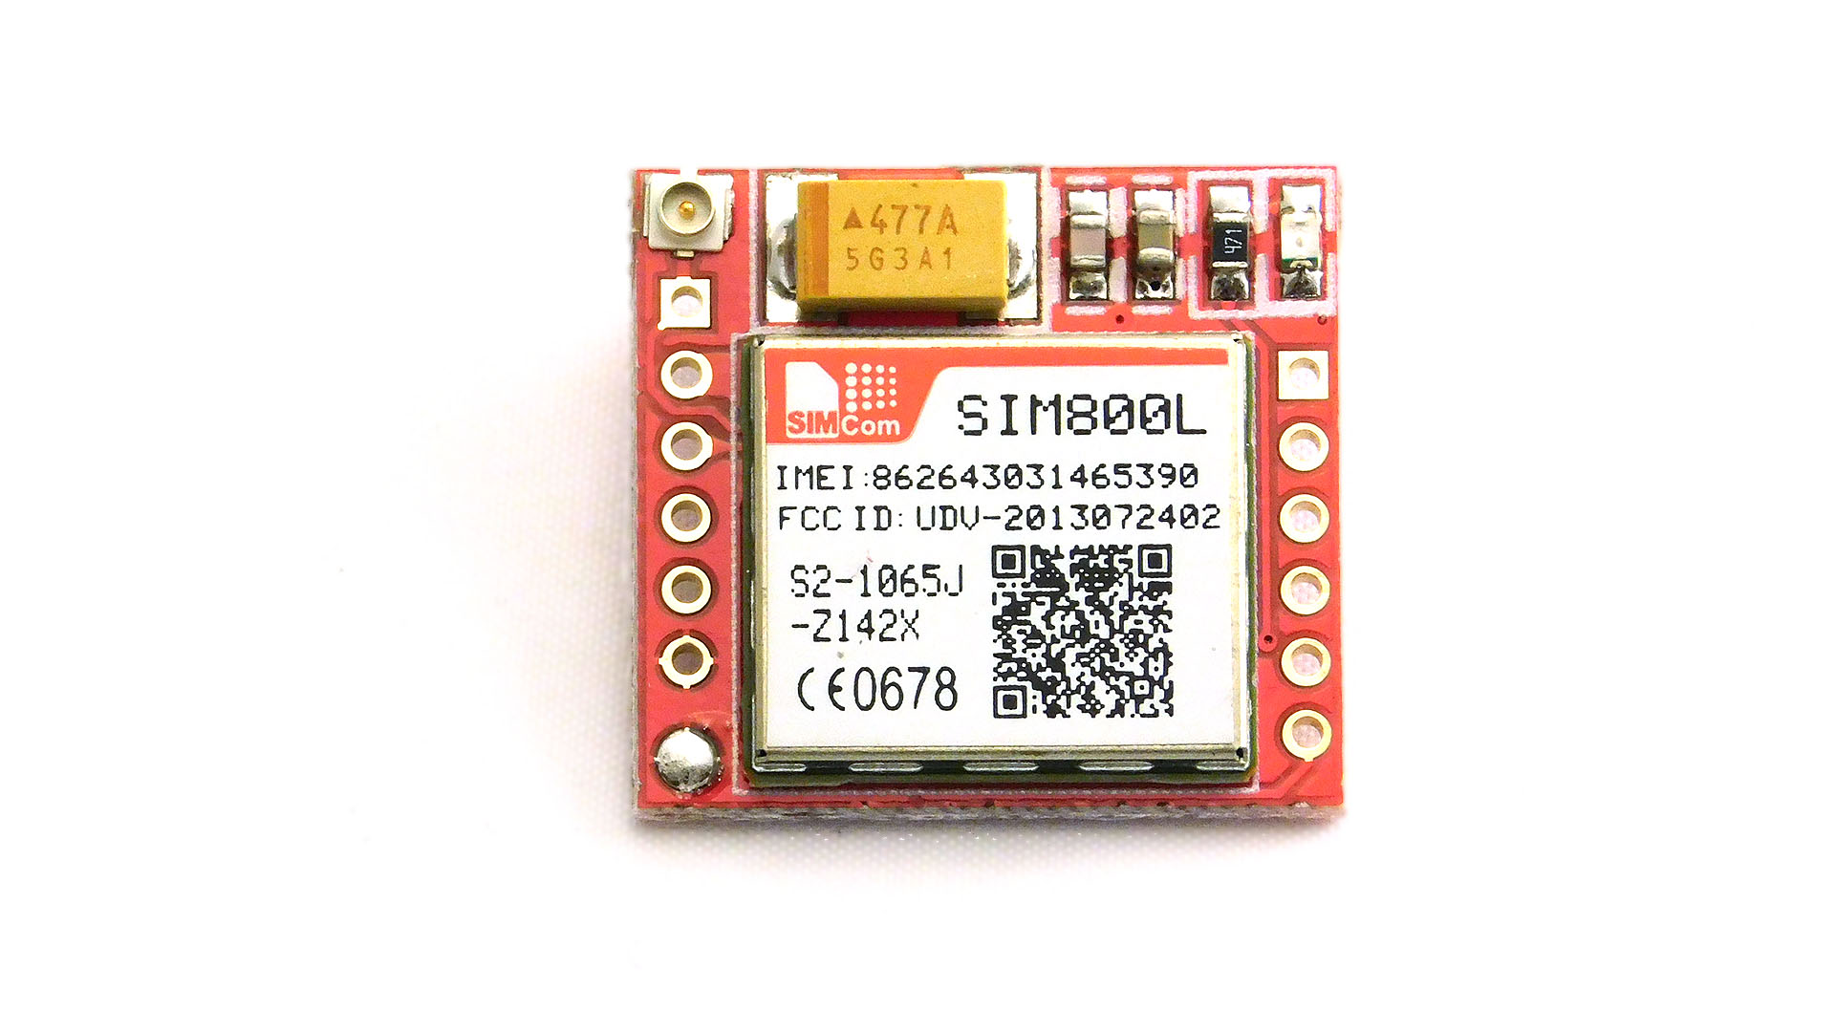
SIM800L GSM module
SIM800L is a miniature cellular module which allows for GPRS transmission, sending and receiving SMS and making and receiving voice calls.
Low cost and small footprint and quad band frequency support make this module perfect solution for any project that require long range connectivity.

Slide 8
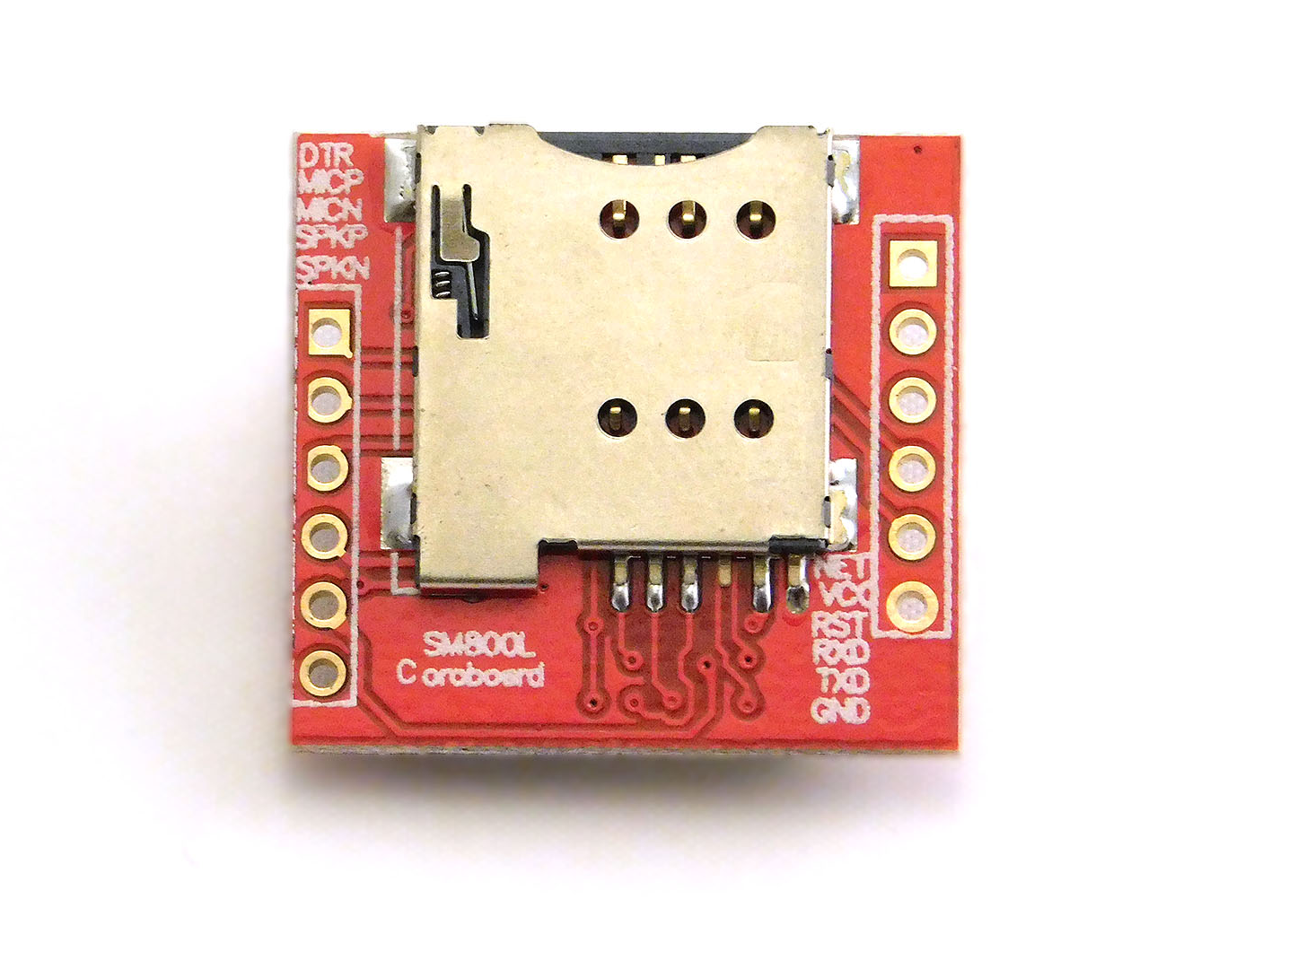
SIM800L GSM module
Supply voltage: 3.8V - 4.2V
Recommended supply voltage: 4V
Power consumption:
sleep mode < 2.0mA
idle mode < 7.0mA
GSM transmission (avg): 350 mA
GSM transmission (peek): 2000mA
Module size: 25 x 23 mm
Interface: UART (max. 2.8V) and AT commands
SIM card socket: micro-SIM (bottom side)

Slide 9
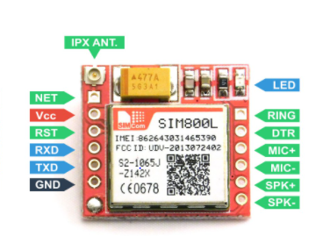
Sim800L Pinout :
Bottom side – left :
RING (not marked on PBC, first from top, square) - LOW state while receiving call
DTR - sleep mode. Default in HIGH state (module in sleep mode, serial communication disabled). After setting it in LOW the module will wake up.
MICP, MICN - microphone (P + / N -)
SPKP, SPKN - speaker (P + / N -)
Bottom side – right :
NET - antenna
VCC - supply voltage
RESET - reset
RXD - serial communication
TXD - serial communication
GND - ground

Slide 10
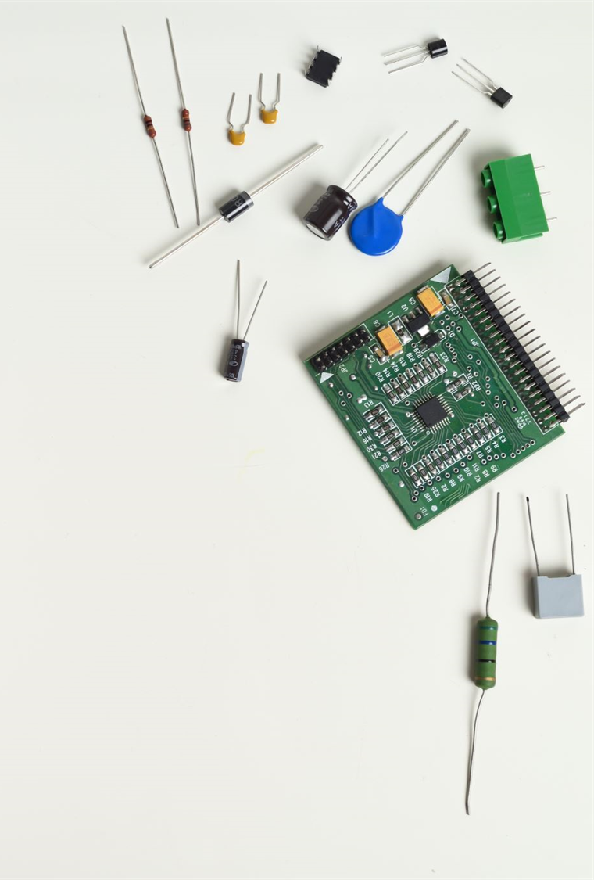
Sim800L Pinout
NET is a pin where you can solder Helical Antenna provided along with the module.
VCC supplies power for the module. This can be anywhere from 3.4V to 4.4 volts. Remember connecting it to 5V pin will likely destroy your module! It doesn’t even run on 3.3 V! An external power source like Li-Po battery or DC-DC buck converters rated 3.7V 2A would work.
RST (Reset) is a hard reset pin. If you absolutely got the module in a bad space, pull this pin low for 100ms to perform a hard reset.
RxD (Receiver) pin is used for serial communication.

Slide 11
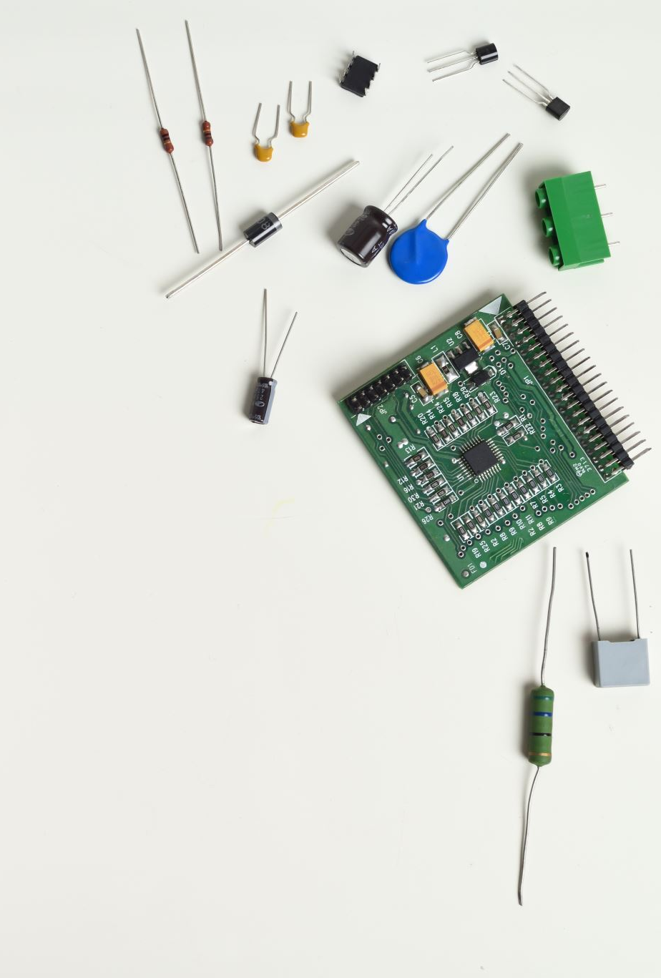
Sim800L Pinout
TxD (Transmitter) pin is used for serial communication.
GND is the Ground Pin and needs to be connected to GND pin on the LPC1768.
RING pin acts as a Ring Indicator. It is basically the ‘interrupt’ out pin from the module. It is by default high and will pulse low for 120ms when a call is received. It can also be configured to pulse when an SMS is received.
MIC± is a differential microphone input. The two microphone pins can be connected directly to these pins.
SPK± is a differential speaker interface. The two pins of a speaker can be tied directly to these two pins.

Slide 12

LED Status Indicators:
There is an LED on the top right side of the SIM800L Cellular Module which indicates the status of your cellular network. It’ll blink at various rates to show what state it’s in.
Blink every 1s
The module is running but hasn’t made connection to the cellular network yet.
Blink every 2s:
The GPRS data connection you requested is active.
Blink every 3s
The module has made contact with the cellular network & can send/receive voice and SMS.

Slide 13

Selecting Antenna
An antenna is required to use the module for any kind of voice or data communications as well as some SIM commands. So, selecting an antenna could be a crucial thing.
There are two ways you can add an antenna to your SIM800L module.
Helical GSM antenna
3dBi GSM antenna

Slide 14
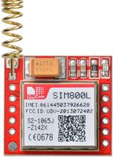
Helical GSM Antenna:
The first one is a Helical GSM antenna which usually comes with the module and solders directly to NET pin on PCB. This antenna is very useful for projects that need to save space but struggles in getting connectivity especially if your project is indoors.

Slide 15
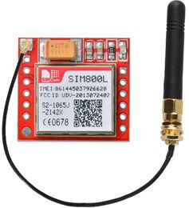
3dBi GSM Antenna :
The second one is any 3dBi GSM antenna along with a U.FL to SMA adapter which can be obtained online for less than $3. You can snap-fit this antenna to small u.fl connector located on the top-left corner of the module. This type of antenna has a better performance and allows putting your module inside a metal case – as long the antenna is outside.

Slide 16
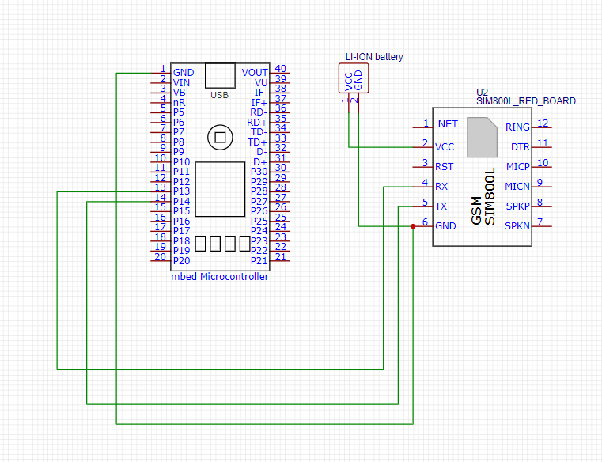
Schematic diagram

Slide 17
Connections :
VCC of GSM module is connected to +VE terminal of battery.
GND is connected to GND pin of battery
RX pin is connected to pin 13 of LPC1768
TX is connected to pin 14 of LPC1768.

Slide 18
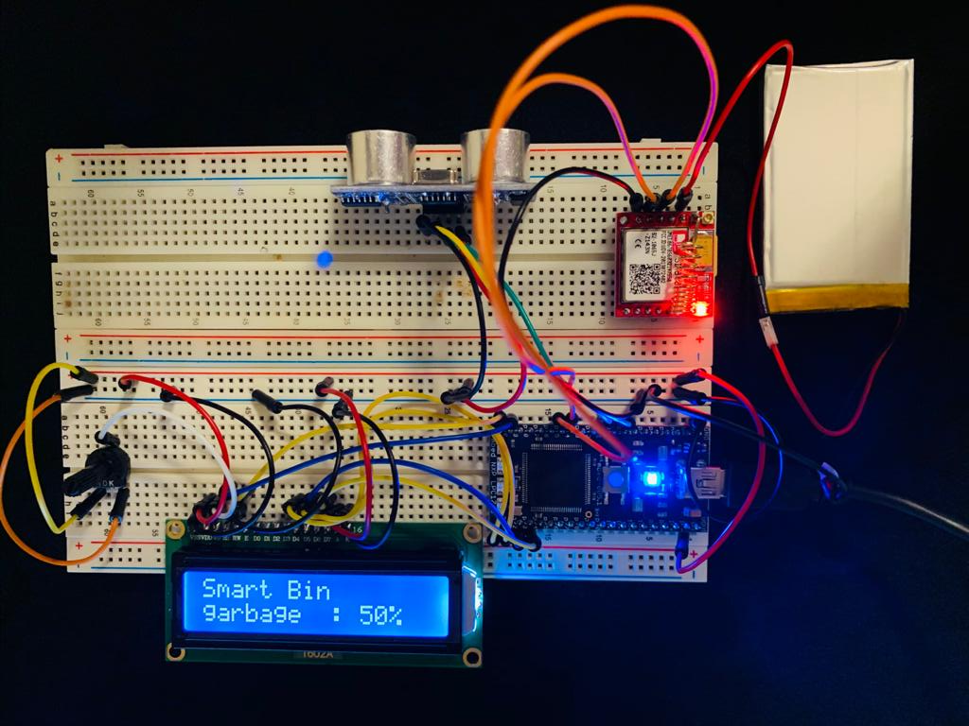
Hardware setup

Slide 19
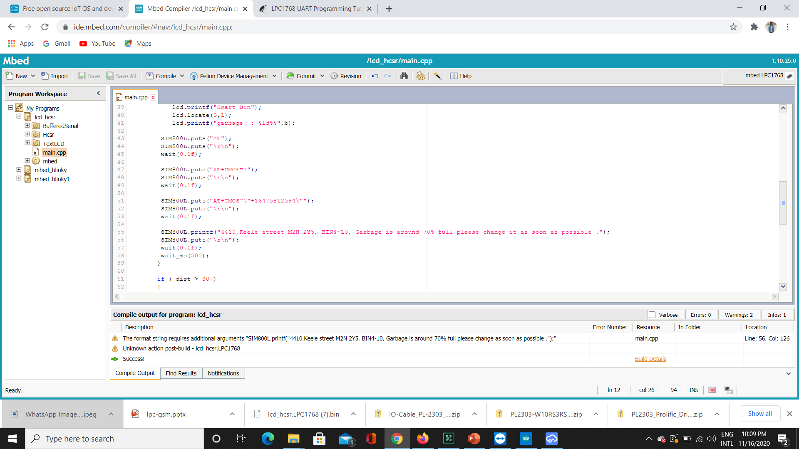
Interfacing code :

Slide 20

References
Mbed Compiler - Handbook. (n.d.). Retrieved November 03, 2020, from https://os.mbed.com/handbook/mbed-Compiler
Mbed. (n.d.). Retrieved November 03, 2020, from https://os.mbed.com/
Retrieved November 2020, from https://www.pantechsolutions.net/how-to-interface-gsm-with-lpc2148-arm

