Slide 1
NiziChat
Giving privacy back to users
A group chat app that
‘DOESN’T TRACK YOU’

Slide 2
INTRODUCTION
NiziChat is an anonymous group chat application which lets you chat securely by secretly agreed private chat codes.
It lets you do that without exposing any information to anybody and keeping your chat truly PRIVATE.

Slide 3

INTRODUCTION
It respects your privacy and doesn’t track you.
Don’t make your private chat subject to some computer algorithms and ultimately to surveillance programs and Corporations.

Slide 4

YOU
THINK
NO ONE IS
WATCHING
YOU?

Slide 5
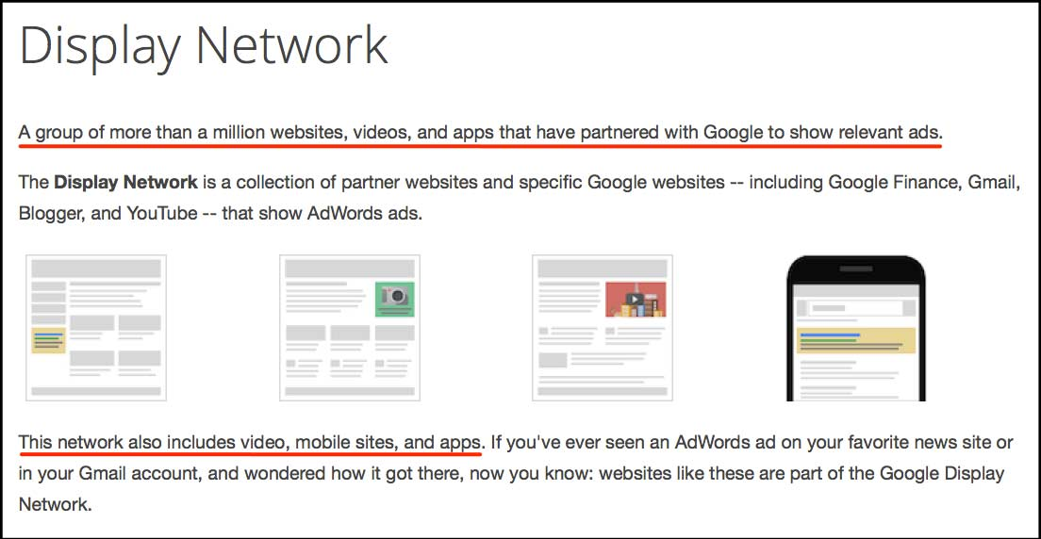

Slide 6
TECHNOLOGIES USED
Node.js
Socket.io
Express.js
Javascript + Jquery
Jade/Pug
CSS3 + Bootstrap3

Slide 7
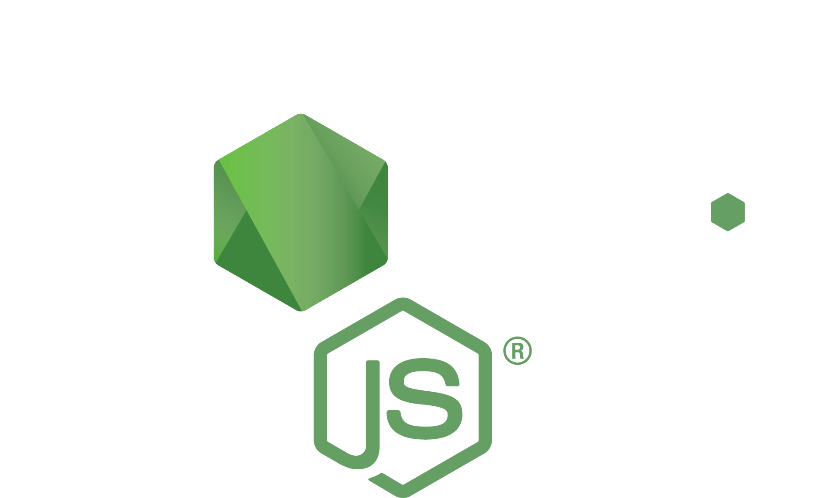
Node.js is a JavaScript runtime built on Chrome's V8 JavaScript engine.
Node.js uses an event-driven, non-blocking I/O model that makes it lightweight and efficient.
Express.js is fast, unopinionated, minimalist web framework for Node.js, specially used for routing.

Slide 8
Socket.IO
Socket.IO enables real-time bidirectional event-based communication.
It is a thin wrapper over HTML5 WebSockets protocol (RFC 6455).
Makes persistent connnection, and works faster( I mean a lot) than AJAX.

Slide 9
Web Frontend
Jquery and javascript is used for client side scripting for handling socket events and DOM manipulation.
Pug(Formerly known as Jade) is used as templating engine
CSS3 is used for styling and effects.
Twitter Bootstrap is used for achieving responsive design and reducing boilerplate frontend code

Slide 10
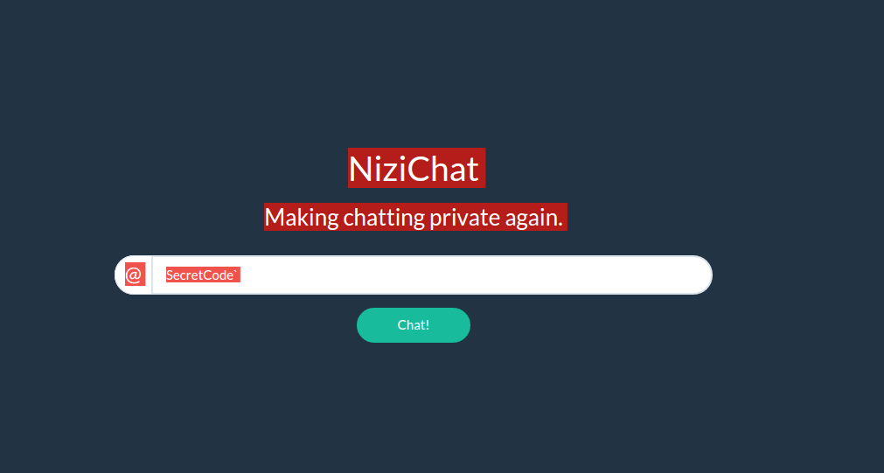
Screenshots

Slide 11
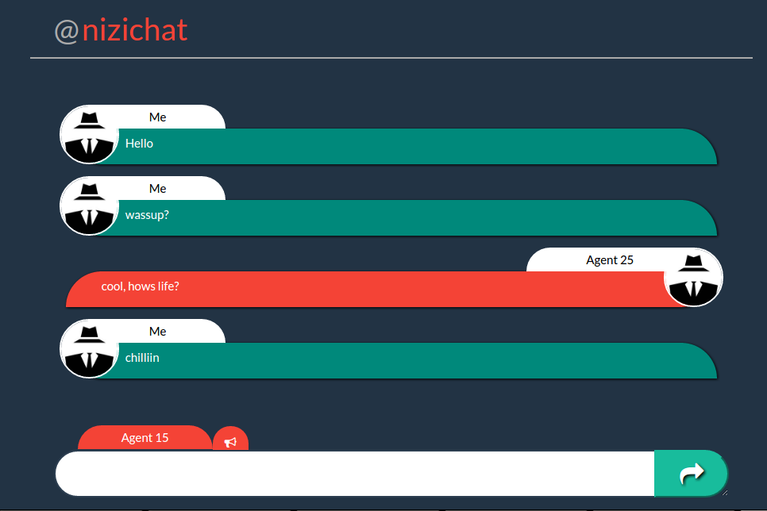
Screenshots

Slide 12
ADVICE
Use a VPN or TOR setup to protect your identity.
Always use incognito mode for accessing NiziChat.
Use DuckDuckGo as your search engine.
Raise awareness towards privacy.

Slide 13

Contribute
Help me to make this better by:
Suggesting new features
Finding Bugs and filing issues to bug tracker.
Cloning, making improvements and sending a pull request to me.
https://github.com/lokeshthegenius/nizichat

Slide 14
Any
Suggestions or
Queries?

