Slide 1
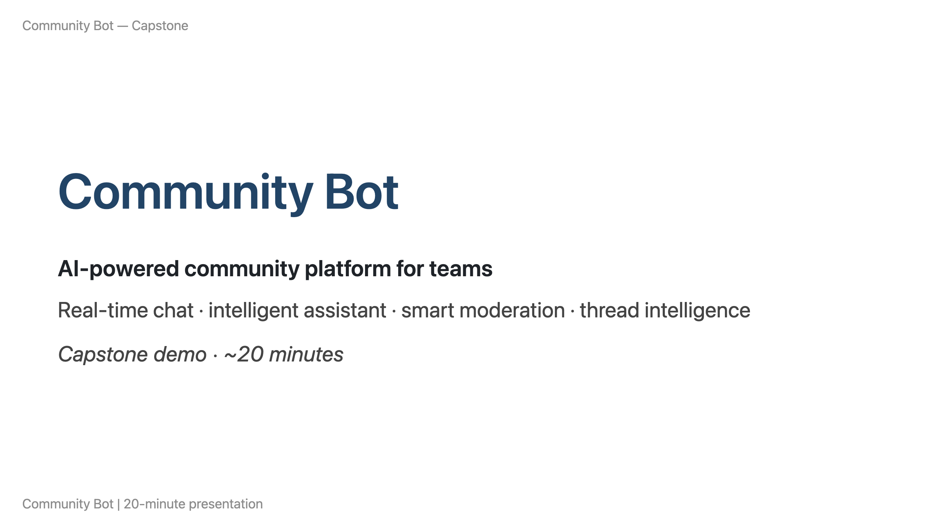

Slide 2
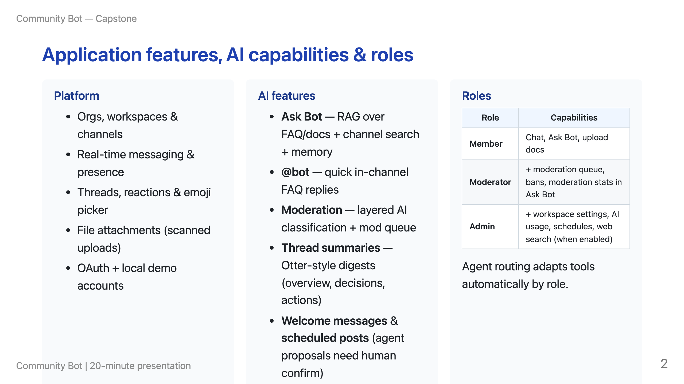

Slide 3
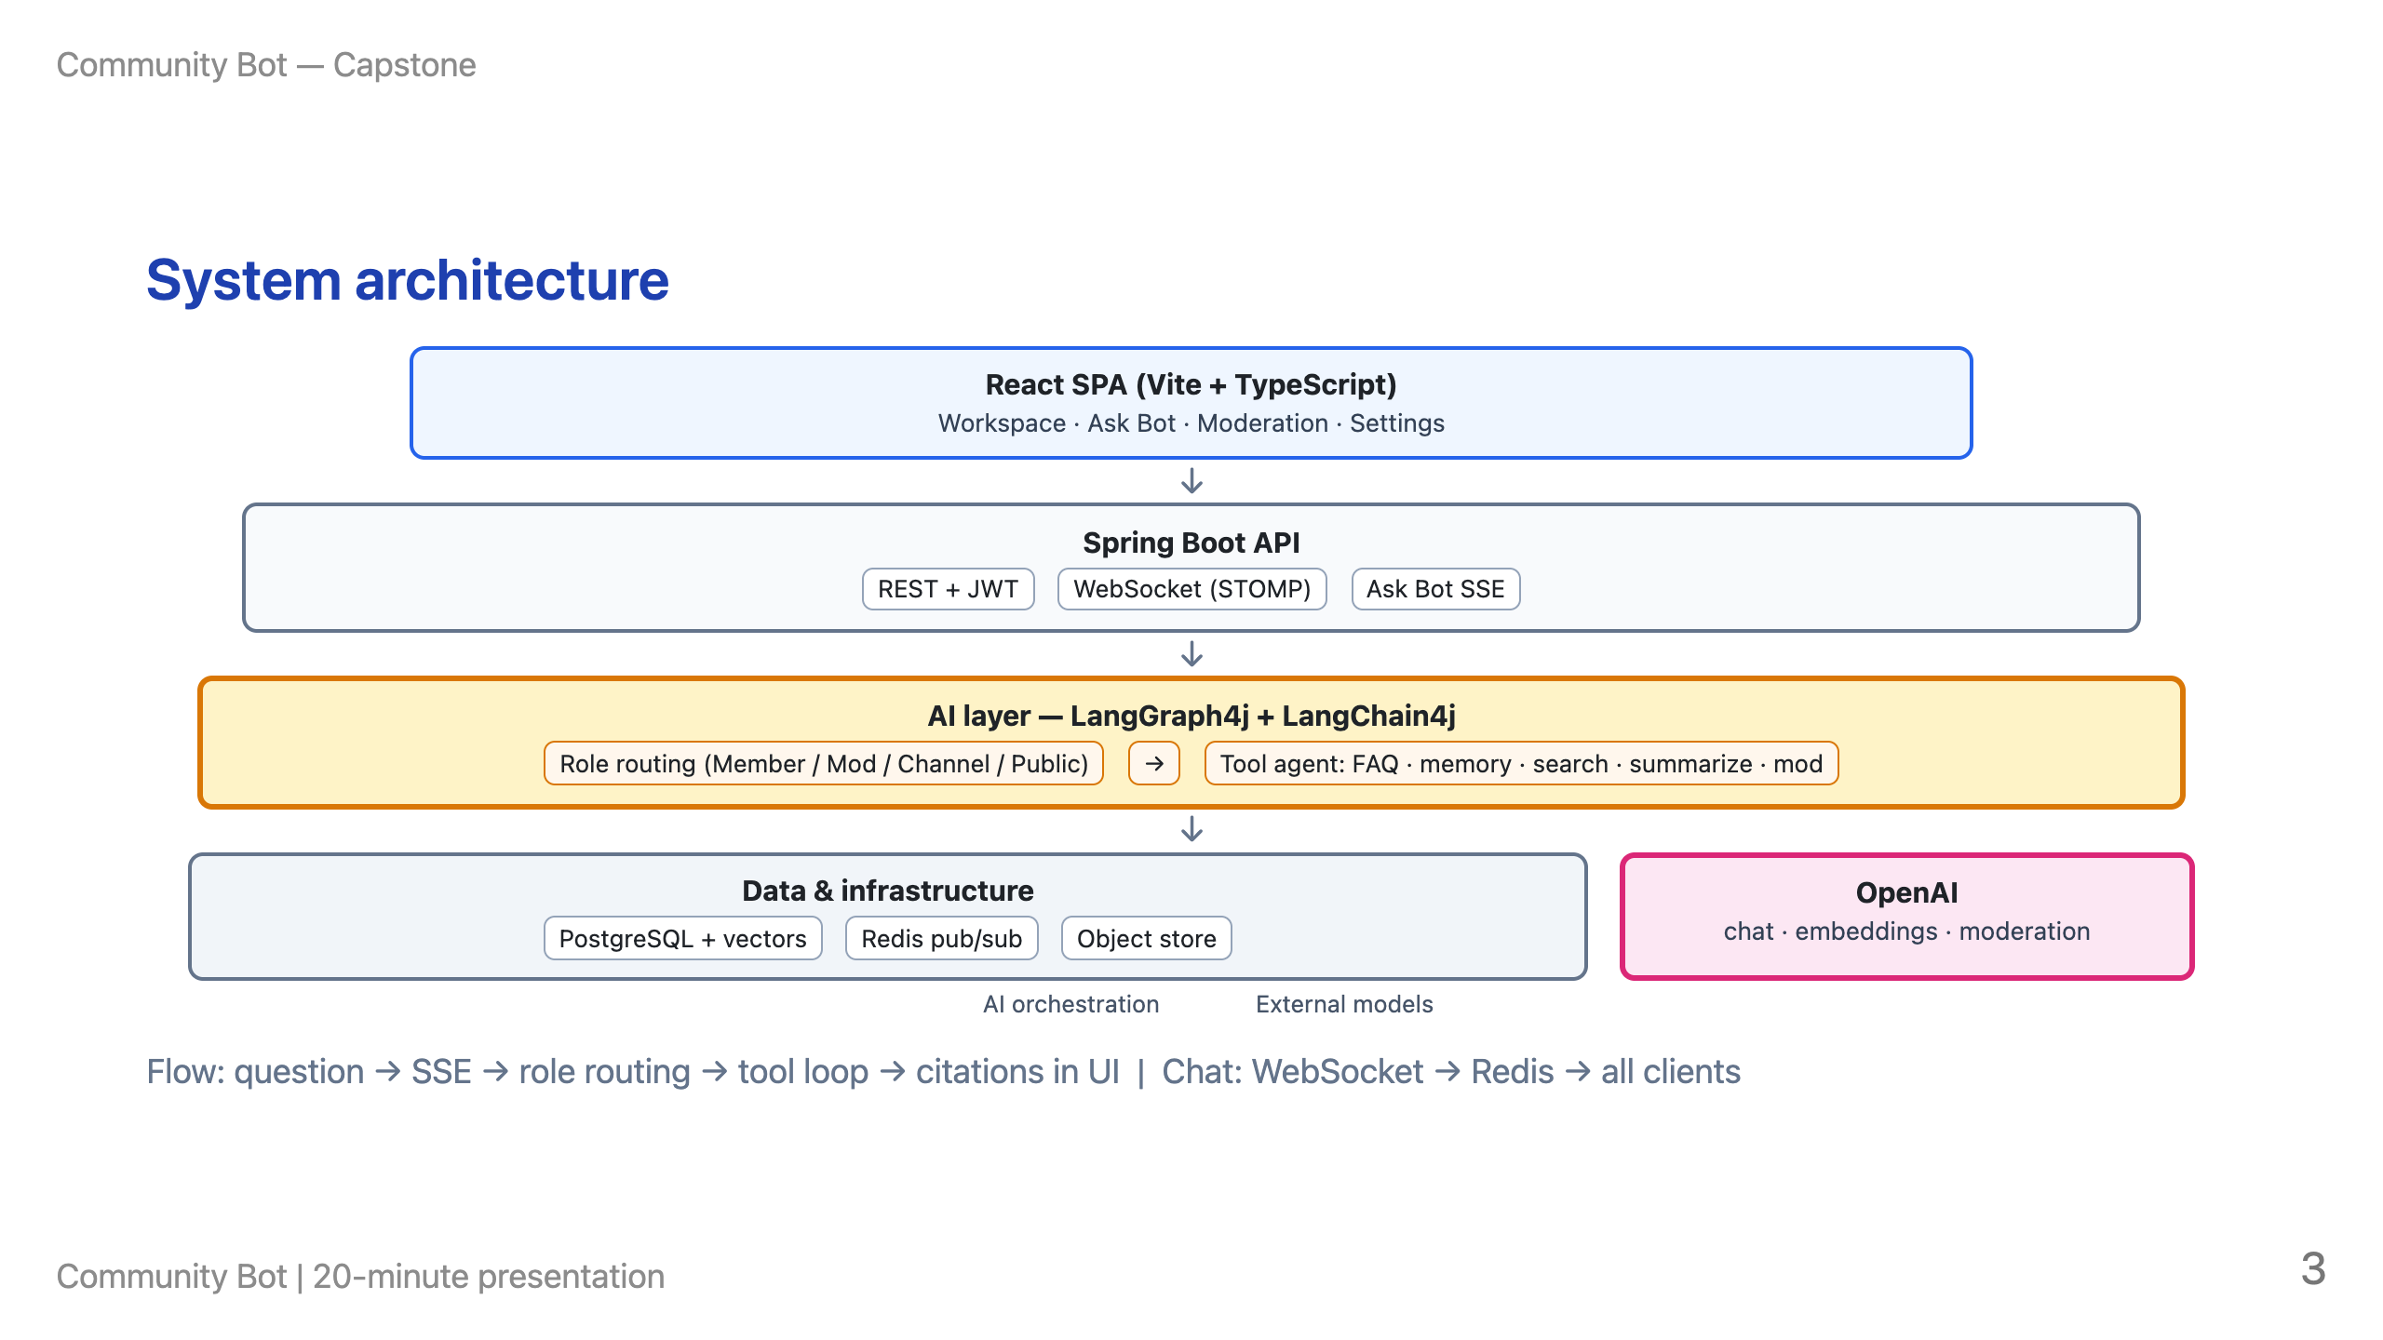

Slide 4
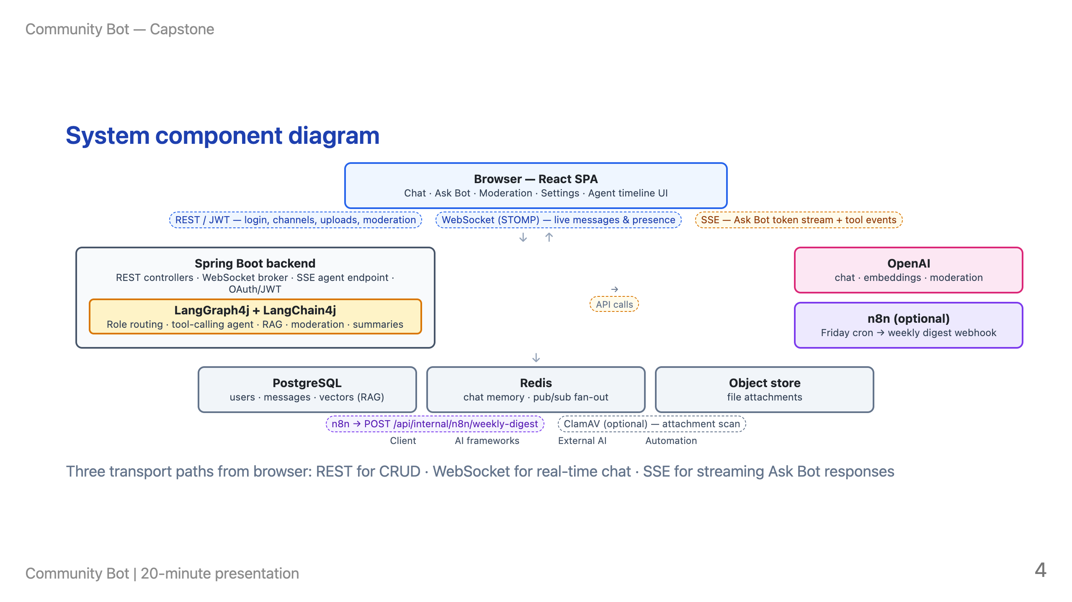

Slide 5
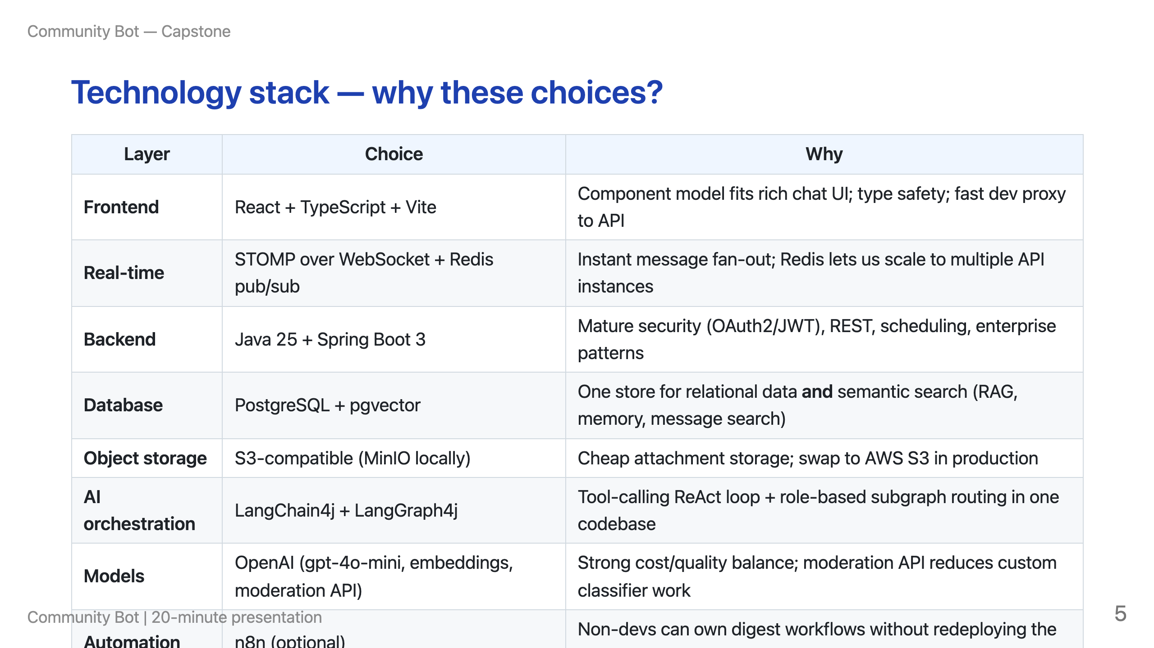

Slide 6
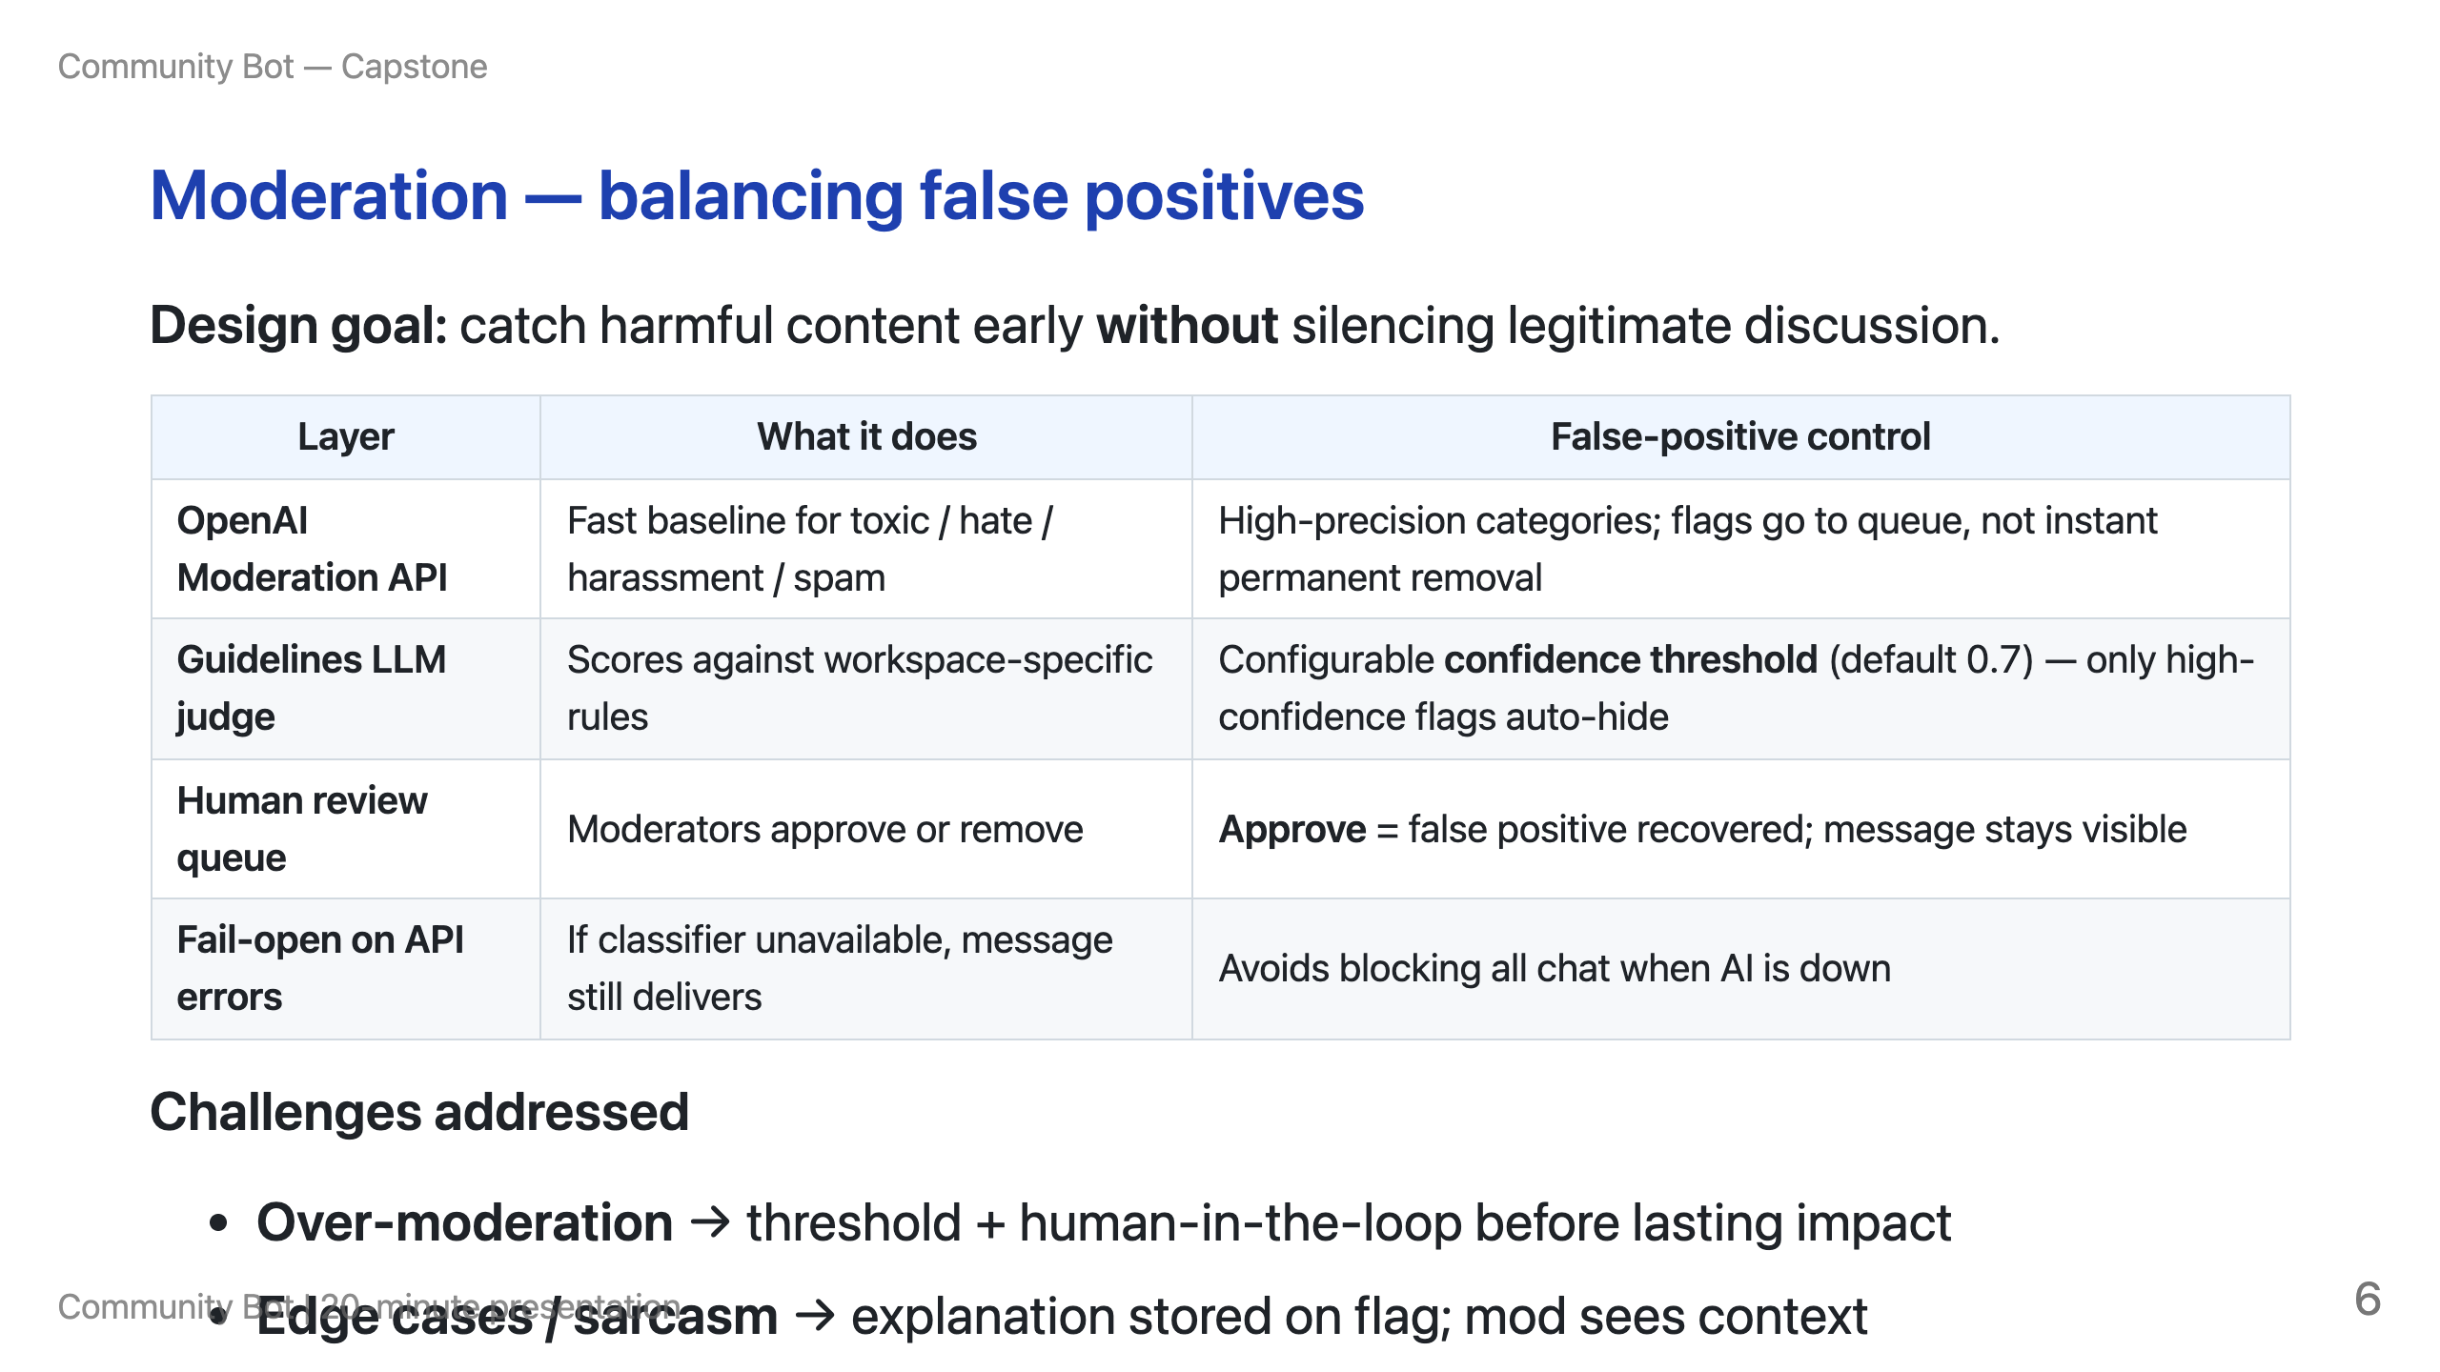

Slide 7
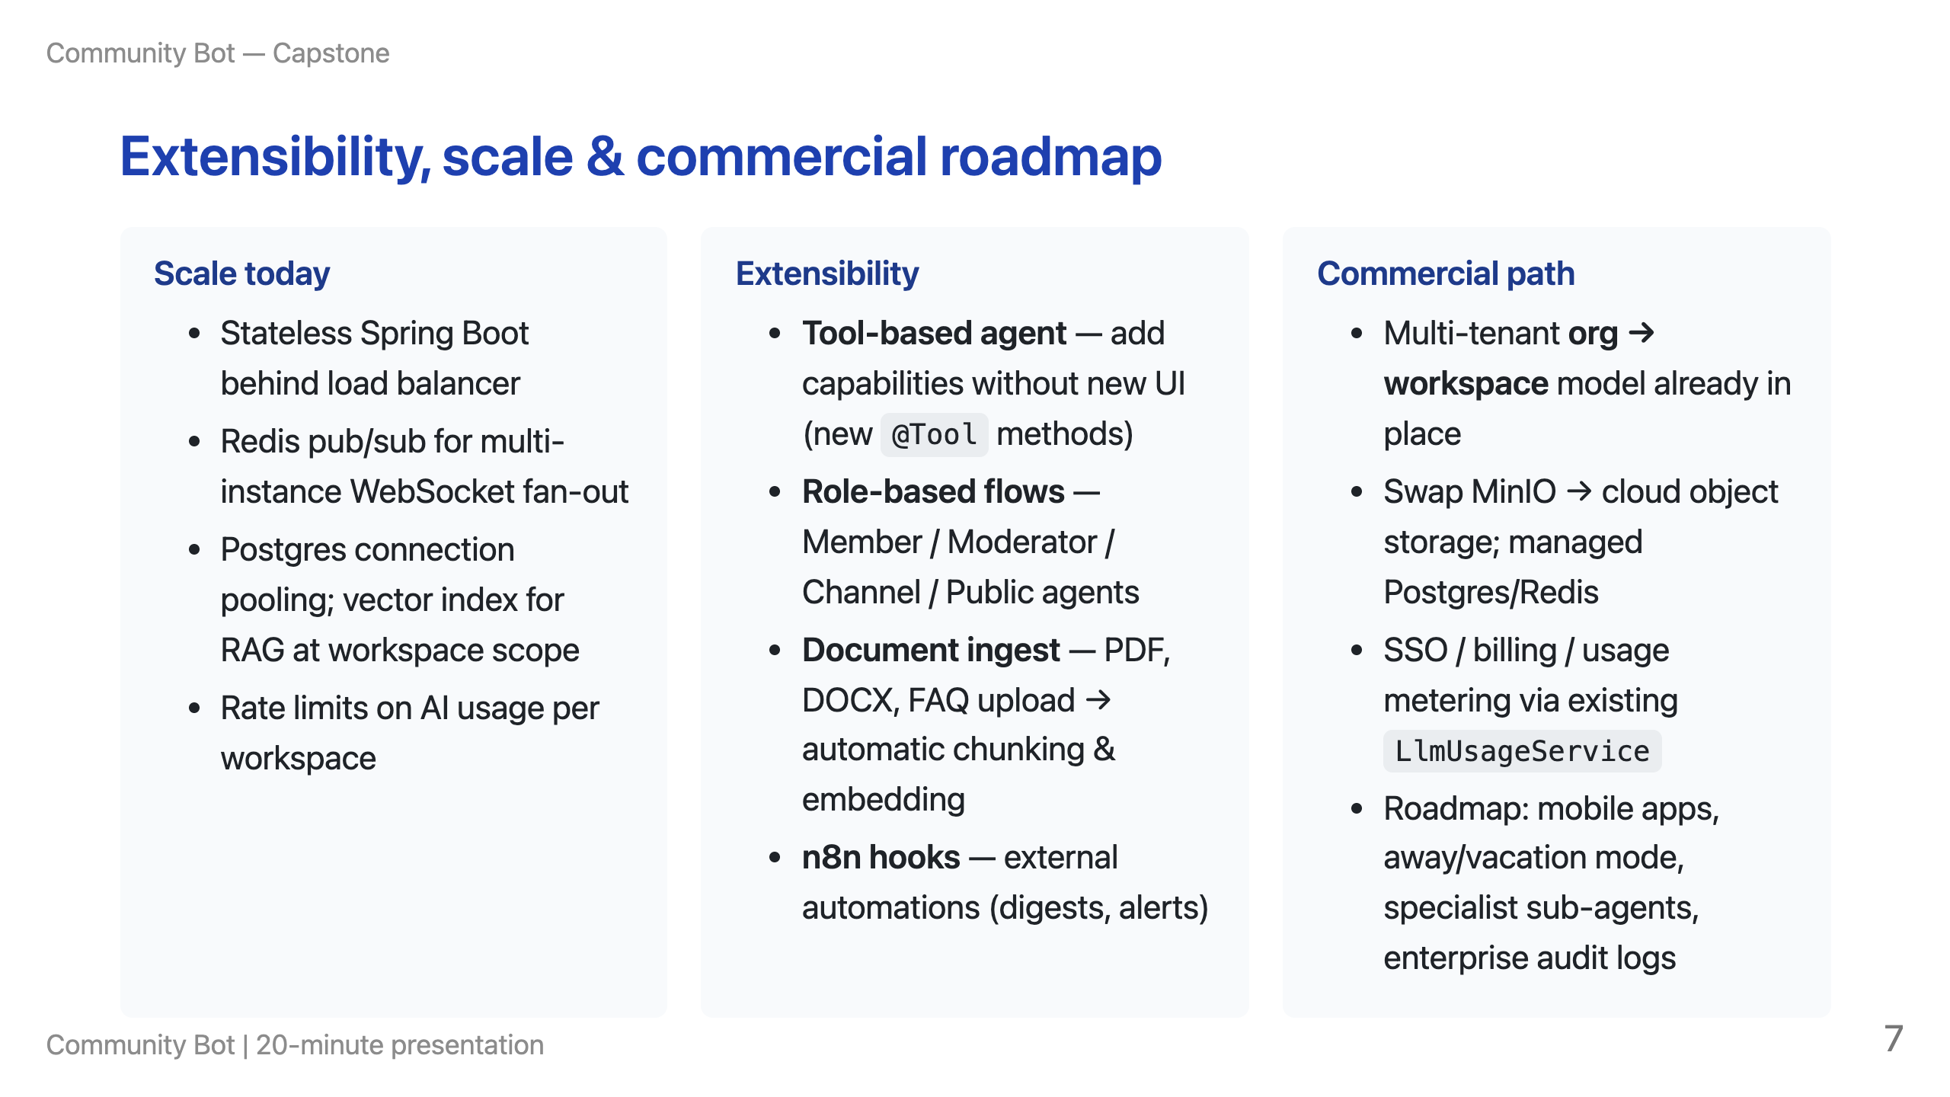

Slide 8
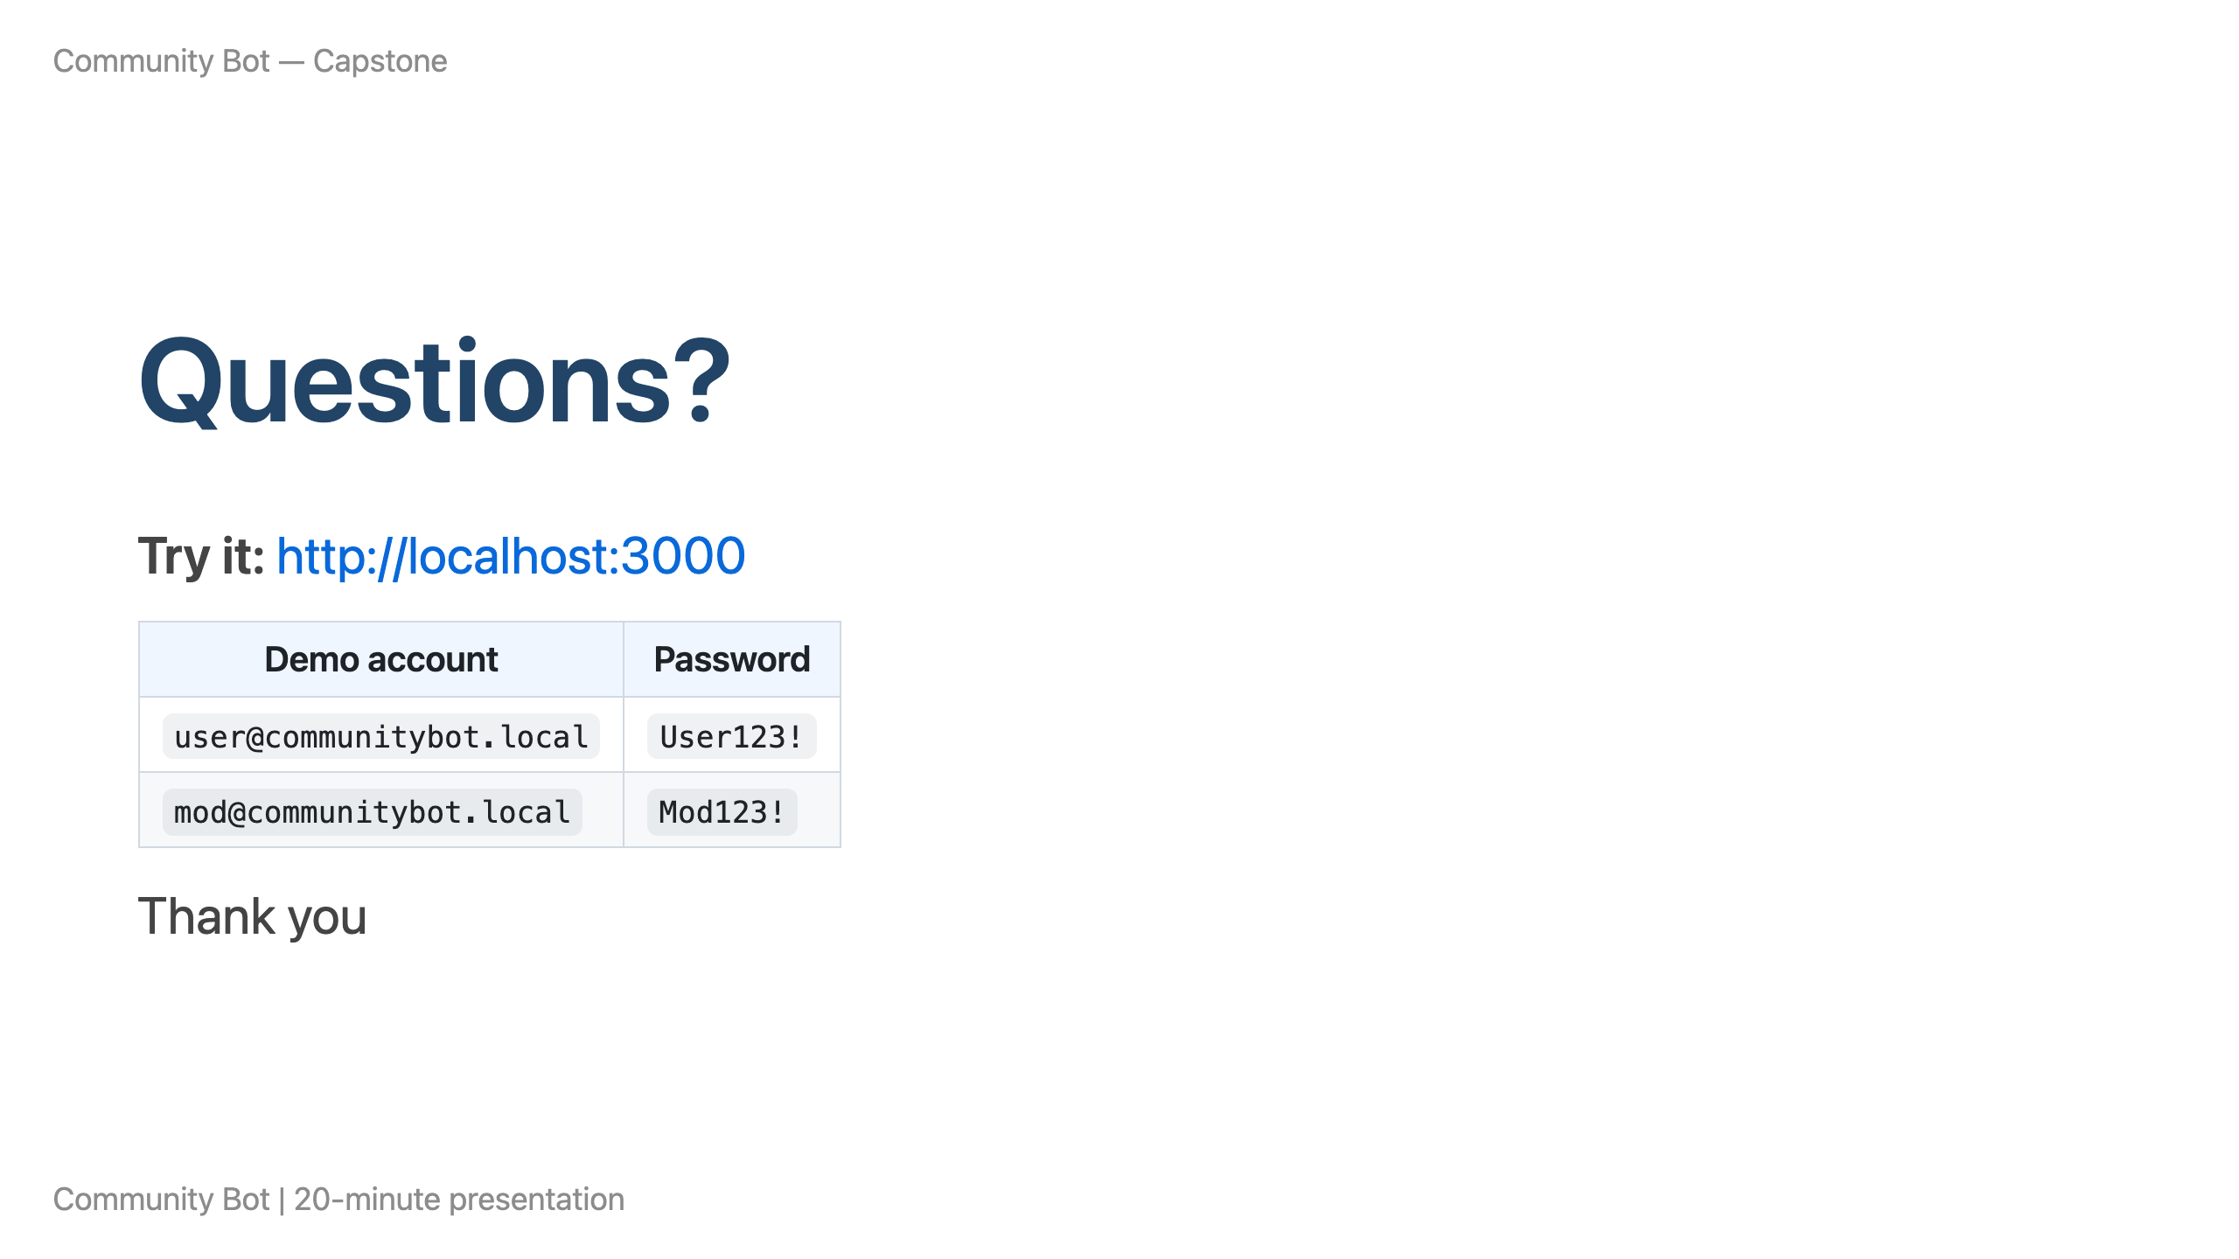

Slide 9

Notes:
PRESENTER GUIDE (~20 min) — not exported to slides 0:00–2:00 Title + features slide — problem/solution verbally 2:00–6:00 Architecture slides — layered stack + component diagram (REST vs WebSocket vs SSE) 5:00–8:00 Moderation slide — false positives, threshold, human queue 8:00–17:00 LIVE DEMO (3 beats): 1. Ask Bot: "How does moderation work?" or workspace FAQ question 2. Post borderline message as member → show flag in mod dashboard → approve as false positive 3. Ask Bot: "Summarize thread …" on an active thread OR show existing thread summary 17:00–19:00 Extensibility / roadmap — scale story, commercial deployment 19:00–20:00 Q&A Talking points for objectives not on slides: - Summarization: Otter-style structured sections; transcript-only, no invented facts; on-demand via Ask Bot tool - Context: Redis short-term memory + vector long-term Ask Bot memory + channel/thread search tools - Edge cases: FAQ fallback when OpenAI unavailable; sanitizer hides infra from user-facing bot answers Export: npx @marp-team/marp-cli --no-stdin docs/presentation-community-bot.md -o docs/presentation-community-bot.pptx

