Slide 1

Understanding Of Internet Movie Database(imdb) Website

Slide 2
About me
Name : Janjirala Rahul
Qualification : B.Tech (IT)
Experience : Fresher
Data science has a wide range of applications in different industries, including healthcare, finance, marketing, and technology. Many people are attracted to the potential for making a positive impact on society by using data to inform decision-making and solve important problems.
Name : Sadhula Sai Nikhil
Qualification : B.Tech (IT)
Experience : Fresher
Data science has a wide range of applications in different industries, including healthcare, finance, marketing, and technology. Many people are attracted to the potential for making a positive impact on society by using data to inform decision-making and solve important problems.

Slide 3
Contents
Introduction
Problem Statement
Tools Used
Steps For Collecting Data
Collected Data
Steps For Cleaning Data
Cleaned Data
Data Visualization
Conclusion

Slide 4

Introduction to IMDB (Internet Movie Database):
IMDB, or the Internet Movie Database, is an online database that serves as a comprehensive resource for information related to films, television shows, actors, directors, and other industry professionals.
IMDb began as a fan-operated movie database on the Usenet group "rec.arts.movies" in 1990, and moved to the Web in 1993. Since 1998, it has been owned and operated by IMDb.com, Inc., a subsidiary of Amazon.

Slide 5
PROBLEM STATEMENT(Objective):
Viewers frequently rely on IMDb ratings as a quick and accessible way to gauge the quality and popularity of a particular movie or TV series. High ratings can attract more viewers, contributing to a project's success, while lower ratings may deter potential viewers. As a result, IMDb ratings have a substantial impact on the visibility and success of entertainment content in a highly competitive industry, influencing the choices of millions of viewers worldwide.

Slide 6
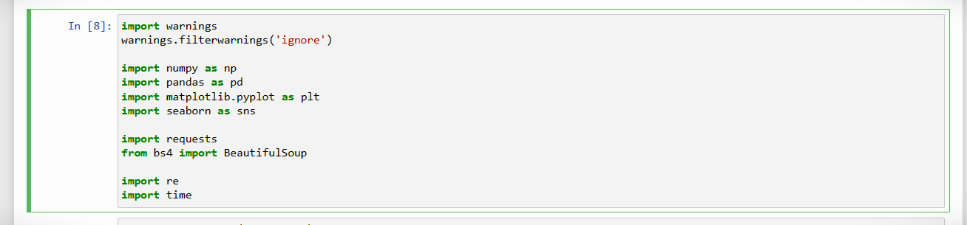
TOOLS
# importing all required libraries

Slide 7
Steps For Collecting Data
Install Necessary Libraries
Inspect the Website
Write the Python Script
Send an HTTP Request
Check Request Status
Parse HTML Content using BeautifulSoup
Identify HTML Elements
Handle Pagination and Dynamic Content
Data Storage

Slide 8
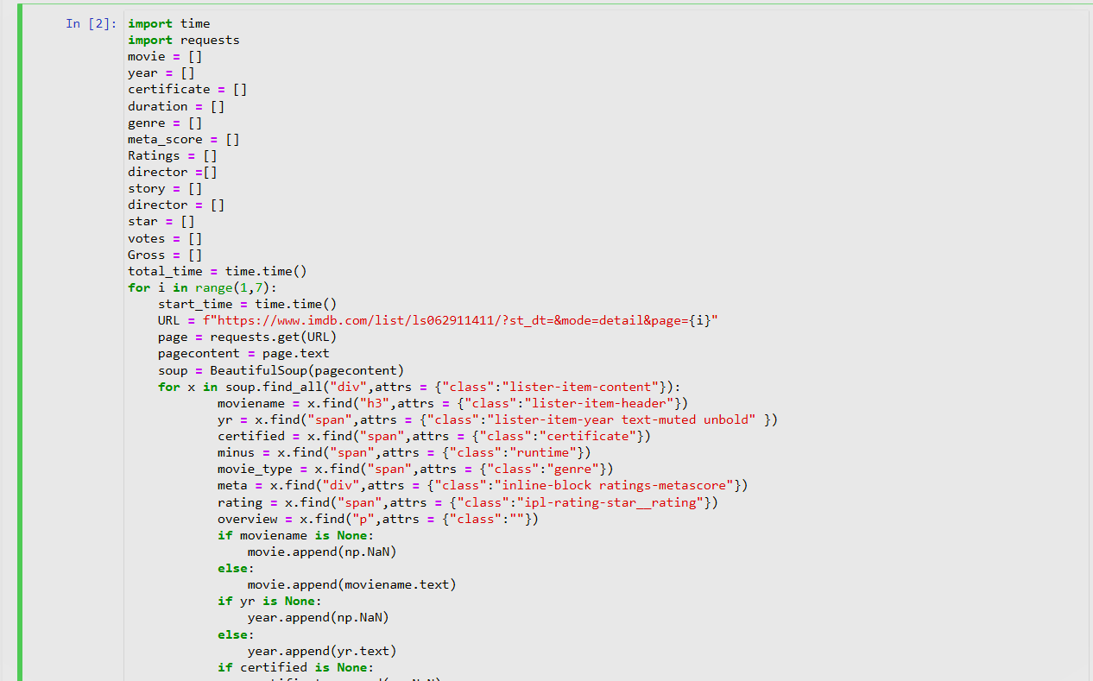
Sample Code

Slide 9
Collected Data
Title : Name of the movie
Released Year : Year at which that movie released
Certificate : Certificate earned by that movie
Runtime : Total runtime of the movie
Genre : Genre of the movie
IMDB Rating : Rating of the movie at IMDB site
Overview : mini story/ summary
MetaScore : Score earned by the movie
Director : Name of the Director
Star1,Star2,Star3,Star4 : Name of the Stars
No of votes : Total number of votes
Gross : Money earned by that movie

Slide 10
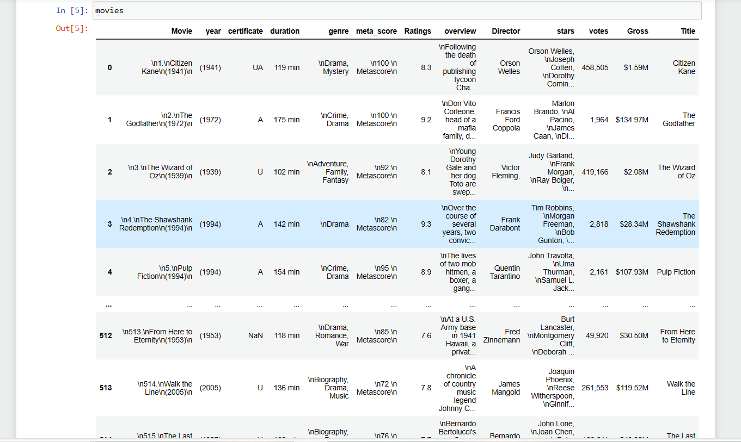
Raw Data

Slide 11
Steps For Cleaning Data
After executing the program , create a DataFrame using dictionary and check whether the data inside it is cleaned or not .
If not, try to clean the data .
For cleaning the data in the dataframe ,check for the null values and duplicate data, if all the columns is zero then it is appropriate for further processing.
Clean text data by removing unnecessary whitespaces, special characters, and HTML tags from text data and remove irrelevant information using Regex.
Convert the data types. By default all the types of columns are objects, change according to the column like float32 or int32 etc..
Check the shape of the database and save the cleaned data.

Slide 12
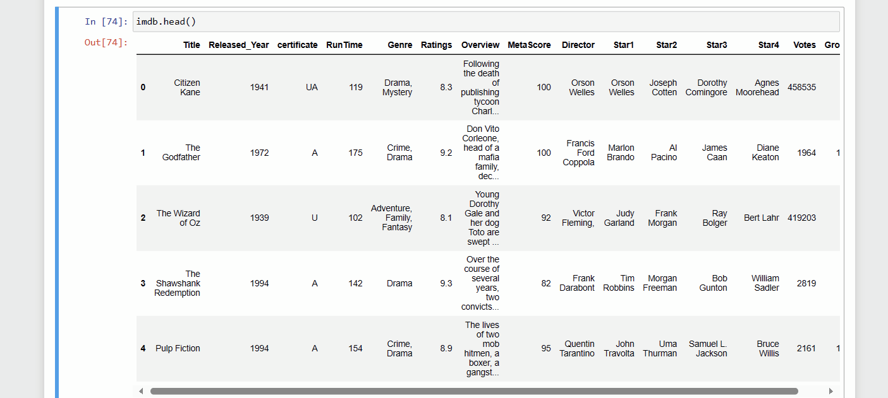
Quick view of Cleaned data

Slide 13
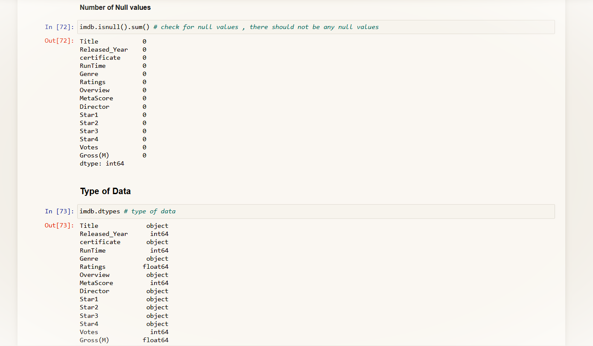
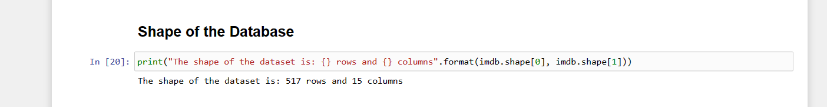
Type and shape of data

Slide 14
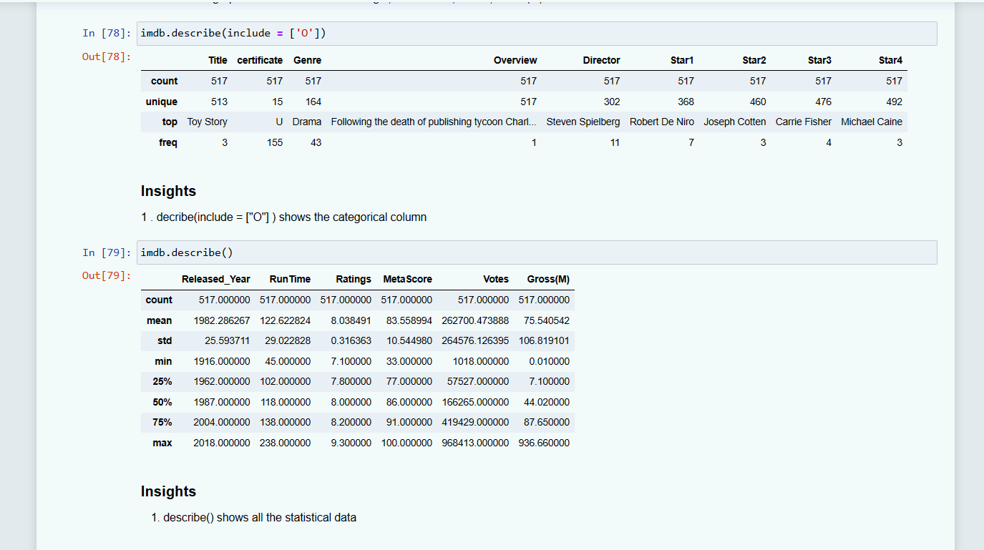
statistical data

Slide 15
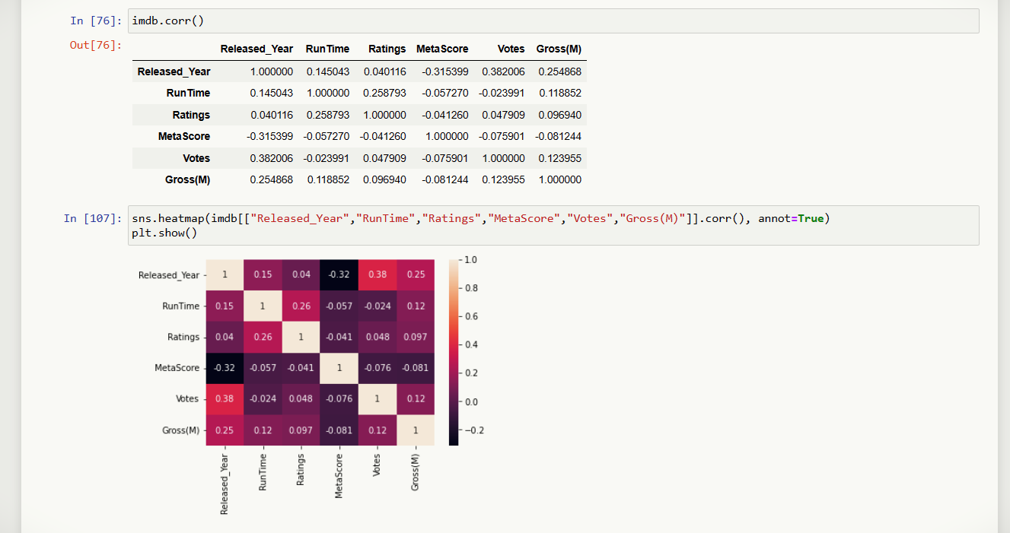
Finding correlation of data

Slide 16
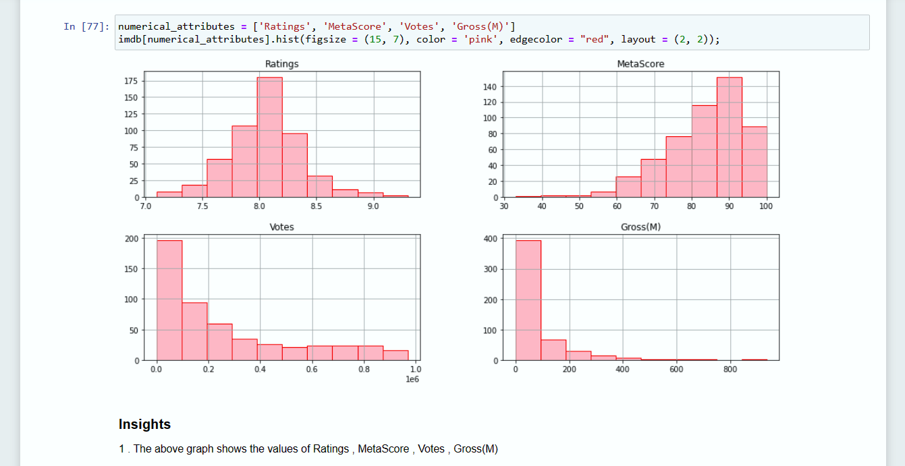
BarGraphs

Slide 17
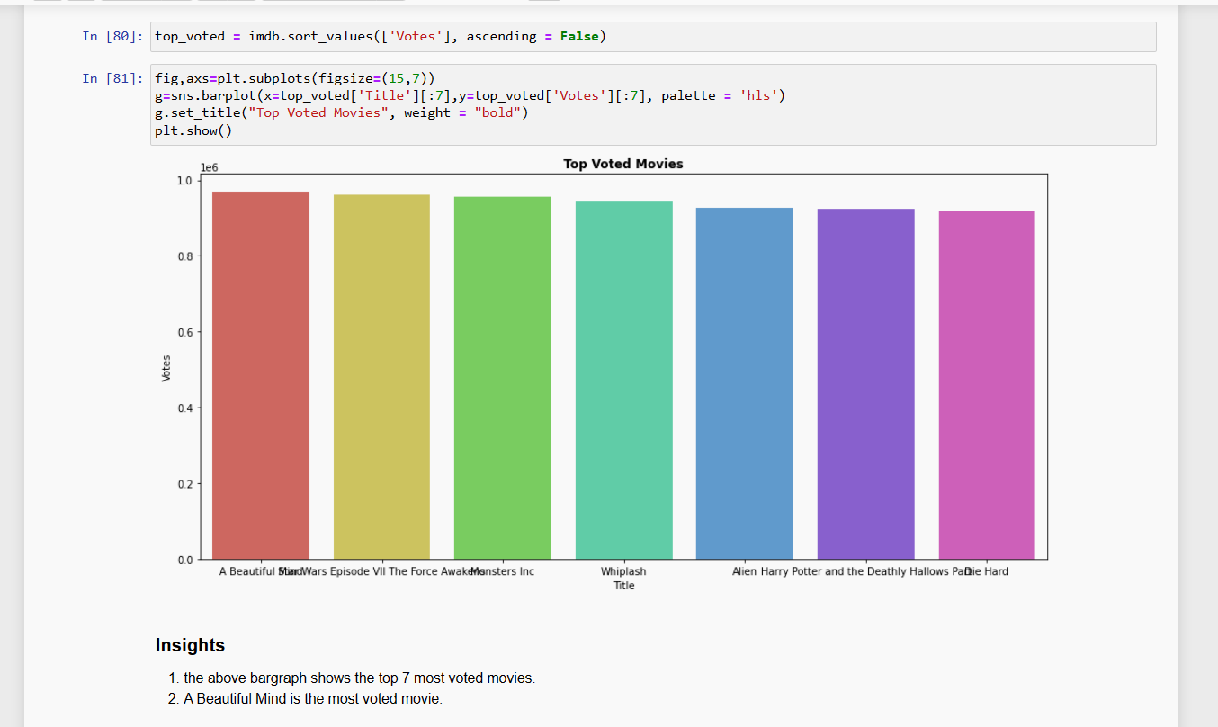
Top 7 voted movies

Slide 18
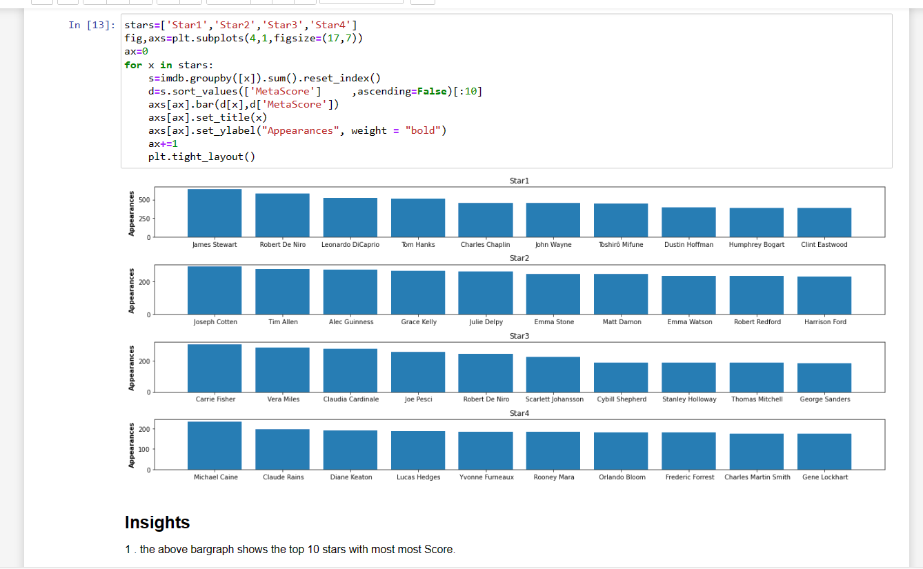
Appearance of stars in top meta-score

Slide 19
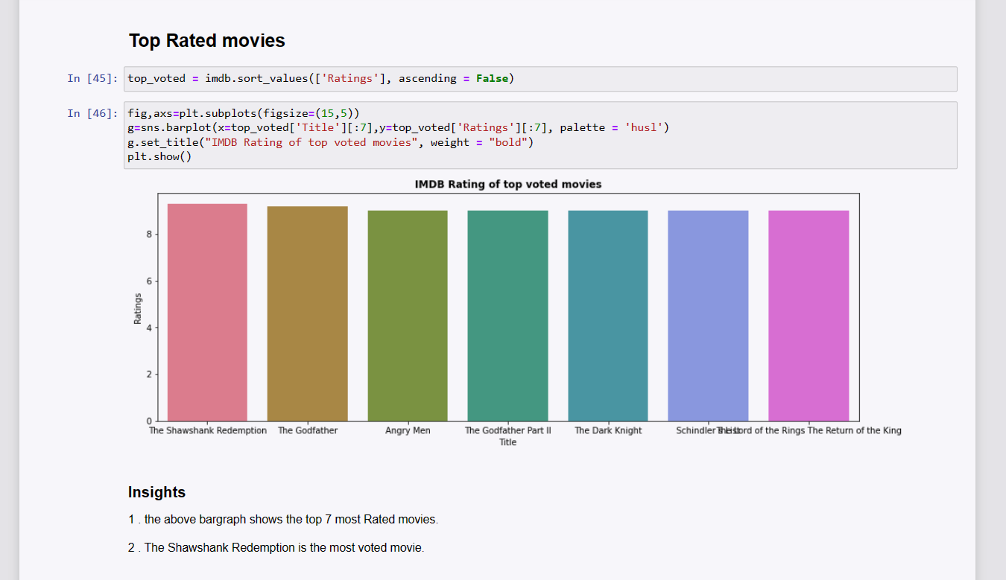
Top 7 rated movies

Slide 20
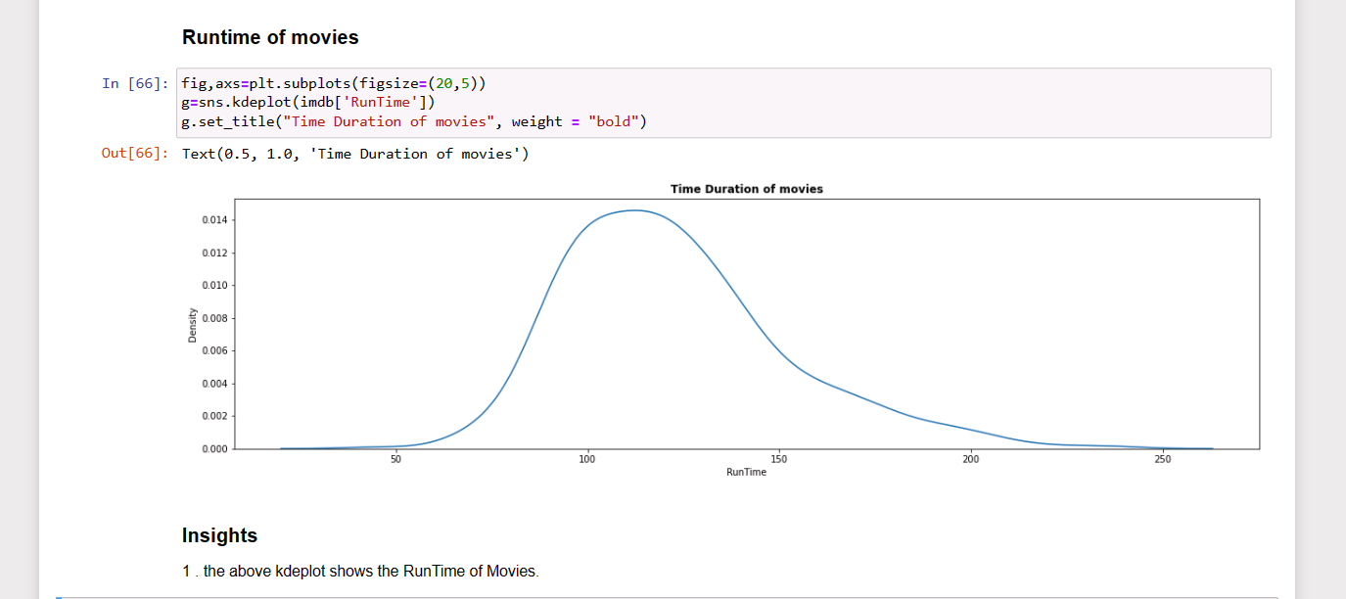
kernel density estimation(kde)

Slide 21
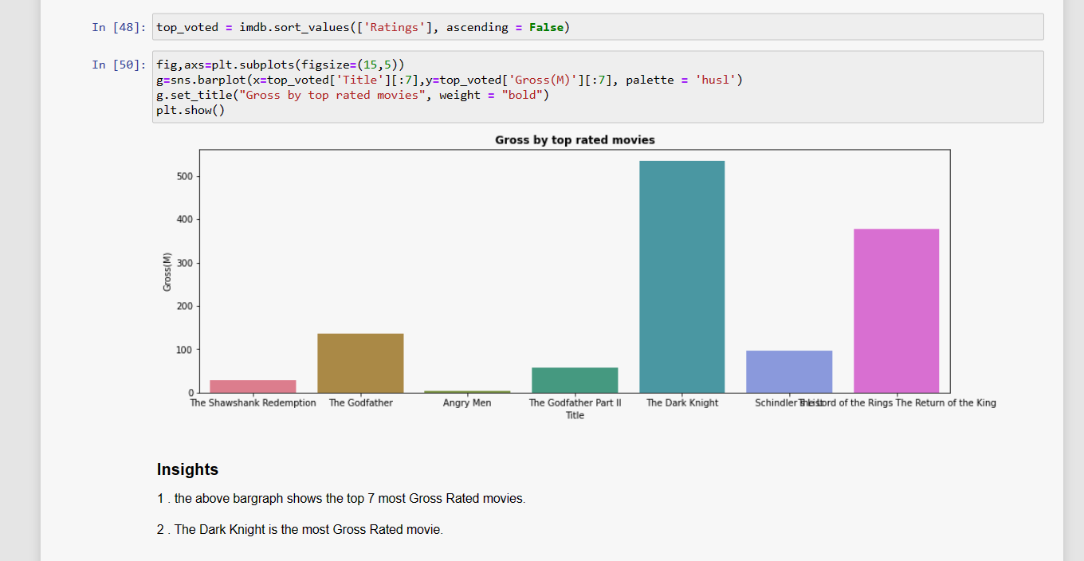
Gross of top rated movies

Slide 22
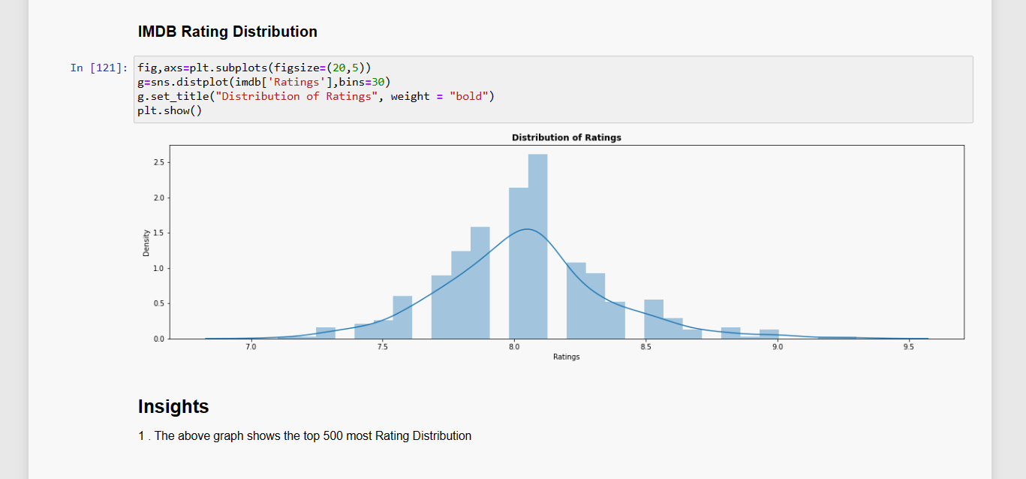
Rating distribution

Slide 23
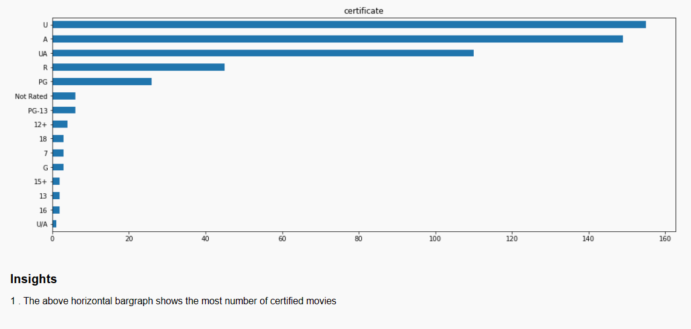
Number of certified movies

Slide 24
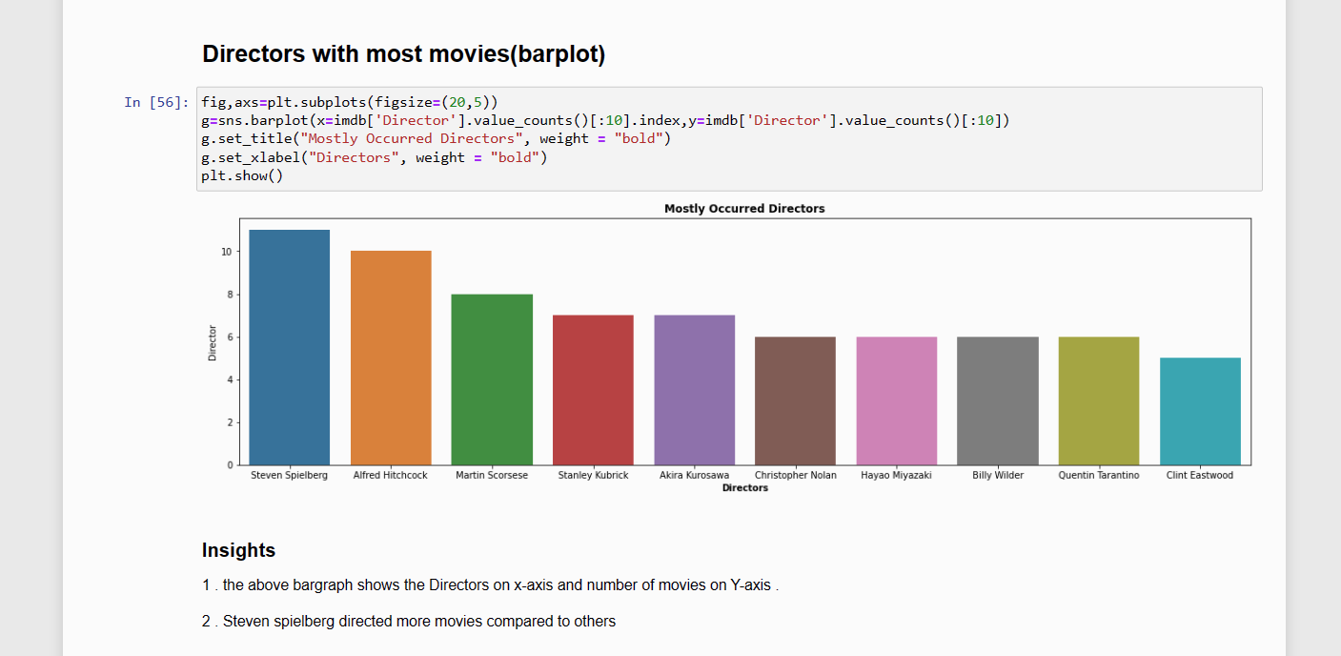
Directors with most movies(bar-plot)

Slide 25
CONCLUSION
After scraping the IMDb website, the process revealed valuable insights into movie-related information such as ratings, cast details, and reviews. .
The web scraping effort provided a foundation for further analysis and exploration of IMDb's rich movie database.
After scraping IMDb we concluded that reviews and ratings determine people’s opinions on movies.
Most of the movies that people loved involves real-life emotional values and incidents.

Slide 26

THANK YOU

