Slide 1
Chatbot system Akash roll no 2 janvi soni roll no 17 Lokesh roll no 23 Niraj Raj roll no 30

Slide 2
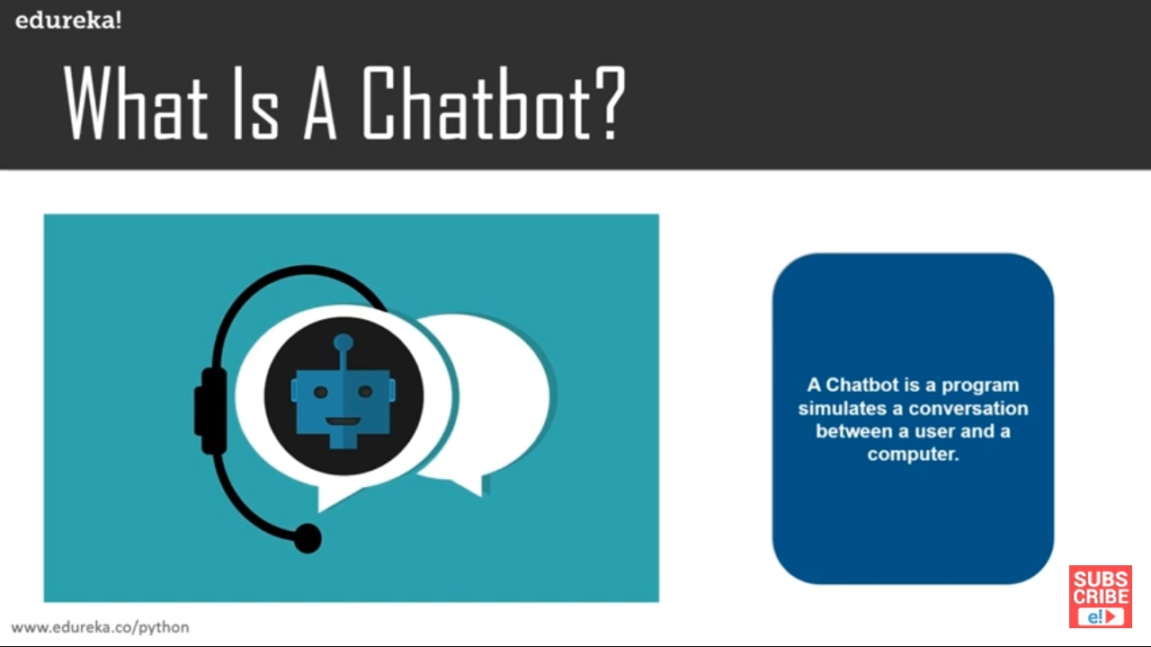
A CHATBOT IS A PROGRAM THAT SIMULATES A CONVERSATION BETWEEN A USER AND A COMPUTER

Slide 3
Natural Language Processing or NLP is a prerequisite for our project. NLP allows computers and algorithms to understand human interactions via various languages. In order to process a large amount of natural language data, an AI will definitely need NLP or Natural Language Processing. Currently, we have a number of NLP research ongoing in order to improve the AI chatbot and help them understand the complicated nuances and undertones of human conversations.

Slide 4
STEPS REQUIRED
PYTHON LIBRARIES
AUTOMATED RESPONSES
ML ALGORITHMS
LANGUAGE INDEPENDENT
TRAIN DATA

Slide 5
GET INPUT FROM USER
PROCESS INPUT AND RETURN THE VALUE THAT GENERATED THE HIGHEST CONFIDENCE VALUE FROM LOGICAL ADAPTERS
RETURN THE RESPONSE FROM THE INPUT

Slide 6
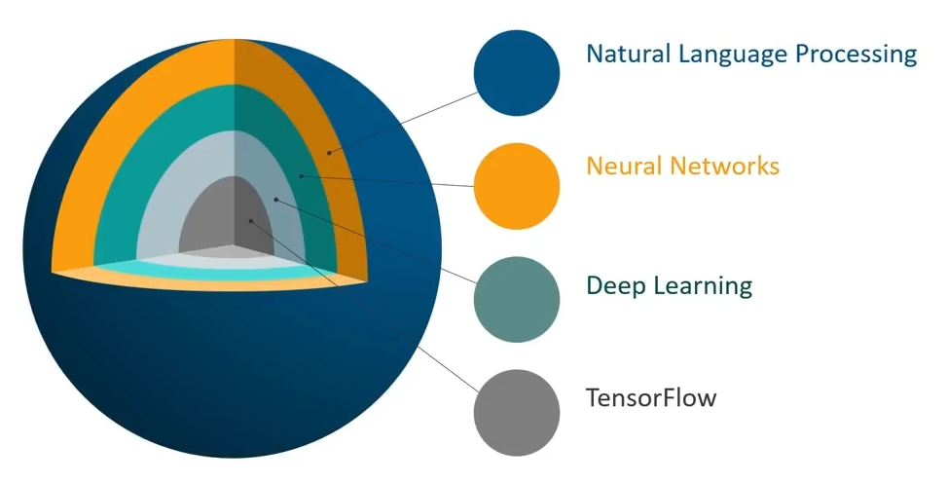
LAYERS OF CHATBOT

Slide 7
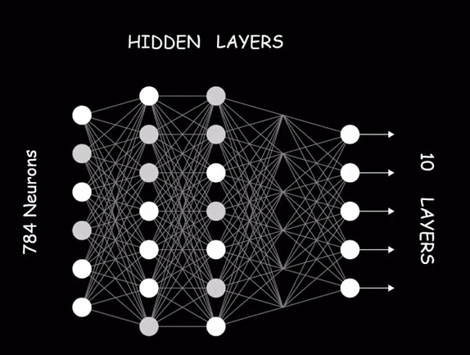
NEURAL NETWORK
Type of machine learning which models itself just like a human brain

Slide 8
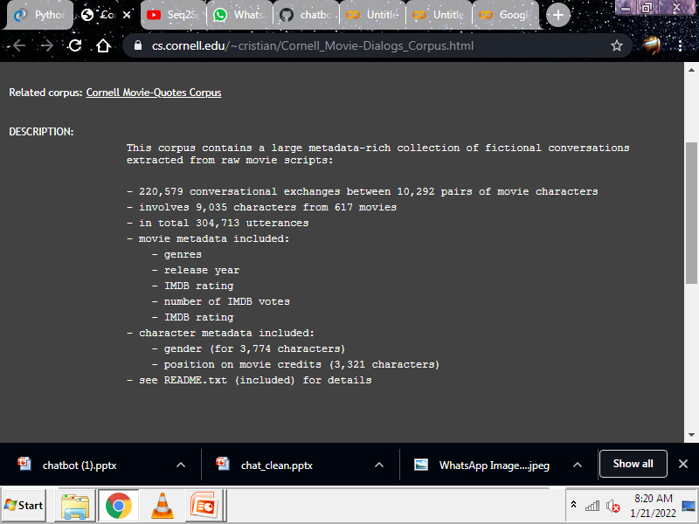
dataset

Slide 9
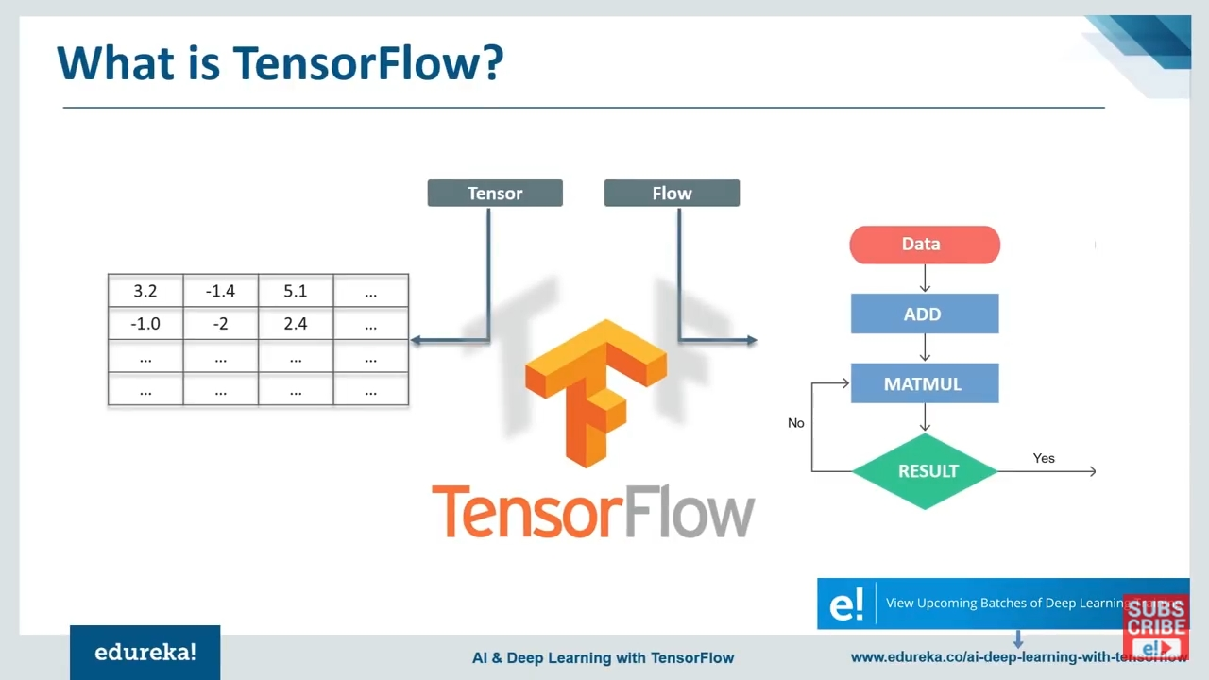

Slide 10
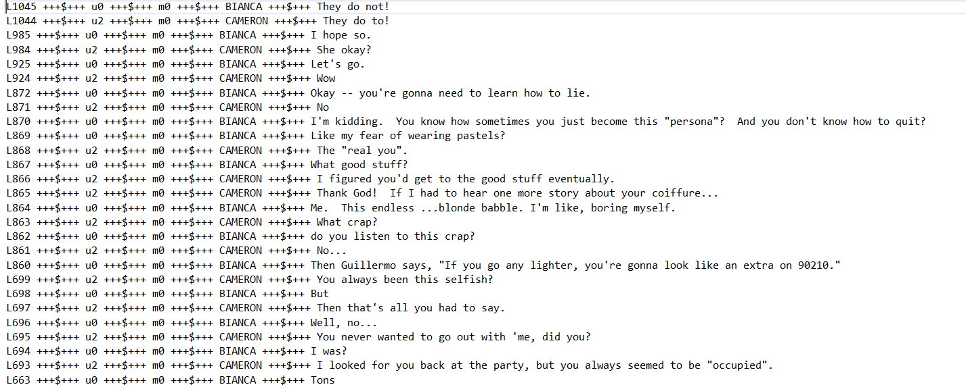
movie_lines.txt

Slide 11
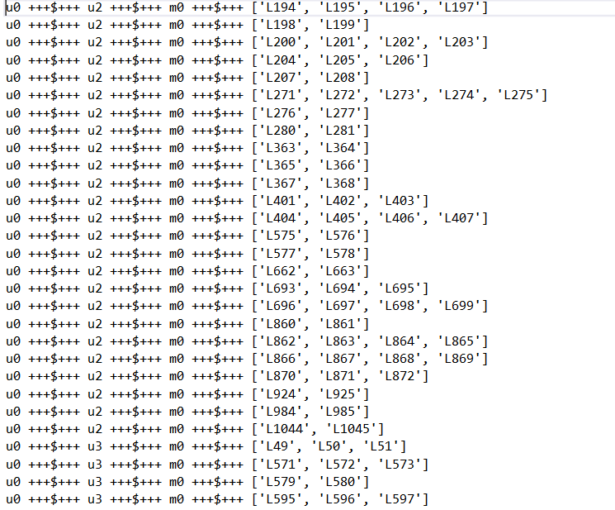
movie_conversations.txt

Slide 12
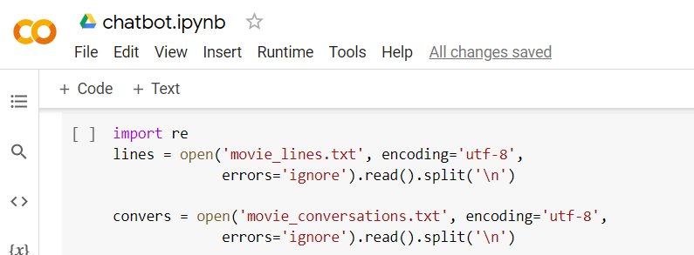
.
We are making two list “lines” and “covers”.

Slide 13
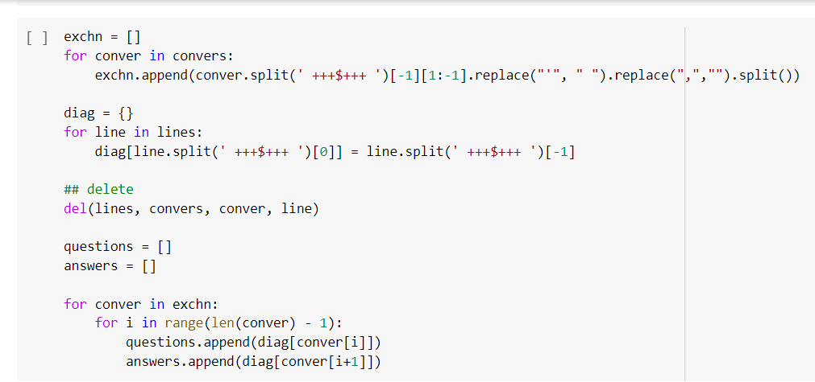
Creating list (‘exchn’) which have the conversation data and dictionary(‘diag’) which have the lines data Converting our data into questions and answers.

Slide 14
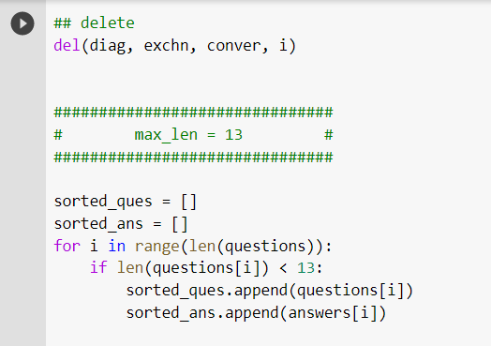
Fixing the length of questions.

Slide 15
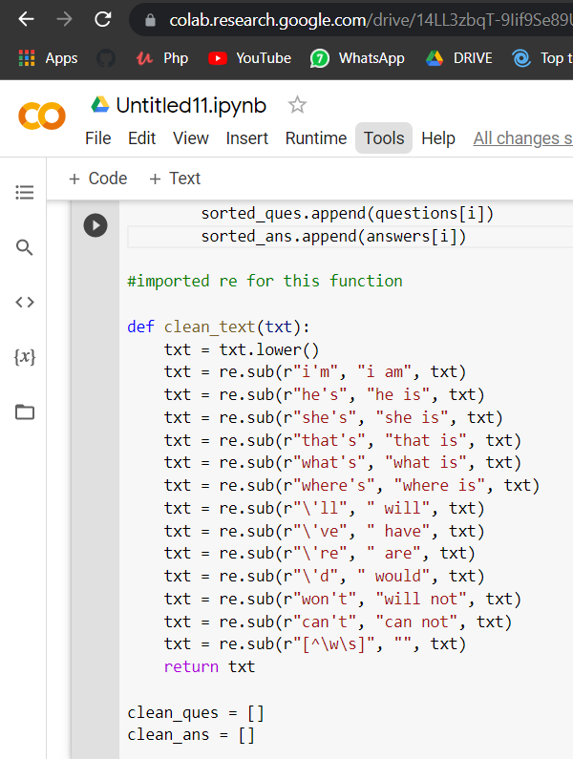
We have imported re for this function only.
re stands for regular expression , we use to clean up our text using the clean_text function.
For example it will convert
I’m to I am
She’s to she is
Punctuation , commas will be replaced with nothing.

Slide 16
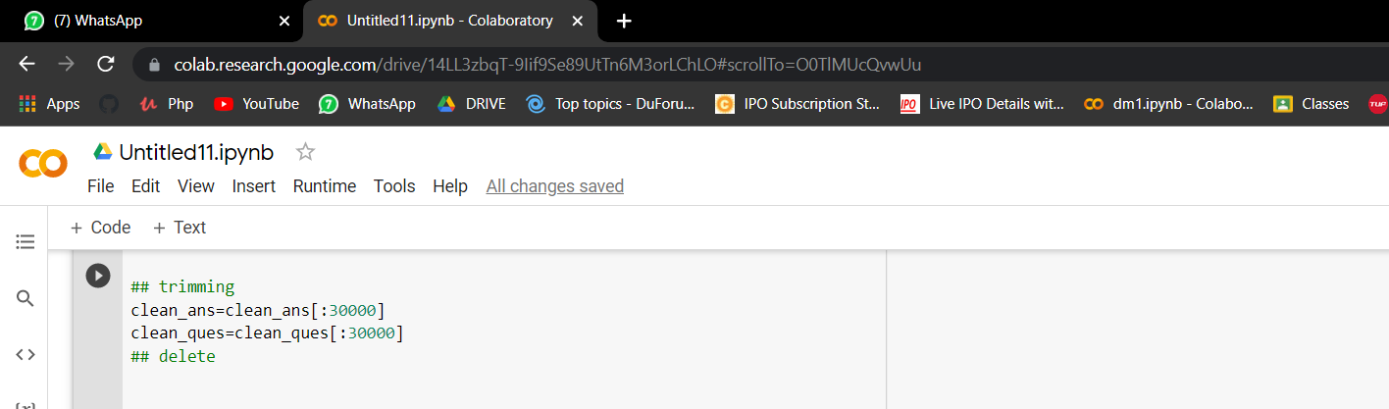
Here we are trimming our words to 30,000 only in both the lists

Slide 17
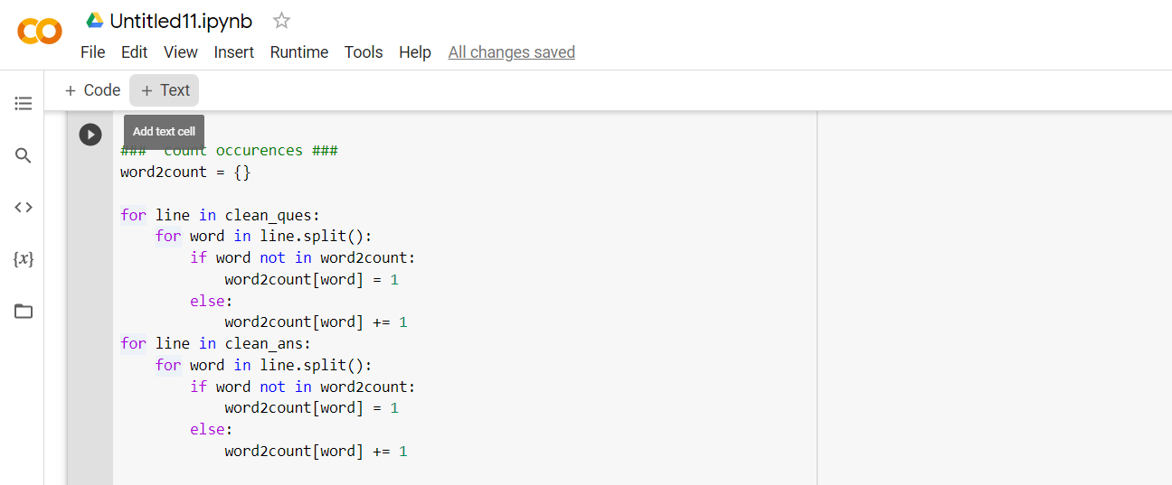
Here we a making a dictionary from clean_ques and clean_ans
and storing the word count.
We are iterating from the lists and appending new words to the
dictionary and keeping a count of it .

Slide 18
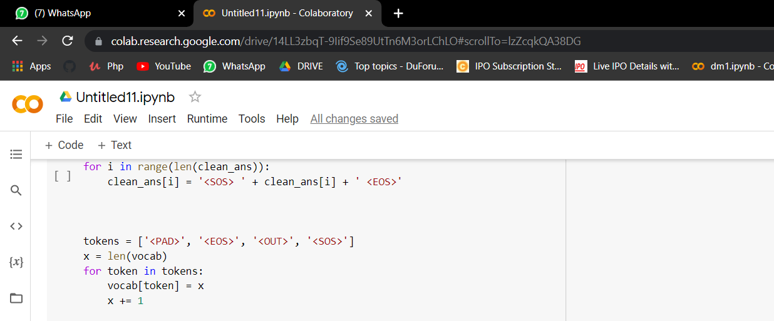
As we can see here we are adding <sos> i.e. start of the string
and <eos> i.e. end of the string to each string present in lists.
These token are required for our model .
After that we need to add token as well to our dictionary.

Slide 19
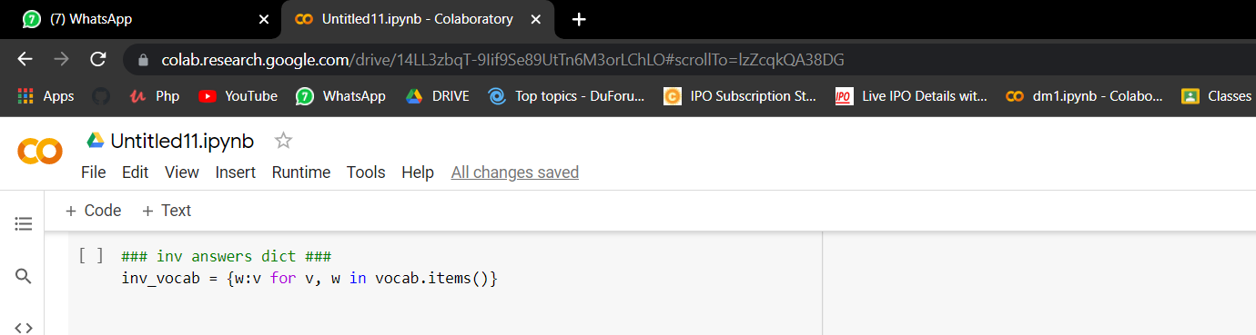
Now we will make a reverse dictionary for our model to be used later on which is inv_vocab

Slide 20
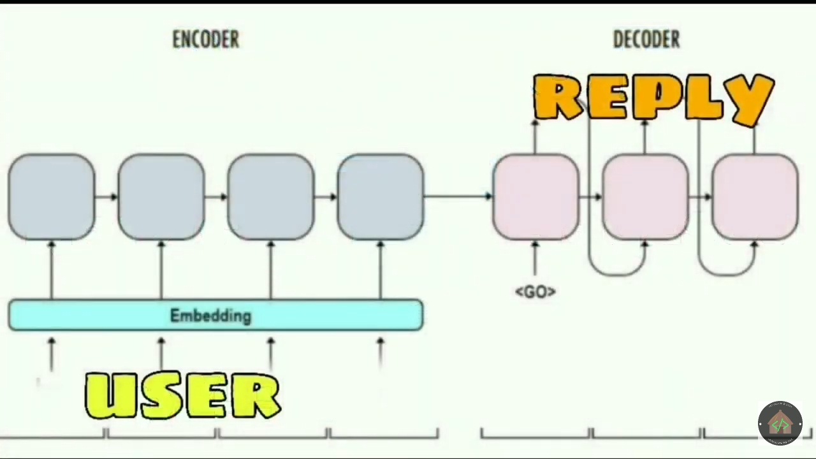
ENCODER DECODER

Slide 21
ENCODERS
DECODERS
W
X
Y
Z
<EOS>
A
B
C
<EOS>
W
X
Y
Z
PROBABILITY(y’ | <x1,x2,x3…….xn>
LOSS(y,y’)

Slide 22
MEMORY CELL
C<2>
C<4>
Long term memory
h<2>
h<4>
Short term memory

Slide 23
TRADITIONAL RNN
ROHAN
ROHAN,
EATS
EATS,
SAMOSA
SAMOSA,
ALMOST
CUISINE.
IS????

Slide 24
encoder_inp = []
for line in clean_ques:
lst = []
for word in line.split():
if word not in vocab:
lst.append(vocab['<OUT>'])
else:
lst.append(vocab[word])
encoder_inp.append(lst)
decoder_inp = []
for line in clean_ans:
lst = []
for word in line.split():
if word not in vocab:
lst.append(vocab['<OUT>'])
else:
lst.append(vocab[word])
decoder_inp.append(lst)

Slide 25
Teacher enforcing
A advancement in RNN method of back propagation in to the model.
The previous output is provided as input to the model to predict next step.
Example “I hope so”
Step 1: add start and end tokens. As initial start value is required in the teacher forcing and end token to make the model understand that the sentence is completed.
Therefore: “[start] i hope so [end]”
Input: prediction
[start]: i
[start], i: hope
[start], i, hope: so
[start], i, hope, so: [end]

Slide 26
Keras Embedding Layer
Keras offers an Embedding layer that can be used for neural networks on text data.
In this each word is represented by a unique integer.
This data preparation step can be performed using the Tokenizer API also provided with Keras.
The Embedding layer is initialized with random weights and will learn an embedding for all of the words in the training dataset.
It can be used to load a pre-trained word embedding model, a type of transfer learning.

Slide 27
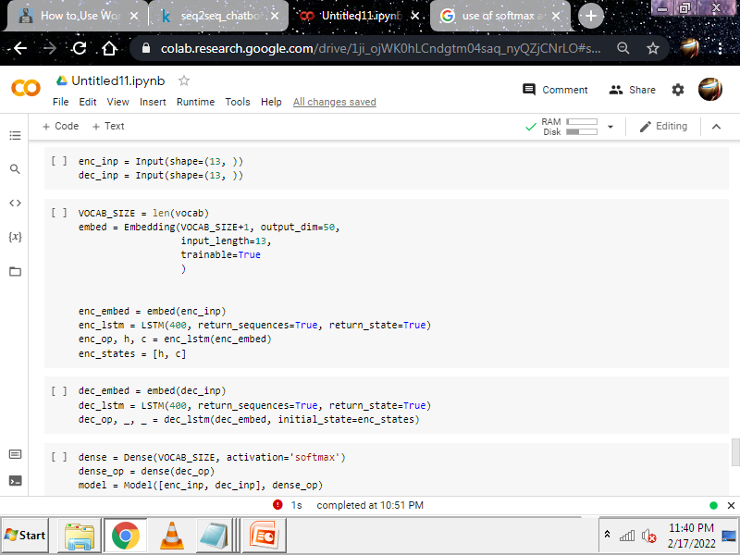

Slide 28
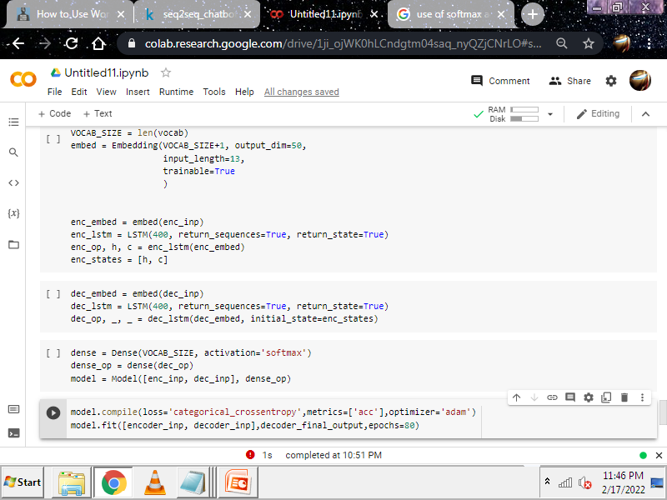
The softmax function is used as the activation function in the output layer of neural network models that predict a multinomial probability distribution. That is, softmax is used as the activation function for multi-class classification problems where class membership is required on more than two class labels

Slide 29
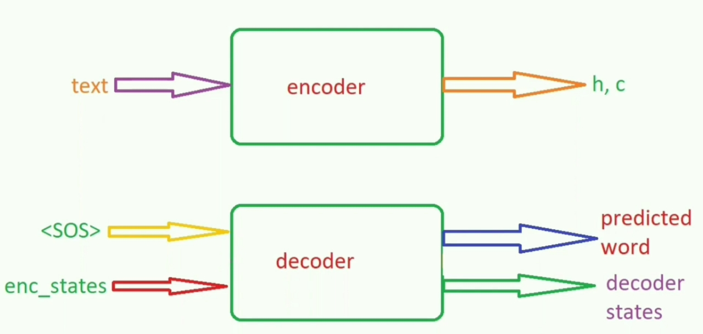
WORK FLOW OF INFERENCE MODEL

Slide 30
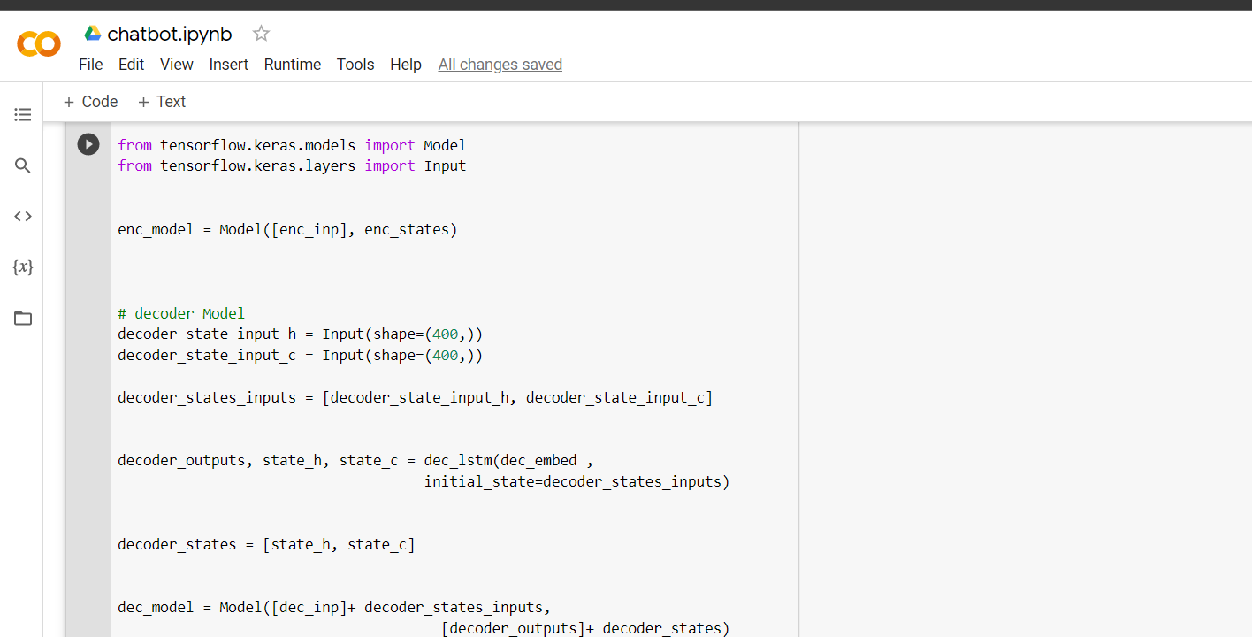

Slide 31
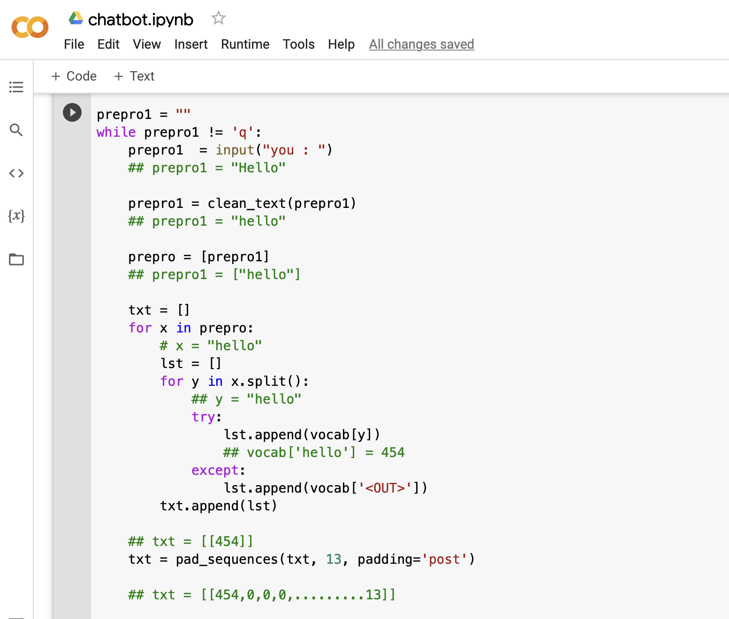
pad_sequences is used to ensure that all sequences in a list have the same length. By default this is done by padding 0 in the beginning of each sequence until each sequence has the same length as the longest sequence.
pad_sequence:
Args:
Sequences - List of sequences (each sequence is a list of integers).
Maxlen - Int, maximum length of all sequences. If not provided, sequences will be padded to the length of the longest individual sequence.
Padding - String, 'pre' or 'post' (optional, defaults to 'pre'): pad either before or after each sequence.

Slide 32
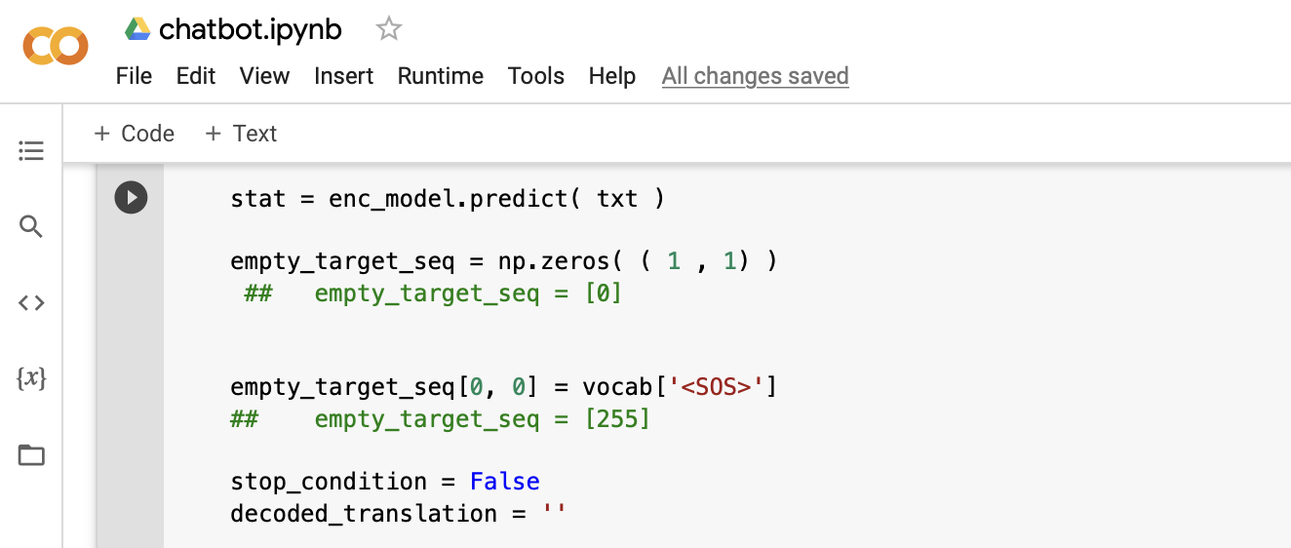
Sending SOS token to decoder model to convert SOS model to integer value and set it to empty target index 0,0 index

Slide 33
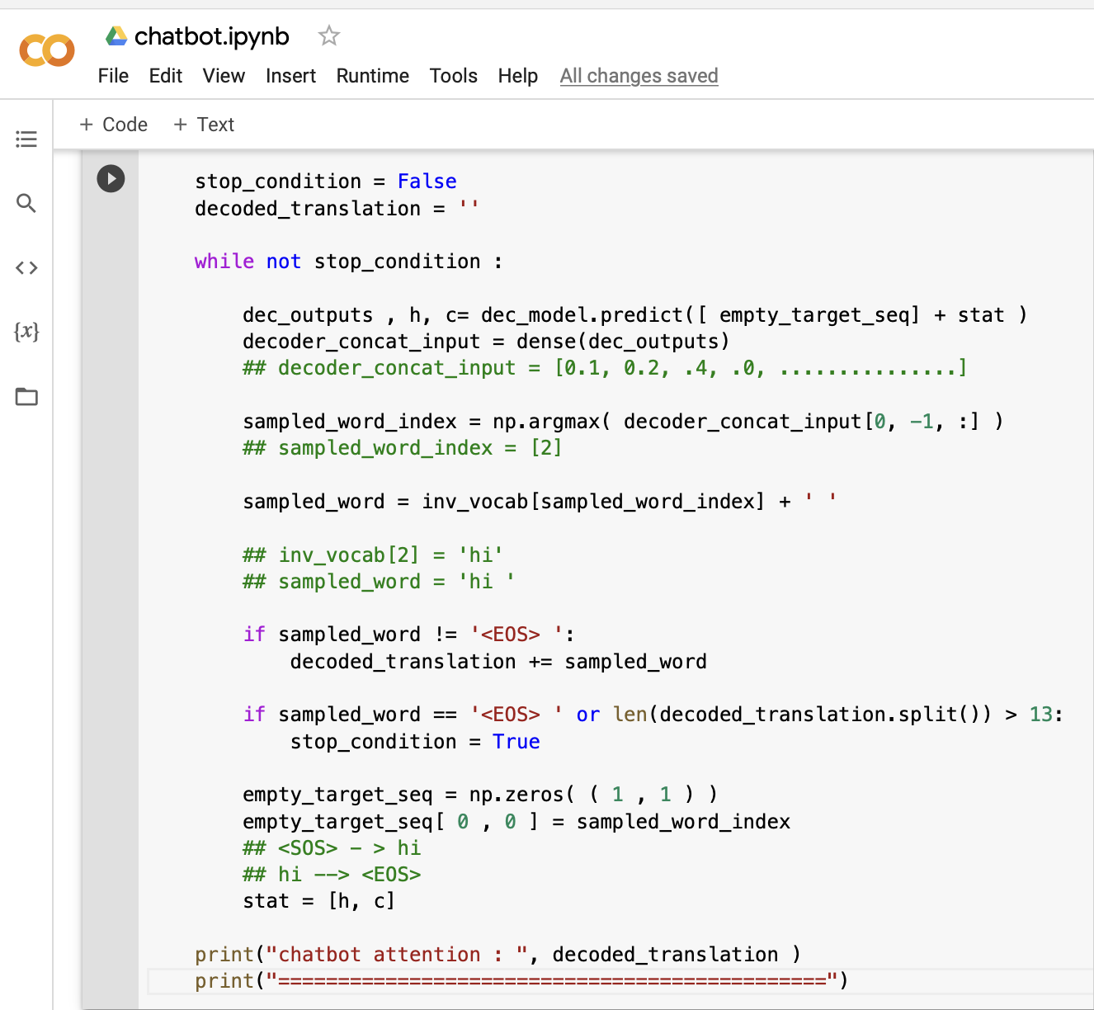

Slide 34
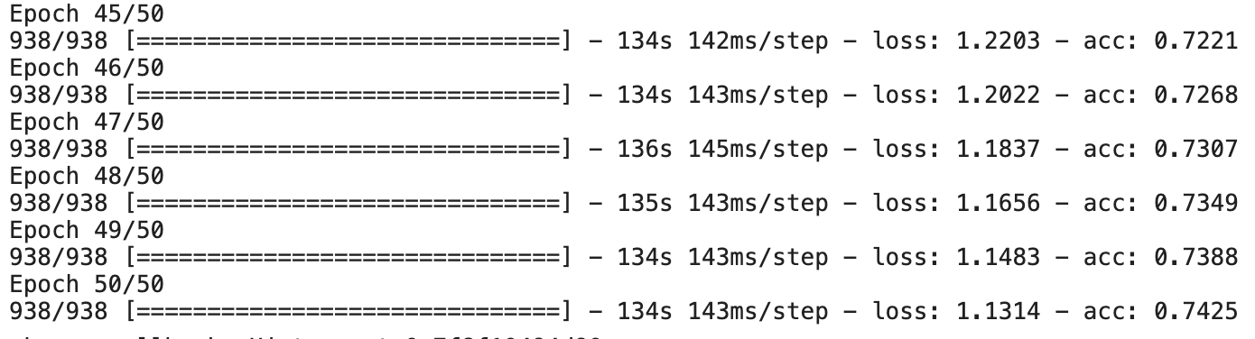
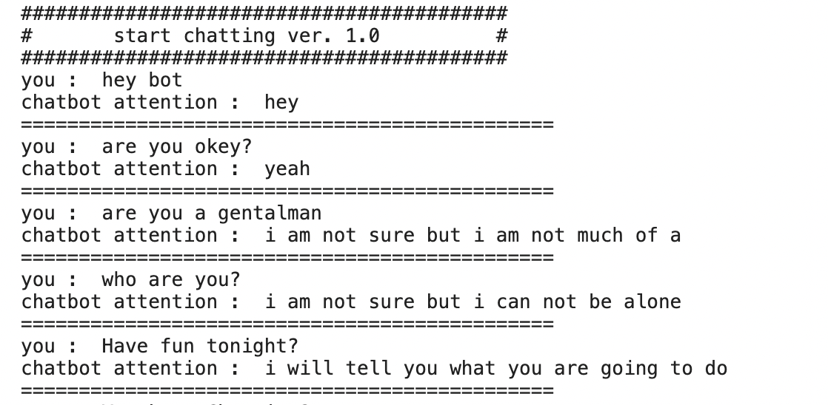
Accuracy after 50 epoch
Conversation…

Slide 35
Thank you

