Slide 1
Automobile (CAR) DATA VISUALIZATION
Lokesh Kanagala
#800957960

Slide 2
Introduction
This visualization helps user in finding a better car by presenting various useful interactive visualizations.
The dataset contains the following information:
Make
Fuel Type
Body Style
Width
Height
Curb Weight
Engine Size
Horse Power
Maximum RPM
Highway Mileage
City Mileage and
Price etc.,

Slide 3
Tasks INTENDED:
The user should be able to get the Maximum Horsepower for a given Make (ex: Toyota, BMW) and Type (ex: Convertible, Sedan).
The user should be able to view the Market Popularity of various Car Manufacturers.
The user should be able to view the Market Popularity of various Body Types.
The user should also be able to view the Market Popularity of a particular Manufacturer-Body Type combination.
The user should be able to view the price variance for different body types.
The user should be able to view the Mileage and Horse Power for a particular Body Type.

Slide 4
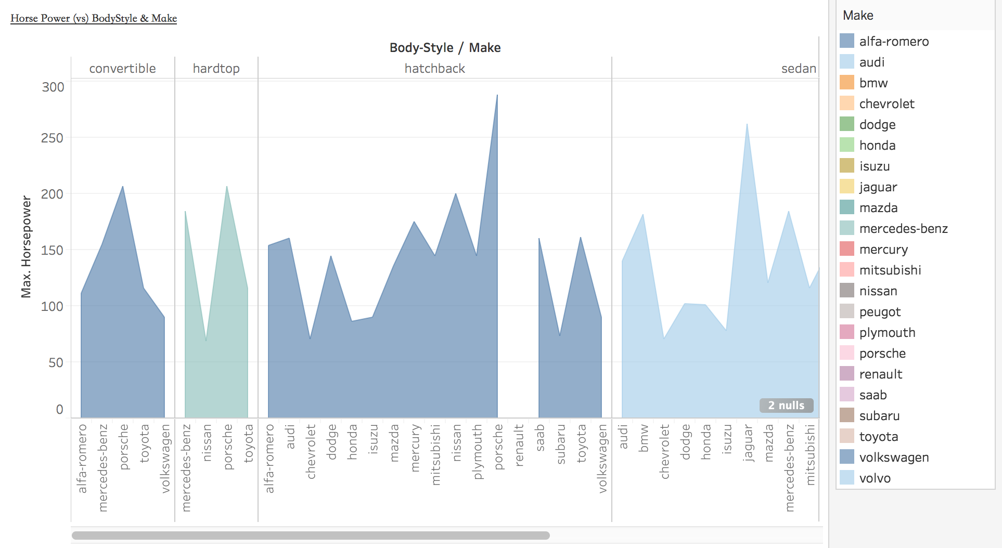
To find the Maximum Horsepower:

Slide 5
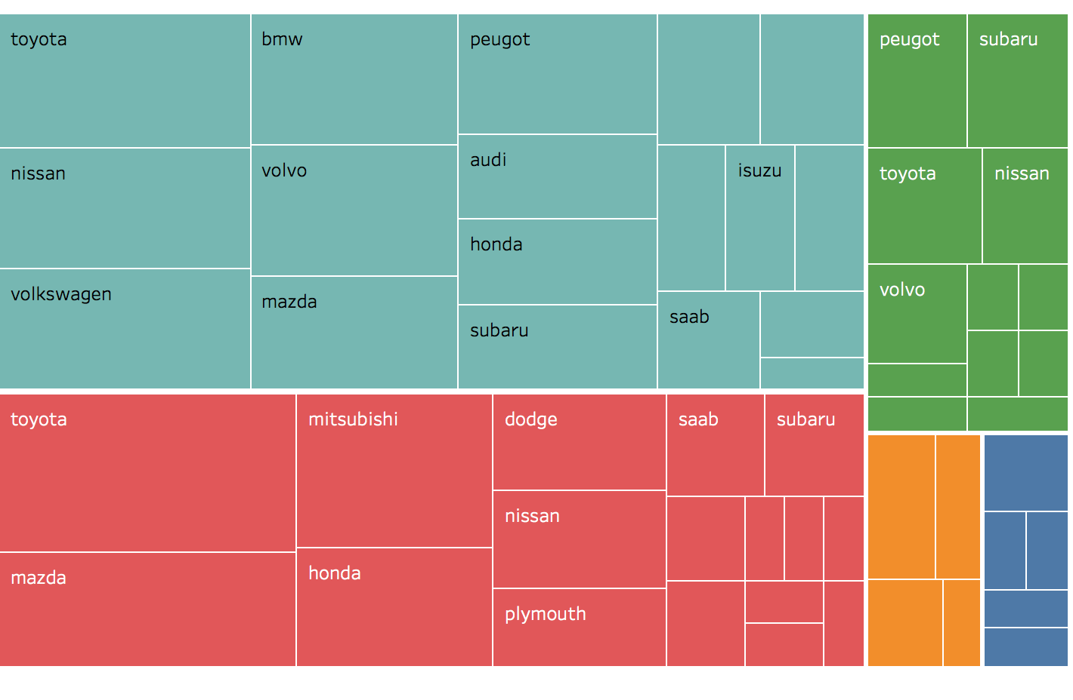
To find the market share of a car manufacturer

Slide 6
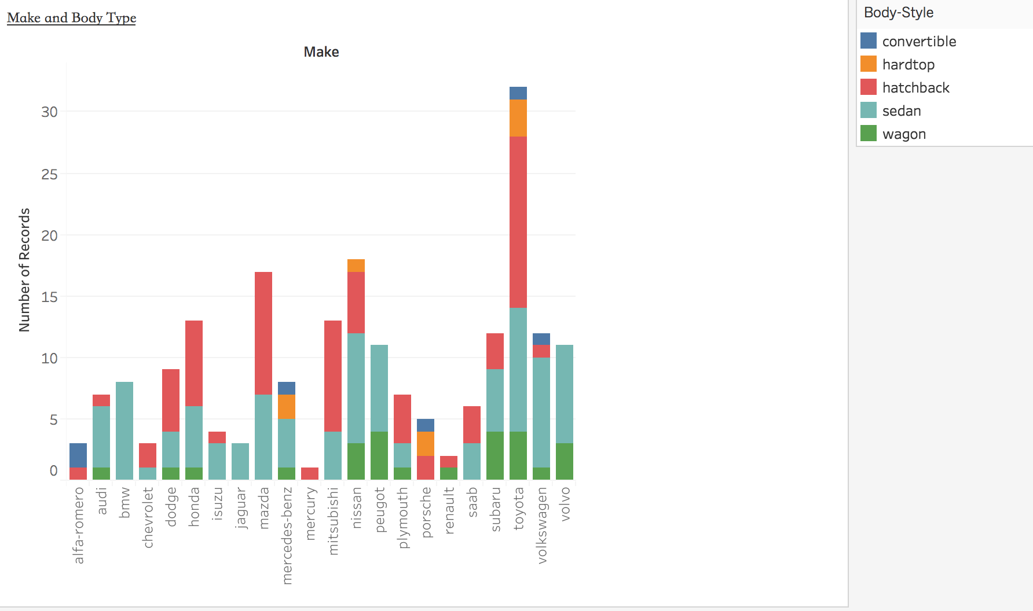
To find out what all car types a particular brand manufactures.

Slide 7
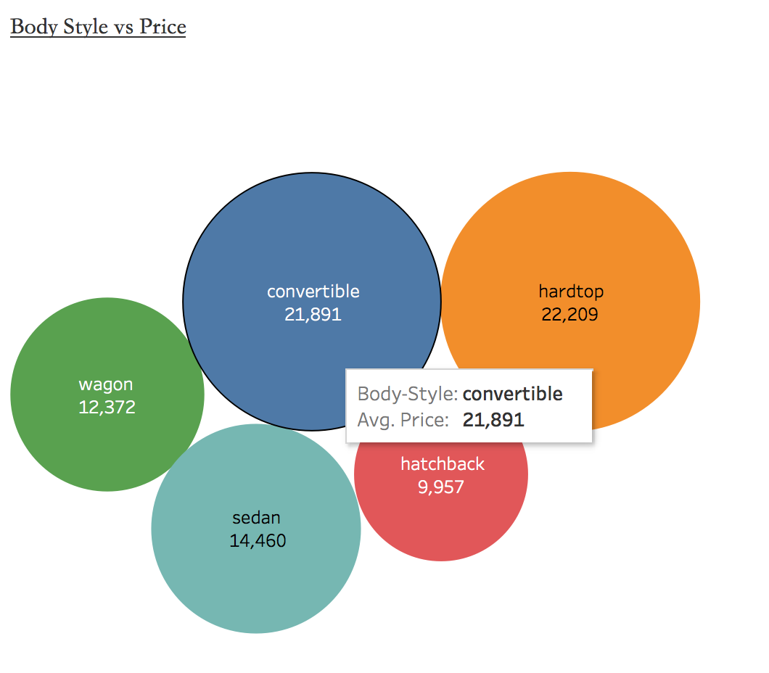
To find out the price range for various body types.

Slide 8
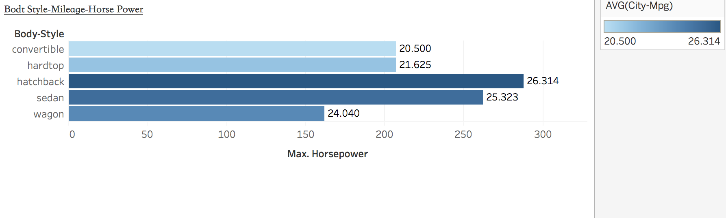
Mileage vs Horse Power for a body type

Slide 9
External link to Automobile Dataset:
https://www.kaggle.com/toramky/automobile-dataset

Slide 10
Thank You.

