Slide 1
Cloud Computing & DevOps

Slide 2
Agenda
Introduction about DevOps
Cloud Computing(AWS)
Version Control Introduction
Continuous Integration
Continuous Deployment

Slide 3
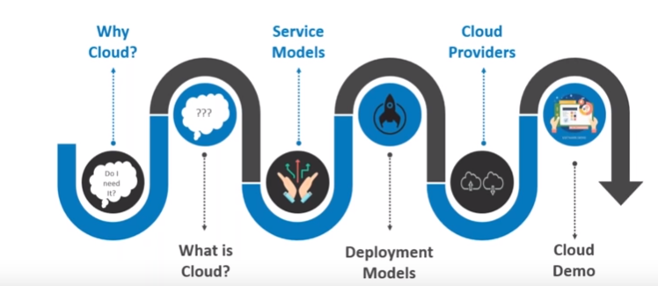
.

Slide 4
About Cloud Computing
Cloud Computing is a term which indicates delivery of computing resources - servers, storage, network etc.
It can be accessed from anywhere, anytime over the internet
Cloud market is expanding extremely fast, and its business revenue is predicted to quadruple in the next decade.

Slide 5
Over view
Why Cloud?
What is Cloud?
Why Cloud computing?
Essential characteristics of cloud computing
Cloud service models
Cloud Deployment models
Top Cloud service providers
Course Summary

Slide 6
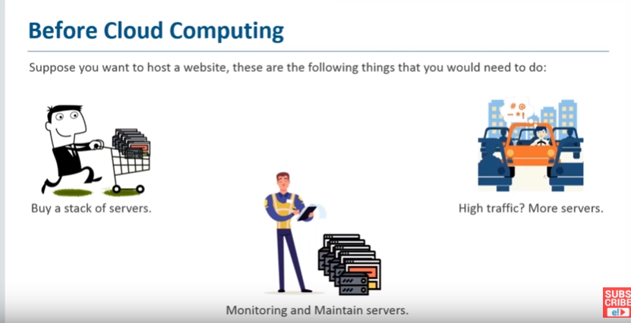
Why Cloud?

Slide 7
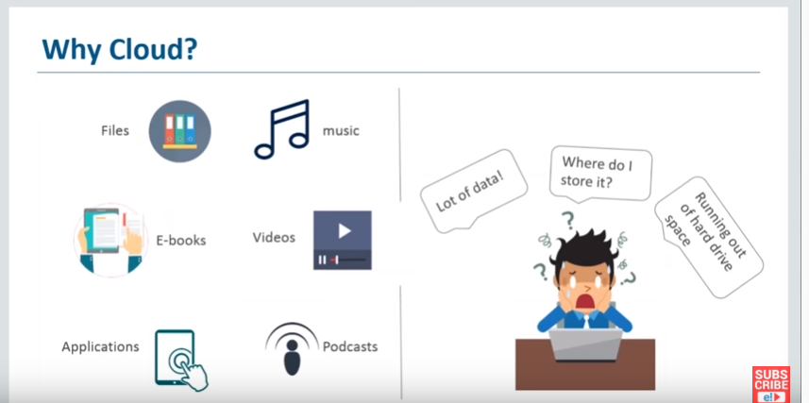
Why Cloud?
Notes:
Cloud computing require very less initial capital investment and you pay only for capacity used.
Cloud resources can be accessed through internet from anywhere, anytime.

Slide 8
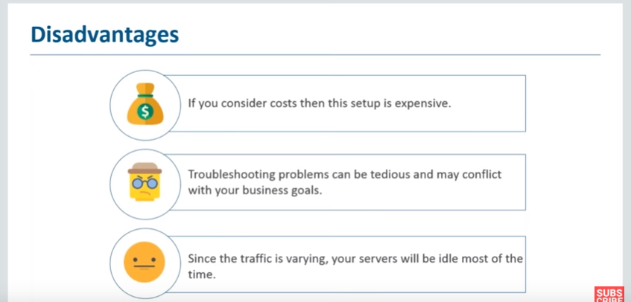
Problems with Traditional Computing
Onpremesis-own Data center
Notes:
Cost of Ownership (CoW) associated with their IT infrastructure

Slide 9
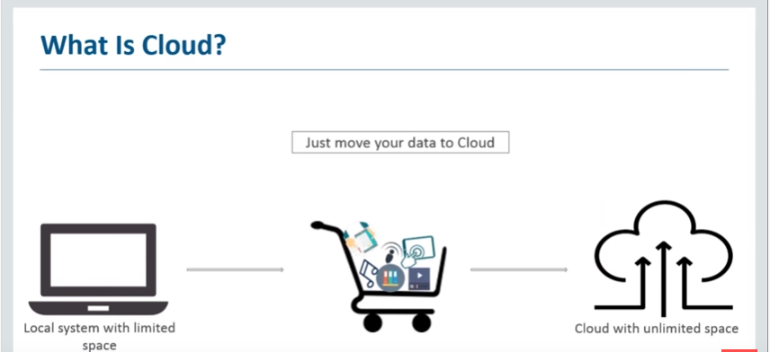
What is cloud?

Slide 10
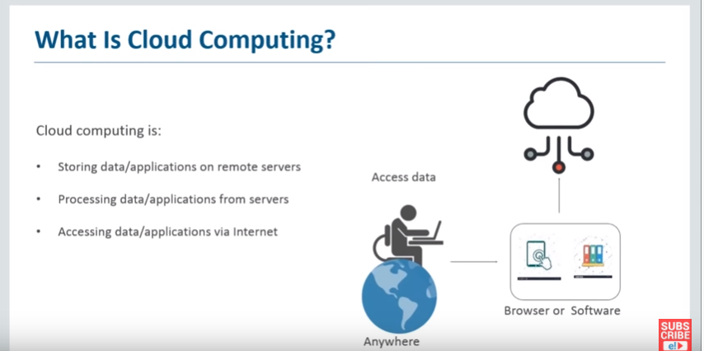
What is cloud computing ?
Notes:
Cloud computing is a delivery of computing resources - servers, storage, network etc. over internet and can be accessed from anywhere, anytime.

Slide 11

Why Cloud Computing?
Electricity - A Utility Model
Notes:
Electricity is made available to you with much greater efficiency that you could generate on your own. You will not know details such as source of electricity, the mode of power generation, fuel type in the power plant etc. You simply connect appliances to power sockets and consume electricity.
It is available to you on-demand and you pay for what you use.
Cloud computing is a similar utility model.
Here, compute, storage, network resources provisioned by third parties, can be accessed on-demand over internet. In cloud computing, you pay only for what you consume.

Slide 12
Essential characteristics of cloud computing
On-demand self service
Any time anywhere network access
Rapid elasticity
Location independent resource pooling
Measured service
Notes:
Reference: https://www.youtube.com/watch?v=tAUuY0Yld0E
Location independent resource pooling- CPU,memory,storage
Measured service – utilization of cloud resource

Slide 13
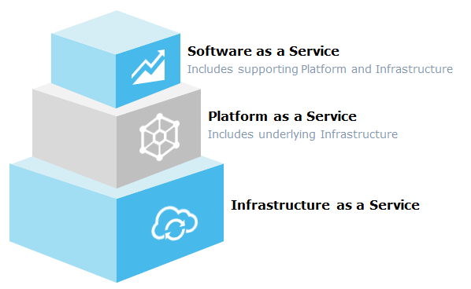
Cloud Service Models
Notes:
Based on the type of services delivered, there are three basic delivery models of cloud computing

Slide 14
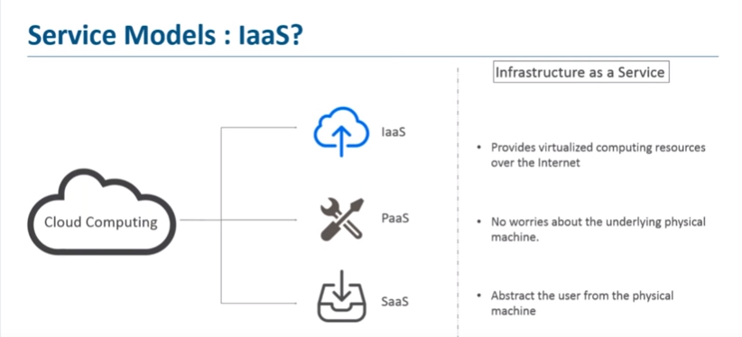
Infrastructure as a Service (IaaS)

Slide 15
Infrastructure as a Service (IaaS)
In IaaS service model, the cloud consumer:
Get processing, storage, networks, and other fundamental computing resources
Does not manage or control the underlying cloud infrastructure
Has control over operating systems, storage, deployed applications and limited control of certain networking components, such as host firewalls
Notes:
Examples of IaaS services: Elastic Compute Cloud (EC2) service from Amazon Web Services, Google Compute Engine (GCE) from Google cloud etc.
Major IaaS services and providers:
Elastic Compute Cloud (EC2) from Amazon Web Services (AWS)
Virtual machines from Microsoft Azure
Google Compute Engine (GCE) from Google Cloud Platform
Virtual Server from IBM Cloud
Compute service from Oracle
Elastic Compute Service(ECS) from Alibaba Cloud

Slide 16
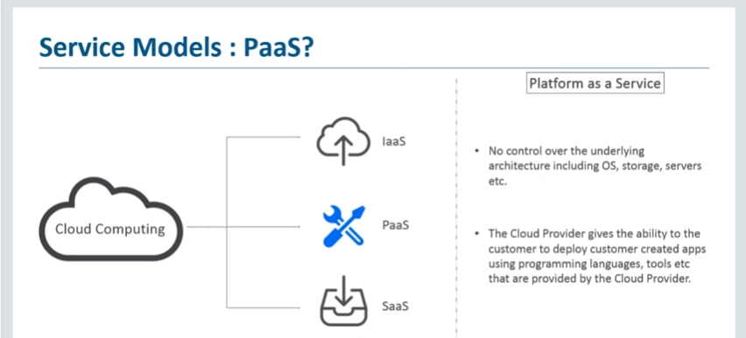
Platform as a Service (PaaS)

Slide 17
Platform as a Service (PaaS)
In PaaS model, the consumer:
Deploys consumer-created or acquired applications onto the cloud infrastructure
Uses run time environments, platforms and tools provided by the service provider
Does not manage or control the underlying cloud infrastructure such as network, servers, operating systems, storage etc.
Has control over the deployed applications and possibly application hosting environment configurations
Notes:
Examples of PaaS services: Google App Engine(GAE) from Google Cloud, Elastic Beanstalk from Amazon Web Services etc.
Major PaaS service providers:
App Cloud from Salesforce.com Inc.
Google App Engine(GAE) from Google Cloud Platform
Mendix application platform from Mendix
OpenShift from Red Hat Inc.
Oracle cloud platform from Oracle
OutSystems platform from Outsystems

Slide 18
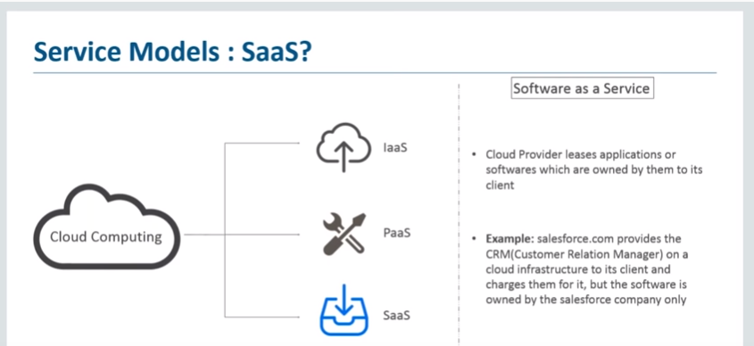
Software as a Service (SaaS)

Slide 19
Software as a Service (SaaS)
In SaaS model, the consumer:
Uses the provider’s software applications running on a cloud infrastructure
Access software application from various client devices through a thin client interface such as a Web browser or a program interface
Does not manage or control the underlying cloud infrastructure or individual application capabilities except a very limited user-specific application configuration settings
Notes:
Examples of SaaS products: Microsoft Office 356 suite, SalesForce CRM solution etc.
Major SaaS products and providers
Office 365 from Microsoft Corporation
Adobe Creative Cloud from Adobe Systems
JIRA from Atlassian
GSuits from Google
ServiceNow from ServiceNow Inc.
Box
Slack by Slack Technologies
Zendesk by Zendesk Inc.

Slide 20
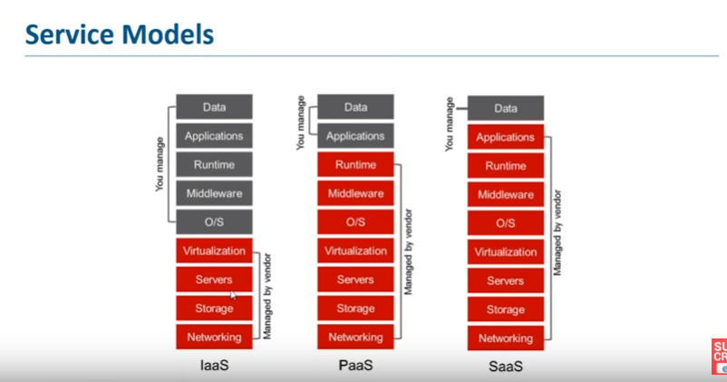
Service Models: Component Management
Notes:
Based on the level of control required on various levels of cloud environment, organizations chooses appropriate cloud service models.
The responsibilities managed by CSP and users for each service models, are indicated below.

Slide 21
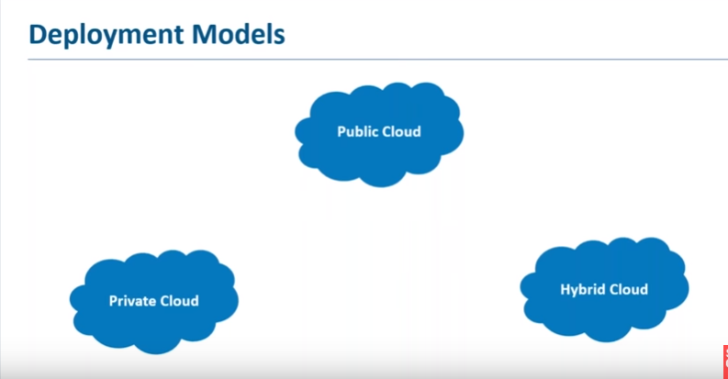
Cloud Deployment Models

Slide 22
Cloud Deployment Models
Public Cloud
Infrastructure available to public
Owned by Cloud Service Provider
Private Cloud
Operated solely for an organization
Can exist either on-premises or off premise
Hybrid Cloud
Two or more clouds that inter-operate or federated through technology
Community Cloud
Infrastructure shared by several organizations supporting specific community that have common concerns
Typically hosted outside organization's environment

Slide 23
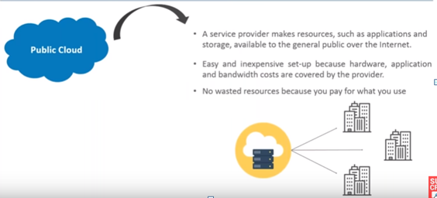
Public Cloud

Slide 24
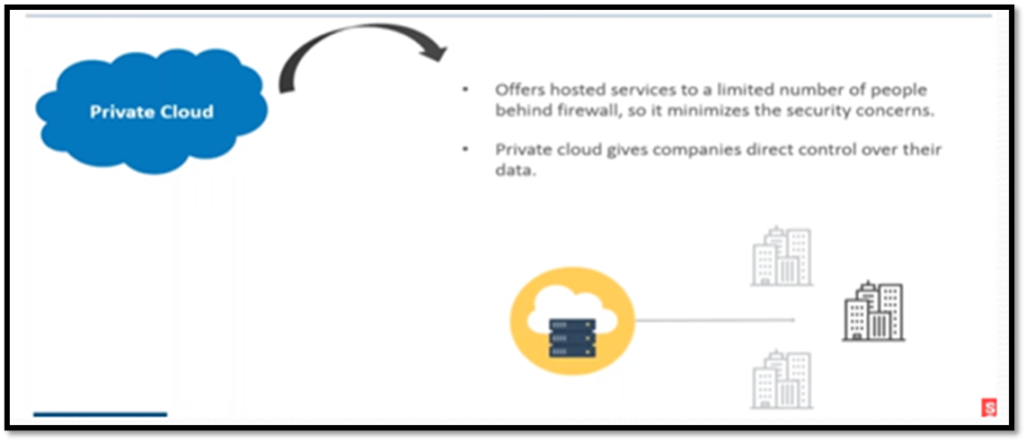
Private Cloud

Slide 25
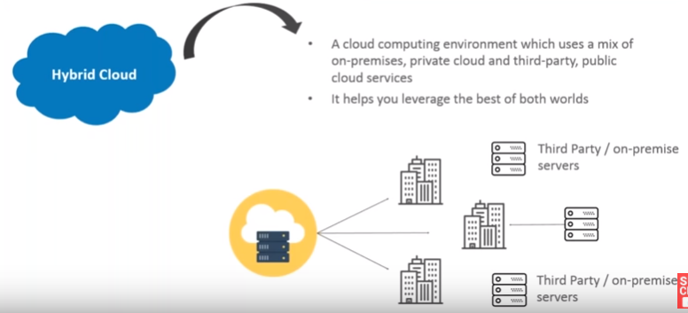
Hybrid Cloud

Slide 26
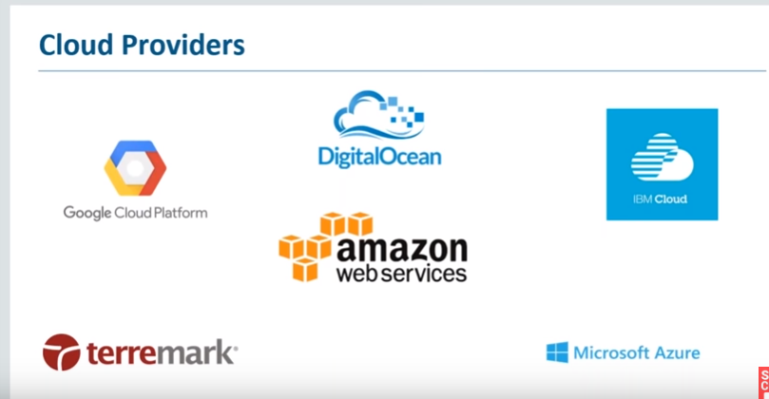
CLOUD PROVIDERS

Slide 27
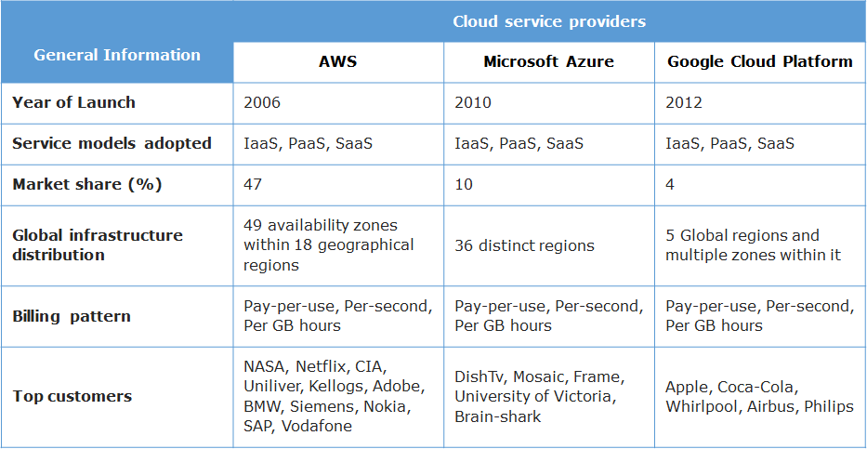
Top CSPs - A Comparison
Notes:
You will now explore the capabilities of top three CSPs (Amazon, Microsoft and Google) by comparing their most widely used services and features.

Slide 28
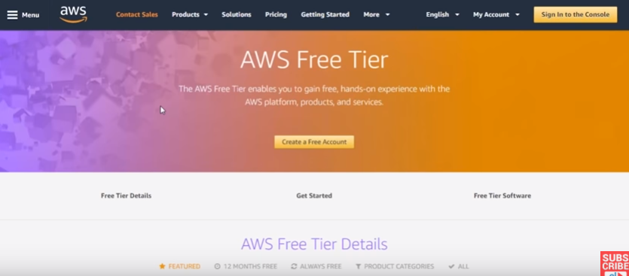
AWS Free Tier

Slide 29
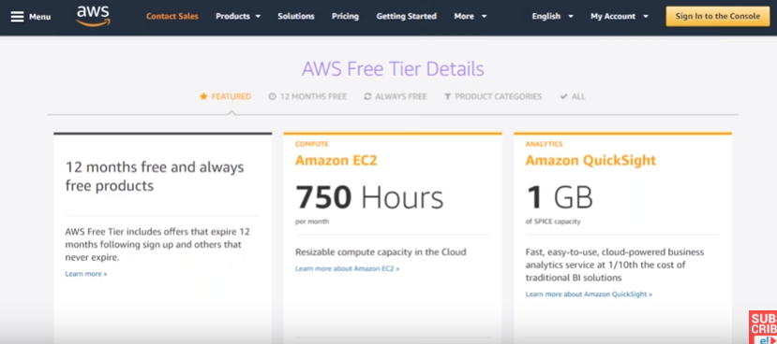
AWS Free Tier

Slide 30
Course Summary
Why should I learn cloud
Comparison of traditional and cloud computing models
Cloud service and deployment models
Major IaaS, PaaS and SaaS providers

