Slide 1
Socket Programming

Slide 2
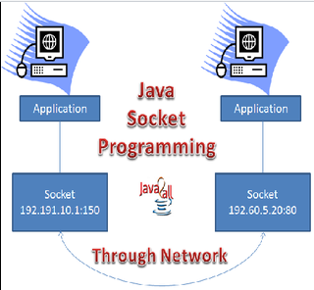

Slide 3
Terminology
IP Address
Protocol
Port Number
MAC Address
Connection-oriented and connection-less protocol
Socket

Slide 4
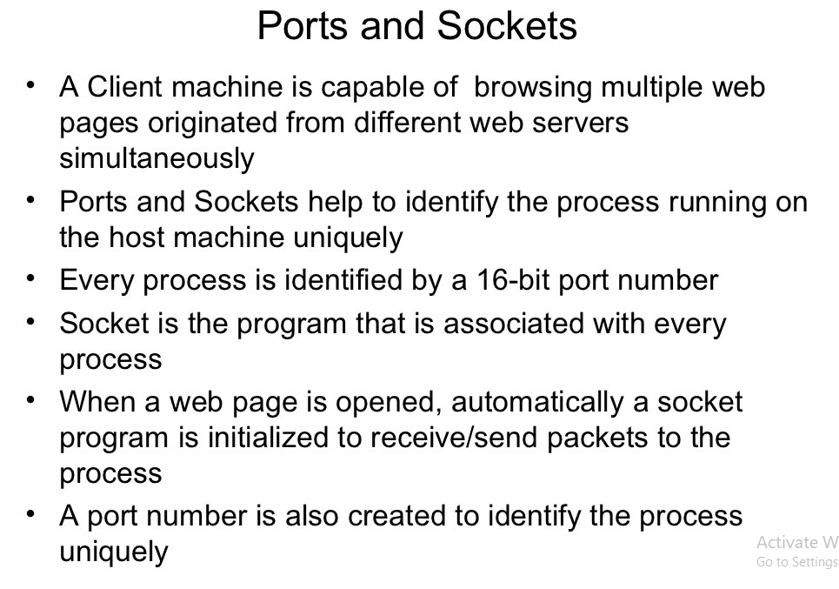

Slide 5
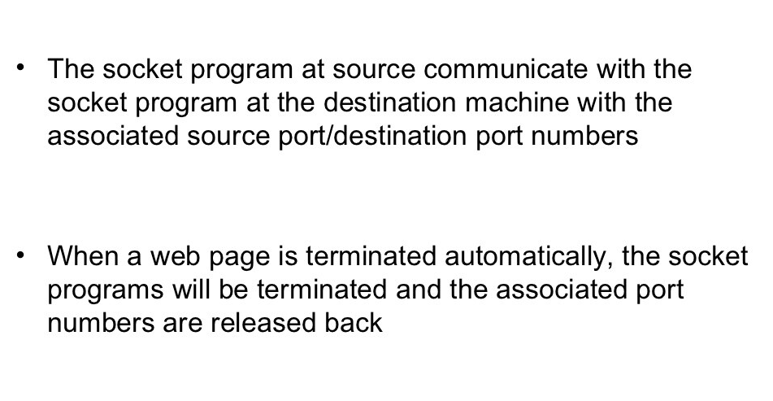

Slide 6
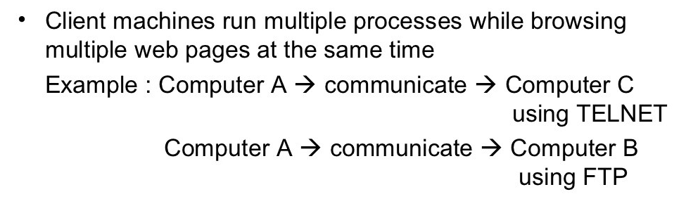
Why Socket Program

Slide 7
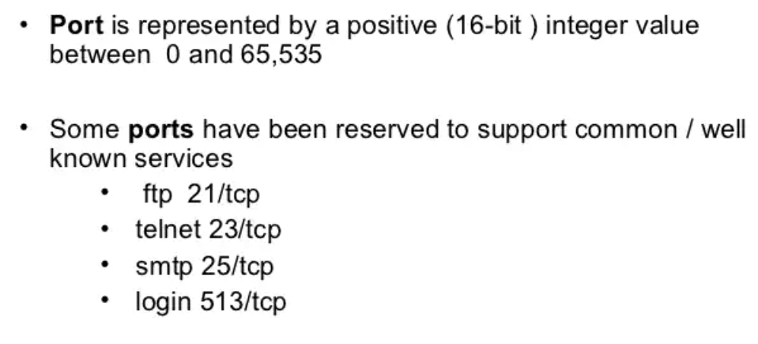
Port

Slide 8
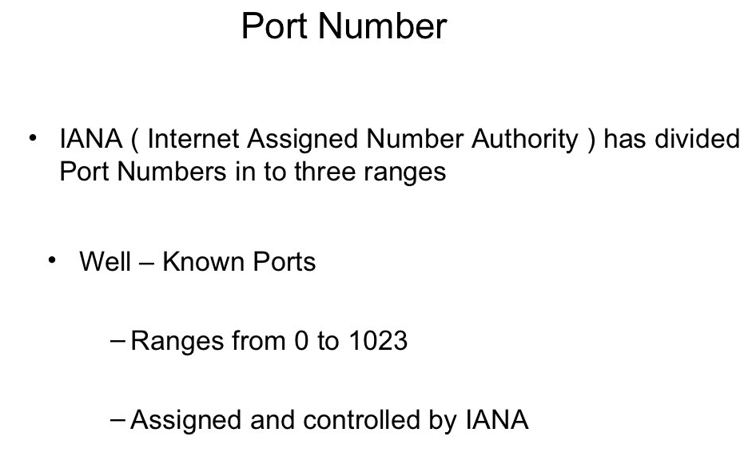

Slide 9
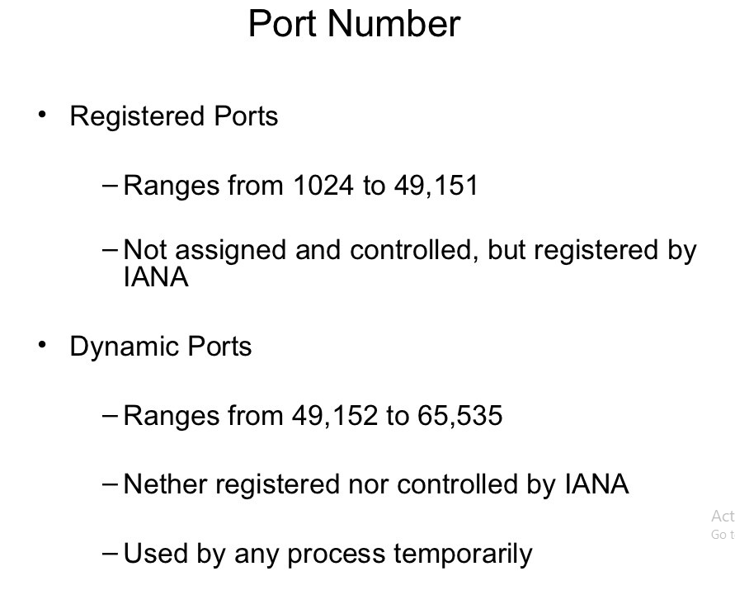

Slide 10
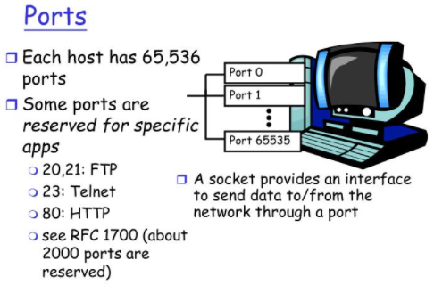

Slide 11
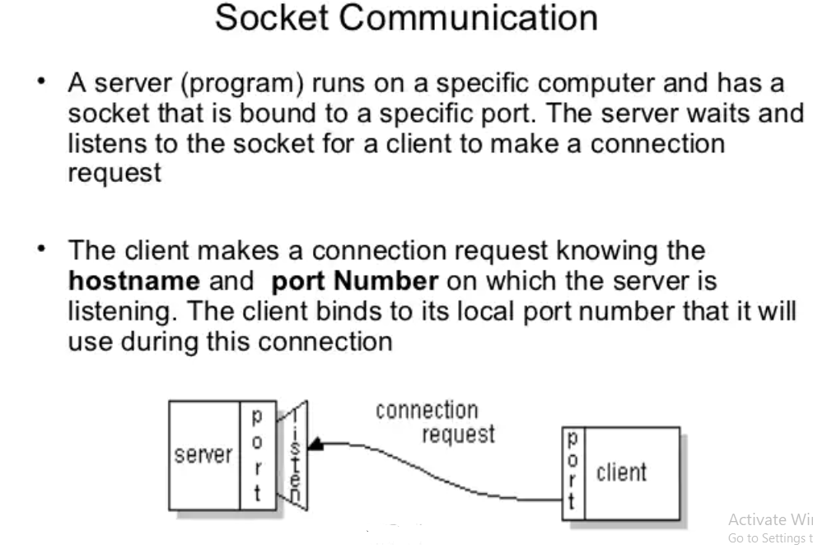

Slide 12
Socket Classes
Java Socket programming is used for communication between the applications running on different machine
Socket programming can be connection-oriented or connection-less.
Socket and ServerSocket classes are used for connection-oriented socket programming
DatagramSocket and DatagramPacket classes are used for connection-less socket programming.

Slide 13
Client
Client need :
  IP Address of Server, and
  Port number
Classes
  Socket
  ServerSocket

Slide 14
Server
accept() method of ServerSocket class blocks the console until the client is connected.
After the successful connection of client, it returns the instance of Socket at server-side.

Slide 15
Socket() and ServerSocket()
A socket is simply an endpoint for communications between the machines. The Socket class can be used to create a socket.
The ServerSocket class can be used to create a server socket. This object is used to establish communication with the clients.

Slide 16
Creating Server
ServerSocket ss=new ServerSocket(6666);
Socket s=ss.accept();//establishes connection and waits for the client

Slide 17
Creating Client
Socket s=new Socket("localhost",6666);

Slide 18
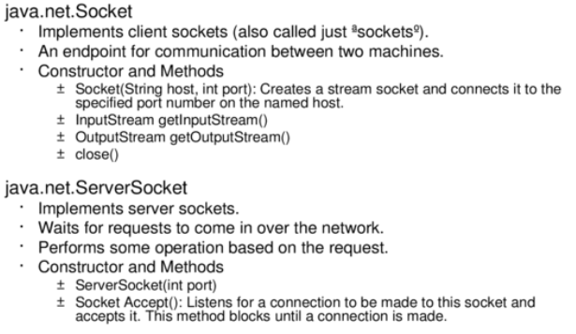

Slide 19
Client Program
import java.io.*;
import java.net.*;
public class MyClient {
public static void main(String[] args) {
try{
Socket s=new Socket("localhost",6666);
DataOutputStream dout=new DataOutputStream(s.getOutputStream());
dout.writeUTF("Hello Server");
dout.flush();
dout.close();
s.close();
}catch(Exception e){System.out.println(e);}
}
}

Slide 20
Server Program
import java.io.*;
import java.net.*;
public class MyServer {
public static void main(String[] args){
try{
ServerSocket ss=new ServerSocket(6666);
Socket s=ss.accept();//establishes connection
DataInputStream dis=new DataInputStream(s.getInputStream());
String str=(String)dis.readUTF();
System.out.println("message= "+str);
ss.close();
}catch(Exception e){System.out.println(e);}
}
}

Slide 21
Execution
open two command prompts and execute each program at each command prompt

Slide 22
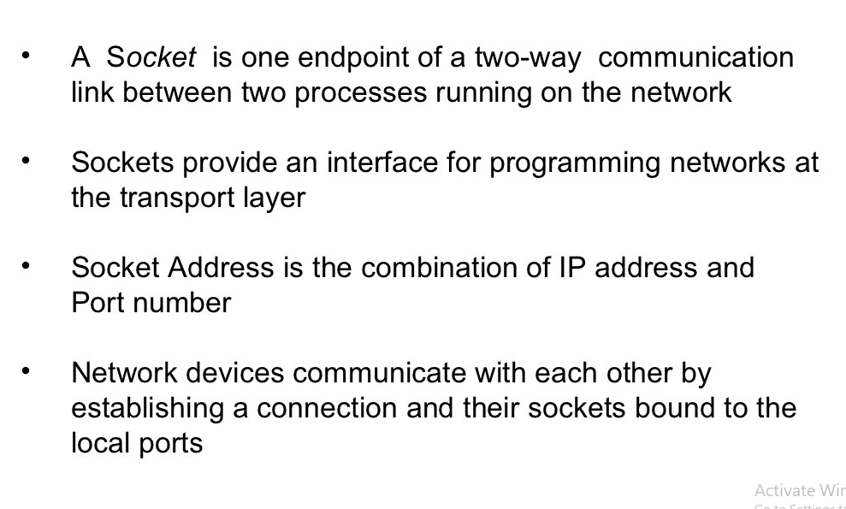
Summary

