Slide 1

Chapter 14
Unicast Routing Protocols:
RIP, OSPF, and BGP
Objectives
Upon completion you will be able to:
Distinguish between intra and interdomain routing
Understand distance vector routing and RIP
Understand link state routing and OSPF
Understand path vector routing and BGP
TCP/IP Protocol Suite

Slide 2
14.1 INTRA- AND INTERDOMAIN
ROUTING
Routing inside an autonomous system is referred to as intradomain routing. Routing between autonomous systems is referred to as interdomain routing.
TCP/IP Protocol Suite

Slide 3
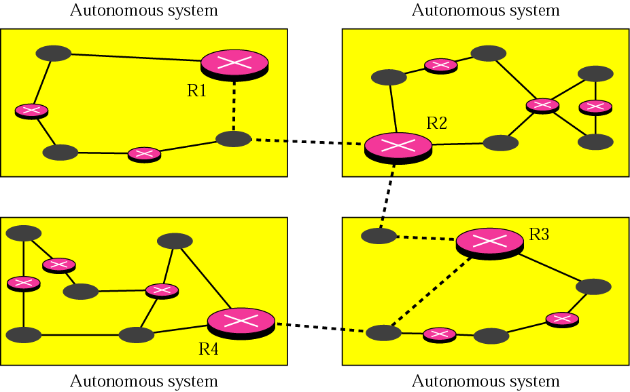
Figure 14.1 Autonomous systems
TCP/IP Protocol Suite

Slide 4
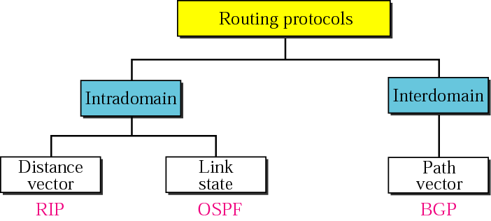
Figure 14.2 Popular routing protocols
TCP/IP Protocol Suite

Slide 5
14.2 DISTANCE VECTOR ROUTING
In distance vector routing, the least cost route between any two nodes is the route with minimum distance. In this protocol each node maintains a vector (table) of minimum distances to every node
The topics discussed in this section include:
Initialization
Sharing
Updating
When to Share
Two-Node Loop Instability
Three-Node Instability
TCP/IP Protocol Suite

Slide 6
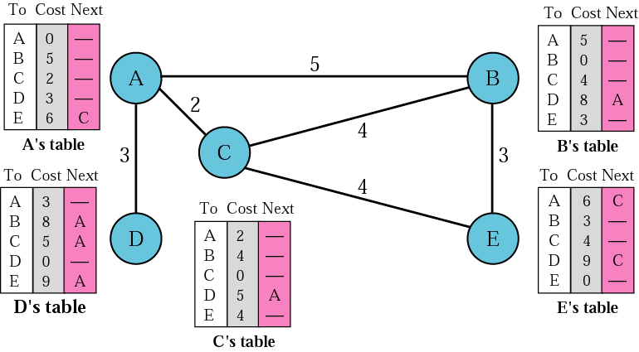
Figure 14.3 Distance vector routing tables
TCP/IP Protocol Suite

Slide 7
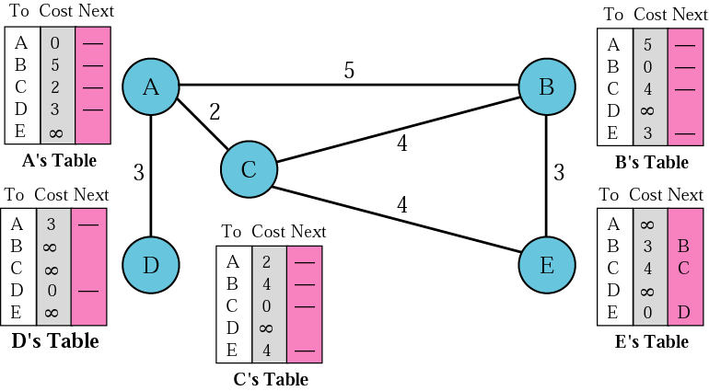
Figure 14.4 Initialization of tables in distance vector routing
TCP/IP Protocol Suite

Slide 8

Note:
In distance vector routing, each node shares its routing table with its immediate neighbors periodically and when there is a change.
TCP/IP Protocol Suite

Slide 9
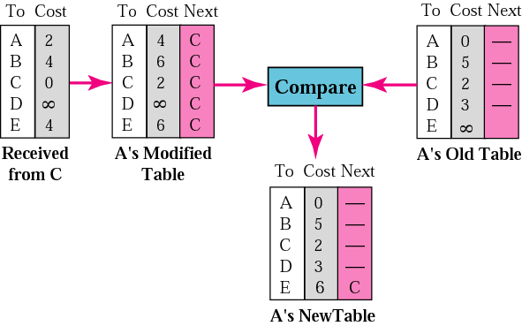
Figure 14.5 Updating in distance vector routing
TCP/IP Protocol Suite

Slide 10
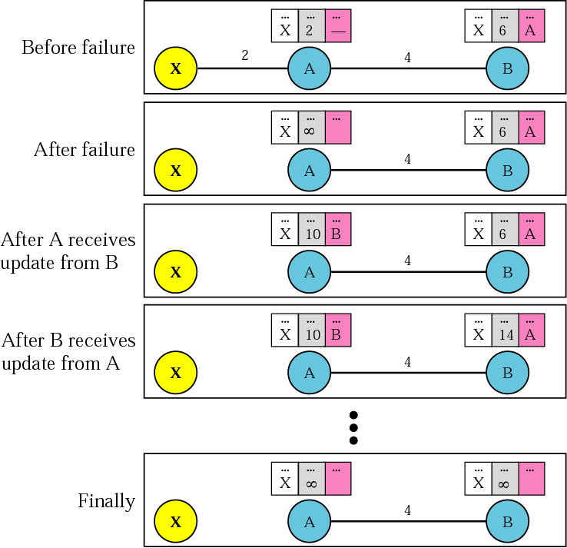
Figure 14.6 Two-node instability
TCP/IP Protocol Suite

Slide 11
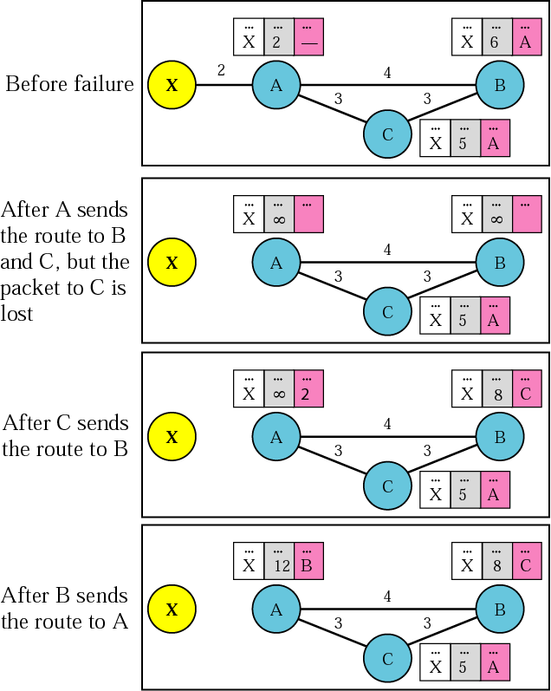
Figure 14.7 Three-node instability
TCP/IP Protocol Suite

Slide 12
14.3 RIP
The Routing Information Protocol (RIP) is an intradomain routing protocol used inside an autonomous system. It is a very simple protocol based on distance vector routing.
The topics discussed in this section include:
RIP Message Format
Requests and Responses
Timers in RIP
RIP Version 2
Encapsulation
TCP/IP Protocol Suite

Slide 13
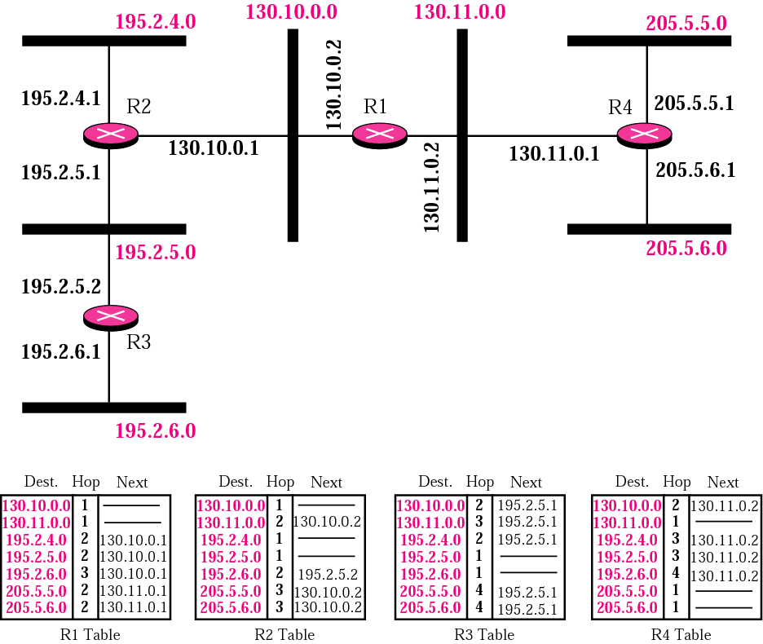
Figure 14.8 Example of a domain using RIP
TCP/IP Protocol Suite

Slide 14
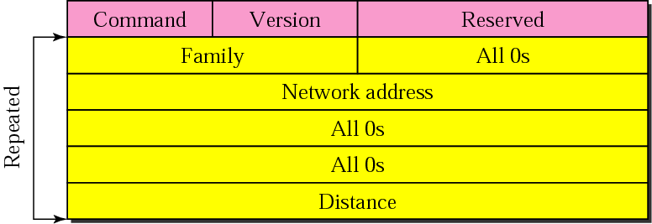
Figure 14.9 RIP message format
TCP/IP Protocol Suite

Slide 15
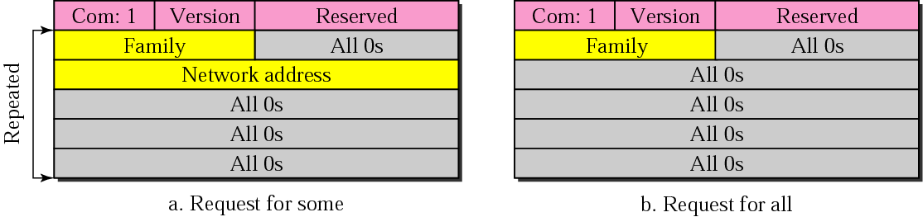
Figure 14.10 Request messages
TCP/IP Protocol Suite

Slide 16
Example 1
Figure 14.11 shows the update message sent from router R1 to router R2 in Figure 14.8. The message is sent out of interface 130.10.0.2.
The message is prepared with the combination of split horizon and poison reverse strategy in mind. Router R1 has obtained information about networks 195.2.4.0, 195.2.5.0, and 195.2.6.0 from router R2. When R1 sends an update message to R2, it replaces the actual value of the hop counts for these three networks with 16 (infinity) to prevent any confusion for R2. The figure also shows the table extracted from the message. Router R2 uses the source address of the IP datagram carrying the RIP message from R1 (130.10.02) as the next hop address.
See Next Slide
TCP/IP Protocol Suite

Slide 17
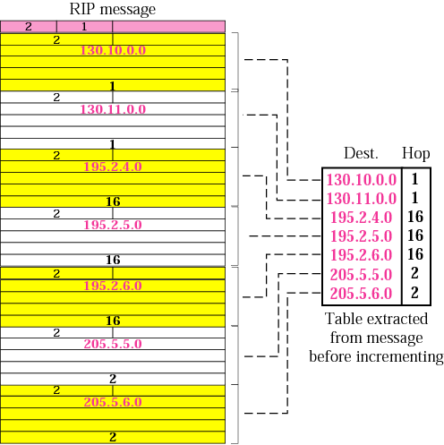
Figure 14.11 Solution to Example 1
TCP/IP Protocol Suite

Slide 18
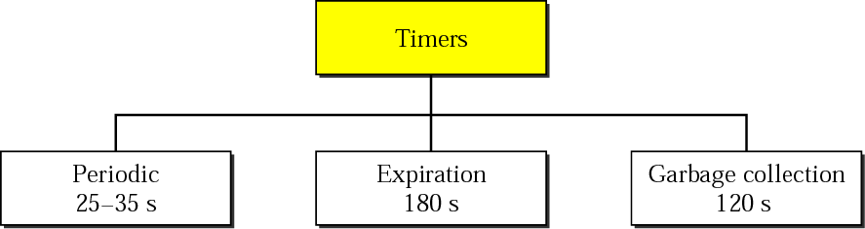
Figure 14.12 RIP timers
TCP/IP Protocol Suite

Slide 19
Example 2
A routing table has 20 entries. It does not receive information about five routes for 200 s. How many timers are running at this time?
Solution
The 21 timers are listed below:
Periodic timer: 1
Expiration timer: 20 − 5 = 15
Garbage collection timer: 5
TCP/IP Protocol Suite

Slide 20
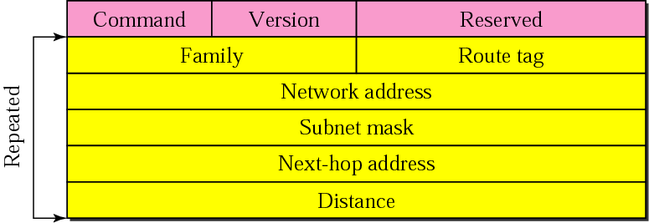
Figure 14.13 RIP version 2 format
TCP/IP Protocol Suite

Slide 21
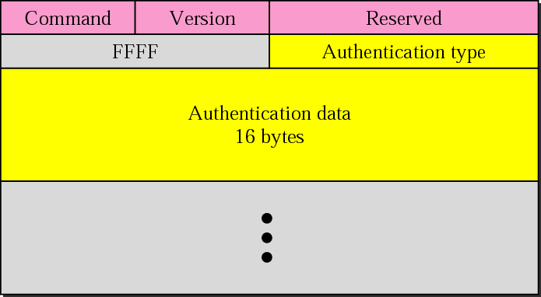
Figure 14.14 Authentication
TCP/IP Protocol Suite

Slide 22
Note:
RIP uses the services of UDP on
well-known port 520.
TCP/IP Protocol Suite

Slide 23
14.4 LINK STATE ROUTING
In link state routing, if each node in the domain has the entire topology of the domain, the node can use Dijkstra’s algorithm to build a routing table.
The topics discussed in this section include:
Building Routing Tables
TCP/IP Protocol Suite

Slide 24
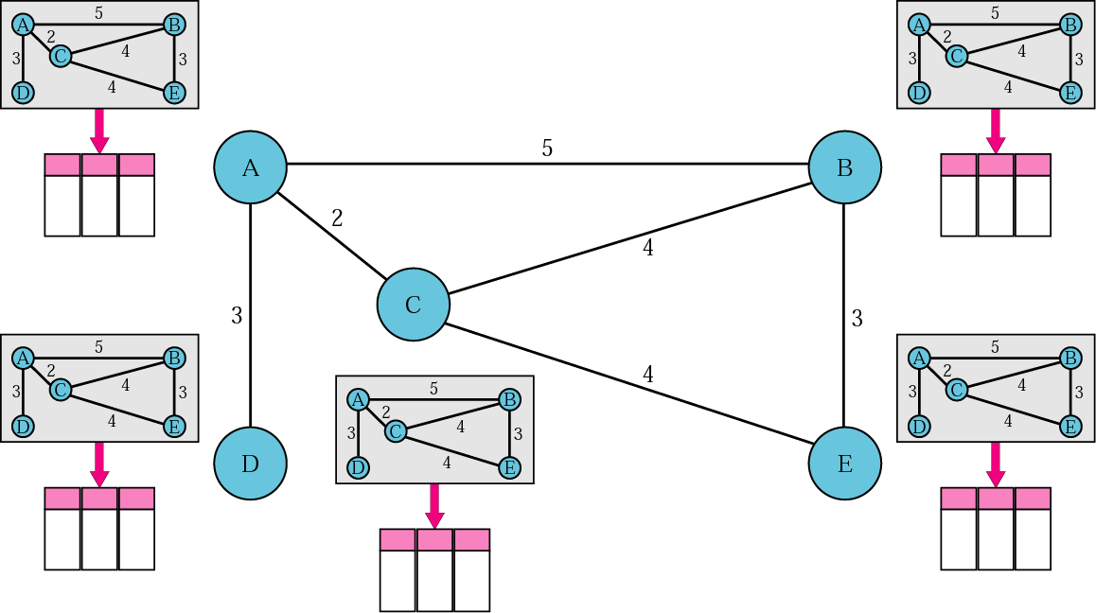
Figure 14.15 Concept of link state routing
TCP/IP Protocol Suite

Slide 25
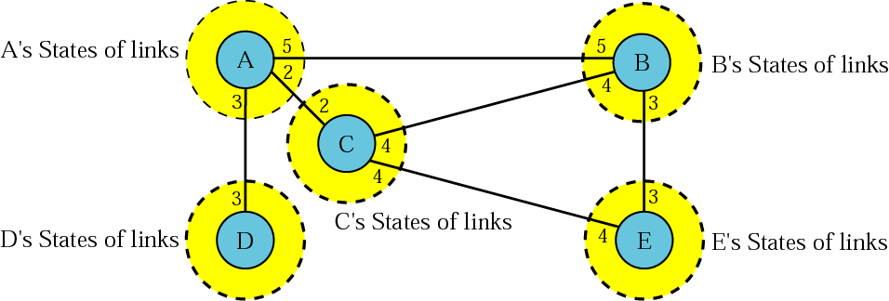
Figure 14.16 Link state knowledge
TCP/IP Protocol Suite

Slide 26
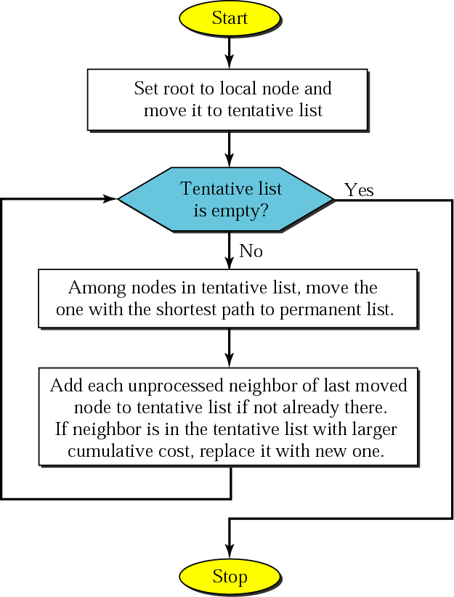
Figure 14.17 Dijkstra algorithm
TCP/IP Protocol Suite

Slide 27
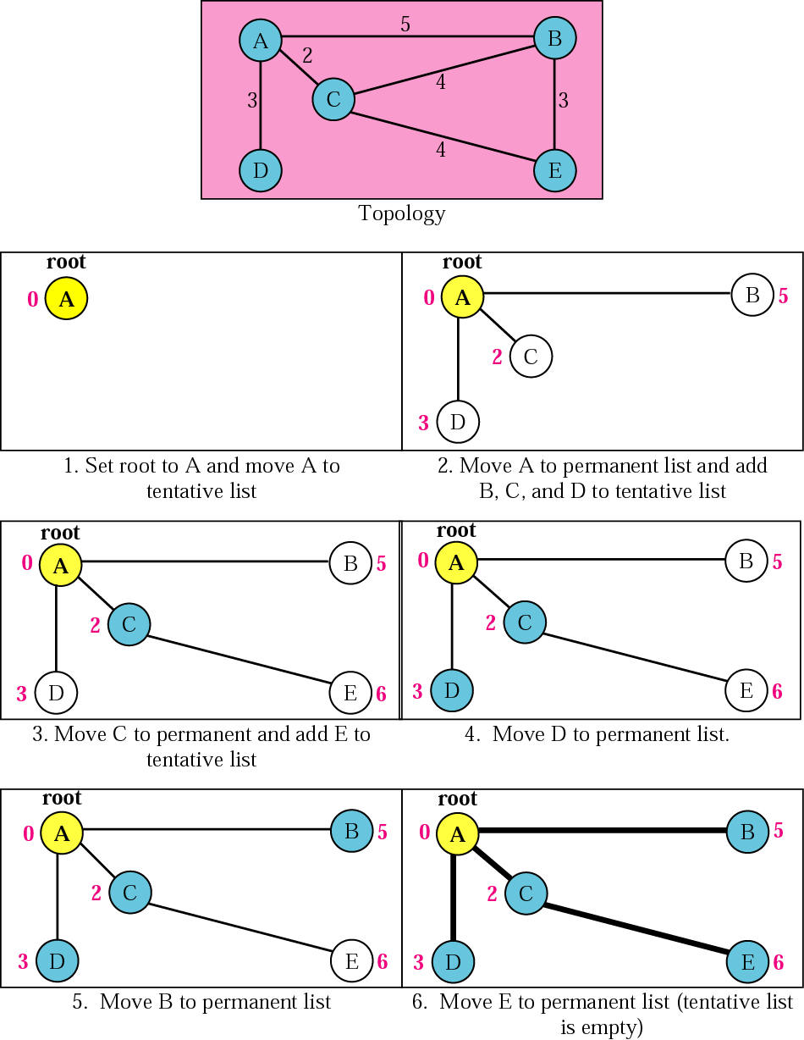
Figure 14.18 Example of formation of shortest path tree
TCP/IP Protocol Suite

Slide 28
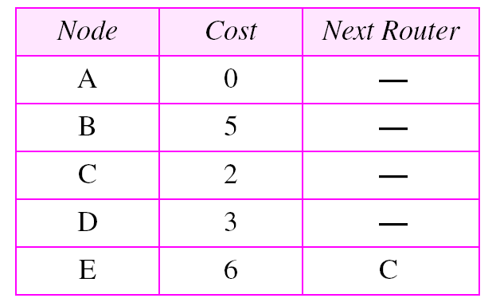
Table 14.1 Routing table for node A
TCP/IP Protocol Suite

Slide 29
14.5 OSPF
The Open Shortest Path First (OSPF) protocol is an intradomain routing protocol based on link state routing. Its domain is also an autonomous system.
The topics discussed in this section include:
Areas
Metric
Types of Links
Graphical Representation
OSPF Packets
Link State Update Packet
Other Packets
Encapsulation
TCP/IP Protocol Suite

Slide 30
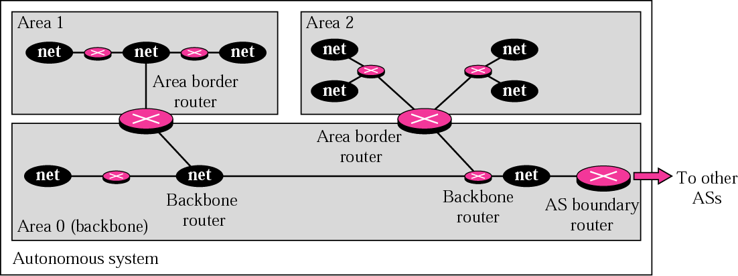
Figure 14.19 Areas in an autonomous system
TCP/IP Protocol Suite

Slide 31
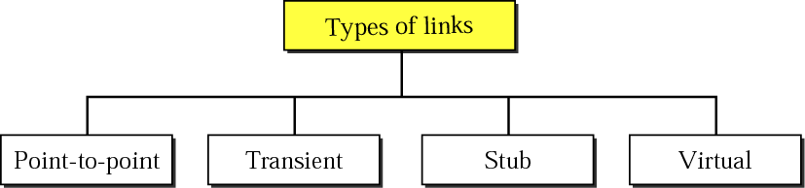
Figure 14.20 Types of links
TCP/IP Protocol Suite

Slide 32
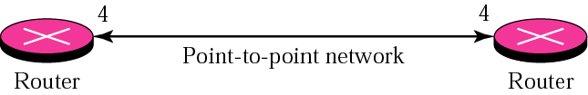
Figure 14.21 Point-to-point link
TCP/IP Protocol Suite

Slide 33
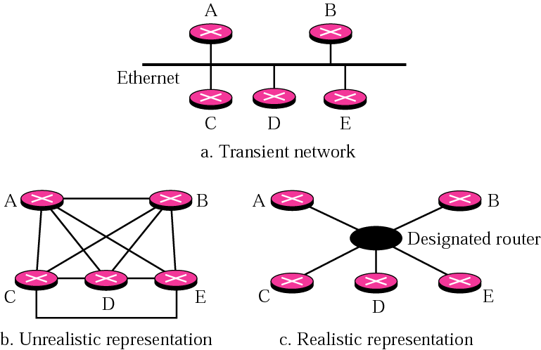
Figure 14.22 Transient link
TCP/IP Protocol Suite

Slide 34
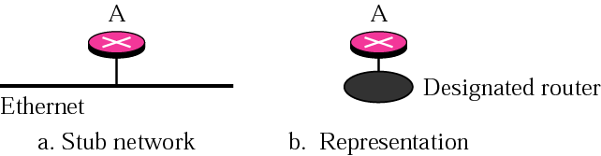
Figure 14.23 Stub link
TCP/IP Protocol Suite

Slide 35
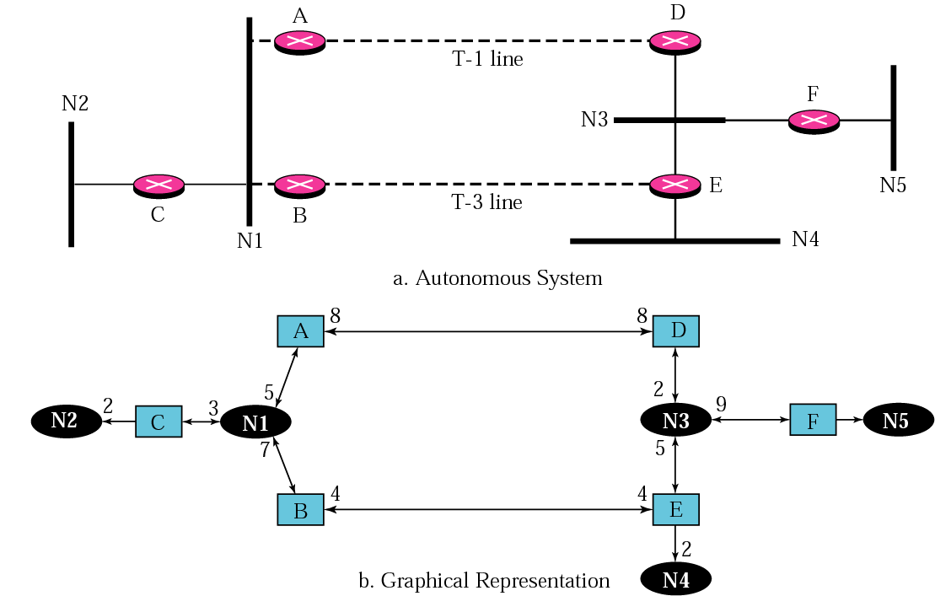
Figure 14.24 Example of an AS and its graphical representation in OSPF
TCP/IP Protocol Suite

Slide 36
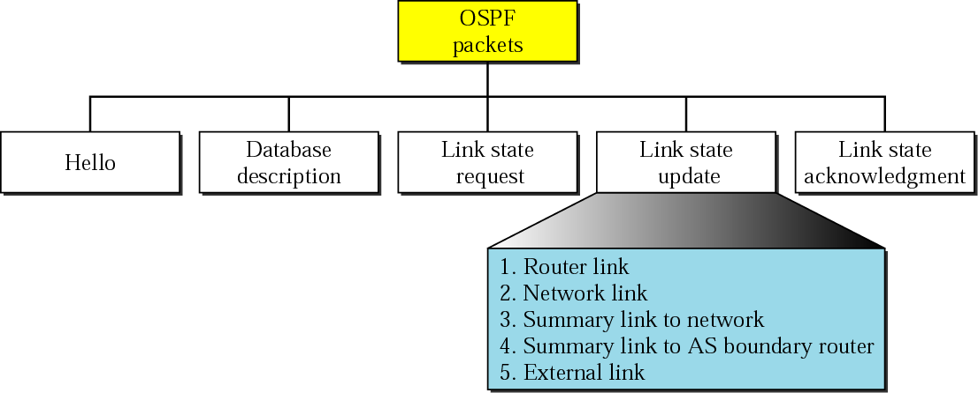
Figure 14.25 Types of OSPF packets
TCP/IP Protocol Suite

Slide 37
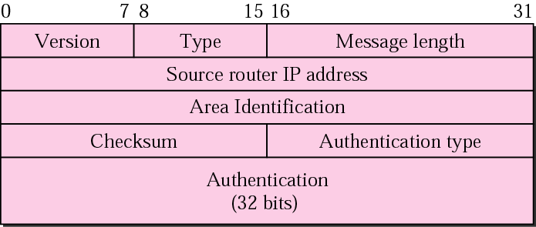
Figure 14.26 OSPF common header
TCP/IP Protocol Suite

Slide 38
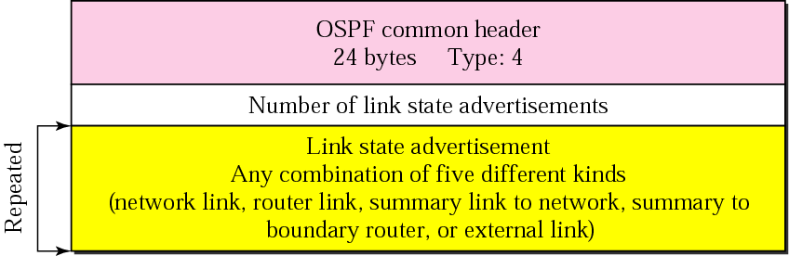
Figure 14.27 Link state update packet
TCP/IP Protocol Suite

Slide 39
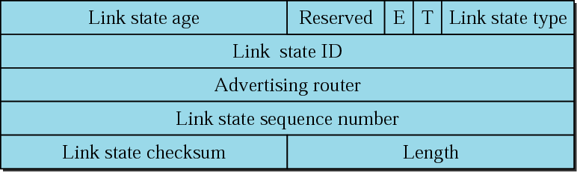
Figure 14.28 LSA general header
TCP/IP Protocol Suite

Slide 40
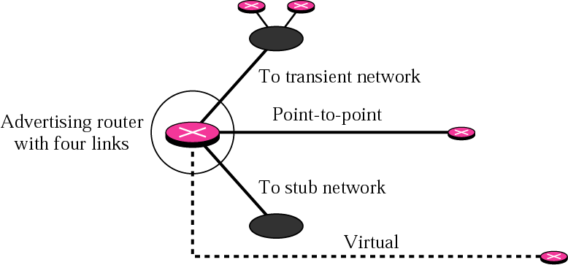
Figure 14.29 Router link
TCP/IP Protocol Suite

Slide 41
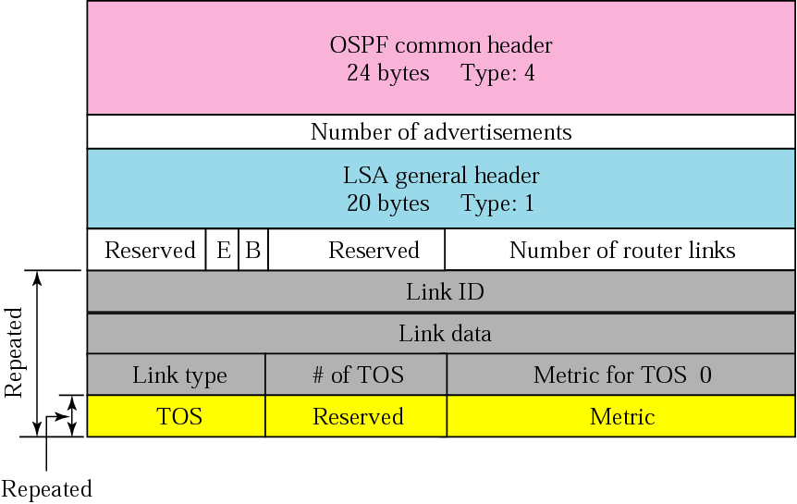
Figure 14.30 Router link LSA
TCP/IP Protocol Suite

Slide 42
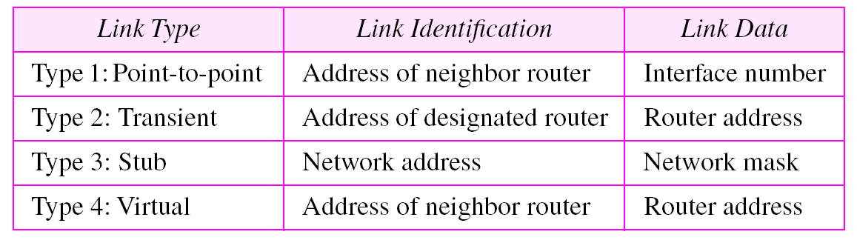
Table 14.2 Link types, link identification, and link data
TCP/IP Protocol Suite

Slide 43
Example 3
Give the router link LSA sent by router 10.24.7.9 in Figure 14.31.
See Next Slide
Solution
This router has three links: two of type 1 (point-to-point) and one of type 3 (stub network). Figure 14.32 shows the router link LSA.
See Figure 14.32
TCP/IP Protocol Suite

Slide 44
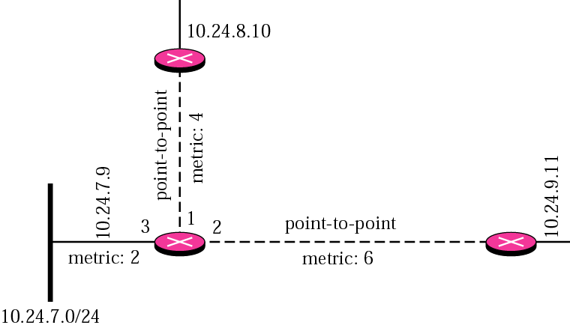
Figure 14.31 Example 3
TCP/IP Protocol Suite

Slide 45
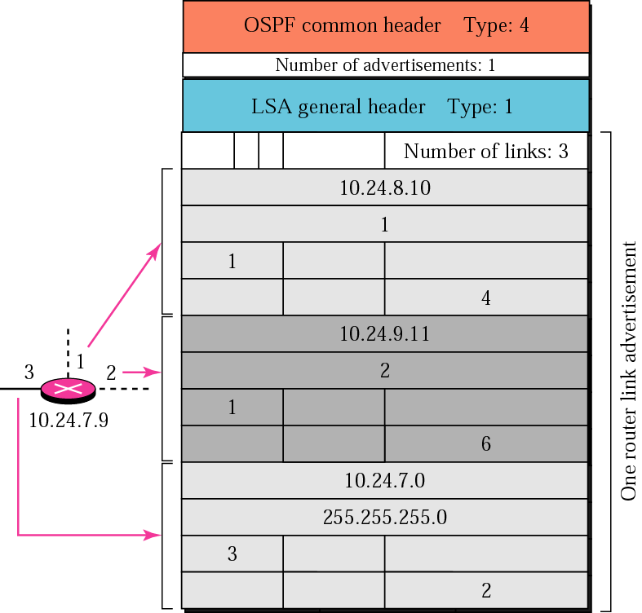
Figure 14.32 Solution to Example 3
TCP/IP Protocol Suite

Slide 46
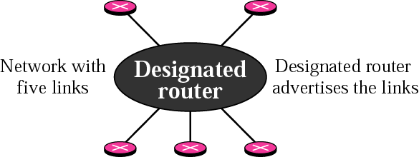
Figure 14.33 Network link
TCP/IP Protocol Suite

Slide 47
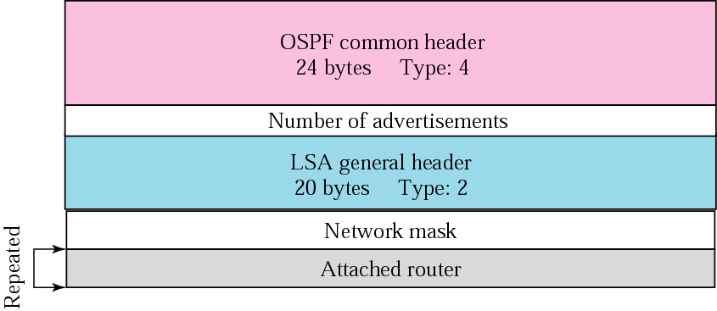
Figure 14.34 Network link advertisement format
TCP/IP Protocol Suite

Slide 48
Example 4
Give the network link LSA in Figure 14.35.
See Next Slide
Solution.
See Figure 14.36
TCP/IP Protocol Suite

Slide 49

Figure 14.35 Example 4
TCP/IP Protocol Suite

Slide 50
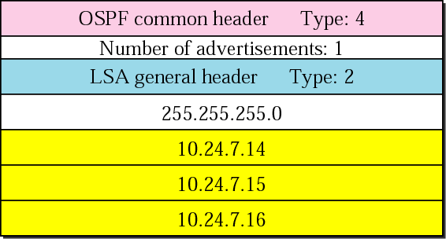
Figure 14.36 Solution to Example 4
TCP/IP Protocol Suite

Slide 51
Example 5
In Figure 14.37, which router(s) sends out router link LSAs?
See Next Slide
Solution
All routers advertise router link LSAs.
a. R1 has two links, N1 and N2.
b. R2 has one link, N1.
c. R3 has two links, N2 and N3.
TCP/IP Protocol Suite

Slide 52
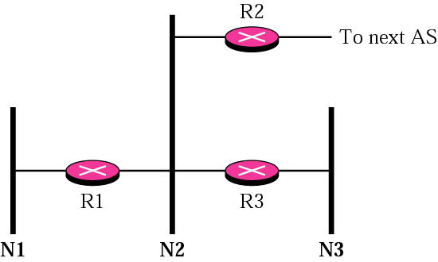
Figure 14.37 Example 5 and Example 6
TCP/IP Protocol Suite

Slide 53
Example 6
In Figure 14.37, which router(s) sends out the network link LSAs?
Solution
All three network must advertise network links:
a. Advertisement for N1 is done by R1 because it is the only
attached router and therefore the designated router.
b. Advertisement for N2 can be done by either R1, R2, or R3,
depending on which one is chosen as the designated router.
c. Advertisement for N3 is done by R3 because it is the only
attached router and therefore the designated router.
TCP/IP Protocol Suite

Slide 54
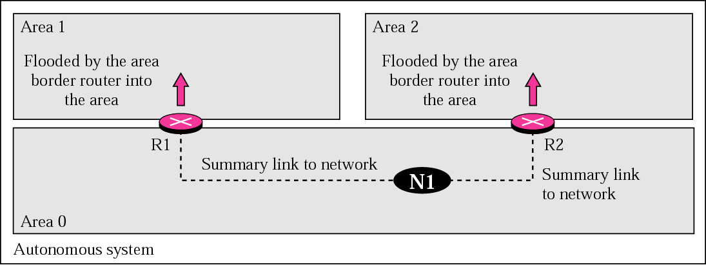
Figure 14.38 Summary link to network
TCP/IP Protocol Suite

Slide 55
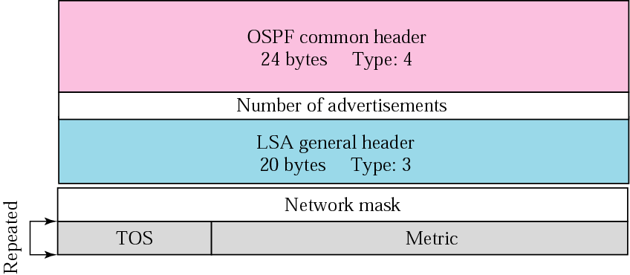
Figure 14.39 Summary link to network LSA
TCP/IP Protocol Suite

Slide 56
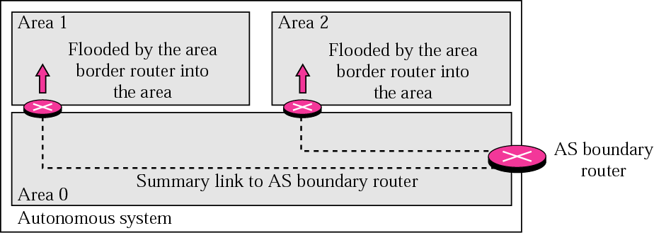
Figure 14.40 Summary link to AS boundary router
TCP/IP Protocol Suite

Slide 57
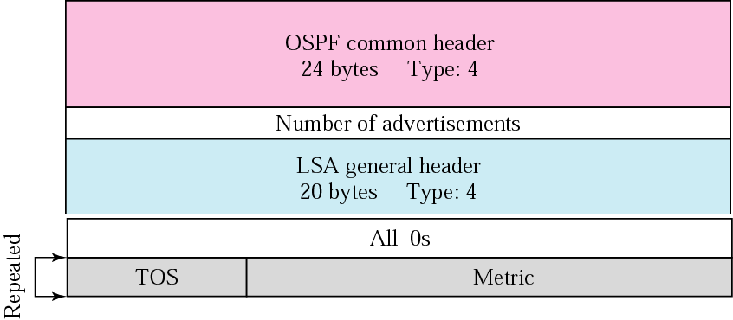
Figure 14.41 Summary link to AS boundary router LSA
TCP/IP Protocol Suite

Slide 58
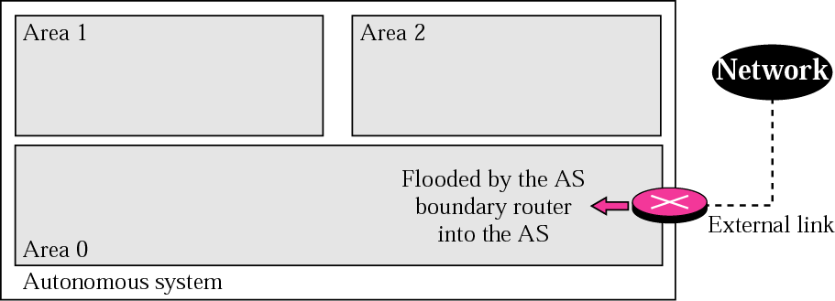
Figure 14.42 External link
TCP/IP Protocol Suite

Slide 59
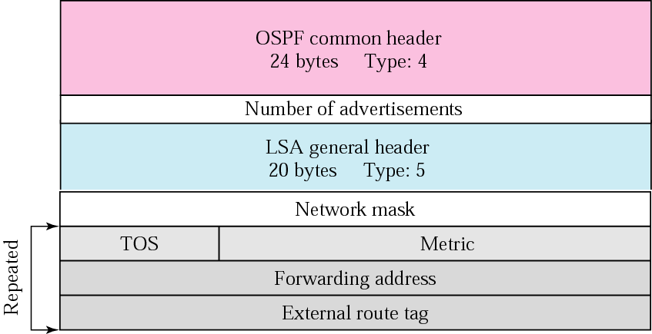
Figure 14.43 External link LSA
TCP/IP Protocol Suite

Slide 60
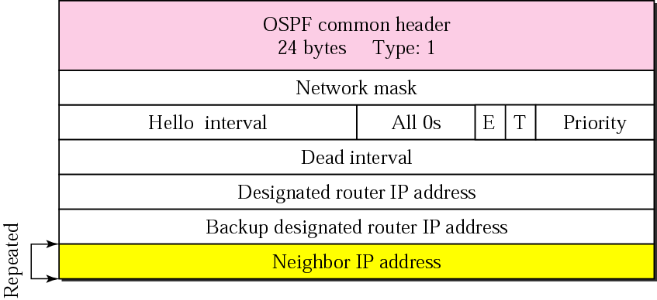
Figure 14.44 Hello packet
TCP/IP Protocol Suite

Slide 61
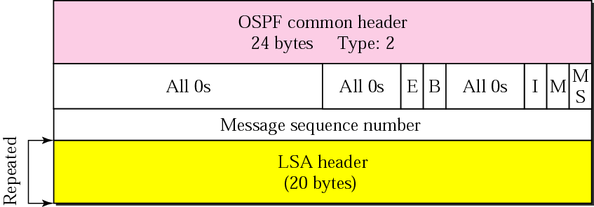
Figure 14.45 Database description packet
TCP/IP Protocol Suite

Slide 62
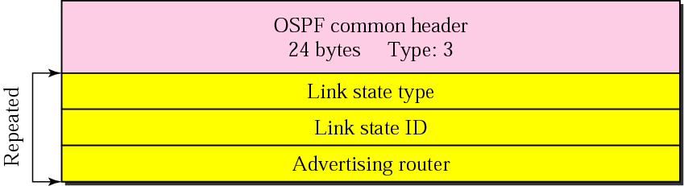
Figure 14.46 Link state request packet
TCP/IP Protocol Suite

Slide 63
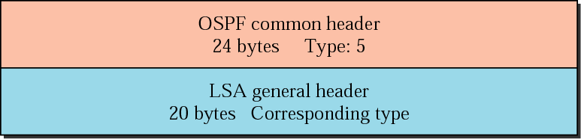
Figure 14.47 Link state acknowledgment packet
TCP/IP Protocol Suite

Slide 64
Note:
OSPF packets are encapsulated in IP datagrams.
TCP/IP Protocol Suite

Slide 65
14.6 PATH VECTOR ROUTING
Path vector routing is similar to distance vector routing. There is at least one node, called the speaker node, in each AS that creates a routing table and advertises it to speaker nodes in the neighboring ASs..
The topics discussed in this section include:
Initialization
Sharing
Updating
TCP/IP Protocol Suite

Slide 66
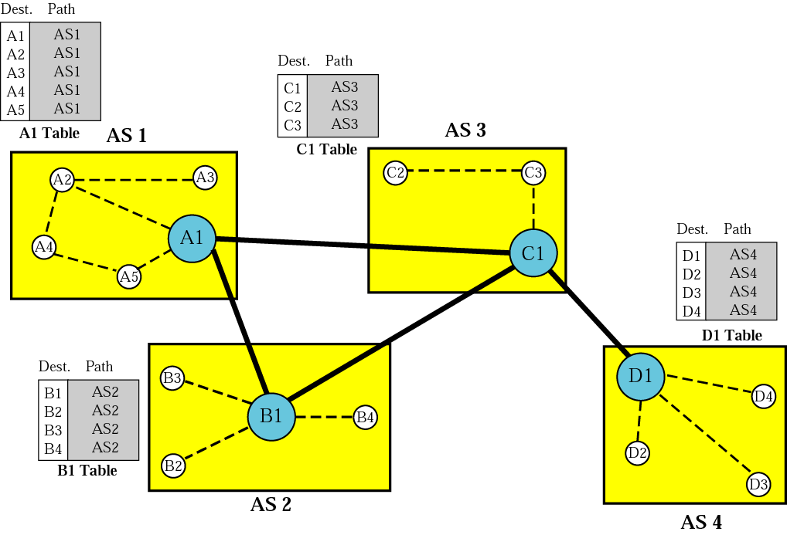
Figure 14.48 Initial routing tables in path vector routing
TCP/IP Protocol Suite

Slide 67
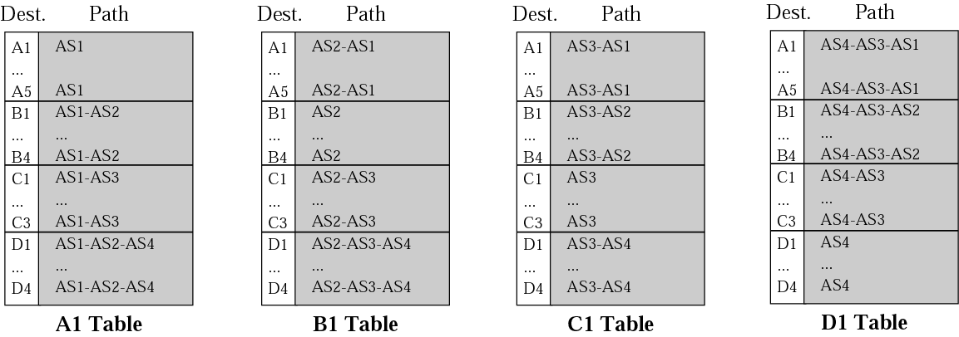
Figure 14.49 Stabilized tables for four autonomous systems
TCP/IP Protocol Suite

Slide 68
14.7 BGP
Border Gateway Protocol (BGP) is an interdomain routing protocol using path vector routing. It first appeared in 1989 and has gone through four versions.
The topics discussed in this section include:
Types of Autonomous Systems
Path Attributes
BGP Sessions
External and Internal BGP
Types of Packets
Packet Format
Encapsulation
TCP/IP Protocol Suite

Slide 69

Figure 14.50 Internal and external BGP sessions
TCP/IP Protocol Suite

Slide 70

Figure 14.51 Types of BGP messages
TCP/IP Protocol Suite

Slide 71

Figure 14.52 BGP packet header
TCP/IP Protocol Suite

Slide 72

Figure 14.53 Open message
TCP/IP Protocol Suite

Slide 73

Figure 14.54 Update message
TCP/IP Protocol Suite

Slide 74
Note:
BGP supports classless addressing and CIDR.
TCP/IP Protocol Suite

Slide 75

Figure 14.55 Keepalive message
TCP/IP Protocol Suite

Slide 76

Figure 14.56 Notification message
TCP/IP Protocol Suite

Slide 77

Table 14.3 Error codes
TCP/IP Protocol Suite

Slide 78
Note:
BGP uses the services of TCP
on port 179.
TCP/IP Protocol Suite

