Slide 1
BGP and DNS Security
CS 6431
Vitaly Shmatikov

Slide 2
Internet Is a Network of Networks
backbone
ISP
local network
Internet service
provider (ISP)
  Autonomous system (AS) is a collection of IP networks under control of a single administrator (e.g., ISP)
local network
TCP/IP for packet routing and connections
Border Gateway Protocol (BGP) for route discovery
Domain Name System (DNS) for IP address discovery
slide <number>

Slide 3
IP (Internet Protocol)
Connectionless
  Unreliable, “best-effort” protocol
Uses numeric addresses for routing
Typically several hops in the route
Alice’s computer
Bob’s ISP
Alice’s ISP
Packet
Source
128.83.130.239
Dest
171.64.66.201
128.83.130.239
Seq
3
Bob’s computer
171.64.66.201
slide <number>

Slide 4
IP Routing
Routing of IP packets is based on IP addresses
  32-bit host identifiers (128-bit in IPv6)
Routers use a forwarding table
  Entry = destination, next hop, network interface, metric
  Table look-up for each packet to decide how to route it
Routers learn routes to hosts and networks via routing protocols
  Host is identified by IP address, network by IP prefix
BGP (Border Gateway Protocol) is the core Internet protocol for establishing inter-AS routes
slide <number>

Slide 5
Distance-Vector Routing
Each node keeps vector with distances to all nodes
Periodically sends distance vector to all neighbors
Neighbors send their distance vectors, too; node updates its vector based on received information
  Bellman-Ford algorithm: for each destination, router picks the neighbor advertising the cheapest route, adds his entry into its own routing table and re-advertises
  Used in RIP (routing information protocol)
Split-horizon update
  Do not advertise a route on an interface from which you learned the route in the first place!
slide <number>

Slide 6
Good News Travels Fast
A: 0
A: 1
A: 2
A: 3
A: 4
A: 5
1
1
1
1
1
G1
G2
G3
G4
G5
G1 advertises route to network A with distance 1
G2-G5 quickly learn the good news and install the routes to A via G1 in their local routing tables
slide <number>

Slide 7
Bad News Travels Slowly
Exchange
routing tables
A: 0
A: 1
A: 2
A: 3
A: 4
A: 5
1
1
1
1
G1
G2
G3
G4
G5
G1’s link to A goes down
G2 is advertising a pretty good route to G1 (cost=2)
G1’s packets to A are forever looping between G2 and G1
G1 is now advertising a route to A with cost=3, so G2 updates its own route to A via G1 to have cost=4, and so on
  G1 and G2 are slowly counting to infinity
  Split-horizon updates only prevent two-node loops
slide <number>

Slide 8
Overview of BGP
BGP is a path-vector protocol between ASes
Just like distance-vector, but routing updates contain an actual path to destination node
  The list of traversed ASes and the set of network prefixes belonging to the first AS on the list
Each BGP router receives update messages from neighbors, selects one “best” path for each prefix, and advertises this path to its neighbors
  Can be the shortest path, but doesn’t have to be
    “Hot-potato” vs. “cold-potato” routing
  Always route to the most specific prefix for a destination
slide <number>

Slide 9
BGP Example
[Wetherall]
1
3
3 2 7
4
2 7
2 6 5
2 6 5
3 2 6 5
5
8
2
2 7
6 5
7 2 6 5
7
2 7
7
6
6 2 7
5
7
2 6 5
5
AS 2 provides transit for AS 7
  Traffic to and from AS 7 travels through AS 2
slide <number>

Slide 10
Some (Old) BGP Statistics
BGP routing tables contain about 125,000 address prefixes mapping to about 17-18,000 paths
Approx. 10,000 BGP routers
Approx. 2,000 organizations own AS
Approx. 6,000 organizations own prefixes
Average route length is about 3.7
50% of routes have length less than 4 ASes
95% of routes have length less than 5 ASes
slide <number>

Slide 11
BGP Misconfiguration
Domain advertises good routes to addresses it does not know how to reach
  Result: packets go into a network “black hole”
April 25, 1997: “The day the Internet died”
  AS7007 (Florida Internet Exchange) de-aggregated the BGP route table and re-advertised all prefixes as if it originated paths to them
    In effect, AS7007 was advertising that it has the best route to every host on the Internet
  Huge network instability as incorrect routing data propagated and routers crashed under traffic
slide <number>

Slide 12
BGP (In)Security
BGP update messages contain no authentication or integrity protection
Attacker may falsify the advertised routes
  Modify the IP prefixes associated with a route
    Can blackhole traffic to certain IP prefixes
  Change the AS path
    Either attract traffic to attacker’s AS, or divert traffic away
    Interesting economic incentive: an ISP wants to dump its traffic on other ISPs without routing their traffic in exchange
  Re-advertise/propagate AS path without permission
    For example, a multi-homed customer may end up advertising transit capability between two large ISPs
slide <number>

Slide 13
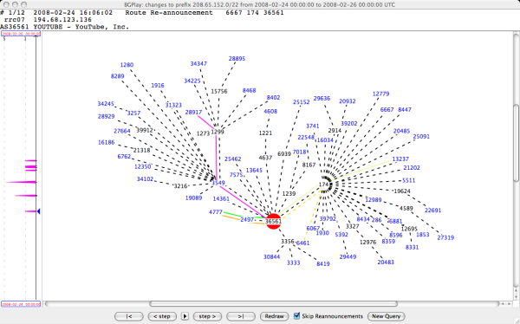
YouTube (Normally)
AS36561 (YouTube) advertises 208.65.152.0/22
slide <number>

Slide 14
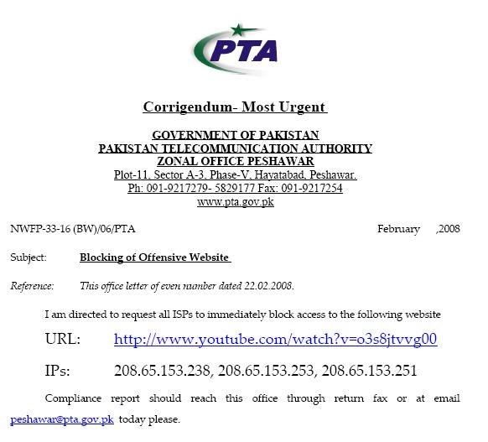
February 24, 2008
Pakistan government wants to block YouTube
AS17557 (Pakistan Telecom)
advertises 208.65.153.0/24 outwards
  All YouTube traffic worldwide directed to AS17557
More specific than the /22 prefix advertised by YouTube itself
slide <number>

Slide 15
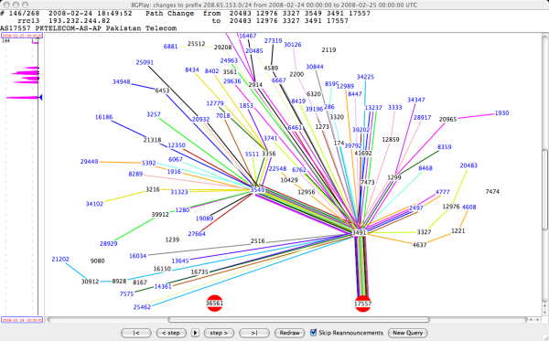
Two-Hour YouTube Outage
slide <number>

Slide 16
Other BGP Incidents
May 2003: Spammers hijack unused block of IP addresses belonging to Northrop Grumman
  Entire Northrop Grumman ends up on spam blacklist
  Took two months to reclaim ownership of IP addresses
Dec 2004: Turkish ISP advertises routes to the entire Internet, including Amazon, CNN, Yahoo
Apr 2010: Small Chinese ISP advertises routes to 37,000 networks, incl. Dell, CNN, Apple
Feb-May 2014: Someone uses BGP to hijack the addresses of Bitcoin mining-pool servers, steals $83,000 worth of Bitcoins
slide <number>

Slide 17
Preventing Prefix Hijacking
Origin authentication
  Secure database lists which AS owns which IP prefix
soBGP
  Digitally signed certificates of prefix ownership
Prefix hijacking is not the only threat… in general, BGP allows ASes to advertise bogus routes
  Remove another AS from a path to make it look shorter, more attractive, get paid for routing traffic
  Add another AS to a path to trigger loop detection, make your connectivity look better
slide <number>

Slide 18
Securing BGP
Dozens of proposals, various combinations of cryptographic mechanisms and anomaly detection
  IRV, SPV, psBGP, Pretty Good BGP, PHAS, Whisper…
  Example: Secure BGP (S-BGP)
    Origin authentication + entire AS path digitally signed
    Can verify that the route is recent, no ASes have been added or removed, the order of ASes is correct
How many of these have been deployed?
None
No complete, accurate registry of prefix ownership
Need a public-key infrastructure
Cannot react rapidly to changes in connectivity
Cost of cryptographic operations
Not deployable incrementally
slide <number>

Slide 19
DNS: Domain Name Service
DNS maps symbolic names to numeric IP addresses
(for example, www.cs.cornell.edu ↔ 128.84.154.137)
root & edu
DNS server
www.cs.cornell.edu
www.cs.cornell.edu
NS cornell.edu
cornell.edu
DNS server
Local
DNS recursive
resolver
NS cs.cornell.edu
Client
www=IPaddr
cs.cornell.edu
DNS server
slide <number>

Slide 20
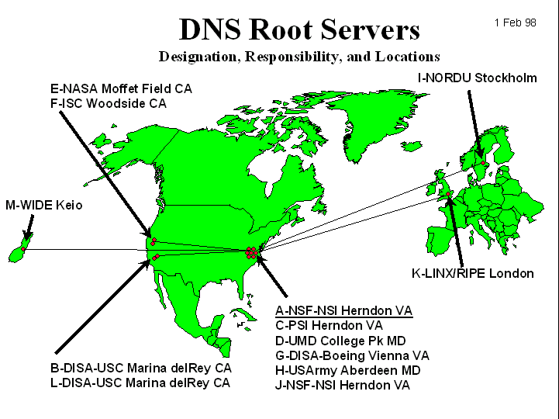
DNS Root Name Servers
Root name servers for top-level domains
Authoritative name servers for subdomains
Local name resolvers contact authoritative servers when they do not know a name
Feb 6, 2007: Botnet DoS attack on
root DNS servers
slide <number>

Slide 21

The hacking group, called Turkguvenligi, targeted the net's Domain Name System (DNS)
Turkguvenligi revealed that it got access to the files using a well-established attack method known as SQL injection
slide <number>

Slide 22
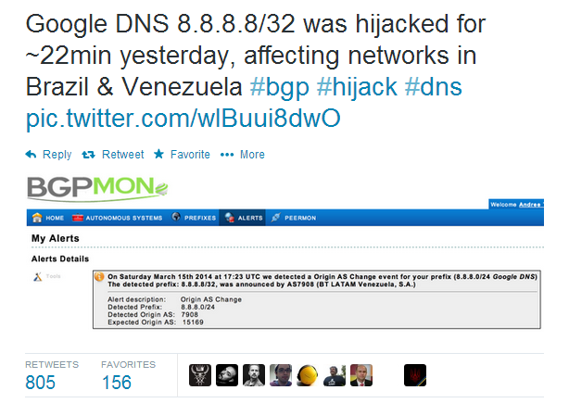
March 16, 2014
It is suspected that hackers exploited a well-known vulnerability in the so-called Border Gateway Protocol (BGP)
slide <number>

Slide 23
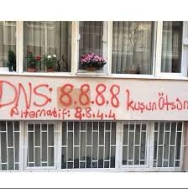
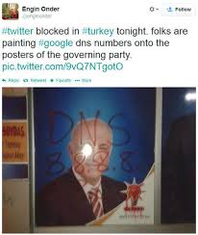
Turkey (2014)
slide <number>

Slide 24

DNS Amplification Attack
x50 amplification
EDNS response
(3000 bytes)
DNS query
SrcIP: DoS Target
(60 bytes)
DoS
Source
DNS
Server
DoS
Target
2006: 0.58M open resolvers on Internet (Kaminsky-Shiffman)
2013: 21.7M open resolvers (openresolverproject.org)
March 2013: 300 Gbps DDoS attack on Spamhaus
slide <number>

Slide 25
(Not Just DNS)
x206 amplification
“Give me the addresses of the
last 600 machines you talked to”
Spoofed SrcIP: DoS target
(234 bytes)
600 addresses
(49,000 bytes)
DoS
Source
NTP
(Network Time Protocol)
server
DoS
Target
December 2013 – February 2014:
400 Gbps DDoS attacks involving 4,529 NTP servers
7 million unsecured NTP servers on the Internet (Arbor)
slide <number>

Slide 26
DNS Caching
DNS responses are cached
  Quick response for repeated translations
  Other queries may reuse some parts of lookup
    NS records identify name servers responsible for a domain
DNS negative queries are cached
  Don’t have to repeat past mistakes (misspellings, etc.)
Cached data periodically times out
  Lifetime (TTL) of data controlled by owner of data, passed with every record
slide <number>

Slide 27
Cached Lookup Example
root & edu
DNS server
ftp.cs.cornell.edu
cornell.edu
DNS server
Local
DNS recursive
resolver
ftp.cs.cornell.edu
Client
ftp=IPaddr
cs.cornell.edu
DNS server
slide <number>

Slide 28
DNS “Authentication”
Request contains random 16-bit TXID
root & edu
DNS server
www.cs.cornell.edu
www.cs.cornell.edu
NS cornell.edu
cornell.edu
DNS server
Response accepted if TXID is the same,
stays in cache for a long time (TTL)
Local
DNS recursive
resolver
NS cs.cornell.edu
Client
www=IPaddr
cs.cornell.edu
DNS server
slide <number>

Slide 29

DNS Spoofing
6.6.6.6
Trick client into looking up host1.foo.com (how?)
Guess TXID, host1.foo.com is at 6.6.6.6
Another guess, host1.foo.com is at 6.6.6.6
Another guess, host1.foo.com is at 6.6.6.6
host1.foo.com
TXID, host1.foo.com
Local
resolver
ns.foo.com
DNS server
Client
host1.foo.com is at 1.2.3.4
Several opportunities to win the race.
If attacker loses, has to wait until TTL expires…
… but can try again with host2.foo.com, host3.foo.com, etc.
… but what’s the point of hijacking host3.foo.com?
slide <number>

Slide 30
Exploiting Recursive Resolving
[Kaminsky]
6.6.6.6
Trick client into looking up host1.foo.com
Guessed TXID, very long TTL
I don’t know where host1.foo.com is, but
ask the authoritative server at ns2.foo.com
It lives at 6.6.6.6
host2.foo.com
host1.foo.com
TXID, host1.foo.com
Local
resolver
ns.foo.com
DNS server
Client
host1.foo.com is at 1.2.3.4
If win the race, any request for XXX.foo.com will go to 6.6.6.6
The cache is poisoned… for a very long time!
No need to win future races!
If lose, try again with <ANYTHING>.foo.com
slide <number>

Slide 31
Triggering a Race
Any link, any image, any ad, anything can cause a DNS lookup
  No JavaScript required, though it helps
Mail servers will look up what bad guy wants
  On first greeting: HELO
  On first learning who they’re talking to: MAIL FROM
  On spam check (oops!)
  When trying to deliver a bounce
  When trying to deliver a newsletter
  When trying to deliver an actual response from an actual employee
slide <number>

Slide 32
Reverse DNS Spoofing
Trusted access is often based on host names
  Example: permit all hosts in .rhosts to run remote shell
Network requests such as rsh or rlogin arrive from numeric source addresses
  System performs reverse DNS lookup to determine requester’s host name and checks if it’s in .rhosts
If attacker can spoof the answer to reverse DNS query, he can fool target machine into thinking that request comes from an authorized host
  No authentication for DNS responses and typically no double-checking (numeric → symbolic → numeric)
slide <number>

Slide 33
Pharming
Many anti-phishing defenses rely on DNS
Can bypass them by poisoning DNS cache and/or forging DNS responses
  Browser: “give me the address of www.paypal.com”
  Attacker: “sure, it’s 6.6.6.6” (attacker-controlled site)
Dynamic pharming
  Provide bogus DNS mapping for a trusted server, trick user into downloading a malicious script
  Force user to download content from the real server, temporarily provide correct DNS mapping
  Malicious script and content have the same origin!
slide <number>

Slide 34
Other DNS Vulnerabilities
DNS implementations have vulnerabilities
  Multiple buffer overflows in BIND over the years
  MS DNS for NT 4.0 crashes on chargen stream
Denial of service
  Oct ’02: ICMP flood took out 9 root servers for 1 hour
Can use “zone transfer” requests to download DNS database and map out the network
  “The Art of Intrusion”: NYTimes.com and Excite@Home
See http://cr.yp.to/djbdns/notes.html
slide <number>

Slide 35
DNS Vulnerabilities: Summary
Cache impersonation
Corrupting data
Impersonating master
Zone
administrator
master
resolver
Zone file
Dynamic
updates
slaves
stub
resolver
Cache pollution by
data spoofing
Unauthorized updates
slide <number>

Slide 36
Solving the DNS Spoofing Problem
Long TTL for legitimate responses
  Does it really help?
Randomize port in addition to TXID
  32 bits of randomness, makes it harder for attacker to guess TXID+port
DNSSEC
  Cryptographic authentication of host-address mappings
slide <number>

Slide 37
DNSSEC
Goals: authentication and integrity of DNS requests and responses
PK-DNSSEC (public key)
  DNS server signs its data – done in advance
  How do other servers learn the public key?
SK-DNSSEC (symmetric key)
  Encryption and MAC: E_{k}(m, MAC(m))
  Each message contains a nonce to avoid replay
  Each DNS node shares a symmetric key with its parent
  Zone root server has a public key (hybrid approach)
slide <number>

Slide 38

Querying DNSSEC Servers
[Bernstein]
Why so big?
3 Mbps/site
22 Mbps/server
20000 Mbps
DNSSEC query
(78 bytes)
2,526,996 bytes
DNSSEC
Server
Client
3113-byte response
DoS
Target
DNSSEC
Server
Query 94 servers
(77118 bytes total)
Spoofed source:
target’s IP address
DNSSEC
Server
DNSSEC
Server
5 times per second, from 200 sites
slide <number>

Slide 39
Using DNSSEC for DDoS
[Bernstein]
RFC 4033 says:
“DNSSEC provides no protection against denial of
service attacks”
RFC 4033 doesn’t say:
“DNSSEC is a remote-controlled double-barreled
shotgun, the worst DDoS amplifier on the Internet”
slide <number>

Slide 40
DNSSEC In Action
DNSSEC server
for cornell.edu
Where does
cs.cornell.edu live?
cs.cornell.edu: 128.84.96.11
math.cornell.edu: 128.84.234.110
zoo.cornell.edu: 128.84.12.95
Client
Where does
zoo.cornell.edu live?
All signed in advance
(for performance!)
???
Where does
DNSSECIsTehSuck.cornell.edu live?
Each name has exactly one signed record
Why can’t the resolver simply send an empty record
when queried for a domain that does not exist?
slide <number>

Slide 41
Authenticated Denial of Existence
DNSSEC server
for cornell.edu
NSEC
Where does
DNSSECIsTehSuck.cornell.edu
live?
cs.cornell.edu: 128.84.96.11
math.cornell.edu: 128.84.234.110
zoo.cornell.edu: 128.84.12.95
Where does
TehSuckThyNameIsDNSSEC.cornell.edu
live?
There are no DNSSEC
subdomains of .cornell.edu
between “cs” and “math”
All signed in advance
(for performance!)
Client
There are no DNSSEC
subdomains of .cornell.edu
between “math” and “zoo”
Use DNSSEC as an oracle to
enumerate all subdomains
(equivalent to zone transfer)
slide <number>

Slide 42
NSEC3
[Bernstein]
Domain names hashed, hashes sorted in lexicographic order
Denials of existence certify that there are no DNSSEC domains whose hash values fall into a certain interval
  As opposed to actual domain names
Are domain names random?
Vulnerable to brute-force guessing attacks
slide <number>

Slide 43
Delegation in DNSSEC
Delegation is essential for scalability
  For example, there are 100,000,000 .com domains
DNSSEC server
for cs.cornell.edu
DNSSEC server
for .cornell.edu
Where does
www.cs.cornell.edu
live?
cs.cornell.edu name server: 128.84.96.5
Its key is E45FBBG…
I don’t know, but ask
cs.cornell.edu name server,
it lives at 128.84.96.5;
its key is E45FBBG…
math.cornell.edu name server: 128.84.234.2
Client
zoo.cornell.edu name server: …
signed
Its key is …
Why are only the
key records signed?
Hint: who owns NS records of children zones?
slide <number>

Slide 44
Forging Delegation Responses
[Bernstein]
DNSSEC domains
DNSSEC server
for .cornell.edu
Where does
www.math.cornell.edu
live?
cs.cornell.edu name server: 128.84.96.5
Its key is E45FBBG…
X
I don’t know, but ask
math.cornell.edu name server,
it lives at 128.84.234.2
…
There are no DNSSEC
subdomains between
H(“cs”) and H(“zoo”)
math.cornell.edu name server: 128.84.234.2
Client
zoo.cornell.edu name server: …
Its key is …
6.6.6.6
signed
I don’t know, but ask
math.cornell.edu name server,
it lives at 6.6.6.6
Non-DNSSEC domain
Signed DNSSEC response yet NS record
has been forged… what happened??!!
slide <number>

Slide 45
Delegating to Secure Zones
Q: When does verification of signatures on DNSSEC records actually happen?
A: At the very end, when the resolver has the complete chain
But the delegation record is not signed… what if it has been forged?
Current DNSSEC deployments are only “secure” down to the ISP’s resolver
  Stub resolvers on users’ machines only get an unsigned flag saying that the response is “secure”
slide <number>

Slide 46
DNSSEC “Features”
[Bernstein]
Does nothing to improve DNS availability
Allows astonishing levels of DDoS amplication, damaging Internet availability
  Also CPU exhaustion attacks
Does nothing to improve DNS confidentiality, leaks private DNS data (even with NSEC3)
Does not prevent forgery of delegation records
Does not protect the “last mile”
Implementations suffered from buffer overflows
slide <number>

