Slide 1
CMSC 414
Computer and Network Security
Jonathan Katz

Slide 2
Introduction and overview
What is computer/network security? Why is it important?
Course philosophy and goals
Course organization and information
High-level overview of topics
A broad perspective on “computer security”

Slide 3
“Security”
Most of computer science is concerned with achieving desired behavior
Security is concerned with preventing undesired behavior
  Different way of thinking!
  An enemy/opponent/hacker/adversary who is actively and maliciously trying to circumvent any protective measures you put in place

Slide 4
One illustration of the difference
Software testing determines whether a given program implements a desired functionality
  Test I/O characteristics
  Q/A
How do you test whether a program does not allow for undesired functionality?
  Penetration testing helps, but only up to a point

Slide 5
Security is interdisciplinary
Draws on all areas of CS
  Theory (especially cryptography)
  Networking
  Operating systems
  Databases
  AI/learning theory
  Computer architecture/hardware
  Programming languages/compilers
  HCI, psychology

Slide 6
Fortunately, we are winning the security battle
Strong cryptography
Firewalls, intrusion detection, virus scanners
Buffer overflow detection/prevention
User education

Slide 7
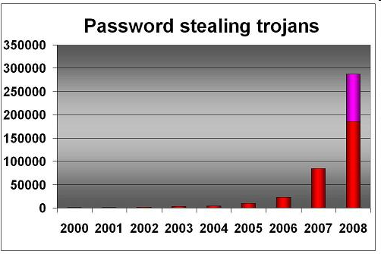
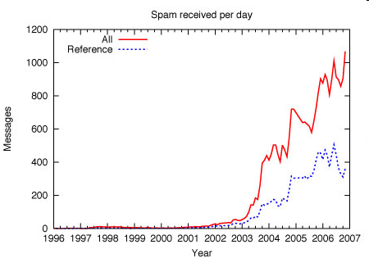
Really??!
Security incidents (reported)

Slide 8
Philosophy of this course
We are not going to be able to cover everything
  We are not going to be able to even mention everything
Main goals
  A sampling of many different aspects of security
  The security “mindset”
  Become familiar with basic acronyms (RSA, SSL, PGP, etc.), and “buzzwords” (phishing, …)
  Become an educated security consumer
  Try to keep it interesting with real-world examples and “hacking” projects

Slide 9
Course Organization

Slide 10
A High-Level Introduction
to Computer Security

Slide 11
A naïve view
Computer security is about CIA:
  Confidentiality, integrity, and availability
These are important, but security is about much more…

Slide 12


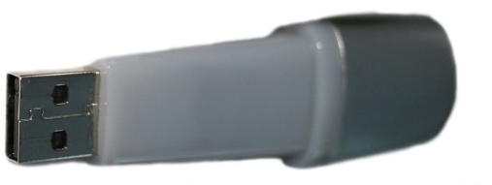
A naïve view
password

Slide 13


In reality…
Where does security end?
password
forgot password?

Slide 14
One good attack
Use public records to figure out someone’s password
  Or, e.g., their SSN, so can answer security question…
The problem is not (necessarily) that SSNs are public
The problem is that we “overload” SSNs, and use them for more than they were intended
Note: “the system” here is not just the computer, nor is it just the network…

Slide 15
A naïve view
Achieve “absolute” security

Slide 16
In reality…
Absolute security is easy to achieve!
  How…?
Absolute security is impossible to achieve!
  Why…?
Good security is about risk management

Slide 17
Security as a trade-off
The goal is not (usually) “to make the system as secure as possible”…
…but instead, “to make the system as secure as possible within certain constraints” (cost, usability, convenience)
Must understand the existing constraints
  E.g., passwords…

Slide 18
Cost-benefit analysis
Important to evaluate what level of security is necessary/appropriate
  Cost of mounting a particular attack vs. value of attack to an adversary
  Cost of damages from an attack vs. cost of defending against the attack
  Likelihood of a particular attack
Sometimes the best security is to make sure you are not the easiest target for an attacker…

Slide 19
“More” security not always better
“No point in putting a higher post in the ground when the enemy can go around it”
Need to identify the weakest link
  Security of a system is only as good as the security at its weakest point…
Security is not a “magic bullet”
Security is a process, not a product

Slide 20
Computer security is not just about security
Detection, response, audit
  How do you know when you are being attacked?
  How quickly can you stop the attack?
  Can you identify the attacker(s)?
  Can you prevent the attack from recurring?
Recovery
  Can be much more important than prevention
Economics, insurance, risk management…
Offensive techniques
Security is a process, not a product…

Slide 21
Computer security is not just about computers
What is “the system”?
Physical security
Social engineering
  Bribes for passwords
  Phishing
“External” means of getting information
  Legal records
  Trash cans
Security is a process, not a product…(!)

Slide 22
Security mindset
Learn to think with a “security mindset” in general
  What is “the system”?
  How could this system be attacked?
    What is the weakest point of attack?
  How could this system be defended?
    What threats am I trying to address?
    How effective will a given countermeasure be?
    What is the trade-off between security, cost, and usability?

Slide 23
An example: airline security
Ask: what is the cost (economic and otherwise) of current airline security?
Ask: do existing rules (e.g., banning liquids) make sense?
Ask: are the tradeoffs worth it?
  (Why do we not apply the same rules to train travel?)
  (Would spending money elsewhere be more effective?)
Ask: how would you get on a plane if you were on the no-fly list?
  (I will not give you the answer – you can find it online)
  This is a thought experiment only!

Slide 24
Summary
“The system” is not just a computer or a network
Prevention is not the only goal
  Cost-benefit analysis
  Detection, response, recovery
Nevertheless…in this course, we will focus on computer security, and primarily on prevention
  If you want to be a security expert, you need to keep the rest in mind

Slide 25
Why is computer security so hard?
Computer networks are “systems of systems”
  Your system may be secure, but then the surrounding environment changes
Too many things dependent on a small number of systems
Society is unwilling to trade off features for security
Ease of attacks
  Cheap
  Distributed, automated
  Anonymous
  Insider threats
Security not built in from the beginning
Humans in the loop…
Computers ubiquitous…

Slide 26
Computers are everywhere…
…and can always be attacked
Electronic banking, social networks, e-voting
iPods, iPhones, PDAs, RFID transponders
Automobiles
Appliances, TVs
(Implantable) medical devices
Cameras, picture frames(!)
  See http://www.securityfocus.com/news/11499

Slide 27
“Trusting trust”
(or: how hard is security?)

Slide 28
“Trusting trust”
Consider a compiler that embeds a trapdoor into anything it compiles
How to catch?
  Read source code? (What if replaced?)
  Re-compile compiler?
What if the compiler embeds the trojan code whenever it compiles a compiler?
  (That’s nasty…)

Slide 29
“Trusting trust”
Whom do you trust?
Does one really need to be this paranoid??
  Probably not
  Sometimes, yes
Shows that security is complex…and essentially impossible
Comes back to risk/benefit trade-off

Slide 30
Next time:
begin cryptography

