Slide 1
Network Security and Privacy
CS 361S
Vitaly Shmatikov
http://www.cs.utexas.edu/~shmat/courses/cs361s/

Slide 2
Prerequisites
Required: working knowledge of C and JavaScript
  The first project is about Web security
  The second involves writing buffer overflow attacks in C
    You must have detailed understanding of x86 architecture, stack layout, calling conventions, etc.
Recommended: Introduction to Computer Security; Cryptography; Computer Networks; Compilers and/or Operating Systems
  Not much overlap with this course, but will help gain deeper understanding of security mechanisms and where they fit in the big picture
slide <number>

Slide 3
Course Materials
Textbook:
Kaufman, Perlman, Speciner. “Network Security”
  Lectures will not follow the textbook
  Lectures will focus on “big-picture” principles and ideas of network attack and defense
  Attend lectures! Lectures will cover some material that is not in the textbook – and you will be tested on it!
Occasional assigned readings
  Start reading “Smashing the Stack For Fun and Profit” by Aleph One (from Phrack hacker magazine)
  Understanding it will be essential for your project
slide <number>

Slide 4
Other Helpful Books
Ross Anderson’s “Security Engineering”
  Focuses on design principles for secure systems
  Wide range of entertaining examples: banking, nuclear command and control, burglar alarms
“The Shellcoder’s Handbook”
  Practical how-to manual for hacking attacks
  Not a required text, but you may find it useful for the buffer overflow project
Kevin Mitnick’s “The Art of Intrusion”
  Real-world hacking stories
  Good illustration for many concepts in this course
slide <number>

Slide 5
Main Themes of the Course
Vulnerabilities of networked software
  Worms and botnets, denial of service, attacks on Web applications, attacks on infrastructure
Defensive technologies
  Protection of information in transit: cryptography, application- and transport-layer security protocols
  Protection of networked software: memory integrity, firewalls, antivirus tools, intrusion detection
Study a few deployed protocols in detail: from design principles to implementation details
  Kerberos, SSL/TLS, IPsec (if time permits)
slide <number>

Slide 6
What This Course is Not About
Not a comprehensive course on computer security
Not a course on ethical, legal, or economic issues
  No file sharing, DMCA, piracy, free speech issues
  No surveillance
Only a cursory overview of cryptography
  Take CS 346 for deeper understanding
Only some issues in systems security
  Very little about OS security, secure hardware, physical security, security of embedded devices…
slide <number>

Slide 7
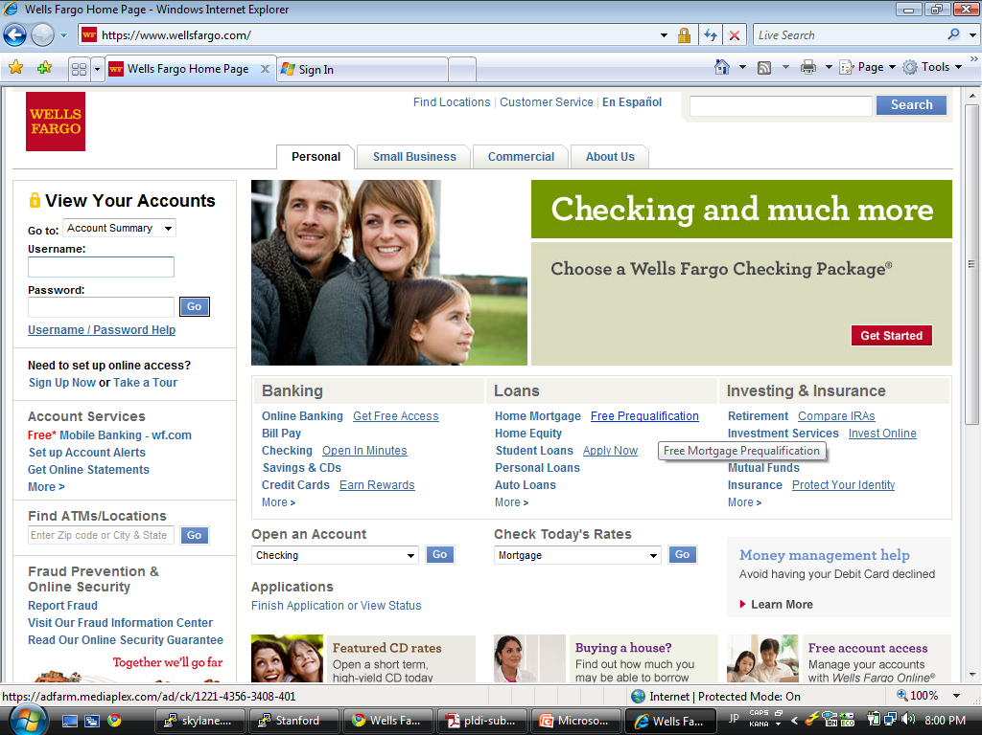

Motivation
https://
slide <number>

Slide 8
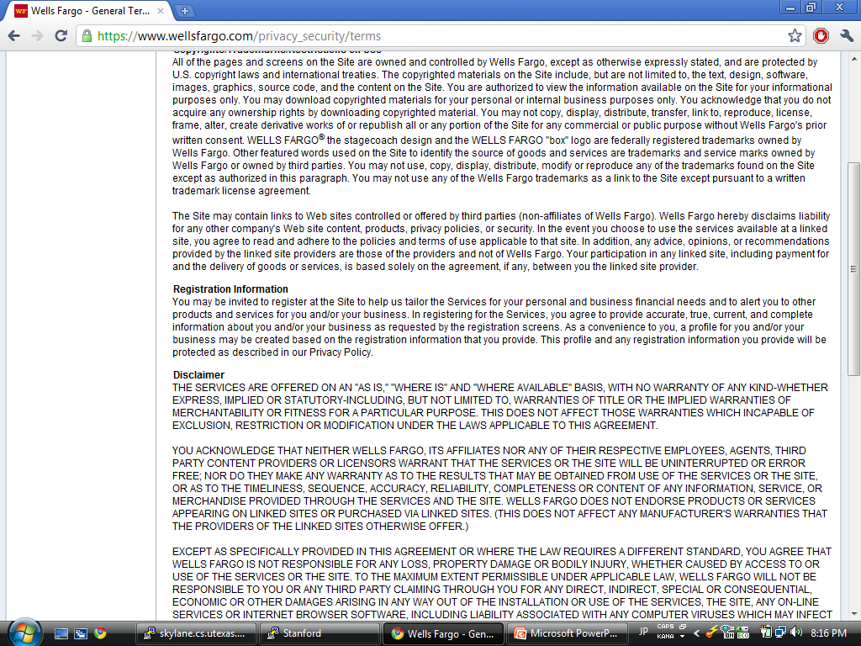
Excerpt From “General Terms of Use”
YOU ACKNOWLEDGE THAT NEITHER WELLS FARGO, ITS AFFILIATES NOR ANY OF THEIR RESPECTIVE EMPLOYEES, AGENTS, THIRD PARTY CONTENT PROVIDERS OR LICENSORS WARRANT THAT THE SERVICES OR THE SITE WILL BE UNINTERRUPTED OR ERROR FREE; NOR DO THEY MAKE ANY WARRANTY AS TO THE RESULTS THAT MAY BE OBTAINED FROM USE OF THE SERVICES OR THE SITE, OR AS TO THE TIMELINESS, SEQUENCE, ACCURACY, RELIABILITY, COMPLETENESS OR CONTENT OF ANY INFORMATION, SERVICE, OR MERCHANDISE PROVIDED THROUGH THE SERVICES AND THE SITE.
slide <number>

Slide 9
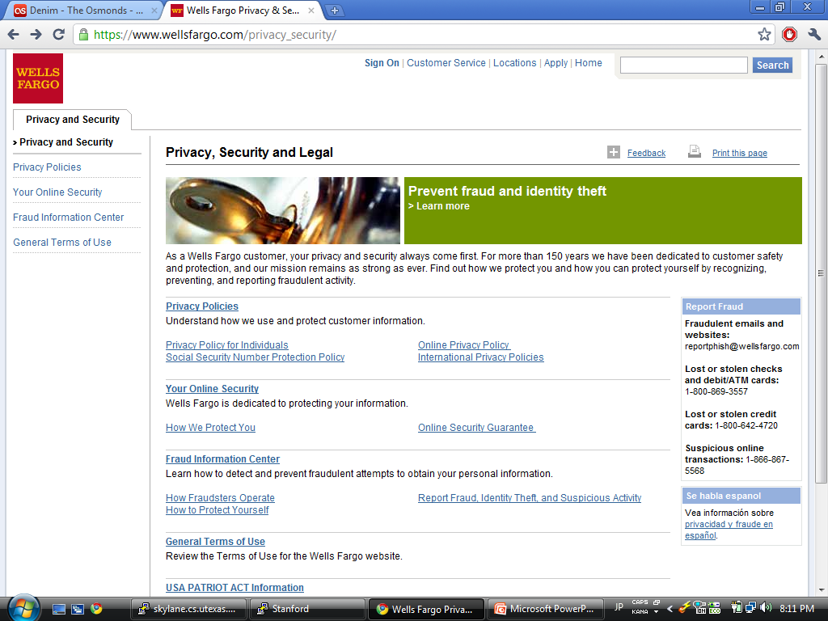
“Privacy, Security and Legal”
“As a Wells Fargo customer, your privacy and security always come first.”
Privacy policies
  Privacy policy for individuals
  Online privacy policy
  Social Security Number protection policy
  International privacy policies
Your online security
  How we protect you
  Online security guarantee
Fraud information center
  How fraudsters operate
  How to protect yourself
USA PATRIOT ACT information
slide <number>

Slide 10
What Do You Think?
What do you think should be included in
“privacy and security” for an e-commerce website?
?
slide <number>

Slide 11
Desirable Security Properties
Authenticity
Confidentiality
Integrity
Availability
Accountability and non-repudiation
Access control
Privacy of collected information
…
slide <number>

Slide 12
Syllabus (1): Security Mechanisms
Basics of cryptography
  Symmetric and public-key encryption, certificates, cryptographic hash functions, pseudo-random generators
Authentication and key establishment
  Case study: Kerberos
Web security
  Case study: SSL/TLS
IP security (if time permits)
  Case study: IPsec protocol suite
slide <number>

Slide 13
Syllabus (2): Attacks and Defenses
Web attacks
  Cross-site scripting and request forgery, SQL injection
Network attacks
  Worms, viruses, botnets
  Spam, phishing, denial of service
  Attacks on routing and DNS infrastructure
Buffer overflow / memory corruption attacks
Defense tools
  Firewalls, antivirus, intrusion detection systems
Wireless security
slide <number>

Slide 14



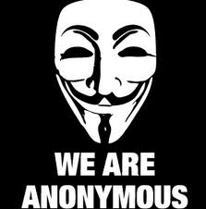

Peek at the Dark Side
The only reason we will be
learning about attack techniques
is to build better defenses
Don’t even think about using
this knowledge to attack anyone
slide <number>

Slide 15

A Security Engineer’s Mindset
[Bruce Schneier]
slide <number>

Slide 16

Ken Thompson
ACM Turing Award, 1983
slide <number>

Slide 17
“Reflections on Trusting Trust”
http://www.acm.org/classics/sep95
What code can we trust?
Consider "login" or "su" in Unix
  Is Ubuntu binary reliable? RedHat?
  Does it send your password to someone?
  Does it have backdoor for a “special” remote user?
Can't trust the binary, so check source code or write your own, recompile
Does this solve problem?
slide <number>

Slide 18
“Reflections on Trusting Trust”
http://www.acm.org/classics/sep95
Who wrote the compiler?
Compiler looks for source code that looks the login process, inserts backdoor into it
Ok, inspect the source code of the compiler… Looks good? Recompile the compiler!
Does this solve the problem?
slide <number>

Slide 19
“Reflections on Trusting Trust”
http://www.acm.org/classics/sep95
The compiler is written in C …
  compiler(S) {
  if (match(S, "login-pattern")) {
  compile (login-backdoor)
  return
  }
  if (match(S, "compiler-pattern")) {
  compile (compiler-backdoor)
  return
  }
  .... /* compile as usual */
  }
slide <number>

Slide 20
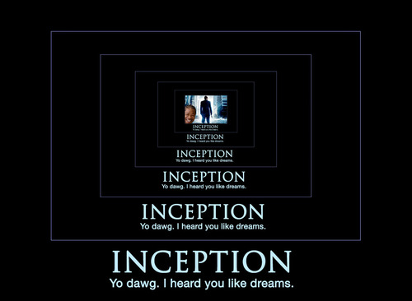
“Reflections on Trusting Trust”
http://www.acm.org/classics/sep95
“The moral is obvious. You can't trust code that
you did not totally create yourself. (Especially
code from companies that employ people like me.)”
slide <number>

Slide 21
Network Stack
Phishing attacks, usability
people
email, Web, NFS
Sendmail, FTP, NFS bugs, chosen-protocol and version-rollback attacks
application
RPC
RPC worms, portmapper exploits
session
TCP
SYN flooding, RIP attacks,
sequence number prediction
transport
IP
IP smurfing and other
address spoofing attacks
network
802.11
data link
WEP attacks
physical
RF
RF fingerprinting, DoS
Only as secure as the single weakest layer…
… or interconnection between the layers
slide <number>

Slide 22

Network Defenses
People
End uses
Password managers,
company policies…
Implementations
Firewalls, intrusion
detection…
Systems
Protocols and policies
TLS, IPsec, access control…
Blueprints
Building blocks
Cryptographic primitives
RSA, DSS, SHA-1…
All defense mechanisms must work correctly and securely
slide <number>

Slide 23
Correctness versus Security
System correctness:
system satisfies specification
  For reasonable input, get reasonable output
System security:
system properties preserved in face of attack
  For unreasonable input, output not completely disastrous
Main difference: active interference from adversary
Modular design may increase vulnerability …
  Abstraction is difficult to achieve in security: what if the adversary operates below your level of abstraction?
… but also increase security (small TCB)
slide <number>

Slide 24
What Drives the Attackers?
Put up a fake financial website, collect users’ logins and passwords, empty out their accounts
Insert a hidden program into unsuspecting users’ computers, use it to spread spam or for espionage
Subvert copy protection for music, video, games
Stage denial of service attacks on websites, extort money
Wreak havoc, achieve fame and glory in the blackhat community
slide <number>

Slide 25
Marketplace for Vulnerabilities
Option 1: bug bounty programs
  Google: up to $3133.7 in 2010, now up to $20K per bug
  Facebook: up to $20K per bug
  Microsoft: up to $150K per bug
  Pwn2Own competition: $10-15K
Option 2: vulnerability brokers
  ZDI, iDefense: $2-25K
Option 3: gray and black markets
  Up to $100-250K reported (hard to verify)
  A zero-day against iOS sold for $500K (allegedly)
slide <number>

Slide 26
It’s a Business
Several companies specialize in finding and selling exploits
  ReVuln, Vupen, Netragard, Exodus Intelligence
  The average flaw sells for $35-160K
  $100K+ annual subscription fees
Nation-state buyers
  “Israel, Britain, Russia, India and Brazil are some of the biggest spenders. North Korea is in the market, as are some Middle Eastern intelligence services. Countries in the Asian Pacific, including Malaysia and Singapore, are buying, too” -- NY Times (Jul 2013)
slide <number>

Slide 27
Marketplace for Stolen Data
[Dell SecureWorks, 2013]
Single credit card number: $4-15
Single card with magnetic track data: $12-30
“Fullz”: $25-40
  Full name, address, phone, email addresses (with passwords), date of birth, SSN, bank account and routing numbers, online banking credentials, credit cards with magnetic track data and PINs
Online credentials for a bank account with $70-150K balance: under $300
Prices dropped since 2011, indicating supply glut
slide <number>

Slide 28
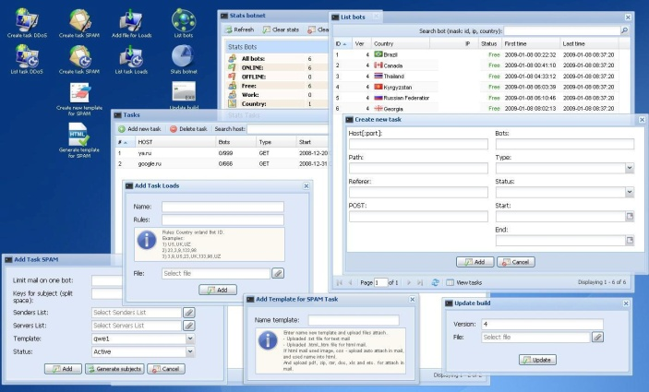
Marketplace for Victims
[Trend Micro, “Russian Underground 101”, 2012]
Pay-per-install on compromised machines
  US: $100-150 / 1000 downloads, “global mix”: $12-15
  Can be used to send spam, stage denial of service attacks, perform click fraud, host scam websites
Botnets for rent
  DDoS: $10/hour or $150/week
  Spam: from $10/1,000,000 emails
Tools and services
  Basic Trojans ($3-10), Windows rootkits ($300), email, SMS, ICQ spamming tools ($30-50), botnet setup and support ($200/month, etc.)
slide <number>

Slide 29
Bad News
Security often not a primary consideration
  Performance and usability take precedence
Feature-rich systems may be poorly understood
Implementations are buggy
  Buffer overflows are the “vulnerability of the decade”
  Cross-site scripting and other Web attacks
Networks are more open and accessible than ever
  Increased exposure, easier to cover tracks
Many attacks are not even technical in nature
  Phishing, social engineering, etc.
slide <number>

Slide 30
Better News
There are a lot of defense mechanisms
  We’ll study some, but by no means all, in this course
It’s important to understand their limitations
  “If you think cryptography will solve your problem, then you don’t understand cryptography… and you don’t understand your problem”
  Many security holes are based on misunderstanding
Security awareness and user “buy-in” help
Other important factors: usability and economics
slide <number>

Slide 31
Reading Assignment
Review Kaufman, section 1.5
  Primer on networking
Start reading buffer overflow materials on the course website
  “Smashing the Stack for Fun and Profit”
  You will definitely need to understand it for the buffer overflow project
slide <number>

