Slide 1
1BCP308 / COMMUNITY PROJECT / CLASSROOM PRESENTATION
Sahaya
AUTHOR
Small steps.
Meaningful learning.
Dr. Lokesh M R
Professor
Department of Information
Science & Engineering
An English–Kannada browser learning prototype
for educator-guided foundational practice.
A J Institute of Engineering
and Technology
Mangaluru, Karnataka, India
PO5 / PO6 / SDG 4
DAKSHINA KANNADA
Affiliated to VTU, Belagavi
20–25 minute lesson • demonstration • discussion
Based on the complete project package and 48-page continuation report · 20 September 2026
Dr. Lokesh M R | Professor, ISE | AJIET, Mangaluru
01
Notes:
01 | Opening
Timing: ~45 seconds
Introduce Sahaya as a technically tested educational prototype, not a completed school intervention. The deck is built from the project ZIP and its 48-page report. The session moves from the course mandate and district context to the learner experience, open data, a small model, test evidence and responsible deployment. There are no fabricated school names, participants or learning gains.
Classroom cue: Ask: What makes an educational tool useful beyond simply working on a laptop?
Evidence / source: Report front matter; package README.md
Status discipline: These slides describe the delivered prototype and recorded technical tests. They do not claim school approval, a learner trial, educational impact, or remote Render deployment.

Slide 2
SAHAYA / PROJECT
One course mandate. A clear boundary.
Sl. No. | Broad Areas/Project titles | Measurable engineering outcome | Specific POs | SDGs
1 | Computer-Based Learning Tool for Mentally Challenged Students | Design and develop a web/browserbased learning tool as per the requirements of the special school. | 5, 6 | 4
The quoted syllabus row is preserved exactly. New project language is learner-centred and respectful.
PO5 · tools and limits | PO6 · responsible community use | SDG 4 · inclusive education
School-specific requirements have not yet been collected or approved.
Report PDF p. 4; package docs/REQUIREMENTS.md
Dr. Lokesh M R | Professor, ISE | AJIET, Mangaluru
03
Notes:
03 | Prescribed project row
Timing: ~1 minute
Read the engineering outcome, emphasizing the words “as per the requirements of the special school.” The title is reproduced only because it is the prescribed course wording. In the rest of the presentation use “learners with intellectual disabilities” or “learners requiring individualized support.” The generic prototype is delivered, but the school-specific part of the outcome is still pending. PO and SDG mapping is intended alignment rather than a certification or achieved score.
Classroom cue: Which part of this outcome cannot be proved with code alone? Answer: requirements from, and acceptance by, the special school.
Evidence / source: Report PDF p. 4; docs/REQUIREMENTS.md
Status discipline: These slides describe the delivered prototype and recorded technical tests. They do not claim school approval, a learner trial, educational impact, or remote Render deployment.

Slide 3
SAHAYA / PROJECT
Start with the learner—not with the model.
Three questions guide the baseline design; a school must validate the answers.
Can I follow it?
Can I control it?
Can I use it safely?
Short prompts
Familiar visual examples
English + Kannada
No response timer
Supportive retries
Small practice sessions
No learner account
Local practice records
Clear exit and reset
Boundary: no diagnosis, ability ranking, cloud learner database, or claim of improved learning.
Report Chs. 3–4; docs/REQUIREMENTS.md; docs/FIELD_PROTOCOL.md
Dr. Lokesh M R | Professor, ISE | AJIET, Mangaluru
04
Notes:
04 | Problem and scope
Timing: ~1 minute
Explain that these are design questions and assumptions, not findings from a local needs survey. The scope is foundational practice supported by an educator. The tool does not assess disability, rank ability, replace instruction or keep identified student accounts. Model selection comes later and serves a narrow demonstrative purpose. Requirements must reflect the actual learner, input method, communication preferences and classroom context.
Classroom cue: Ask learners to name one accessibility requirement that may differ between two users.
Evidence / source: Report Chs. 3–4; docs/REQUIREMENTS.md; docs/FIELD_PROTOCOL.md
Status discipline: These slides describe the delivered prototype and recorded technical tests. They do not claim school approval, a learner trial, educational impact, or remote Render deployment.

Slide 4
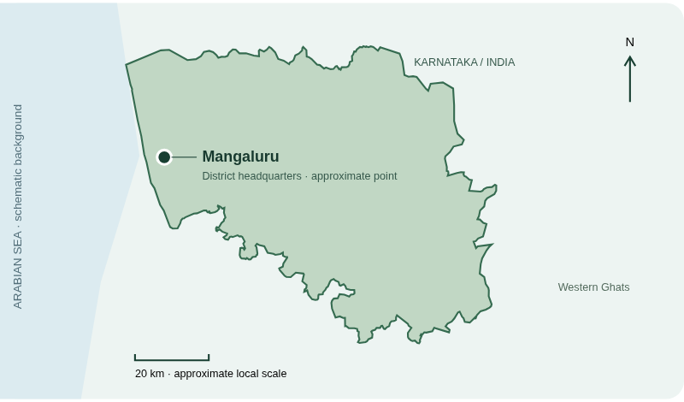
SAHAYA / PROJECT
Local context: Dakshina Kannada
Karnataka, India • district headquarters: coastal Mangaluru
2021 BOUNDARY VINTAGE
District context.
No school directory.
Mangaluru point: approximate
School locations: not collected
Boundary licence: ODbL 1.0
Report Ch. 2 & Appendix A; geoBoundaries IND ADM2; dk.nic.in/en/about-district/
Dr. Lokesh M R | Professor, ISE | AJIET, Mangaluru
05
Notes:
05 | District context and map provenance
Timing: ~50 seconds
Identify Karnataka and Mangaluru. The outline is extracted from geoBoundaries India ADM2, represented year 2021, source Pathways Data Pvt. Ltd. and lgdirectory.gov.in. Retrieval in 2026 does not update its boundary vintage. The Mangaluru point is an approximate hand-entered orientation marker; sea shading is schematic. No school location, partnership or service coverage is implied. The derivative GeoJSON is supplied under ODbL 1.0.
Classroom cue: Why is displaying a boundary year important?
Evidence / source: Report Ch. 2 and Appendix A; public/data/dakshina-kannada.geojson; docs/SOURCES.md
Status discipline: These slides describe the delivered prototype and recorded technical tests. They do not claim school approval, a learner trial, educational impact, or remote Render deployment.

Slide 5
SAHAYA / LEARNER EXPERIENCE
30 cards. Two kinds of content.
Everyday practice is authored; the optional handwriting module uses real secondary data.
5
5
5
5
10
Numbers
Colours
Shapes
Everyday
life
Handwritten
digits
20 author-written everyday cards
10 UCI cards
All cards have English and Kannada prompts. Kannada and teaching suitability require educator review.
Report Ch. 9; public/data/lessons.json; scripts/make_lessons.py
Dr. Lokesh M R | Professor, ISE | AJIET, Mangaluru
06
Notes:
06 | Content composition
Timing: ~45 seconds
Count five cards each for numbers, colours, shapes and everyday life: twenty authored cards. Ten additional handwriting cards use UCI test examples and are available from the educator workspace. Do not call the twenty authored cards a secondary dataset or a survey. All thirty have both language fields. A structural language-field check is not proof of good translation or suitable teaching content. Each short session presents three or five cards, so the full pack is not shown at once.
Classroom cue: Ask the class to distinguish “authored teaching content” from “secondary data.”
Evidence / source: Report Ch. 9; public/data/lessons.json; scripts/make_lessons.py
Status discipline: These slides describe the delivered prototype and recorded technical tests. They do not claim school approval, a learner trial, educational impact, or remote Render deployment.

Slide 6
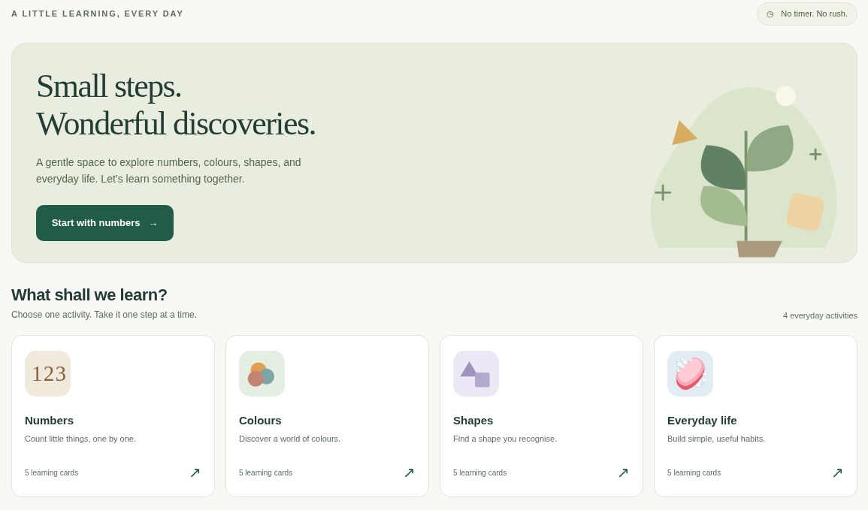
SAHAYA / LEARNER EXPERIENCE
A calm starting point
Actual application screen from the delivered project—not a classroom photograph.
1
Choose
Four everyday activities.
2
Try
No time pressure.
3
Continue
Short, repeatable practice.
Package evidence/app-desktop.png; report Part A and Ch. 8
Dr. Lokesh M R | Professor, ISE | AJIET, Mangaluru
07
Notes:
07 | Home screen walkthrough
Timing: ~45 seconds
Point to the numbers, colours, shapes and everyday-life cards. The interface gives a clear entry point rather than starting with an assessment or profile form. This is a screenshot captured from the delivered app, not evidence of use in a school. Explain where progress, district context and educator resources live in the navigation. The live demonstration later will use the same interface.
Classroom cue: Invite one student to describe the first action they would take on this screen.
Evidence / source: Package evidence/app-desktop.png; report Part A and Ch. 8
Status discipline: These slides describe the delivered prototype and recorded technical tests. They do not claim school approval, a learner trial, educational impact, or remote Render deployment.

Slide 7
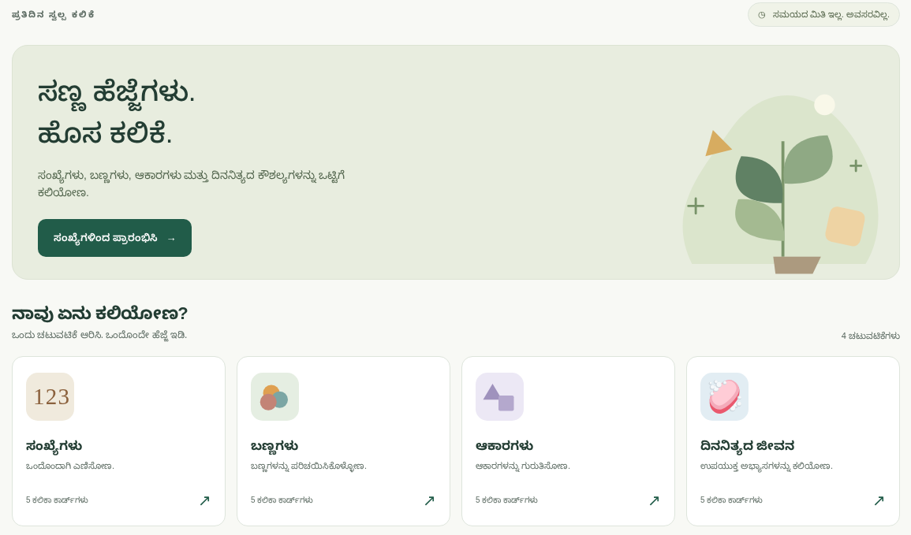
SAHAYA / LEARNER EXPERIENCE
Same activity. A choice of language.
Learner-facing interface and prompts support English and Kannada.
English ⇄ Kannada
Bundled font
No font CDN needed
Review still needed:
Kannada wording
Local examples
Individual suitability
Package evidence/app-kannada.png; docs/REQUIREMENTS.md, R1
Dr. Lokesh M R | Professor, ISE | AJIET, Mangaluru
08
Notes:
08 | Language support
Timing: ~45 seconds
The Kannada screenshot shows the actual language switch, not an English-only mock-up with a translated title. A bundled Noto Sans Kannada font avoids reliance on an external font CDN. However, no local special educator has certified the text. Technical educator notes and map annotations remain English-only. Read-aloud uses the browser’s available voices and is not guaranteed to supply a Kannada voice or work offline.
Classroom cue: What should a local language reviewer check besides literal translation?
Evidence / source: Package evidence/app-kannada.png; docs/SOURCES.md; docs/REQUIREMENTS.md
Status discipline: These slides describe the delivered prototype and recorded technical tests. They do not claim school approval, a learner trial, educational impact, or remote Render deployment.

Slide 8
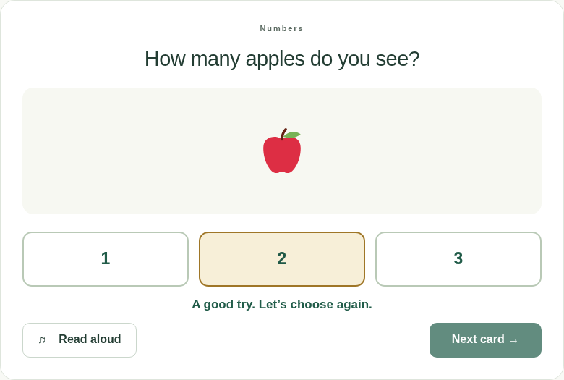
SAHAYA / LEARNER EXPERIENCE
Practice supports another try.
The model does not decide whether a learner can continue.
1
Choose
Select an activity.
2
Respond
Pick an answer; no timer.
3
Receive feedback
Retry, or confirm success.
4
Continue
Next card or a break.
3 or 5 cards • deterministic rotation, not adaptive AI
Report Ch. 8; public/engine.js; browser check: retry feedback and first-try accounting
Dr. Lokesh M R | Professor, ISE | AJIET, Mangaluru
09
Notes:
09 | Practice loop
Timing: ~1 minute
A wrong answer produces supportive feedback and leaves the card available. A correct answer unlocks Next. The log distinguishes first-try success from a card completed after retries, but this does not make it an ability measure. Category sessions rotate using the device completion count; this is a simple deterministic rule, not machine-learning personalization. The screenshot was captured for the presentation from the delivered app with an automated example, not a learner trial.
Classroom cue: Ask: Why should “eventually correct” and “correct on the first try” be recorded separately?
Evidence / source: Report Ch. 8; public/engine.js and app.js; screenshot from the local delivered app
Status discipline: These slides describe the delivered prototype and recorded technical tests. They do not claim school approval, a learner trial, educational impact, or remote Render deployment.

Slide 9
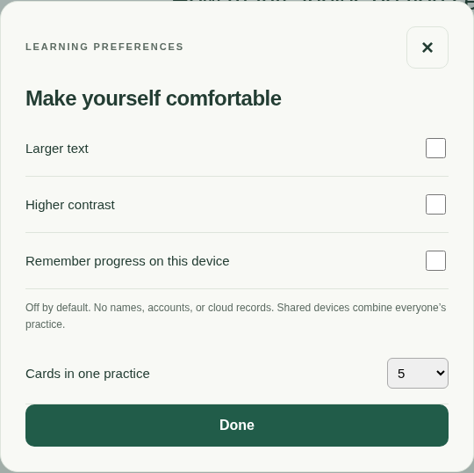
SAHAYA / LEARNER EXPERIENCE
Accessible design is a starting point.
Technical checks do not establish universal accessibility or individual suitability.
Adjust the presentation
Larger text, higher contrast, visible keyboard focus.
Reduce pressure
No timed answers; short sessions; supportive retries.
Offer alternatives
Colour, shape and digit recognition are visual tasks.
CLASS PROMPT Which activities would need an alternative for a learner who cannot see the screen?
Report Ch. 11; docs/FIELD_PROTOCOL.md; actual settings screen
Dr. Lokesh M R | Professor, ISE | AJIET, Mangaluru
10
Notes:
10 | Accessibility and individual needs
Timing: ~1 minute
Describe the included design features without promising universal accessibility. The application provides larger text, contrast settings, visible focus, untimed choices and supportive feedback. Visual recognition activities still require alternatives for some users. A clean automated accessibility scan cannot establish cognitive accessibility, keyboard/switch suitability, screen-reader quality or educational usefulness. Educators and learners must validate the actual device, input method and sensory preferences.
Classroom cue: Use the displayed question. A good answer proposes an equivalent learning goal with a non-visual activity rather than merely increasing contrast.
Evidence / source: Report Ch. 11; docs/FIELD_PROTOCOL.md; evidence/accessibility.json; settings screenshot from delivered app
Status discipline: These slides describe the delivered prototype and recorded technical tests. They do not claim school approval, a learner trial, educational impact, or remote Render deployment.

Slide 10
SAHAYA / LEARNER EXPERIENCE
Practice stays local by design.
No names, diagnoses, learner accounts, analytics, or learner uploads.
01
02
03
Default: session memory
Optional: device storage
Export: local CSV
Records disappear after reload.
“Remember progress” is opt-in.
Use school-approved handling.
Shared-device records are not per-learner records. Clear them before changing users.
Browser voices and external links may use the network; hosting still sees ordinary request metadata.
Report Ch. 8; docs/REQUIREMENTS.md, R5; package app.js and CSV schema
Dr. Lokesh M R | Professor, ISE | AJIET, Mangaluru
11
Notes:
11 | Privacy and persistence
Timing: ~1 minute
Clarify the distinction between local processing and total anonymity. The app itself does not collect names, diagnoses or accounts and does not upload practice logs. Ordinary hosting request metadata still exists, and optional browser voice providers may use the network. Persistence is off by default; opt-in storage combines practice on a shared browser. Exported CSVs remain files needing responsible handling. The CSV schema is date, session token, category, card, attempts and firstCorrect. There is no secure per-student database.
Classroom cue: Ask why shared-device progress should not be interpreted as one child’s progress.
Evidence / source: Report Ch. 8; docs/REQUIREMENTS.md; docs/DEPLOYMENT.md; public/app.js
Status discipline: These slides describe the delivered prototype and recorded technical tests. They do not claim school approval, a learner trial, educational impact, or remote Render deployment.

Slide 11
SAHAYA / ENGINEERING
Use open resources—with provenance.
A licence and a source are part of the engineering result.
Resource | How this project uses it | Licence
UCI handwritten digits | Model fit/test; 10 optional digit cards | CC BY 4.0
geoBoundaries IND ADM2 | Extracted district geometry and map | ODbL 1.0
Twemoji graphics | Apple, banana, soap and water SVGs | CC BY 4.0
scikit-learn 1.6.1 | Executed 3-NN reference implementation | BSD-3-Clause
Noto Sans Kannada | Bundled Kannada font | SIL OFL 1.1
IndicTrans2: documented as an optional model—not downloaded, executed, or integrated.
Finders: UCI • Google Dataset Search • Hugging Face • OGD India • Kaggle
Report Appendix A; docs/SOURCES.md; all licences apply to their own artifacts
Dr. Lokesh M R | Professor, ISE | AJIET, Mangaluru
12
Notes:
12 | Source register
Timing: ~1 minute
Distinguish data, graphics, model code and fonts. The MIT project licence does not override CC BY, ODbL or OFL obligations on included materials. The district’s actual metadata lists ODbL 1.0, so do not assume every geoBoundaries feature is CC BY. AI4Bharat IndicTrans2 has a model card listing MIT and Kannada support, but is only a future candidate here. Dataset finder links are discovery aids, not live integrations or guarantees of lawful, representative data.
Classroom cue: Ask the class to identify which row contains executable model code rather than a dataset.
Evidence / source: Report Appendix A; docs/SOURCES.md; docs/MODEL_CARD.md
Status discipline: These slides describe the delivered prototype and recorded technical tests. They do not claim school approval, a learner trial, educational impact, or remote Render deployment.

Slide 12

SAHAYA / ENGINEERING
A transparent model: three nearest neighbours
Classifies repository digit images—not learners, disability, or learning progress.
64 values
3-NN
PREDICTION
3
Intensity range
0 to 16
Euclidean distance
Uniform voting
8 × 8 image
UCI example: “3”
Python evaluates the full source split. A small JavaScript equivalent runs examples locally in the educator view.
Report Ch. 9; docs/MODEL_CARD.md; UCI test row 3 used as the illustrated example
Dr. Lokesh M R | Professor, ISE | AJIET, Mangaluru
13
Notes:
13 | How 3-NN works
Timing: ~1 minute
Use the illustrated UCI test example, row 3. The source provides sixty-four values for an eight-by-eight image, each between zero and sixteen. The model measures Euclidean distance to training vectors and uses the labels of the three nearest neighbours with uniform voting. The displayed prediction for this example is three. Python uses scikit-learn; the browser has an original small equivalent. Browser tie handling may differ in edge cases, and saved parity tests cover twenty examples. No learner drawing is collected.
Classroom cue: If two of three neighbours vote for 3 and one for 8, what is the result?
Evidence / source: Report Ch. 9; docs/MODEL_CARD.md; public/data/digits-examples.json; public/engine.js
Status discipline: These slides describe the delivered prototype and recorded technical tests. They do not claim school approval, a learner trial, educational impact, or remote Render deployment.

Slide 13
SAHAYA / EVIDENCE
97.83% measures digit recognition.
It does not measure learner improvement.
97.83%
3,823 training rows
Original UCI training file.
1,758 / 1,797 test digits classified correctly
1,797 test rows
Original held-out test file.
20 browser examples
39 errors • original fixed split • no test-label tuning
Prediction parity checks, not a full browser evaluation.
Do not report this percentage as a learning gain, disability score, or Kannada handwriting accuracy.
public/data/model-metrics.json; original UCI optdigits.tra / optdigits.tes; report Ch. 9
Dr. Lokesh M R | Professor, ISE | AJIET, Mangaluru
14
Notes:
14 | Interpret the evaluation correctly
Timing: ~1 minute
The full Python reference evaluation gives 1,758 correct out of 1,797 held-out source digits, or 97.8297 percent. There are thirty-nine classification errors. Training uses the original 3,823 rows; the original source split has distinct writer groups and was not tuned on test labels here. The browser parity test checks twenty examples only. The dataset is not a validated sample of local special-school learners and does not establish fairness or clinical or pedagogical validity.
Classroom cue: Ask: Which conclusion is justified—“the model classified source digits well” or “children learned 97.83% better”?
Evidence / source: public/data/model-metrics.json; docs/MODEL_CARD.md; report Ch. 9
Status discipline: These slides describe the delivered prototype and recorded technical tests. They do not claim school approval, a learner trial, educational impact, or remote Render deployment.

Slide 14
SAHAYA / ENGINEERING
A small static architecture
Build-time data processing is separate from learner practice.
OPEN SOURCES
PREPARE
PUBLISH
USE
UCI digits
District geometry
Illustrations + font
Python scripts
Model evaluation
JSON + map artifacts
HTML / CSS / JS
Bundled model + data
Service-worker cache
Learner activities
Local records
Educator model demo
No application backend, database,
or mandatory API key.
Offline only after the first successful cache.
Some voices and source links need internet.
Report Chs. 8–10; scripts/prepare_data.py; public/engine.js; scripts/build.mjs
Dr. Lokesh M R | Professor, ISE | AJIET, Mangaluru
15
Notes:
15 | Architecture
Timing: ~1 minute
Walk left to right. Python is a build and reproducibility dependency, not part of Render’s runtime. The deployable public directory includes the lesson pack, model vectors, font and map. The browser grades practice by the authored answer key; the 3-NN model is a separate educator demonstration. A content-derived service-worker key supports offline caching after an initial complete download. Browser cache can be evicted, and direct file:// opening is not promised. No model API, database or authenticated teacher backend is present.
Classroom cue: Why can Render serve this project without a Python start command?
Evidence / source: Report Chs. 8–10; scripts/prepare_data.py; public/engine.js; render.yaml
Status discipline: These slides describe the delivered prototype and recorded technical tests. They do not claim school approval, a learner trial, educational impact, or remote Render deployment.

Slide 15
SAHAYA / EVIDENCE
Evidence, not just a working screenshot.
Recorded engineering checks from the delivered package.
9
19
15
22
Engine tests
Browser checks
Week programs
Artifact hashes
Content, grading, CSV, model examples.
Language, storage, reset, mobile, offline.
Two runs each; byte-identical stdout.
Checked before and after regeneration.
0 detected axe violations across 4 main views ≠ full accessibility certification.
evidence/unit-transcript.txt; browser-results.json; capture-summary.txt; artifact-verification.txt
Dr. Lokesh M R | Professor, ISE | AJIET, Mangaluru
16
Notes:
16 | Technical evidence
Timing: ~1 minute
The delivered package records nine passing Node tests and nineteen passing Chromium checks. The browser flow includes wrong-answer feedback, first-try counting, completion, CSV download, persistence opt-in, clearing data, language switch, map serving, model demo, source filtering, mobile width and offline use. Fifteen week checks were each run twice with equal stdout. Twenty-two source/site artifact hashes match before and after regeneration. Timing values and screenshots are not claimed byte-identical. Axe scans found zero violations in four main views but cannot certify universal accessibility. These are existing recorded results, not a new classroom evaluation.
Classroom cue: Which additional checks require real people and the actual school device?
Evidence / source: Package evidence folder; report Chs. 11 and 14
Status discipline: These slides describe the delivered prototype and recorded technical tests. They do not claim school approval, a learner trial, educational impact, or remote Render deployment.

Slide 16
SAHAYA / DEMONSTRATION
Classroom demonstration: three minutes
Use the live app; slides 7–10 are the screenshot fallback.
1
Open and orient
Home → Numbers. Point out the absence of a timer.
2
Try, retry, continue
Choose one wrong answer, then the correct one.
3
Switch and adjust
Toggle Kannada; show larger text and contrast.
4
Inspect the evidence
Progress → CSV/reset. Educators → model. Our district → map.
Before class: open the app once while online, verify assets, and keep a local copy available.
Delivered app; docs/DEPLOYMENT.md; demonstration uses no learner personal data
Dr. Lokesh M R | Professor, ISE | AJIET, Mangaluru
17
Notes:
17 | Live demonstration run sheet
Timing: ~3 minutes
Before presenting, start the app from the extracted sahaya directory using node scripts/build.mjs and node server.mjs, then visit http://localhost:3000 on the presenter computer. No cloud account is required. Have the site ready before starting the three-minute walkthrough. Use a deliberately wrong number choice, then the correct answer; explain the difference between retry and first-try success. Show language/settings, then progress and reset without entering personal data. The educator workspace demonstrates source examples only. Finish on the district map. If the app cannot run, use screenshots on slides 7–10; do not imply a deployment exists.
Classroom cue: Invite the audience to predict what changes after an incorrect answer, then demonstrate it.
Evidence / source: docs/DEPLOYMENT.md; public app; screenshot fallback slides 7–10
Status discipline: These slides describe the delivered prototype and recorded technical tests. They do not claim school approval, a learner trial, educational impact, or remote Render deployment.

Slide 17
SAHAYA / HANDOVER
Git → Render: prepared, not published.
The package includes local history, a static-site Blueprint, and deployment instructions.
1
2
3
4
Review locally
Push your Git repo
Connect Render
Verify HTTPS
Run and test the
delivered source.
Use your own account;
keep secrets out.
New → Blueprint;
review render.yaml.
Test Kannada, CSV,
model, map and offline.
Build: node scripts/build.mjs | Publish: public | Secrets: none
Remote Git push and Render account deployment have not been performed.
Report Ch. 15 & Appendix D; docs/DEPLOYMENT.md; render.yaml; supplied Git bundle
Dr. Lokesh M R | Professor, ISE | AJIET, Mangaluru
18
Notes:
18 | Deployment handover
Timing: ~1 minute
A live sandbox preview is not the same as a public Render service. The owner must create or connect a remote Git repository and authenticate through their own account. The Render Blueprint uses runtime static and publishes public/. The build command is node scripts/build.mjs; there is no backend start command or database. Check current hosting quotas and charges rather than promising universal free hosting. Verify the final HTTPS URL and initial offline cache on the actual device. The supplied Git bundle preserves local history if the source ZIP is copied without .git metadata.
Classroom cue: Ask which steps require the project owner’s account and cannot be claimed complete here.
Evidence / source: Report Ch. 15 and Appendix D; docs/DEPLOYMENT.md; render.yaml
Status discipline: These slides describe the delivered prototype and recorded technical tests. They do not claim school approval, a learner trial, educational impact, or remote Render deployment.

Slide 18
SAHAYA / HANDOVER
The 15-week course journey
A proposed schedule—not an attendance or fieldwork record.
WEEKS 1–5
WEEKS 6–10
WEEKS 11–15
Frame the problem
Design and build
Validate and hand over
Ethics and scope
Community questions
Requirements and sources
Plan and feasibility
Data, model and map
Browser prototype
Technical tests
Approved fieldwork, if ready
Report, viva and deployment
Planned effort: 30 hours term work + 30 hours self-learning = 60 hours
Report TLP table & Ch. 6; docs/plan.json; docs/PLAN.md
Dr. Lokesh M R | Professor, ISE | AJIET, Mangaluru
19
Notes:
19 | Course alignment and planning
Timing: ~45 seconds
The 48-page report organizes work according to the same fifteen-week progression as the supplied book. Two hours of term work and two hours of self-learning per week produce thirty plus thirty hours. The engineering prototype was built for the delivery; the schedule is a proposed educational organization of work, not proof that a fifteen-week intervention has happened. Week 12 fieldwork remains pending. Role slots cover coordination and ethics, content and accessibility, engineering and data, and QA and documentation. Team names and guide details must be supplied locally.
Classroom cue: What should the report say if field permission is delayed? Answer: pending—not simulated participation.
Evidence / source: Report TLP table and Ch. 6; docs/plan.json; docs/PLAN.md
Status discipline: These slides describe the delivered prototype and recorded technical tests. They do not claim school approval, a learner trial, educational impact, or remote Render deployment.

Slide 19
SAHAYA / HANDOVER
A delivered output is not a measured outcome.
DELIVERED ENGINEERING
BEFORE CLASSROOM ADOPTION
Working bilingual app
Sourced map and datasets
Model and technical evidence
Git / Render handover files
School-approved requirements
Kannada and access review
Permission, consent and assent
Supervised trial and feedback
Learner improvement: not measured. School surveys and learner trials: none claimed.
Report Chs. 12–13; docs/FIELD_PROTOCOL.md; docs/REQUIREMENTS.md, R10
Dr. Lokesh M R | Professor, ISE | AJIET, Mangaluru
20
Notes:
20 | Responsible next steps
Timing: ~1 minute
Make the outcome distinction explicit. The app, code, map, model and receipts are delivered outputs. School acceptance, usefulness, engagement and learning would require approved evaluation. Start with school permission and a special educator’s review. Apply caregiver consent and learner assent where required, allow stopping without penalty, and collect only necessary observations. Do not place signed forms or identifiable records in the public repository. An automation-generated CSV cannot be presented as a learner session.
Classroom cue: Ask the class to place “30 cards” and “improved independence” in the correct columns.
Evidence / source: Report Chs. 12–13; docs/FIELD_PROTOCOL.md; docs/REQUIREMENTS.md
Status discipline: These slides describe the delivered prototype and recorded technical tests. They do not claim school approval, a learner trial, educational impact, or remote Render deployment.

Slide 20
SAHAYA / AUTHOR PROFILE
Research, teaching & academic service
Over 22 years in teaching, research and administration across premier institutions in Karnataka.
RESEARCH SPECIALISATIONS
Publications & patent
Cyber-Physical
Systems
Artificial Immune
Systems
Published extensively in Scopus-indexed and UGC-approved journals; holds a granted patent.
Supervision & funded research
Fault-Tolerant
Computing
Multi-Agent
Systems
Supervises Ph.D. scholars under VTU; contributed to KSCST- and AICTE-funded research projects.
LIFE MEMBER
CSI and ISTE
Invited talks
FDPs, workshops and conferences.
Professional biography supplied for this presentation; no additional publication or patent counts inferred.
Dr. Lokesh M R | Professor, ISE | AJIET, Mangaluru
21
Notes:
21 | Research & academic service
Timing: ~45 seconds
The supplied professional profile lists Cyber-Physical Systems, Artificial Immune Systems, Fault-Tolerant Computing and Multi-Agent Systems as Dr. Lokesh M R’s specialisations. It also states extensive publication in Scopus-indexed and UGC-approved journals, a granted patent, current supervision of Ph.D. scholars under VTU, invited talks at FDPs, workshops and conferences, and contributions to KSCST- and AICTE-funded projects. Life memberships: CSI and ISTE. No publication total, patent number or specific grant value has been added because none was supplied.
Classroom cue: Use the scholarly-profile links on the next slide for the author’s publication and professional records.
Evidence / source: Author biography supplied by the user; not independently verified.
Status discipline: These slides describe the delivered prototype and recorded technical tests. They do not claim school approval, a learner trial, educational impact, or remote Render deployment.

Slide 21
SAHAYA / AUTHOR PROFILE
Contact & scholarly profiles
Dr. Lokesh M R • select a link to open the corresponding profile.
ORCID
EMAIL
0000-0003-0025-7941
lokeshmrmysore@gmail.com
SCOPUS
Author ID: 57687382800
MOBILE
GOOGLE SCHOLAR
+91 9964050926
CCfMxaMAAAAJ
LINKEDIN
WEB OF SCIENCE ID
lokesh-m-r-b6880b169
JCF-0012-2023
GITHUB
lokeshmr23
Professor, ISE • AJIET, Mangaluru
VIDWAN
Profile: 344450
Contact details and identifiers supplied for publication in these slides.
Dr. Lokesh M R | Professor, ISE | AJIET, Mangaluru
22
Notes:
22 | Contact & scholarly profiles
Timing: Reference only
All contact details and profile URLs are reproduced from the information supplied by the user. Email: lokeshmrmysore@gmail.com. Mobile: +91 9964050926. ORCID: https://orcid.org/0000-0003-0025-7941 . Scopus: https://www.scopus.com/authid/detail.uri?authorId=57687382800 . Google Scholar: https://scholar.google.co.in/citations?user=CCfMxaMAAAAJ . LinkedIn: https://www.linkedin.com/in/lokesh-m-r-b6880b169/ . GitHub: https://github.com/lokeshmr23 . VIDWAN: https://vidwan.inflibnet.ac.in/profile/344450 . Web of Science ID: JCF-0012-2023. Links are embedded; opening external profiles requires connectivity.
Classroom cue: Share the slide rather than asking the audience to transcribe identifiers. No live-link validation or ownership verification is claimed.
Evidence / source: User-supplied contact and profile information.
Status discipline: These slides describe the delivered prototype and recorded technical tests. They do not claim school approval, a learner trial, educational impact, or remote Render deployment.

Slide 22
SAHAYA / AUTHOR
Acknowledgement & dedication
The author expresses gratitude to:
VTU, Belagavi
DEDICATION
For the curriculum framework.
To all VTU students who aspire to excel in their examinations.
A J Institute of Engineering and Technology
For infrastructure.
Deep Learning textbook
Ian Goodfellow, Yoshua Bengio and Aaron Courville.
All students who provided feedback
For their feedback.
Family
For constant support and encouragement.
Acknowledgement and dedication supplied by the author for inclusion in this presentation.
Dr. Lokesh M R | Professor, ISE | AJIET, Mangaluru
23
Notes:
23 | Acknowledgement & dedication
Timing: ~30 seconds
Acknowledge VTU, Belagavi for the curriculum framework; A J Institute of Engineering and Technology, Mangaluru for infrastructure; Prof. Ian Goodfellow, Yoshua Bengio and Aaron Courville for their textbook Deep Learning; all students who provided feedback; and family for constant support and encouragement. The supplied dedication reads: “This book is dedicated to all VTU students who aspire to excel in their examinations.” The slide adapts this wording to a presentation without changing its audience or intent. The acknowledgement of general student feedback is not evidence of a special-school pilot or a learner trial for Sahaya.
Classroom cue: Thank the contributors while keeping the project’s outstanding school-validation requirements clear.
Evidence / source: Acknowledgement and dedication text supplied by the user.
Status discipline: These slides describe the delivered prototype and recorded technical tests. They do not claim school approval, a learner trial, educational impact, or remote Render deployment.

Slide 23
REFLECT / DISCUSS / DEFEND
What would you validate
before the first class?
The learner
The evidence
The setting
Language, input, sensory needs.
Source quality, tests, model limits.
Permission, device, support, privacy.
Build transparently. Validate locally. Report only what the evidence supports.
Report Chs. 13–15 and Appendix C; no new impact or deployment claim
Dr. Lokesh M R | Professor, ISE | AJIET, Mangaluru
24
Notes:
24 | Closing discussion
Timing: ~1 minute
Invite two or three responses before offering the summary. Strong answers connect technical evidence to the actual learner and classroom rather than assuming an accuracy percentage guarantees educational value. Revisit the three boundaries: no primary fieldwork yet, no clinical or learning assessment by the model, and no remote account deployment completed. The defensible conclusion is a sourced, technically tested, deployable prototype whose next step is authorized local validation.
Classroom cue: Exit ticket: Name one completed engineering result, one unsupported claim to avoid, and one next action.
Evidence / source: Report Chs. 13–15; Appendix C; docs/FIELD_PROTOCOL.md
Status discipline: These slides describe the delivered prototype and recorded technical tests. They do not claim school approval, a learner trial, educational impact, or remote Render deployment.

Slide 24
SAHAYA / REFERENCE
References and reproducibility
Source files are included in the project package; repository links below are clickable.
PRIMARY DELIVERABLES
Community-Project-Sahaya-Continuation.pdf • 48 pages
Sahaya-Project-Package.zip • code, data, evidence, Git bundle
UCI HANDWRITTEN DIGITS
Alpaydin & Kaynak, 1998 • DOI: 10.24432/C50P49 • CC BY 4.0
DISTRICT GEOMETRY + CONTEXT
geoBoundaries IND ADM2, 2021 • ODbL 1.0; official district profile
OPEN-SOURCE MODEL
scikit-learn 1.6.1 • KNeighborsClassifier • BSD-3-Clause
OPTIONAL MODEL ONLY
AI4Bharat IndicTrans2 En–Indic 200M • not integrated
DEPLOYMENT
Render Blueprint documentation • account setup remains pending
Asset credits: Twemoji / Twitter contributors (CC BY 4.0); Noto Sans Kannada (SIL OFL 1.1).
Deck based on supplied package and 48-page PDF. External source metadata follows their source register.
Dr. Lokesh M R | Professor, ISE | AJIET, Mangaluru
25
Notes:
25 | Source and reproduction guide
Timing: Reference only
Use this slide as a reference rather than reading every line aloud. The principal evidence is the delivered report and package. The source register in docs/SOURCES.md gives licence details, modifications and pinned geography provenance. Additional URLs: official district profile https://dk.nic.in/en/about-district/ ; Twemoji https://github.com/twitter/twemoji/tree/v14.0.2 ; Kannada font https://github.com/google/fonts/tree/main/ofl/notosanskannada . To reproduce, follow README.md and docs/DEPLOYMENT.md. The model card states the original split, limitations and browser parity scope. The full report retains the prescribed course row and week-led evidence.
Classroom cue: Offer the PPTX/PDF and package to anyone who wants to inspect or reproduce the evidence.
Evidence / source: Report Appendix A and Appendix D; package README.md; docs/SOURCES.md
Status discipline: These slides describe the delivered prototype and recorded technical tests. They do not claim school approval, a learner trial, educational impact, or remote Render deployment.

