Slide 1
VISVESVARAYA TECHNOLOGICAL UNIVERSITY, BELAGAVI
B.E./B.Tech • Computer Science & Engineering • 2025-2026 Scheme
MODULE 1
ARTIFICIAL INTELLIGENCE
Introduction to AI and Applications (1BAIA103/203)
Classroom Teaching Slides • 8-Hour Lesson Plan
Machine Intelligence · Knowledge Representation · Search Algorithms
Based on notes by Dr. Lokesh M R | Prepared for UG classroom delivery

Slide 2
8-Hour Lesson Plan — Module 1
VTU Syllabus
Hour | Topic | Key Coverage
1 | Introduction to AI | Definitions, how AI works, advantages/limitations, history
2 | Types of AI; AI vs ML/DL | Weak/Strong AI; reactive to self-aware; AI-ML-DL relationship
3 | Intelligence & Agents | Gardner's intelligence; components; rational agents; PEAS
4 | Agent types & Environments | Reflex/model/goal/utility/learning agents; environment types
5 | Uninformed Search I | Search problem; DFS, DLS, BFS
6 | Uninformed Search II | UCS, IDDFS, Bidirectional; comparison
7 | Informed Search & KR | Heuristics, greedy best-first; knowledge representation
8 | Knowledge-Based Agents | KBA architecture, TELL/ASK/PERFORM, types of knowledge
VTU 1BAIA103/203 • Introduction to AI & Applications • Module 1
1

Slide 3
Course Outcomes — After Module 1
COs
▪ CO1: Define AI and trace its historical evolution and key milestones.
▪ CO2: Classify AI systems by capability and functionality with real examples.
▪ CO3: Distinguish AI, ML, deep learning, augmented intelligence and cognitive computing.
▪ CO4: Design rational agents using PEAS and classify task environments.
▪ CO5: Apply and compare uninformed search algorithms (DFS, BFS, UCS, IDDFS, bidirectional).
▪ CO6: Apply informed (heuristic/greedy) search and explain knowledge representation.
▪ CO7: Describe knowledge-based agents and the types of knowledge used in AI.
VTU 1BAIA103/203 • Introduction to AI & Applications • Module 1
2

Slide 4
HOUR 1
Introduction to Artificial Intelligence
Definitions · How AI works · Advantages & limitations · History

Slide 5
What is Artificial Intelligence?
Hour 1
▪ McCarthy (2004): science & engineering of making intelligent machines, especially intelligent computer programs.
▪ Turing (1950): 'Can machines think?' → Turing Test (interrogator cannot tell machine from human by text).
▪ Layman: machines mimic human actions; learn from experience, adapt, perform human-like tasks.
▪ Researcher: algorithms that produce results without explicit instruction — think/act rationally & humanely.
▪ NITI Aayog: ability to perform cognitive tasks — think, perceive, learn, solve problems, decide.
Key Languages
▪ R
▪ Python
▪ Java
Examples
▪ Chess-playing computers
▪ Self-driving cars
▪ Voice assistants
▪ NLP / chatbots
VTU 1BAIA103/203 • Introduction to AI & Applications • Module 1
3

Slide 6
How Does AI Work?
Hour 1
Large labelled training data → find correlations/patterns → predict future states.
Labelled
Data
Learn
Patterns
Reason
(algorithm)
Self-correct
Predict /
Act
▪ Learning: acquire data + rules (algorithms) to turn it into actionable information.
▪ Reasoning: choose the right algorithm to reach the desired outcome.
▪ Self-correction: continually refine algorithms for accurate results.
Case study: Uber uses ML to predict rider demand and dispatch drivers before they are needed.
VTU 1BAIA103/203 • Introduction to AI & Applications • Module 1
4

Slide 7
Advantages & Disadvantages of AI
Hour 1
Advantages
Disadvantages
▪ Handles data-intensive tasks well
▪ Processes huge data fast
▪ Consistent, accurate results
▪ Available 24×7
▪ Optimises resources
▪ Automates complex processes
▪ Predicts maintenance (less downtime)
▪ Faster, higher-quality new products
▪ High development/infrastructure cost
▪ Requires technical expertise
▪ Shortage of trained professionals
▪ Bad/incomplete data → disastrous results
▪ Limited ability to generalise across tasks
VTU 1BAIA103/203 • Introduction to AI & Applications • Module 1
5

Slide 8
History of AI — Key Milestones
Hour 1
Year | Milestone
1943 | McCulloch & Pitts — first neural-network model
1950 | Turing Test; Shannon's chess paper; Asimov's Three Laws
1956 | John McCarthy coins 'AI' at Dartmouth — birth of AI
1958 | McCarthy develops LISP
1959 | Newell, Simon & Shaw build GPS; Samuel coins 'machine learning'
1966 | ELIZA chatbot; 1974–80 First AI Winter (funding cuts)
1980 | DEC's R1/XCON expert system; 1982–93 FGCS & Second AI Winter
1997 | IBM Deep Blue beats Kasparov
2011 | Apple Siri; IBM Watson wins Jeopardy!
2016 | DeepMind AlphaGo defeats Lee Sedol; Sophia the robot
2018 | Google BERT; Waymo One
2020 | Baidu LinearFold for COVID-19 vaccine
VTU 1BAIA103/203 • Introduction to AI & Applications • Module 1
6

Slide 9
Hour 1 — Recap & Practice
Review
▪ Recall: Who coined 'AI' and when? (McCarthy, 1956)
▪ Understand: three cognitive skills of AI programming (learning, reasoning, self-correction).
▪ Apply: give two real applications where AI performs human-intelligence tasks.
VTU / GATE-style check
▪ Define AI as per John McCarthy and NITI Aayog. (VTU, 6/8 marks)
▪ Explain three cognitive skills of AI with a case study. (VTU, 8 marks)
▪ GATE: The term AI was coined in — (A) 1950 (B) 1956 (C) 1969 (D) 1980. Ans: B
VTU 1BAIA103/203 • Introduction to AI & Applications • Module 1
7

Slide 10
HOUR 2
Types of AI · AI vs ML/DL
Weak/Strong · Reactive to Self-aware · Augmented & Cognitive Computing

Slide 11
Types of AI — by Capability
Hour 2
Artificial
Intelligence
Weak (Narrow)
AI
Strong AI
(AGI / ASI)
Weak / Narrow AI
Strong AI (AGI/ASI)
▪ Specific task within a limited context
▪ Most successful AI today
▪ Uses supervised/unsupervised learning
▪ Examples: Siri, Alexa, Google Search, Watson, self-driving cars
▪ Resembles the human brain across tasks
▪ Cognitive skills + fuzzy logic
▪ Vision, speech, decisions, translation
▪ Currently sci-fi (e.g., HAL in 2001); quantum computing may help
VTU 1BAIA103/203 • Introduction to AI & Applications • Module 1
8

Slide 12
Types of AI — by Functionality
Hour 2
Type | Memory? | Description / Example
Reactive Machines | No memory | Perceive & react to current state; no learning. Deep Blue, AlphaGo*.
Limited Memory | Short-term | Use recent data briefly; autonomous vehicles. Models: RL, LSTM, E-GAN.
Theory of Mind | Theoretical | Represent thoughts/emotions to understand behaviour; future AI.
Self-Awareness | Future | Human-level consciousness; understands its own existence & others' feelings.
VTU 1BAIA103/203 • Introduction to AI & Applications • Module 1
9

Slide 13
AI vs Augmented Intelligence vs Cognitive Computing
Hour 2
Term | Core idea | Example
True AI (Strong/AGI) | Machines with human-like intelligence for complex tasks | AGI/ASI (aspirational)
Augmented Intelligence | Weak AI that assists/improves human decisions | Auto-highlight key business info
Cognitive Computing | Mimics/augments human thought processes | Watson-style assistants
AI vs Machine Learning vs Deep Learning
Artificial Intelligence
Machine Learning
Deep Learning
▪ AI is the superset; ML is a subset (a tool to achieve AI); Deep Learning is a subset of ML using multi-layer neural nets.
▪ ML = learn from data without being explicitly programmed (supervised / unsupervised).
VTU 1BAIA103/203 • Introduction to AI & Applications • Module 1
10

Slide 14
Traditional Programming vs ML; Features of AI
Hour 2
Input + Program
=
Output
Input + Output
=
Program
Traditional Programming
Machine Learning
▪ Autonomous — decides without human intervention; learns from data/experience
▪ Predicts & adapts to patterns; continuously learns; reactive (perceive → act)
▪ Data-driven — cheap storage + fast CPU/GPU/TPU + deep-learning algorithms
▪ Accurate predictions from past experience can outperform humans (needs large labelled data)
▪ Futuristic — scope across domains keeps expanding
VTU 1BAIA103/203 • Introduction to AI & Applications • Module 1
11

Slide 15
Hour 2 — Recap & Practice
Review
▪ Classify: Siri/Alexa (narrow weak AI); Deep Blue (reactive); self-driving car (limited memory).
▪ Contrast: traditional program (Input+Program=Output) vs ML (Input+Output=Program).
▪ Order: AI ⊃ ML ⊃ Deep Learning.
VTU / GATE-style check
▪ Differentiate weak AI and strong AI with examples. (VTU, 6 marks)
▪ Explain four functionality-based types of AI. (VTU, 10 marks)
▪ GATE: Deep learning is a subset of — (A) NLP (B) ML (C) Robotics. Ans: B
▪ Compare AI, augmented intelligence and cognitive computing. (VTU, 8 marks)
VTU 1BAIA103/203 • Introduction to AI & Applications • Module 1
12

Slide 16
HOUR 3
Intelligence & Rational Agents
Gardner's types · Components · Agent/environment · Rationality · PEAS

Slide 17
Defining Intelligence
Hour 3
Gardner's 7 types of intelligence
Components of Intelligence
▪ Linguistic — language (narrators)
▪ Musical — pitch/rhythm (composers)
▪ Logical-mathematical — abstract ideas (scientists)
▪ Spatial — visual/3D (astronauts)
▪ Bodily-kinesthetic — body control (players)
▪ Intrapersonal — self-feelings
▪ Interpersonal — others' feelings (interviewers)
Reasoning
Learning
Problem
Solving
Perception
Linguistic
Intelligence
▪ Reasoning: inductive (specific→broad) vs deductive (general→specific).
▪ Learning: auditory, episodic, motor, observational, perceptual, relational, spatial, stimulus-response.
▪ Perception: sense organs in humans; sensors in AI.
VTU 1BAIA103/203 • Introduction to AI & Applications • Module 1
13

Slide 18
Human vs Machine Intelligence
Hour 3
# | Human Intelligence | Machine Intelligence
1 | Perceives by patterns | Perceives by analysing data against rules
2 | Stores/recalls by patterns | Uses search algorithms to store & recall
3 | Deduces missing/distorted info | Lacks high-accuracy deduction of missing info
Reasoning example
▪ Inductive: 'Manvi is a topper and studious; therefore all toppers are studious.' (may be false)
▪ Deductive: 'Students ≥80% are placed; Manan scored 90%; therefore Manan is placed.'
VTU 1BAIA103/203 • Introduction to AI & Applications • Module 1
14

Slide 19
Agent and Environment
Hour 3
SENSORS
AGENT
EFFECTORS
▪ Agent: anything that perceives and acts — person, robot, software.
▪ Sensors/effectors: human (eyes/hands); robotic (cameras/motors); software (bit-strings in/out).
Term | Meaning
Percept / Percept sequence | Input at an instant / all inputs received to date
Agent function | Maps percept sequence → action
Performance measure | Criterion of agent success
VTU 1BAIA103/203 • Introduction to AI & Applications • Module 1
15

Slide 20
Rationality & PEAS
Hour 3
▪ Rational agent: does the 'right thing' to maximise performance given percept sequence + prior knowledge.
▪ Rationality depends on: performance measure, percept sequence, prior knowledge, available actions.
▪ Structure: Agent = Architecture + Agent Program.
PEAS — Performance, Environment, Actuators, Sensors
Agent | Performance | Environment | Actuators | Sensors
Autonomous taxi | Safe, fast, legal | Roads, traffic | Steering, brake | Cameras, lidar, GPS
Vacuum cleaner | Cleanliness, efficiency | Rooms, carpet | Wheels, brush | Bump/dirt sensors
Medical diagnosis | Correct diagnosis | Patient, hospital | Display diagnosis | Symptoms, tests
VTU 1BAIA103/203 • Introduction to AI & Applications • Module 1
16

Slide 21
Hour 3 — Recap & Practice
Review
▪ List: Gardner's intelligence types and five components of intelligence.
▪ Define: agent, percept, percept sequence, agent function, rationality.
▪ Apply: write a PEAS description for an autonomous taxi.
▪ Explain agent structure with a diagram; list sensors/effectors. (VTU, 8 marks)
▪ Define rational agent; explain factors of rationality. (VTU, 10 marks)
▪ Give PEAS for (a) satellite image analysis (b) vacuum cleaner. (GATE/VTU)
▪ Differentiate inductive and deductive reasoning with examples. (VTU, 6 marks)
VTU 1BAIA103/203 • Introduction to AI & Applications • Module 1
17

Slide 22
HOUR 4
Agent Types & Environments
Reflex · Model · Goal · Utility · Learning | Environment dimensions

Slide 23
Types of Intelligent Agents
Hour 4
Agent Type | Basis of Action | Key Point
Simple reflex | Current percept only; condition–action rules | Needs fully observable env; may loop if partial
Model-based reflex | Internal state + model of world | Handles partial observability
Goal-based | Actions chosen to reach goals | Explicit goal knowledge; flexible
Utility-based | Maximise expected utility ('happiness') | Handles conflicting goals
Learning | Learning element + critic + performance + problem generator | Improves from experience
VTU 1BAIA103/203 • Introduction to AI & Applications • Module 1
18

Slide 24
Learning Agent & Types of Environments
Hour 4
Learning agent components
Learning
Element
Critic
(feedback)
Performance
Element
Problem
Generator
Environment dimensions (classify any task)
Dimension | Meaning | Example
Observable / Partial | Complete state from percepts? | Chess (full); Kriegspiel (partial)
Deterministic / Stochastic | Next state fixed by state+action? | Chess; ludo/dice
Static / Dynamic | Changes while agent acts? | Crossword; self-driving car
Discrete / Continuous | Finite states/actions? | Chess; driving
Single / Multi-agent | One or several agents? | Vacuum; chess (competitive)
Episodic / Sequential | Decisions affect future? | Anomaly detection; chess
VTU 1BAIA103/203 • Introduction to AI & Applications • Module 1
19

Slide 25
Hour 4 — Recap & Practice
Review
▪ Compare: five agent types by what they use to choose actions.
▪ Classify: chess, self-driving car, vacuum, ludo across environment dimensions.
▪ Explain: four components of a learning agent.
▪ Explain agent-program types with diagrams. (VTU, 12 marks)
▪ Differentiate fully/partial, deterministic/stochastic, static/dynamic, episodic/sequential environments with examples. (VTU, 10 marks)
▪ GATE: a self-driving car is best described as — partially observable, stochastic, dynamic, continuous, multi-agent.
▪ What is PEAS? Give PEAS for an autonomous taxi. (VTU, 6 marks)
VTU 1BAIA103/203 • Introduction to AI & Applications • Module 1
20

Slide 26
HOUR 5
Uninformed Search — I
Search problem · DFS · DLS · BFS

Slide 27
Search Problem & Properties
Hour 5
▪ State space: all states an agent can reach.
▪ Start state: where search begins.
▪ Goal test: is current state the goal?
▪ Solution/plan: action sequence start→goal.
Four evaluation properties
▪ Completeness: finds a solution if one exists.
▪ Optimality: finds lowest-cost solution.
▪ Time complexity: time taken.
▪ Space complexity: memory required.
State
Space
Start
State
Goal
Test
Solution
(Plan)
Notation: b=branching factor, d=shallowest goal depth, m=max depth, l=depth limit.
VTU 1BAIA103/203 • Introduction to AI & Applications • Module 1
21

Slide 28
DFS, DLS & BFS
Hour 5
Algorithm | Data Structure | How it works | Complete? | Optimal? | Time | Space
DFS | Stack (LIFO) | Goes deep, then backtracks | Finite only | No | O(b^m) | O(b·m)
DLS | Stack + limit l | DFS up to depth l | Within l | No | O(b^l) | O(b·l)
BFS | Queue (FIFO) | Level by level | Yes | If cost=1 | O(b^d) | O(b^d)
▪ DFS: low memory but can loop/infinite; use cut-off depth.
▪ BFS: finds shortest path in unweighted graphs; exponential memory; used in crawlers, GPS, P2P networks.
▪ DLS: overcomes infinite DFS path but is incomplete if goal is beyond l.
VTU 1BAIA103/203 • Introduction to AI & Applications • Module 1
22

Slide 29
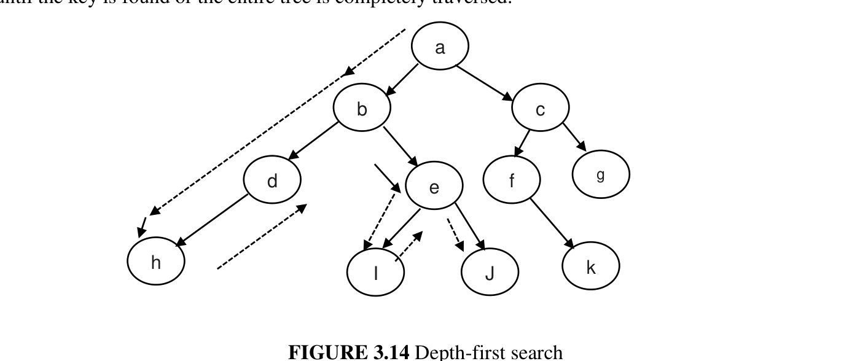
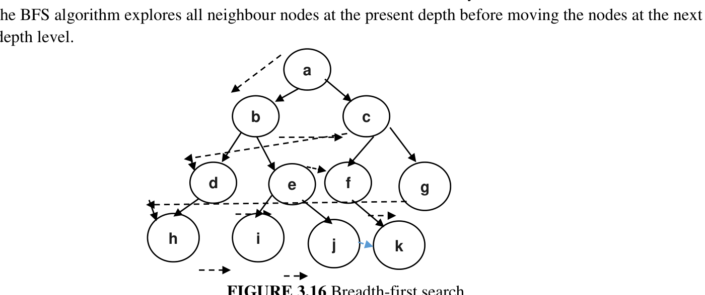
DFS vs BFS Traversal (visual)
Hour 5
Figure: DFS explores deepest node first (a,b,d,e,i,j...)
Figure: BFS explores level by level (a,b,c,d...)
VTU 1BAIA103/203 • Introduction to AI & Applications • Module 1
23

Slide 30
BFS Pseudocode & Applications
Hour 5
BFS(G, s):
Q = queue()
Q.enqueue(s); mark s visited
while Q is not empty:
v = Q.dequeue()
for each neighbour w of v:
if w not visited:
Q.enqueue(w); mark w visited
▪ Crawlers / search-engine indexing
▪ GPS navigation — nearest locations
▪ Shortest path in unweighted graphs
▪ Network broadcasting
▪ Peer-to-peer (BitTorrent) neighbour discovery
Worked example: BFS finds shallowest goal. For b=2, d=3, worst-case nodes = b+b²+b³ = 2+4+8 = 14 (plus root). DFS stores only the path O(bm); BFS stores the whole frontier O(b^d).
VTU 1BAIA103/203 • Introduction to AI & Applications • Module 1
24

Slide 31
Hour 5 — Recap & Practice
Review
▪ Write: BFS pseudocode and state DFS time/space complexity.
▪ Apply: BFS and DFS traversal on a given tree.
▪ Compare: completeness/optimality of DFS, DLS, BFS.
▪ Explain DFS with a diagram; give time & space complexity. (VTU, 10 marks)
▪ Explain BFS with an example, merits/demerits. (VTU, 10 marks)
▪ GATE: BFS uses a ___; DFS uses a ___. (queue; stack)
▪ GATE: which guarantees shortest path in unweighted graph? — BFS.
VTU 1BAIA103/203 • Introduction to AI & Applications • Module 1
25

Slide 32
HOUR 6
Uninformed Search — II
UCS · IDDFS · Bidirectional · Comparison

Slide 33
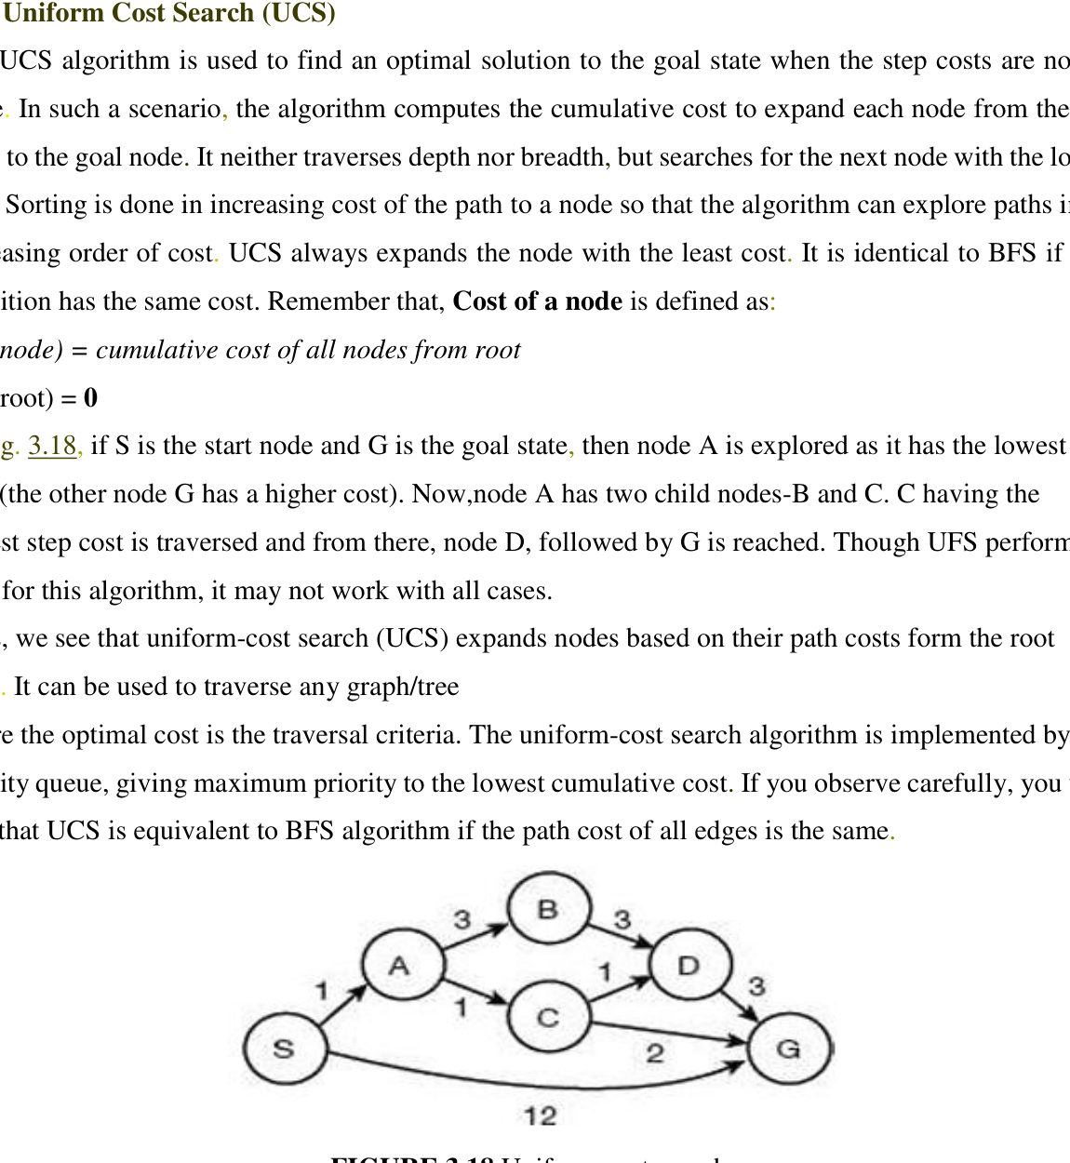
Uniform-Cost Search (UCS)
Hour 6
▪ Idea: expand lowest cumulative path-cost node (priority queue).
▪ Rule: cost(root)=0; cost(node)=sum of edge costs from root.
▪ Same as BFS when all edge costs are equal.
▪ Complete & optimal (no zero-cost loops / negative edges).
▪ Use: route planning with unequal distances.
Worked example: edges S-A(1), S-B(4), A-B(1), B-G(1), A-G(5). UCS expands S(0)→A(1)→B(2)→G(3). Path S→A→B→G, cost = 3.
VTU 1BAIA103/203 • Introduction to AI & Applications • Module 1
26

Slide 34
IDDFS & Bidirectional Search
Hour 6
Iterative Deepening DFS
Bidirectional Search
▪ Runs DFS with limits l=1,2,3,... until goal found.
▪ Combines BFS completeness/optimality with DFS memory efficiency.
▪ Complete when b is finite; optimal if cost non-decreases with depth.
▪ Time O(b^d); Space O(b·d).
▪ Ideal when search space is large and goal depth unknown.
▪ Repeats upper-level work (small overhead).
▪ Searches forward from start AND backward from goal.
▪ Stops when frontiers meet; each covers ~half the path.
▪ Time/space O(b^(d/2)) — far less than O(b^d).
▪ Complete/optimal with BFS + uniform costs.
▪ Needs a known goal and similar branching both ways.
▪ b=10,d=6: BFS ~10^6 nodes vs bidirectional ~2×10^3.
VTU 1BAIA103/203 • Introduction to AI & Applications • Module 1
27

Slide 35
Comparison of Uninformed Searches
Hour 6
Algorithm | Structure | Complete? | Optimal? | Time | Space
DFS | Stack | Finite only | No | O(b^m) | O(b·m)
DLS | Stack + limit | Within l only | No | O(b^l) | O(b·l)
BFS | Queue | Yes | If cost=1 | O(b^d) | O(b^d)
UCS | Priority queue | Yes* | Yes* | O(b^(1+⌊c*/ε⌋)) | O(b^(1+⌊c*/ε⌋))
IDDFS | Stack | Yes (finite b) | Non-decreasing cost | O(b^d) | O(b·d)
Bidirectional | Two queues | With BFS both ways | Uniform cost | O(b^(d/2)) | O(b^(d/2))
* complete with finite states & no zero-cost loops; optimal with no negative edges. ε = minimum step cost, c* = optimal cost.
VTU 1BAIA103/203 • Introduction to AI & Applications • Module 1
28

Slide 36
Hour 6 — Recap & Practice
Review
▪ Explain: UCS priority ordering with a cost example.
▪ Justify: when IDDFS and bidirectional search are preferred.
▪ Compare: all six uninformed searches (memorise the table).
▪ What is UCS? How does it differ from BFS? (VTU, 8 marks)
▪ Explain DLS and IDDFS with examples. (VTU, 10 marks)
▪ Explain bidirectional search; give time & space. (VTU, 8 marks)
▪ GATE numerical: b=10,d=6 — compare BFS O(10^6) vs bidirectional O(2×10^3).
VTU 1BAIA103/203 • Introduction to AI & Applications • Module 1
29

Slide 37
HOUR 7
Informed Search & Knowledge Representation
Heuristics · Greedy best-first · What is KR · Types of knowledge

Slide 38
Informed (Heuristic) Search
Hour 7
▪ Informed search uses extra knowledge (estimated distance/cost) to explore less and reach the goal faster.
▪ Heuristic h(n): estimates optimal cost from node n to a goal; always positive. Admissible if h(n) ≤ h*(n) (never overestimates).
Pure Heuristic Search
Greedy Best-First Search
▪ Expands nodes by h(n) (lowest first).
▪ Maintains OPEN (unexpanded) and CLOSED (expanded).
▪ Saves shorter paths; continues until goal.
▪ Always expands node with smallest h(n) (closest to goal).
▪ Priority queue; combines DFS + BFS.
▪ Can loop; NOT optimal; worst-case O(b^m).
▪ A* improves it by minimising f(n)=g(n)+h(n).
VTU 1BAIA103/203 • Introduction to AI & Applications • Module 1
30

Slide 39
Greedy Best-First — Worked Example
Hour 7
▪ OPEN/CLOSED trace: start from S; repeatedly move the lowest-h node from OPEN to CLOSED; expand; stop when a successor is the goal.
▪ Example: S→B (lowest h)→F→G. Path S→B→F→G.
Step | OPEN (nodes by h) | CLOSED
Start | [A, B] | [S]
1 (expand B) | [A] | [S, B]
2 (expand F) | [I, E, A] | [S, B, F]
3 (G found) | [I, E, A] | [S, B, F, G] → success
Limitation: greedy ignores cost-so-far g(n), so it may take a costly path or loop. A* uses f(n)=g(n)+h(n).
VTU 1BAIA103/203 • Introduction to AI & Applications • Module 1
31

Slide 40
Knowledge Representation (KR)
Hour 7
▪ KR & Reasoning (KRR): part of AI about how agents think and produce intelligent behaviour.
▪ Beyond a database: it lets the machine learn from knowledge/experience and reason to solve complex problems (diagnosis, NLP).
Perception
Learning
Knowledge Rep.
& Reasoning
Planning &
Execution
What knowledge must be represented?
▪ Objects, Events, Performance (how actions are done)
▪ Meta-knowledge (knowledge about knowledge), Facts, Knowledge base (technical sentences)
VTU 1BAIA103/203 • Introduction to AI & Applications • Module 1
32

Slide 41
Types of Knowledge & Logic
Hour 7
Type | Meaning
Meta | Knowledge about knowledge
Heuristic | Rule-of-thumb experience
Procedural | How to do something (rules, strategies)
Declarative | Facts/attributes of objects
Structural | Relationships: kind-of/part-of
Logic has 3 elements
▪ Syntax: valid sentence structure.
▪ Semantics: meaning; relates to the real world. 'Bike is riding Ram' is syntactically valid but semantically wrong.
▪ Inference: derive conclusions using algorithms.
KR requirements
▪ Representational accuracy • Inferential adequacy • Inferential efficiency • Acquisitional efficiency
VTU 1BAIA103/203 • Introduction to AI & Applications • Module 1
33

Slide 42
Hour 7 — Recap & Practice
Review
▪ Define: heuristic, admissibility (h ≤ h*), OPEN/CLOSED lists.
▪ Trace: greedy best-first on a given graph.
▪ List: five types of knowledge and the KR cycle.
▪ Explain greedy best-first search with an algorithm and example. (VTU, 10 marks)
▪ What is KR? Explain the KR cycle in AI with a diagram. (VTU, 10 marks)
▪ GATE: an admissible heuristic ____ the true cost. (never overestimates / ≤)
▪ Differentiate syntax, semantics and logical inference. (VTU, 8 marks)
VTU 1BAIA103/203 • Introduction to AI & Applications • Module 1
34

Slide 43
HOUR 8
Knowledge-Based Agents
KBA architecture · TELL/ASK/PERFORM · Levels · Types of knowledge

Slide 44
Knowledge-Based Agent (KBA)
Hour 8
▪ Knowledge base (KB): stores real-world facts as sentences in a KR language.
▪ Inference engine (IE): derives new knowledge; agent perceives → IE consults KB → decides; learning element updates KB.
Perceive
environment
Inference
Engine
⇅ Knowledge Base
(+ Learning)
Decide /
Act
Operations
▪ TELL: add knowledge / record chosen action to KB.
▪ ASK: query KB for which action to perform.
▪ PERFORM: execute the selected action.
VTU 1BAIA103/203 • Introduction to AI & Applications • Module 1
35

Slide 45
Generic KBA Program & Levels
Hour 8
Level | Description
Knowledge | What agent knows & its goals (fixes behaviour)
Logical | Knowledge encoded into logical sentences
Implementation | Physical execution of knowledge/logic
function KB-AGENT(percept):
persistent: KB, t = 0
TELL(KB, MAKE-PERCEPT-SENTENCE(percept, t))
action = ASK(KB, MAKE-ACTION-QUERY(t))
TELL(KB, MAKE-ACTION-SENTENCE(action, t))
t = t + 1
return action
▪ Design approaches: Declarative (TELL sentences into empty KB), Procedural (encode behaviour as code, e.g. LISP/Prolog), Hybrid (used in practice).
▪ Example (AC): knowledge = 'adjust per weather'; logical = when/how; implementation = actual thermostat change.
VTU 1BAIA103/203 • Introduction to AI & Applications • Module 1
36

Slide 46
Types of Knowledge in KR
Hour 8
Type | Representation | Inference? | Example
Simple relational | Relational tables | Very little | Student table (USN, name, marks)
Inheritable | IS-A class hierarchy | Inherits properties down the hierarchy | UG-Student IS-A Student; Zinya IS-A UG-Student
Inferential | Formal logic | Derives new facts | Student(Diya); ∀x Student(x)→Bright(x); ⊢ Bright(Diya)
Inheritable knowledge uses an IS-A hierarchy: generalised class → specialised class → instance; properties are inherited. Inferential knowledge uses formal logic to derive new facts accurately.
VTU 1BAIA103/203 • Introduction to AI & Applications • Module 1
37

Slide 47
Hour 8 — Recap & Practice
Review
▪ Explain: KBA architecture and the roles of KB and inference engine.
▪ Trace: the KB-AGENT function using TELL and ASK.
▪ Differentiate: relational, inheritable and inferential knowledge.
▪ Explain KBA architecture with a diagram. (VTU, 10 marks)
▪ What are TELL, ASK and PERFORM? Explain the generic KBA program. (VTU, 8 marks)
▪ Explain knowledge, logical and implementation levels with an example. (VTU, 8 marks)
▪ Explain relational, inheritable and inferential knowledge with examples. (VTU, 8 marks)
VTU 1BAIA103/203 • Introduction to AI & Applications • Module 1
38

Slide 48
Module 1 — Quick Revision
Summary
▪ Definitions: McCarthy, Turing, layman, researcher, NITI Aayog.
▪ AI types: weak/strong by capability; reactive → limited memory → theory of mind → self-aware by function.
▪ Relationship: AI ⊃ ML ⊃ Deep Learning; augmented/cognitive differ from true AI.
▪ Agents: Agent = Architecture + Program; PEAS; five agent types; eight environment dimensions.
▪ Uninformed search: DFS O(bm) space, BFS optimal at cost=1, UCS for unequal costs, IDDFS depth-unknown, bidirectional O(b^(d/2)).
▪ Informed search: heuristic h(n), admissibility h≤h*, greedy (not optimal), A* uses f=g+h.
▪ KR: cycle perception→learning→KRR→planning; five knowledge types; KBA = KB + IE with TELL/ASK/PERFORM.
▪ Knowledge types: simple relational, inheritable (IS-A), inferential (formal logic).
VTU 1BAIA103/203 • Introduction to AI & Applications • Module 1
39

Slide 49
How to Prepare for Internals & GATE
Strategy
Bloom L1–L6
GATE Focus
VTU End-Sem
▪ L1 Recall definitions/dates
▪ L2 Explain concepts
▪ L3 Apply to examples
▪ L4 Compare/analyse
▪ L5 Evaluate/judge
▪ L6 Design a system/PEAS
▪ Search complexity (BFS/DFS/UCS)
▪ Greedy/A* and admissibility
▪ PEAS & environment types
▪ BFS/DFS traversal orders
▪ Agent function/rationality
▪ ML vs traditional programming
▪ 20-mark: agent types, searches with diagrams
▪ 10-mark: AI types, ML/DL, environments
▪ 8-mark: definitions, PEAS, KBA
▪ Always label figures & tables
▪ Practise traversal numerics
VTU 1BAIA103/203 • Introduction to AI & Applications • Module 1
40

Slide 50
Thank You
Questions & Discussion
Module 1 — Introduction to AI and Applications (1BAIA103/203)
Based on notes by Dr. Lokesh M R | VTU Textbook Series

