Slide 1
LABORATORY COURSE · SEMESTER I / II
C PROGRAMMING LAB
Classroom presentation · 14 experiments in record format — algorithms & flowcharts, programs compiled and run, captured outputs, viva voices
COURSE CODE
1BPOPL107/207
1 credit · Teaching 0 : 0 : 2 : 0 / week · CIE 50 + SEE 50 = 100 · Exam 3 hours (practical)
by
Dr. Lokesh M R
Professor, Department of Information Science & Engineering · A J Institute of Engineering and Technology (AJIET), Mangaluru
Visvesvaraya Technological University (VTU), Belagavi · 2022/2025 Scheme · slides derived from the C-Programming-Lab course book — outputs captured with gcc 14.2

Slide 2
COURSE INFORMATION
The Course at a Glance
• One-credit laboratory course: every skill of the theory course is exercised at the bench — compile, run, and defend programs in record format.
• Teaching: 0 : 0 : 2 : 0 — two practical hours per week over the semester; each experiment ≈ one double session.
• Environment: GCC 14.2 on the lab Linux machines (math library via -lm); identical sources run in Code::Blocks / VS Code / online gdb on Windows.
• Everything shown here was actually compiled and run: the outputs are captured terminal sessions (pty echo — input lands right after its prompt), never retyped.
• Assessment: CIE 50 (record + internals through rubrics) + SEE 50 = 100.
COURSE OUTCOMES (VERBATIM)
CO1: Develop programs in C to solve simple computational problems. CO2: Make use of C language derived datatypes to solve simple real-world problems. CO3: Build a document consisting of experiment setup, design, implementation and results with inferences.
CO1–CO4 span files & storage → libraries → pointers & dynamic memory → structures & files.
C Programming Lab · 1BPOPL107/207 — classroom slides
1

Slide 3
HOW THE DECK FOLLOWS THE RECORD
One Experiment, Seven Faces
AIM & THEORY
the question verbatim + the idea that makes the code obvious
ALGORITHM
numbered steps a marker can trace without the code
FLOWCHART
the standard symbols — the one approved visual of the course
CODE
complete source, compiled with -Wall -Wextra
CAPTURED RUNS
terminal evidence: ordinary, boundary, guard
OBSERVATIONS
hand-checks of the printed values, table of tests
RESULT & VIVA
the record's closing sentence + the oral defence
• Every experiment chapter here = one record page.
• Slides 6–55 keep the seven faces on one or two screens each.
The book pairs each face with page references — use them as the assignment; these slides are the classroom walkthrough.
C Programming Lab · 1BPOPL107/207 — classroom slides
2

Slide 4
P A R T
A
Conventional Experiments — Items 1 to 8
IN THIS PART
• Item 1 — Straight-Line Distance Between Two Points — the Robot’s Measure
• Item 2 — Marks to Grade — Choosing the Right Control Structure
• Item 3 — KYC Verification — a Switch Statement Dispatching on ID Type
• Item 4 — Nature of the Roots of a Quadratic Equation — Three Worlds from One Discriminant
• Item 5 — Approximating sin(x) with a Series — Loops, Factorials and the Performance Story
• Item 6 — Keyword Search in a Course Description — the String Functions at Work
• Item 7 — Pass or Fail Through a Function — Modular Design with a Predicate
• Item 8 — Swapping Two Balances — Pointers Take the Function Seriously
Fixed set: every item specified by the university, each with algorithm, flowchart, complete program, captured compile-and-run evidence, observations table, result and viva trail.
3

Slide 5
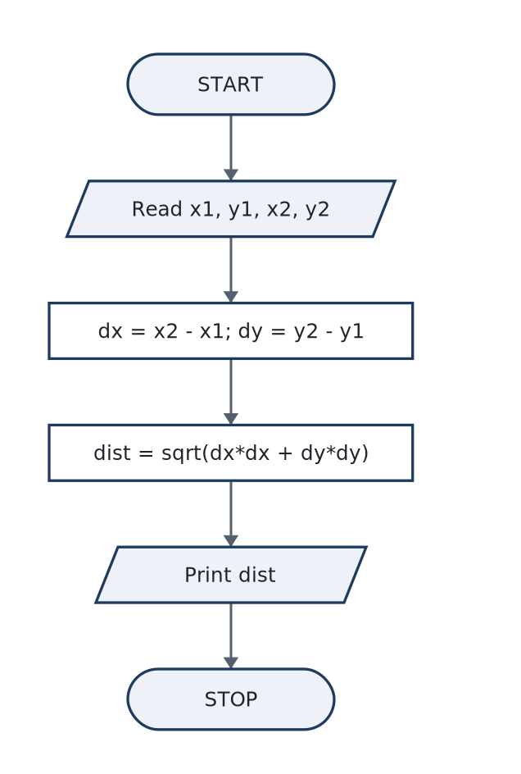
PART-A · ITEM 1
Part-A · Item 1 — Straight-Line Distance Between Two Points — the Robot’s Measure
AIM / TASK (VERBATIM FROM THE BOOK)
To develop, compile and run a C program that reads two points (x1, y1) and (x2, y2) on a 2D plane and displays the straight-line (Euclidean) distance between them, as a robot would need for a travel estimate.
Objective — Use float variables and the standard math library (sqrt(), pow()) to translate a mathematical formula into a C expression; verify the program’s output against a hand calc
THE IDEA THE THEORY ESTABLISHES
• The straight line between two points is the hypotenuse of a right triangle whose legs are the horizontal gap and the vertical gap between them — Pythagoras’ theorem:
• C has no exponent operator, so the formula must be expressed either with library calls or with repeated multiplication. The two spellings differ in cost and in precision behaviour:
• Three language mechanics matter while transcribing the formula:
ALGORITHM & FLOWCHART — figure from §1.2
ALGORITHM IN STEPS
• 1. START
• 2. Read the four real numbers x1, y1, x2, y2.
• 3. Compute dx = x2 − x1 and dy = y2 − y1.
• 4. Compute dist = sqrt(dx·dx + dy·dy).
• 5. Print dist with four decimal places.
• 6. STOP.
C Programming Lab · 1BPOPL107/207 — classroom slides
4
Notes:
Full explanation: course book, Experiment 1 §1.1 (Theory) and §1.2 (Algorithm & Flowchart). Objective: Use float variables and the standard math library (sqrt(), pow()) to translate a mathematical formula into a C expression; verify the program’s output against a hand calculation; record the algorithm,

Slide 6
PART-A · ITEM 1 · CODE & RUNS
Part-A · Item 1 — Source, Build & Captured Runs
a01_distance.c · complete source as compiled · 22 lines
Run 1 — an ordinary robot hop, from (2, 3) to (10, −5)
/* Experiment A1 -- straight-line distance between two points on a 2D plane
File : a01_distance.c
Build : gcc -Wall a01_distance.c -o a01_distance -lm */
#include <stdio.h>
#include <math.h>
int main(void)
{
float x1, y1, x2, y2, dist;
printf("Enter coordinates of point 1 (x1 y1): ");
scanf("%f %f", &x1, &y1);
printf("Enter coordinates of point 2 (x2 y2): ");
scanf("%f %f", &x2, &y2);
dist = sqrt(pow(x2 - x1, 2) + pow(y2 - y1, 2));
printf("Distance between (%.2f, %.2f) and (%.2f, %.2f) = %.4f units\n",
x1, y1, x2, y2, dist);
return 0;
}
Enter coordinates of point 1 (x1 y1): 2 3
Enter coordinates of point 2 (x2 y2): 10 -5
Distance between (2.00, 3.00) and (10.00, -5.00) = 11.3137 units
Run 2 — the classic 3-4-5 triangle from the origin
Run 3 — identical endpoints (a zero-length move)
Enter coordinates of point 1 (x1 y1): 0 0
Enter coordinates of point 2 (x2 y2): 3 4
Distance between (0.00, 0.00) and (3.00, 4.00) = 5.0000 units
Enter coordinates of point 1 (x1 y1): -4 -3
Enter coordinates of point 2 (x2 y2): -4 -3
Distance between (-4.00, -3.00) and (-4.00, -3.00) = 0.0000 units
C Programming Lab · 1BPOPL107/207 — classroom slides
5
Notes:
Compile at the bench with exactly this command (the book's §1.4 shows the same terminal). Runs captured in out/: a01_distance_r1.txt, a01_distance_r2.txt, a01_distance_r3.txt. Run interactively: prompts answered at the keyboard (b05 takes none — it auto-feeds values, as the book notes).

Slide 7
PART-A · ITEM 1 · DEFENCE
Part-A · Item 1 — Observations, Result & Viva
OBSERVATIONS & ANALYSIS
VIVA — AS ASKED AT THE INTERNAL
Hand-check of Run 1: dx = 10 − 2 = 8 and dy = −5 − 3 = −8, so d = √(8² + (−8)²) = √128 = 11.3137…, exactly what the program printed. Run 2 reproduces the 3-4-5 right triangle (√(9+16) = 5), and Run 3 shows the degenerate case a robot may actually meet — no motion, zero distance — handled with no special code at all. Inference. One formula plus one library call turns a navigation question into a program of fifteen lines. …
• Q1. What is the difference between a function declared in <math.h> and one in <stdio.h>, and why does only one need -lm?
• Q2. Why does scanf require &x1 but printf does not?
• Q3. What does the format specifier %.4f mean?
• Q4. If you swap the two input points, does the output change? Why or why not?
Test | (x1, y1) | (x2, y2) | Expected d | Program output | Match
1 | (2, 3) | (10, −5) | √128 = 11.3137 | 11.3137 units | ✓
2 | (0, 0) | (3, 4) | 5.0000 | 5.0000 units | ✓
3 | (−4, −3) | (−4, −3) | 0.0000 | 0.0000 units | ✓
RESULT. The C program to calculate the straight-line distance between two given coordinates on a 2D plane was developed, compiled without warnings (gcc -Wall -Wextra, zero diagnostics) and executed. …
C Programming Lab · 1BPOPL107/207 — classroom slides
6
Notes:
Viva answers for this experiment, all of them, are in the book §1.7 — the on-slide panel shows Q1–Q4 plus the first model answer.

Slide 8
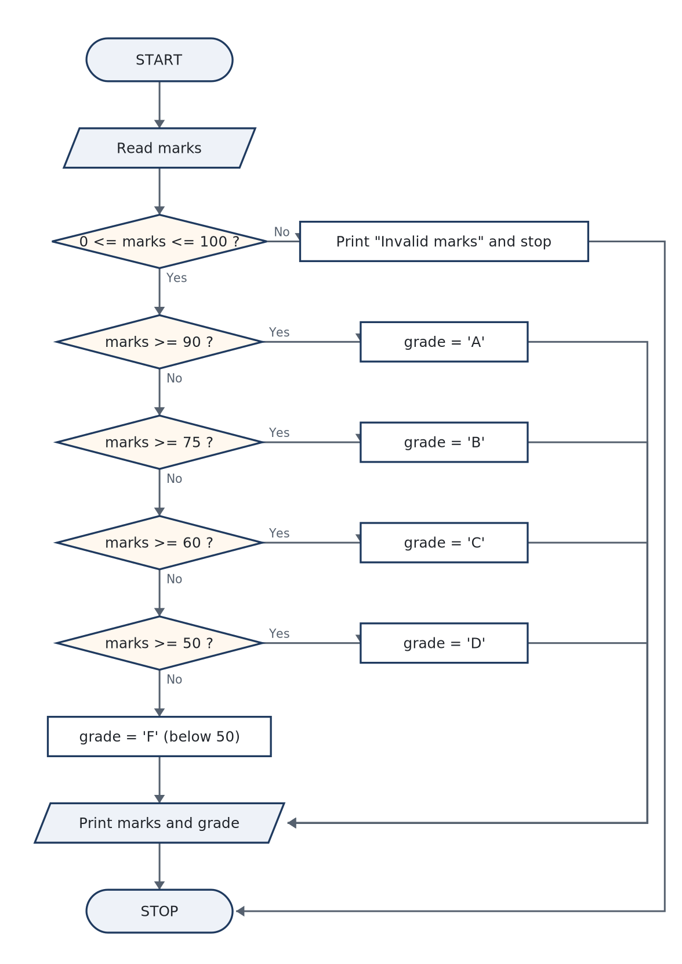
PART-A · ITEM 2
Part-A · Item 2 — Marks to Grade — Choosing the Right Control Structure
AIM / TASK (VERBATIM FROM THE BOOK)
To develop a C program that takes a student’s marks as input and displays the grade corresponding to the prescribed criteria (90 and above: A; 75–89: B; 60–74: C; 50–59: D; below 50: F), choosing a suitable control structure and justifying that choice in the record.
Objective — Construct a correct ordered if–else if–else ladder for a partitioned range; show that the ladder’s order is what makes each branch exclusive; test every boundary value of
THE IDEA THE THEORY ESTABLISHES
• Two control structures can express the rule: the if–else if ladder and the switch. The syllabus phrase “choose a suitable control structure” invites the comparison, so give it in the record:
• The key property of the ladder is that an else if is reached only when everything above it has failed. Testing marks >= 90 first and marks >= 75 second means the second branch silently means “75 to 89”, because anyone at 90 or above …
• Swap the first two rungs to if (marks >= 75) … else if (marks >= 90) … and the 90-and-above branch becomes dead code: a student with 95 satisfies the first test and silently receives Grade B. The program still compiles and still runs; …
ALGORITHM & FLOWCHART — figure from §2.2
ALGORITHM IN STEPS
• 1. START.
• 2. Read marks (a float).
• 3. If marks < 0 or marks > 100: print “Invalid marks” and STOP.
• 4. If marks ≥ 90 → grade = A; else if marks ≥ 75 → grade = B; else if marks ≥ 60 → grade = C; else if marks ≥ 50 → grade = D; else → grade = F.
• 5. Print the marks and the grade.
• 6. STOP.
C Programming Lab · 1BPOPL107/207 — classroom slides
7
Notes:
Full explanation: course book, Experiment 2 §2.1 (Theory) and §2.2 (Algorithm & Flowchart). Objective: Construct a correct ordered if–else if–else ladder for a partitioned range; show that the ladder’s order is what makes each branch exclusive; test every boundary value of the grading scale.

Slide 9
PART-A · ITEM 2 · CODE & RUNS
Part-A · Item 2 — Source, Build & Captured Runs
a02_grade.c · complete source as compiled · 28 lines
Run 1 — 95.5, comfortably in Grade A territory
Run 2 — 68, the middle of Grade C
/* Experiment A2 -- student marks to grade using a control structure
File : a02_grade.c
Build : gcc -Wall a02_grade.c -o a02_grade */
#include <stdio.h>
int main(void)
{
float marks;
char grade;
printf("Enter the student's marks (0-100): ");
scanf("%f", &marks);
if (marks < 0.0f || marks > 100.0f) { /* invalid entry first */
printf("Invalid marks. Please enter a value between 0 and 100.\n");
return 1;
}
if (marks >= 90.0f) grade = 'A'; /* 90 and above */
else if (marks >= 75.0f) grade = 'B'; /* 75 to 89 */
else if (marks >= 60.0f) grade = 'C'; /* 60 to 74 */
else if (marks >= 50.0f) grade = 'D'; /* 50 to 59 */
else grade = 'F'; /* below 50 */
printf("Marks = %.2f -> Grade = %c\n", marks, grade);
return 0;
}
Enter the student's marks (0-100): 95.5
Marks = 95.50 -> Grade = A
Enter the student's marks (0-100): 68
Marks = 68.00 -> Grade = C
Run 3 — 49, one mark below the D cut-off
Run 4 — 150, outside the accepted domain: the guard answers
Enter the student's marks (0-100): 49
Marks = 49.00 -> Grade = F
Enter the student's marks (0-100): 150
Invalid marks. Please enter a value between 0 and 100.
C Programming Lab · 1BPOPL107/207 — classroom slides
8
Notes:
Compile at the bench with exactly this command (the book's §2.4 shows the same terminal). Runs captured in out/: a02_grade_r1.txt, a02_grade_r2.txt, a02_grade_r3.txt, a02_grade_r4.txt. Run interactively: prompts answered at the keyboard (b05 takes none — it auto-feeds values, as the book notes).

Slide 10
PART-A · ITEM 2 · DEFENCE
Part-A · Item 2 — Observations, Result & Viva
OBSERVATIONS & ANALYSIS
VIVA — AS ASKED AT THE INTERNAL
Inference. The single-run transcripts above and the boundary sweep together demonstrate that the ladder partitions the whole 0–100 range with no gaps and no overlaps, and that the “90 and above” edge belongs to A, not B. The chosen structure was the if–else if ladder because the criteria are ranges over a real quantity — the switch’s constant-label matching would need the (int)marks/10 workaround and would still mishandle 89.5 without extra care.
• Q1. Why must the grade tests run from the largest cut-off downward? What breaks in the other order?
• Q2. Could a switch be used here? Explain the integer trick and why it still fails on real marks.
• Q3. What is the difference between else if and a separate if for each rule?
• Q4. How does the program classify 89.9? (Think before answering — the rule says 75 to 89 is B.)
Marks | Boundary being probed | Grade printed | Expected by rule | Match
100.0 | top of scale | A | A | ✓
95.5 | — | A | A | ✓
89.0 / 90.0 | A∣B cut (90 inclusive) | B / A | B / A | ✓
60.0 | B∣C cut | C | C | ✓
49.0 | last F before the pass floor | F | F | ✓
150 | invalid input | reject message | reject | ✓
RESULT. A C program mapping marks to grades A/B/C/D/F per the prescribed criteria was developed using an if–else if–else ladder preceded by a range guard. …
C Programming Lab · 1BPOPL107/207 — classroom slides
9
Notes:
Viva answers for this experiment, all of them, are in the book §2.7 — the on-slide panel shows Q1–Q4 plus the first model answer.

Slide 11
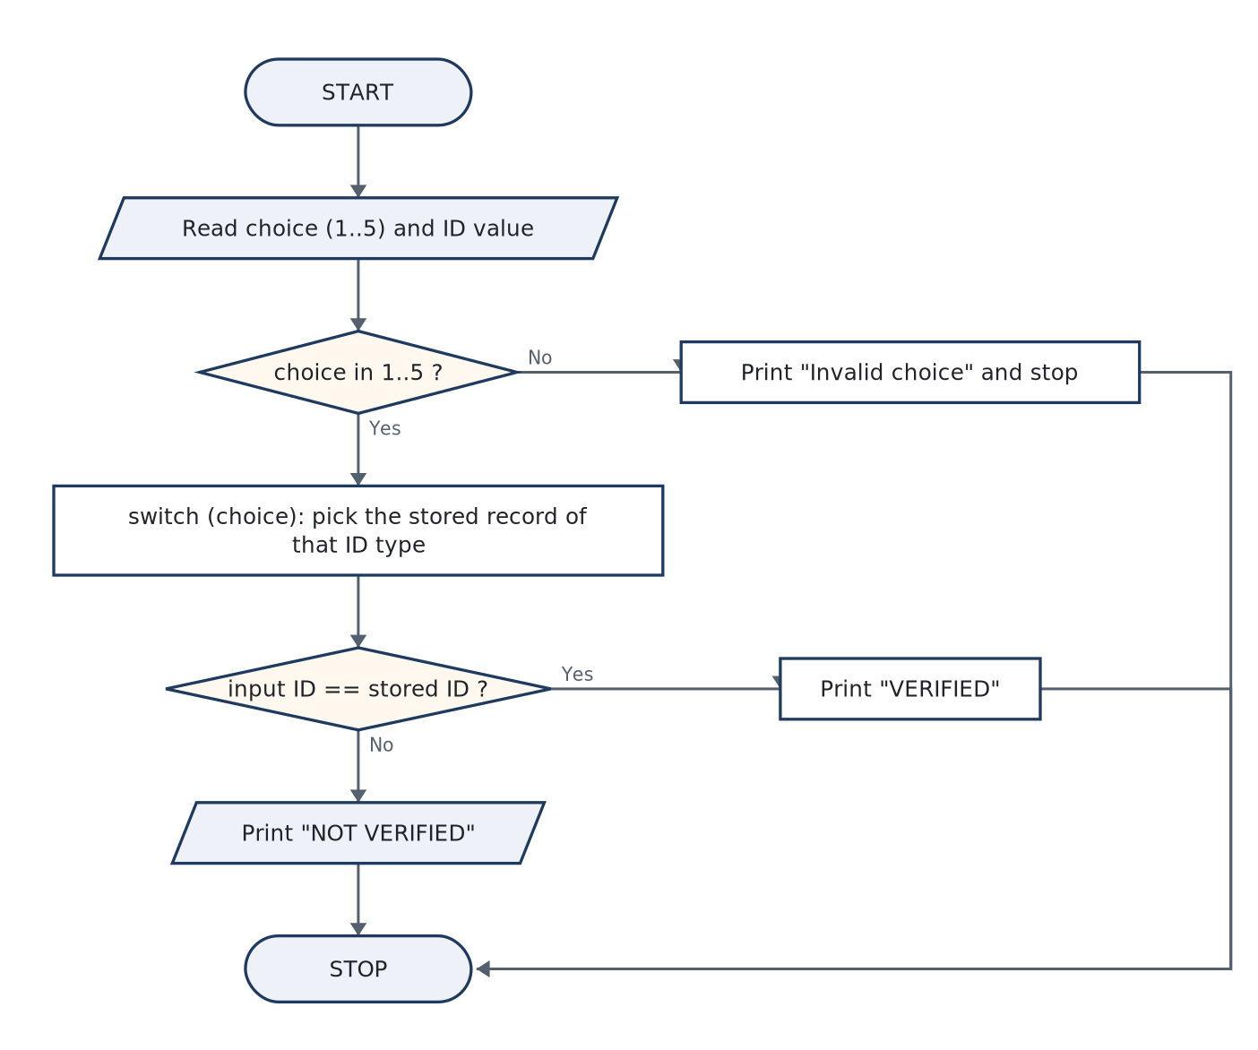
PART-A · ITEM 3
Part-A · Item 3 — KYC Verification — a Switch Statement Dispatching on ID Type
AIM / TASK (VERBATIM FROM THE BOOK)
To develop a C program that accepts a unique identification (AADHAR, APAAR, PAN, Driving License or Passport, entered as an integer) together with its type, checks it against a set of stored KYC records, and displays whether the individual is verified, using a switch to dispatch on the ID type.
Objective — Use switch–case with break to select one of several stored values; combine a selection statement with an equality test; distinguish long int storage for large identifiers
THE IDEA THE THEORY ESTABLISHES
• The matching problem has a shape: select one branch out of a small set of constant integer labels. C’s switch is built for that shape:
• The program’s two-step logic is: switch on the type, then compare the number. Each case body performs the same shape of test against a different stored record and sets a verified flag; one printf at the end converts the flag into the …
• Aadhaar-like 12-digit values exceed 2 × 10⁹? No — 10¹² does exceed int on any machine, so the identifiers are held in long int and scanned with %ld. Mismatched conversion specifiers (%d on a long) are undefined behaviour: the typical …
ALGORITHM & FLOWCHART — figure from §3.2
ALGORITHM IN STEPS
• 1. START.
• 2. Display the menu of five KYC ID types; read choice (1–5).
• 3. Read the identifier input_id as a long integer.
• 4. If choice is not in 1..5: print “Invalid choice” and STOP.
• 5. Enter switch (choice): case 1 compares input_id with the stored Aadhaar, case 2 the APAAR, case 3 the PAN, case 4 the licence, case 5 the passport; ea
• 6. If verified print “VERIFIED against the KYC records”, else print “NOT VERIFIED. No matching KYC record.”
• 7. STOP.
C Programming Lab · 1BPOPL107/207 — classroom slides
10
Notes:
Full explanation: course book, Experiment 3 §3.1 (Theory) and §3.2 (Algorithm & Flowchart). Objective: Use switch–case with break to select one of several stored values; combine a selection statement with an equality test; distinguish long int storage for large identifiers from the 16-bit assumption st

Slide 12
PART-A · ITEM 3 · CODE & RUNS
Part-A · Item 3 — Source, Build & Captured Runs
a03_kyc.c · complete source as compiled · 48 lines
Run 1 — the registered Aadhaar number: a verified hit
/* Experiment A3 -- KYC verification against stored records using switch
File : a03_kyc.c
Build : gcc -Wall a03_kyc.c -o a03_kyc */
#include <stdio.h>
int main(void)
{
long int aadhar = 123456789012L; /* stored KYC records */
long int apaar = 550123456789L;
long int pan = 450098765L;
long int licence = 770011223L;
long int passport= 980055443L;
int choice;
long int input_id;
int verified = 0; /* assume not verified */
printf("--- KYC VERIFICATION DESK ---\n");
printf("1. AADHAR Number\n");
printf("2. APAAR ID\n");
printf("3. PAN Number\n");
printf("4. Driving License\n");
printf("5. Passport Number\n");
printf("Select the ID type to verify: ");
scanf("%d", &choice);
printf("Enter the %s value: ",
choice == 1 ? "AADHAR" : choice == 2 ? "APAAR" :
choice == 3 ? "PAN" : choice == 4 ? "Licence" : "Passport");
scanf("%ld", &input_id);
switch (choice) { /* one jump table, five cases */
case 1: verified = (input_id == aadhar); break;
case 2: verified = (input_id == apaar); break;
case 3: verified = (input_id == pan); break;
case 4: verified = (input_id == licence); break;
case 5: verified = (input_id == passport); break;
default:
printf("Invalid choice: no such ID type in this system.\n");
return 1;
}
printf("ID %ld ", input_id);
printf("is %s\n", verified ? "VERIFIED against the KYC records."
: "NOT VERIFIED. No matching KYC record.");
return 0;
}
--- KYC VERIFICATION DESK ---
1. AADHAR Number
2. APAAR ID
3. PAN Number
4. Driving License
5. Passport Number
Select the ID type to verify: 1
Enter the AADHAR value: 123456789012
ID 123456789012 is VERIFIED against the KYC records.
Run 2 — a PAN that is off by a digit: rejected
Run 3 — the stored APAAR ID: verified through a different case
--- KYC VERIFICATION DESK ---
1. AADHAR Number
2. APAAR ID
3. PAN Number
4. Driving License
5. Passport Number
Select the ID type to verify: 3
Enter the PAN value: 450099999
ID 450099999 is NOT VERIFIED. No matching KYC record.
--- KYC VERIFICATION DESK ---
1. AADHAR Number
2. APAAR ID
3. PAN Number
4. Driving License
5. Passport Number
Select the ID type to verify: 2
Enter the APAAR value: 550123456789
ID 550123456789 is VERIFIED against the KYC records.
C Programming Lab · 1BPOPL107/207 — classroom slides
11
Notes:
Compile at the bench with exactly this command (the book's §3.4 shows the same terminal). Runs captured in out/: a03_kyc_r1.txt, a03_kyc_r2.txt, a03_kyc_r3.txt. Run interactively: prompts answered at the keyboard (b05 takes none — it auto-feeds values, as the book notes).

Slide 13
PART-A · ITEM 3 · DEFENCE
Part-A · Item 3 — Observations, Result & Viva
OBSERVATIONS & ANALYSIS
VIVA — AS ASKED AT THE INTERNAL
Runs 1 and 3 pass through different cases of the same switch, proving the dispatch selects the right drawer each time: choice 1 consults only the Aadhaar record, choice 2 only the APAAR. Run 2 proves the comparison is numeric, not a format check — the wrong PAN is well-formed but unknown, and the record it is compared against is the PAN store, not the Aadhaar store. A useful counter-test for the record: entering Aadhaar number under menu choice 3 (PAN) must fail verification, demonstrating that number and type are checked as a pair. …
• Q1. Why can switch not switch on a float — what does the standard forbid?
• Q2. What happens if you forget a break in case 2? Trace the output precisely.
• Q3. Why is default considered good practice even when the menu “cannot” be mistyped?
• Q4. Why are the identifiers stored in long int and printed with %ld?
RESULT. A C program for KYC verification was developed in which a switch statement dispatches a menu-selected ID type (AADHAR, APAAR, PAN, Driving License, Passport — all held as integers) onto the matching stored record and an equality test sets the outcome. …
C Programming Lab · 1BPOPL107/207 — classroom slides
12
Notes:
Viva answers for this experiment, all of them, are in the book §3.7 — the on-slide panel shows Q1–Q4 plus the first model answer.

Slide 14
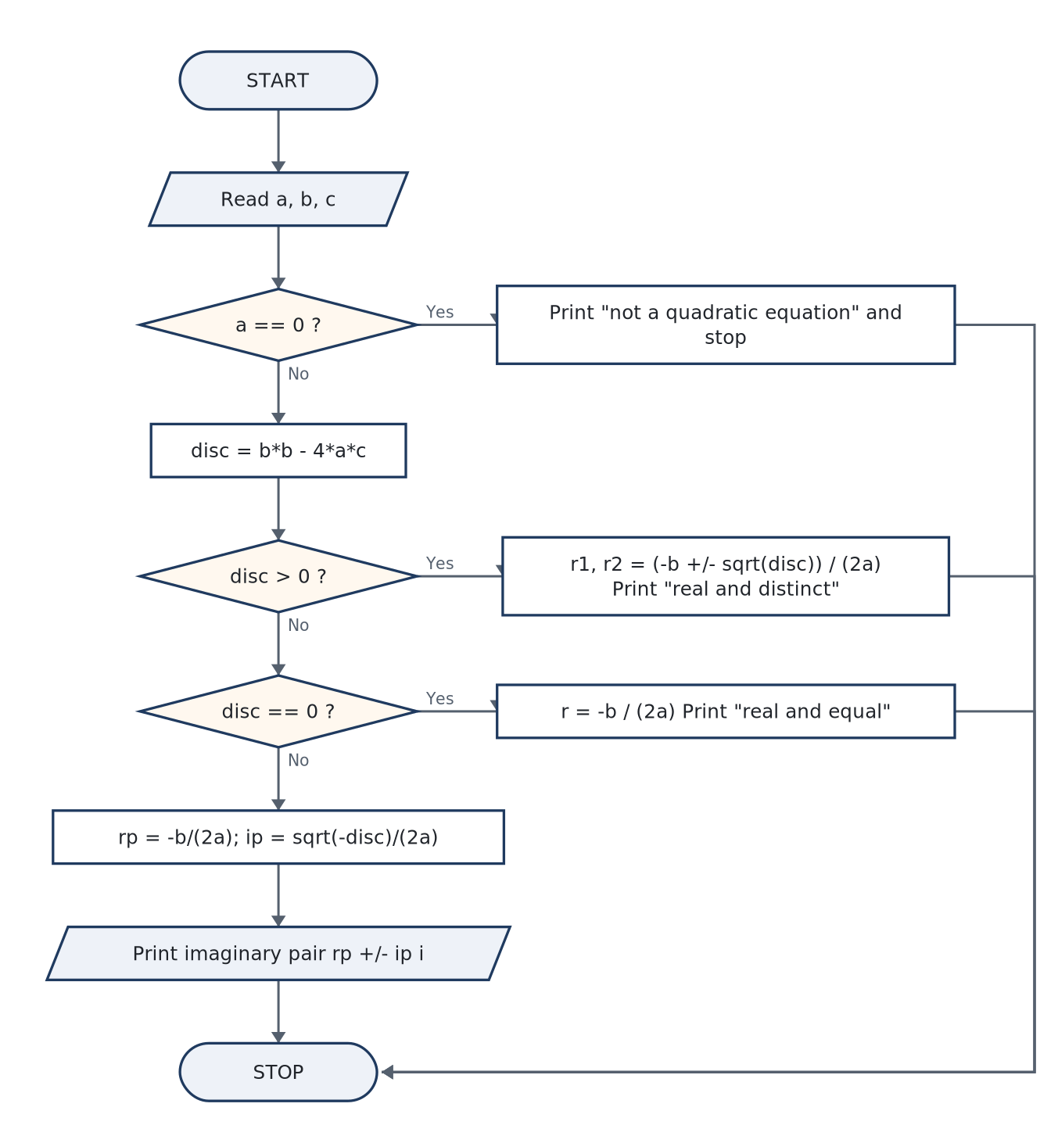
PART-A · ITEM 4
Part-A · Item 4 — Nature of the Roots of a Quadratic Equation — Three Worlds from One Discriminant
AIM / TASK (VERBATIM FROM THE BOOK)
To develop a C program that reads the coefficients a, b, c of ax² + bx + c = 0, computes the discriminant, determines the nature of the roots (real and distinct, real and equal, or complex conjugates) and displays the roots themselves in the correct form for each case.
Objective — Implement a piecewise mathematical definition with nested if–else if–else decisions; use sqrt() only where its argument is guaranteed non-negative; handle the degenerate
THE IDEA THE THEORY ESTABLISHES
• For ax² + bx + c = 0 (a ≠ 0), the quadratic formula and the discriminant D = b² − 4ac:
• The structure is a decision tree of exactly three leaves, so the program is a cascade of tests over D. Two details carry most of the marks:
• The branch test disc == 0.0f catches inputs that exactly produce zero (b² = 4ac in binary floating-point is rare but happens for small integers such as the run below: 1, −6, 9). A production math app tests fabs(disc) eps instead. …
ALGORITHM & FLOWCHART — figure from §4.2
ALGORITHM IN STEPS
• 1. START.
• 2. Read a, b, c.
• 3. If a = 0: print “not a quadratic equation” and STOP.
• 4. Compute disc = b·b − 4·a·c and print it.
• 5. If disc > 0: compute r1, r2 = (−b ± √disc)/(2a); print “real and distinct” with both values.
• 6. Else if disc = 0: compute r = −b/(2a); print “real and equal”.
• 7. Else: compute real part rp = −b/(2a) and imaginary part ip = √(−disc)/(2a); print the pair rp ± ip·i.
• 8. STOP.
C Programming Lab · 1BPOPL107/207 — classroom slides
13
Notes:
Full explanation: course book, Experiment 4 §4.1 (Theory) and §4.2 (Algorithm & Flowchart). Objective: Implement a piecewise mathematical definition with nested if–else if–else decisions; use sqrt() only where its argument is guaranteed non-negative; handle the degenerate a = 0 input as a defined error

Slide 15
PART-A · ITEM 4 · CODE & RUNS
Part-A · Item 4 — Source, Build & Captured Runs
a04_quadratic.c · complete source as compiled · 38 lines
Run 1 — x² − 5x + 6 = 0: the textbook (x−2)(x−3) factorisation
/* Experiment A4 -- nature of roots and the roots of a quadratic equation
File : a04_quadratic.c
Build : gcc -Wall a04_quadratic.c -o a04_quadratic -lm */
#include <stdio.h>
#include <math.h>
int main(void)
{
float a, b, c, disc, r1, r2, rp, ip;
printf("Enter coefficients a, b, c of ax^2 + bx + c = 0: ");
scanf("%f %f %f", &a, &b, &c);
if (a == 0.0f) {
printf("Coefficient a is zero: this is not a quadratic equation.\n");
return 1;
}
disc = b * b - 4.0f * a * c;
printf("Discriminant = %.4f\n", disc);
if (disc > 0.0f) { /* two real, unequal */
r1 = (-b + sqrt(disc)) / (2.0f * a);
r2 = (-b - sqrt(disc)) / (2.0f * a);
printf("Roots are real and distinct: r1 = %.4f, r2 = %.4f\n", r1, r2);
} else if (disc == 0.0f) { /* two real, equal */
r1 = -b / (2.0f * a);
printf("Roots are real and equal: r1 = r2 = %.4f\n", r1);
} else { /* complex pair */
rp = -b / (2.0f * a);
ip = sqrt(-disc) / (2.0f * a);
printf("Roots are imaginary: %.4f + %.4fi and %.4f - %.4fi\n",
rp, ip, rp, ip);
}
return 0;
}
Enter coefficients a, b, c of ax^2 + bx + c = 0: 1 -5 6
Discriminant = 1.0000
Roots are real and distinct: r1 = 3.0000, r2 = 2.0000
Run 2 — x² − 6x + 9 = 0: a perfect square, one repeated root
Run 3 — x² + 2x + 5 = 0: a negative discriminant, complex conjugates
Enter coefficients a, b, c of ax^2 + bx + c = 0: 1 -6 9
Discriminant = 0.0000
Roots are real and equal: r1 = r2 = 3.0000
Enter coefficients a, b, c of ax^2 + bx + c = 0: 1 2 5
Discriminant = -16.0000
Roots are imaginary: -1.0000 + 2.0000i and -1.0000 - 2.0000i
C Programming Lab · 1BPOPL107/207 — classroom slides
14
Notes:
Compile at the bench with exactly this command (the book's §4.4 shows the same terminal). Runs captured in out/: a04_quadratic_r1.txt, a04_quadratic_r2.txt, a04_quadratic_r3.txt. Run interactively: prompts answered at the keyboard (b05 takes none — it auto-feeds values, as the book notes).

Slide 16
PART-A · ITEM 4 · DEFENCE
Part-A · Item 4 — Observations, Result & Viva
OBSERVATIONS & ANALYSIS
VIVA — AS ASKED AT THE INTERNAL
Every one of the three decision leaves is reached by exactly one run, and each printed value survives substitution back into the equation — the discriminant line printed first even lets the reader see why the branch was chosen. The complex row deserves a note in the record: the program does not invent a “complex number type”; it prints two real numbers under a ± sign, which is a piece of small but genuine design. Inference. …
• Q1. Why is disc == 0.0f risky in general and yet fine for the test data used here?
• Q2. What does C compute for 1.0f/0.0f, and why does the program therefore check a first?
• Q3. If D < 0, why is the imaginary part √(−D)/(2a) and not √D/(2a)?
• Q4. One of the roots of x² − 5x + 6 prints as 3.0000, the other 2.0000. Which sign of the ± gives which?
a, b, c | D = b²−4ac | Program verdict | Hand check | Match
1, −5, 6 | 25−24 = 1 > 0 | 3.0 and 2.0, real & distinct | (5±1)/2 → 3, 2 ✓ | ✓
1, −6, 9 | 36−36 = 0 | 3.0 doubled, real & equal | (x−3)² ✓ | ✓
1, 2, 5 | 4−20 = −16 | −1 ± 2i | (−1+2i)² + 2(−1+2i) + 5 = 0 ✓ | ✓
RESULT. A C program was developed that classifies and solves a quadratic equation from its three coefficients. …
C Programming Lab · 1BPOPL107/207 — classroom slides
15
Notes:
Viva answers for this experiment, all of them, are in the book §4.7 — the on-slide panel shows Q1–Q4 plus the first model answer.

Slide 17
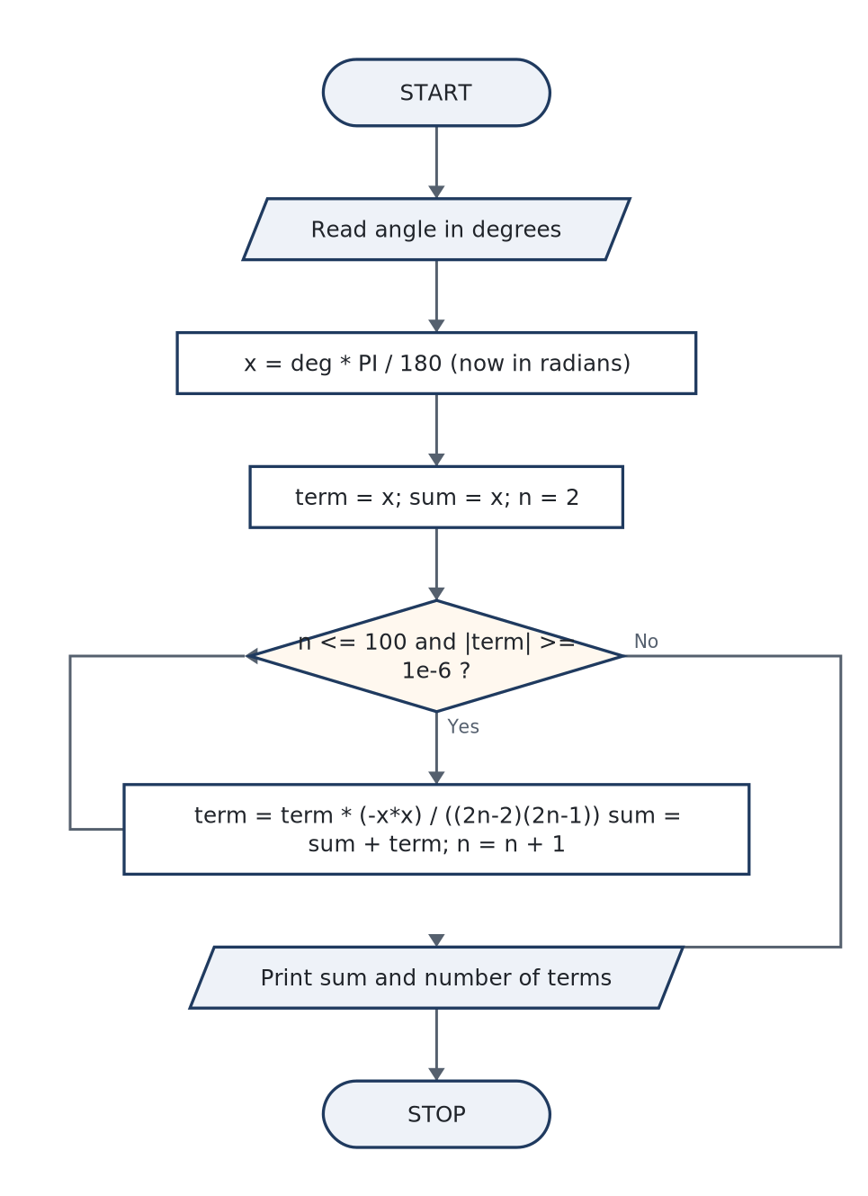
PART-A · ITEM 5
Part-A · Item 5 — Approximating sin(x) with a Series — Loops, Factorials and the Performance Story
AIM / TASK (VERBATIM FROM THE BOOK)
To develop a C program that approximates sin(x) for a user-supplied angle using the Taylor series expansion x − x³/3! + x⁵/5! − x⁷/7! + …, iterating until successive terms fall below a stated tolerance, and to compare the approximation with the standard library value.
Objective — Use a while loop with a numeric convergence test; derive and apply the term-to-term recurrence that replaces factorial evaluation; work in radians and manage the degree–r
THE IDEA THE THEORY ESTABLISHES
• The Maclaurin series for the sine is the engine of the program — it converges for every real x:
• The naïve term-by-term transcription computes a power and a factorial per term: xⁿ grows to enormous intermediates, n! overflows int past 12!, and both costs are paid again every loop. The record’s “improved performance” phrase asks …
• because dividing x²ᵏ⁺¹/(2k+1)! by x²ᵏ⁻¹/(2k−1)! cancels all but one copy of x² and the two new factorial factors. The program therefore keeps one running value and multiplies it by a small rational each round: no pow(), no factorial …
ALGORITHM & FLOWCHART — figure from §5.2
ALGORITHM IN STEPS
• 1. START.
• 2. Read the angle in degrees; convert x = deg · π/180.
• 3. Initialise term = x, sum = x, count = 1, n = 2.
• 4. While n ≤ 100 and |term| ≥ 10⁻⁶:
• 5. a. term ← term · (−x·x) / ((2n−2)(2n−1)); sum ← sum + term; count++; n++.
• 6. Print sum with six decimals, the term count, the library sin(x), and |sum − sin|.
• 7. STOP.
C Programming Lab · 1BPOPL107/207 — classroom slides
16
Notes:
Full explanation: course book, Experiment 5 §5.1 (Theory) and §5.2 (Algorithm & Flowchart). Objective: Use a while loop with a numeric convergence test; derive and apply the term-to-term recurrence that replaces factorial evaluation; work in radians and manage the degree–radian conversion; quantify acc

Slide 18
PART-A · ITEM 5 · CODE & RUNS
Part-A · Item 5 — Source, Build & Captured Runs
a05_sin_series.c · complete source as compiled · 39 lines
Run 1 — 30°, a value the reader knows by heart: sin 30° = 0.5
/* Experiment A5 -- approximation of sin(x) by series expansion
File : a05_sin_series.c
Build : gcc -Wall a05_sin_series.c -o a05_sin_series -lm
Series : sin x = x - x^3/3! + x^5/5! - x^7/7! + ... (x in radians) */
#include <stdio.h>
#include <math.h>
#define PI 3.14159265358979f
int main(void)
{
float deg, x, term, sum;
int n, count;
printf("Enter the angle in degrees: ");
scanf("%f", &deg);
x = deg * PI / 180.0f; /* radians: the series needs them */
term = x; /* first term: x */
sum = x;
count = 1;
n = 2;
/* keep adding terms while they are still big enough to matter.
No factorial is ever computed: each term reuses the previous one. */
while (n <= 100 && fabs(term) >= 1e-6f) {
term *= (-x * x) / ((2.0f * n - 2.0f) * (2.0f * n - 1.0f));
sum += term;
count++;
n++;
}
printf("Approximated sin(%.2f) = %.6f (%d terms)\n", deg, sum, count);
printf("Library sin(%.2f) = %.6f\n", deg, sin((double)x));
printf("Absolute error = %.8f\n", fabs(sum - sin((double)x)));
return 0;
}
Enter the angle in degrees: 30
Approximated sin(30.00) = 0.500000 (5 terms)
Library sin(30.00) = 0.500000
Absolute error = 0.00000001
Run 2 — 90°, the peak of the curve, where the alternating series must turn around
Run 3 — 45°, an irrational-looking target to stress the tolerance
Enter the angle in degrees: 90
Approximated sin(90.00) = 1.000000 (7 terms)
Library sin(90.00) = 1.000000
Absolute error = 0.00000006
Enter the angle in degrees: 45
Approximated sin(45.00) = 0.707107 (5 terms)
Library sin(45.00) = 0.707107
Absolute error = 0.00000003
C Programming Lab · 1BPOPL107/207 — classroom slides
17
Notes:
Compile at the bench with exactly this command (the book's §5.4 shows the same terminal). Runs captured in out/: a05_sin_series_r1.txt, a05_sin_series_r2.txt, a05_sin_series_r3.txt. Run interactively: prompts answered at the keyboard (b05 takes none — it auto-feeds values, as the book notes).

Slide 19
PART-A · ITEM 5 · DEFENCE
Part-A · Item 5 — Observations, Result & Viva
OBSERVATIONS & ANALYSIS
VIVA — AS ASKED AT THE INTERNAL
All three runs agree with the library to the printed six decimals; the absolute error line puts numbers on it (10⁻⁸ at 30°, 10⁻⁸ at 45°, and — most informatively — 6×10⁻⁸ at 90°, the worst of the three because the terms there peak before decaying). The term counts 5, 7 and 5 tell the real story of a Taylor series: convergence is fast near zero and slows as |x| grows — the reason good implementations first fold the angle into [−π/2, π/2] using the periodicity of sine. Performance note for the record. …
• Q1. Why must x be in radians for the series to be the sine — what breaks if degrees are fed in?
• Q2. Derive the update formula term = term·(−x²)/((2n−2)(2n−1)) in one breath.
• Q3. Why does the loop test |term| rather than “is the sum accurate enough”?
• Q4. What would the tolerance 1e-6f buy if the output were printed with ten decimals?
RESULT. A C program approximating sin(x) by its Maclaurin series was developed with a recurrence-based term update (no factorial or power recomputation) and a tolerance-driven while loop. …
C Programming Lab · 1BPOPL107/207 — classroom slides
18
Notes:
Viva answers for this experiment, all of them, are in the book §5.7 — the on-slide panel shows Q1–Q4 plus the first model answer.

Slide 20
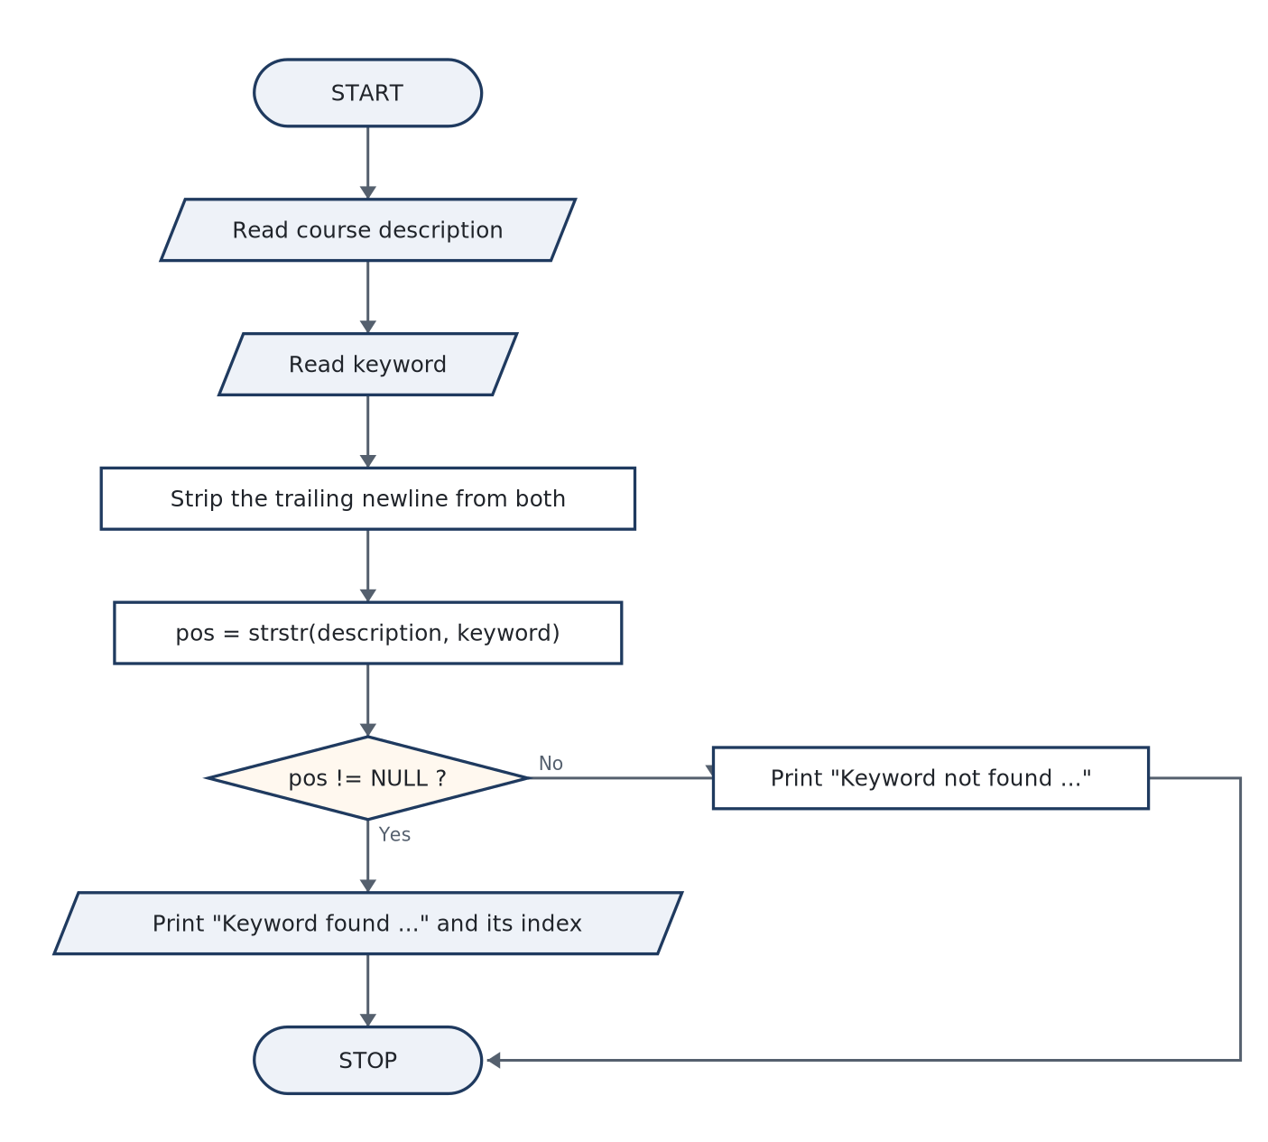
PART-A · ITEM 6
Part-A · Item 6 — Keyword Search in a Course Description — the String Functions at Work
AIM / TASK (VERBATIM FROM THE BOOK)
To develop a C program that accepts a course description string and a keyword, searches whether the keyword occurs within the description using appropriate string functions, and displays the prescribed “Keyword ‘…’ found/not found in the course description.” message.
Objective — Read lines of text safely with fgets; understand the trailing newline it stores and strip it; use strstr() as a pointer-valued search (found ⇒ non-NULL) and derive the ma
THE IDEA THE THEORY ESTABLISHES
• A C string is a char array terminated by the null byte '\0'. That one convention decides every behaviour the experiment exercises:
• The position line is a small pointer-algebra trick worth recording: pos − desc is the index of the match because subtracting two pointers into the same array yields the element distance between them.
• The standard function performs a literal, byte-wise substring match — case sensitive (“C” ≠ “c”), matching fragments of words (the keyword “our” is found inside “course”), and reporting only the first occurrence. Word-boundary or …
ALGORITHM & FLOWCHART — figure from §6.2
ALGORITHM IN STEPS
• 1. START.
• 2. Read the course description with fgets; strip its trailing newline with the strcspn idiom.
• 3. Read the keyword the same way.
• 4. If the keyword is empty: print an error and STOP.
• 5. pos = strstr(description, keyword).
• 6. If pos ≠ NULL: print “Keyword "kw" found …” and the index pos − desc; otherwise print the not-found sentence.
• 7. STOP.
C Programming Lab · 1BPOPL107/207 — classroom slides
19
Notes:
Full explanation: course book, Experiment 6 §6.1 (Theory) and §6.2 (Algorithm & Flowchart). Objective: Read lines of text safely with fgets; understand the trailing newline it stores and strip it; use strstr() as a pointer-valued search (found ⇒ non-NULL) and derive the match position from pointer subt

Slide 21
PART-A · ITEM 6 · CODE & RUNS
Part-A · Item 6 — Source, Build & Captured Runs
a06_keyword_search.c · complete source as compiled · 37 lines
Run 1 — the keyword sits mid-sentence: found, with its index
/* Experiment A6 -- keyword search in a course description with string functions
File : a06_keyword_search.c
Build : gcc -Wall a06_keyword_search.c -o a06_keyword_search */
#include <stdio.h>
#include <string.h>
int main(void)
{
char desc[256], keyword[64];
char *pos;
printf("Enter the course description: ");
fgets(desc, sizeof(desc), stdin);
desc[strcspn(desc, "\n")] = '\0'; /* strip trailing newline */
printf("Enter the keyword to search: ");
fgets(keyword, sizeof(keyword), stdin);
keyword[strcspn(keyword, "\n")] = '\0';
if (keyword[0] == '\0') { /* empty keyword guard */
printf("Keyword cannot be empty.\n");
return 1;
}
pos = strstr(desc, keyword); /* first occurrence or NULL */
if (pos != NULL) {
printf("Keyword \"%s\" found in the course description.\n", keyword);
printf("First occurrence starts at index %d of %d characters.\n",
(int)(pos - desc), (int)strlen(desc));
} else {
printf("Keyword \"%s\" not found in the course description.\n",
keyword);
}
return 0;
}
Enter the course description: This course introduces programming in C using a structured approach
Enter the keyword to search: programming
Keyword "programming" found in the course description.
First occurrence starts at index 23 of 67 characters.
Run 2 — an absent keyword: the exact not-found sentence
Enter the course description: Learn C fundamentals: operators arrays functions pointers
Enter the keyword to search: java
Keyword "java" not found in the course description.
C Programming Lab · 1BPOPL107/207 — classroom slides
20
Notes:
Compile at the bench with exactly this command (the book's §6.4 shows the same terminal). Runs captured in out/: a06_keyword_search_r1.txt, a06_keyword_search_r2.txt. Run interactively: prompts answered at the keyboard (b05 takes none — it auto-feeds values, as the book notes).

Slide 22
PART-A · ITEM 6 · DEFENCE
Part-A · Item 6 — Observations, Result & Viva
OBSERVATIONS & ANALYSIS
VIVA — AS ASKED AT THE INTERNAL
Run 1 prints index 23, and the reader can verify: the description begins “This course introduces ” — 23 characters — and “programming” indeed starts there. The character count (67) after trimming matches the typed sentence, proving the newline was removed before measurement. Run 2 shows the second sentence is identical in shape to the first except for the verb, which is the point of the prescribed wording: one code path differs only by the branch. …
• Q1. Why does fgets keep the trailing newline while a keyword read with scanf("%s") does not?
• Q2. What type does strstr return, and why is comparing it to NULL the correct test rather than comparing to 0?
• Q3. Explain how pos − desc can be an index — what must be true for pointer subtraction to be legal?
• Q4. Why is strlen called on the trimmed string and not the raw fgets buffer, and what would differ?
RESULT. A C program was developed that reads a course description and a keyword, strips the stored newlines, and answers containment with strstr(), printing the prescribed found / not found sentences plus the first-match index and string length. …
C Programming Lab · 1BPOPL107/207 — classroom slides
21
Notes:
Viva answers for this experiment, all of them, are in the book §6.7 — the on-slide panel shows Q1–Q4 plus the first model answer.

Slide 23
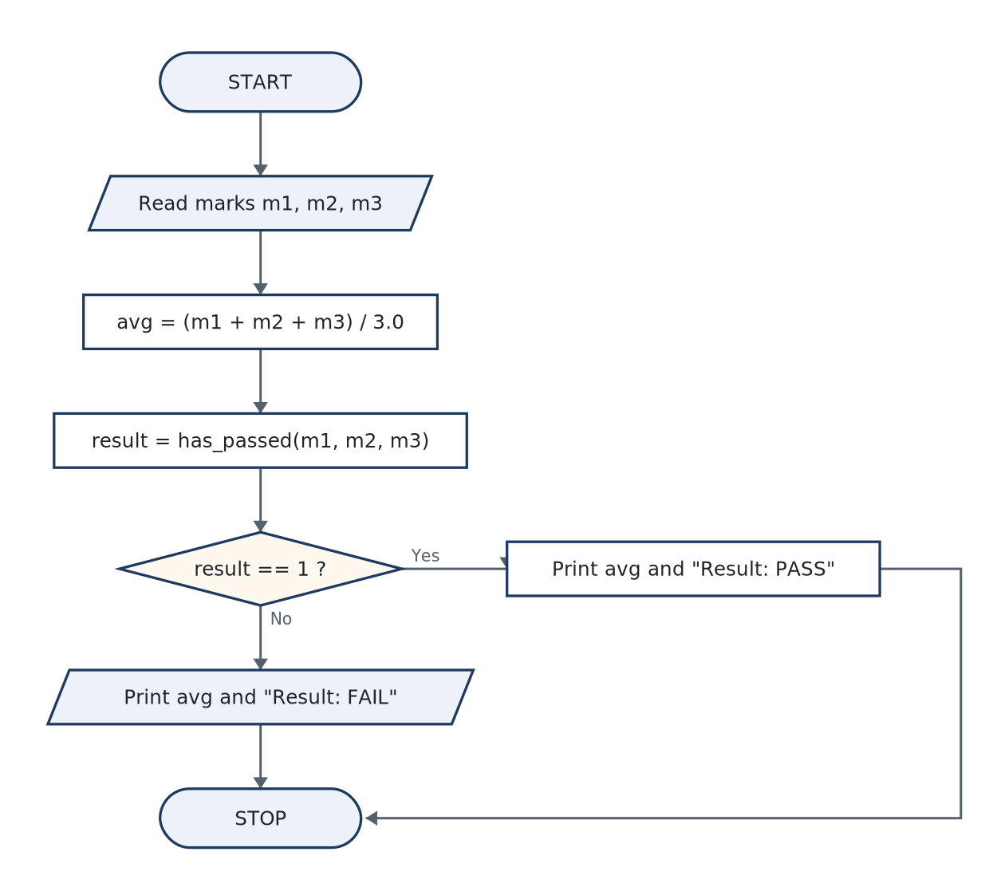
PART-A · ITEM 7
Part-A · Item 7 — Pass or Fail Through a Function — Modular Design with a Predicate
AIM / TASK (VERBATIM FROM THE BOOK)
To develop a C program that accepts marks in three subjects, uses a separate function to decide whether the student has passed (a minimum of 40 marks in each subject), and displays the average together with the PASS/FAIL verdict.
Objective — Define and call a predicate function with parameters and an int return value; keep the rule (“all three marks ≥ 40”) in exactly one place; observe call-by-value semantics
THE IDEA THE THEORY ESTABLISHES
• A function is a named, self-contained program unit: parameters in, one value out. The general form the record should quote:
• The average is the experiment’s trap wrapped in a convenience: (m1+m2+m3)/3 with int operands performs integer division (55+48+62 = 165 → 55 exactly by luck; 35+60+55 → 150/3 = 50; try 55, 48, 61 → 164/3 = 54, not 54.67). Writing / …
• has_passed prints nothing. Decisions belong to functions; communication belongs to main. A predicate that returned bool from stdbool.h> would be the modern spelling — int 1/0 is kept here because it also lets the viva ask “what is a …
ALGORITHM & FLOWCHART — figure from §7.2
ALGORITHM IN STEPS
• 1. START.
• 2. Read the three integer marks m1, m2, m3.
• 3. Call has_passed(m1, m2, m3): inside it, return 1 if m1 ≥ 40 AND m2 ≥ 40 AND m3 ≥ 40, else 0.
• 4. Compute avg = (m1 + m2 + m3) / 3.0f.
• 5. Print the marks, the average, and “Result: PASS” or “Result: FAIL” according to the returned verdict.
• 6. STOP.
C Programming Lab · 1BPOPL107/207 — classroom slides
22
Notes:
Full explanation: course book, Experiment 7 §7.1 (Theory) and §7.2 (Algorithm & Flowchart). Objective: Define and call a predicate function with parameters and an int return value; keep the rule (“all three marks ≥ 40”) in exactly one place; observe call-by-value semantics (the function cannot see or c

Slide 24
PART-A · ITEM 7 · CODE & RUNS
Part-A · Item 7 — Source, Build & Captured Runs
a07_pass_check.c · complete source as compiled · 36 lines
Run 1 — 55 48 62: every subject above the floor, average 55
/* Experiment A7 -- pass check through a function; average of three subjects
File : a07_pass_check.c
Build : gcc -Wall a07_pass_check.c -o a07_pass_check */
#include <stdio.h>
#define PASS_MARK 40
/* Returns 1 if the student has >= 40 marks in EVERY subject, else 0. */
int has_passed(int m1, int m2, int m3)
{
if (m1 >= PASS_MARK && m2 >= PASS_MARK && m3 >= PASS_MARK)
return 1;
return 0;
}
int main(void)
{
int m1, m2, m3;
float avg;
printf("Enter marks for three subjects: ");
scanf("%d %d %d", &m1, &m2, &m3);
avg = (m1 + m2 + m3) / 3.0f;
printf("Marks: %d, %d, %d\n", m1, m2, m3);
printf("Average = %.2f\n", avg);
if (has_passed(m1, m2, m3))
printf("Result: PASS (minimum %d marks in each subject)\n", PASS_MARK);
else
printf("Result: FAIL (minimum %d marks needed in each subject)\n",
PASS_MARK);
return 0;
}
Enter marks for three subjects: 55 48 62
Marks: 55, 48, 62
Average = 55.00
Result: PASS (minimum 40 marks in each subject)
Run 2 — 35 60 55: an average over 40 and still a FAIL — the AND rule demonstrated
Enter marks for three subjects: 35 60 55
Marks: 35, 60, 55
Average = 50.00
Result: FAIL (minimum 40 marks needed in each subject)
C Programming Lab · 1BPOPL107/207 — classroom slides
23
Notes:
Compile at the bench with exactly this command (the book's §7.4 shows the same terminal). Runs captured in out/: a07_pass_check_r1.txt, a07_pass_check_r2.txt. Run interactively: prompts answered at the keyboard (b05 takes none — it auto-feeds values, as the book notes).

Slide 25
PART-A · ITEM 7 · DEFENCE
Part-A · Item 7 — Observations, Result & Viva
OBSERVATIONS & ANALYSIS
VIVA — AS ASKED AT THE INTERNAL
Run 2 is the soul of this experiment: average 50.00 with a FAIL printed. If the rule had been written on the average, this student would have passed — the program documents that “minimum 40 each” and “average ≥ 40” are different policies, and the function makes the actual policy visible in four lines. Inference. …
• Q1. What are the two “copies” the marks travel through before the comparison runs? (Parameter and…) — state the passing mechanism precisely.
• Q2. Why can has_passed never change m1 in main?
• Q3. Give an input where dividing by 3 instead of 3.0f changes the printed average — and one where it could change the grade if the rule had been average-based.
• Q4. Why does the return type matter to the caller, and what would int vs bool change?
m1, m2, m3 | avg (÷3.0f) | avg if ÷3 (integer) | has_passed | Printed
55, 48, 62 | 55.00 | 55 | 1 | PASS
35, 60, 55 | 50.00 | 50 | 0 | FAIL
55, 48, 61 | 54.67 | 54 ← one-third less | 1 | PASS
RESULT. A C program was developed in which a four-line predicate function has_passed(), taking the three marks by value, decides pass/fail against a single-source minimum of 40, while main computes the float-correct average. …
C Programming Lab · 1BPOPL107/207 — classroom slides
24
Notes:
Viva answers for this experiment, all of them, are in the book §7.7 — the on-slide panel shows Q1–Q4 plus the first model answer.

Slide 26
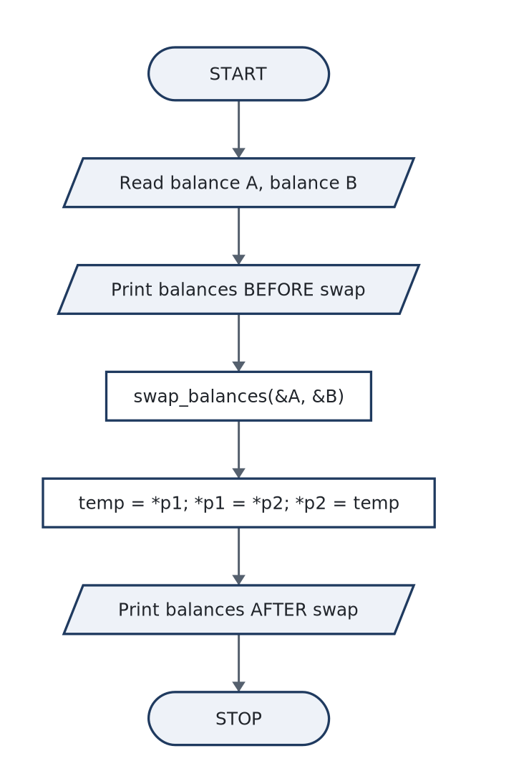
PART-A · ITEM 8
Part-A · Item 8 — Swapping Two Balances — Pointers Take the Function Seriously
AIM / TASK (VERBATIM FROM THE BOOK)
To develop a C program that accepts two account balances and swaps them by calling a function that receives the two addresses, displaying the balances before and after the swap so the change of ownership is visible.
Objective — Declare parameters of pointer type and dereference them to read (*p) and write; pass addresses with &; contrast call-by-value (Experiment 7) with call-by-reference-in-C o
THE IDEA THE THEORY ESTABLISHES
• A pointer is a variable that holds an address. Two operators rule all of pointer syntax, and the record must state them without hesitation:
• The function signature void swap_balances(float *bal1, float *bal2) declares two parameters “of type pointer-to-float”. Call by value still happens — the addresses themselves are copied into the function — which is why C purists say …
• The three-line body is the only correct swap through temps. The classic failures to name in the inference: (1) swapping the pointers — p1 = p2; merely redirects the local copies, main never notices; (2) no temp at all — *p1 = *p2; *p2 …
ALGORITHM & FLOWCHART — figure from §8.2
ALGORITHM IN STEPS
• 1. START.
• 2. Read balance A and balance B as floats.
• 3. Print both balances (BEFORE).
• 4. Call swap_balances(&A, &B) — pass addresses.
• 5. Inside the function: temp = *p1; *p1 = *p2; *p2 = temp.
• 6. Back in main, print both balances (AFTER) — the order has exchanged.
• 7. STOP.
C Programming Lab · 1BPOPL107/207 — classroom slides
25
Notes:
Full explanation: course book, Experiment 8 §8.1 (Theory) and §8.2 (Algorithm & Flowchart). Objective: Declare parameters of pointer type and dereference them to read (*p) and write; pass addresses with &; contrast call-by-value (Experiment 7) with call-by-reference-in-C on the same operation — swap —

Slide 27
PART-A · ITEM 8 · CODE & RUNS
Part-A · Item 8 — Source, Build & Captured Runs
a08_swap_pointers.c · complete source as compiled · 30 lines
Run 1 — two live accounts: 15000.50 and 8250.75 change places
/* Experiment A8 -- swap two ATM balances through a function using pointers
File : a08_swap_pointers.c
Build : gcc -Wall a08_swap_pointers.c -o a08_swap_pointers */
#include <stdio.h>
/* Writes through the addresses: the caller's variables really change. */
void swap_balances(float *bal1, float *bal2)
{
float temp = *bal1;
*bal1 = *bal2;
*bal2 = temp;
}
int main(void)
{
float account_a, account_b;
printf("Enter balance of account A: ");
scanf("%f", &account_a);
printf("Enter balance of account B: ");
scanf("%f", &account_b);
printf("\nBefore swap -> A = %.2f, B = %.2f\n", account_a, account_b);
swap_balances(&account_a, &account_b); /* pass addresses */
printf("After swap -> A = %.2f, B = %.2f\n", account_a, account_b);
return 0;
}
Enter balance of account A: 15000.50
Enter balance of account B: 8250.75
Before swap -> A = 15000.50, B = 8250.75
After swap -> A = 8250.75, B = 15000.50
C Programming Lab · 1BPOPL107/207 — classroom slides
26
Notes:
Compile at the bench with exactly this command (the book's §8.4 shows the same terminal). Runs captured in out/: a08_swap_pointers_r1.txt. Run interactively: prompts answered at the keyboard (b05 takes none — it auto-feeds values, as the book notes).

Slide 28
PART-A · ITEM 8 · DEFENCE
Part-A · Item 8 — Observations, Result & Viva
OBSERVATIONS & ANALYSIS
VIVA — AS ASKED AT THE INTERNAL
The before/after pair proves the function did what main could not do from outside: the values that main printed are the values the function wrote. A single run suffices for the verdict, but the record gains depth from a control attempt: reproduce Experiment 7-style call-by-value (parameters float v1, float v2) and show it fails — the printed AFTER line stays unchanged. That negative result, one line of output, is the strongest evidence in this experiment. Inference. …
• Q1. State the types involved in this program: the two main variables, the two function parameters, the addresses.
• Q2. What is the output if the function body omits the temp? Prove it by stepping the two assignments.
• Q3. “C has no call by reference.” Explain that sentence with respect to this exact program.
• Q4. What is wrong — at compile time or at runtime — with writing swap_balances(A, B) against the pointer-taking function?
RESULT. A C program swapping two ATM account balances was developed: main reads and prints the balances, calls swap_balances(&A, &B), which dereferences its two float * parameters through a three-line temp-swap, and main re-prints the exchanged values. …
C Programming Lab · 1BPOPL107/207 — classroom slides
27
Notes:
Viva answers for this experiment, all of them, are in the book §8.7 — the on-slide panel shows Q1–Q4 plus the first model answer.

Slide 29
P A R T
B
Open-Ended Experiments — Items 1 to 6
Design-led tasks: the requirement is read for the behaviour it demands, the design is argued, then tested. Each item here: cover with the requirement + design decisions, complete source with captured runs, and the observation/viva defence.
IN THIS PART
• Item 9 (b01) — Book Search on a Sorted Digital Shelf — Designing for Speed
• Item 10 (b02) — The 100-Metre Result Sheet — Choosing a Sorting Strategy
• Item 11 (b03) — Branch Revenue by Matrix-Style Multiplication — Two Datasets, One Total
• Item 12 (b04) — Joining Names Without the Library — Rebuilding strlen, strcpy, strcat
• Item 13 (b05) — The Currency Booth That Previews — Call by Value and Call by Reference in One Program
• Item 14 (b06) — The Library Catalogue — Structures: A Row for Every Book
28

Slide 30
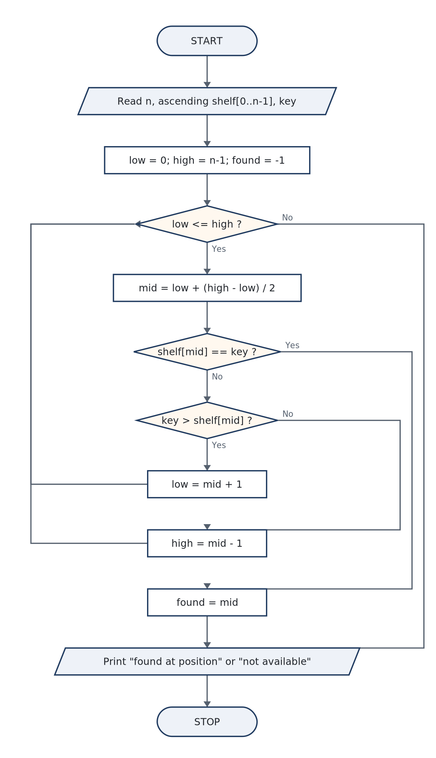
PART-B · ITEM 1
Part-B · Item 1 — Book Search on a Sorted Digital Shelf — Designing for Speed
AIM / TASK (VERBATIM FROM THE BOOK)
To design, implement and evaluate a C program that, given a shelf of Book IDs sorted in ascending order, decides whether a requested ID is present — and to justify the chosen search strategy by measured or counted work rather than by assertion.
Objective — Recognise “ascending order” as a promise that can be used; implement binary search (or defend an alternative); count comparisons in both strategies and report the ratio;
THE IDEA THE THEORY ESTABLISHES
• Two algorithms answer “is x in a sorted array of n?”; the whole open-ended value of the experiment lies in the gap between them.
• Binary search is a lesson in assumptions as preconditions: discard-half only works if the array really is sorted. A shelf stored out of order does not make the algorithm “a little slower” — it makes it wrong, silently. The record …
• Two implementation details distinguish a careful submission from a hurried one:
ALGORITHM & FLOWCHART — figure from §9.2
DESIGN NOTE
Requirement read-out. “Quickly” is the operative word: the design must be able to report its own speed. Chosen design (one of several defensible ones): binary search returning the index or −1, with a comparison counter wrapped around it, and the linear scan retained in the source as the baseline for measurement. Test plan. (i) each of the ten shelf entries individually — every index must be found; (ii) numbers just below, betw
C Programming Lab · 1BPOPL107/207 — classroom slides
29
Notes:
Full explanation: course book, Experiment 9 §9.1 (Theory) and §9.2 (Algorithm & Flowchart). Objective: Recognise “ascending order” as a promise that can be used; implement binary search (or defend an alternative); count comparisons in both strategies and report the ratio; state the failure mode of the

Slide 31
PART-B · ITEM 1 · CODE & RUNS
Part-B · Item 1 — Source, Build & Captured Runs
b01_binary_search.c · complete source as compiled · 42 lines
Run 1 — ID 73 sits at position 6 of ten: three probes suffice
/* Experiment B1 -- binary search for a Book ID on a sorted digital shelf
File : b01_binary_search.c
Build : gcc -Wall b01_binary_search.c -o b01_binary_search */
#include <stdio.h>
int main(void)
{
int shelf[50], n = 0, key, low, high, mid, found = -1, probes = 0;
printf("How many books on the shelf? ");
scanf("%d", &n);
printf("Enter %d Book IDs in ASCENDING order: ", n);
for (int i = 0; i < n; i++)
scanf("%d", &shelf[i]);
printf("Enter the Book ID to search: ");
scanf("%d", &key);
low = 0; high = n - 1;
while (low <= high) {
mid = low + (high - low) / 2; /* overflow-safe midpoint */
probes++;
if (shelf[mid] == key) { /* hit: position is the answer */
found = mid;
break;
} else if (shelf[mid] < key) /* key is in the right half */
low = mid + 1;
else /* key is in the left half */
high = mid - 1;
}
if (found != -1)
printf("Book ID %d found at shelf position %d (index %d).\n",
key, found + 1, found);
else
printf("Book ID %d is NOT available on the shelf.\n", key);
printf("Comparisons used: %d (linear search worst case would use %d).\n",
probes, (found != -1) ? found + 1 : n);
return 0;
}
How many books on the shelf? 10
Enter 10 Book IDs in ASCENDING order: 12 27 34 51 68 73 84 91 97 105
Enter the Book ID to search: 73
Book ID 73 found at shelf position 6 (index 5).
Comparisons used: 3 (linear search worst case would use 6).
Run 2 — ID 50 is absent: the halving proves it and says so
How many books on the shelf? 10
Enter 10 Book IDs in ASCENDING order: 12 27 34 51 68 73 84 91 97 105
Enter the Book ID to search: 50
Book ID 50 is NOT available on the shelf.
Comparisons used: 4 (linear search worst case would use 10).
C Programming Lab · 1BPOPL107/207 — classroom slides
30
Notes:
Compile at the bench with exactly this command (the book's §9.4 shows the same terminal). Runs captured in out/: b01_binary_search_r1.txt, b01_binary_search_r2.txt. Run interactively: prompts answered at the keyboard (b05 takes none — it auto-feeds values, as the book notes).

Slide 32
PART-B · ITEM 1 · DEFENCE
Part-B · Item 1 — Observations, Result & Viva
OBSERVATIONS & ANALYSIS
VIVA — AS ASKED AT THE INTERNAL
The program prints its own evidence: for the ten-book shelf, finding 73 needed 3 comparisons where a linear scan would walk 6 entries to reach it — already a 2× win, and the gap widens as the shelf grows (20 books ⇒ ≤ 5 probes; 1000 ⇒ ≤ 10; 1 000 000 ⇒ ≤ 20 while a scan averages 500 000). Run 2 shows the negative answer arrives the same way: when [low, high] collapses to the empty interval, absence is proved, not guessed. Extension for full marks. …
• Q1. State the loop invariant of binary search in one sentence; where in the code is it maintained?
• Q2. Why is (low + high) / 2 considered fragile?
• Q3. What does binary search do on an unsorted shelf — slow, wrong, or both? Justify with a two-element example.
• Q4. Compare worst cases: 1024 books, linear vs binary.
RESULT. A C program implementing binary search over a sorted array of Book IDs was designed, implemented and run; found and not-found paths were exercised (ID 73 → position 6 in 3 comparisons; ID 50 → “NOT available”), the returned index and comparison count. …
C Programming Lab · 1BPOPL107/207 — classroom slides
31
Notes:
Viva answers for this experiment, all of them, are in the book §9.7 — the on-slide panel shows Q1–Q4 plus the first model answer.

Slide 33
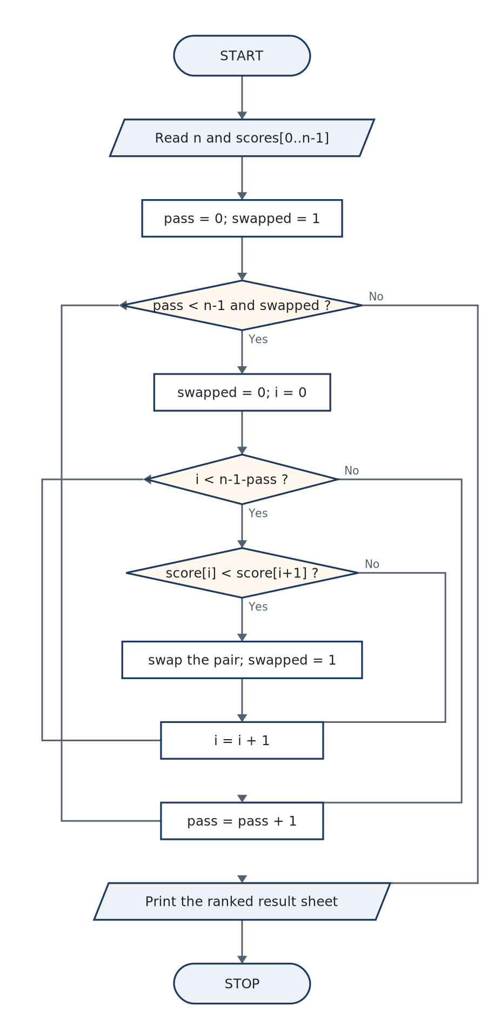
PART-B · ITEM 2
Part-B · Item 2 — The 100-Metre Result Sheet — Choosing a Sorting Strategy
AIM / TASK (VERBATIM FROM THE BOOK)
To design, implement and evaluate a C program that reads the scores recorded by a sports teacher for a 100 m race and arranges them in descending order (highest to lowest) for the result sheet, documenting the sorting strategy chosen and why it suits a class-sized dataset.
Objective — Implement an in-place exchange sort with a swap-count early exit; reason about direction (a single flipped comparison sign turns “ascending” into the required descending)
THE IDEA THE THEORY ESTABLISHES
• The problem hands you the algorithm name only implicitly: “arrange in order” with tens of values is the natural habitat of the exchange family. The two candidates worth defending:
• Three details make this a real design exercise rather than a template:
ALGORITHM & FLOWCHART — figure from §10.2
DESIGN NOTE
Requirement read-out. n is class-sized (tens), input arrives unsorted, output must be a rank sheet. Any correct sort wins; bubble was chosen for (i) the early-exit flag, which rewards already-ranked lists, (ii) two-line in-place swaps with no extra memory beyond the array, (iii) provable stability for ties. A future gym with 10⁵ entries would need a different conversation — say so, that is exactly the kind of judgement open-en
C Programming Lab · 1BPOPL107/207 — classroom slides
32
Notes:
Full explanation: course book, Experiment 10 §10.1 (Theory) and §10.2 (Algorithm & Flowchart). Objective: Implement an in-place exchange sort with a swap-count early exit; reason about direction (a single flipped comparison sign turns “ascending” into the required descending), about equal scores (ties), a

Slide 34
PART-B · ITEM 2 · CODE & RUNS
Part-B · Item 2 — Source, Build & Captured Runs
b02_race_sort.c · complete source as compiled · 39 lines
Run 1 — five scores into a ranked sheet
/* Experiment B2 -- bubble-sort 100 m race scores in DESCENDING order
File : b02_race_sort.c
Build : gcc -Wall b02_race_sort.c -o b02_race_sort */
#include <stdio.h>
int main(void)
{
float score[50];
int n, pass;
float temp;
int swapped;
printf("How many students ran the 100 m race? ");
scanf("%d", &n);
printf("Enter %d scores (points; higher is better): ", n);
for (int i = 0; i < n; i++)
scanf("%f", &score[i]);
/* Bubble sort, largest floats up. Flag exits early if already sorted. */
for (pass = 0; pass < n - 1; pass++) {
swapped = 0;
for (int i = 0; i < n - 1 - pass; i++) {
if (score[i] < score[i + 1]) { /* '<' -> descending */
temp = score[i];
score[i] = score[i + 1];
score[i + 1] = temp;
swapped = 1;
}
}
if (!swapped)
break;
}
printf("\nResult sheet (rank order):\n");
for (int i = 0; i < n; i++)
printf("Rank %d : score %.1f\n", i + 1, score[i]);
return 0;
}
How many students ran the 100 m race? 5
Enter 5 scores (points; higher is better): 78 92 65 88 71
Result sheet (rank order):
Rank 1 : score 92.0
Rank 2 : score 88.0
Rank 3 : score 78.0
Rank 4 : score 71.0
Rank 5 : score 65.0
Run 2 — a dead heat at 90.0: the tie keeps entry order
How many students ran the 100 m race? 4
Enter 4 scores (points; higher is better): 90 90 85 88
Result sheet (rank order):
Rank 1 : score 90.0
Rank 2 : score 90.0
Rank 3 : score 88.0
Rank 4 : score 85.0
C Programming Lab · 1BPOPL107/207 — classroom slides
33
Notes:
Compile at the bench with exactly this command (the book's §10.4 shows the same terminal). Runs captured in out/: b02_race_sort_r1.txt, b02_race_sort_r2.txt. Run interactively: prompts answered at the keyboard (b05 takes none — it auto-feeds values, as the book notes).

Slide 35
PART-B · ITEM 2 · DEFENCE
Part-B · Item 2 — Observations, Result & Viva
OBSERVATIONS & ANALYSIS
VIVA — AS ASKED AT THE INTERNAL
Run 2 is the observation that lifts the record: both 90.0 entries remain in input order — the strict-< comparison is what buys that, and it is called stability. In Run 1, count the moves yourself for one pass: 78 92 65 88 71 after pass 1 is 92 78 88 71 65 — the smallest has sunk to its final slot, exactly the invariant the outer loop relies on; pass 2 needs only one swap (the 88). A trace table of those two rows in the record shows the algorithm, not just the answer. Measured curiosity. …
• Q1. After outer pass k, which part of the array is guaranteed final — the front or the tail? Defend it.
• Q2. What exactly does the swapped flag observe? Give the input that makes it end sorting after one pass.
• Q3. Why do the two 90.0 entries not swap? Which single character in the code encodes that policy?
• Q4. Bubble vs selection: which wins on writes, and why might writes matter in real hardware?
RESULT. A C program that ranks 100 m race scores for the result sheet was implemented with a flag-accelerated bubble sort producing descending order. …
C Programming Lab · 1BPOPL107/207 — classroom slides
34
Notes:
Viva answers for this experiment, all of them, are in the book §10.7 — the on-slide panel shows Q1–Q4 plus the first model answer.

Slide 36
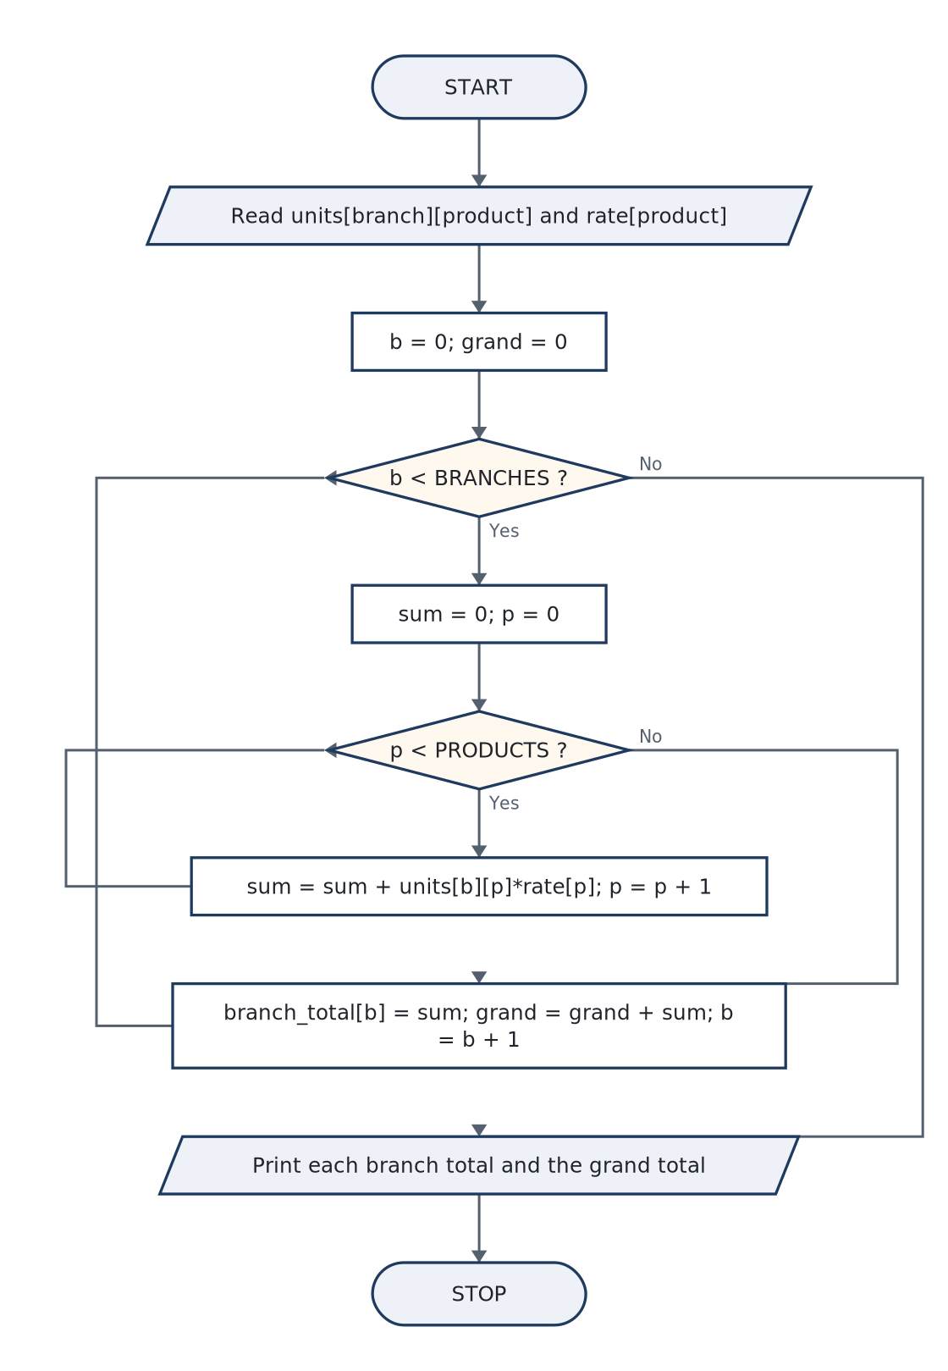
PART-B · ITEM 3
Part-B · Item 3 — Branch Revenue by Matrix-Style Multiplication — Two Datasets, One Total
AIM / TASK (VERBATIM FROM THE BOOK)
To design and implement a C program that combines a shipped-units table (branches × products) with a per-unit revenue vector, producing the total revenue of every branch and of the company, with the accumulation structure chosen and justified.
Objective — Use a two-dimensional array as a genuine grid (row = branch, column = product); nest for loops so each cell multiplies into the right total; keep two accumulators (per-br
THE IDEA THE THEORY ESTABLISHES
• Formally: units U is an R×C table (R branches, C products), rate is a C-vector; branch total Bᵣ = Σc U[r][c] · rate[c]. In C the sum is one nested loop — and the entire design risk lives in which index belongs to which bracket:
• Why the product of the two datasets is money: units[c] × rate[c] is revenue for one product from one branch, and summing across products is exactly “combine the datasets”. The grand total is then a fold over the branch totals — and …
ALGORITHM & FLOWCHART — figure from §11.2
DESIGN NOTE
Requirement read-out. Fixed-size demo (3 branches × 4 products) chosen for hand-verifiable output; the loop bounds use #defines, so resizing is a one-line change. Test plan: (i) one hand-computed branch (below); (ii) a branch that ships nothing (all zeros ⇒ total 0 — the empty row must not poison the grand); (iii) a zero rate product; (iv) the Σ-identity cross-check. Design questions: What if a product exists at branch 2 but n
C Programming Lab · 1BPOPL107/207 — classroom slides
35
Notes:
Full explanation: course book, Experiment 11 §11.1 (Theory) and §11.2 (Algorithm & Flowchart). Objective: Use a two-dimensional array as a genuine grid (row = branch, column = product); nest for loops so each cell multiplies into the right total; keep two accumulators (per-branch, grand) consistent; valid

Slide 37
PART-B · ITEM 3 · CODE & RUNS
Part-B · Item 3 — Source, Build & Captured Runs
b03_warehouse.c · complete source as compiled · 38 lines
Run 1 — three branches, four products, every rupee hand-checkable
/* Experiment B3 -- warehouse revenue: shipped units x per-unit revenue
File : b03_warehouse.c
Build : gcc -Wall b03_warehouse.c -o b03_warehouse */
#include <stdio.h>
#define BRANCHES 3
#define PRODUCTS 4
int main(void)
{
int units[BRANCHES][PRODUCTS]; /* units[branch][product] */
float rate[PRODUCTS]; /* revenue per unit of each product */
float branch_total[BRANCHES] = {0}, grand = 0;
printf("Enter shipped units: %d rows (branches) x %d columns (products)\n",
BRANCHES, PRODUCTS);
for (int b = 0; b < BRANCHES; b++)
for (int p = 0; p < PRODUCTS; p++)
scanf("%d", &units[b][p]);
printf("Enter per-unit revenue for each of the %d products: ", PRODUCTS);
for (int p = 0; p < PRODUCTS; p++)
scanf("%f", &rate[p]);
for (int b = 0; b < BRANCHES; b++) {
for (int p = 0; p < PRODUCTS; p++) {
branch_total[b] += units[b][p] * rate[p]; /* combine here */
}
grand += branch_total[b];
}
printf("\nTotal revenue per branch:\n");
for (int b = 0; b < BRANCHES; b++)
printf(" Branch %d : Rs %.2f\n", b + 1, branch_total[b]);
printf("Company total : Rs %.2f\n", grand);
return 0;
}
Enter shipped units: 3 rows (branches) x 4 columns (products)
120 80 60 40
90 110 70 55
150 60 80 100
Enter per-unit revenue for each of the 4 products: 25.50 30 12.75 45
Total revenue per branch:
Branch 1 : Rs 8025.00
Branch 2 : Rs 8962.50
Branch 3 : Rs 11145.00
Company total : Rs 28132.50
C Programming Lab · 1BPOPL107/207 — classroom slides
36
Notes:
Compile at the bench with exactly this command (the book's §11.4 shows the same terminal). Runs captured in out/: b03_warehouse_r1.txt. Run interactively: prompts answered at the keyboard (b05 takes none — it auto-feeds values, as the book notes).

Slide 38
PART-B · ITEM 3 · DEFENCE
Part-B · Item 3 — Observations, Result & Viva
OBSERVATIONS & ANALYSIS
VIVA — AS ASKED AT THE INTERNAL
Hand-check of branch 2 from the run: 90·25.50 + 110·30 + 70·12.75 + 55·45 = 2295.00 + 3300.00 + 892.50 + 2475.00 = 8962.50 — the printed line. The grand total 28132.50 equals 8025.00 + 8962.50 + 11145.00, and independently equals the sum of all twelve cell products; the two routes agreeing is the cross-check the design promised. What the nested loops really say. Reading row-wise means “ask branch 2 what it did”: the inner loop’s products are one row of the table. …
• Q1. Which loop nesting order is cache-friendly and why? (Contiguity of a C 2D array is the answer. Say it precisely.)
• Q2. What happens if the rate array has only 3 entries — which loop bound saves you?
• Q3. Show that units×rate computes branch totals even if you swap the roles of the indices — and what the report would mean then.
• Q4. Why can float hold the demo totals but an accountant would object? Give the C-side fix.
RESULT. A C program combining a 3×4 shipped-units table with a four-product revenue vector was designed, implemented and run. …
C Programming Lab · 1BPOPL107/207 — classroom slides
37
Notes:
Viva answers for this experiment, all of them, are in the book §11.7 — the on-slide panel shows Q1–Q4 plus the first model answer.

Slide 39
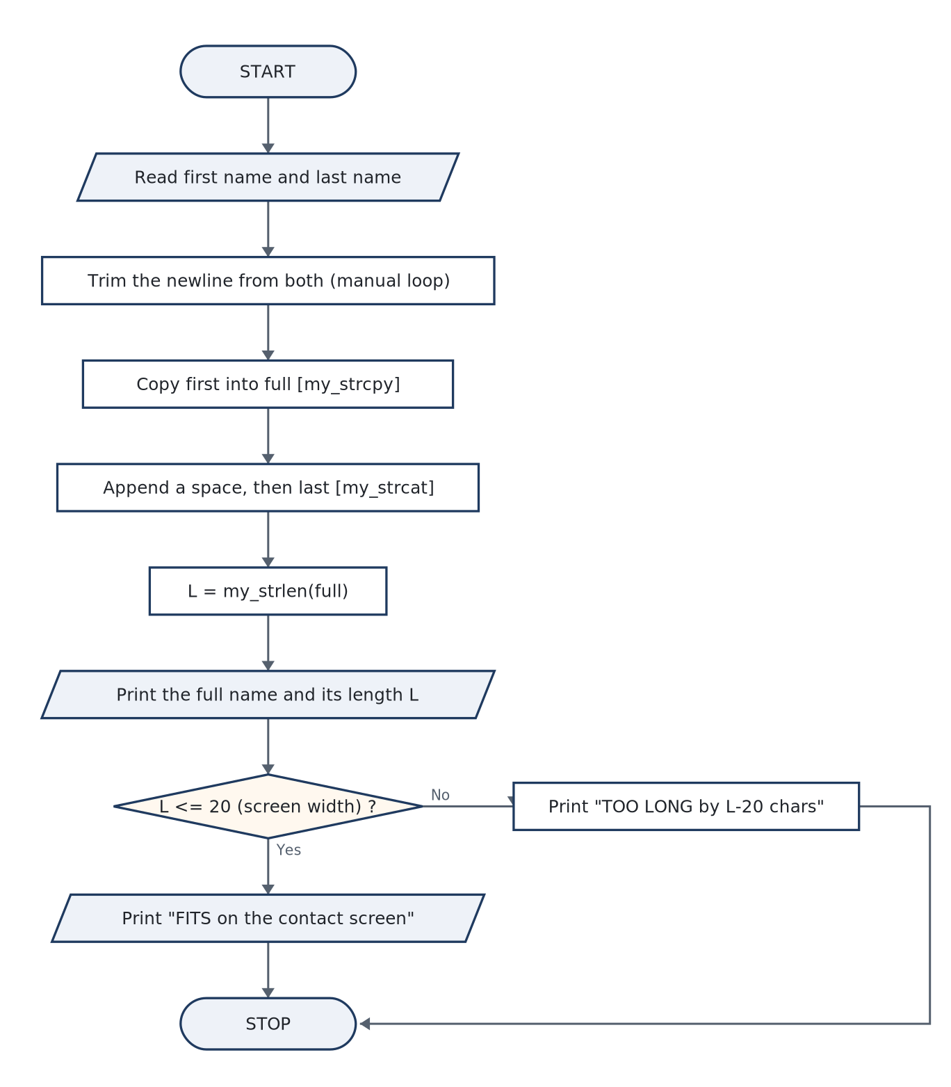
PART-B · ITEM 4
Part-B · Item 4 — Joining Names Without the Library — Rebuilding strlen, strcpy, strcat
AIM / TASK (VERBATIM FROM THE BOOK)
To design and implement a C program, without using built-in string functions, that concatenates a first name and a last name (with a separating space) for the contact display, and independently measures the full name’s length to check that it fits the screen.
Objective — Implement manual strlen, strcpy, strcat over char arrays; treat the terminating null byte as the only string “size” information; reserve buffers large enough for the conc
THE IDEA THE THEORY ESTABLISHES
• A C string carries no length field. Every “manual” string operation is therefore the same pattern: start at index 0, advance while the byte is not '\0'. The three functions the program must rebuild differ only in what they do on the way:
• The concatenation of “first + space + last” needs buffer arithmetic before any code runs: full must hold len(first) + 1 + len(last) + 1 ≤ sizeof(full). With 40+40 inputs and a 90-byte target the program is safe for legal input — say …
• fgets stores the Enter key, so every read must be followed by a trim loop: walk until '\n', write '\0' there, stop. That loop is a string scan — you already know how to write it, and refusing strcspn keeps the experiment’s promise of …
ALGORITHM & FLOWCHART — figure from §12.2
ALGORITHM IN STEPS
• 1. START; read first name and last name with fgets.
• 2. Trim each: scan for '\n', replace with '\0' (manual loop).
• 3. my_strcpy: copy first into full byte-by-byte including the terminator.
• 4. my_strcat: append a space (strlen full, write one char, terminate).
• 5. my_strcat: append last the same way — start at the current end, copy, terminate.
• 6. L = my_strlen(full); if L ≤ 20 print FITS, else print TOO LONG (and by how much).
• 7. STOP.
C Programming Lab · 1BPOPL107/207 — classroom slides
38
Notes:
Full explanation: course book, Experiment 12 §12.1 (Theory) and §12.2 (Algorithm & Flowchart). Objective: Implement manual strlen, strcpy, strcat over char arrays; treat the terminating null byte as the only string “size” information; reserve buffers large enough for the concatenation; state what the libr

Slide 40
PART-B · ITEM 4 · CODE & RUNS
Part-B · Item 4 — Source, Build & Captured Runs
b04_name_join.c · complete source as compiled · 66 lines
Run 1 — “Kavya” + “Krishnan” fits the 20-char screen at 14
/* Experiment B4 -- join first + last name manually, no built-in string fns
File : b04_name_join.c
Build : gcc -Wall b04_name_join.c -o b04_name_join */
#include <stdio.h>
#define SCREEN_WIDTH 20 /* characters the contact list can show */
int my_strlen(const char *s) /* counts to the terminator */
{
int len = 0;
while (s[len] != '\0')
len++;
return len;
}
void my_strcpy(char *dest, const char *src)
{
int i = 0;
while (src[i] != '\0') { dest[i] = src[i]; i++; }
dest[i] = '\0';
}
void my_strcat(char *dest, const char *src)
{
int i = my_strlen(dest); /* start after the existing text */
int j = 0;
while (src[j] != '\0') { dest[i] = src[j]; i++; j++; }
dest[i] = '\0';
}
void trim_newline(char *s) /* remove the Enter key fgets keeps */
{
int i = 0;
while (s[i] != '\0') {
if (s[i] == '\n') { s[i] = '\0'; return; }
i++;
}
}
int main(void)
{
char first[40], last[40], full[90];
printf("Enter first name: ");
fgets(first, sizeof(first), stdin);
printf("Enter last name : ");
fgets(last, sizeof(last), stdin);
trim_newline(first);
trim_newline(last);
my_strcpy(full, first); /* full = first */
my_strcat(full, " "); /* full = first + " " */
my_strcat(full, last); /* full = first + " " + last */
printf("Full name : %s\n", full);
printf("Length : %d characters\n", my_strlen(full));
if (my_strlen(full) <= SCREEN_WIDTH)
printf("Display check: FITS on the %d-character contact screen.\n",
SCREEN_WIDTH);
else
printf("Display check: TOO LONG for the %d-character screen "
"(needs %d).\n", SCREEN_WIDTH, my_strlen(full) - SCREEN_WIDTH);
return 0;
}
Enter first name: Kavya
Enter last name : Krishnan
Full name : Kavya Krishnan
Length : 14 characters
Display check: FITS on the 20-character contact screen.
Run 2 — a long double-barrelled name overruns the screen by 11
Enter first name: Ananya Lakshmi
Enter last name : Narayanan Iyer R
Full name : Ananya Lakshmi Narayanan Iyer R
Length : 31 characters
Display check: TOO LONG for the 20-character screen (needs 11).
C Programming Lab · 1BPOPL107/207 — classroom slides
39
Notes:
Compile at the bench with exactly this command (the book's §12.4 shows the same terminal). Runs captured in out/: b04_name_join_r1.txt, b04_name_join_r2.txt. Run interactively: prompts answered at the keyboard (b05 takes none — it auto-feeds values, as the book notes).

Slide 41
PART-B · ITEM 4 · DEFENCE
Part-B · Item 4 — Observations, Result & Viva
OBSERVATIONS & ANALYSIS
VIVA — AS ASKED AT THE INTERNAL
Run 1: 5 + 1 + 8 = 14, printed and counted by the manual strlen — the two independent ways to see the same number. Run 2 exists to show the length check earning its place: 31 > 20 triggers the TOO LONG branch with the exact overrun (11), which is the contact-list design question (abbreviate? scroll? reject?). Deeper observation for the record. My_strcat calls my_strlen first — so joining k names by repeated my_strcat is O(total²) over the output (each append re-walks the whole prefix). …
• Q1. Why must my_strcpy copy the '\0' — what is the visible symptom if it doesn’t?
• Q2. Give the one-line while-loop form of my_strlen and explain why an array of chars that is not terminated is worse than an error.
• Q3. What does the library’s strncat guarantee that the manual my_strcat does not — and where is that guarantee in this program?
• Q4. Trace my_strcat appending “Krishnan”: which indices of full are written, starting where?
RESULT. A C contact program joining first and last names, with no built-in string functions, was implemented via hand-written my_strlen, my_strcpy and my_strcat over null-terminated buffers, with the buffer sizes justified by the worst legal input. …
C Programming Lab · 1BPOPL107/207 — classroom slides
40
Notes:
Viva answers for this experiment, all of them, are in the book §12.7 — the on-slide panel shows Q1–Q4 plus the first model answer.

Slide 42
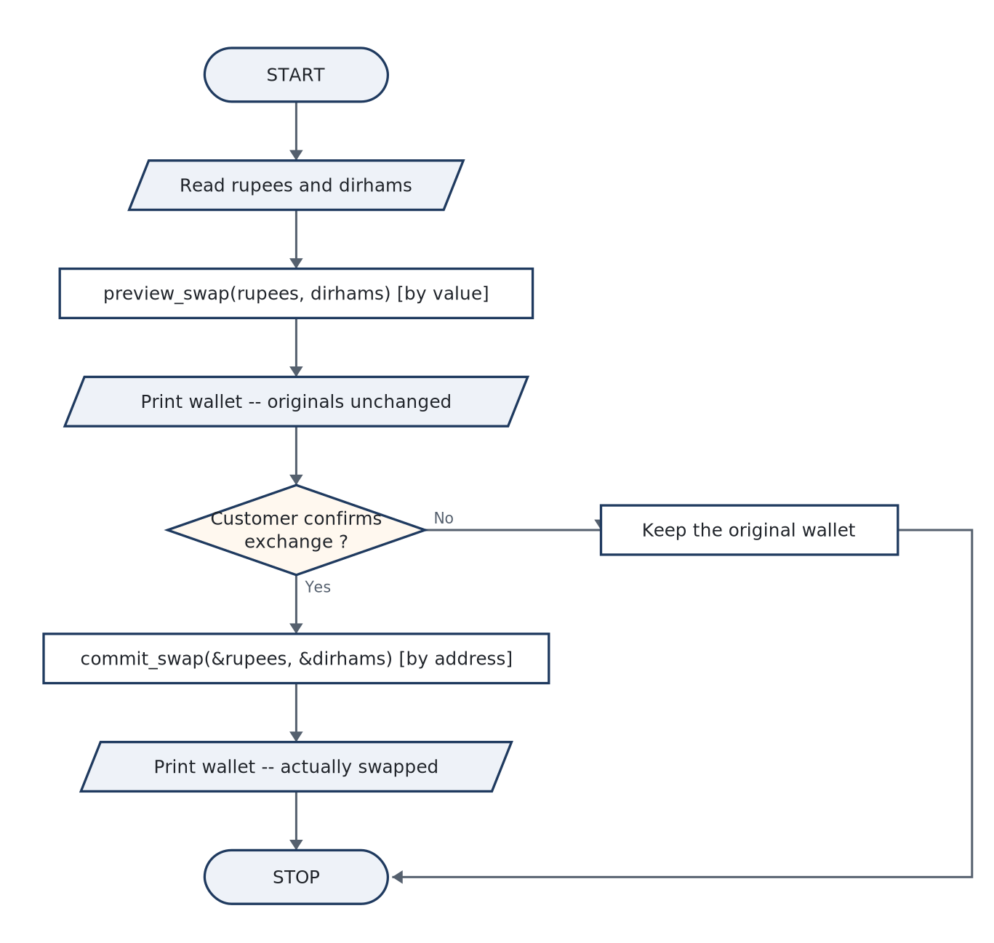
PART-B · ITEM 5
Part-B · Item 5 — The Currency Booth That Previews — Call by Value and Call by Reference in One Program
AIM / TASK (VERBATIM FROM THE BOOK)
To design and implement a C program for a currency-exchange preview flow in which the same swap of two amounts is provided twice — once as a simulation that must not touch the customer’s actual balances (call by value) and once as the committed exchange (call by reference through pointers) — and to demonstrate both outcomes from identical starting data.
Objective — Explain and exhibit the observable difference between the two calling mechanisms; choose the mechanism per effect (preview ⇒ copy; commit ⇒ address); audit the program’s
THE IDEA THE THEORY ESTABLISHES
• An activation record is the box of variables a call creates; C passes every argument by value — by copy into that box. What differs is only the kind of value copied:
• So “call by reference in C” is an honest shorthand for call by value of a pointer — and the distinction is not pedantry: the pointer itself lives in the callee’s box and dies there (harmless), while the data it points at lives in …
ALGORITHM & FLOWCHART — figure from §13.2
DESIGN NOTE
Behaviour specification. Booth flow: read balances → preview-swap → print wallet (must be identical to before) → confirm → commit-swap → print wallet (must be exactly the previewed state). The preview’s output line and the post-commit line together form the correctness proof: the committed wallet equals what the preview promised, and the pre-commit wallet equals the untouched original. Designing the prints around that proof is
C Programming Lab · 1BPOPL107/207 — classroom slides
41
Notes:
Full explanation: course book, Experiment 13 §13.1 (Theory) and §13.2 (Algorithm & Flowchart). Objective: Explain and exhibit the observable difference between the two calling mechanisms; choose the mechanism per effect (preview ⇒ copy; commit ⇒ address); audit the program’s contract by printing the walle

Slide 43
PART-B · ITEM 5 · CODE & RUNS
Part-B · Item 5 — Source, Build & Captured Runs
b05_swap_modes.c · complete source as compiled · 43 lines
Run 1 — preview promises, originals resist, commit delivers
/* Experiment B5 -- currency booth: preview swap (call by value) vs real
swap (call by reference)
File : b05_swap_modes.c
Build : gcc -Wall b05_swap_modes.c -o b05_swap_modes */
#include <stdio.h>
/* Works on a COPY: the booth can show the preview without touching data. */
void preview_swap(float give, float get)
{
float temp = give;
give = get;
get = temp;
printf(" [preview] you would give %.2f and get %.2f\n", give, get);
}
/* Works through ADDRESSES: the booth commits the actual exchange. */
void commit_swap(float *give, float *get)
{
float temp = *give;
*give = *get;
*get = temp;
}
int main(void)
{
float rupees = 4500.0f, dirhams = 0.0f;
printf("Wallet before : Rs %.2f | AED %.2f\n", rupees, dirhams);
printf("\n1) PREVIEW MODE (call by value) -- originals must not change\n");
preview_swap(rupees, dirhams);
printf("Wallet after : Rs %.2f | AED %.2f <- unchanged\n",
rupees, dirhams);
printf("\n2) COMMIT MODE (call by reference) -- exchange becomes real\n");
rupees = 4500.0f; /* reset to the same starting wallet for clarity */
dirhams = 0.0f;
commit_swap(&rupees, &dirhams);
printf("Wallet after : Rs %.2f | AED %.2f <- actually swapped\n",
rupees, dirhams);
return 0;
}
Wallet before : Rs 4500.00 | AED 0.00
1) PREVIEW MODE (call by value) -- originals must not change
[preview] you would give 0.00 and get 4500.00
Wallet after : Rs 4500.00 | AED 0.00 <- unchanged
2) COMMIT MODE (call by reference) -- exchange becomes real
Wallet after : Rs 0.00 | AED 4500.00 <- actually swapped
C Programming Lab · 1BPOPL107/207 — classroom slides
42
Notes:
Compile at the bench with exactly this command (the book's §13.4 shows the same terminal). Runs captured in out/: b05_swap_modes_r1.txt. Run interactively: prompts answered at the keyboard (b05 takes none — it auto-feeds values, as the book notes).

Slide 44
PART-B · ITEM 5 · DEFENCE
Part-B · Item 5 — Observations, Result & Viva
OBSERVATIONS & ANALYSIS
VIVA — AS ASKED AT THE INTERNAL
Read the transcript as three facts: [preview] line shows 4500 swapped into 0 — inside the callee the values genuinely exchanged; the very next line shows the wallet unchanged — the proof the exchange was only inside the box; the commit line shows the wallet now equal to the promise. A program whose every state is printed is a program whose bugs cannot hide: that print layout is itself the design result. …
• Q1. In strict standard-C terms, does call by reference exist? Answer with the phrase “by value of a…
• Q2. Draw (or describe) both activation records at the moment the preview swap finishes; which numbers differ from main’s?
• Q3. Write the three statements of the alias-safe swap; explain what goes wrong without the temp when both parameters are &account.
• Q4. When is passing by value safer than passing a pointer, independent of cost?
RESULT. A C program implementing a currency booth’s two exchange modes was designed and run: preview_swap(float, float) altered only its copies and left the wallet untouched (4500.00 / 0.00 before and after), while commit_swap(float*, float*) through the add. …
C Programming Lab · 1BPOPL107/207 — classroom slides
43
Notes:
Viva answers for this experiment, all of them, are in the book §13.7 — the on-slide panel shows Q1–Q4 plus the first model answer.

Slide 45
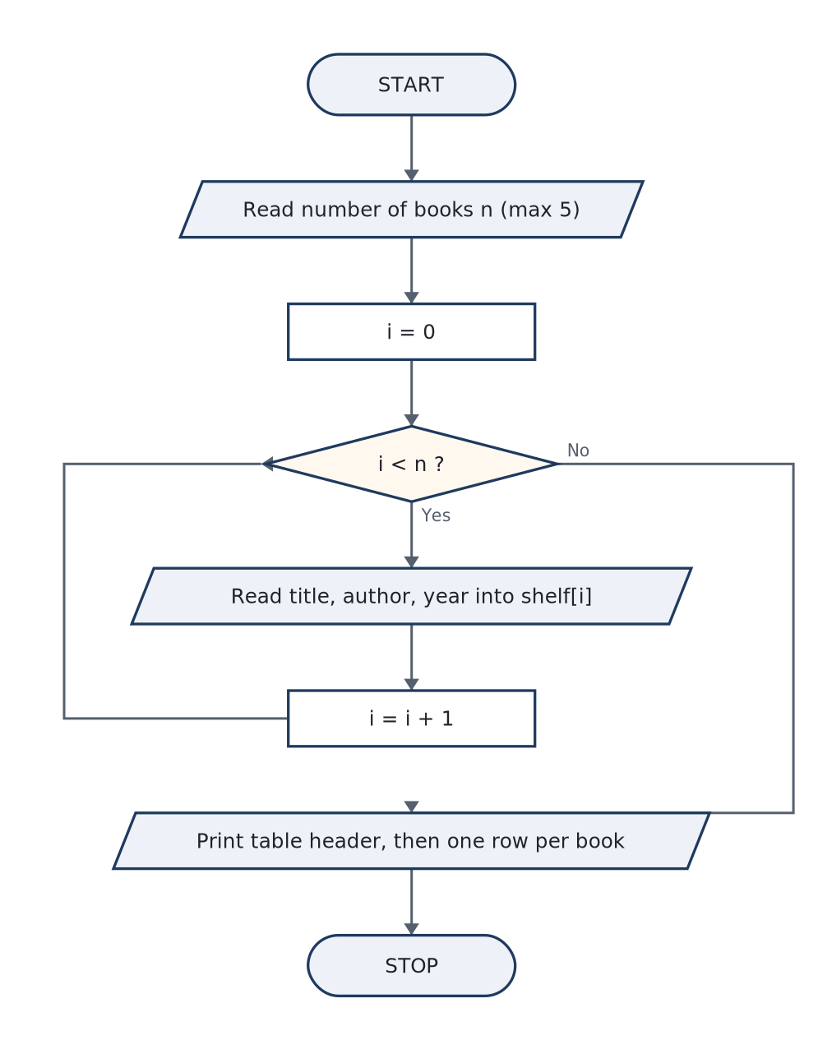
PART-B · ITEM 6
Part-B · Item 6 — The Library Catalogue — Structures: A Row for Every Book
AIM / TASK (VERBATIM FROM THE BOOK)
To design a structure capable of holding a book’s title, author and year of publication and to develop a C program that enters a list of such books into an array and displays the catalogue as an aligned table, in a design that can later be extended to search and sort.
Objective — Declare a struct type and an array of structs; read strings and numbers safely in the same loop (the getchar() after scanf); access members through the dot operator, pass
THE IDEA THE THEORY ESTABLISHES
• A struct definition is a blueprint, not storage — it says how much room a struct Book needs. This program’s row is 60 + 40 + 4 bytes (plus a few of alignment padding — mention it if asked: sizeof returns 108 on the lab machines, not …
• Two design notes turn this from syntax into engineering. One mixed read per row: scanf("%d") leaves its newline in the stream — a later fgets would read that leftover as an empty line; the standard cure getchar(); eats exactly one …
• Entering the count with scanf("%d", &n) and then jumping straight into the first fgets makes only the first book’s title misbehave: the fgets grabs the Enter key from the count and reports an empty title. This happens in every batch, …
ALGORITHM & FLOWCHART — figure from §14.2
DESIGN NOTE
Requirement read-out. “Store and display” with room to grow: rows of the catalogue are structs; the display is a separate function so a future “print by author” or “search by year” reuses the data path, not the print path. Test plan: two books including one with an overlong title (truncation in the table must be neat, not ragged — visible in Run 1’s first row); a zero-count run (empty catalogue prints the header only, no crash
C Programming Lab · 1BPOPL107/207 — classroom slides
44
Notes:
Full explanation: course book, Experiment 14 §14.1 (Theory) and §14.2 (Algorithm & Flowchart). Objective: Declare a struct type and an array of structs; read strings and numbers safely in the same loop (the getchar() after scanf); access members through the dot operator, pass whole books (or arrays of the

Slide 46
PART-B · ITEM 6 · CODE & RUNS
Part-B · Item 6 — Source, Build & Captured Runs
b06_library_struct.c · complete source as compiled · 47 lines
Run 1 — two books entered, one overlong title clipped to the column
/* Experiment B6 -- library book register using a structure
File : b06_library_struct.c
Build : gcc -Wall b06_library_struct.c -o b06_library_struct */
#include <stdio.h>
#include <string.h>
#define MAX_BOOKS 5
struct Book {
char title[60];
char author[40];
int year;
};
void show_books(struct Book b[], int n)
{
printf("\n%-3s %-28.28s %-20.20s %s\n", "#", "TITLE", "AUTHOR", "YEAR");
for (int i = 0; i < n; i++)
printf("%-3d %-28.28s %-20.20s %d\n", i + 1, b[i].title, b[i].author,
b[i].year);
}
int main(void)
{
struct Book shelf[MAX_BOOKS];
int n = 0;
printf("How many books to enter (max %d)? ", MAX_BOOKS);
scanf("%d", &n);
if (n > MAX_BOOKS) n = MAX_BOOKS;
getchar(); /* eat the newline after the count */
for (int i = 0; i < n; i++) {
printf("\nBook %d\n", i + 1);
printf(" Title : "); fgets(shelf[i].title, 60, stdin);
printf(" Author : "); fgets(shelf[i].author, 40, stdin);
printf(" Year : "); scanf("%d", &shelf[i].year);
getchar();
shelf[i].title[strcspn(shelf[i].title, "\n")] = '\0';
shelf[i].author[strcspn(shelf[i].author, "\n")] = '\0';
}
printf("\n===== LIBRARY CATALOGUE =====");
show_books(shelf, n);
return 0;
}
How many books to enter (max 5)? 2
Book 1
Title : C Programming Absolute Beginner's Guide
Author : Greg Perry
Year : 2014
Book 2
Title : Let Us C
Author : Yashavant Kanetkar
Year : 2023
===== LIBRARY CATALOGUE =====
# TITLE AUTHOR YEAR
1 C Programming Absolute Begin Greg Perry 2014
2 Let Us C Yashavant Kanetkar 2023
C Programming Lab · 1BPOPL107/207 — classroom slides
45
Notes:
Compile at the bench with exactly this command (the book's §14.4 shows the same terminal). Runs captured in out/: b06_library_struct_r1.txt. Run interactively: prompts answered at the keyboard (b05 takes none — it auto-feeds values, as the book notes).

Slide 47
PART-B · ITEM 6 · DEFENCE
Part-B · Item 6 — Observations, Result & Viva
OBSERVATIONS & ANALYSIS
VIVA — AS ASKED AT THE INTERNAL
Run 1’s first row shows the truncation policy doing its job: “C Programming Absolute Begin” is the 28-column window onto a 39-character title — the stored string keeps the full text, the table sacrifices the tail. That difference (display ≠ storage) is the whole argument for keeping widths out of the data model; a truncated stored title would lose information. Both books display with aligned columns; the year column proves the int/char-array mixture in one row is no trouble once the input discipline is right. Inference. …
• Q1. What does the compiler reserve for struct Book shelf[5] — and how do you check the size of one row?
• Q2. Why does shelf[i].title need no & in fgets while shelf[i].year needs & in scanf?
• Q3. What is the visible effect of forgetting getchar() after the count scanf?
• Q4. Explain %-28.28s field by field.
RESULT. A catalogue program was designed around struct Book {char title[60]; char author[40]; int year;} and an array of five rows; with a mixed fgets/scanf input loop (including the newline discipline), a display function printed an aligned, truncation-safe. …
C Programming Lab · 1BPOPL107/207 — classroom slides
46
Notes:
Viva answers for this experiment, all of them, are in the book §14.7 — the on-slide panel shows Q1–Q4 plus the first model answer.

Slide 48
P A R T
C
Appendices — Reference, Records, Viva, Sources
IN THIS PART
• Appendix A — C language quick reference (compilation, operators, storage, library, top diagnostics)
• Appendix B — record format, evaluation rubrics and the terminal-checking procedure
• Appendix C — consolidated viva bank across the 14 experiments
• Appendix D — textbook, references and the provenance of every capture
47

Slide 49
PART C · APPENDICES
One-Page C Reference (from Appendix A)
Compile & build
Types & library
Strings & arrays
Pointers & structs
gcc -Wall -Wextra f.c -o f -lm
run: ./f
link order: source BEFORE -lm
-std=c11 for modern
warnings are part of the record
int/long/float/double/char
scanf("%f", &x) — the & is required
math.h: sqrt pow fabs
stdlib: rand srand malloc free
printf: %d %f %.2f %s %c %ld %p
char s[N]; read: fgets
strlen strcpy strcmp — string.h
arrays decay to pointers
2-D: a[R][C] row-major
NULL terminator '\0' is real
*p deref &addr
p->fld == (*p).fld
malloc + NULL check + free
struct S {…} — . operator
typedef hides the tag
The classic diagnostic: undefined reference to `sqrt` ⇒ rebuild with -lm AFTER the source — the exact command line above.
C Programming Lab · 1BPOPL107/207 — classroom slides
48

Slide 50
PART C · APPENDICES
Viva Preparation — the Recurring Twelve
• 1. 'T' or 'F' in the output? printf has no bool — you printed an int.
• 2. why does 7/2 print 3? (integer division — the top semantic bug)
• 3. scanf returns what — and why must you read it?
• 4. buffer overflow: char name[16] then 2000 letters — what happens, which command shows it?
• 5. sqrt() won't link — the one-command fix, and why the order matters
• 6. 1-D vs 2-D arrays: what does a[i][j] become in memory?
• 7. malloc without a NULL check — the sentence to say at the bench
• 8. struct-by-value vs pointer-to-struct — when does the caller see the change?
• 9. realloc vs malloc+copy+free — why the growth factor costs memory
• 10. what is 'garbage' in C — which line of your own output proves it exists
• 11. why does the flowchart have a loop-back arrow? (iteration, exit condition)
• 12. the result sentence — say your experiment in one breath
HOW THE INTERNAL VIVA RUNS
1 · pick one program cold; run it at the bench.
2 · questions turn on YOUR code — name the construct per line.
3 · open with: data flow → key construct → the evidence in the output.
Answer the 'why': 7/2 == 3 is a fact; 'both operands are int' is the tick.
C Programming Lab · 1BPOPL107/207 — classroom slides
49

Slide 51
PART C · APPENDICES
References & Sources
• Prescribed textbook: R. G. Sivanagamani, G. Deepa — Programming in C for First-Year Engineering Students, Pearson, Second Edition, 2025.
• Reference: Reema M. Tharakan — Let Us Understand C: A Programmers' Approach, S. Chand & Company Pvt. Ltd., Second Edition, 2015.
• E-resources: smile.ece.cmu.edu/~german/15110-f17 (recursion) · u.osu.edu/cerc/TeachingMaterials/ (flowcharts) · en.cppreference.com/w/c (the C standard library reference)
• Slides source: the C-Programming-Lab course book (1BPOPL107/207) — code read from the same src/*.c files, flowcharts from the same figures, outputs from the out/*.txt pty captures; all built with gcc 14.2 -Wall -Wextra.
• Honesty panel: no output on these slides was hand-typed; where a guard run is shown, it was provoked deliberately.
END OF DECK · the complete 92-page record-format book carries every section in full — the experiments, the rubrics, the viva bank and the appendices.
C Programming Lab · 1BPOPL107/207 — classroom slides
50

