Slide 1
Online Customer Intention Prediction
LOKESH MULPURU
IBM Advanced Data Science Capstone

Slide 2

Use Case
Model user behavior based on their interactions with an e-commerce website
Measure which website actions correlate with revenue and sales
Identify seasonality and trends in buying behaviors

Slide 3
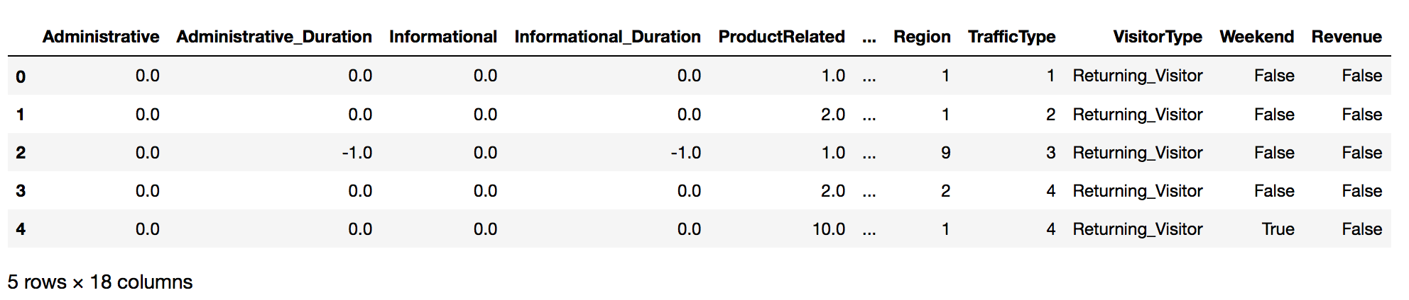
Dataset
The dataset was obtained from Kaggle (https://www.kaggle.com/roshansharma/online-shopper-s-intention)
Dataset consists of 12316 samples and 18 features of which 8 are categorical and 10 are numeric

Slide 4
Data Quality Assessment
The Data consists of 0.11 percent Missing values
Some duration values were negative suggesting outliers or missing values
The numerical features are highly skewed.
The Prediction classes are imbalanced with 1908 True and 10422 False classes

Slide 5
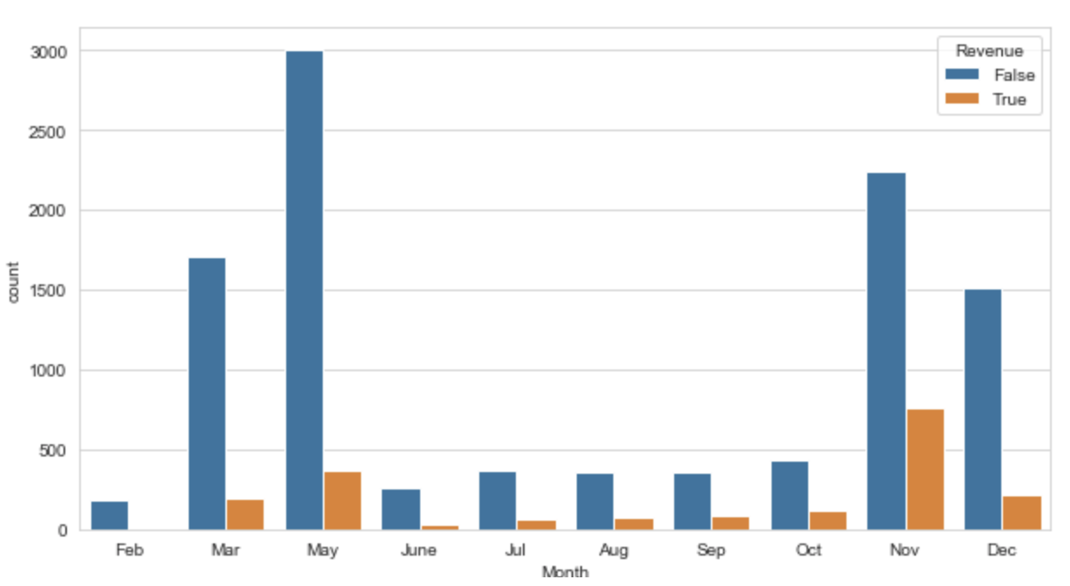
Exploration and Visualization
Website visitors and their contribution towards Revenue for different Months

Slide 6
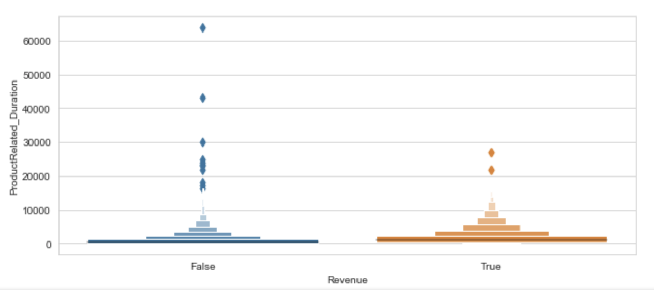
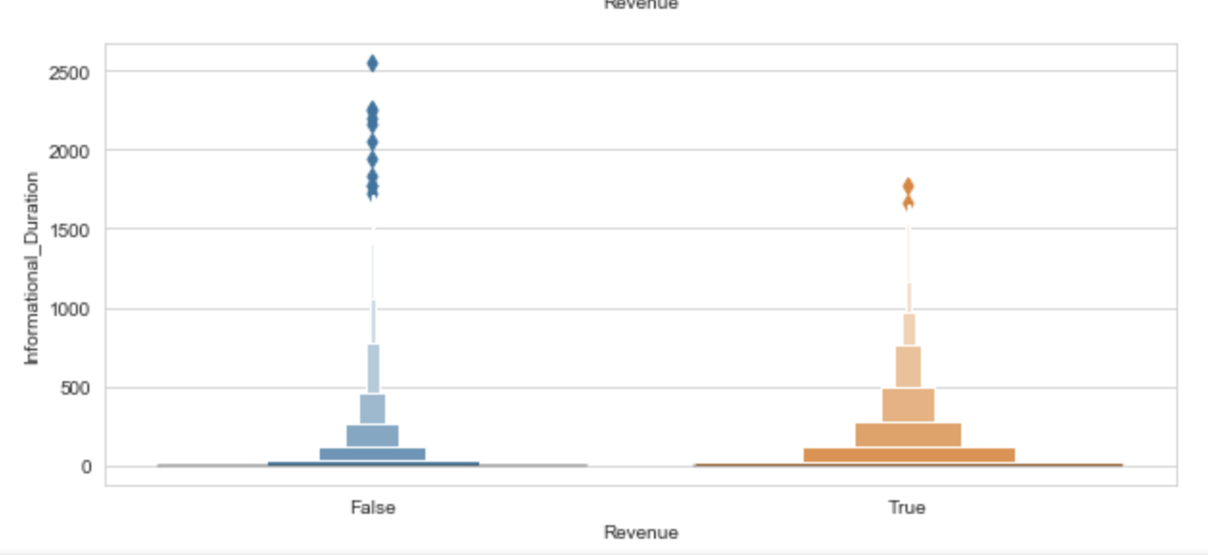
Exploration and Visualization
Enhanced Box Plots for outlier Detection

Slide 7
Feature Engineering
Missing values were dropped
Each numerical values was clipped to remove outliers
Categorical variables were One Hot encoded
Three different feature sets were generated
  No scaling
  Scaled using MinMax scaler
  Yeo Johnson transformation

Slide 8
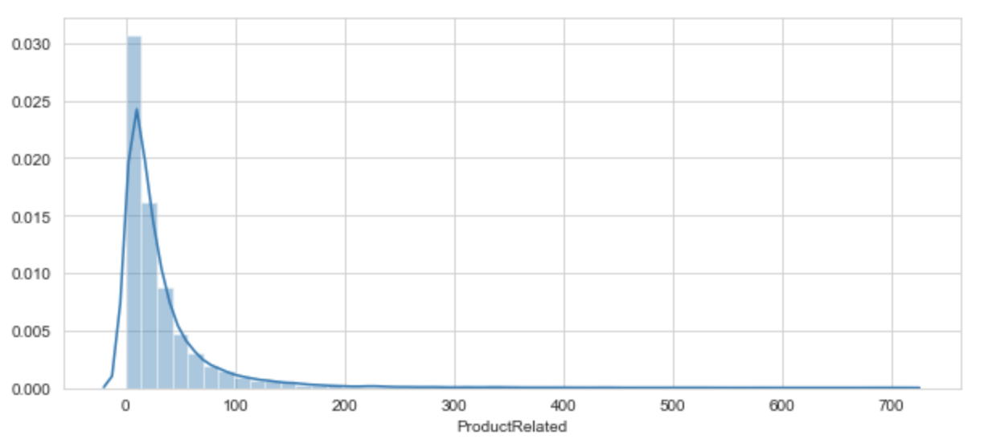
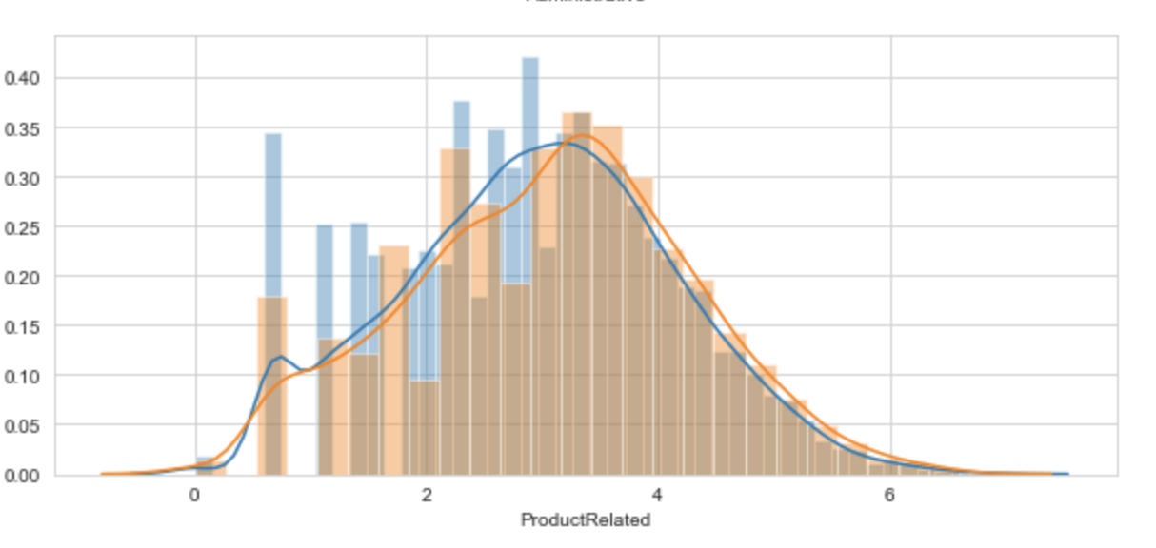
Exploration and Visualization
Before (left) and after applying Yeo Johnson Transformation on one feature

Slide 9
Model Performance Indicator
To handle imbalance of classes Balanced accuracy score was used
Balanced accuracy is calculated as the average of the proportion corrects of each class individually.

Slide 10
Model Selection
Two models were uses:-
  Gradient boosted tree implemented with LightGBM
  Deep Neural Network implemented with Keras
Hyper-parameters For each models were optimized using Bayesian optimization
The models were evaluated on all 3 three feature sets.

Slide 11
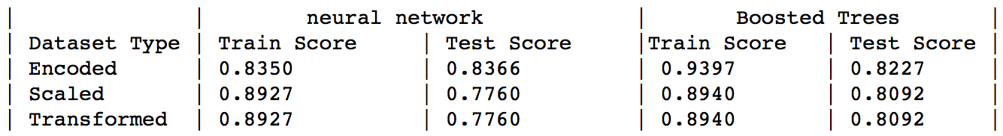
Results

Slide 12
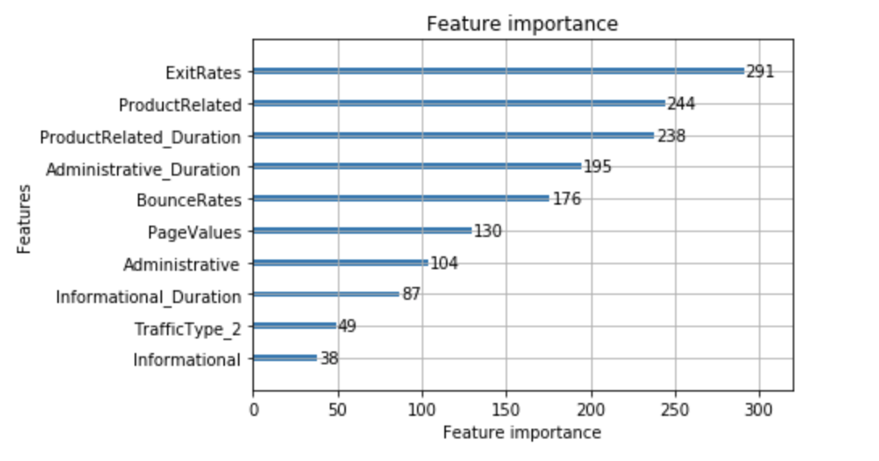
Results
TOP 10 most important features

Slide 13
Conclusion
Dataset was cleaned , explored and visualized
Three transformations were tested and applied
Two models were trained
Top 10 correlating features were isolated

Slide 14
THANK YOU

