Slide 1
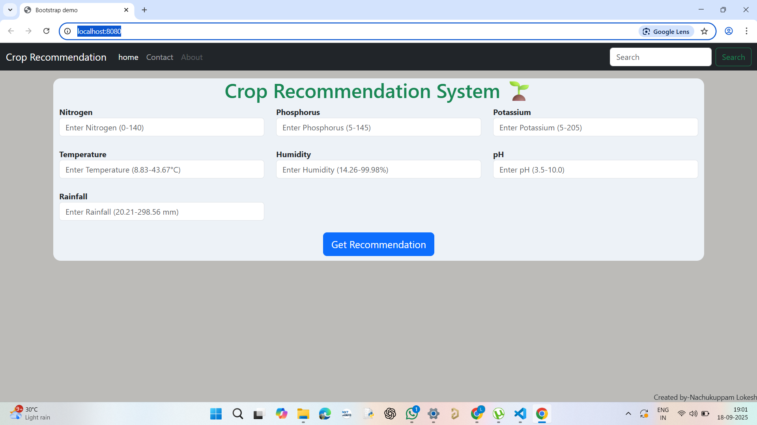
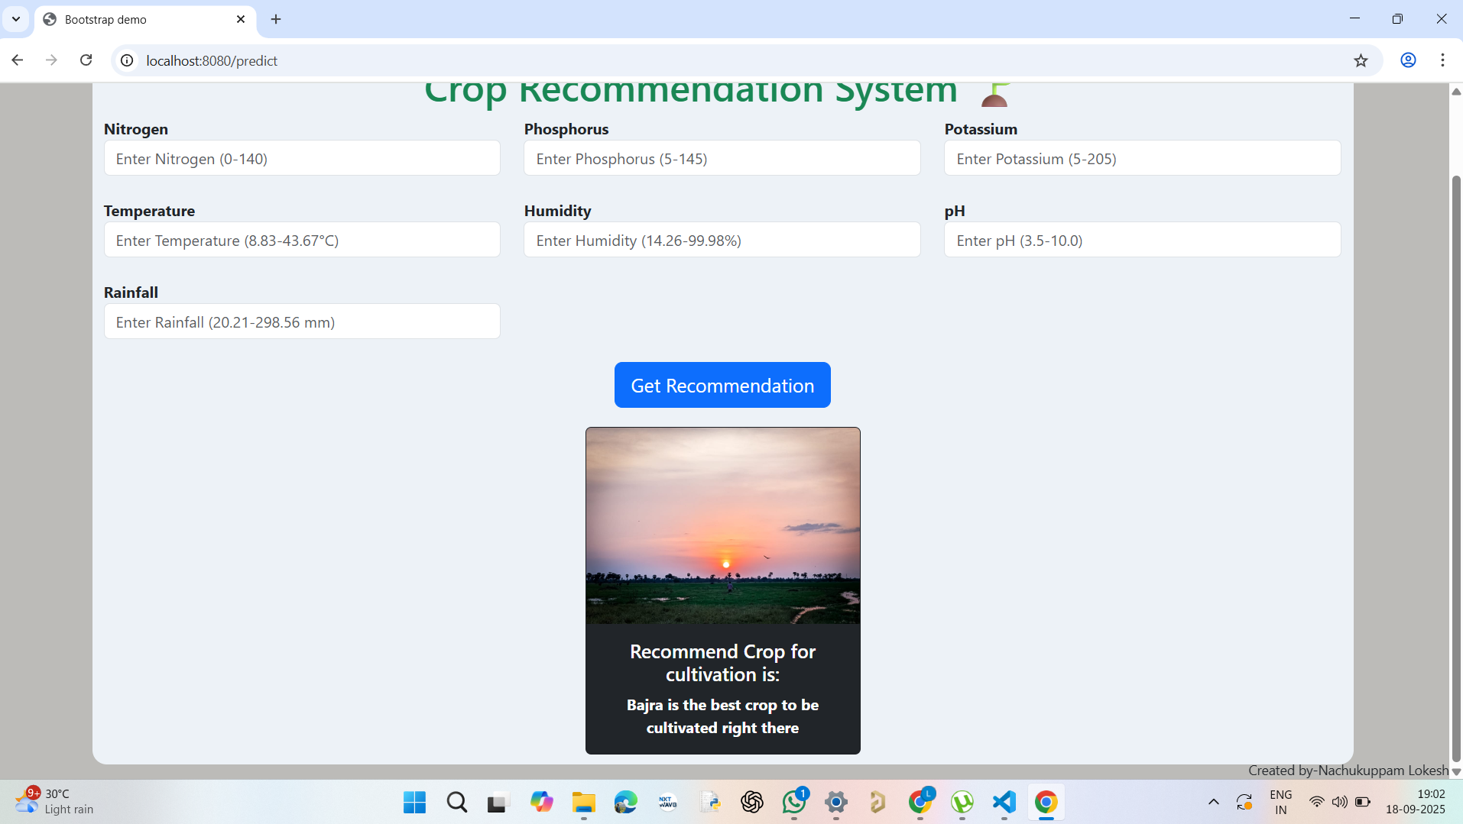
Crop Yield Forecasting Using Environmental and Soil Data
Created by
Nachukuppam Lokesh

Slide 2
Agenda
1. Introduction
2. Project Objective
3. System Architecture
4. Technologies & Dependencies
5. Machine Learning Model
6. Demonstration
7. Conclusion

Slide 3
Introduction
Agriculture is highly dependent on environmental and soil conditions.
Farmers face challenges in choosing the right crop.
This project leverages machine learning for crop yield forecasting.
Web application developed using Flask.

Slide 4
Project Objective
Forecast the best crop to cultivate based on soil and environmental data.
Provide farmers with reliable crop recommendations.
Improve agricultural productivity and decision-making.

Slide 5
System Architecture
1. User inputs soil and environmental parameters.
2. Data preprocessing using MinMaxScaler.
3. Trained RandomForestClassifier predicts the suitable crop.
4. Flask web app displays crop recommendation.

Slide 6
Technologies & Dependencies
Libraries Used:
• Flask – Web application framework
• NumPy – Numerical computations
• Pandas – Data manipulation
• Scikit-learn – Machine learning
• Pickle – Model storage
Models Used:
• RandomForestClassifier
• MinMaxScaler

Slide 7
Demonstration
• Web interface for inputting soil and weather data.
• Example: Nitrogen, Phosphorus, Potassium, Temperature, Humidity, pH, Rainfall.
• System outputs the recommended crop.
• Helps farmers make data-driven decisions.

Slide 8
Conclusion
• Machine learning improves crop forecasting accuracy.
• Supports farmers in sustainable agriculture.
• Future Scope: Integration with real-time IoT sensors and weather APIs.

