Slide 1
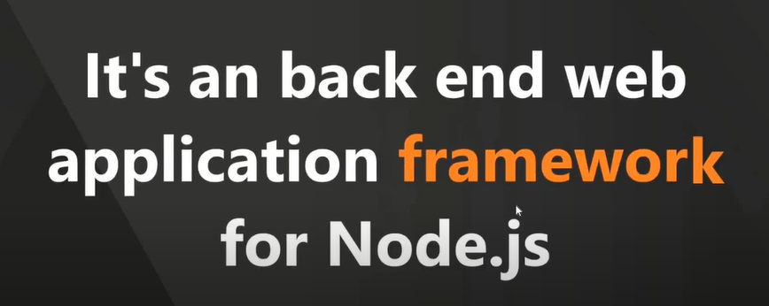
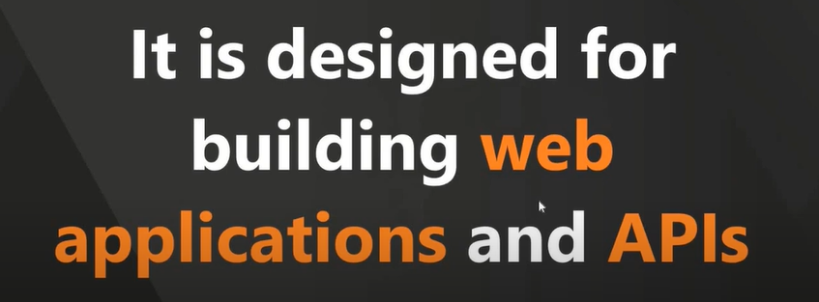
ExpressJS

Slide 2
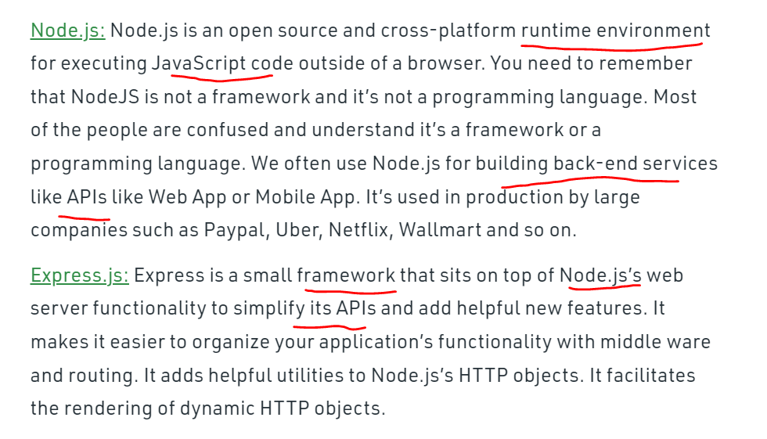
NodeJS Vs ExpressJS

Slide 3
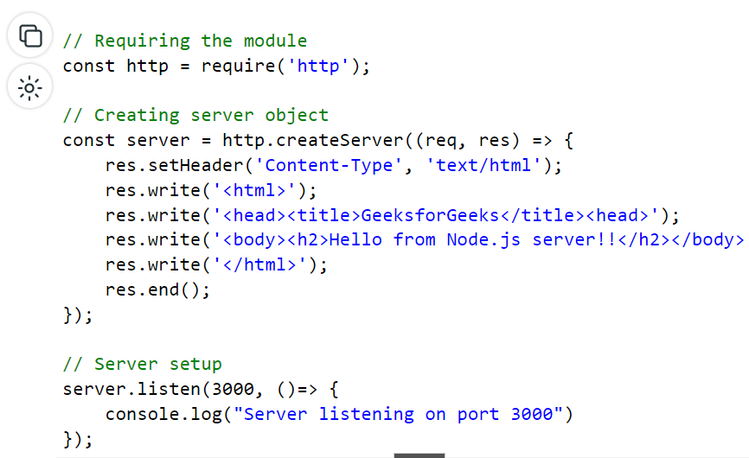
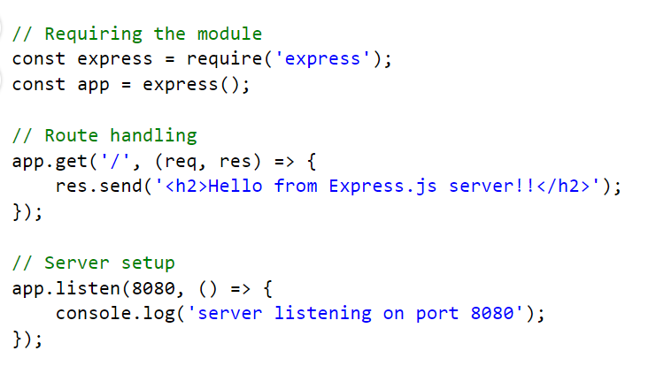
Starting a server in Node.js & Express.js
Automatic status code is generated

Slide 4
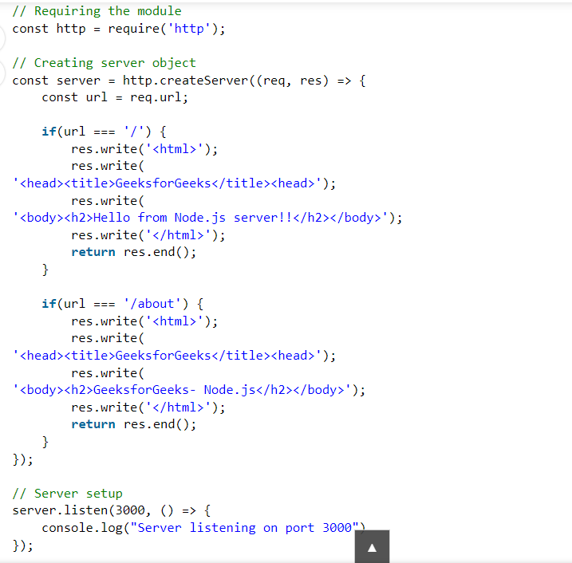
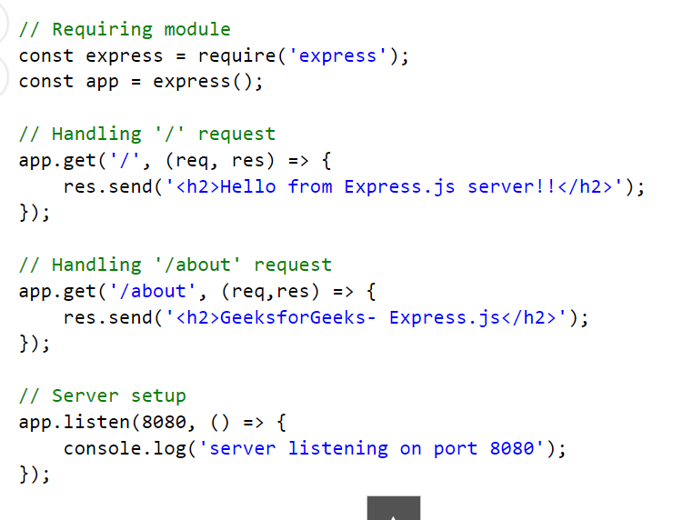
Routing in Node.js & Express.js
Routing is provided

Slide 5
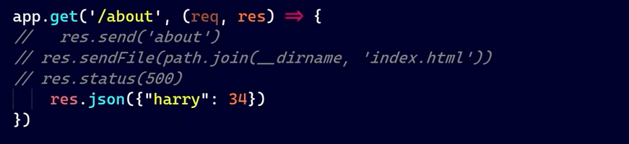
Passing html file, status code and json data
No setHeader required

Slide 6
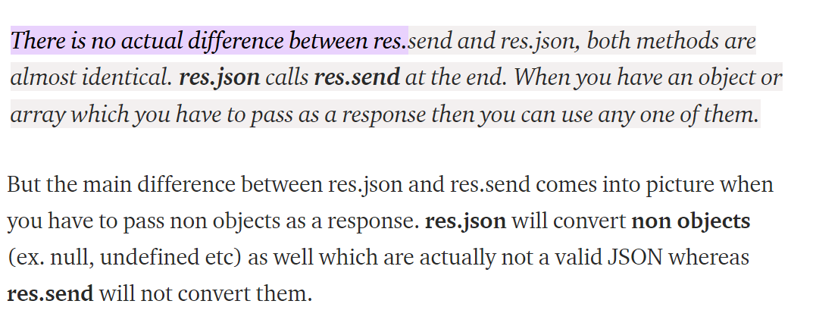
res.json Vs res.send

Slide 7
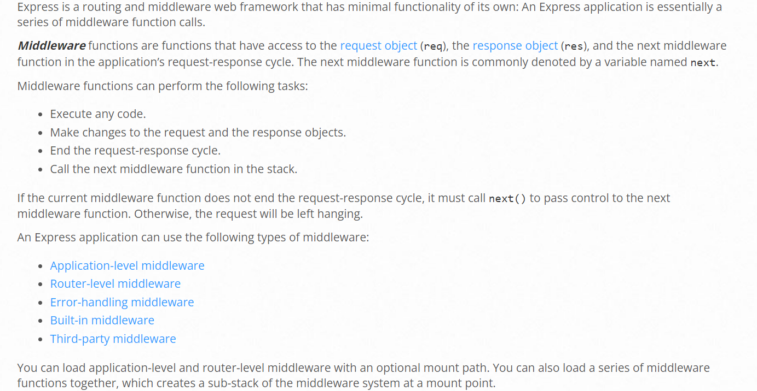




Middleware
https://expressjs.com/en/guide/using-middleware.html

Slide 8
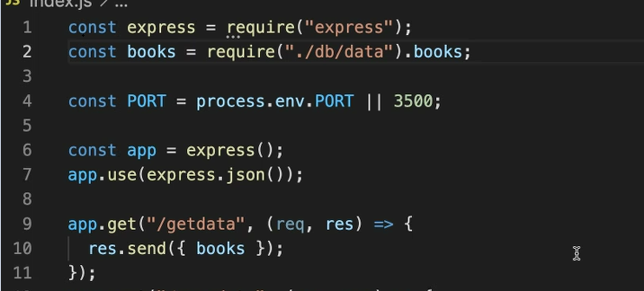

Ex :

Slide 9
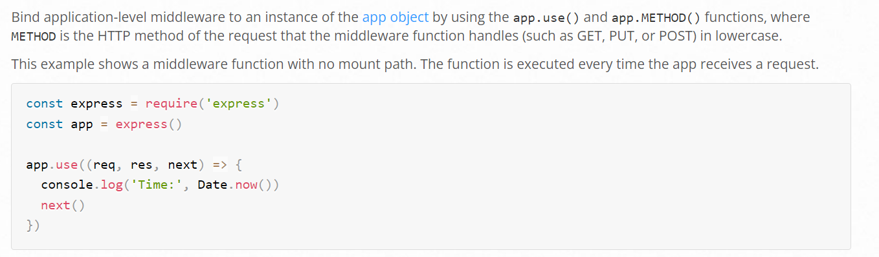

Application-level middleware

Slide 10
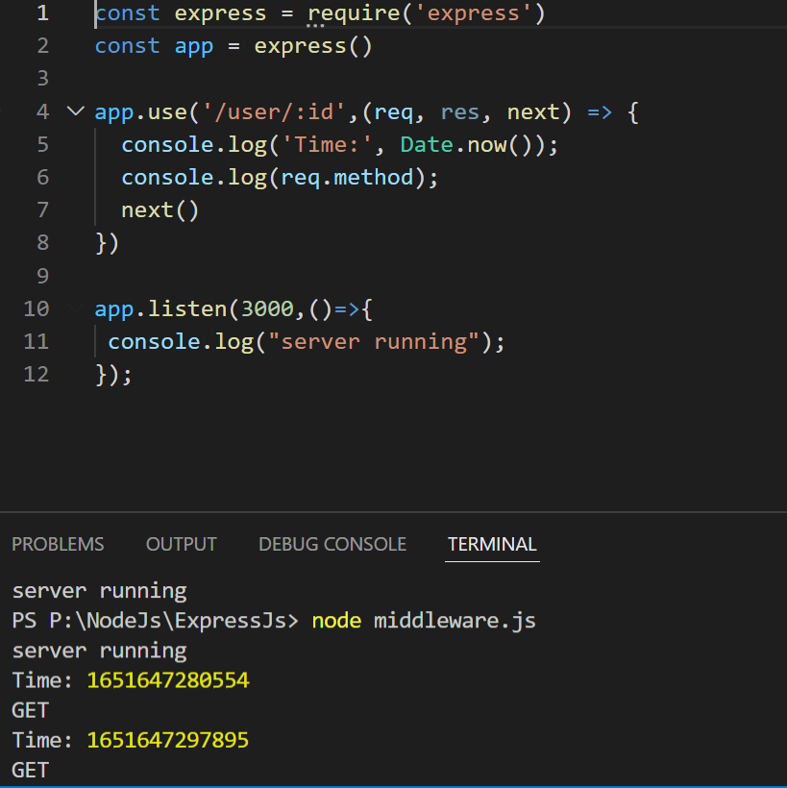
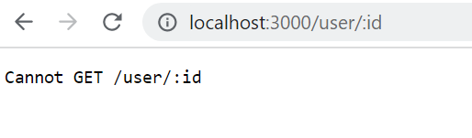
Application-level middleware
This example shows a middleware function mounted on the /user/:id path. The function is executed for any type of HTTP request on the /user/:id path.

Slide 11
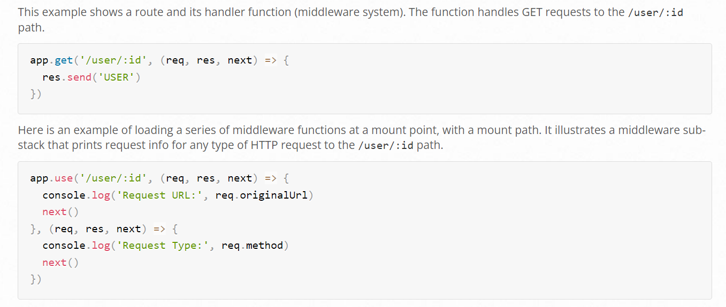
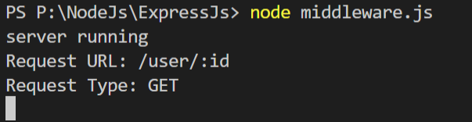





Application-level middleware

Slide 12
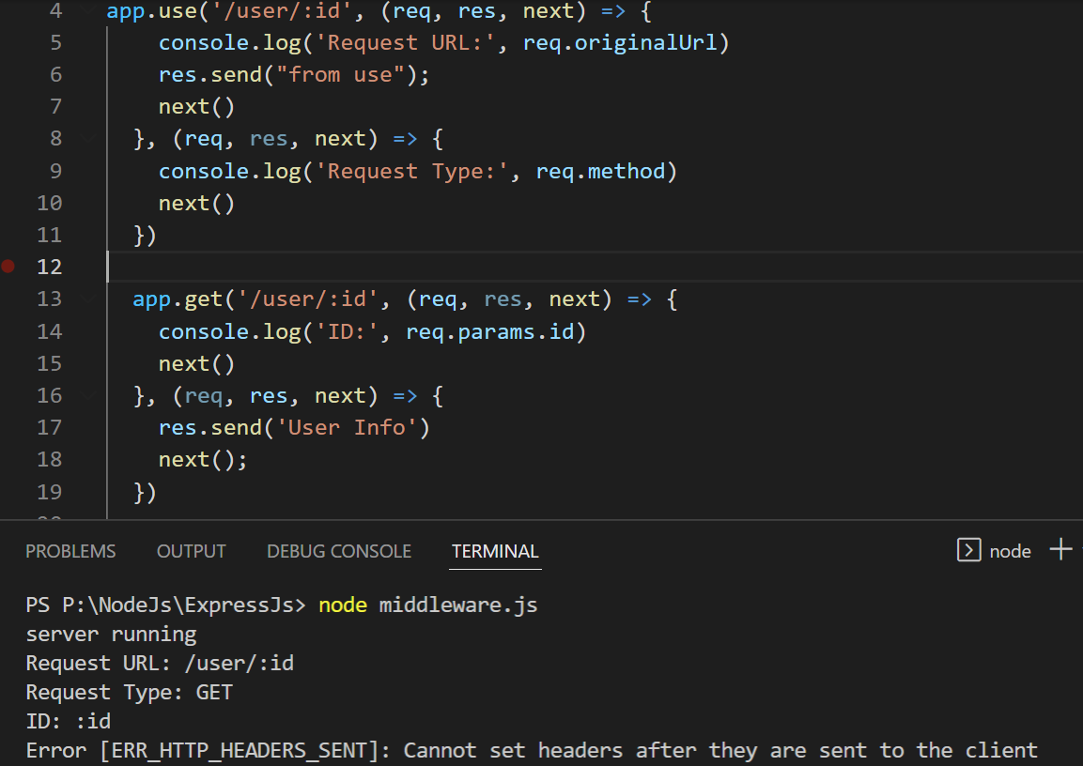
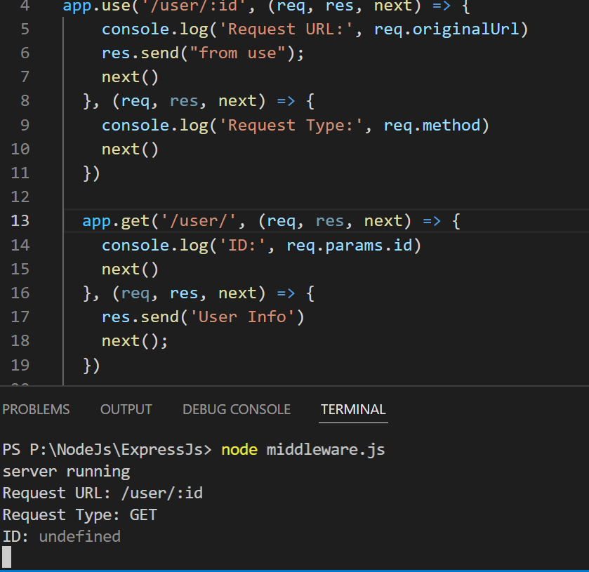
Application-level middleware
Error

Slide 13
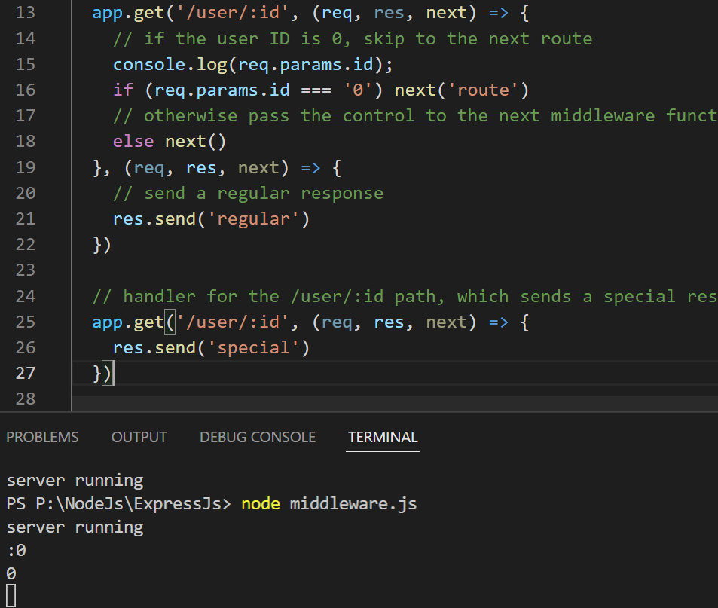
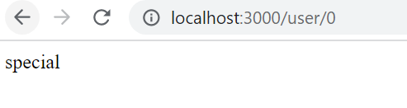
Application-level middleware
To skip the rest of the middleware functions from a router middleware stack, call next('route') to pass control to the next route. NOTE: next('route') will work only in middleware functions that were loaded by using the app.METHOD() or router.METHOD() functions.
This example shows a middleware sub-stack that handles GET requests to the /user/:id path.

Slide 14
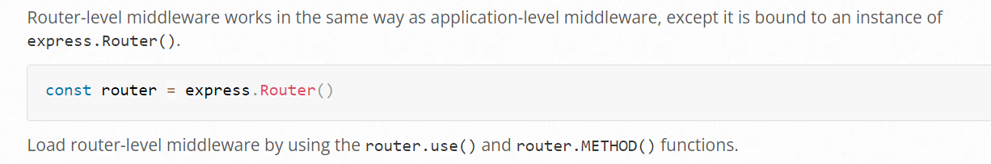
Router-level middleware

Slide 15
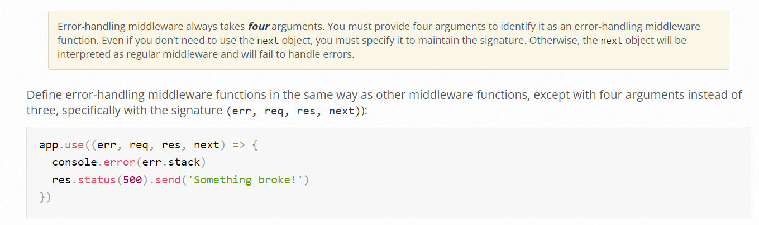
Error-handling middleware

Slide 16
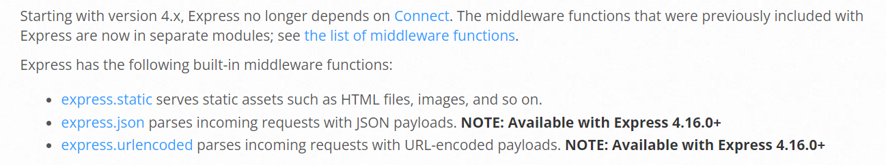
Built-in middleware

Slide 17
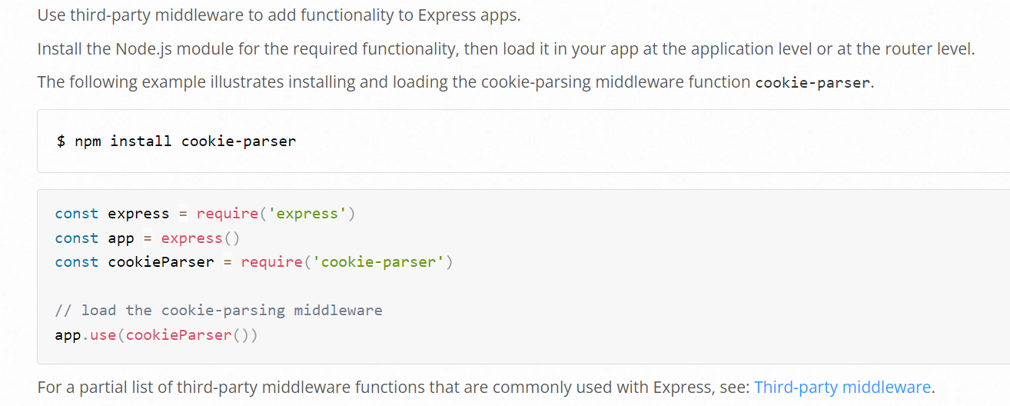
Third-party middleware

Slide 18
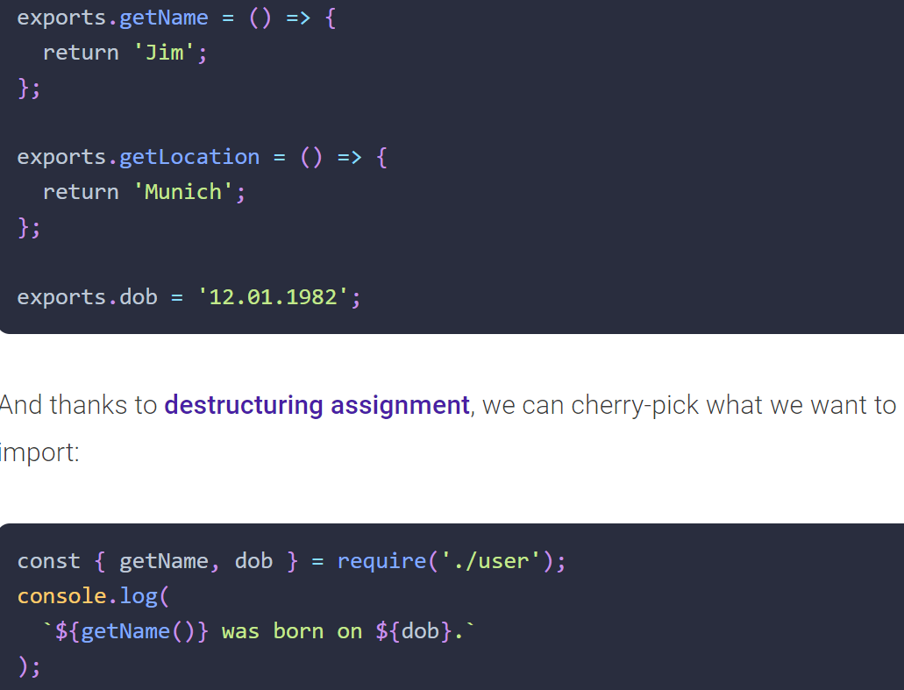
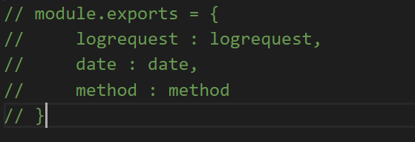
Export and import multiple functions

Slide 19
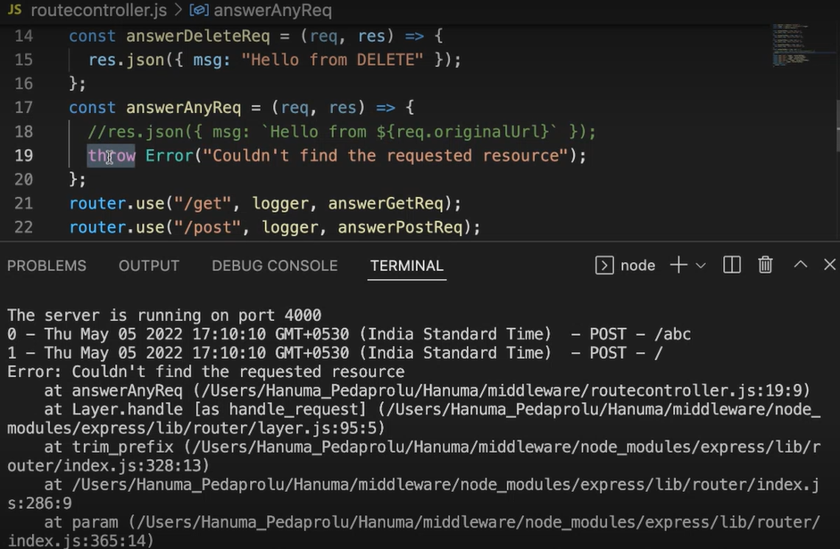
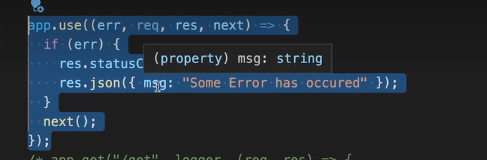
For invalid requests throwing error
Here, server crashes,
So for that, we use error handler middleware.

