Slide 1
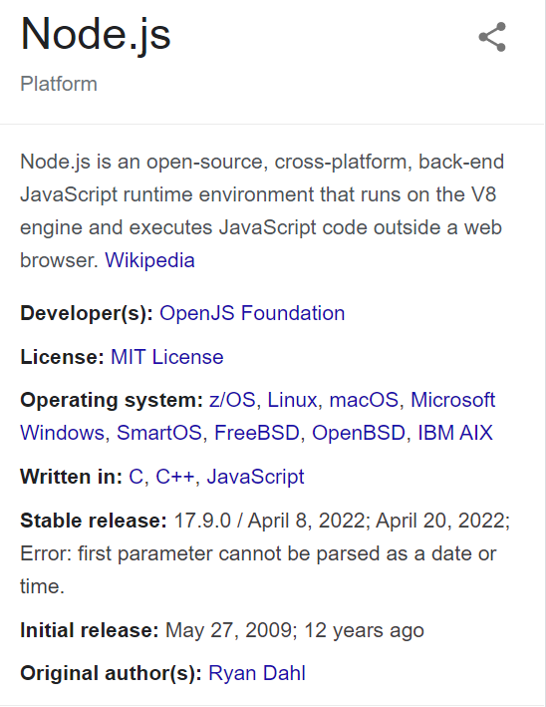
What is Node js

Slide 2
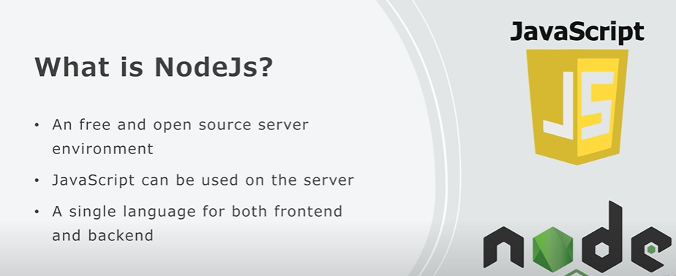

Slide 3
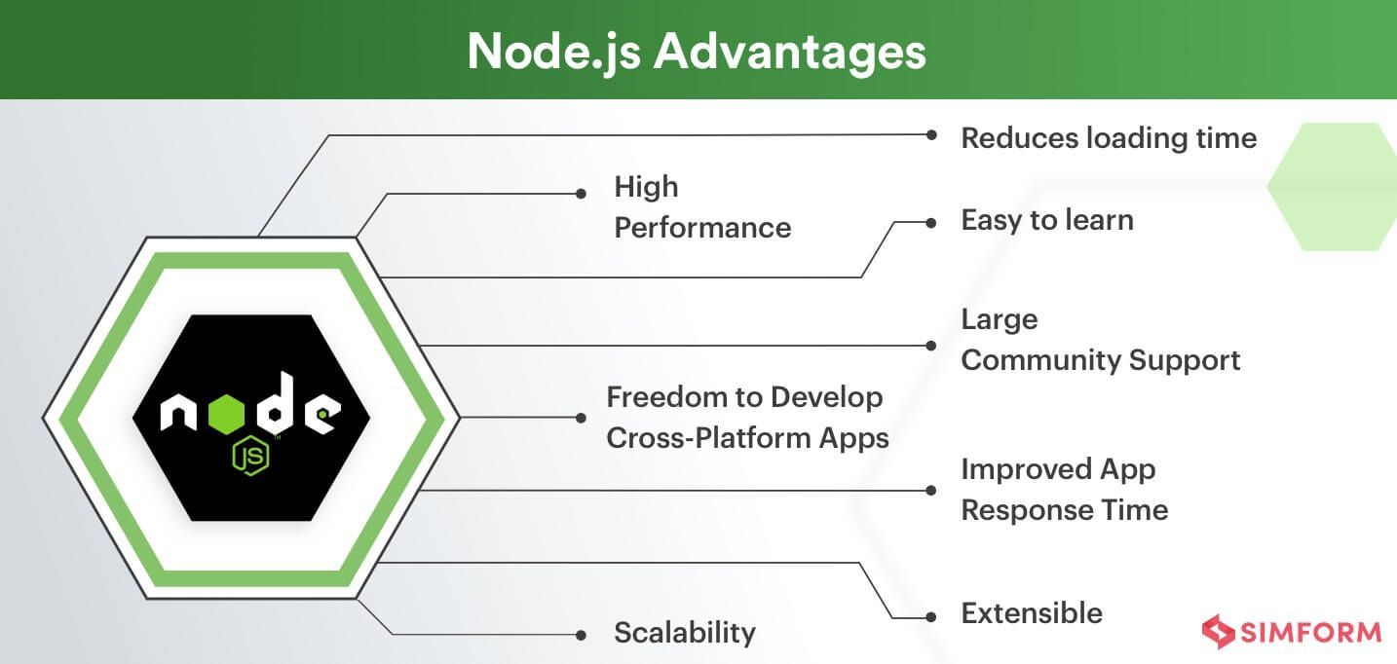
Why NodeJS
Asynchronous Non Blocking I/O Model

Slide 4
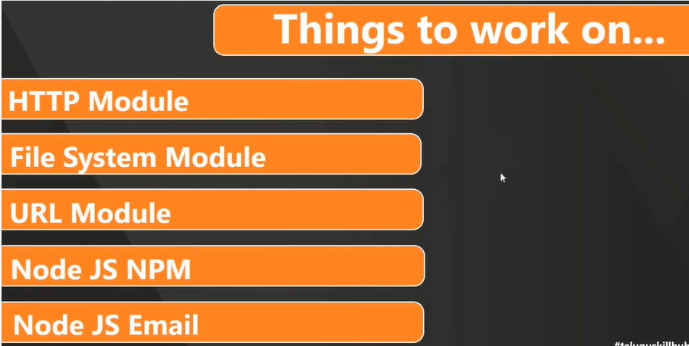
Ref: https://nodejs.org/api/ -- Imp

Slide 5
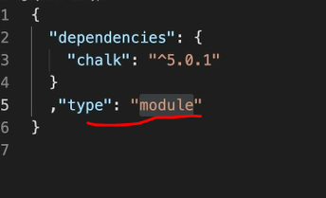
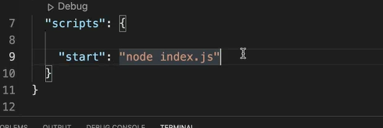
npm init – to initialize and create package.json file
Before using any module after installing, include type: ‘module’ for es6 and ‘commonjs’ for es5 before.
We transfer only package.json and our js file with others
shortcut

Slide 6
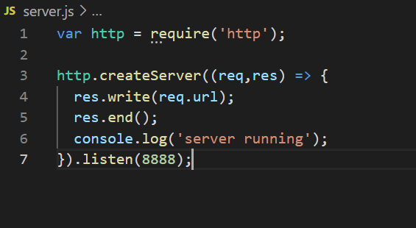
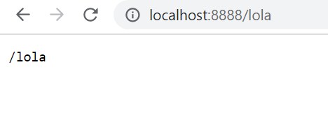
Http Module

Slide 7
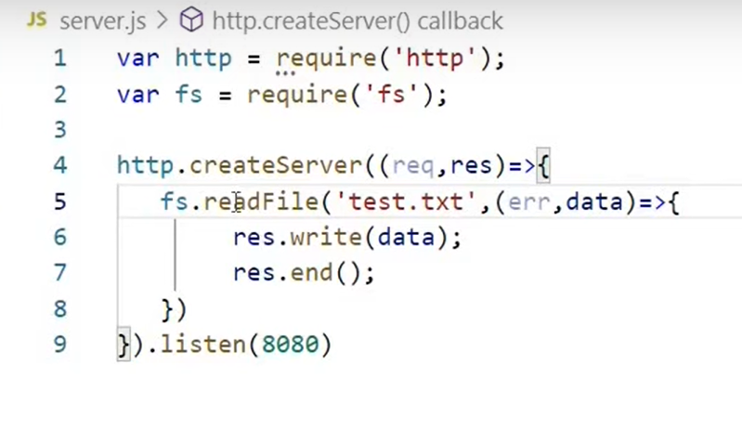
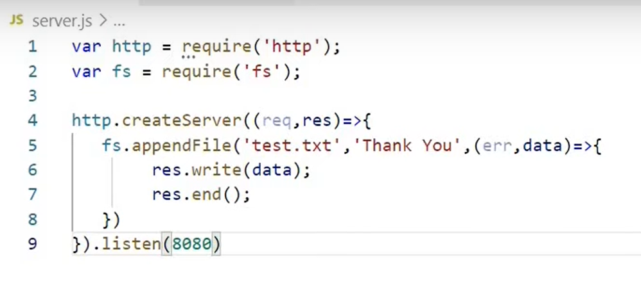
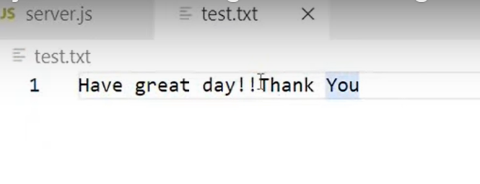
File System Module
writeFile – overridden, unlink - delete

Slide 8
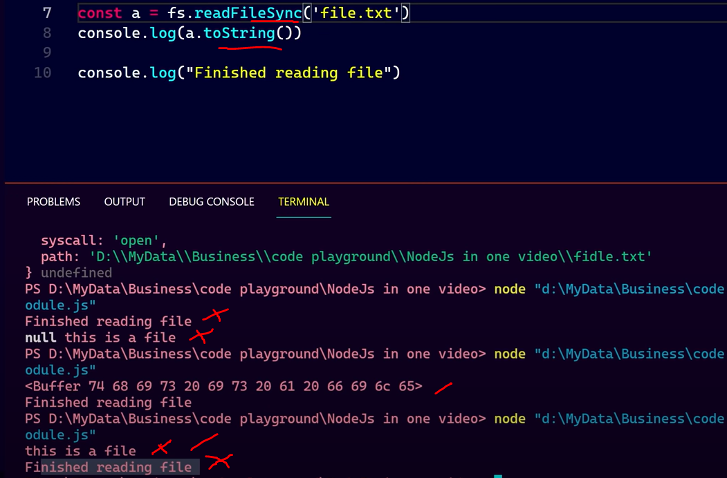
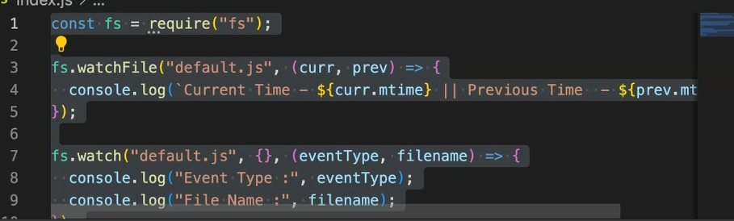

Slide 9
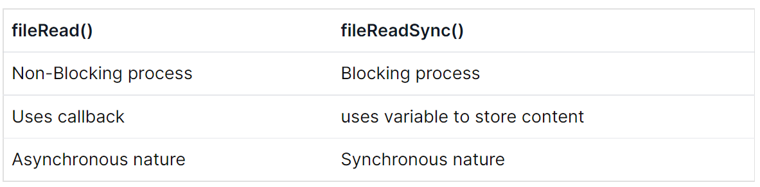
fileRead Vs fileReadSync

Slide 10
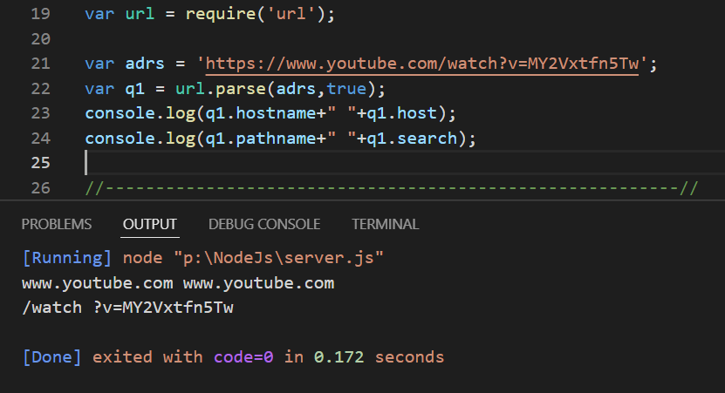
URL Module
Ref: https://nodejs.org/api/url.html

Slide 11
Some other modules
os
path
events
Ref : https://nodejs.org/api/

Slide 12
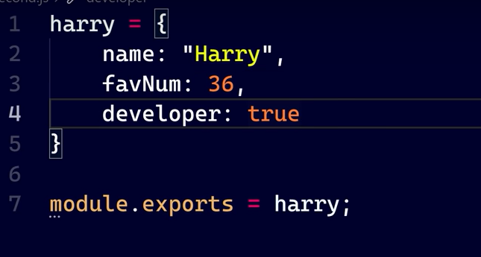
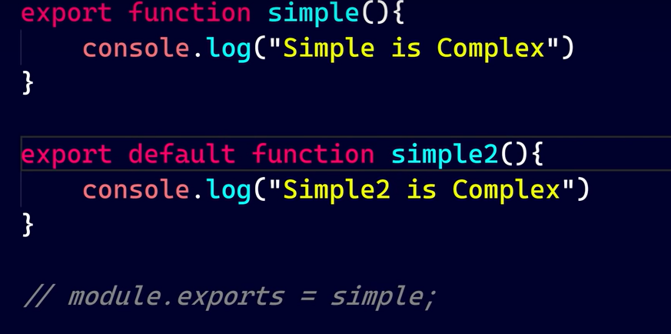
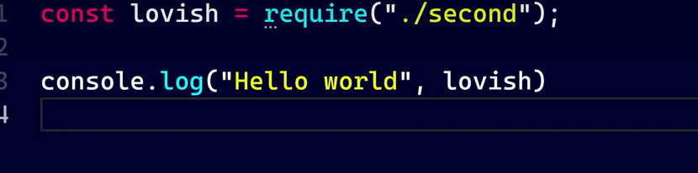
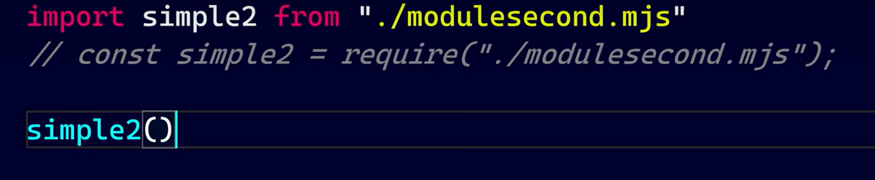

Export and Import modules
Common js modules
ES6 modules

Slide 13
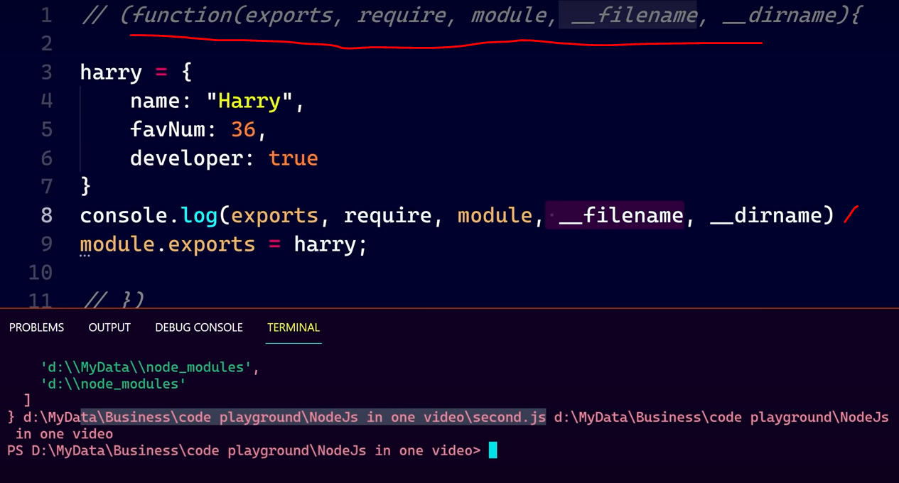
Module Wrapper Function
In nodejs, every module is automatically wrapped

Slide 14
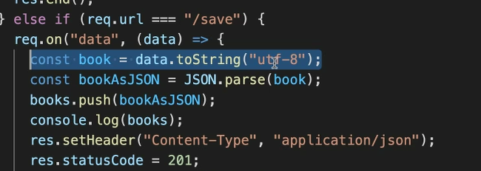
On Fn for Post request

