Slide 1


Course Name: Engineering Design Project
Course Code: (ACSD29)
Topic Name: LOKSAMADHAN 360
Batch Number: 03
Presenter’s names and roll no: B LOKESH(25955A6610) Ch KOUSHIK(24951A6678)
Department Name – CSE-(AI&ML)
Semester & Section – V Sem B-Section
Presentation Date – 28/10/2026

Slide 2

Contents of the Presentation
Abstract
Problem Statement
Introduction
Requirements
Prerequisites
Technologies Used
Algorithms Used
Literature Review
Methodology
Result and Discussions
Conclusion and Future Scope

Slide 3
Abstract
LokSamadhan360 is an AI-powered civic complaint management platform designed to improve public services and government accountability. It enables citizens to report issues related to roads, water supply, electricity, sanitation, and other civic facilities. Users can submit complaints with images and GPS-based locations for accurate identification. The system assigns complaints to relevant departmental employees based on the issue category and location. AI techniques help detect duplicate complaints, assess severity, and prioritize critical issues. Real-time status tracking, resolution verification, and escalation mechanisms promote transparency and accountability. Overall, LokSamadhan360 aims to build smarter, more responsive, and citizen-centric urban governance.

Slide 4
Problem Statement
Traditional civic complaint management systems often face challenges such as delayed responses, poor coordination between departments, duplicate complaints, lack of transparency, and inadequate monitoring of issue resolution. Citizens struggle to track their complaints and ensure timely action, while authorities lack efficient tools to prioritize problems based on severity and public impact. Therefore, LokSamadhan360 aims to develop an AI-powered civic complaint management platform that enables location-based complaint reporting, intelligent categorization, severity assessment, department-wise assignment, real-time status tracking, and resolution verification to improve government accountability and deliver faster, more efficient, and citizen-centric public services.

Slide 5
Introduction
LokSamadhan360 is an AI-powered civic complaint management platform that connects citizens with government authorities to resolve public issues efficiently. It enables location-based complaint reporting, automatic categorization, department-wise assignment, and real-time status tracking. The platform aims to improve transparency, accountability, and the quality of public services.

Slide 6
Requirements
Hardware Requirements:
Processor: Intel Core i3 or above
RAM: Minimum 4 GB (8 GB recommended)
Storage: Minimum 256 GB HDD/SSD
GPS Device: GPS-enabled smartphone for location-based complaint reporting
Camera: Smartphone camera or webcam for capturing civic issues
Software Requirements:
Operating System: Windows 10/11 or Linux
Frontend: HTML, CSS, JavaScript, React.js
Backend: Node.js
Database: MongoDB
AI/ML: Python, Machine Learning libraries
Maps & Location: Google Maps API / OpenStreetMap
Development Tools: Visual Studio Code, Git, GitHub

Slide 7
Prerequisites
Prerequisites:
Basic knowledge of web development (HTML, CSS, JavaScript).
Understanding of frontend and backend technologies.
Basic knowledge of databases and data management.
Familiarity with AI/ML concepts for complaint analysis.
Access to GPS, maps, and image-upload services.
Visual Studio Code and Git/GitHub for development.
Stable internet connection for API integration and testing.

Slide 8
Technologies Used
Frontend: React.js, HTML, CSS, JavaScript
Backend: Node.js, Express.js
Database: MongoDB
AI/ML: Python, Machine Learning
Maps & Geolocation: Google Maps API / OpenStreetMap
Authentication: JWT / OTP verification
Image Processing: OpenCV
Development Tools: Visual Studio Code, Git, GitHub
Deployment: Vercel / Render

Slide 9
Algorithms Used
Classification Algorithm: Categorizes civic complaints into departments such as roads, electricity, water, and sanitation.
Duplicate Detection Algorithm: Uses text similarity to identify repeated complaints about the same issue.
Severity Assessment Algorithm: Assigns priority levels based on complaint type, severity, and public impact.
Geolocation Algorithm: Uses GPS coordinates to identify the complaint location and nearby issues.
Image Classification Algorithm: Uses computer vision to analyze uploaded images and identify civic problems.
Priority Ranking Algorithm: Ranks complaints based on urgency, severity, and community impact.
Clustering Algorithm: Groups nearby complaints to identify civic problem hotspots.

Slide 10
Literature Review
S.No. | Research Area | Description
1 | E-Governance Systems | Enable citizens to submit complaints online and track their status.
2 | Smart City Applications | Use digital technologies to improve urban infrastructure and public services.
3 | GIS-Based Complaint Management | Uses geographical information to identify and locate civic issues.
4 | AI-Based Classification | Automatically categorizes complaints and assigns them to relevant departments.
5 | Image Processing | Analyzes uploaded images to identify civic problems and estimate their severity.

Slide 11
Methodology
User Registration: Citizens and departmental employees log in securely.
Complaint Submission: Citizens upload images, descriptions, and location details of civic issues.
Complaint Classification: The system categorizes complaints based on issue type.
AI-Based Analysis: AI identifies duplicate complaints and assesses issue severity.
Department Assignment: Complaints are assigned to the appropriate department.
Status Tracking: Employees update complaints as Pending, In Progress, or Completed.
Resolution Verification: Completed work is verified to improve transparency and accountability.
Monitoring and Reporting: Authorities analyze complaint data to identify recurring issues and improve public services.

Slide 12
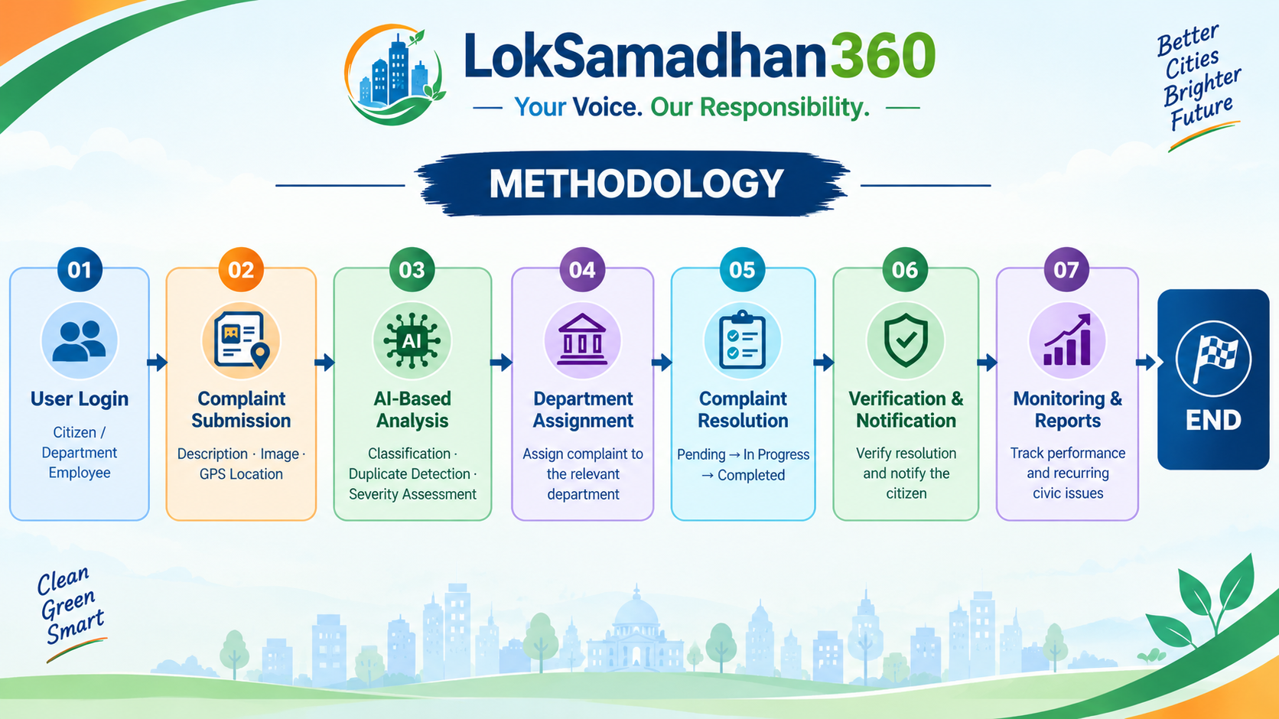
Methodology (Contd…)

Slide 13
Results and Discussions
Efficient Complaint Reporting: Citizens can submit civic complaints with images, descriptions, and GPS locations.
AI-Based Classification: Complaints are categorized according to the type of civic issue.
Duplicate Detection: Similar complaints can be identified to reduce repeated entries.
Severity Assessment: Critical issues can be prioritized based on their severity.
Department-Wise Assignment: Complaints are directed to the appropriate departmental employees.
Real-Time Tracking: Citizens can monitor complaint status from Pending to In Progress and Completed.
Resolution Verification: Completed complaints can be verified to improve accountability.
Improved Governance: Reports help authorities identify recurring problems and improve public service delivery.

Slide 14
Conclusion
LokSamadhan360 is an AI-powered civic complaint management platform designed to improve transparency, accountability, and efficiency in public services. It simplifies complaint reporting, enables intelligent classification, supports department-wise assignment, and provides real-time status tracking. By integrating AI analysis and resolution verification, the platform aims to reduce delays and strengthen communication between citizens and government authorities. Overall, LokSamadhan360 promotes smarter governance and a more responsive, citizen-centric approach to resolving civic issues.

Slide 15
Future Scope
Advanced AI Integration: Use advanced AI to automatically identify civic issues from images and predict potential problems.
Multilingual Support: Enable citizens to report complaints in regional languages using voice and text.
IoT Integration: Connect smart sensors to detect water leakage, waste overflow, and infrastructure problems automatically.
Predictive Analytics: Analyze historical complaint data to identify hotspots and help authorities plan preventive actions.

Slide 16
Thank You
20

