Slide 1

Military IoT Sensor Network
Four Sensors : Thermal, Motion, GPS, Acoustic.
Lokesh Sakamuri Gajendra
MSc Cloud Computing — National College of Ireland
Module: Fog and Edge Computing
Professor : Giovani Estrada
Student ID : 25103512
Military sensors generate massive noisy data
Direct cloud upload wastes bandwidth and delays threat detection
Edge + Fog layers filter and aggregate locally before cloud
Serverless backend auto-scales with zero server management
Dashboard: http://military-dashboard-env.eba-3wmt7qy3.us-east-1.elasticbeanstalk.com
GitHub: https://github.com/lokeshsg1091998/fog-and-edge-project

Slide 2
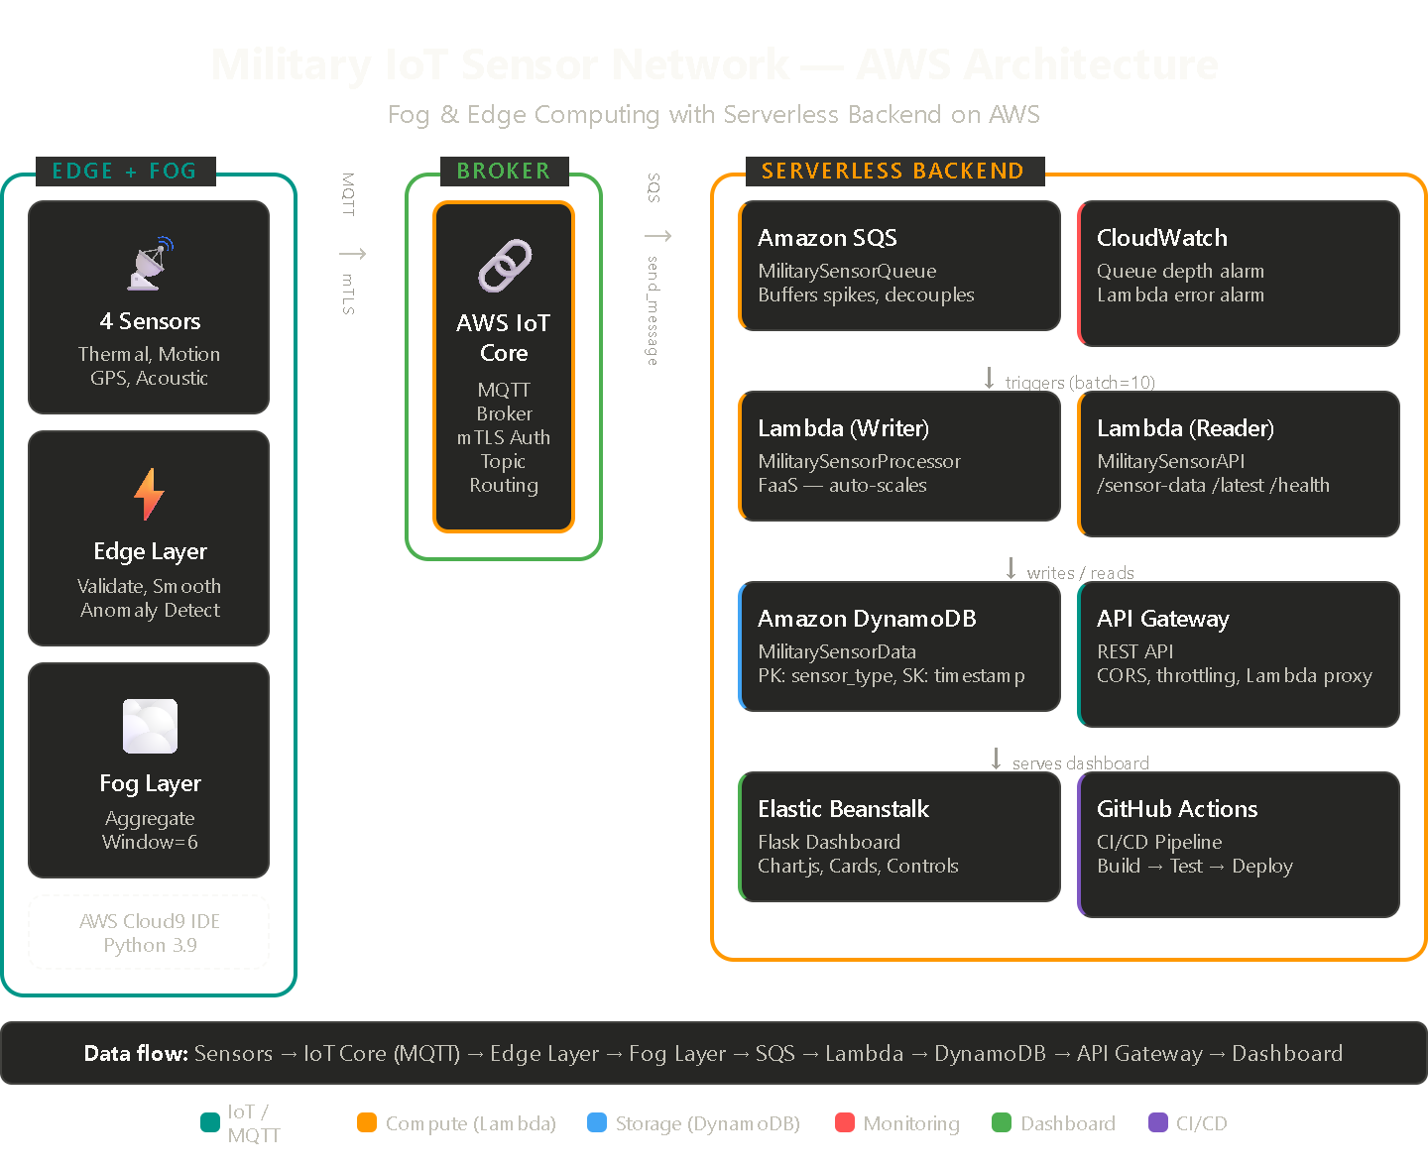
Architecture — AWS Services used
AWS IoT Core
Amazon SQS
MQTT broker — routes sensor messages between layers using pub/sub with mTLS certificates for security
Message queue — buffers data spikes between fog and Lambda so no readings are lost during bursts
AWS Lambda (x2)
Amazon DynamoDB
FaaS — Writer processes SQS batches into DynamoDB; Reader serves REST API. Both auto-scale to zero when idle
NoSQL database — stores time-series sensor data with partition key (sensor_type) + sort key (timestamp)
API Gateway
Elastic Beanstalk
Managed REST API — routes /sensor-data, /latest, /health requests to Lambda with CORS and throttling
Hosts the Flask dashboard — managed platform with auto-scaling capability for the web UI
GitHub Actions
CloudWatch
CI/CD — auto-tests and deploys dashboard to EBS on every git push to main branch
Monitoring — 2 alarms: queue depth > 50 (pipeline backed up) and Lambda errors > 5 (processing failure)

Slide 3
Sensor Data Generation & Edge Processing
How data is generated (sensor_simulator.py)
Edge processing (edge_layer.py)
random.gauss(22, 4)°C
25% chance heat signature
IR intensity: 5-95
Thermal
Range Validation
1
Discard readings outside physical limits.
Prevents garbage data reaching the cloud.
30% chance detection
Velocity: 0-12 m/s
Direction: 0-360°
Motion
EMA Smoothing
2
Reduces sensor noise and jitter.
Dublin start (53.35, -6.26)
Cumulative Gauss drift
Simulates patrol movement
GPS
Anomaly Detection
Weighted classification:
Ambient 40%, Footstep 25%
Gunshot 5%, Aircraft 10%
3
IR>70 = Intruder, vel>8 = HIGH threat,
gunshot/aircraft = threat sound.
Acoustic
Sensors publish to military/raw/# → Edge subscribes, processes → Publishes to military/edge/#

Slide 4
Fog Layer & Serverless Backend
Fog layer (fog_layer.py)
Serverless pipeline flow
Rolling window aggregation (last 6 readings per sensor)
Computes: avg temperature, max IR, detection rate, threat counts
Dispatches to SQS (not directly to DynamoDB)
Also publishes MQTT summary to military/fog/processed
SQS Queue
Buffers messages
↓
Lambda (Writer)
Batch=10, auto-scales
↓
DynamoDB
Time-series storage
↓
Lambda (Reader)
REST API handler
↓
API Gateway
Routes HTTP requests

Slide 5
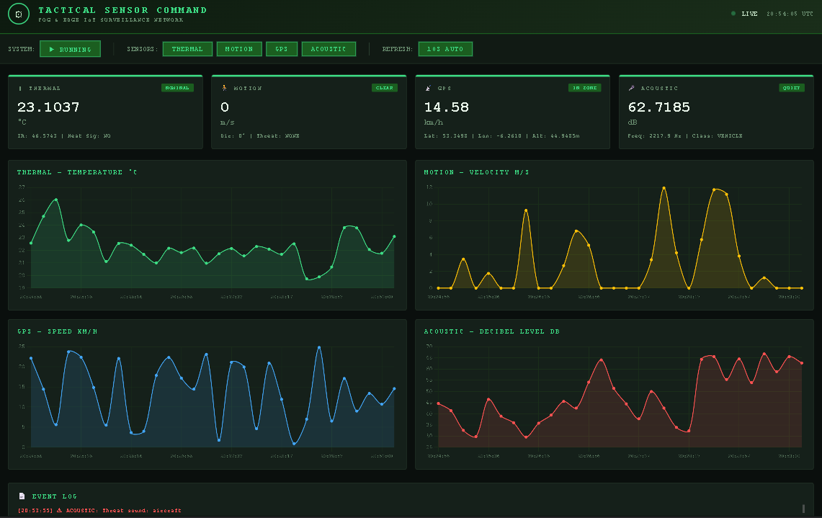
Live Dashboard Demo
military-dashboard-env.eba-3wmt7qy3.us-east-1.elasticbeanstalk.com
Sensor Cards
Line Charts
Controls
Event Log
Live values + anomaly badges
Last 30 readings per sensor
Start/Stop, enable/disable sensors
Real-time anomaly alerts

Slide 6
Learnings & Conclusion
Key Learnings
Edge intelligence reduces latency — anomaly detection happens in milliseconds, not round-trip to cloud
SQS decoupling is essential — one line change (send_message vs put_item) transformed a fragile pipeline into a resilient one
Lambda FaaS auto-scales from 0 to 1000 instances — zero ops overhead for variable workloads
Not all intelligence needs the cloud — edge and fog layers make local decisions that save bandwidth
Managed services (IoT Core, DynamoDB, API Gateway) eliminate infrastructure management entirely
Dashboard: http://military-dashboard-env.eba-3wmt7qy3.us-east-1.elasticbeanstalk.com/
GitHub: https://github.com/lokeshsg1091998/fog-and-edge-project
CI/CD: GitHub Actions — Build + Test + Deploy to Elastic Beanstalk on push to main
Thank you — Questions?

