Slide 1
Countermeasures against Buffer Overflow Attacks
By
Lokesh Sharma M (195002067)
Sharik Anwar A G (195002109)
Guided by
Dr. S. Chithra

Slide 2
Problem Statement
The buffer overflow occurs when a program, while writing data to a buffer, overruns the buffer’s boundary and overwrites adjacent memory locations.
Attackers can exploit this vulnerability by introducing their malicious code into the overflowed memory and execute this in the victim system.
The buffer overflow problem has been around for quite some time. It is one of the most commonly known vulnerabilities and this continues to be an ever present issue.

Slide 3
Literature Survey
Title: Buffer Overflow Exploit and Defensive Techniques
Authors: Desheng Fu , Feiyue Shi
Inference:
Buffer overflow attacks, whether by software error or an attack, is one of the most important security problems that represent a common vulnerability of software security and cyber risks. In this paper, they have presented simple concepts of the buffer overflow attacks, its types, vulnerabilities. They talk about different types of attacks such as stack based, heap based, integer overflow and format-string buffer overflow and some methods to solve buffer overflow.

Slide 4
Literature Survey
Title: The Buffer Overflow Attack and How to Solve Buffer Overflow in Recent Research. 2. 5-11.
Authors: Al Husayni, Samah & Alsuwat, Dr.Emad. (2020)
Inference:
In this paper they have discussed about different types of buffer overflow attacks and some countermeasures for them. Some of the counter measures are Data Execution Prevention (DEP) that offers protection against malicious code from being executed directly from the buffer value by allowing only specific memory location to have execution privileges and Address space layout randomization (ASLR) - mechanism randomizes the memory address of the binary and external libraries each time it gets executed.

Slide 5
Literature Survey
Title: Exploiting stack-based buffer overflow using modern day techniques
Authors: Ștefan Nicula, Răzvan Daniel Zota
Inference:
Nowadays, due to multiple protection mechanisms enforced by the operating system and on the executable level, the buffer overflow has become harder to exploit. Multiple bypassing techniques are often required to be used in order to successfully exploit the vulnerability and control the execution flow of the studied executable. Most of the protection mechanisms require certain techniques in order to bypass them and many of these techniques are using some form of address memory leakage in order to leverage an exploit. A stack-based buffer overflow can be exploited in multiple ways depending on several variables

Slide 6
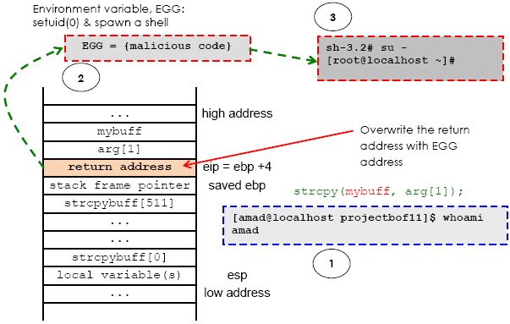

Slide 7
Challenges
Modern day OS have ASLR already installed in them, so it's hard to exploit buffer overflow.
Every processor has different buffer sizes and breakpoints, so it presents a challenge during debugging.
The shell code required to exploit changes according to OS. So one has to generate different shell codes for different OS.

Slide 8
Proposed Methodology
First we are trying to demonstrate different attacks for better understanding of what buffer overflow attacks are capable of.
Then we set out to develop prevention and protection methods that will try to stop buffer overflow situations during compile time and runtime.

Slide 9
Proposed Methodology
We follow the below steps to exploit buffer overflow:
Spiking: Spike is protocol stress tests. Spiking is like fuzzing. The difference is that spiking send only garbage data with the aim of bringing down the security features of the system, while fuzzing is intended to get some useful information out of the data it sends.
Fuzzing using python: Fuzzing or fuzz testing is an automated software testing technique that involves providing invalid, unexpected, or random data as inputs to a computer program.
Finding the offset: We used a fuzzing script to find an approximate byte size where the process crashed. We have to find the EIP’s memory address.
Overwriting the EIP: We need to overwrite the EIP. To overwrite the EIP, we need certain bytes to get to EIP plus 4 bytes because the EIP size is 4 bytes.

Slide 10
Proposed Methodology
Finding bad characters: We can now generate bad character byte arrays. A bad character is simply a list of unwanted characters that can break the shell codes. depending on the application and the developer logic there is a different set of bad characters for every program that we would encounter. Therefore, we will have to find out the bad characters in every application before writing the shell code.
Finding the right module: We are going to check for dll or something comparable in the vulnserver.exe that does not have memory protection settings.
Generating shellcode and gaining access: After successfully generating and executing the shell code, we’ll gain access to the victim’s system.

Slide 11
References
Moatsum Alawida, Abiodun Esther Omolara, Oludare Isaac Abiodun, Murad Al-Rajab, ”A deeper look into cybersecurity issues in the wake of Covid-19: A survey”,Journal of King Saud University - Computer and Information Sciences, Volume 34, Issue 10, Part A, 2022, ISSN 1319-1578
Ștefan Nicula, Răzvan Daniel Zota, “Exploiting stack-based buffer overflow using modern day techniques”,
Procedia Computer Science, Volume 160, 2019, ISSN 1877-0509
Erick Leon, Stefan D. Bruda, “Counter-Measures against Stack Buffer Overflows in GNU/Linux Operating Systems”, Procedia Computer Science,Volume 83, 2016, ISSN 1877-0509

