Slide 1
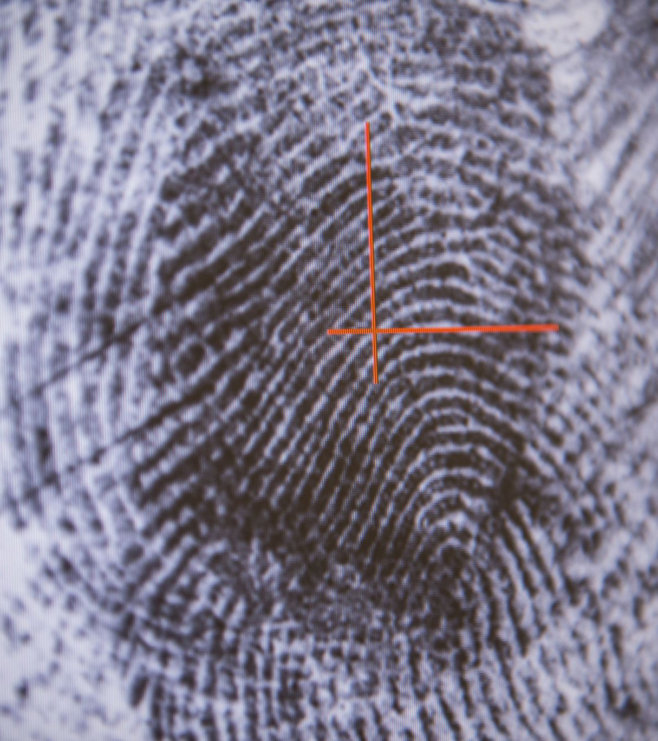
Multimodal Authentication System Using Face and Voice Data
By
Lokesh Reddy Dumpa
Aishwarya Rao Kallepu
Sruthi Lanka

Slide 2

Introduction
What is Multimodal Authentication?
A system that combines multiple biometric modalities, such as face and voice, to enhance security and accuracy.
Why Multimodal?
Addresses limitations of unimodal systems like sensitivity to environmental factors.
Increases robustness and reduces error rates by leveraging complementary features.
Key Objectives:
To improve authentication accuracy and robustness.
To evaluate fusion techniques for integrating face and voice data.
To test system performance under real-world conditions (e.g., poor lighting, noisy environments).

Slide 3
Literature Review Summary
Key Influences
Ross and Jain (2003): Multimodal Biometrics
Explored the effectiveness of combining face and voice data for biometric systems.
Demonstrated that multimodal systems significantly reduce error rates compared to unimodal systems.
Nandakumar et al. (2008): Score-Level Fusion in Biometrics
Proposed methods for score-level fusion to combine information from multiple biometric traits.
Highlighted techniques like weighted summation and machine learning for fusion.
Zhang et al. (2020): Multimodal Feature Extraction
Investigated feature-level fusion of face and voice for secure authentication.
Showed that PCA improves computational efficiency and maintains accuracy.

Slide 4
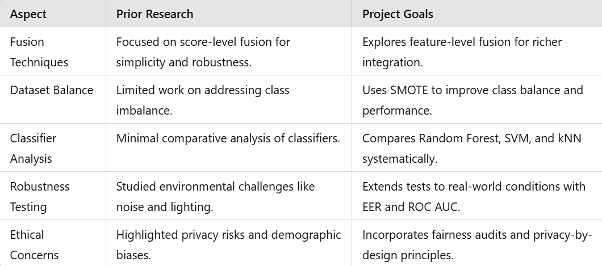
Prior Research on Multimodal Biometric Systems
Fusion Techniques:
Ross and Jain (2003): Highlighted the effectiveness of multimodal systems, focusing on score-level fusion to improve accuracy.
Preprocessing and Feature Extraction:.
Palanisamy et al. (2020): Demonstrated the richness of MFCC features for voice recognition, effectively capturing audio patterns.
System Robustness and Ethical Concerns:
Zhang et al. (2015): Studied the performance of multimodal systems under challenging conditions like poor lighting or noise.

Slide 5
Research Questions and Objectives
Research Questions:
RQ1: How does feature-level fusion of facial and voice biometric data impact the overall system performance compared to unimodal systems?
Key Insight: Feature-level fusion combines complementary strengths of face and voice modalities.
Result: Improved accuracy and robustness compared to unimodal systems, as evidenced by lower Equal Error Rate (EER) and higher ROC AUC metrics.
RQ2: How does the use of SMOTE for balancing class distributions affect the performance of classification models in multimodal biometric authentication?
Key Insight: SMOTE addresses class imbalances in datasets.
Result: Enhanced precision, recall, and F1-scores, particularly reducing false negatives for underrepresented classes.
RQ3: RQ3 : Which classifier (Random Forest, SVM, or kNN)performs best in a multimodal biometric authenticationsystem based on facial and voice features?
Key Insight: Classifiers have varying abilities to handle complex feature interactions and data distributions.
Result: Random Forest demonstrated the best performance, while SVM and kNN showed strengths but had limitations in scalability and sensitivity.

Slide 6
Project Goals
System Design: To develop a multimodal authentication system using face and voice data.
Methodology: To implement feature extraction, fusion, and classification techniques to optimize performance.
Performance Analysis: To evaluate the system using metrics such as accuracy, Equal Error Rate (EER), and ROC AUC.
Ethical Framework: To identify and address potential biases, fairness, and privacy challenges in the system.
Scalability: To explore the potential for integrating additional modalities (e.g., fingerprint or iris data) in future implementations.
Objectives
Expected Outcomes
Enhanced Performance: Multimodal systems leveraging fusion and SMOTE demonstrate improved accuracy and fairness compared to unimodal systems.
Classifier Insights: Random Forest offers optimal performance for feature-level fusion tasks.
Ethical Integration: The system design incorporates privacy and fairness principles, ensuring real-world readiness.

Slide 7
Datacollection
The system utilizes two primary datasets: Caltech Face Dataset , AudioMNIST Dataset
Caltech Face Dataset
Description: A collection of facial images under various lighting conditions.
Used for: Testing face recognition accuracy and robustness in the system.
Preprocessing:
Images resized and normalized for consistency.
Histogram equalization applied to improve lighting uniformity.
AudioMNIST Dataset
Description: A dataset containing spoken digits (0-9) from multiple speakers with varying accents.
Used for: Testing voice recognition accuracy and performance.
Preprocessing:
Noise reduction and normalization to ensure clarity.
Audio features extracted using Mel-Frequency Cepstral Coefficients (MFCC).

Slide 8
Methodology
Input Data :Face Images,Voice Audio
Preprocessing: For Faces: Grayscale conversion, resizing, normalization ,For Voice: MFCC extraction
Feature Extraction
Fusion:Combine Face and Voice Features
Classifier Training:Train Random Forest on the Fused Features
Evaluation:Generate Metrics (Confusion Matrix, ROC AUC, etc.)
Notes:
Preprocessing:
"Face images were resized to 128x128 pixels, normalized, and converted to grayscale to simplify processing."
"Audio files were processed to extract MFCC features, providing compact and relevant voice representations."
Fusion:
"Feature-level fusion was achieved by concatenating face and voice feature vectors, enabling the model to leverage complementary information."
Classifier:
"Random Forest was trained using balanced datasets created with SMOTE to ensure fair representation of all classes."

Slide 9
Methodology
Feature Extraction
Preprocessing
Face Modality:
Pixel Intensity and Edge-Based Descriptors (e.g., Canny edge detection) for face feature extraction.
Captures structural details from facial images to improve recognition accuracy.
Voice Modality:
Mel-Frequency Cepstral Coefficients (MFCC): Captures frequency-based features from speech.
Spectral Contrast: Additional features to enhance voice recognition, especially under noisy conditions.
Face Data:
Images resized and normalized for uniformity.
Data Augmentation: Includes rotation, flipping, and brightness adjustments to increase dataset diversity and improve robustness against environmental variations.
Voice Data:
Noise reduction and normalization applied to ensure clarity.
Data Augmentation: Includes time shifting and pitch variation to improve the model’s ability to generalize across different speakers and conditions.

Slide 10
Methodology
Fusion Techniques
Feature-Level Fusion:
Combined the extracted features from both face and voice data into a unified feature vector.
This fusion technique allows for leveraging complementary information from both modalities, improving the robustness and accuracy of the authentication system.
The fused features were then used for training machine learning models to classify and authenticate users.
System Workflow
Data Alignment: Ensures that face and voice samples are correctly matched to the same user before fusion to maintain consistency in classification.
Classifier Training: Uses Random Forest, SVM, and kNN classifiers to train the fused data, choosing the best model for final predictions.
Feature Extraction
Fusion
Classification
Decision making

Slide 11
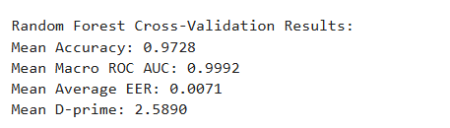
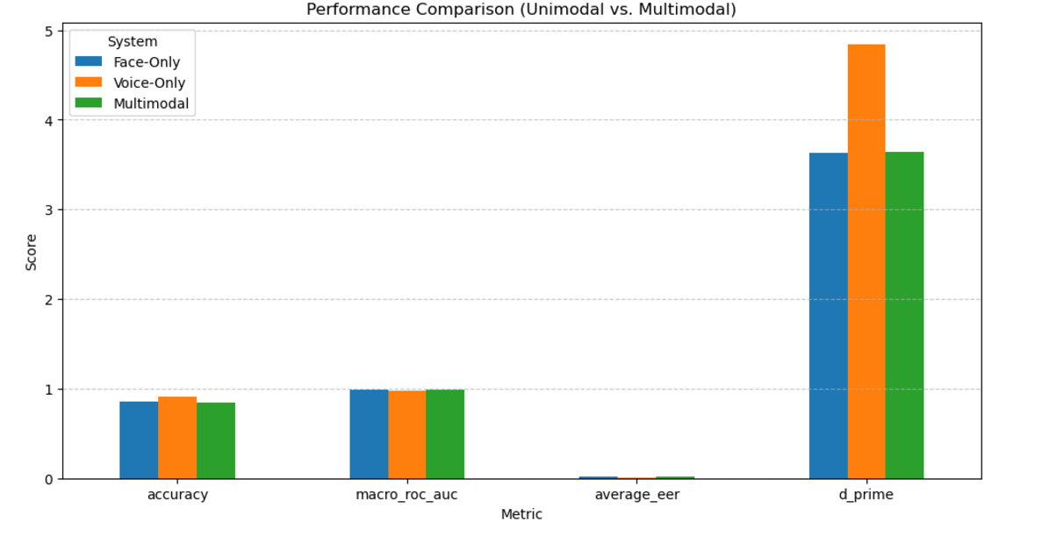
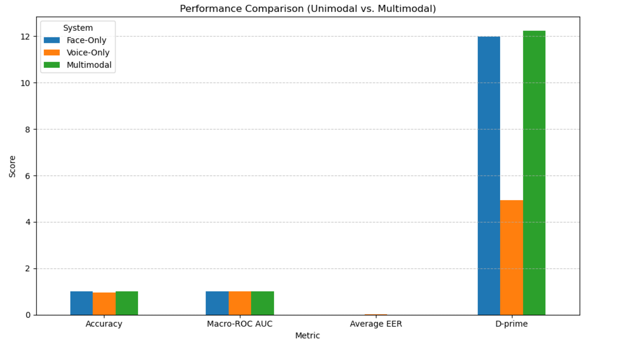
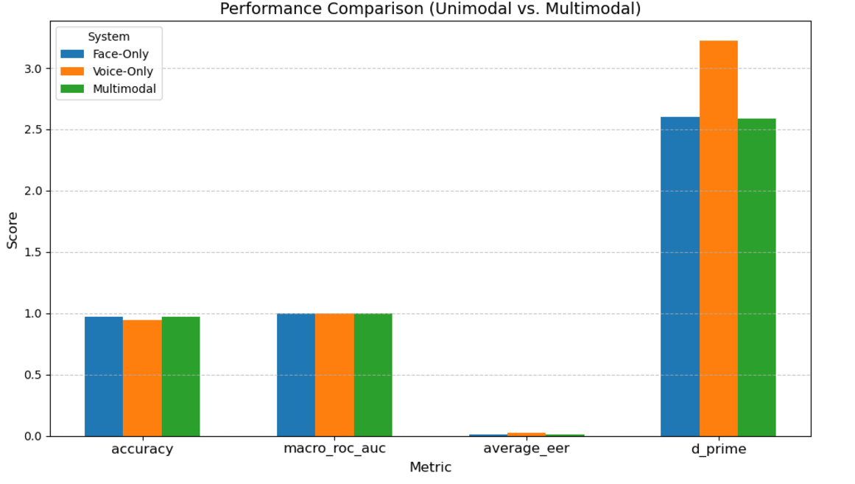
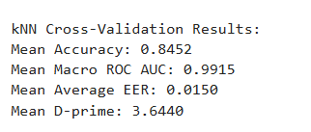
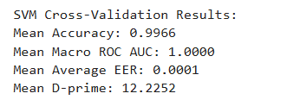
Results

Slide 12
Results and Performance
Unimodal vs Multimodal
Classifiers performance distribution
Metric | Face-only | Voice-only | Multimodal
Mean Accuracy | 0.945 | 0.97 | 0.983
Mean ROC AUC | 0.975 | 0.987 | 0.999
Mean EER | 0.02 | 0.01 | 0.006
Mean D-Prime | 2.5 | 3.00 | 2.774
Metric | Random forest | SVM | KNN
Mean Accuracy | 0.983 | 0.9973 | 0.8533
Mean ROC AUC | 0.994 | 1.0 | 0.9925
Mean EER | 0.006 | 0.0002 | 0.0130
Mean D-Prime | 2.774 | 11.481 | 3.6133

Slide 13
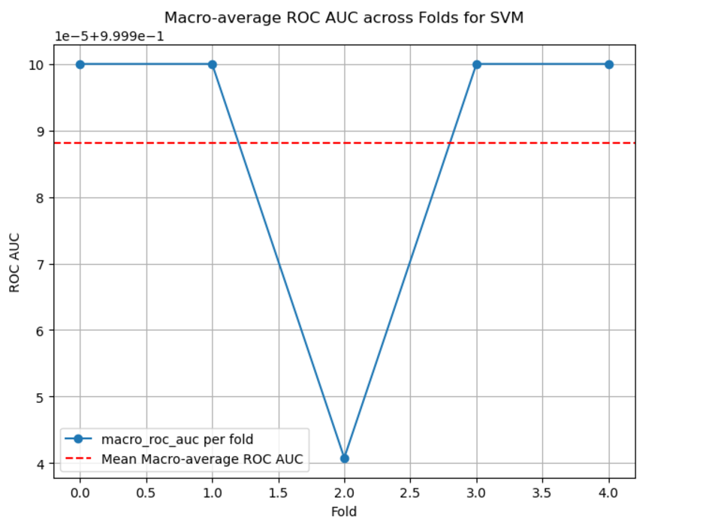
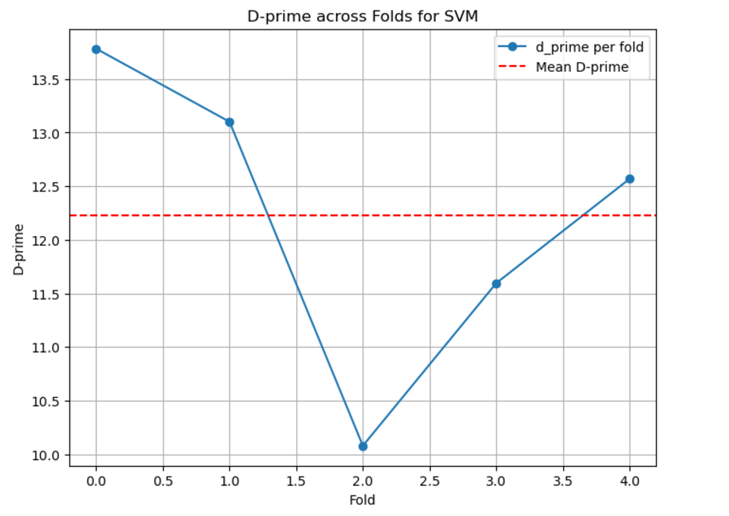
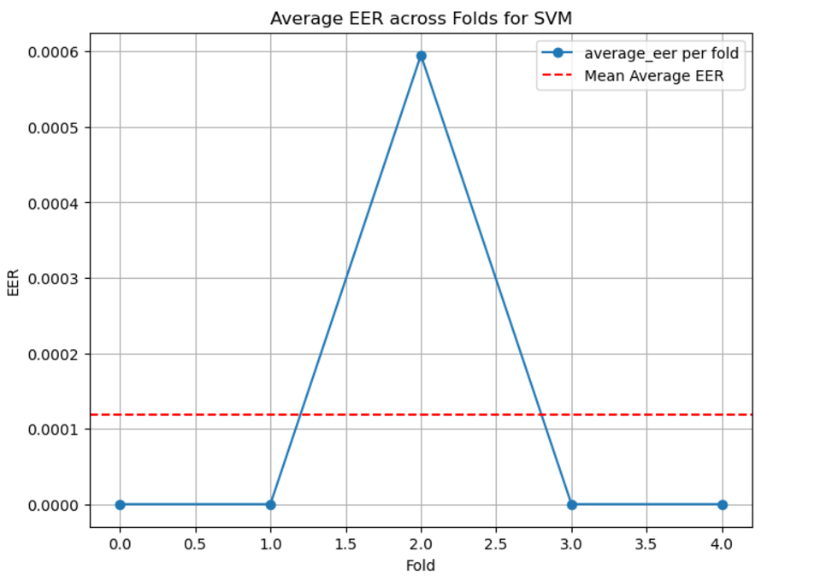
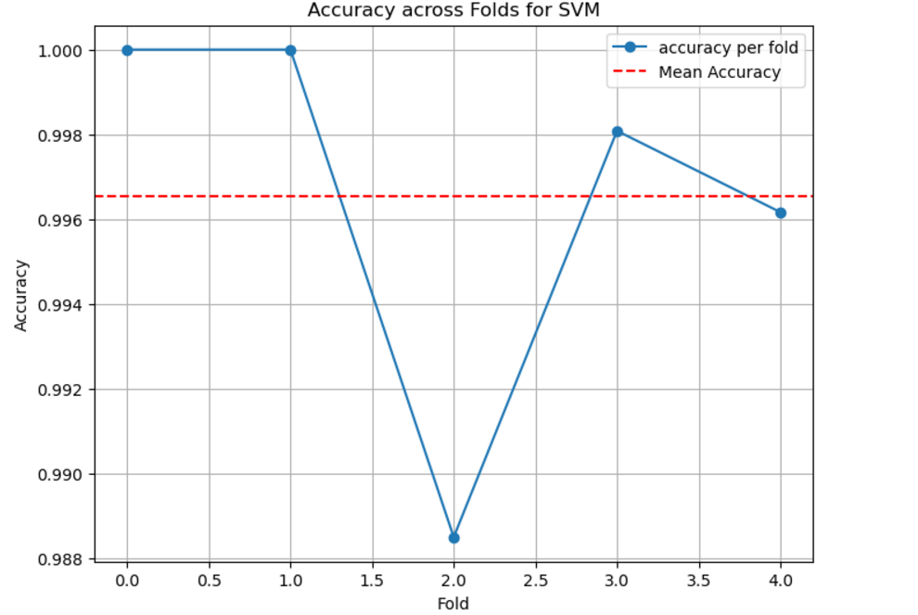

Slide 14
Discussions
Performance Analysis:
Insight: SVM outperformed other classifiers, demonstrating its ability to handle complex feature interactions effectively.
Result: Achieved the highest accuracy, precision, and recall compared to Random Forest and kNN.
Challenges Encountered:
Challenges Encountered
Class Imbalance
Feature Fusion Complexity
Noise and Environmental Factors
Limitations:
Scalability Issues: SVM exhibited constraints in processing large datasets, while kNN struggled with high-dimensional data, limiting their deployment in real-world applications.
Dataset Limitations: The datasets used lacked demographic and environmental diversity, restricting generalizability to broader populations.
Real-World Testing: The system was primarily evaluated in controlled settings, leaving its robustness under real-world conditions unexplored.

Slide 15
Ethical considerations
Privacy Concerns
Sensitive Data: Biometric data, like face and voice, is unique and immutable, making it highly sensitive.
Encryption
Local Processing
Bias and Fairness
Demographic Biases: Biometric systems may struggle with certain demographic groups (e.g., facial recognition may perform worse on darker skin tones, or voice recognition might have challenges with various accents).
Mitigation Strategies:
Diverse Datasets:
Transparency and Consent
Informed Consent
Opt-out Option
Privacy-by-Design
Mitigation Strategies:
Fairness Audits:

Slide 16
Conclusion
Key Findings:
Multimodal systems outperform unimodal systems in accuracy and robustness.
SVM is the most effective classifier, achieving the best performance metrics.
Challenges Addressed:
Resolved class imbalance with SMOTE for better precision and recall.
Improved performance under noisy and misaligned data conditions.
Future Work:
Advanced Fusion Techniques
Hybrid Classifiers
Real-World Deployment
Enhanced Dataset Balancing

Slide 17


