Slide 1


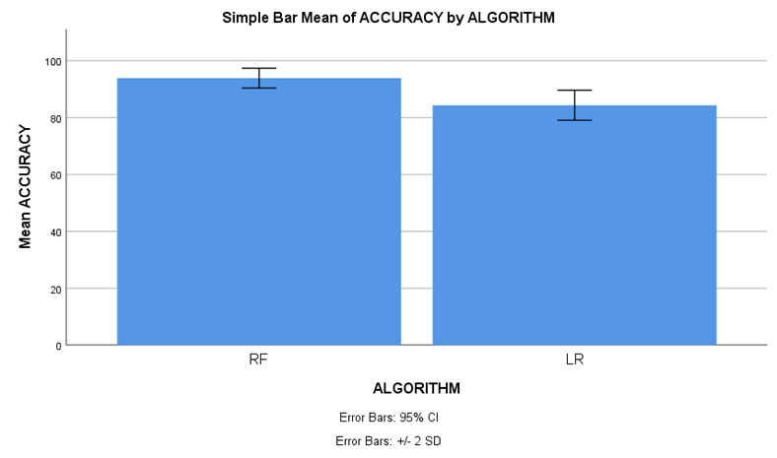
Name: Mr. Telapolu Mani Sai Lokesh Register Number: 192224105
Guided by Dr. R. Manikandan
Ms. Poorani.S
Guided by Dr. Mary Valantina. G
Improving Social Media Impact Prediction Accuracy for Marketing Strategy: Accuracy Analysis in Random Forest and Logistic Regression machine learning models
INTRODUCTION
Social media has emerged as a pivotal tool for market analysis, offering real-time insights into consumer behavior and market trends. By harnessing social media data, businesses can gain a competitive edge by understanding consumer preferences, sentiment, and engagement patterns.
This dynamic platform enables businesses to make informed decisions and adapt marketing strategies to meet evolving market demands effectively.
The aim of this study is to separate Innovative Machine Learning (ML) algorithms to enhance the accuracy of predicting social media impact for marketing strategies, to identify the most effective predictive model for optimizing marketing decisions based on social media data.
In this research study, Random Forest algorithm (RFA) is compared with Logistic Regression algorithm (LRA) to enhance accuracy.
It has been demonstrated that Random Forest has proven to be accurate when compared with Logistic Regression.
Fig 1. Online Social Media Marketing Apps or Websites
MATERIALS AND METHODS
Random Forest
algorithm
(Training)
Evaluate Random Forest
algorithm
(Accuracy)
Data Source and
Data Collection
Pre-Processing
Feature Extraction
Logistic Regression algorithm
(Training)
Evaluate Logistic Regression algorithm
(Accuracy)
Compare Performance of results between algorithms
Modelling & Prediction
Marketing Strategy
Formulation and Execution
Social Media Impact Prediction Accuracy for Marketing Strategy
RESULTS
Table 1: Statistical Computations for Random Forest and Logistic Regression
 | ALGORITHM | N | Mean | Std. Deviation | Std. Error Mean
ACCURACY | RF | 20 | 93.90 | 1.744 | 0.390
 | LR | 20 | 84.35 | 2.641 | 0.591
Table 1 involve essential metrics such as mean, standard deviation, and mean standard error, with the accuracy level parameter employed in the t-test. additionally, statistical analysis reveals a significant distinction between the two algorithms, with a p-value of p=0.025 (p<0.05), emphasizing the social media influence for marketing strategy.
Fig 2. Comparative Error Analysis of Random Forest and Logistic Regression
DISCUSSION AND CONCLUSION
Based on t-test Statistical analysis, the significance value of p = 0.025 (independent sample t - test p<0.05) is obtained and shows that there is a statistical significant difference between the Random Forest (RF) and Logistic Regression(LR).
Overall , the accuracy of the Random Forest is 93.90 % and it is better than the other algorithms.
Random Forest(RF) - 93.90% Logistic Regression(LR) - 84.35%
From the work , it is concluded that the Random Forest algorithm attains the high accuracy when comparing with other Machine Learning Algorithms in social media influence prediction accuracy for marketing strategy.
Through real-time feedback, social media marketing has a substantial impact on marketing strategy, increasing brand awareness and boosting conversion rates.
The effectiveness of customised campaigns, made possible by sophisticated audience analysis and precise predictive modelling methods, is what determines the relationship between higher brand recognition and business success.
BIBLIOGRAPHY
Cacheda, Fidel, Diego Fernandez, Francisco J. Novoa, and Victor Carneiro. 2019. “Early Detection of Depression: Social Network Analysis and Random Forest Techniques.” Journal of Medical Internet Research 21 (6): e12554. DOI:10.2196/12554
Dwivedi, Yogesh K., Elvira Ismagilova, Nripendra P. Rana, and Ramakrishnan Raman. "Social media adoption, usage and impact in business-to-business (B2B) context: A state-of-the-art literature review." Information Systems Frontiers (2023): 1-23. DOI:10.1007/s10796-021-10106-y
Konovalova, Elizaveta, Gaël Le Mens, and Nikolas Schöll. 2023. “Social Media Feedback and Extreme Opinion Expression.” PloS One 18 (11): e0293805. DOI: 10.1371/journal.pone.0293805
Kumar, Subodha, and Liangfei Qiu. 2021. Social Media Analytics and Practical Applications: The Change to the Competition Landscape. CRC Press. DOI: 10.1201/9781003196198

