Slide 1
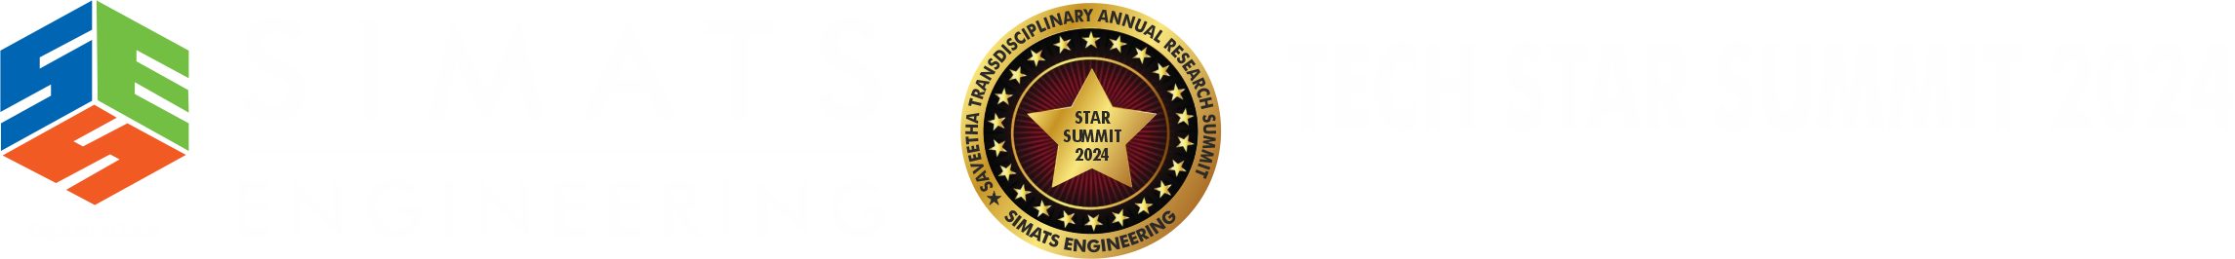

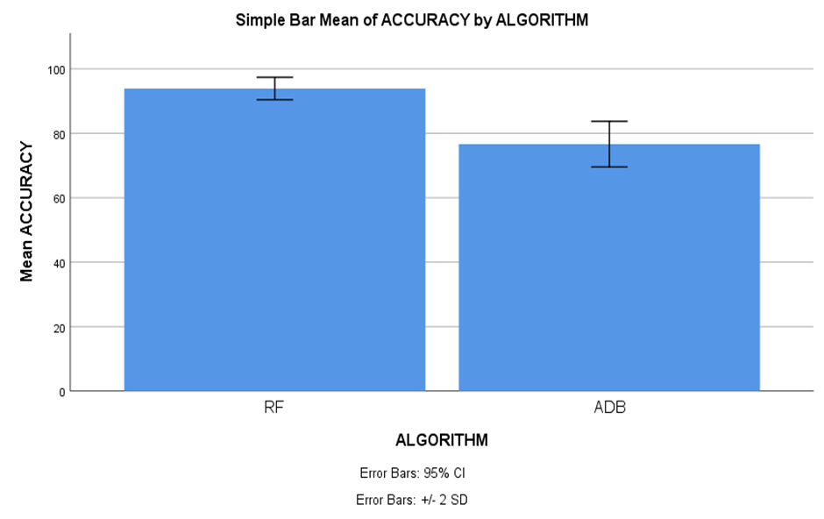
Name: Mr. Telapolu Mani Sai Lokesh Register Number: 192224105
Guided by Dr. R. Manikandan
Ms. Poorani.S
Guided by Dr. Mary Valantina. G
Refining Social Media Influence Prediction A Comparative Evaluation of Random Forest and Ada Boost for Improved Accuracy in Marketing Strategy
INTRODUCTION
Social media now serves as a vital resource for market research, providing up-to-date information on consumer behavior and industry trends. Businesses may get a competitive edge by leveraging social media data to understand customer preferences, sentiment, and interaction patterns.
This dynamic platform enables businesses to make informed decisions and adapt marketing strategies to meet evolving market demands effectively.
The study aims to refine predictions of social media influence, ultimately aiming to boost the accuracy and effectiveness of marketing strategies.
In today's digital age, social media has emerged as a dominant force shaping consumer behavior and influencing purchasing decisions. To leverage this phenomenon effectively, marketers need reliable tools to predict social media influence accurately.
In this research study, Random Forest algorithm (RFA) is compared with Ada Boost algorithm (ADB) to enhance accuracy.
Fig 1. Online Social Media Marketing Networks
MATERIALS AND METHODS
Random Forest
algorithm
(Training)
Evaluate Random Forest
algorithm
(Accuracy)
Data Source
and
Data Collection
Pre-Processing
Feature Extraction
ADA Boost
algorithm
(Training)
Evaluate ADA Boost
algorithm
(Accuracy)
Compare Performance of results between algorithms
Modelling
&
Prediction
Marketing Strategy
Formulation and Execution
Social Media Impact Prediction Accuracy for Marketing Strategy
RESULTS
Table 1 Statistical computations for Random Forest and ADA Boost
 | ALGORITHM | N | Mean | Std. Deviation | Std. Error Mean
ACCURACY | RF | 20 | 93.90 | 1.744 | 0.390
 | ADB | 20 | 76.65 | 3.543 | 0.792
Table 1 Involve essential metrics such as mean, standard deviation, and mean standard error, with the accuracy level parameter employed in the t-test. additionally, statistical analysis reveals a significant distinction between the two algorithms, with a p-value of p=0.049 (p<0.05), emphasizing the social media influence for marketing strategy.
Fig 2. Comparative Error Analysis of Random Forest and
ADA Boost
DISCUSSION AND CONCLUSION
Based on t-test Statistical analysis, the significance value of p=0.049 (independent sample t - test p<0.05) is obtained and shows that there is a statistical significant difference between the Random Forest (RF) and ADA Boost(ADB) .
Overall , the accuracy of the Random Forest is 93.90 % and it is better than the other algorithms.
Random Forest(RF) - 93.90% ADA Boost(ADB) - 76.65%
From the work , it is concluded that the Random Forest algorithm attains the high accuracy when comparing with other Machine Learning Algorithms in social media influence prediction accuracy for marketing strategy.
More accurate forecasting and a deeper understanding of the target audience enable more tailored campaigns that ultimately drive increased brand awareness and business success.
The comparative analysis highlights the importance of algorithm selection for Random Forest excelling in accuracy and scalability, while AdaBoost offers interpretability.
BIBLIOGRAPHY
Aggarwal, Manasvi, and M. N. Murty. 2020. Machine Learning in Social Networks: Embedding Nodes, Edges, Communities, and Graphs. Springer Nature. DOI: 10.1007/978-981-33-4022-0
Salhab, H., S. Aljabaly, M. Zoubi, and M. Othman. "The impact of social media marketing on purchase intention: The mediating role of brand trust and image." International Journal of Data and Network Science 7, no. 2 (2023): 591-600. DOI: 10.5267/j.ijdns.2023.3.012
Rana, Nripendra P., Emma L. Slade, Ganesh P. Sahu, Hatice Kizgin, Nitish Singh, Bidit Dey, Anabel Gutierrez, and Yogesh K. Dwivedi. 2019. Digital and Social Media Marketing: Emerging Applications and Theoretical Development. Springer Nature. DOI: 10.1007/978-3-319-89932-9_11
Singh, Prakash. 2024. “Beyond the Basics: Exploring the Impact of Social Media Marketing Enablers on Business Success.” Heliyon 10 (5): e26435. DOI: 10.1016/j.heliyon.2024.e26435
Sumer, Selay Ilgaz, and Nurettin Parilti. 2023. Social Media Analytics in Predicting Consumer Behavior. CRC Press. DOI: 10.1201/9781003200154

