Slide 1


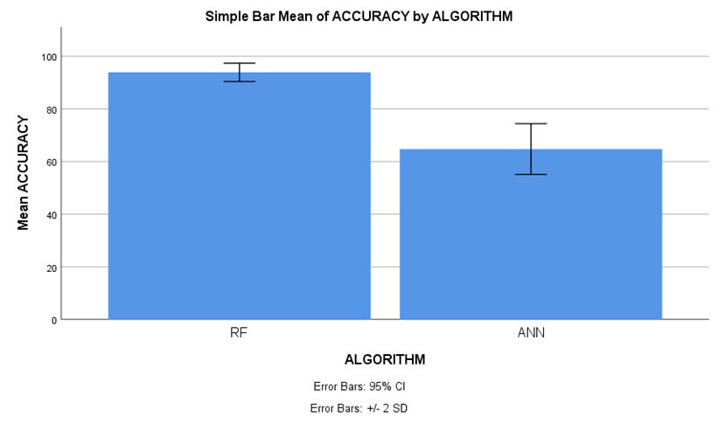
Name: Mr. Telapolu Mani Sai Lokesh Register Number: 192224105
Guided by Dr. R. Manikandan
Ms. Poorani.S
Guided by Dr. Mary Valantina. G
Enhancing Social Media Influence Prediction Accuracy for Marketing Strategy Through Comparative Analysis of Random Forest and Artificial Neural Network
INTRODUCTION
Due to its ability to provide current information on consumer behaviors and industry trends, social media has become an essential instrument for market analysis. Enterprises may acquire a competitive advantage by leveraging social media data to comprehend the inclinations, attitudes, and interaction trends of their customers.
Businesses may make well-informed judgements and modify their marketing plans to successfully satisfy changing consumer expectations thanks to this dynamic platform.
The aim of this study is to separate Innovative Machine Learning (ML) Classifiers to determine which predictive model is most useful for optimizing marketing decisions based on social media data, and to assess the accuracy of social media impact predictions for marketing initiatives.
In this research study , Random Forest algorithm (RFA) is compared with Artificial Neural Network algorithm (ANN) to enhance accuracy.
Fig 1. Social Media Marketing
MATERIALS AND METHODS
Random Forest
algorithm
(Training)
Evaluate Random Forest
algorithm
(Accuracy)
Data Source and
Data Collection
Pre-Processing
Feature Extraction
Artificial Neural Network
algorithm
(Training)
Evaluate Artificial Neural Network
algorithm
(Accuracy)
Compare Performance of results between algorithms
Modelling
&
Prediction
Marketing Strategy
Formulation and Execution
Social Media Impact Prediction Accuracy for Marketing Strategy
RESULTS
Table 1 Statistical computations for Random Forest and Artificial Neural Network
 | ALGORITHM | N | Mean | Std. Deviation | Std. Error Mean
ACCURACY | RF | 20 | 93.90 | 1.744 | 0.390
 | ANN | 20 | 64.75 | 4.822 | 1.078
Table 1 Involve essential metrics such as mean, standard deviation, and mean standard error, with the accuracy level parameter employed in the t-test. additionally, statistical analysis reveals a significant distinction between the two algorithms, with a p-value of p=0.036 (p<0.05), emphasizing the social media influence for marketing strategy.
Fig 2. Comparative Error Analysis of Random Forest and Artificial Neural Network
DISCUSSION AND CONCLUSION
Based on t-test statistical analysis, the significance value of p = 0.036 (independent sample t - test p<0.05) is obtained and shows that there is a statistical significant difference between the Random Forest (RF) and Artificial Neural Network (ANN) .
Overall , the accuracy of the Random Forest is 93.90 % and it is better than the other algorithms.
Random Forest(RF) - 93.90% Artificial Neural Network (ANN) - 64.75%
From the work , it is concluded that the Random Forest algorithm attains the high accuracy when comparing with other Machine Learning Algorithms in social media influence prediction accuracy for marketing strategy.
In order to maximize the fetch time and increase the accuracy bulk data is complicated.
Future Scope: Investigating hybrid models that combine Random Forest and Artificial Neural Network techniques to enhance social media influence prediction accuracy represents a promising avenue for advancing marketing strategy optimization efforts.
BIBLIOGRAPHY
Savitri, Citra, Ratih Hurriyati, L. Wibowo, and Heny Hendrayati. "The role of social media marketing and brand image on smartphone purchase intention." International Journal of Data and Network Science 6, no. 1 (2022): 185-192. DOI:10.1108/apjml-07-2019-0453
Wibowo, Ardy, Uraiporn Wiangin, Yin Ma, and Athapol Ruangkanjanases. "Customer behavior as an outcome of social media marketing: The role of social media marketing activity and customer experience." Sustainability 13, no. 1 (2020): 189. DOI:10.3390/su13010189
Alwafi, Ghadeer, and Bahjat Fakieh. 2024. “A Machine Learning Model to Predict Privacy Fatigued Users from Social Media Personalized Advertisements.” Scientific Reports 14 (1): 3685.DOI:10.1038/s41598-024-54078-w
Rana, Nripendra P., Emma L. Slade, Ganesh P. Sahu, Hatice Kizgin, Nitish Singh, Bidit Dey, Anabel Gutierrez, and Yogesh K. Dwivedi. 2019. Digital and Social Media Marketing: Emerging Applications and Theoretical Development. Springer Nature. DOI: 10.1007/978-3-030-24374-6_16

