Slide 1


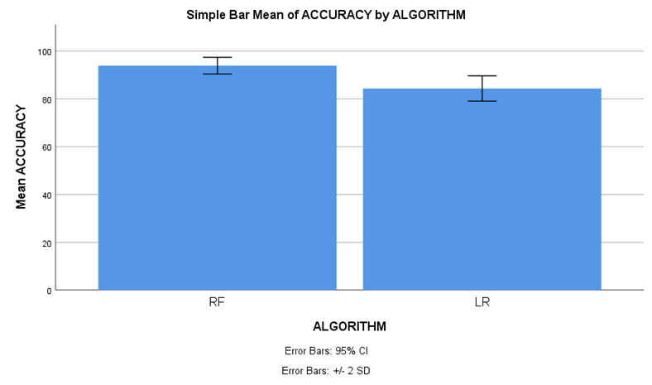
Name: Mr. Telapolu Mani Sai Lokesh Register Number: 192224105
Guided by Dr. R. Manikandan
Ms. Poorani.S
Guided by Dr. Mary Valantina. G
Optimizing Social Media Influence Prediction Accuracy for Marketing Strategy in Comparison of Random Forest and Support Vector Machine
INTRODUCTION
Social media now serves as a vital resource for market research, providing up-to-date information on consumer behaviour and industry trends. Businesses may get a competitive edge by leveraging social media data to understand customer preferences, sentiment, and interaction patterns.
Businesses may make well-informed judgements and modify their marketing strategy to efficiently meet changing market needs thanks to this dynamic platform.
The objective of this study is to analyze methods for improving the precision of social media influence prediction, ultimately aiming to elevate the efficacy of marketing strategies.
In today's marketing landscape, social media stands as a cornerstone for brands to connect with their audience.
In this research study , Random Forest algorithm (RFA) is compared with Support Vector Machine algorithm (SVM) to enhance accuracy.
Fig 1. Online Social Media Marketing
MATERIALS AND METHODS
Random Forest
algorithm
(Training)
Evaluate Random
Forest algorithm
(Accuracy)
Data Source and
Data Collection
Pre-Processing
Feature Extraction
Support Vector Machine
algorithm
(Training)
Evaluate
Support Vector Machine
algorithm
(Accuracy)
Compare Performance of results between algorithms
Modelling
&
Prediction
Marketing Strategy
Formulation and Execution
Social Media Impact Prediction Accuracy For Marketing Strategy
RESULTS
Table 1 Statistical computations for Random Forest and Support Vector Machine
 | ALGORITHM | N | Mean | Std. Deviation | Std. Error Mean
ACCURACY | RF | 20 | 93.90 | 1.744 | 0.390
 | SVM | 20 | 58.65 | 2.739 | 0.612
Table 1 Involve essential metrics such as mean, standard deviation, and mean standard error, with the accuracy level parameter employed in the t-test. additionally, statistical analysis reveals a significant distinction between the two algorithms, with a p-value of p=0.036 (p<0.05), emphasizing the social media influence for marketing strategy.
Fig 2. Comparative Error Analysis of Random Forest and Support Vector Machine
DISCUSSION AND CONCLUSION
Based on t-test Statistical analysis, the significance value of p=0.036 (independent sample t - test p<0.05) is obtained and shows that there is a statistical significant difference between the Random Forest (RF) and Support Vector Machine (SVM).
Overall , the accuracy of the Random Forest is 93.90 % and it is better than the other algorithms.
Random Forest(RF) - 93.90% Support Vector Machine (SVM) - 58.65%
From the work , it is concluded that the Random Forest algorithm attains the high accuracy when comparing with other Machine Learning Algorithms in social media influence prediction accuracy for marketing strategy.
This study highlights the importance of enhancing social media influence prediction accuracy to improve marketing strategy effectiveness.
Through comparing and contrasting various algorithms, we may find patterns that help guide strategic choices in digital marketing.
Social media helped the article reach the user base, increasing demand and sales in a short amount of time with significant profits.
BIBLIOGRAPHY
Dabbous, Amal, and Karine Aoun Barakat. "Bridging the online offline gap: Assessing the impact of brands’ social network content quality on brand awareness and purchase intention." Journal of retailing and consumer services 53 (2020): 101966. DOI: 10.1016/j.jretconser.2019.101966
Hanaysha, Jalal Rajeh. "Impact of social media marketing features on consumer's purchase decision in the fast-food industry: Brand trust as a mediator." International Journal of Information Management Data Insights 2, no. 2 (2022): 100102. DOI: 10.31620/jccc.12.21/08
Koay, Kian Yeik, Derek Lai Teik Ong, Kim Leng Khoo, and Hui Jing Yeoh. "Perceived social media marketing activities and consumer-based brand equity: Testing a moderated mediation model." Asia Pacific journal of marketing and logistics 33, no. 1 (2020): 53-72. DOI:10.1108/apjml-07-2019-0453
Watkins, Brandi. 2020. Research Perspectives on Social Media Influencers and Brand Communication. Lexington Books. DOI:10.9756/bp2020.1002/47

