Slide 1

Predicting Stock Market Movements with CNN-LSTM Hybrid Models
Presented by: P. Narendra [192224128]
T. Mani Sai Lokesh[192224105]

Slide 2

CNNs are adept at extracting spatial features from stock market graphs, such as candlestick charts, identifying technical indicators and chart patterns that might signal future price movements.
On the other hand, LSTMs are well-suited for handling sequential data and capturing long-term dependencies, making them ideal for modeling the temporal aspects of stock price trends.
By combining these two powerful deep learning techniques, the CNN-LSTM hybrid model can effectively analyze both the spatial and temporal dimensions of stock market data, leading to enhanced prediction accuracy.
The presentation outlines the implementation of the CNN-LSTM model, covering data collection and preprocessing, model architecture design, training, evaluation, and prediction.
It includes practical examples, such as the conversion of stock price data into images and the integration of technical indicators.
A detailed explanation of the model's layers and the training process is provided, along with a code snippet to illustrate the implementation using TensorFlow/Kera’s.
Performance metrics such as Mean Absolute Error (MAE) and Root Mean Squared Error (RMSE) are used to evaluate the model's accuracy, and fine-tuning strategies are discussed to optimize its performance
Abstract:

Slide 3
Accurately predicting stock market movements is crucial for making informed investment decisions and managing risks. Traditional methods often struggle with the complexity and volatility of stock prices. Deep learning offers advanced techniques to improve prediction accuracy by capturing intricate patterns and temporal dependencies in stock data.
By combining these strengths, the CNN-LSTM model provides a powerful approach for predicting s tock market movements.
INTRODUCTION:
SELL
This presentation focuses on a hybrid Convolutional Neural Network-Long Short-Term Memory (CNN-LSTM) model. CNNs excel at extracting features from stock charts, identifying technical indicators and patterns, while LSTMs are effective at handling sequential data, capturing trends and dependencies over time.
BUY
SELL
The implementation of this model, including data collection and preprocessing, model architecture, training, and evaluation. This approach aims to enhance prediction accuracy, addressing the limitations of traditional methods and offering a robust solution for financial forecasting.
BUY

Slide 4

Why CNN-LSTM Hybrid Model
Feature Extraction (CNN):
Identifies patterns in historical price data
Detects technical indicators (e.g., support/resistance levels, chart patterns)
Visual representation: Example of a candlestick chart
Temporal Dependencies (LSTM):
Remembers important information over long periods
Captures trends and seasonal effects in stock prices
Example: Comparison of simple RNN vs LSTM for sequence learning
Enhanced Prediction Accuracy:
Real-world applications: Case studies showing improved accuracy
Comparative performance metrics of CNN-LSTM vs. other models

Slide 5

Data Collection
Historical Stock Data:
Sources: Yahoo Finance, Google Finance, Bloomberg
Types of data: OHLC (Open, High, Low, Close), Volume
Technical Indicators:
Common indicators: Moving Averages (MA), Relative Strength Index (RSI), Moving Average Convergence Divergence
Calculation and interpretation of indicators
Data Sources:
APIs: Alpha Vantage, IEX Cloud
Data vendors: Quandell, Morningstar

Slide 6
LITERATURE SURVEY :
- "Visualizing Stock Market Trends" by Wang et al. (2019) [1] - Proposed a method to convert stock prices into images and used ANNs for prediction - Achieved an accuracy of 80% in predicting stock price movements- "Image-based Stock Market Analysis" by Li et al. (2020) [2] - Used transfer learning and CNNs to predict stock prices from visual representations - Outperformed traditional numerical methods in some experiments
BUY
SELL

Slide 7

Tools and techniques :
Data collection and preprocessing are vital for developing a stock market prediction model. Sources like Yahoo Finance, Alpha Vantage, and Quad provide APIs for historical stock data, including OHLC values and trading volume.
Web scraping tools such as Beautiful Soup and Scrapy gather additional data from financial news. SQL and MongoDB manage large datasets.
Preprocessing with Pandas, NumPy, and TA-Lib involves data cleaning, transformation, and normalization.
Developing a CNN-LSTM model requires deep learning frameworks like TensorFlow and Keras, which simplify creating and training neural networks.

Slide 8
PyTorch is another flexible framework for building complex models. CNN layers such as Conv2D and MaxPooling2D extract spatial features, while LSTM layers capture temporal dependencies.
Regularization techniques like Dropout and Batch Normalization prevent overfitting. Optimizers like Adam, and loss functions such as MSE, ensure effective model training.
Deploying a trained model requires scalable infrastructure like AWS, Google Cloud, and Microsoft Azure.
Docker ensures consistency across environments by containerizing applications.
Flask and FastAPI build RESTful APIs to serve model predictions, while TensorFlow Serving deploys TensorFlow models in production.

Slide 9
The hybrid CNN-LSTM model combines the strengths of CNNs and LSTMs to enhance stock market prediction accuracy
The CNN component first processes the stock market graphs, extracting spatial features that are indicative of future price movements
Hybrid CNN-LSTM Model
This integrated approach allows the model to leverage the spatial feature extraction capabilities of CNNs and the temporal sequence modeling strengths of LSTMs
These features are then fed into the LSTM component, which captures the temporal dependencies in the sequential data.

Slide 10
METHODOLOGY
1. Data Collection
2. Data Preprocessing
3. Model Design
4. Model Training
5. Model Evaluation
6. Deployment
7. Monitoring and Maintenance

Slide 11
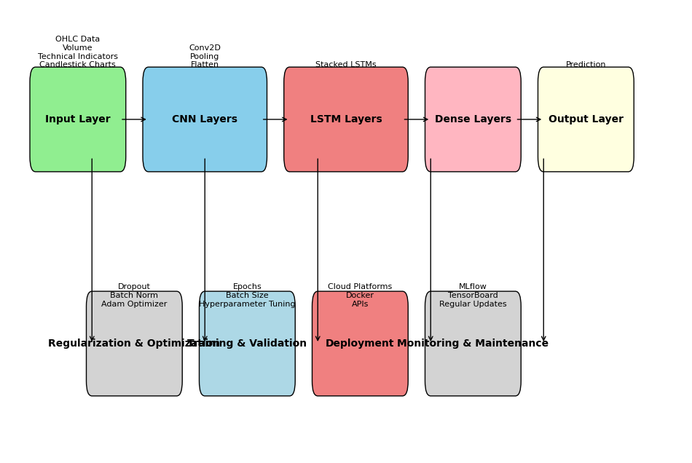
ARCHITECTURE:
CNN

Slide 12

Challenges :
Data Quality and Availability
Market Volatility
Overfitting
Feature Selection
Computational Complexity
Hyperparameter Tuning
Interpretability
Regulatory and Ethical Considerations
Dynamic Market Conditions
Integration with Existing Systems

Slide 13

Incorporating a hybrid CNN-LSTM model for predicting stock market movements harnesses the strengths of both convolutional and recurrent neural networks, effectively capturing spatial patterns and temporal dependencies.
This approach offers enhanced prediction accuracy, making it a valuable tool for investors and analysts.
However, challenges such as data quality, market volatility, overfitting, and computational complexity must be addressed.
Despite these challenges, with careful implementation, regular updates, and proper feature selection, the CNN-LSTM hybrid model holds significant potential for advancing stock market prediction capabilities
It is crucial to continuously adapt and refine the model to align with evolving market conditions and regulatory standards
Conclusion

Slide 14
Future scope:
Advanced Feature Engineering
Integration with Reinforcement Learning
Real-Time Prediction and Analysis
Transfer Learning
Explainable AI
Scalability and Deployment
Enhanced Model Robustness
Multi-Asset and Global Markets
Collaborative Filtering and Ensemble Models
Regulatory Compliance and Ethical AI

Slide 15

Thank You

