Slide 1







21ISP76 – Project Work
EFFICIENT AND ROBUST DEEP LEARNING FOR REAL TIME PLANT DISEASE DETECTION USING CNN
Submitted By
1CR21IS082-Kyle Lewis 1CR21IS083-Lokesh V
1CR21IS126-Rajsree S
Guidance of
Dr. Saba Tahseen, Associate Professor

Slide 2
Outline
2
Abstract
Introduction
Problem Statement
Objectives
Literature Survey
Gap Identification
System Architecture
Proposed Algorithm

Slide 3
Abstract
3
The increasing threat of plant diseases poses significant challenges to global agriculture, often leading to severe yield losses if not detected early. Manual inspection of crops is time-consuming, requires expert knowledge, and may result in inconsistent evaluations. This project aims to develop an automated and efficient deep learning model for real- time plant disease detection using advanced classification and object detection techniques. The model effectively identifies multiple plant diseases from leaf images, optimizing the trade-off between computational efficiency and high accuracy

Slide 4
Objectives
4
Train a CNN-based model which classifies multiple plant diseases based on image data, this involves selecting an appropriate Convolutional Neural Network (CNN) architecture and training it on a labeled dataset of plant leaf images
Develop a real-time prediction system using a Streamlit-based web application for easy user interaction. This entails creating a user-friendly web interface using the Streamlit framework.
Optimize model accuracy and efficiency to ensure reliable disease detection across different plant species and environmental conditions. This incorporates techniques like data augmentation (artificially expanding the training data), hyperparameter tuning (fine-tuning the model's settings), and potentially using transfer learning (leveraging pre- trained models).
Improve classification accuracy through optimized model training and evaluation techniques.
Ensure model reliability across different plant species and environmental conditions..

Slide 5
Introduction
5
Plant diseases are a major threat to global agriculture, leading to significant reductions in crop yield and food security. Diseases such as bacterial blight, powdery mildew, rust, and late blight can severely impact plant health, often spreading rapidly if left undetected.
Early diagnosis and intervention are fatally important for preventing crop damage and maintaining agricultural sustainability. Traditional disease detection methods, such as manual inspection by farmers or agricultural experts, are often time- consuming, subjective, and require specialized knowledge.
Deep learning techniques, particularly Convolutional Neural Networks (CNNs), have shown great potential in automating plant disease classification from leaf images.
This project leverages deep learning to develop a real- time plant disease detection system, helping farmers detect diseases early and take necessary corrective actions.

Slide 6
Introduction
6
Deep learning models have shown significant advancements in image classification, including applications in plant disease detection. However, real-world agricultural challenges, such as variation in plant species, environmental conditions, and dataset imbalances, make it difficult to deploy accurate AI-based solutions.
This study focuses on developing a simple yet effective CNN model capable of effective generalization across different plant disease categories. By ensuring robust classification accuracy, the project seeks to offer scalable, automated solution for early disease detection, reducing farmers’ dependence on manual inspections

Slide 7
Problem Statement
7
Plant diseases significantly impact agricultural productivity, leading to severe crop losses if not detected in time. Conventional methods of disease identification rely on manual inspection, which is labor-intensive, time-consuming, and often inconsistent due to human error.
To address these challenges, this project develops an AI-powered deep learning model based on Convolutional Neural Networks (CNN) for real-time plant disease detection. The system processes leaf images to accurately classify diseases, providing quick and reliable diagnosis. A web-based application is integrated for ease of use, enabling farmers to upload images and receive instant results. This solution improves early detection, enhances decision-making, and promotes sustainable agricultural practices by minimizing crop damage and optimizing disease management.

Slide 8
Literature Survey
8
Traditional methods of plant disease detection rely on manual observation, which is labor
intensive and less accurate.
Automated techniques using machine learning and image processing enhance efficiency and accuracy.
Related Work
Savita N. Ghaiwat et al “Detection and classification of plant leaf diseases using image processing techniques: a review”. Int J Recent Adv Eng Technol, (2014).
Explored various classification techniques for plant disease identification.
k-Nearest Neighbor (KNN) is simple but less effective for non-linearly separable data.
2. Vijai Singha, A.K. Misra “Detection Of Plant Leaf Diseases Using Image Segmentation And Soft Computing Techniques”, information processing in agriculture, 41-49 , 2021
1.Proposed a neural network-based approach for plant disease detection.
2.Helps in early and accurate identification with minimal computational effort.

Slide 9
Literature Survey
9
Deep Learning for Plant Disease Detection
Various studies have explored CNNs for classifying plant diseases using leaf images.
Models like ANN, SVM, and k-NN have been applied, but CNNs provide superior accuracy.
Automated Image Processing Techniques
Image segmentation, feature extraction, and color-based pattern recognition have been widely used.
Previous research highlights the effectiveness of combining these techniques with machine learning.
Challenges and Advancements in AI-Based Agriculture
Traditional methods are time-consuming and dependent on expert knowledge.
AI-based solutions improve efficiency, but challenges remain in generalizing models across different plant species and environmental conditions.

Slide 10
Software Tools Used
12
Programming Language Used – Python
Deep Learning Framework – Keras and TensorFlow
Dataset Management and Processing – NumPy and Pandas
Model Training and Evaluation – Matplotlib
Web Application Development – Streamlit
Development– Google Colab

Slide 11
System Architecture
13
The system consist mainly of 3 components:
User Interface (Frontend) – Allows users to upload plant leaf images.
Backend Processing – Handles image preprocessing, model inference, and disease classification.
Database & Storage – Stores plant disease data and user inputs for future improvements.
System Design Components
1. Input Layer (User Interaction)
Users upload an image of a plant leaf through a Streamlit-based web application.
The image is sent to the backend for processing.
2. Image Processing & Preprocessing
Image resizing and normalization.
Data augmentation techniques (flipping, rotation, brightness adjustments) to improve model robustness.

Slide 12
3. Deep Learning Model (Disease Classification)
A CNN-based model (built with TensorFlow & Keras) processes the image.
Extracts features from the image and classifies it into a disease category.
Uses softmax activation to predict the probability of each class.
4. Output Layer (Result & Recommendations)
The detected disease name and probability score are displayed on the web application.
The system provides disease descriptions.

Slide 13
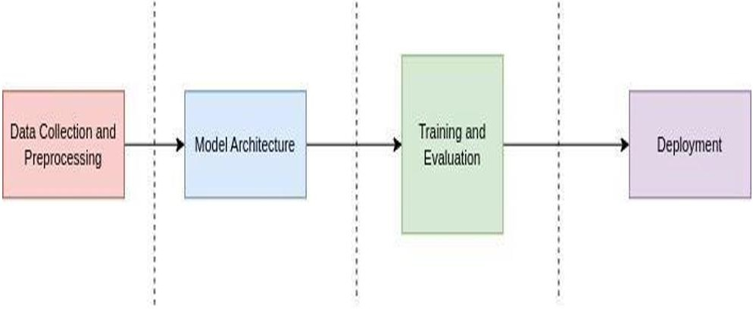
Methodology Overview
15
Step 1: Data Collection & Preprocessing
Dataset: Kaggle Dataset (Leaf images of healthy and diseased plants)
Preprocessing: Image resizing, normalization, and augmentation (flipping, rotation, brightness adjustment)
Step 2: Model Development
Convolutional Neural Network (CNN) is used for image classification.
Model trained using TensorFlow & Keras on GPU for fast processing.
Optimized with techniques like dropout, batch normalization.
Flow of Work

Slide 14
Methodology
16
Step 3: Model Evaluation
Performance measured using Accuracy, Precision, Recall, F1-score.
Tested with real-world plant images for validation.
Step 4: Web Application Development
Frontend: Built using Streamlit, allowing users to upload leaf images.
Backend: Model runs directly in Streamlit.
Output: Displays predicted disease.
Step 5: Deployment
Local Deployment: Runs on a PC/laptop using Python & Streamlit.
Mobile Accessibility (Future Scope): Can be extended for mobile-based disease detection.

Slide 15
Results and Discussion
17
Result: This project integrates a custom CNN model, a Streamlit-based web application, and advanced image processing techniques to detect multiple plant diseases with increased accuracy. The model provides precise classifications and highlights disease-affected regions in plant images, enhancing interpretability for farmers and researchers. The web application enables users to upload images and receive instant predictions, along with tailored agricultural recommendations for each detected condition, ensuring actionable insights. Image processing techniques such as thresholding and contour detection visually emphasize affected areas, supporting better understanding for both agricultural experts and farmers. The platform’s accessibility bridges gaps in agricultural support, particularly in rural and underserved farming communities.
Discussion: This project highlights the transformative role of AI in automating plant disease detection and management, integrating deep learning with an interactive and user- friendly interface. By combining real-time image classification, visual interpretability, and AI- driven recommendations, the system enhances agricultural decision-making and supports sustainable farming practices.

Slide 16
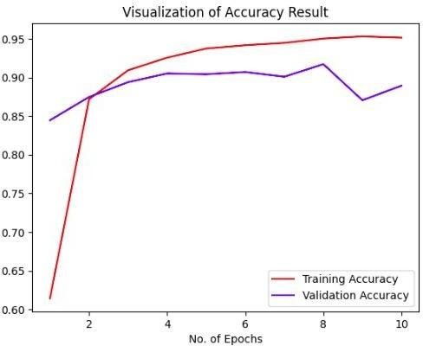
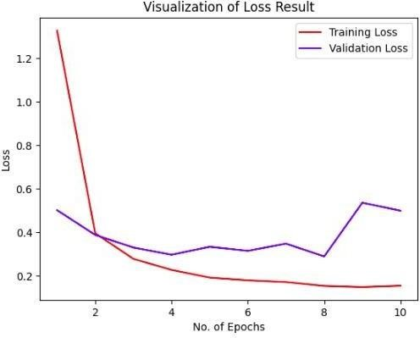
Evaluation Metrics
Model’s Accuracy and Validation-accuracy plot
Model’s Loss and Validation-Loss plot

Slide 17

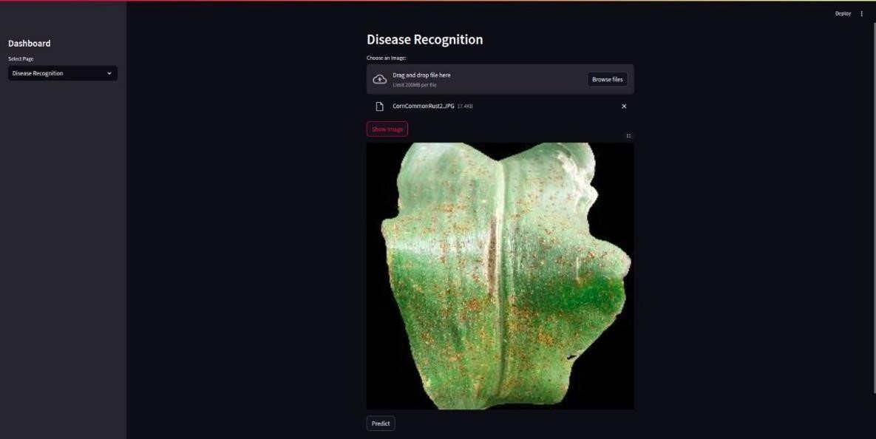
Output Screenshots
19

Slide 18
Future Enhancements
20
Robustness across datasets: Develop models that perform consistently well across various datasets to ensure their practical utility.
Exploration of alternative neural network architectures: Experiment with different neural network architectures beyond CNNs, such as recurrent neural networks, to uncover their potential in disease detection.
Improved computational efficiency: Focus on optimizing model architectures and algorithms to make them suitable for real-time applications.

Slide 19
References
[1] Vijai Singha, A.K. Misra “Detection Of Plant Leaf Diseases Using Image Segmentation And Soft Computing Techniques”, information processing in agriculture, 41-49, 2017.
[2] K. Muthukannan1, P. Latha, R. Pon Selvi1 and P. Nisha 1 “Classification Of Diseased Plant Leaves Using Neural Network Algorithms”, vol. 10, no. 4, March 2016.
[3] Savita N. “Detection and classification of plant leaf diseases using image processing techniques: a review”. Int J Recent Adv Eng Technol, (2014).
[4] Sanjay B. Dhaygude, Nitin P. Kumbhar. “Agricultural plant leaf disease detection using image processing”: Int J Adv Res Electro Electron Instrum Eng, (2013).
[5] Anand H. Kulkarni, R.K. Ashwin Patil. “Applying image processing technique to detect plant diseases”, (2014).
[6] Jia, Y., Shelhamer, E., Donahue, J., Karayev, S., Long, J., Girshick, R., Guadarrama, S., Darrell, T., 2014. Caffe: Convolutional architecture for fast feature embedding, in: Proceedings of the 22nd ACM international conference on Multimedia, ACM. pp. 675– 678.
[7] Kawasaki, Y., Uga, H., Kagiwada, S., Iyatomi, H., 2015. Basic study of automated diagnosis of viral Plant diseases using convolutional neural networks. in: International Symposium on Visual Computing, Springer. pp. 638–645

Slide 20
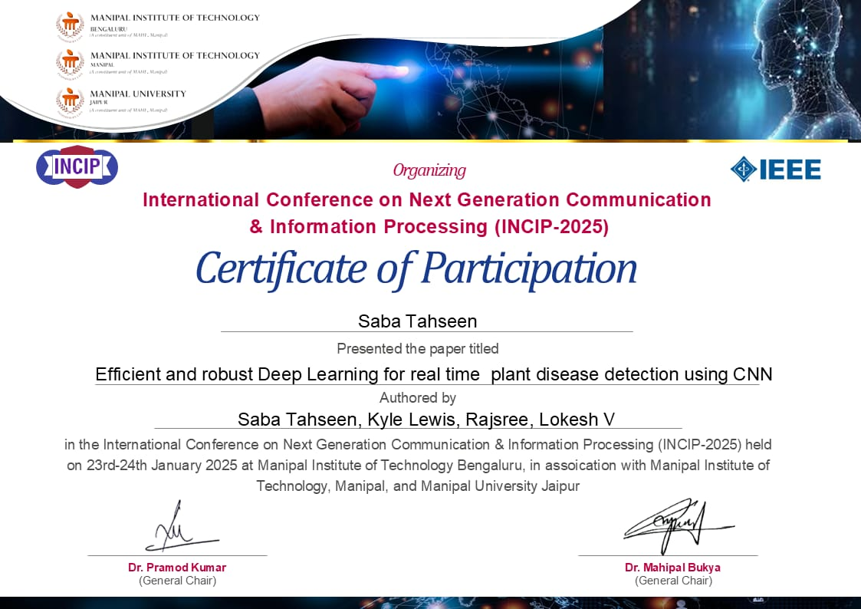

Slide 21
THANK YOU
.

