Slide 1


Dr. N.G.P. INSTITUTE OF TECHNOLOGY
(An Autonomous Institution)
Approved by AICTE, New Delhi & Affiliated to Anna University, Chennai.
Recognized by UGC & Accredited by NAAC with A+ and NBA [BME, CSE, ECE, EEE & Mechanical]
Coimbatore- 641 048
DEPARTMENT OF COMPUTER SCIENCE & ENGINEERING
FARMCONNECT: CROP RECOMMENDATION, GOVERNMENT SCHEME AND COMMUNITY SUPPORT
PRESENTED BY:
Adharsh B -710722104002
Chathurnan S -710722104016
Lokeshwaran V -710722104055
PROJECT GUIDE:
Yathavaraj V,
Assistant Professor,
Department of Computer Science and Engineering,
Dr. N.G.P. Institute of Technology.

Slide 2
Contents
Title, Abstract & Goals
Hardware and Software Requirements
Module Split Up
Module Explanation
Methodology Adopted
100% Project Completion Results
References

Slide 3
abstract
FarmConnect is an integrated online platform designed to address the challenges faced by small farmers, such as scattered information, lack of expert guidance, and complex government schemes. Using machine learning models for crop recommendations, government scheme matching, and community support, the system provides personalized advice, automated eligibility checks, and trusted peer answers through a unified dashboard. Early field results show improved farmer decision-making, increased scheme awareness, reduced consultant dependency, and overall support for data-driven, collaborative agriculture.

Slide 4
Goals
To provide ML-based, personalized crop recommendations considering environmental.
To facilitate trusted knowledge sharing among farmers using reputation and expert inputs.
To simplify and automate matching with suitable government schemes for farmers.
To improve farmer awareness, decision-making, and ease of access to support using a unified digital solution.

Slide 5
Hardware and software requirement
Software Requirements
Frontend:
React.js – For building responsive and modular UI components
Tailwind CSS – For consistent, clean styling
Fetch API – For communicating with backend APIs
Backend:
Node.js + Express.js – For API development
MongoDB– For storing farmers information.
Prediction – Python ml libraries
Hardware Requirements
Server
User System(Laptop / Mobile)
Networking Equipment

Slide 6
Module split up
Dashboard/User Interface:
  Module Presents integrated insights, crop advice, scheme eligibility, and support resources in an easy-to-use dashboard.
Crop Recommendation:
  Processes soil and weather inputs (N, P, K, Temperature, Humidity, pH, Rainfall) using trained ML classification model with feature scaling to recommend suitable crops.
Government Scheme Matching:
  Matches farmer profile details (age, income, land holding, state, category, etc.) with scheme dataset to identify eligible government schemes.
Community Support:
  Farmers can post questions and answers, vote on responses, and build reputation. Expert-approved users improve answer reliability.

Slide 7
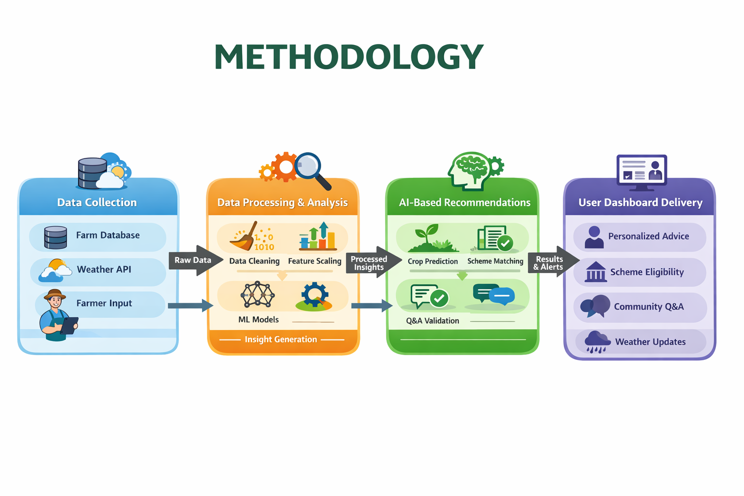
METHODOLOGY

Slide 8
METHODOLOGY
Data Collection
  Farmer inputs (N, P, K, Temperature, Humidity, pH, Rainfall), user profile data (age, income, land holding, state, category), and weather API data.
Data Preprocessing
  Duplicate removal, missing value handling, and feature scaling using StandardScaler.
Machine Learning Model – Crop Recommendation
  Supervised classification model trained on historical crop dataset.
  Scaled soil and weather parameters are used to predict suitable crops.
  Accuracy ≈ 96%.
Scheme Eligibility Matching
  Profile-based filtering using dataset rules (age, income, land, state, crop type, category, gender) to identify eligible schemes.
Output Delivery
  Personalized crop recommendations and eligible schemes displayed through an integrated user dashboard with community support.

Slide 9
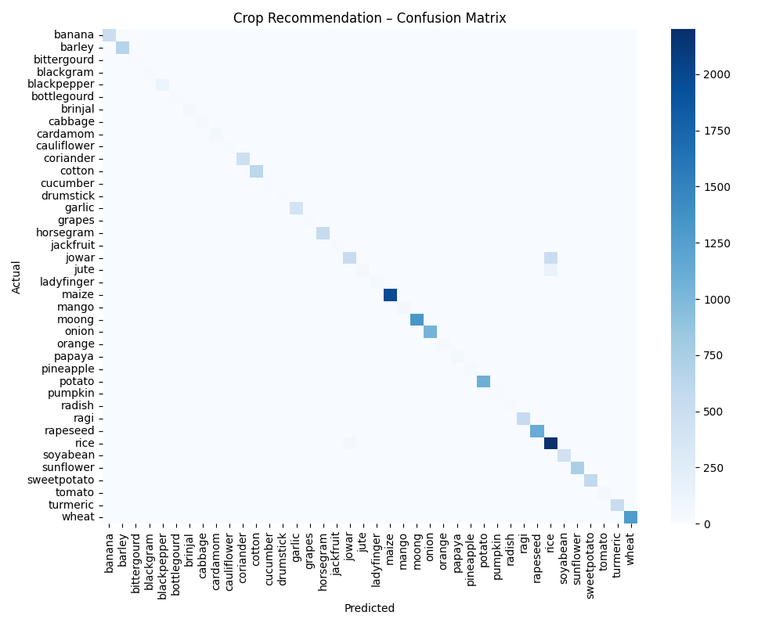
Project completion RESULTS
Crop recommendation model achieved ~96% overall accuracy using supervised classification on soil and weather parameters, demonstrating reliable and consistent prediction performance.
Government scheme eligibility module successfully filtered schemes based on farmer profile attributes, significantly reducing manual search effort and improving identification efficiency.
Community reputation system improved answer reliability through structured upvote/downvote validation and expert approval mechanism, enhancing trust and knowledge quality within the platform.

Slide 10
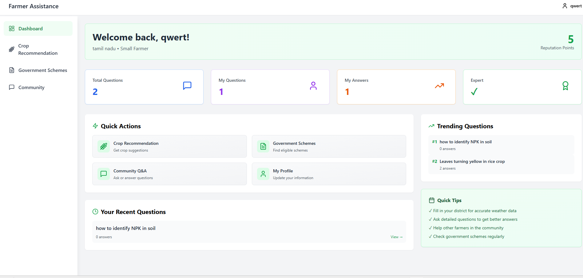
Project completion RESULTS

Slide 11
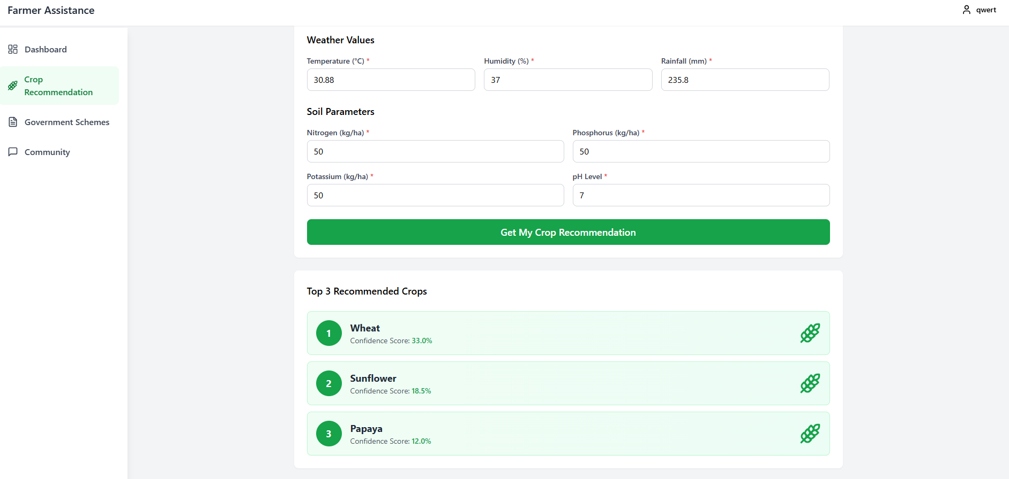
Project completion RESULTS

Slide 12
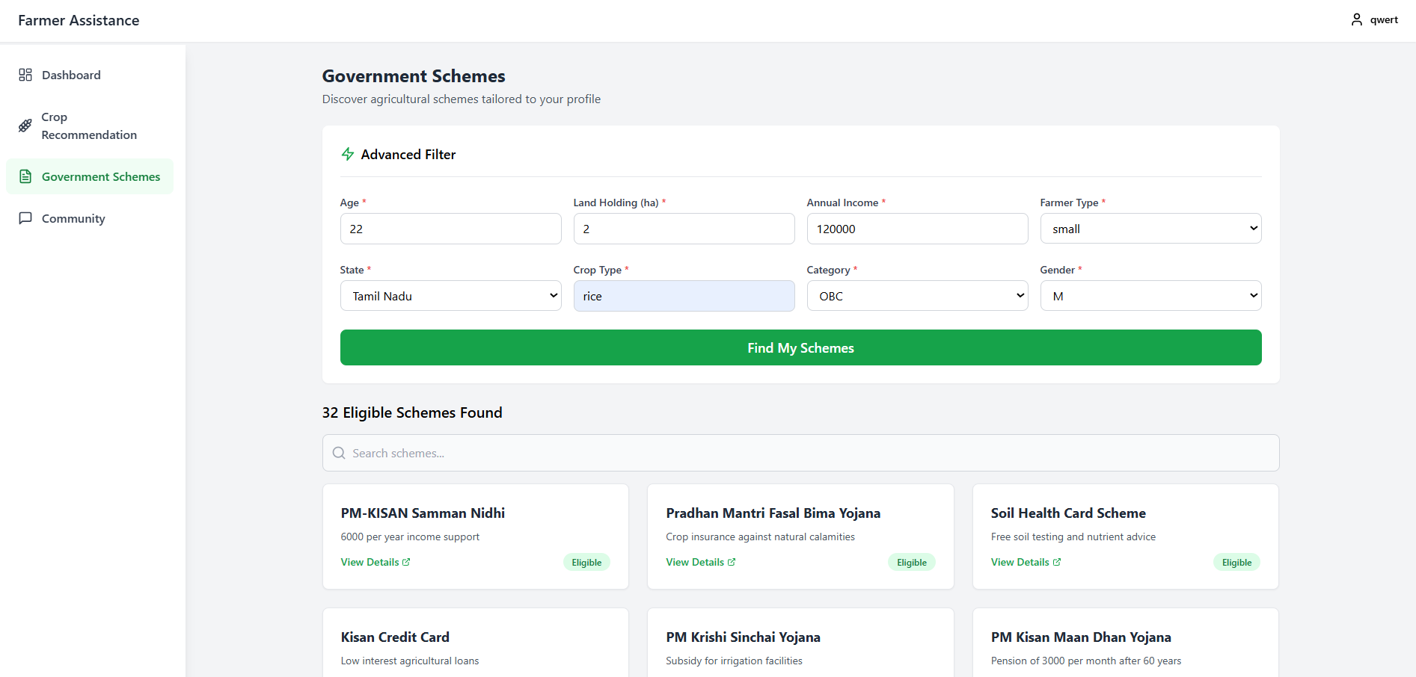
Project completion RESULTS

Slide 13
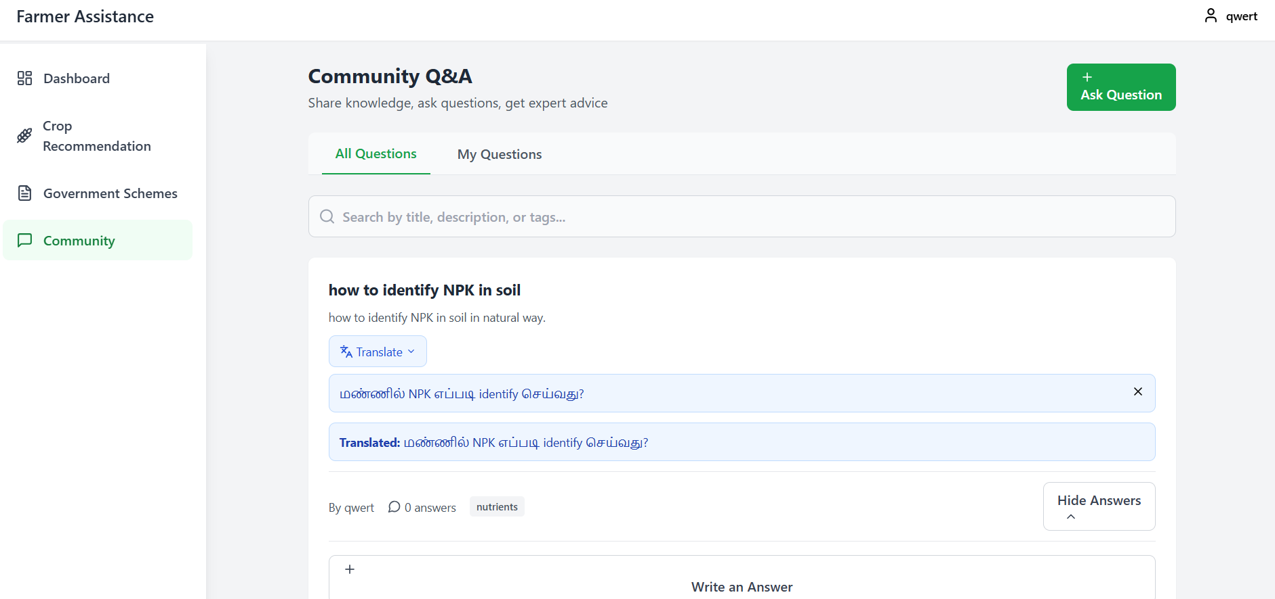
Project completion RESULTS

Slide 14

REFERENCES
  Rao et al., 2025: ML-based classification of farmer land data for scheme eligibility (RAIT Conference).
  Raju et al., 2024: AI-powered crop suggestion, yield prediction, and soil health monitoring (ICACRS Conference).
  Apat et al., 2023: Machine learning algorithms for precision crop recommendation (JSIR Journal).
  Sharafat et al., 2025: IoT-enabled, AI system for real-time crop prediction using soil/weather analytics (Smart Agric. Tech.).
  Sauvagerd et al., 2024: Digital platforms and farmer dependency in agriculture (Big Data Society).

Slide 15


