Slide 1
GROUP 8 PROJECT

Slide 2
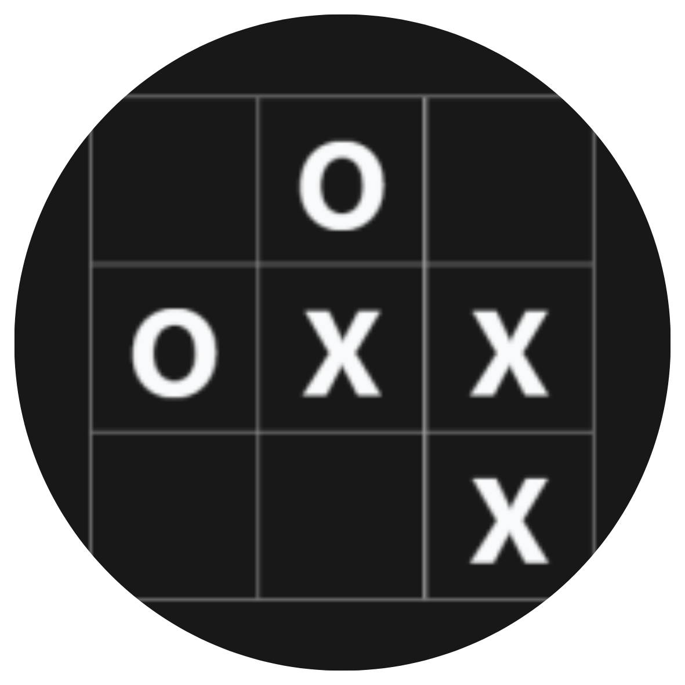
Tic Tac Toe
This project uses Anchor framework to implement the logic of the Tic Tac Toe game on Solana blockchain (devnet) and React JS to implement the frontend logic of the game

Slide 3
#[account] pub struct Game { players : [Pubkey; 2], playerOneMoves : [BoardPoint; 5], playerOneMovePos : u8, playerTwoMoves : [BoardPoint; 5], playerTwoMovePos : u8, winner : String, } #[repr(u8)] #[derive(Debug, AnchorSerialize, AnchorDeserialize, Clone, Copy, PartialEq, Eq)] pub enum BoardPoint { Point1x1 = 1, Point1x2 = 2, Point1x3 = 3, Point2x1 = 4, Point2x2 = 5, Point2x3 = 6, Point3x1 = 7, Point3x2 = 8, Point3x3 = 9, Unknown = 10, }
Game State

Slide 4
#[derive(Accounts)] pub struct SelectPoint<'info> { #[account(mut)] pub game: Account<'info, Game>, pub player: Signer<'info>, } #[derive(Accounts)] pub struct NewGame<'info> { #[account(init, payer = player1, space = 64 + Game::MAXIMUM_SIZE)] pub game: Account<'info, Game>, #[account(mut)] pub player1: Signer<'info>, pub system_program: Program<'info, System>, }
Contexts

Slide 5

Project Details
GitHub Link
https://github.com/lokeshwaran100/solana-bootcamp/tree/main/finale-project

Slide 6


Thank you
Group 8

