Slide 1
Random Forest Classification

Slide 2
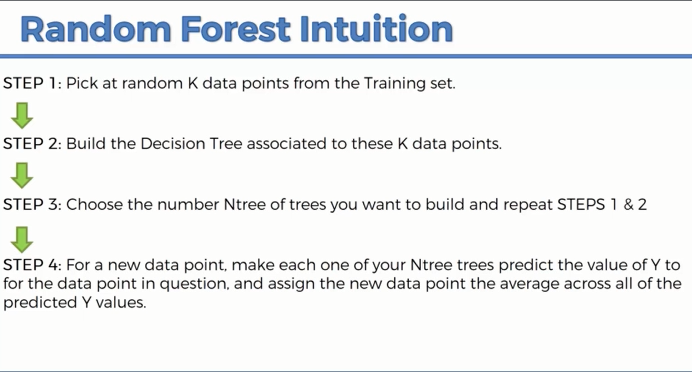

Slide 3
ENSEMBLE LEARNING
Ensemble learning is the process by which multiple models, such as classifiers or experts, are strategically generated and combined to solve a particular computational intelligence problem.
Ensemble learning is primarily used to improve the (classification, prediction, function approximation, etc.) performance of a mode

Slide 4
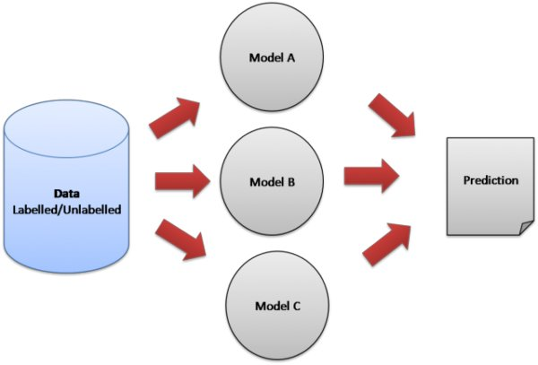

Slide 5
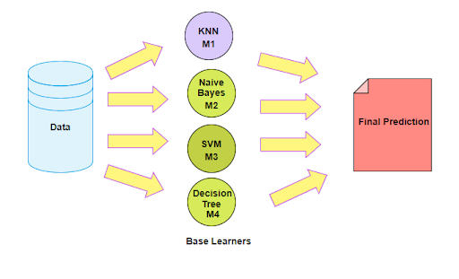

Slide 6

Random Forest Classification
Predicting 1 tree on the basis of forest of trees
Improves the accuracy of the prediction because you are taking average of many predictions
Safe algorithm
More stable because any changes in the dataset could impact one tree but not much impact on the forest of trees

Slide 7

Examples
You have a jar in which you have lots of jelly beans, you need to guess how many beans are there in the jar

