Slide 1
Naïve Bayes

Slide 2
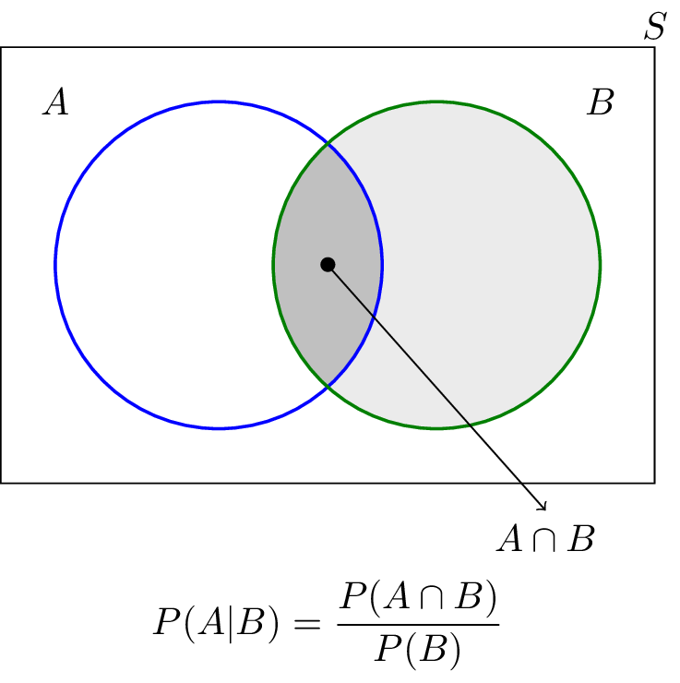

Slide 3
P(B)=30/100=0.3
P(A INTERSECTION B)=20/100=0.2
P(A|B)=0.2/0.3=0.67

Slide 4
P(A|B)=P(A IN B)/P(B)
=0.2/0.3

Slide 5
NAÏVE BAYES CLASSIFIER
For the given dataset,Apply Naïve-BayesAlgorithm and predict the outcome for a Car={Red,Domestic,SUV}
X={Red,domestic,SUV}
SOLUTION:BELONGS TO CLASS NO

Slide 6
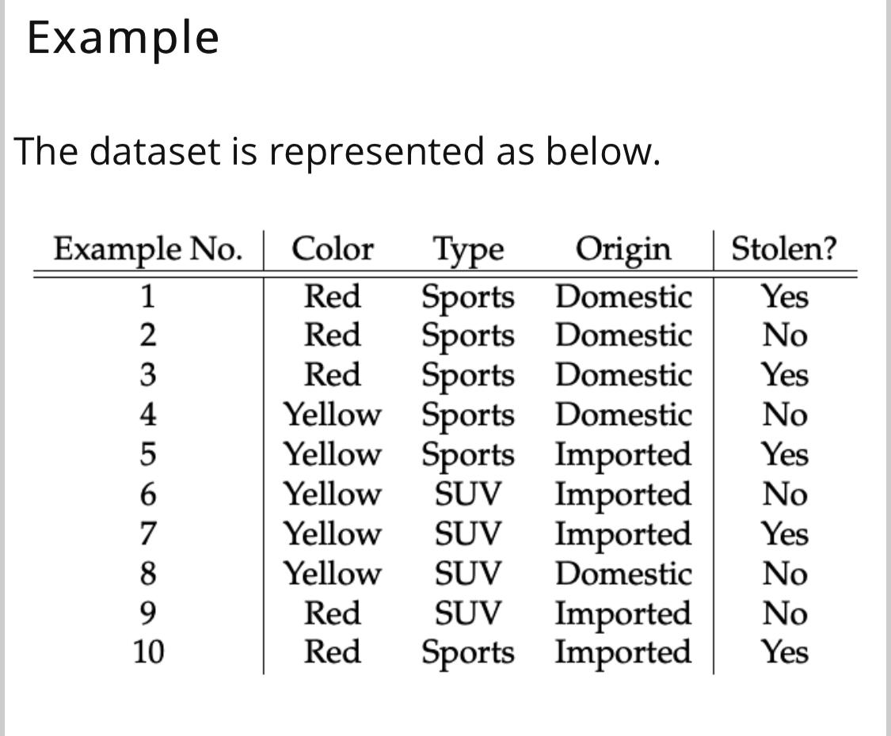

Slide 7
P(RED|YES)=P(YES|RED)*P(RED)/P(YES)=3/5*5/10/5/10=3/5
P(DO

Slide 8
(i)P(RED|YES)=P(YES|RED)*P(RED)/P(YES)=3/5*5/10/5/10 =3/5
(ii)P(Domestic|YES) =2/5
(iii) P(SUV|YES) =1/5
P(X|YES)=3/5*2/5*1/5=6/125=0.024
P(X|NO)=2/5*3/5*2/5=0.072

Slide 9
(II)P(RED|NO)=P(NO|RED)*P(RED)/P(NO)=2/5*5/10/5/10=2/5
P(DOMESTIC|NO)= 3/5
P(SUV|NO)= 2/5
P(X|NO)=2/5*3/5*2/5=0.072

Slide 10
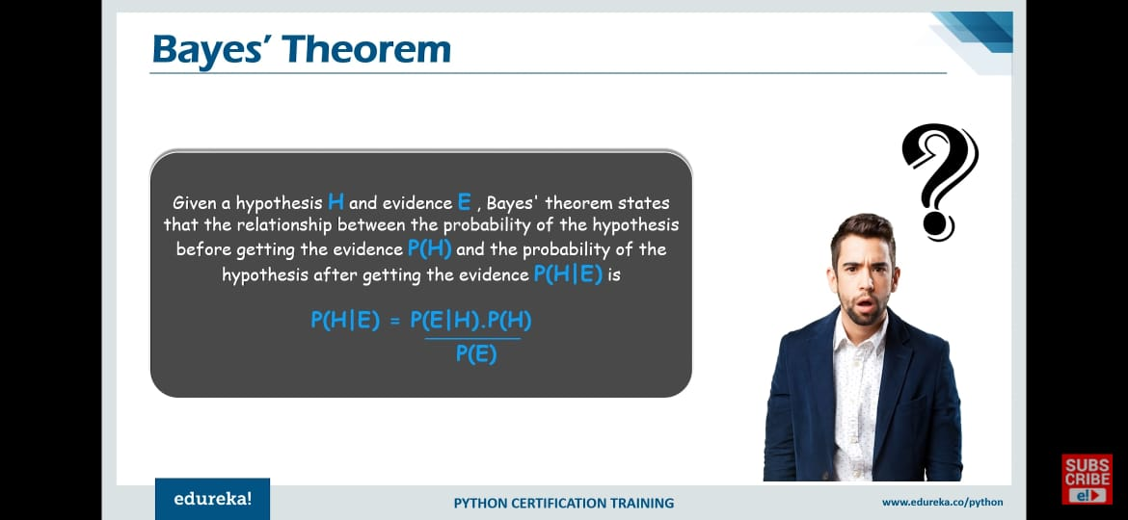

Slide 11
NAÏVE BAYES CLASSIFIER
Naive Bayes classifier performs better compare to other models like logistic regression and you need less training data. It perform well in case of categorical input variables compared to numerical variable,
In statistics, Naive Bayes classifiers are a family of simple "probabilistic classifiers" based on applying Bayes' theorem with strong (naïve) independence assumptions between the features.

Slide 12
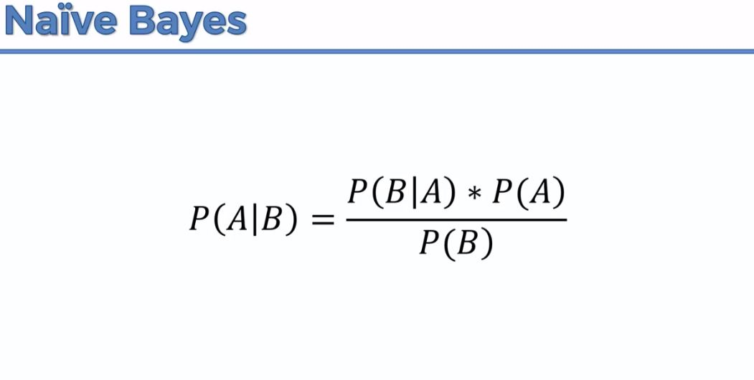

Slide 13
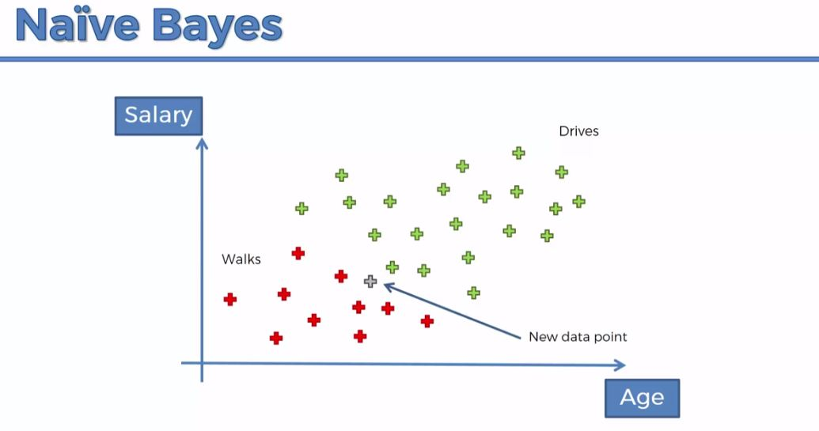

Slide 14
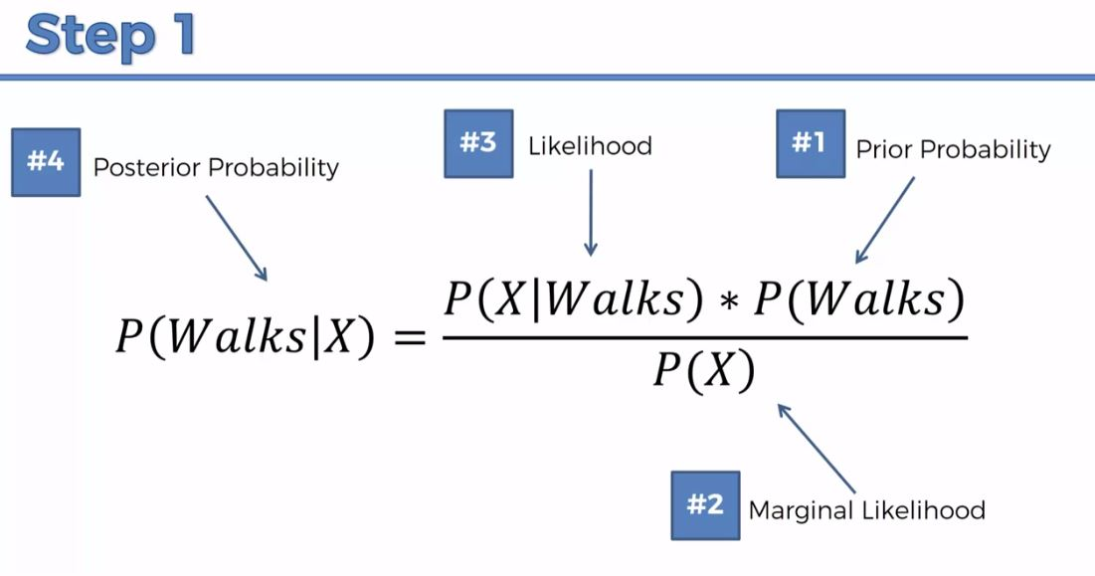

Slide 15
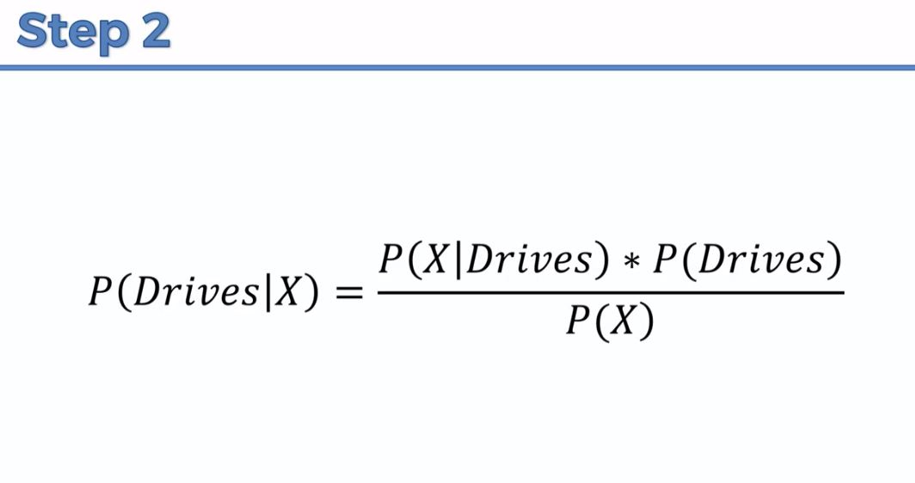

Slide 16
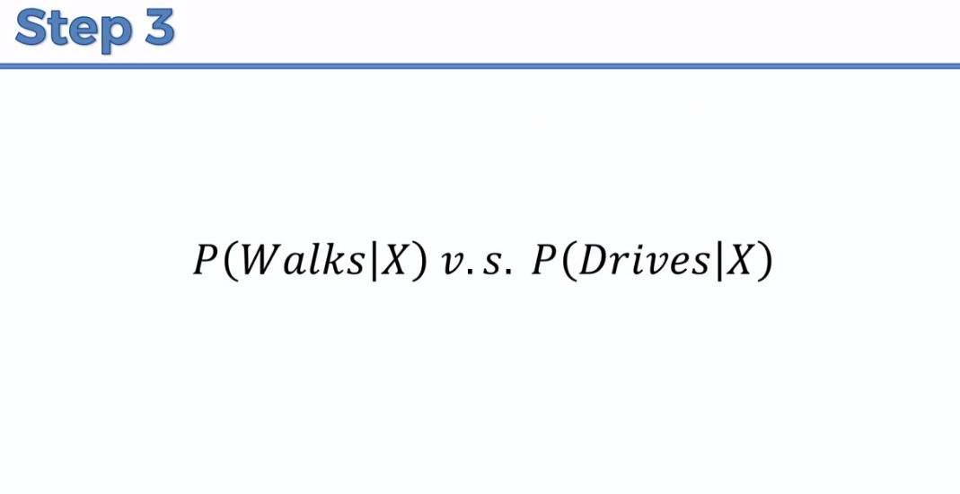

Slide 17
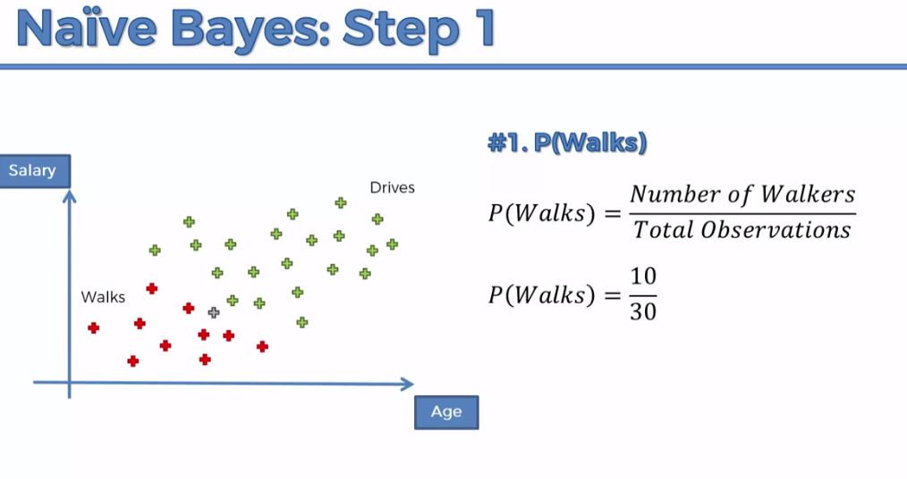

Slide 19
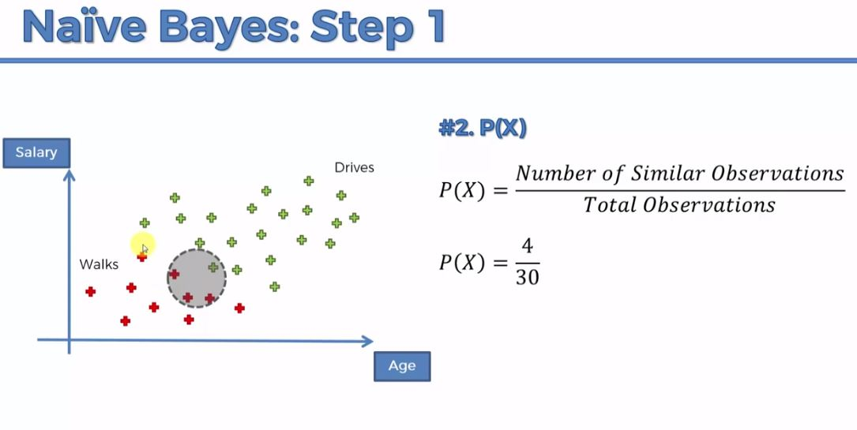

Slide 20
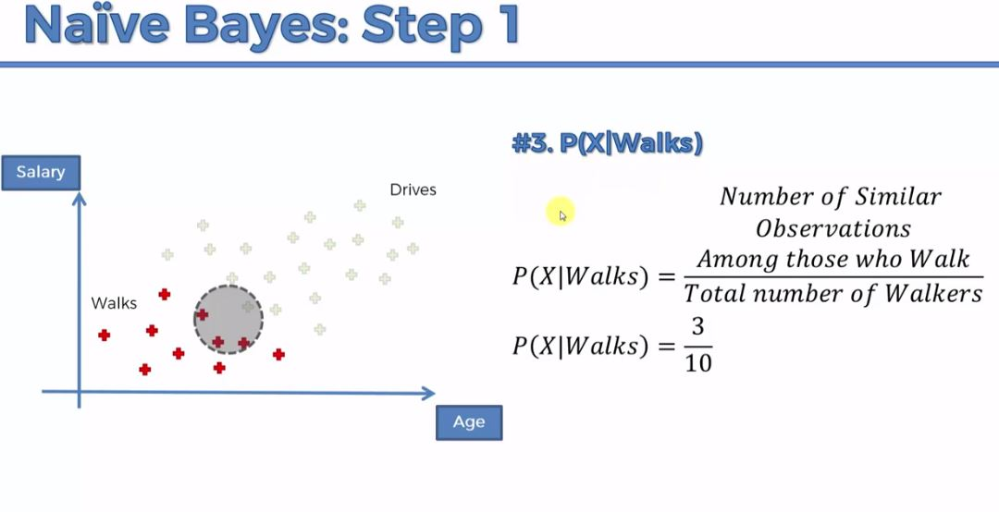

Slide 21
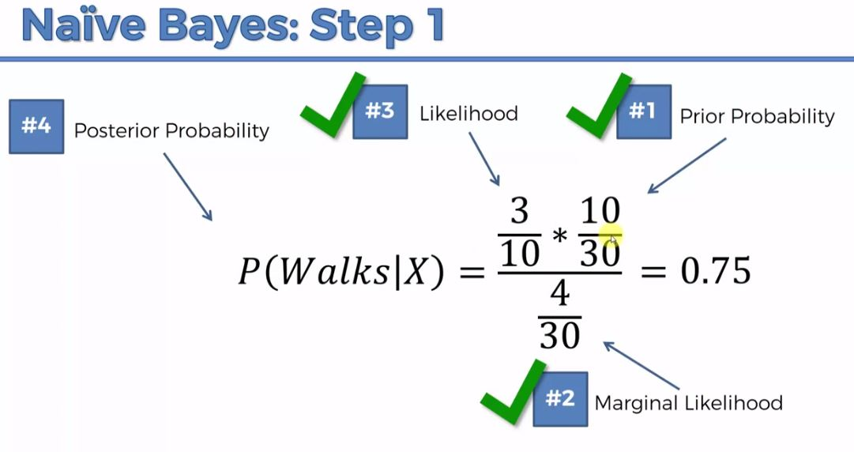

Slide 22
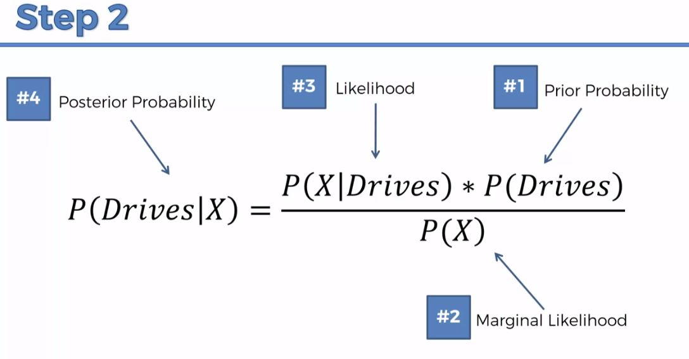

Slide 23
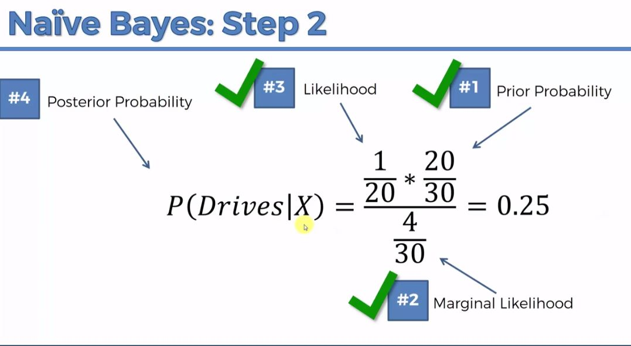

Slide 24
