Slide 1

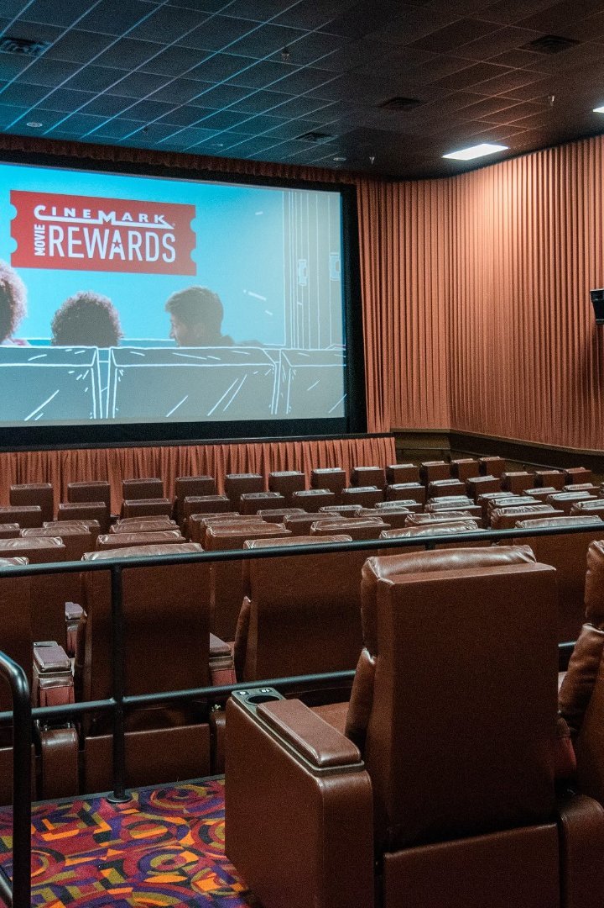
Movie Ticketing Website
Welcome to our movie ticketing website presentation! Discover the convenience and benefits of booking movie tickets online. Let's dive in!
by Gurdev Singh

Slide 2

Introduction
In this section, we will discuss the background of the movie ticketing industry and the purpose of this presentation.

Slide 3
Features of the Website
User-friendly interface
Easy ticket booking process
Our website offers a seamless and intuitive interface, ensuring a smooth ticket booking experience for all users.
With just a few clicks, users can easily navigate through our website to select their preferred movies and showtimes.
Seat selection options
Payment and security
We provide a range of seat selection options, allowing users to choose their desired seats in the cinema.
Our platform ensures secure and hassle-free payment methods, guaranteeing the safety of users' personal and financial information.

Slide 4

Benefits for Users
1
Convenience of booking tickets online
No more waiting in long queues! Users can conveniently book movie tickets from the comfort of their homes.
2
Wide range of movie options
Our website offers a vast selection of movies, catering to diverse interests and preferences of movie enthusiasts.
3
Exclusive offers and discounts
Users can enjoy exclusive offers and discounts, making their movie experience even more affordable and enjoyable.

Slide 5

Future Enhancements and Developments
1
Integration with streaming platforms
By integrating with popular streaming platforms, we aim to provide users with an all-in-one entertainment experience.
2
Mobile app development
To further enhance convenience, we are working on developing a mobile app for seamless ticket booking on the go.
3
Expansion to international markets
We have ambitious plans to expand our services to international markets, enabling movie enthusiasts worldwide to benefit from our platform.

Slide 6
Conclusion
In conclusion, our movie ticketing website provides a user-friendly platform for booking tickets, offers numerous benefits for users, establishes partnerships with cinemas, implements effective marketing strategies, and has exciting future enhancements planned. Join us today and elevate your movie-going experience!

