Slide 1


Slide 2
Agenda
Problem Statement 03
Data Mining - 01 04
Data Mining - 02 05
Exploratory Data Analysis (EDA) 06
Data Visualization 07
Algorithms Used 08
Analysis of Results 09
Conclusion & Future Work 10

Slide 3
Problem Statement
The classification goal is to predict if the client will subscribe (yes/no) to the term deposit (variable y)
Therefore we have to build a Robust term deposit Prediction Model utilizing Machine Learning : Insights from a Real world banking Data set. So that the bank people can increase their marketing methods
The Dataset is taken from Kaggle website. The dataset contains 41188 entries with 20 columns. The columns are 'age', 'job', 'marital’, education', 'default', 'housing', 'loan', 'contact', 'month', 'day_of_week', 'campaign', 'pdays', 'previous', 'poutcome', 'emp.var.rate', 'cons.price.idx', 'cons.conf.idx', 'euribor3m', 'nr.employed', 'y’
Reference :
https://www.kaggle.com/datasets/ruthgn/bank-marketing-data-set

Slide 4
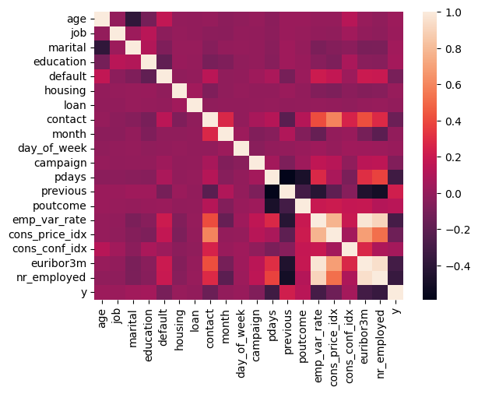
Data Mining – 01
The Ratio between Majority class and minority class of Target Variable is “7.78 : 1”.Hence the dataset is a balanced dataset.
The data.shape function returns (41188,20)
The heatmap of correlation among the variables shown below
There are duplicate entries in the data that can observed from duplicated() function.
The duplicate values can be removed by using remove_duplicated() function
Number of unique values in the column can be identified using nunique() function.

Slide 5
Data Mining – 02
The null values can be identified using Is null().sum() function.
There are no values if they are present they can be handled in various ways
Null values can be handled in many ways like Imputing, Interpolating, filling. The most commonly used technique is Imputing.
There are two types of Imputing. They are Simple Imputer , KNN Imputer.
Simple Imputer Is used handle the categorical or discrete variables .The values are imputed using strategies like Mean , Median , Mode etc.
KNN is used to handle the continuous variables. Since all our variables are continuous we use KNN Imputer imported from Sklearn package to fill the null values.
The datatypes of variables can be identified using info() function.
All the datatypes are converted to int using as type() function.
The variables contains different set of values without range limit. Hence we scale the features into a specific range.
The Scaling is required only for Distance based algorithms like PCA and not used in Tree based algorithms.
There are many scaling techniques like Min Max Scaler , Robust Scaler , Standard Scaler. These are present in scikit learn package.
Here Min Max Scaler is used to Scale the values to a specific range 0-1.

Slide 6
Exploratory Data Analysis (EDA)
The describe() function is used to summarize the data. The output contains mean, median, mode, standard deviation ,25 percentile and 75 percentile.
We perform feature engineering techniques.
We Identify the Dependent and Independent variables.
The data is divided into X and Y , where X contains the data of Independent variables and Y contains the data of Dependent/Target Variable.
The data is splited into train and test data using train_test_split of model_selection library of sklearn package.
The train_test_split takes the parameters x , y ,test_size , random_state . Random_state is used to fix the train and test data.

Slide 7
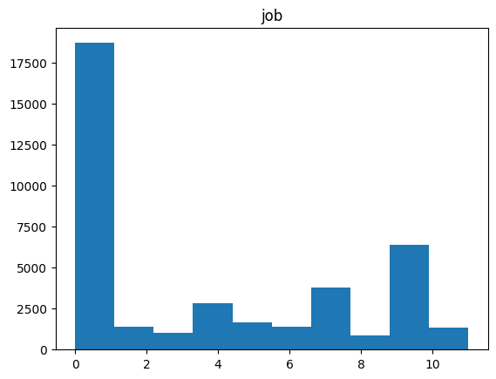
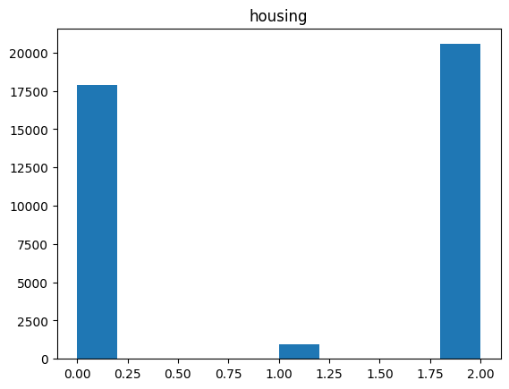
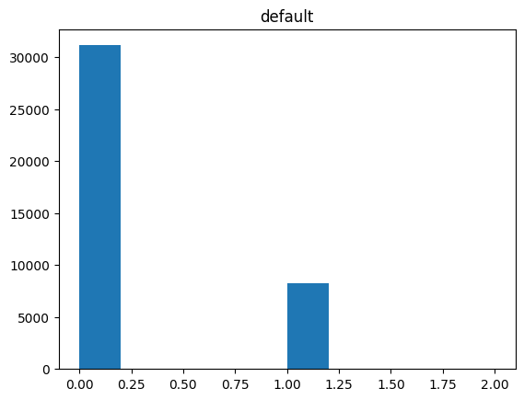
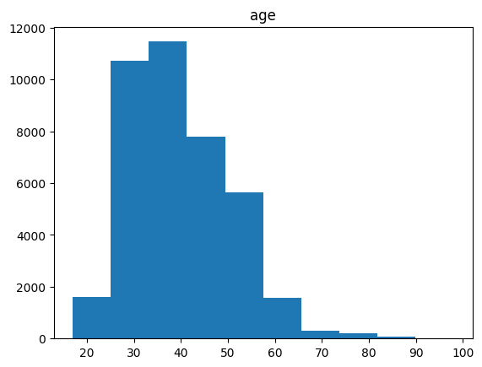
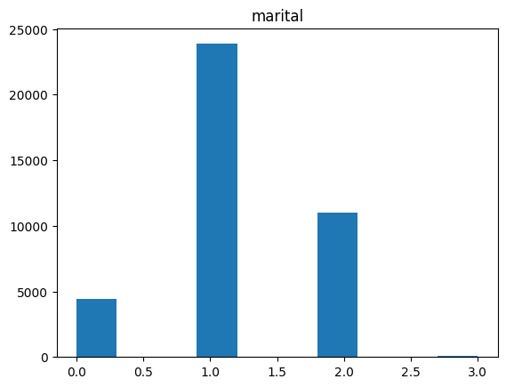
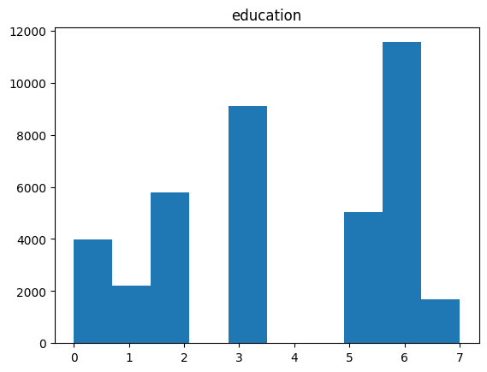
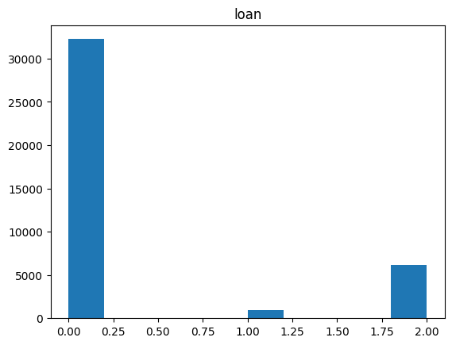
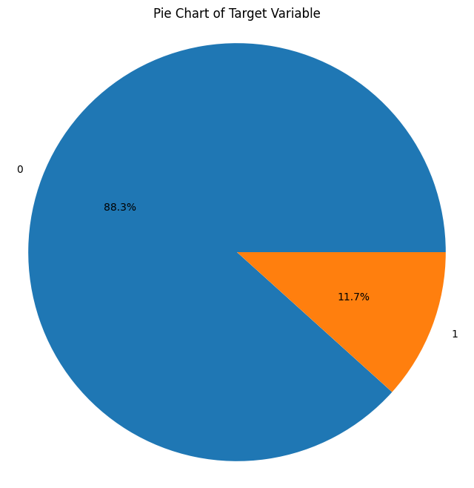
Data Visualization

Slide 8
Algorithms Used
The problem is Term deposit prediction.
The data set contains the class labels hence it is a Supervised Machine Learning.
As the target variable is discrete categorial we use classification algorithm.
There are many classification algorithms. The algorithms used are
Logistic Regression
Decision Tree Classifier
Random Forest Classifier
Extra Trees Classifier
K neighbours Classifier
Naïve Bayes Classifier-GaussianNB
Support Vector Machine
These models are compared based on Confusion matrix and Classification Report. The confusion matrix and classification report are calculated using inbuilt functions of sklearn.metrices package.
The best model is used for predicting the class labels of Target variable.

Slide 9
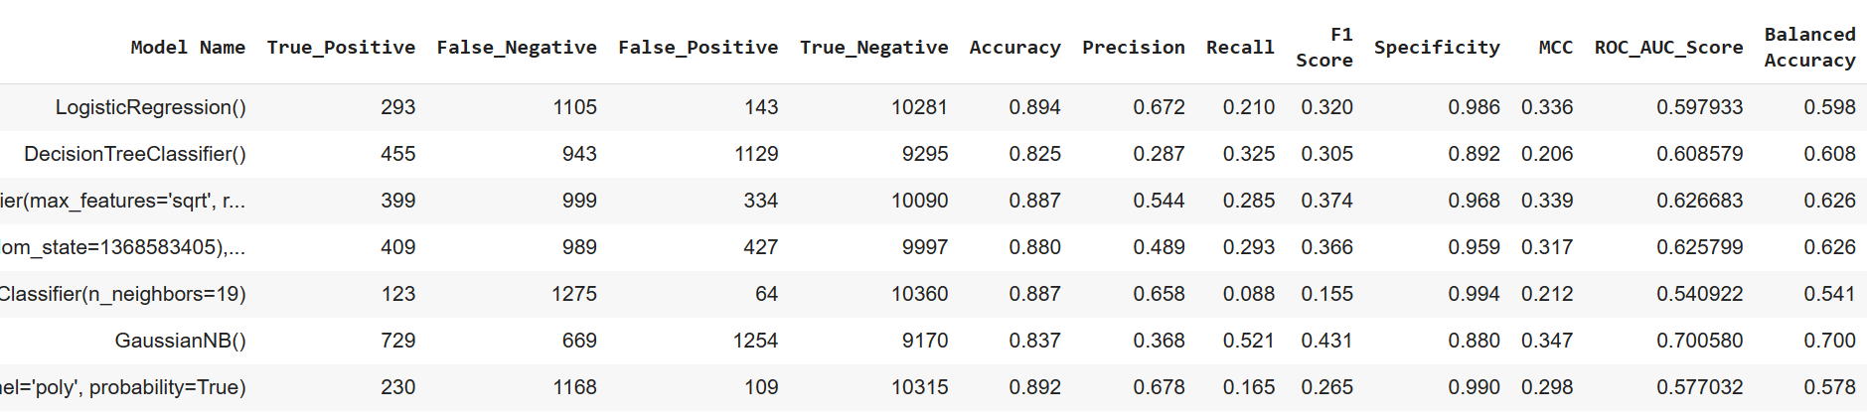
Analysis of Results
The confusion matrix contains values of true positive ,false positive, true negative , false positive.
The classification Report contains Accuracy ,Precision, F1_score, Recall.
The confusion matrix of model to be choosen should have high true positive rate and low false positive rate.
The Accuracy,F1_score,ROC_AUC_Score should be high.
The Logistic Regression model is choosen as the best model for heart disease prediction because the values of confusion matrix are medium and the classification report is better when compare with all other models.
Hence Logistic Regression is used for prediction.

Slide 10

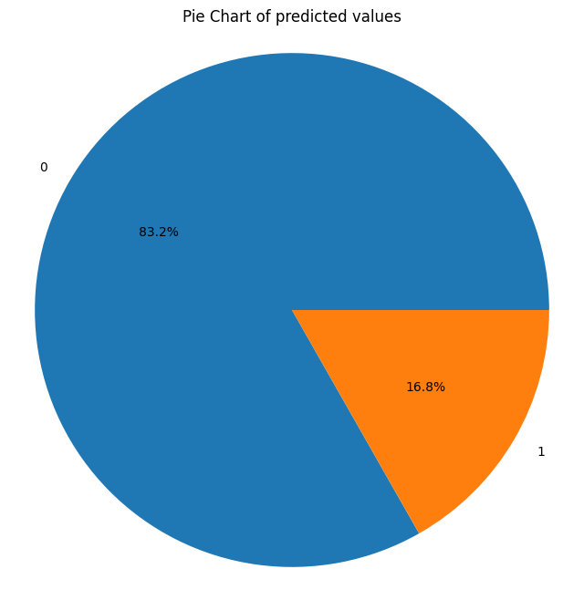
Conclusion and Future Work
Our term deposit prediction model gives the accurate pulse of the customers and helps the bank to take necessary measures to increase their deposits
Future Work:
Enhance model performance through data augmentation and advanced algorithms. Collaborate with banking professionals for seamless integration into clinical practice. Conduct rigorous validation across diverse populations to ensure robustness and reliability.

Slide 11
Thank You
Q & A
S.LOKESWAR
21B91A6152
SRKR Engineering College
Mobile: 8179458030
Email: 21B91A6152@srkrec.ac.in
Bhimavaram - India

