Slide 1
ADF_Generic_Model

Slide 2
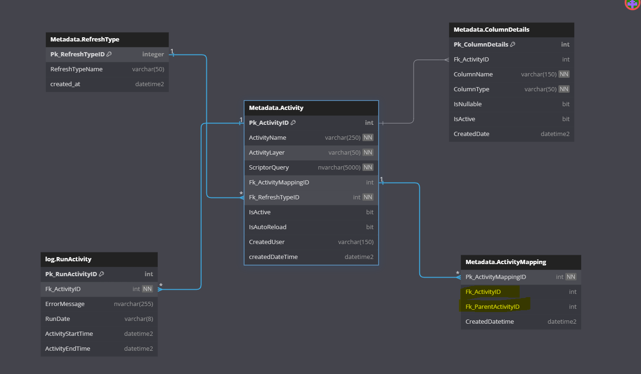

Slide 3
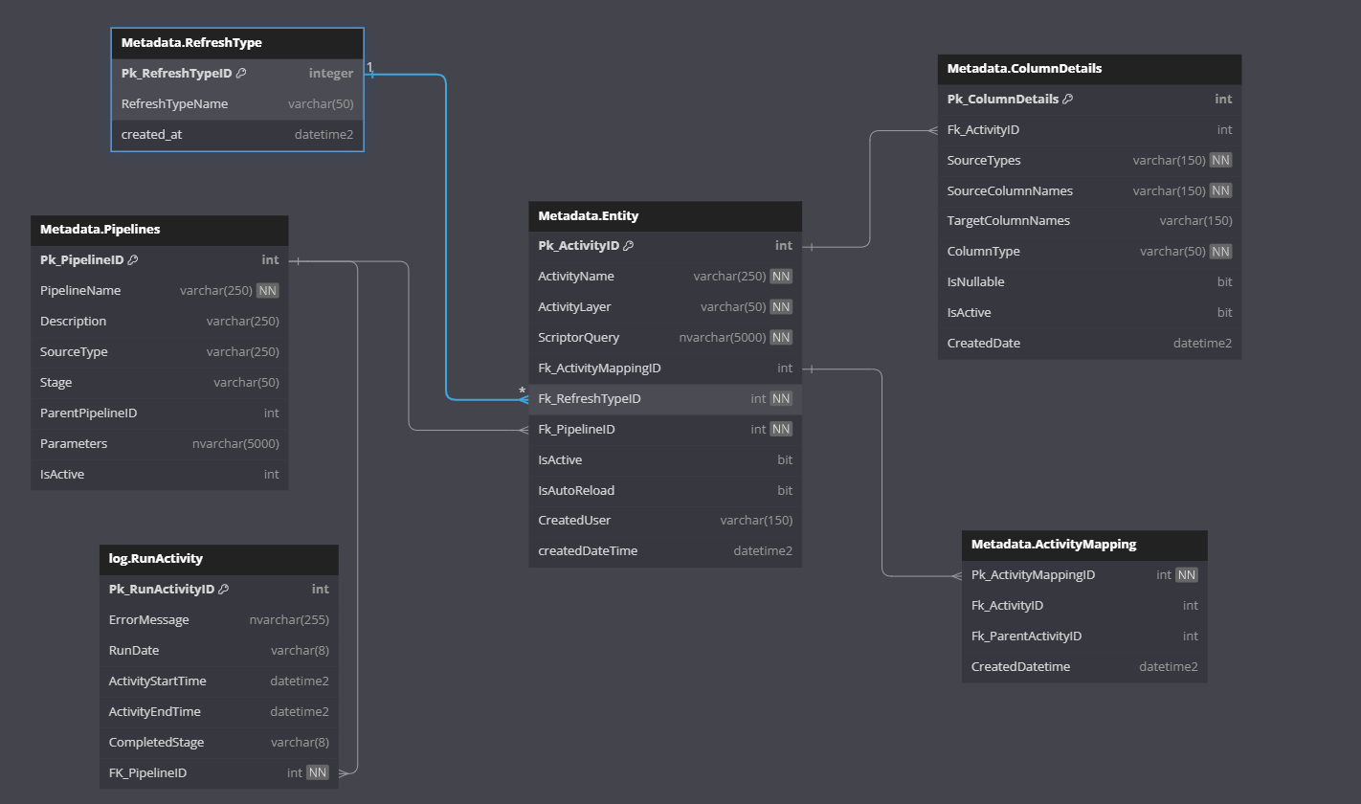

Slide 4
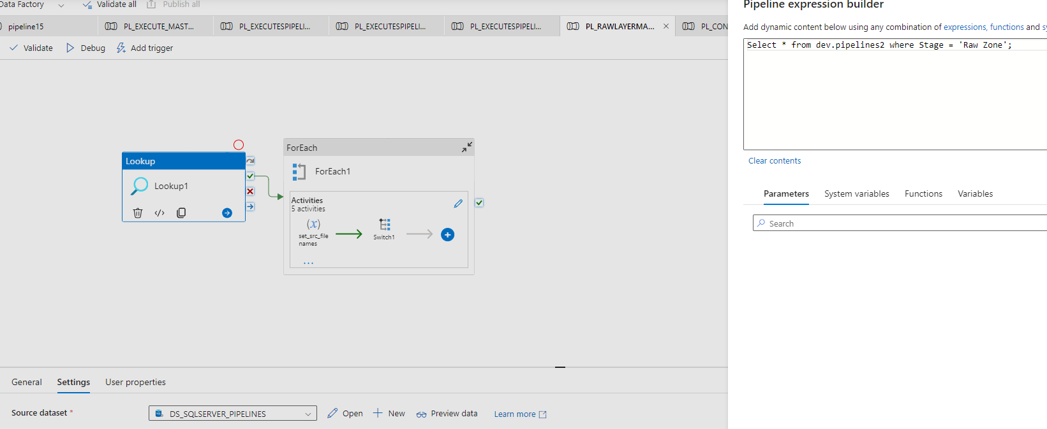
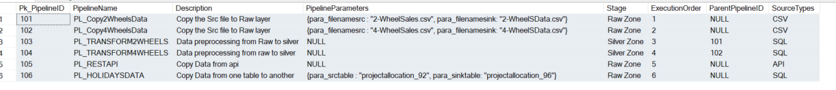
:: PL_RAWLAYERMASTER ::

Slide 5
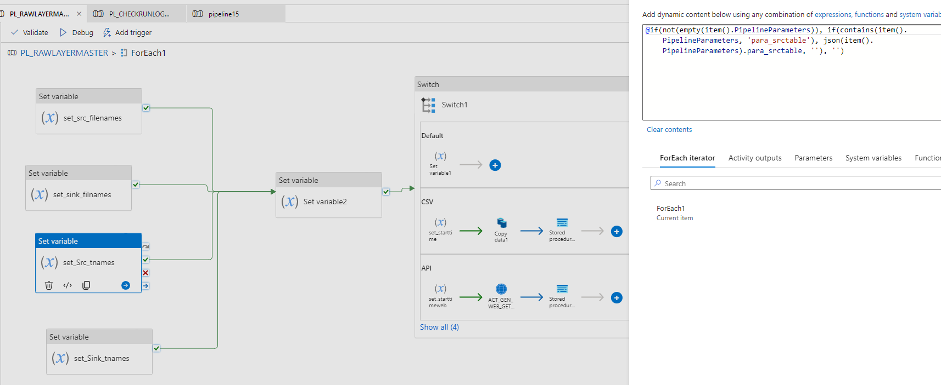



Slide 6
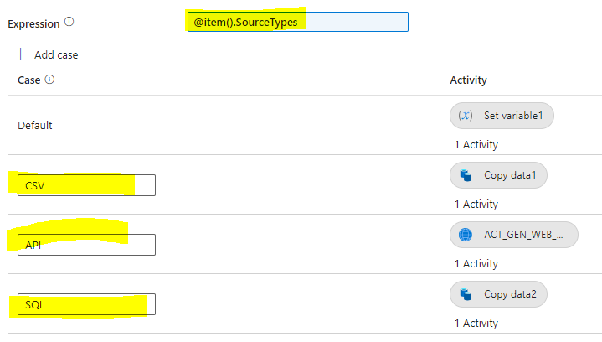
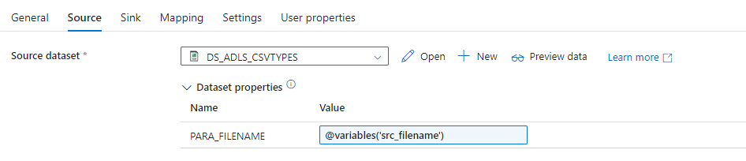

Slide 7
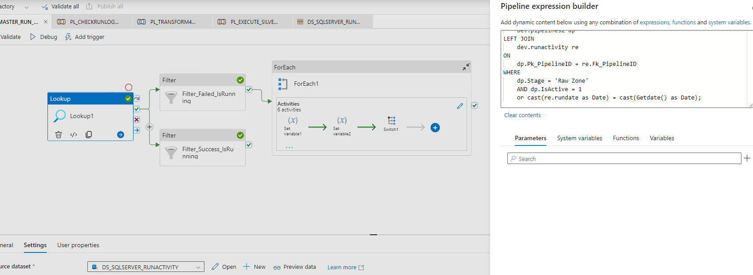
:: PL_MASTER_RUN_RAWLAYER::
Let’s design a Pipeline , which will Look on runactivity logs Table and re-run the Failed Pipeline according to the Source Types
In the next stage we will do filter on top of Success and Failed. If failed Iterate through those pipelines and re-run the Failed one..

Slide 8
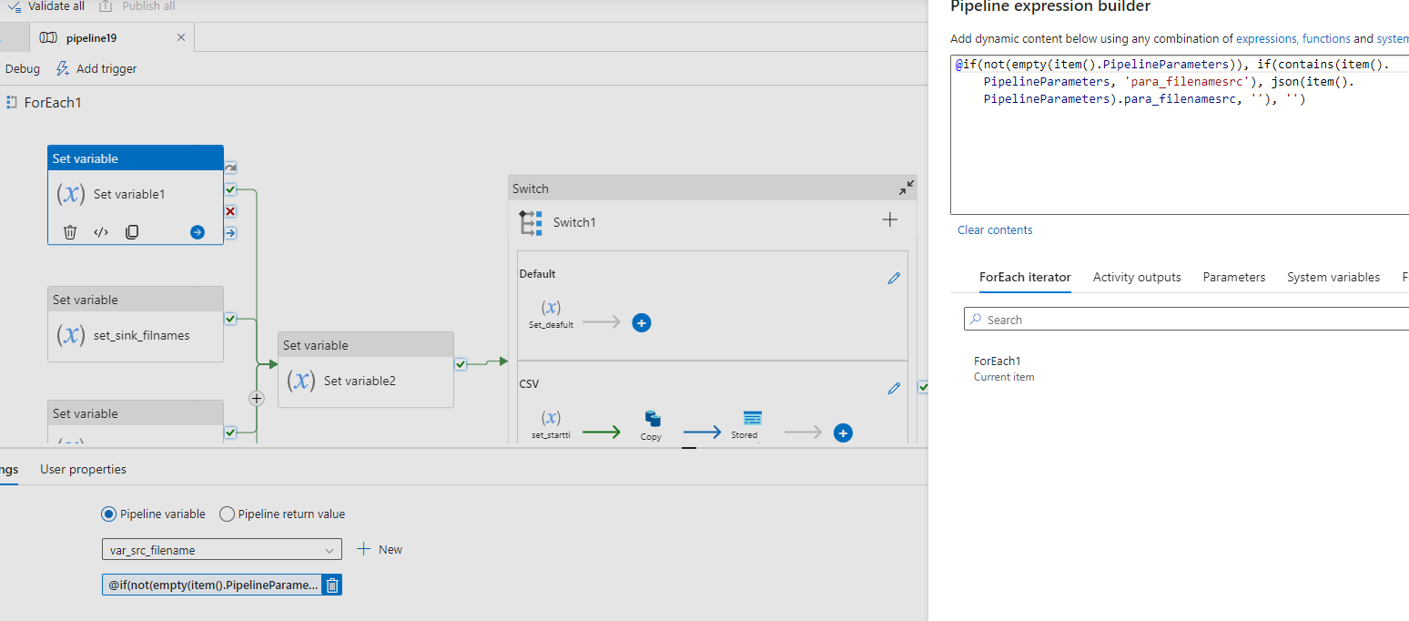
Continue…
@item().Pk_PipelineID

Slide 9
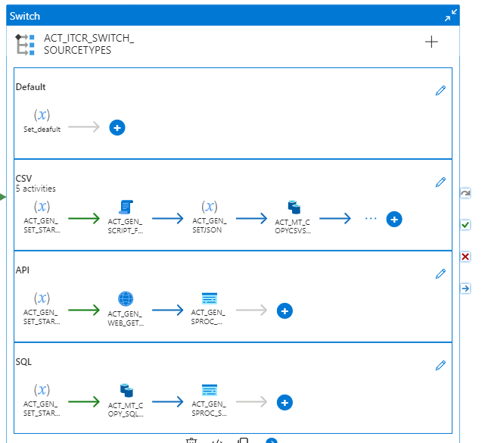
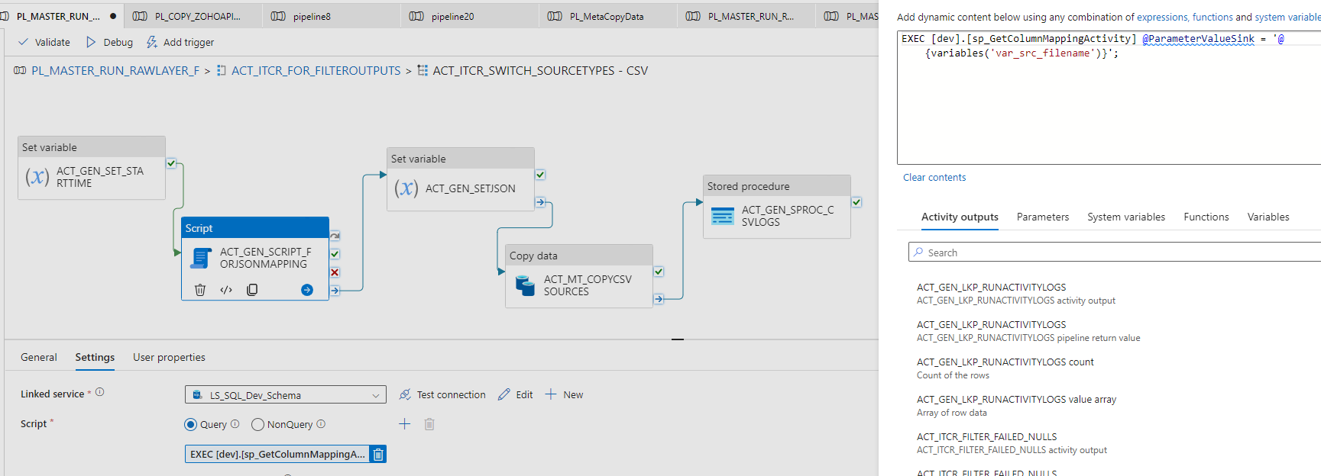
Continue…

Slide 10
Continue…
Runactivity Logs Table Look’s Like

Slide 11
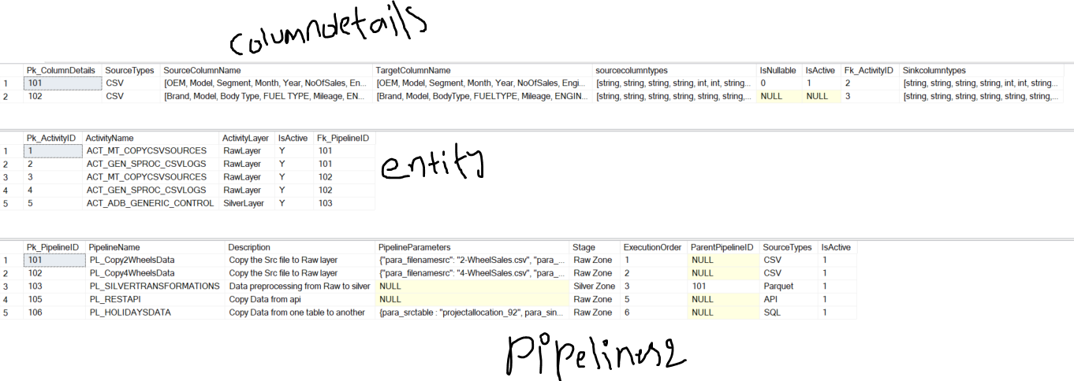
Silver Processing
From the Raw layer data been stored in Adls gen2 as Parquet files .
Here in the Silver Layer , need to pickup that Parquet file and do schema mapping process , null handling etc., using pyspark code in the DataBricks

Slide 12
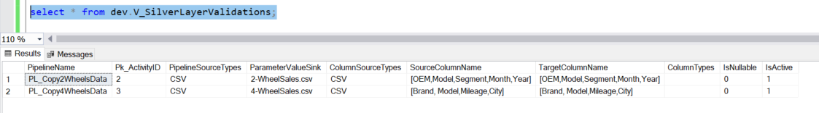
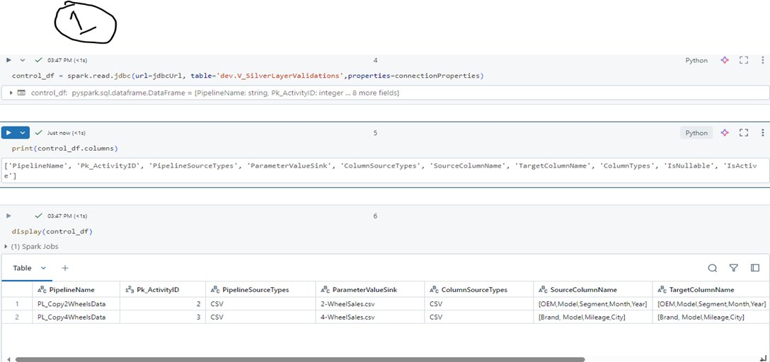
Continue....

Slide 13
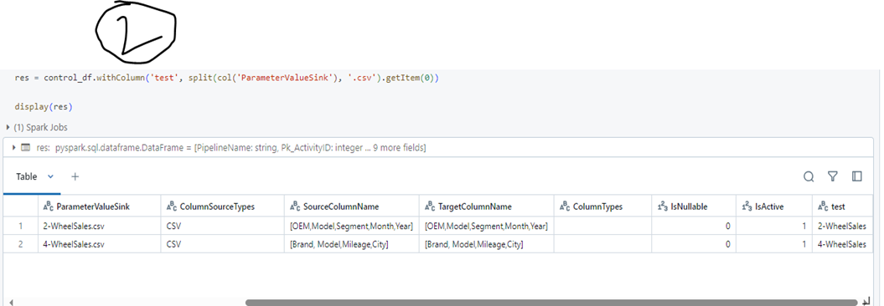
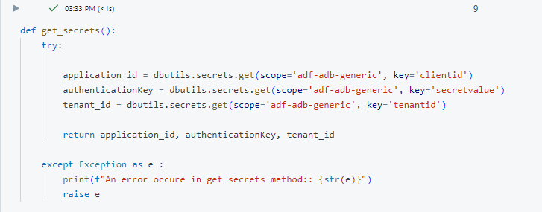

Slide 14
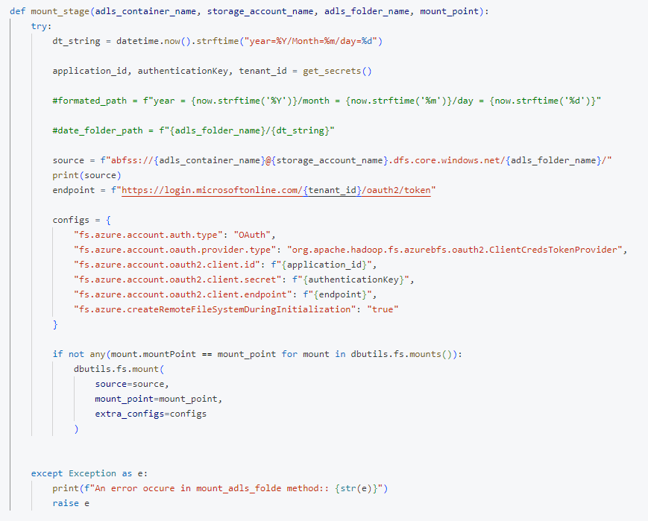

Slide 15
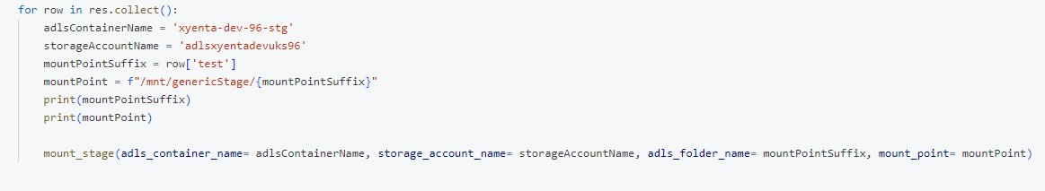

Slide 16
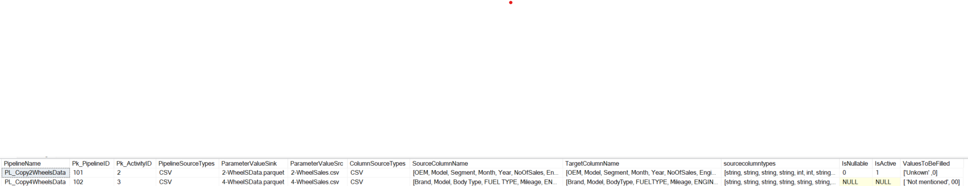
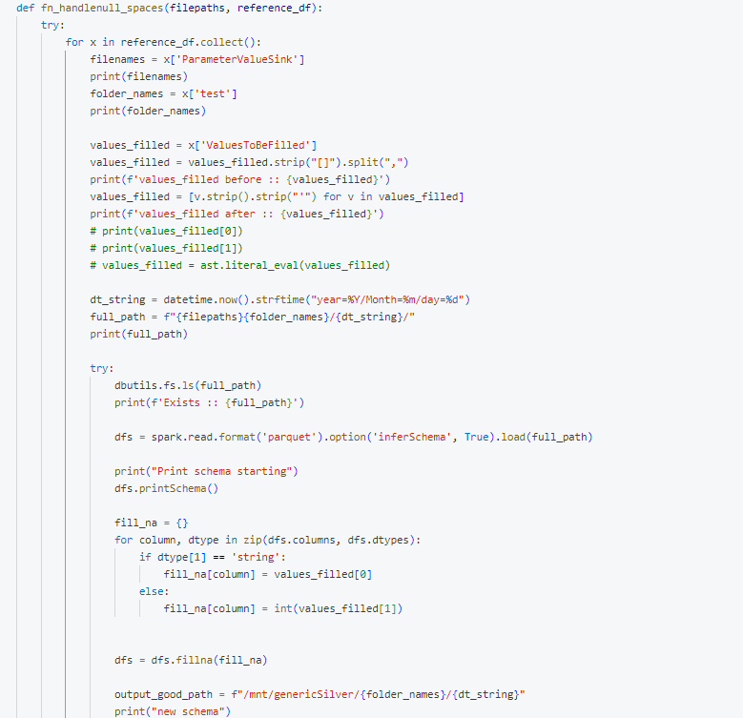
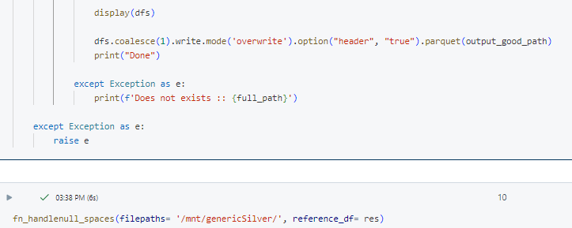
Sample code which will fill the null values in the dfs , for the files coming from the view

Slide 17
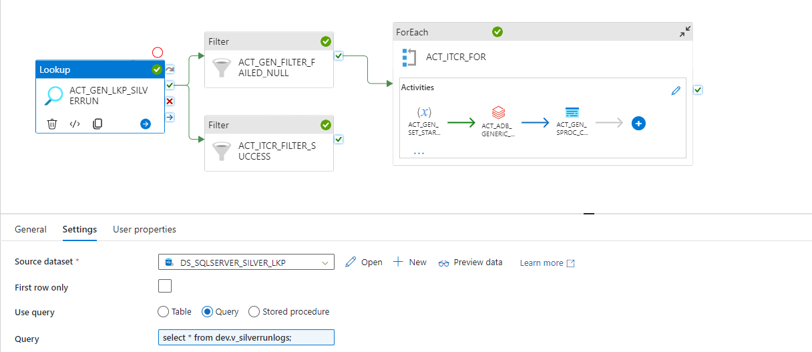
Continue….
ADF master pipeline to run the data processing tasks in the silver layer..

Slide 18
