Slide 1

Azure Synapse-I
Modern ETL TOOL

Slide 2
Context:
Introduction To Synapse : 3
Why Azure Synapse : 4-5
Azure Synapse Architecture : 6-7
Create Synapse Analytics Workspace : 8-14
Serverless SQL Pool : 15 -16
Dedicated SQL Pool : 17 -19
Spark Pool : 20-22
Delta Lake : 23-26
Querying Files using Synapse SQL : 25
External Tables : 26-34
Views : 35-36
Check and Call the Explicit Datatypes on Files : 37- 39

Slide 3
Introduction to synapse:
Azure Synapse or Azure Synapse Analytics is a limitless analytics service that brings together enterprise Datawarehouse and Big Data analytics
It gives you the freedom to query data on your terms using either serverless or dedicated resources-at scale
To wrap up, it’s a one service used to design Datawarehouse as well as Big Data Analytics
Useful link : https://k21academy.com/microsoft-azure/data-engineer/azure-synapse-analytics/

Slide 4
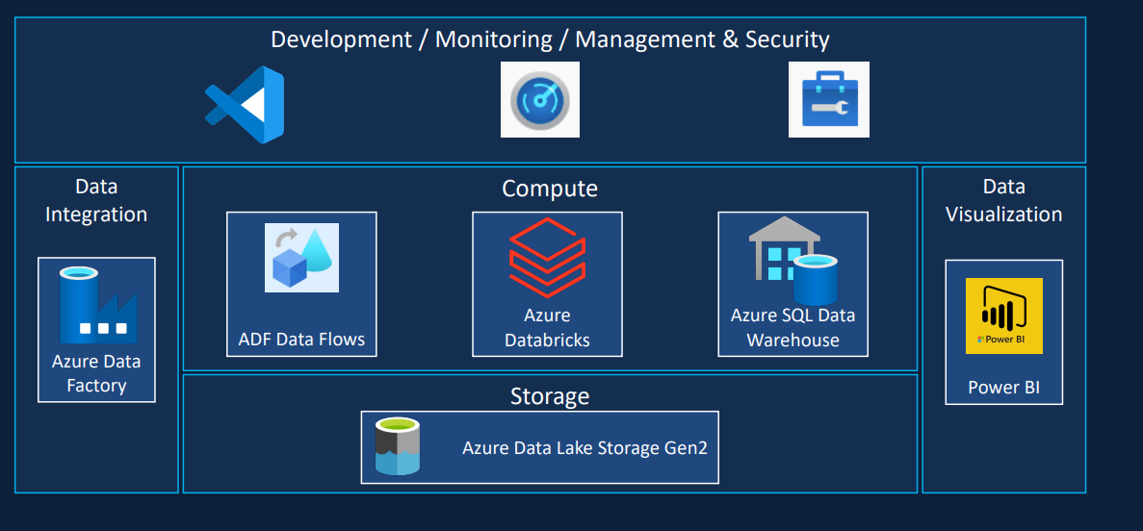
Why Azure SYNAPSE:
The image below shows you the high level Modern DWH architecture with Azure environment

Slide 5
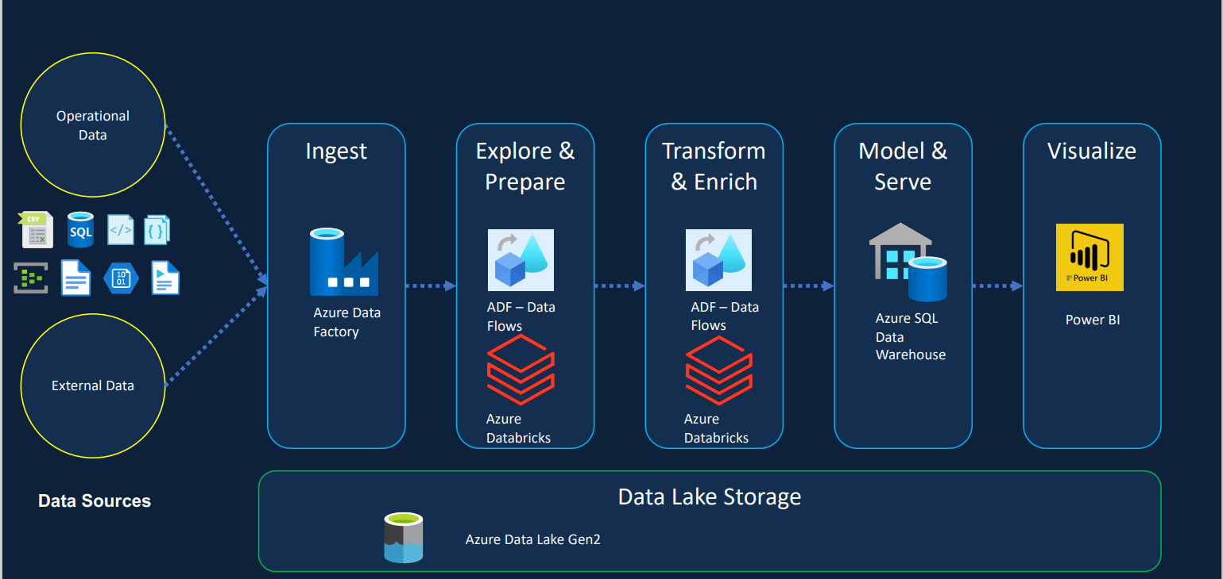

Why Azure Synapse:
The image below shows you the Modern DWH or cloud DWH with Azure environment
Almost all we have 6 different services included and each one require their own development studio, Monitoring and management
No serverless option presented i.e., it takes quite longer time to be available and charge while they running
One service is not aware of objects created by another {Meta data not shared}
These are the couple of Issues with Modern DWH
To address the Issues of Modern DWH Azure Synapse Came into the picture

Slide 6
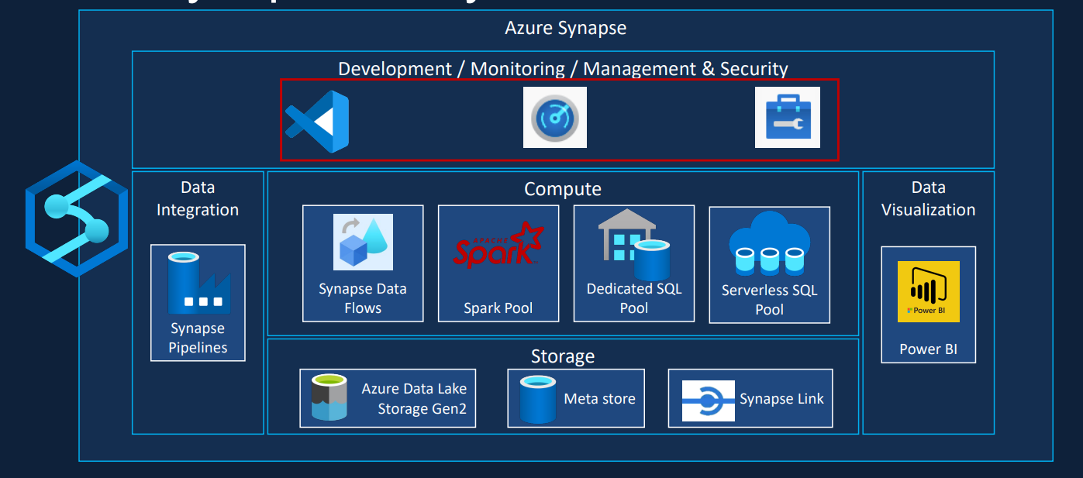
Azure Synapse Architecture ::
To solve the issues of Modern DWH Azure Synapse Analytics introduced . It provide a single platform or frame for all services .
Azure Synapse Architecture:

Slide 7
Continue..
Even though we have different services involved , but they are under one single frame called Synapse.
The major difference between Modern DWH with ADF & Synapse DWH at high level is all about having Serverless Pools and Dedicated Pools
ADF Pipelines replaced by Synapse Pipelines , ADF Data Flows Replaced by Synapse Flows, DataBricks Replaced by the Synapse Notebook or spark pool, Azure SQL replaced by the Azure SQL with dedicated pool and serverless pool
Serverless SQL Pool: Doesn’t require a start to startup and running all the way. It’s available on –Demand, we don’t need to provision any resources to query a data in data lake with T-SQL . Azure itself allocate resources and run’s the query. As we don’t provide any resources we charge , based upon Query run only means Based on amount of data processed rather than resources provision
Meta Store: With help of Meta Store, we can now access the tables from Spark Pool in SQL

Slide 8
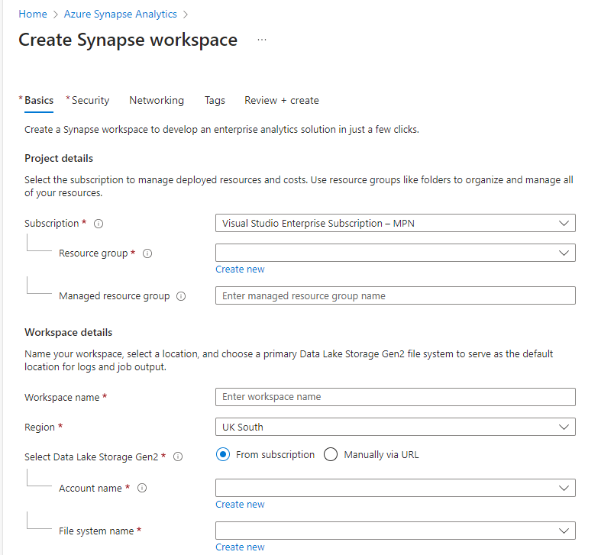
Create Synapse Analytics workspace:
Synapse Workspace default comes with Serverless SQL Pool
Step 1: Login into Portal > Click on Create Resource > Select Azure Synapse Analytics
Step 2: Then you will land into this page. Provide the Resource Group Name in project details
Step3 : In workspace details , provide
Name for the workspace , select the region
To host , provide the Storage account name
And container name (File System name).So, that
Azure Synapse consider that storage account
As primary Storage Layer

Slide 9
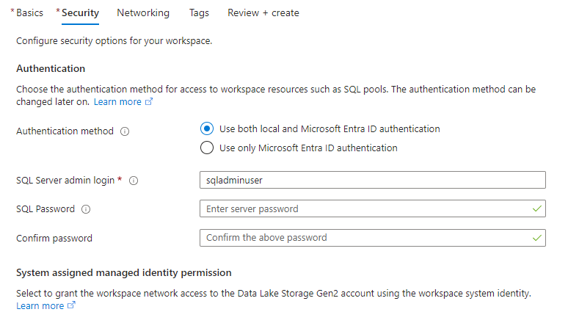
Continue..
Step 4: In security tab under Authentication provide or select suitable Authentication method , as well as you need to provide the SQL Server admin login name , password . So, that we can access the Synapse workspace from SSMS

Slide 10
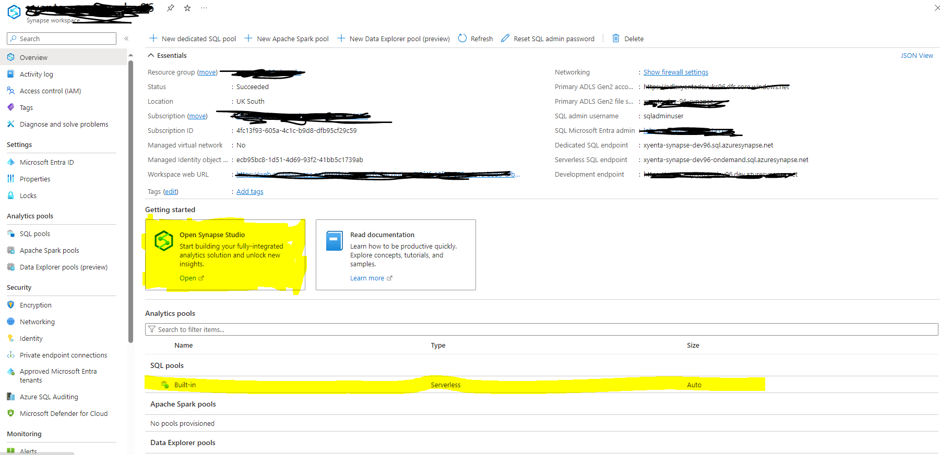
Continue:::
This how it’s looks like once after creation of Azure Synapse Analytics
Click on Open Synapse Studio for design or development of pipelines
Useful link: https://www.sqlshack.com/creating-azure-synapse-analytics-workspaces/

Slide 11
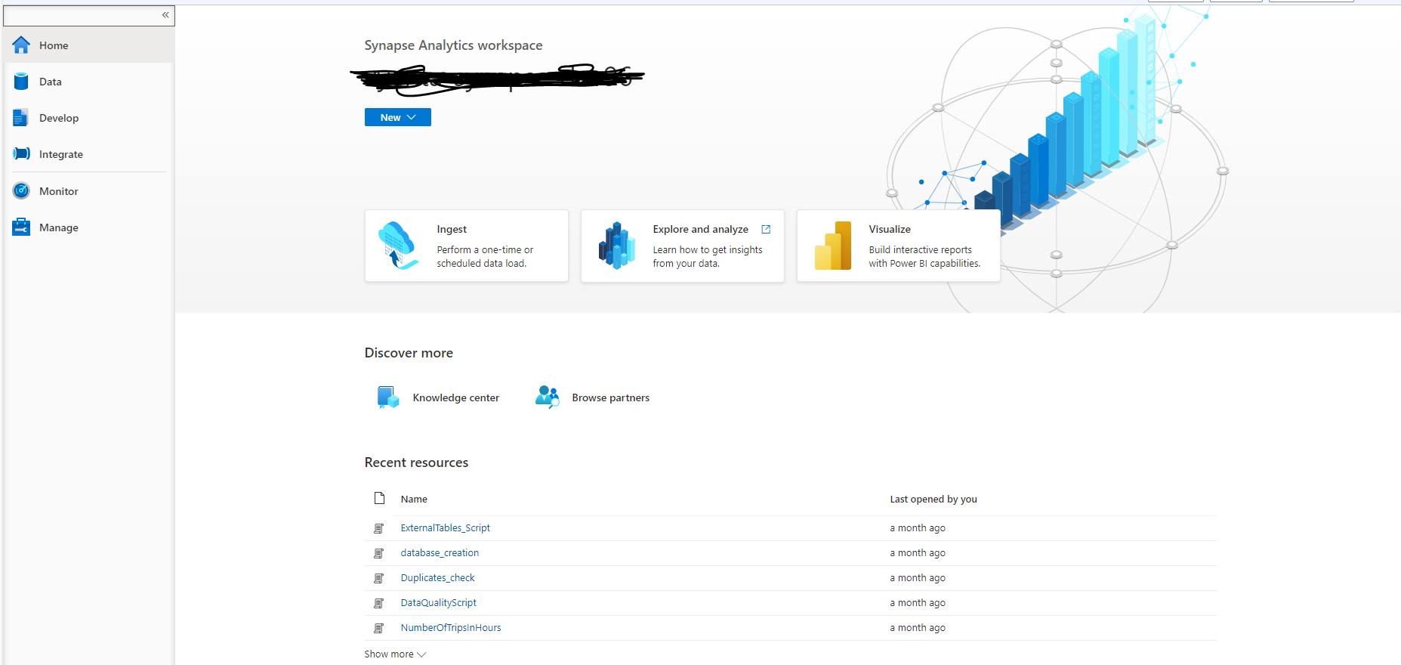
:::Continue:::
Once you click on open studio you will land into this page

Slide 12
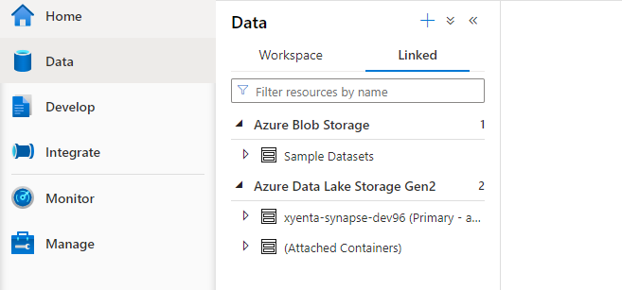
Continue::
In Data (Datahub) : This Tab is used to manage our Data sets . If we click on Plus symbol , we can add more number of Datasets
Linked Tab shows you the Primary Storage account which we used while creating the workspace

Slide 13
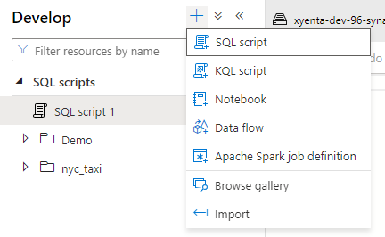
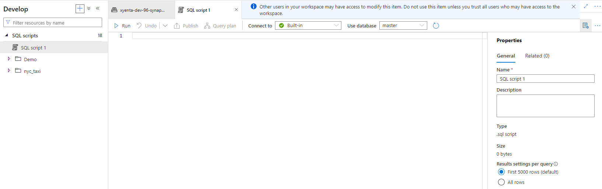
Continue:::
In Develop (Develop hub): This Tab is used to develop the SQL scripts, notebooks, Dataflows etc.,
Once after selecting SQL Script, then we will get like this.. To save the script hit Publish Button , in connect to Tab: we can select the SQL POOLS Built in means (Serverless) and then select the Database

Slide 14
::Continue::
Integrate Tab:: In develop tab we write lot of code for data processing using sql or notebooks .
Here in this tab, we will create pipelines like what we have the pipelines in ADF which will help us for orchestrate
Monitor and Manage Hub:: Monitor tab is used to monitor our pipeline runs, pool runs, trigger runs etc., In Manage Hub we used to create the Linked services, triggers, git configuration etc.,
Useful link : https://www.sqlservercentral.com/articles/an-introduction-to-azure-synapse-analytics-workspace

Slide 15

::Serverless SQL pool::
It’s a serverless distributed query engine that you can use to query data over your DataLake using T-SQL
It follows Driver-Worker Node architecture (Polars is the distributed engine here )as well as it follows Pay-per-query principle means if you don’t run query or script then no pricing would be generated
Use cases:
For Discovery and exploration on data
For Data Transformation
But it don’t have index’s , optimizes like dedicated SQL pool
Useful links: https://learn.microsoft.com/en-us/azure/synapse-analytics/quickstart-serverless-sql-pool

Slide 16
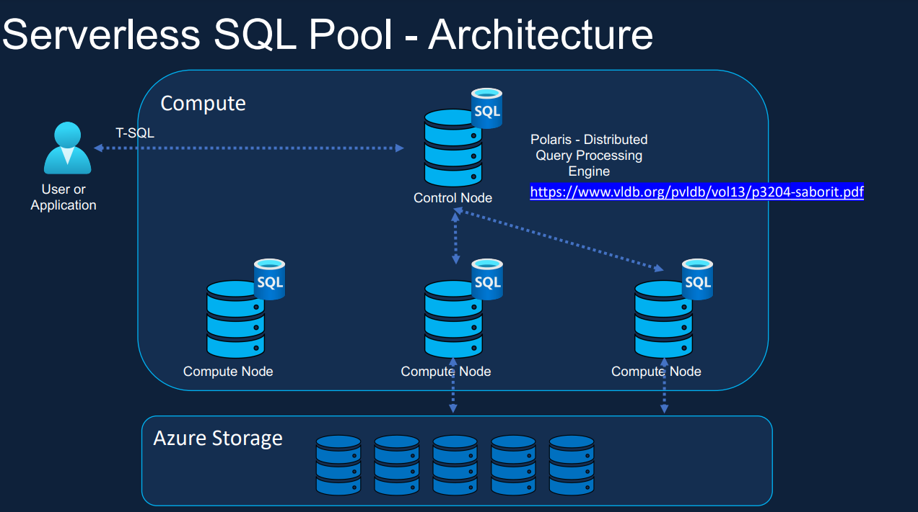
Continue:::
This is how Serverless SQL Pool architecture looks like :
Control Node will take the input from our code then uses compute node to get and process the data from storage account or DataLake . Once data processed at compute node , it’ll send data back to the Control Node and from Control node to user
Control Node :: Driver || Compute Node :: Worker

Slide 17
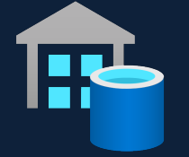
:: Dedicated SQL pool::
Dedicated SQL Pool Formerly known as Datawarehouse. It’s also use distributed query engine (MPP) that you can use to perform high performance big data analytics using T-SQL
Before coming to the Synapse family, the Dedicated SQL pool was earlier known as Azure SQL Data Warehouse. While using Synapse SQL, a dedicated SQL pool represents a collection of analytic resources that are provisioned. In other words, it is a big data solution that stores data in a relational table with columnar storage.
Here we can pause the compute when ever is not required . Billing would be done on Datawarehouse units (DWU)
Use cases:
For Large DWH > 1TB
For smaller kind of DWH its preferred to use Azure SQL

Slide 18
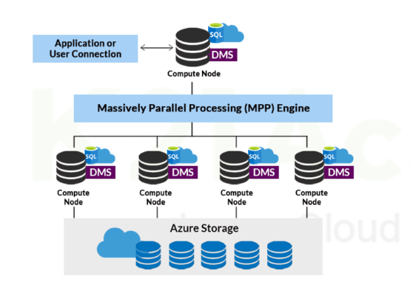
Continue:::
The Dedicated SQL Pool Architecture looks like:
Useful link: https://learn.microsoft.com/en-us/azure/synapse-analytics/sql-data-warehouse/sql-data-warehouse-overview-what-is
https://towardsdatascience.com/what-are-dedicated-sql-pools-in-azure-synapse-analytics-67ff2548966c

Slide 19
::Dedicated vs Serverless pool::
It allows you to query and ingest data from your data lake files.
Need to set up Infrastructure.
Data is stored in relational tables
Cost control is handled by pausing the SQL pool or scaling it down.
Pay per DWU (Data Warehouse Units) provisioned
It allows you to query your data lake files
No need to set up infrastructure or maintain clusters
Data is stored in Data Lake
Charges are made for the data processed on each query.
Pay per TB Processed

Slide 20
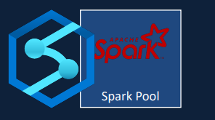
::Spark-pool::
Spark is used for fast computing using cluster computation. Apache Spark is an open-source industry-standard big data engine used for data preparation, data engineering, ETL (Extract, Transform, Load), and machine learning solutions. It is efficient in streaming big data. In Azure, Apache Spark works as a parallel processing framework that supports in-memory processing to boost the performance of big-data analytic applications. Apache spark can auto-scale by adding or removing nodes depending on the need
Spark runs on the engine called cluster consists of Driver and worker nodes . [Nothing but CPU’s]
Spark also uses Python Api’s called Pyspark to develop the code for data processing rather than writing it in Scala or java or R
Useful link: https://learn.microsoft.com/en-us/azure/synapse-analytics/spark/apache-spark-overview

Slide 21
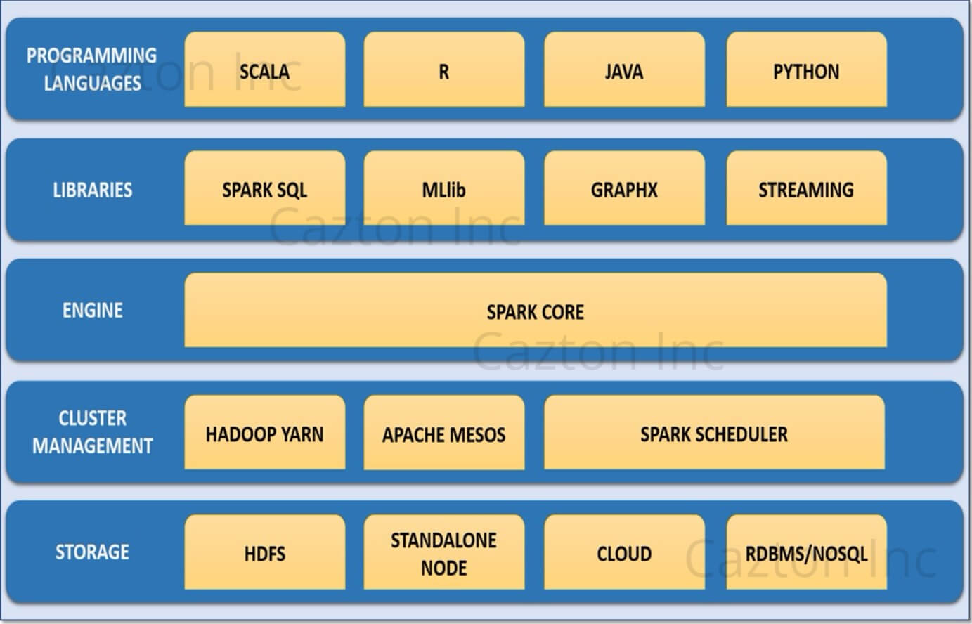
Continue:::
Spark pool Components looks like this :
Spark core: is the base of a whole project, providing distributed task dispatching, scheduling, and basic I/O functionalities
Cluster Management: Also called as “Cluster Manager”
Developed by using YARN or Mesos etc.,
Spark SQL: Using or writing the sql query on top
Of spark
Spark Streaming : Used for real time data
Processing like flight tracking etc.,
Mlib : Used to develop the Machine learning
Models on top of spark
Graphx : used for producing graphical
representations of the computation run by Spark.

Slide 22
Continue::
Programming languages: we can write the code using scala , python (pyspark), R etc., .So, that that code run on top of the Spark
Storage : Spark always underlying the storages like HDFS, S3, Azure Gen2, etc.,
Our Azure Synapse use YARN as Cluster Manager
Spark pool use cases:
Data Processing
ML models development
Spark Pools are created to run the spark notebooks
To learn about Spark Architecture : https://medium.com/@badwaik.ojas/components-of-spark-cluster-b4f8c90f9753
To learn about cluster Manager: https://www.linkedin.com/pulse/spark-cluster-manager-rijika-roy/

Slide 23
Lakehouse
To over come the drawbacks of Both DWH and Data Lake, DataBricks Proposed a paper by saying that just maintain a single system that manages Both (DWH and DataLake features )
Drawbacks of Data Lake:
- No acid transactions, No Schema Enforcement, No Data Versioning , Lot of Data Duplication involved
Drawbacks of DWH :
- It won’t support of Unstructured data
So, To overcome these drawbacks Lakehouse arch developed by the DataBricks
Lakehouse : It brings the Transaction layer on top of Data Lake. So, that it brings transaction capability like DBMS . Using Delta lake, we can implement Lakehouse architecture

Slide 24
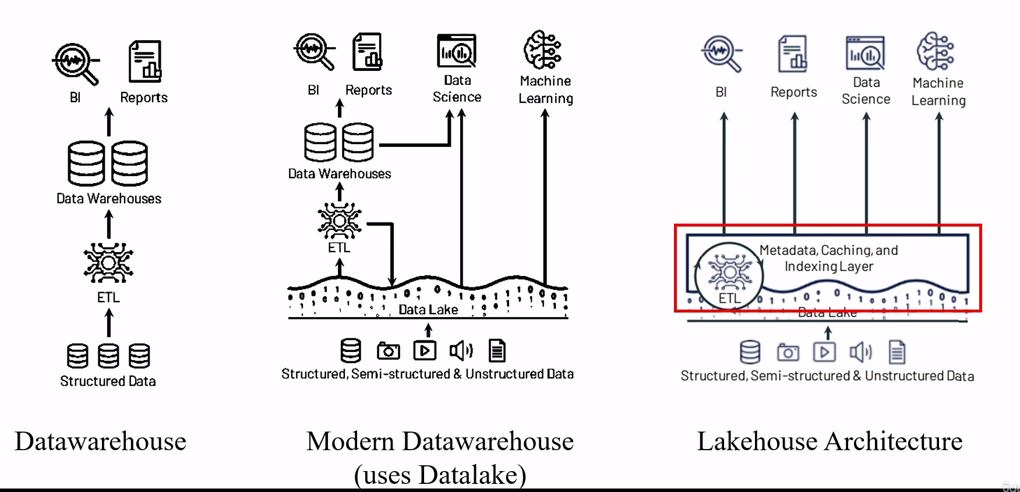
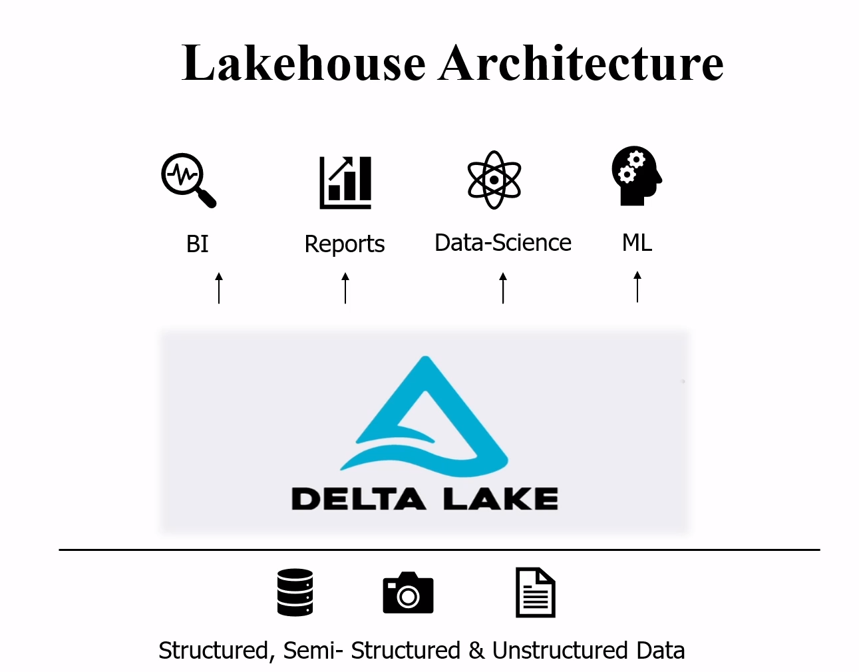
Continue:::

Slide 25

::Delta Lake::
Before going into further details on Delta Lake, we need to remember the concept of Data Lake, so let’s travel through some history.
The Data Lake architecture was proposed in a period of great growth in the data volume, especially in non-structured and semi-structured data, when traditional Data Warehouse systems start to become incapable of dealing with this demand. The proposal is simple — “Throw everything you have here inside and worry later”.
Time passes later everyone thinks about Data Quality, versioning . In Data lake data as files without a defined schema makes it challenging to perform critical data management to enable ETL transactions , based on the hits and misses of the past, new architectures were proposed. The Lakehouse architecture was one of them. In a nutshell, it tries to mix the advantages of both Data Lakes (flexibility) and Data Warehouses (guarantees)
Delta Lake is nothing more than a practical implementation of a storage framework/solution with a Lakehouse vision. (using Delta lake we can implement Lakehouse architecture )

Slide 26
Continue:::
A table in Delta Lake (alias Delta Table) is nothing more than a parquet file with a transaction log in JSON that stores all the change history on that file. In that way, even with data stored in files, it is possible to have total control over all that happened to it, including reading previous versions and reverting operations. Delta Lake also works with the concept of ACID transactions, that is, no partial writing caused by job failures or inconsistent readings. Delta Lake also refuses writes with wrongly formatted data (schema enforcement) and allows for schema evolution. Finally, it also provides the usual CRUD functionalities (insert, update, merge, and delete), usually not available in raw files.
DataBricks is the best example for the Lakehouse
Useful link : https://docs.databricks.com/en/delta/index.html

Slide 27
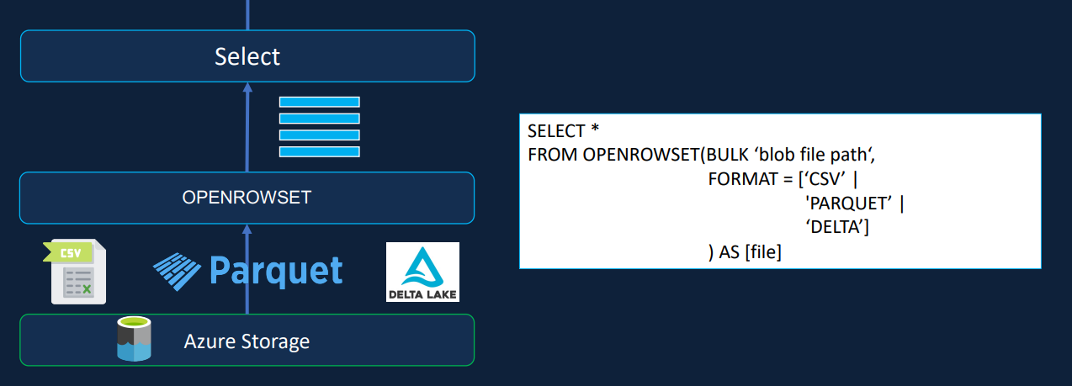
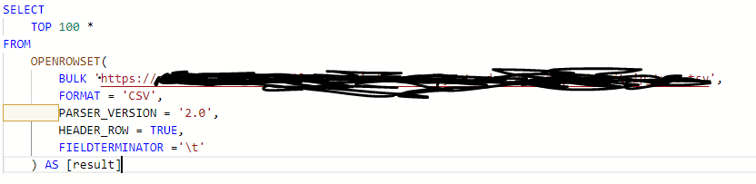
::Querying Files in synapse SQL::
Let’s see who we can query the files like csv, delta, parquet files in Azure Synapse SQL using OPENROWSET function
In Bulk pass the File path url

Slide 28
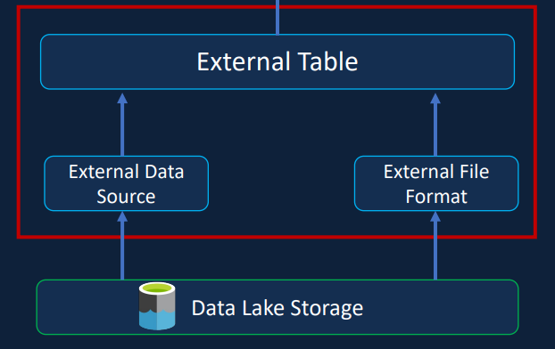
External table::
External Tables are one of the database objects, which can be created table in Database from the data present in the Data Lake Storage . Once you created the External Table you can access those tables like any another table in the Database
With help of external table, you don’t need to create script for table creation .
External table stores files on the HDFS or Azure Gen2 server but tables are not linked to the source file completely. Even if you drop the table then data won’t lost
To wrap up, instead of querying directly on Data present in Storage layer, we will create a tables from the file presented in the Storage layer .
In Synapse to create the external table we must make use of another two objects one is
External data sources and another is External file formats
Useful : https://learn.microsoft.com/en-us/azure/synapse-analytics/sql/create-use-external-tables

Slide 29
Continue….
External Data Source:: This object have the information about the URL of Folder present in the storage account. Ex: Let’s say we have container called Raw and in that container, I have subfolder called Taxi Data with couple of csv files . Now create an external Data source with up to Taxi Data folder, So that next time we can directly query data from External data source
External File Format :: This object have the information about the format of file such as csv / parquet with some format options Ex: As above example, we have of couple of csv files in that subfolder , we need to define certain information about that files like what’s the delimiter, parser version, encoding etc.,
Now making use of these objects we can create external table : External Table can be created in two ways
1) Create External Table
2)Create External Table as Select [CETAS]

Slide 30
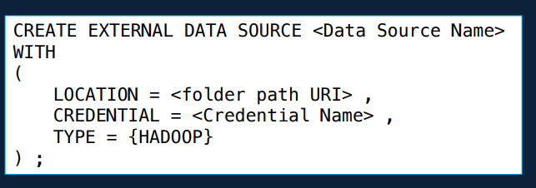
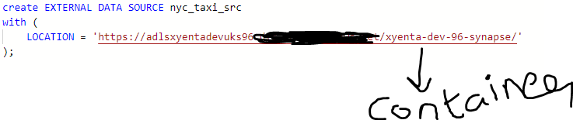
Continue…
External Data source example : Here I given location up to container only
Useful link : https://learn.microsoft.com/en-us/azure/synapse-analytics/sql/develop-tables-external-tables?tabs=hadoop

Slide 31
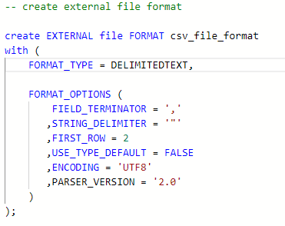
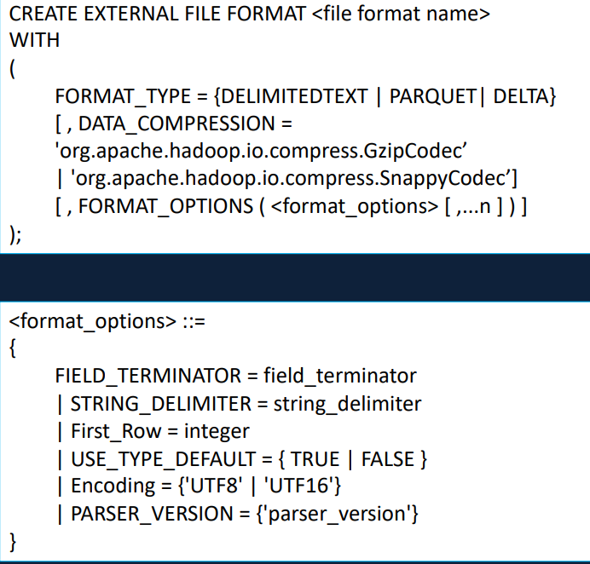
Continue:::
External File Format : Here is the example for creating the external file format of csv in associated with the External Data Source
Useful link : https://learn.microsoft.com/en-us/sql/t-sql/statements/create-external-file-format-transact-sql?view=sql-server-ver16&tabs=delimited

Slide 32
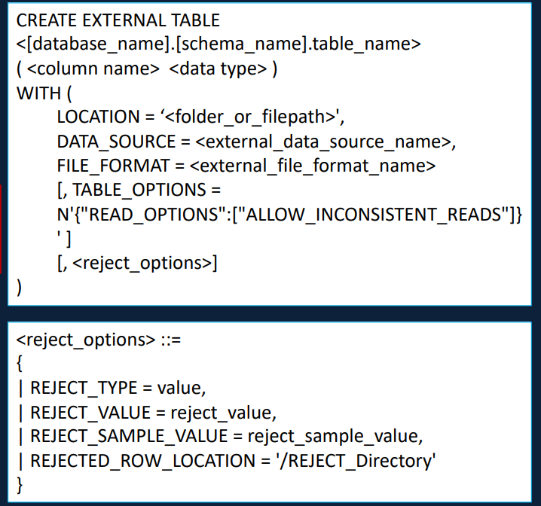
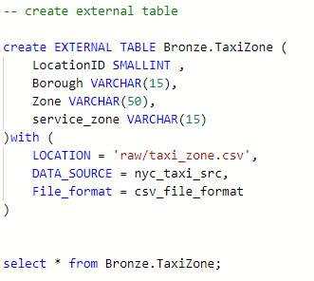
Continue:::
Create External Table : It’s one of the way to create the external table
Let’s discuss in detail in next slide
Useful link : https://learn.microsoft.com/en-us/azure/synapse-analytics/sql/develop-tables-external-tables?tabs=hadoop

Slide 33
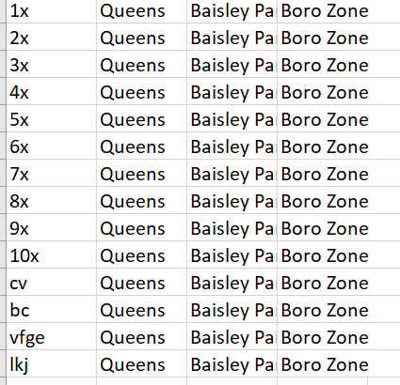
Continue…
Location : Means we created external data source upto Container , in that container we may have subfolders like raw etc., . So, pass that subfolders name and filename in that subfolder
Data_Source : pass the name of the External Data Source we created before
File_format : pass the name of the External File Format we created before
Rejection : Used to handle invalid records , instead of query to fail like if you have column called id and it only accept int values, if we get other than int values then consider them as invalid records . Reject_value must be Integer where we specify how many records that can be rejected before your query fails like 10, 20 upto 2Billion (it will allow 10 or 20 invalid records )
For example, consider the input file which is nyc_taxi_src external data source location_id column has invalid data
We have total 25 records , out off 25/ 15 records are
Invalid
Consider Reject_value = 10 in first choice and then 30 in
Another

Slide 34
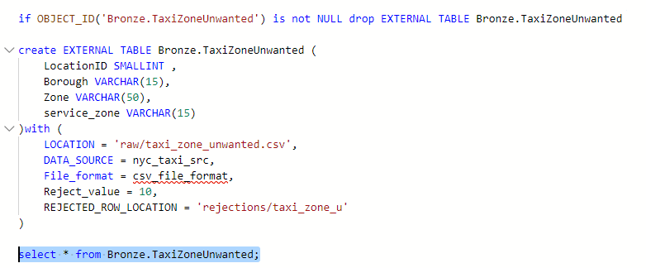
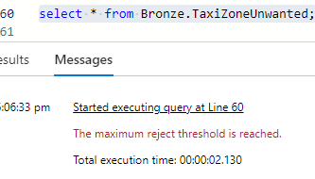
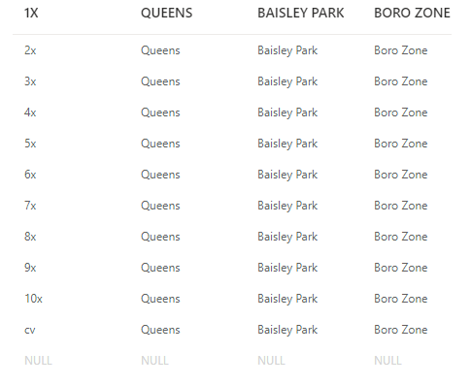
Continue:::
Let’s create an external table and handle or write the invalid records to some other location
Now the output file in rejections/taxi_zone_u/file.csv looks like this: it written only 10 invalid records and remaining invalid not return that is because of Reject_value = 10
what ever location you mentioned, query will automatically create
That specified folder. No need to create before
Error

Slide 35
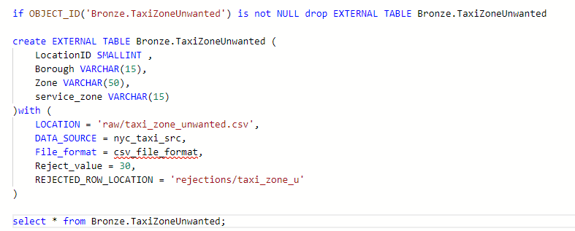
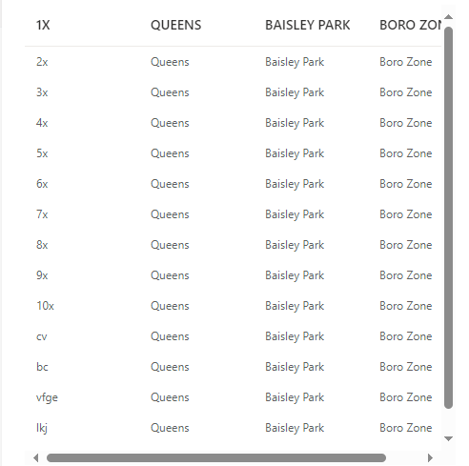
Continue:::
If we increase the value of rejected value to 30 or 20 then it will return invalid records to the specified location with out query failure , because we given greater number
output

Slide 36
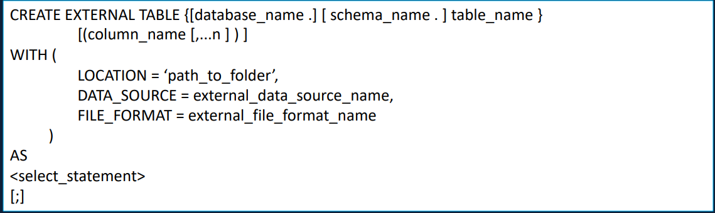
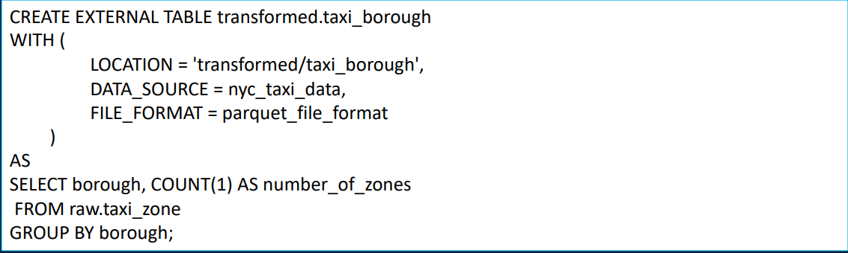
Create external table as select [cetas]
This is the second way of creating External Table. One of the advantage of this method is we can select only required columns; we can define aggregations on top of data while creating Table itself
1
2
Useful link : https://learn.microsoft.com/en-us/azure/synapse-analytics/sql/develop-tables-cetas

Slide 37
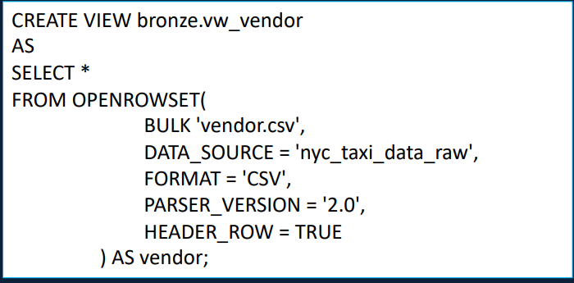
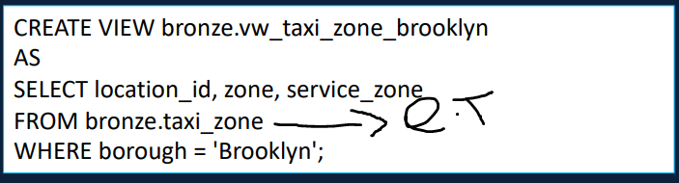
::Views::
Views are virtual tables which is designed from a Query. In Azure Synapse sql pool we can also create views on top of data presented in the Data Lake Storage . In Azure Synapse SQL Pool we can create Views from Openrowset func and from External Table
Useful link : https://learn.microsoft.com/en-us/azure/synapse-analytics/sql/create-use-views

Slide 38
External table v/s VIEWS
Both are just pointers to the data present in the data lake and different objects as well
View is Just a select statement which will save in the database
An external table is table(require physical storage)
External tables are metadata definitions that map to files in a data lake, and the files are read when queries are executed against the table. This means that external tables can benefit from partitioning, indexing, and caching to improve query performance. External tables can also be used in joins, and they can be queried using SQL and Spark APIs.
Views, on the other hand, are virtual tables that are defined by a SQL query. When a view is queried, the SQL query is executed against the data lake files. Views can be useful for simplifying complex queries or hiding details about the underlying data. However, they do not support partitioning, indexing, or caching, and they cannot be used in joins.
In terms of performance, external tables are generally faster than views because they can take advantage of partitioning and caching. Overall, creating an external table is usually the better option if you want to optimize query performance and take advantage of advanced features like partitioning and caching. However, if you just need a simple view to simplify a complex query, then creating a view can be a good option

Slide 39
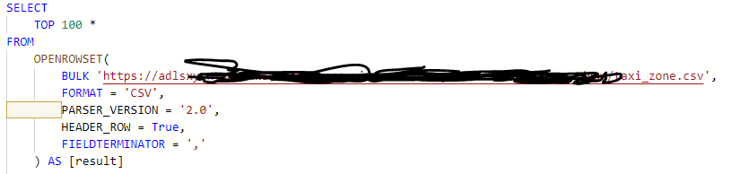
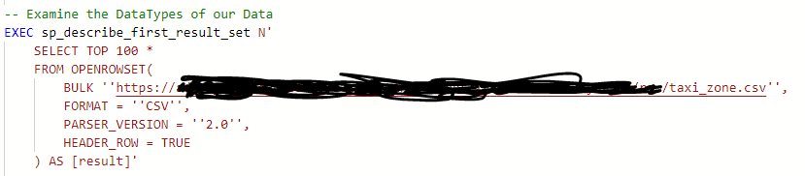
::Check the Datatypes of files::
As part of the Data Validation techniques or Data Discovery part , we need to check the Datatypes of data present in files and modify its types using T-sql as follows::
Read the files using openrowset
Examine the Datatypes on top of our data using storeproc ‘sp_describe_first_result_set’
Define explicit data types using with
For example, let’s read the csv file and apply the storeproc to get to know about the data types and then change those using with.
2
1

Slide 40
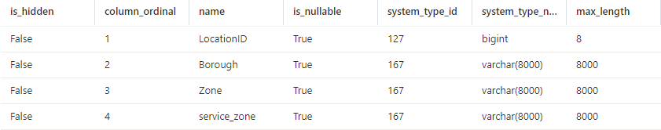
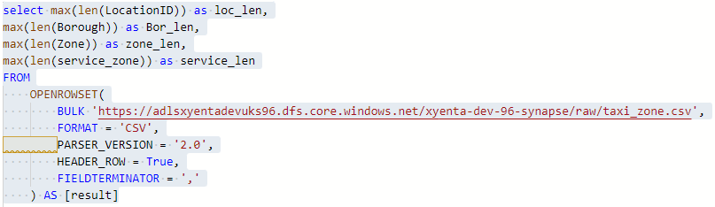


Continue:::
The output looks like this from the storeproc . Afterwards let’s find out the max length of certain column from our data or file
3
5
As you can see, there is significance difference between synapse assumed datatypes and max Len of column. Ex: max len of zone is 45 char only , But synapse consider them as 8000

Slide 41
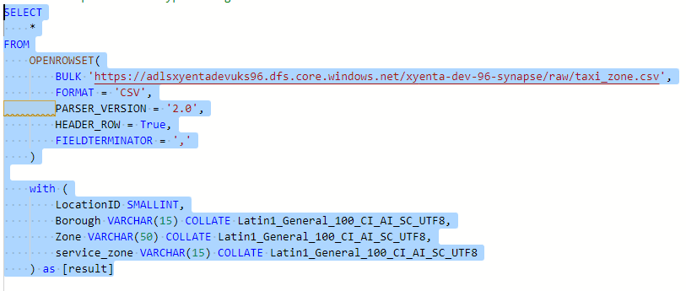
Continue::
Now let's change the datatypes. The reason behind the data type re-define , we all know that server less pool charges on amount of data processed and we don't want synapse to assume such bigger data types and charge you significantly more than expected . On another hand ,the data types affect the query performance and it's recommended to use smaller data types
Collate is used to fit the data types like varchar with UTF-8 considerations.
For any kind of files, we need to follow the same approach
6

