Slide 1
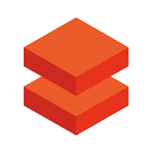
DataBricks
Big Data Processing Tool

Slide 2
Context:
Introduction to Bigdata Processing : 3 - 5
Spark Architecture : 6 - 9
What is DataBricks : 10 - 11
Azure Data Bricks Components : 12 - 13
Cluster Types and Configuration : 14 - 19
Magical Commands : 20-21
DBUtils : 22 - 27
Unity Catalog : 28 - 30

Slide 3
::Big Data Processing::
Before learning DataBricks , its essential to learn about how Big Data processing takes place at High level , why spark evolved.
Distributed Computing is a Backbone for DataBricks.
Any Big Data uses Distributed computing process instead of having single monolithically system for storage and compute .
Initially, Big Data analytics done on only single supercomputer , which manages entire workload . When we want to scale-up , we need to add storage and compute . This type of adding is called as ‘Vertical Scaling’. One of the major drawback of this process , you can’t keep on adding hardware like disk and ram for a single computer which is not the right way of approach.
To overcome this distributed approach came into the picture, were computers added horizontally and parallelly execute the task called as “Horizontal scaling” .
So, group of computers which share and work parallelly to promote the faster completion of tasks are called as “Cluster”.
Each computer have the OS, to co-ordinate this group of computers together called “Cluster Manager”

Slide 4
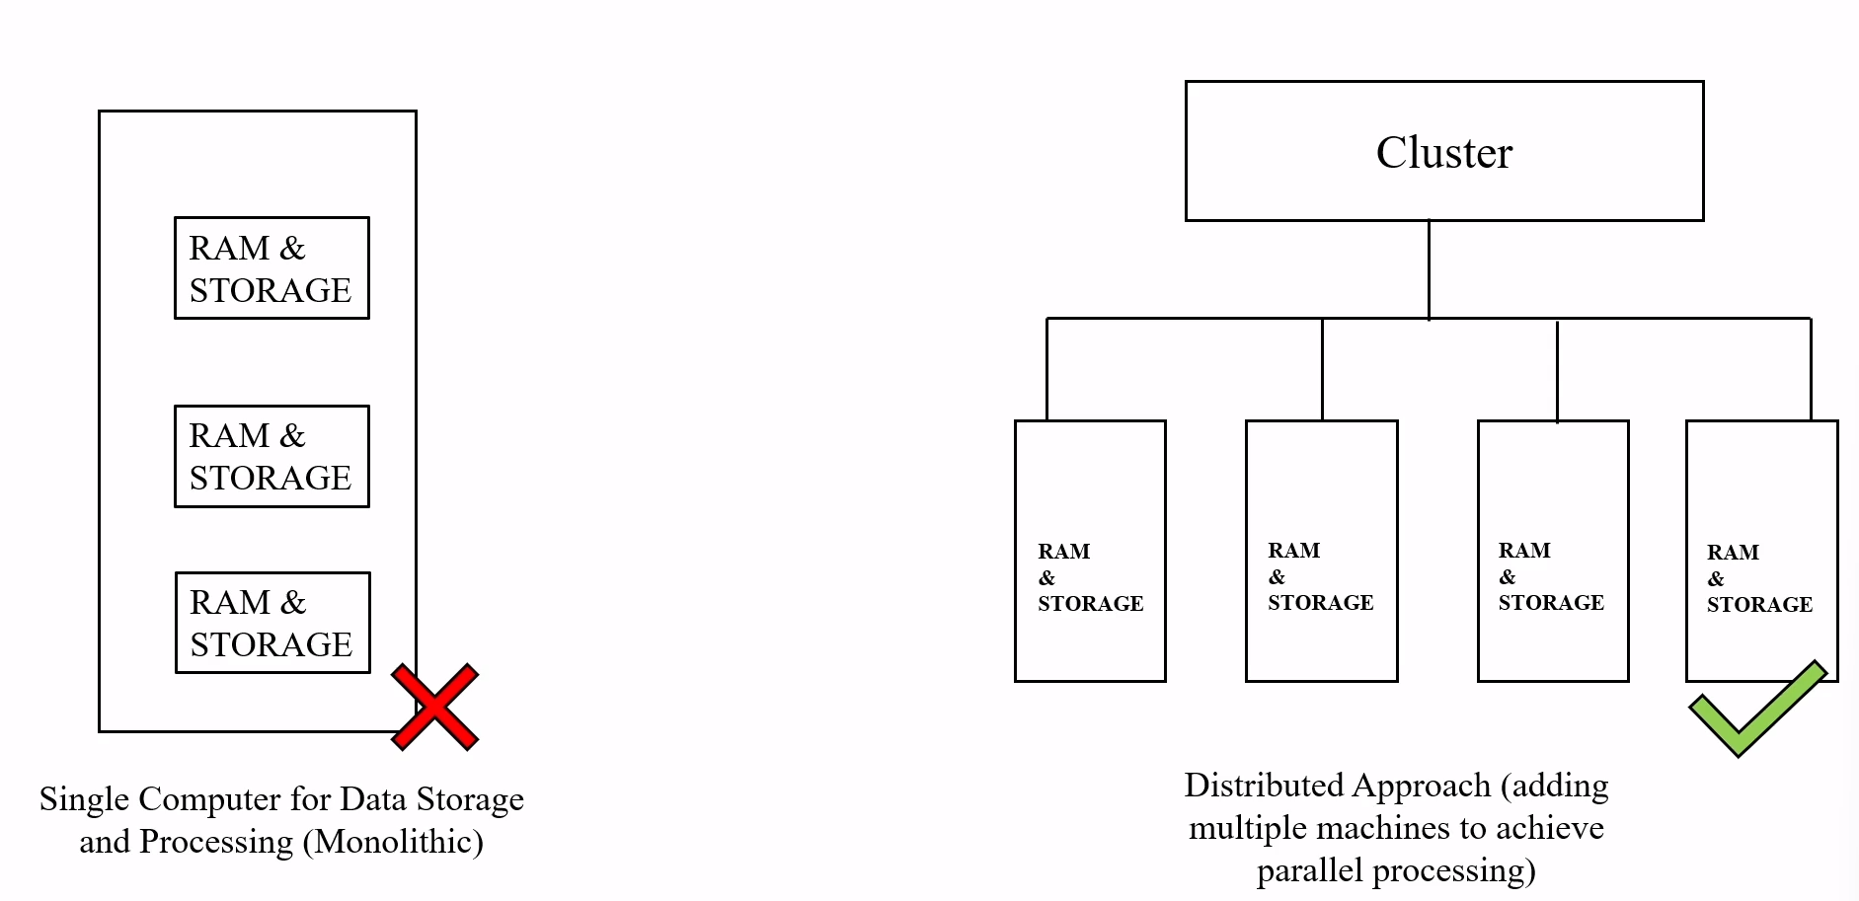
Continue…………..
Vertical Scaling
Horizontal Scaling

Slide 5
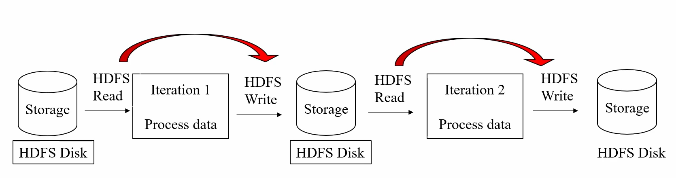
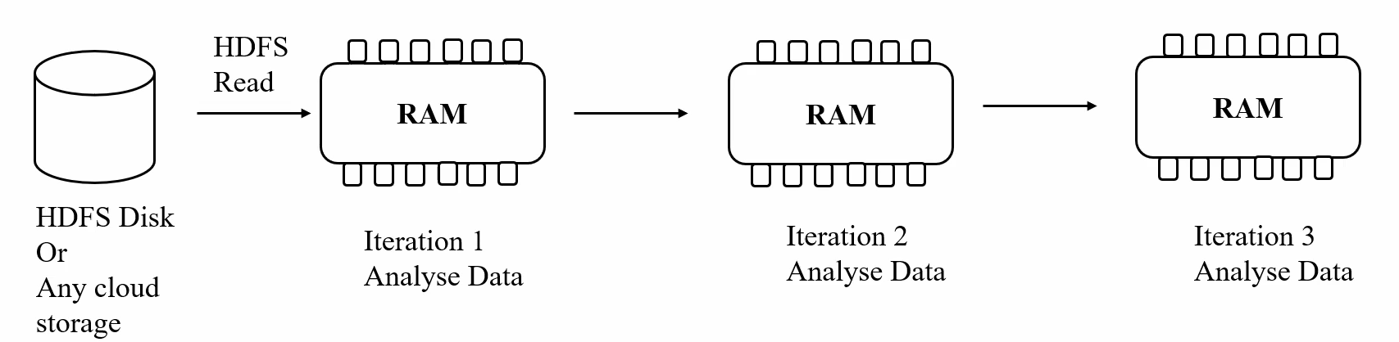
Continue::::::
So, we need a Tool or a product , which will do this distributed storage and computing process.
Initially, Hadoop emerged as a solution with MapReduce for Distributed computing and HDFS for Storage
But One of the major Drawback of MapReduce is it will do operations on Disk ( for every iteration , it used to perform the read and write from the Disk). So, this will case high I/O operations as a result of that it slow down the Data processing (need to wait more time to get the desired output)
To overcome this issue Spark emerged into the market. Spark uses Ram to do Data Processing {in-memory}, it is much faster operation than Disk Based application.
Moreover, Spark supports different languages than MapReduce and the amount of code we written using spark is very less compared to MapReduce
Storage and computation are decoupled in spark, whereas it was Strongly coupled in MapReduce
MapReduce
Spark

Slide 6
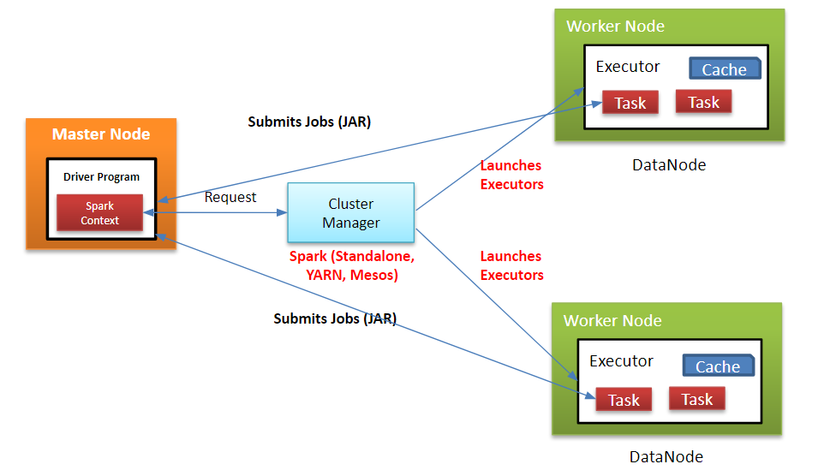
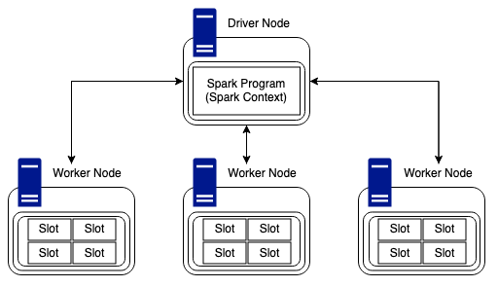
:: Spark Architecture ::
Spark is an open-source in-memory application framework for Distributed Data processing for huge volumes of data. In other words, it’s a compute engine which is used for the Bigdata processing.
Spark uses Cluster ( a group of computers connected each other) for the Distributed Data Processing . The below image shows you the Spark Architecture
Ps: Both images are same only explains the arch of Spark cluster . Follows the Master-Slave process

Slide 7
Continue….
Driver Node (Main CPU): It acts as a main point of contact for complete job execution . It’ll communicate with the cluster Manager for the resource allocation ,It runs the code what ever we submitted . In other words, it’s the process where the main method runs, first it converts the user program into Tasks and after that it schedule the task on the executors. Driver Node uses DAG as a Scheduler which will used to Schedule the operations or task (stages of task).
Cluster Manager : It’s used to co-ordinate with workers and allocate workers to the driver node . Number of worker Node allocation will be based on data volume or Number of partitions . The DAG Scheduler launches the tasks via Cluster Manager
Worker Node (CPU): The worker is used to execute the Task from the driver and returns result back to driver. The worker Node consists of Cores like (i5, i7). The major role of it is used to execute the number of concurrent task in each node (execute the task parallelly in each node )
Executor (JVM): It’s the Heart of the Cluster and it’s nothing but a jvm uses the Cores in the worker node to successful execution of Task . One worker Node can have one or more executors
Cache : It is a High-speed data storage layer which stores a subset of data, typically transient in nature, so that future requests for the data are served up faster than is possible by accessing the data’s primary storage location.
Will discuss more about cluster with examples in the next slides
Useful link : https://medium.com/@amitjoshi7/spark-architecture-a-deep-dive-2480ef45f0be

Slide 8
Continue….
Consider, we have a cluster with One Driver Node, Two Worker Nodes
Suppose we have file with 1GB size , in this case our data divided into multiple parts (partitions) like 250MB, 250MB, 250MB, 250MB . This partition data will distribute equally to the Workers . According to our cluster each worker will get Two Partitions .
Some more important Terminology in spark as follows : :
Lazy Evaluation : Spark is very Lazy to execute our code , you can apply as many Transformations as possible you want like (groupBy, filter, union , flatmap, Distinct, join etc.,), But spark will not execute until an Action is called . The reason behind it , we don’t want to exhaust CPU memory for unnecessary output also it is a technique to delay evaluation or computation until you need an output.
Transformation : These are a kind of operations which will transform your data from one form to another (1DF to Another DF). Transformations are lazily evaluated while actions are not lazy enough . Just used for Transforming the data . Transformations are two Types
Narrow Transformation : ex: Select, filter, withColumn, drop , union
Wide Transformation : ex: GroupBy, Join, distinct, repartition
Action : It used to trigger the Transformation , in order to get the desired output like read, write, collect, count, take etc.,

Slide 9
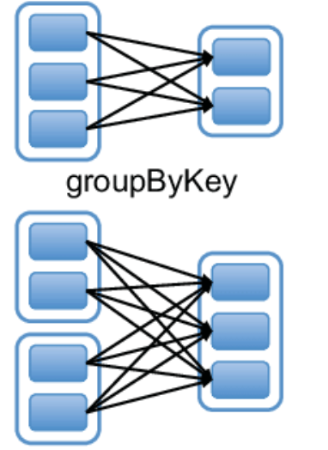
Continue……
Narrow Transformation : Here Transformation will Take each one individually (1:1 computation). Here data processing is fast here, because there is no data shuffle over the network
Wide Transformation : Here 1: N computation happens. Means data processing will be done by grouping the data from multiple partitions . Usually, its slow process and Data will shuffle here
P1
New p1
P1 : Partition one in a single worker Node
P2
New p2
Stages: When there is shuffling happens , spark divide single job into multiple Stages
Task : Smallest Execution unit . It execute instructions like map, filter , group by etc., Cluster manager share those tasks to different worker Nodes. {cluster manager will be our Task Scheduler} (Partition + Transformation = Task)
Useful links : https://www.linkedin.com/pulse/wide-vs-narrow-transformations-sparkdistributed-compute-don-hilborn/
https://medium.com/@hxquangnhat/sysdeg-worksharing-framework-and-its-design-part-1-14addfa802f0

Slide 10
::DataBricks::
Databricks is a unified, open analytics platform for building, deploying, sharing, and maintaining enterprise-grade data, analytics, and AI solutions at scale. The Databricks Data Intelligence Platform integrates with cloud storage and security in your cloud account and manages and deploys cloud infrastructure on your behalf. According to DBU/hr its going to be billed
The Databricks workspace provides a unified interface and tools for most data tasks, including:
Data processing scheduling and management, in particular ETL
Generating dashboards and visualizations
Managing security, governance, high availability, and disaster recovery
Data discovery, annotation, and exploration
Machine learning (ML) modeling, tracking, and model serving
Generative AI solutions
Useful links : https://www.geeksforgeeks.org/introduction-to-databricks/
https://analyticslearn.com/what-is-databricks#google_vignette

Slide 11
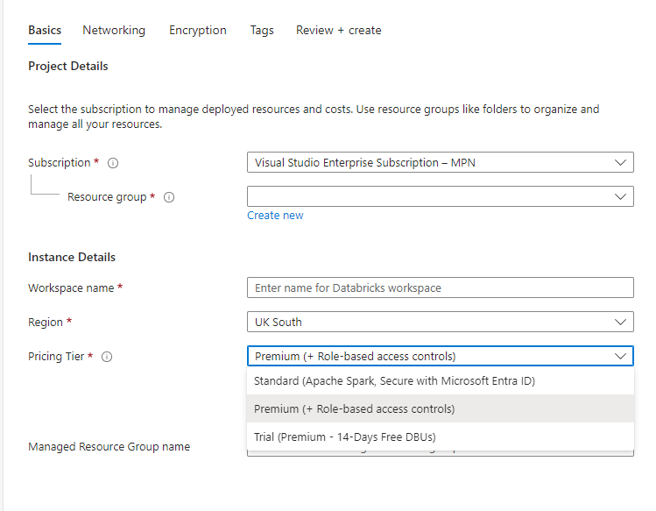
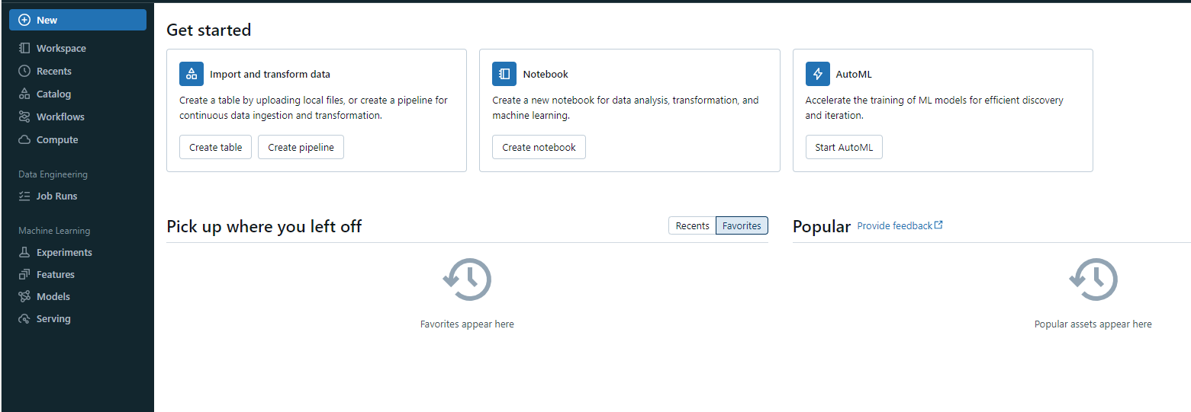
Continue…..
To create Azure DataBricks workspace > Go to Create Resources > Click on DataBricks > give the Resource group name and workspace name , region . In Pricing Tier, we have 3 types one is Free Trail, Standard, Premium
If you create DataBricks workspace by selecting Premium tier, then you will have the role-based access controls, If you select standard then we can secure the workspace with Azure Active Directory

Slide 12
:: Azure DataBricks Components ::
Workspace : A workspace is a place where you can manage all the data or files in a folder format, which can be notebooks, different libraries, Visualization dashboards, ML experiments, etc.You can define fine-grained access control on all these objects, allowing users to use the same workspace, but only giving them restricted access. There are multiple version control options available in the data bricks workspace like GitHub, Bitbucket, Azure DevOps, etc.
Notebook : Notebook is the tool where you can write and execute the code or perform different data transformations on data with Spark-supported languages. So, you can write the transformation logic in python or SQL and extract data using Scala, python in the same notebook. On the other hand, you can build the workflow of data with end-to-end system by invoking the notebooks with another one this can help in creating end-to-end workflows.
Catalog Explorer: It’s the layer which have the Databases using hive as a Meta store. Catalogs could be used to isolate objects of some entity (business unit/project/environments (dev,prod)/...) from objects of other entities. You can give manage permissions of the catalogs to respective admins of the business units, projects, ..., and they can then assign permissions on individual schemas and tables/views.
Workflows : Used to Orchestrate the Notebooks. Here we will create the Job for that orchestration
Compute : Here we will create the cluster and manage the cluster
Job Runs : It’s used to monitor the workflows what we created before

Slide 13
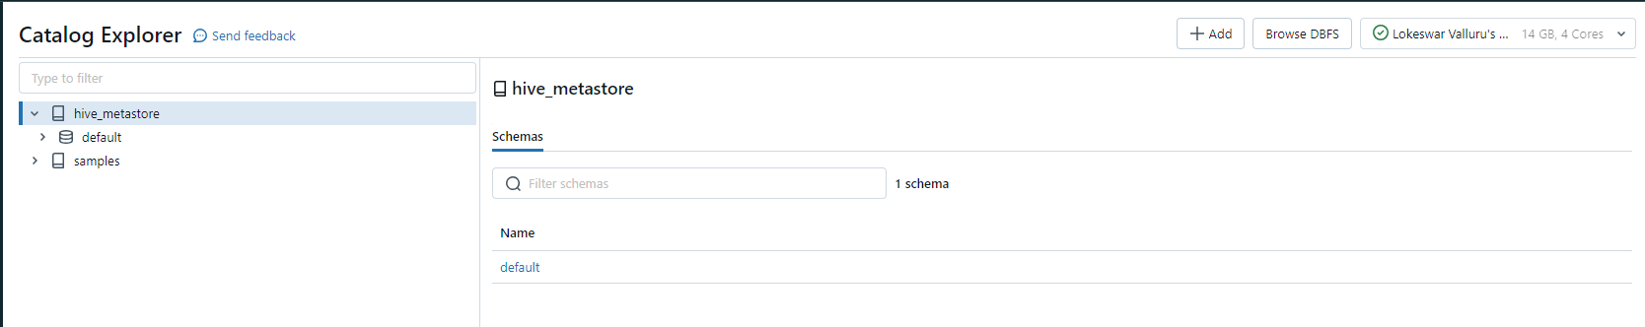
Continue::::::::::::::
DataBricks will comes with a storage layer called DBFS (DataBricks File System ) . You can upload the files in DBFS, and you read that file and write that file to DBFS as well. In Catalog tab you will encounter the DBFS along with Hive Meta Store
Delta Lake: an open-source storage layer that sits on top of cloud storage (e.g., S3 or Azure Blob Storage) and adds ACID transactions, data versioning, and time travel capabilities to Spark.
Useful link : https://learn.microsoft.com/en-us/azure/databricks/administration-guide/workspace-settings/dbfs-browser

Slide 14
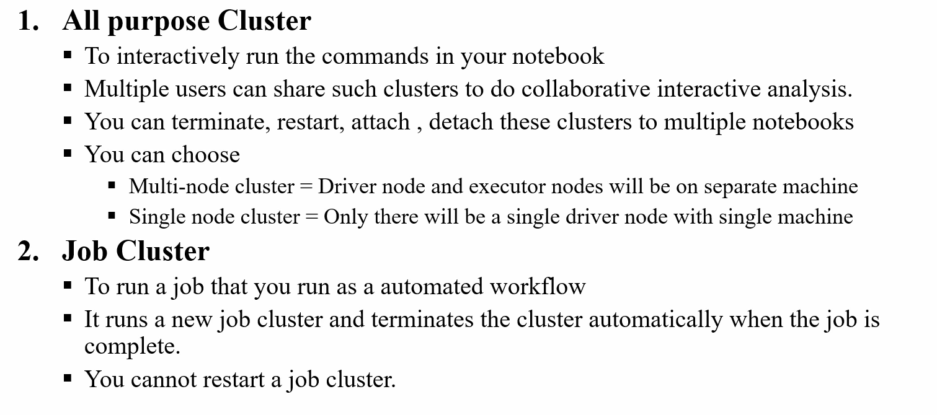
::Cluster Types and Configuration::
Cluster is a group of computers or computation resources and configuration to run our workloads. Workloads can be set of commands in a notebook, the job that you run as an automated notebook . To run these workloads, we have two different types of clusters, different workloads have different clusters
A) All Purpose cluster (interactive) : Used to run interactive queries or set of commands in a notebook , manually need to start and stop the cluster .
B) Job cluster : Used to execute the workflows or job automatically
Clusters usually take time to start and auto-scale, in order to minimize the time for a cluster to start, cluster pool are used. A cluster pool is basically set of idle ready-use VM that allows us to reduce the time taken by cluster to start and auto-scaling times

Slide 15
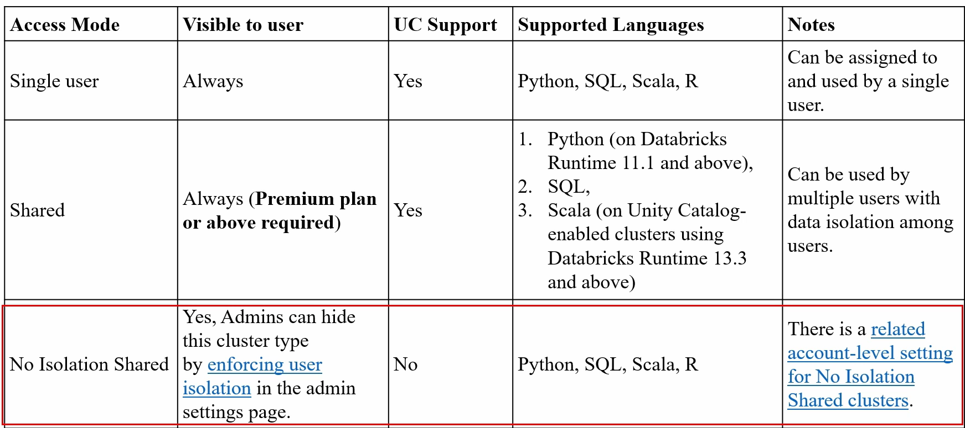
Continue::::
To configure or create a cluster. It’s been divided into following points like
The Policy (if you select Premium this would applicable)
The Access Mode
DataBricks Runtime version
Worker and Driver Node types . So, Keeping these points in our mind and then we will configure the cluster
Access Mode : There are 3 types of Access Modes or cluster modes
a) Single user (standard): This cluster can be accessed by the Single user only.
b) Shared (visible for premium plan): Can used by the multiple users with data isolation among the users means if code written by the first user fails, it won't affect the code running by the second user
c)No –Isolation : Multiple users can use this without isolation among them
Single user: Run SQL, Python, R and Scala workloads as a single user, with access to data secured in Unity Catalog. Shared: Multiple users can share the cluster to run SQL, Python and Scala workloads on data secured in Unity Catalog. No isolation shared: Multiple users can share the cluster to run workloads in any language, with no isolation between users.

Slide 16
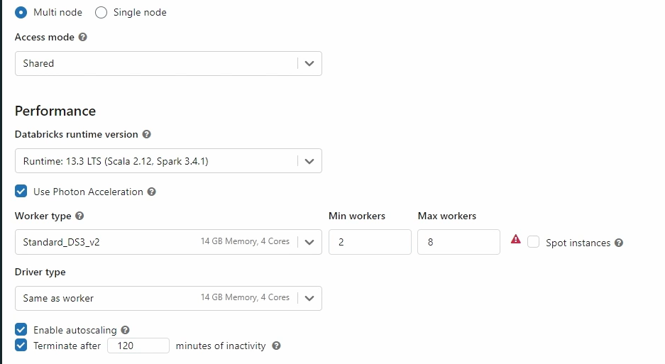
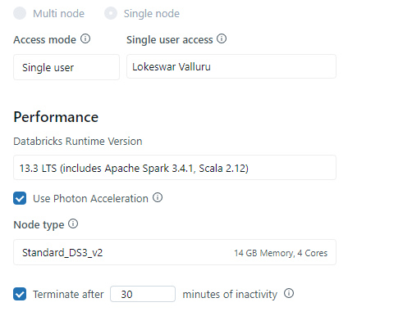
Continue:::
If you select Multi Node, then you will get two separate machines one for driver and another one for worker . Whereas single Node has no worker node, drivers will run the spark job. (Single used for Small level of Testing and POC)
Mult iNode , Shared access
Single Node

Slide 17
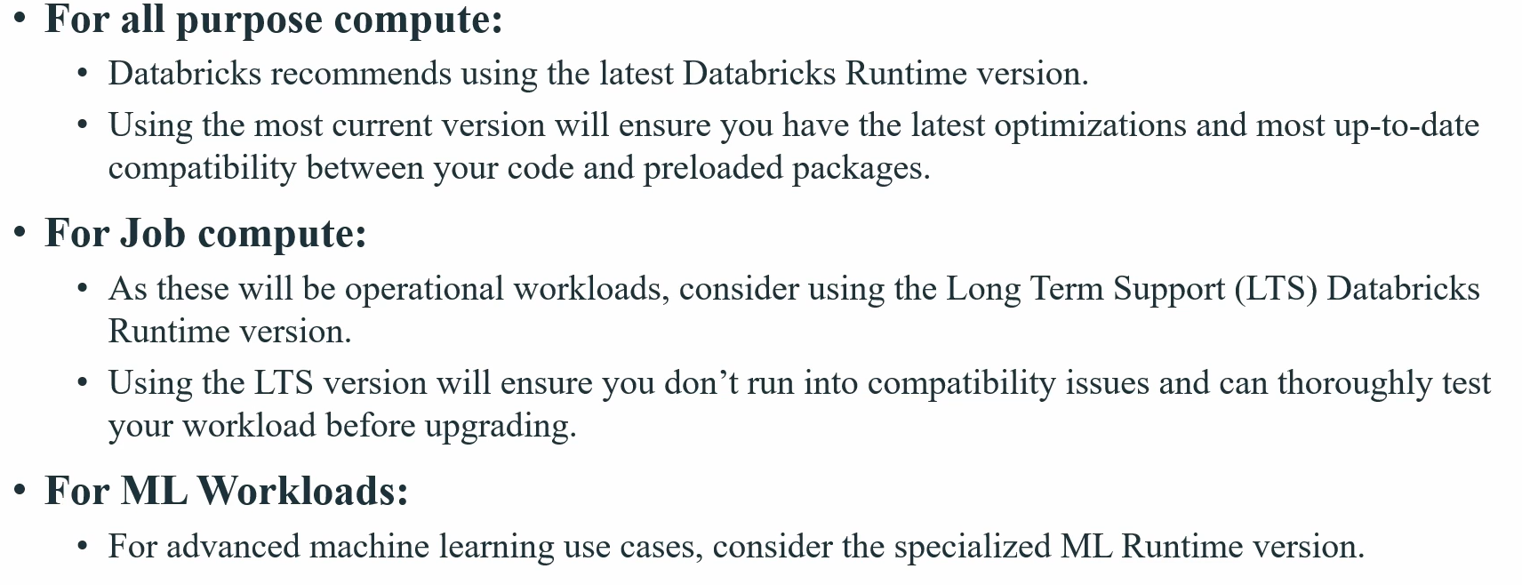
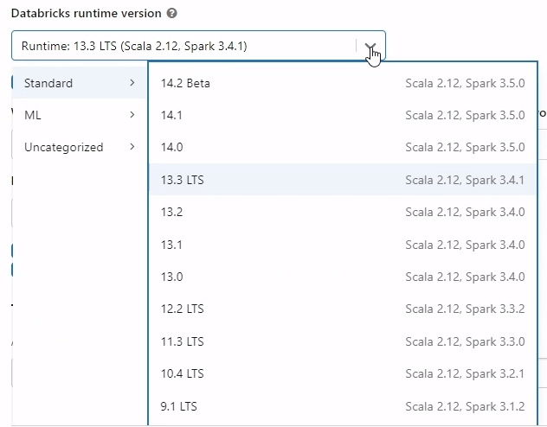
Continue:::::
DataBricks cluster runtime will be select based on our workloads .
Click on Use Photon Acceleration, it’s a engine provided by the DataBricks for better performance (accelerate our speed)

Slide 18
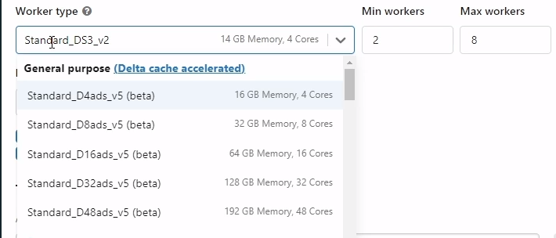
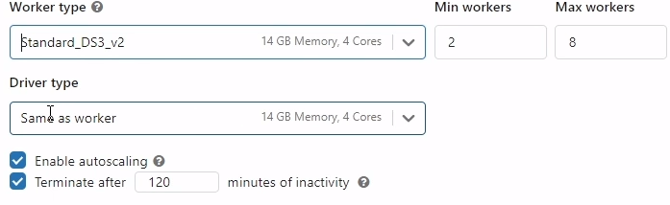
Continue::::
Worker and Driver Node types : Need to select the group of VM’s or VCPU’s for our cluster as follows. Here Standard_xxxxx means the name of VM’s remember like chassis number for engine
Let’s Break down the cluster . Consider the cluster standard_D16_v3 : 64GB RAM, 10 Cores, 10 Nodes .
10 Nodes : 10 individual Machines (CPU's)
10Cores : 10 processing units like i7, i10 etc., for each machines
Total Memory of Cluster : 64GB * 10Nodes = 640GB ~ 0.64TB Means our cluster can handle 0.64Tb of data at a time. Total Number of Cores = 10 C * 10N = 100Cores
Let’s assume each node have 2 executors of 5cpu cores, 4GB RAM .
Total Number of Executors = 10Nodes * 2 = 20Executors

Slide 19
Continue::::::::::::
Now the executors (20 executors) can utilize 1 to 10 available cores on its Node.
Total Memory of executors = 4GB*2E per Nodes = 8GB
DataBricks will take of auto-scaling the workers and executors in a smart way . No need for us to think about Executors . We have to Focus on our code , reset will take care by the DataBricks

Slide 20
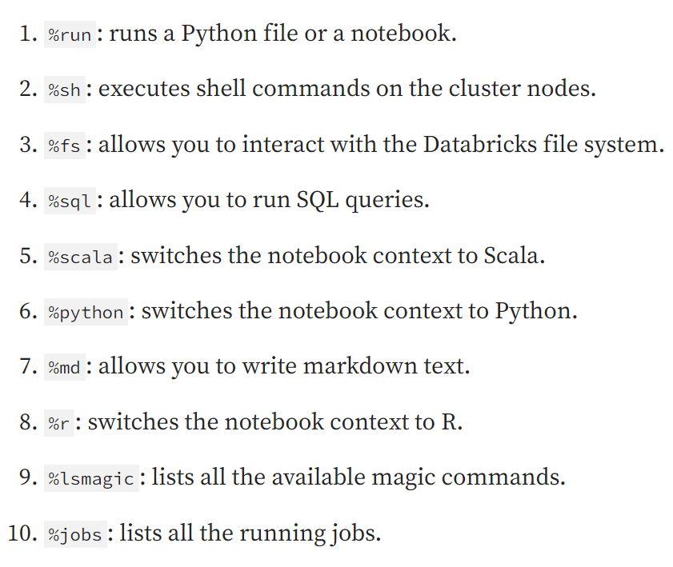
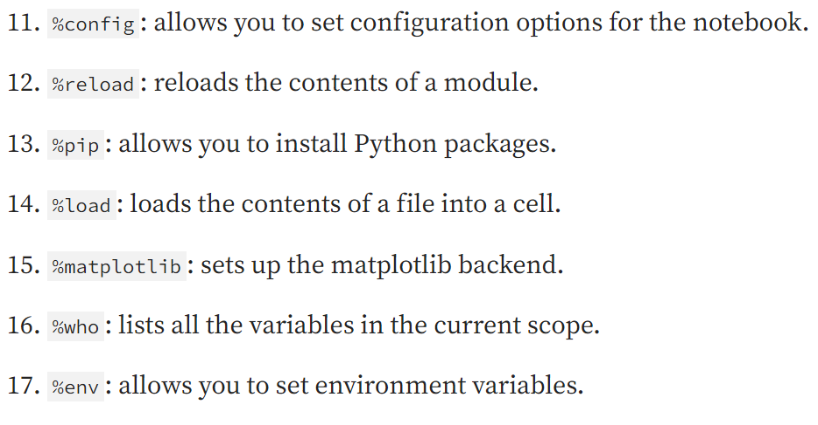
:: DataBricks Magical Commands ::
Magic commands in Databricks let you execute the code snippets other than the default language of the notebook. Magic command start with %<Choice of Your code snippet language>
Following are the possible magic commands used in the Databricks
Useful link : https://learn.microsoft.com/en-us/azure/databricks/notebooks/notebooks-code

Slide 21
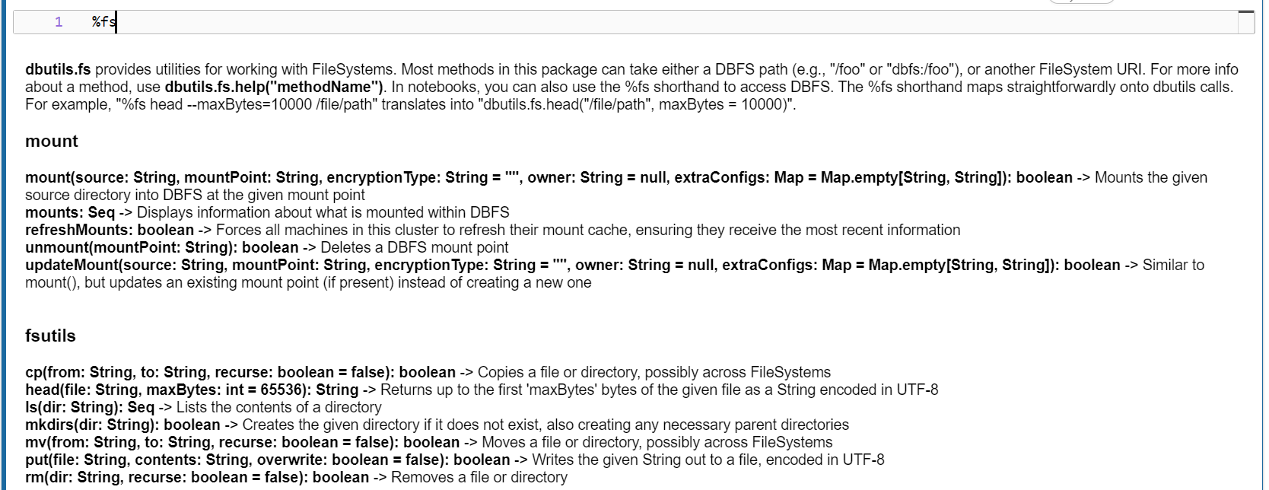
Continue::::::::::::
Here are some of the examples : %fs: Allows you to use DBUtils filesystem commands. For example, to run the dbutils.fs.ls command to list files, you can specify %fs ls

Slide 22
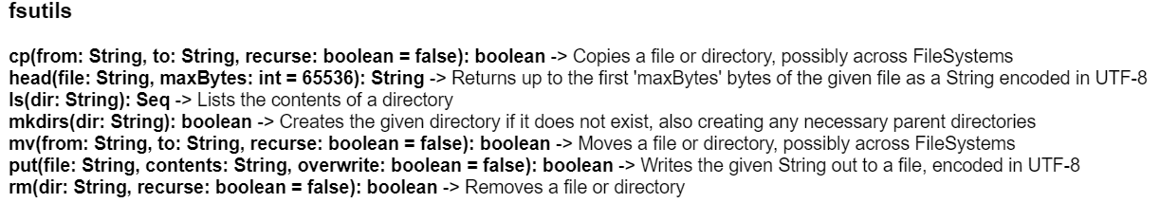
::DBUTILS::
DataBricks provides a set of utilities to interact with notebooks effectively . Most common utilities are
File System utils, b)Widgets utils , c) Notebook utils
To understand what kind of utils are there then use this commands dbutils.help()
To get more about File System utils dbutils.fs.help()
To get more about Widgets Utils dbutils.widgest.help()
To get more about Notebook Utils dbutils.notebook.help()
A) Files System Utils : Here are the examples for file system utils

Slide 23
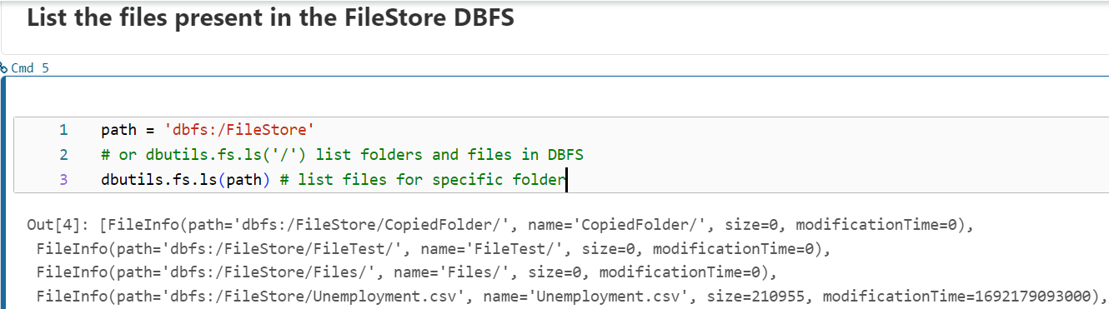
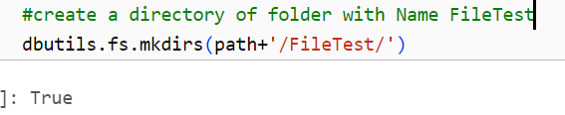
:::::::::::Continue:::::::::::
Useful link: https://drive.google.com/file/d/1NsINTbI161W_pml-OK1veHiBYX8zh9zo/view?usp=sharing

Slide 24
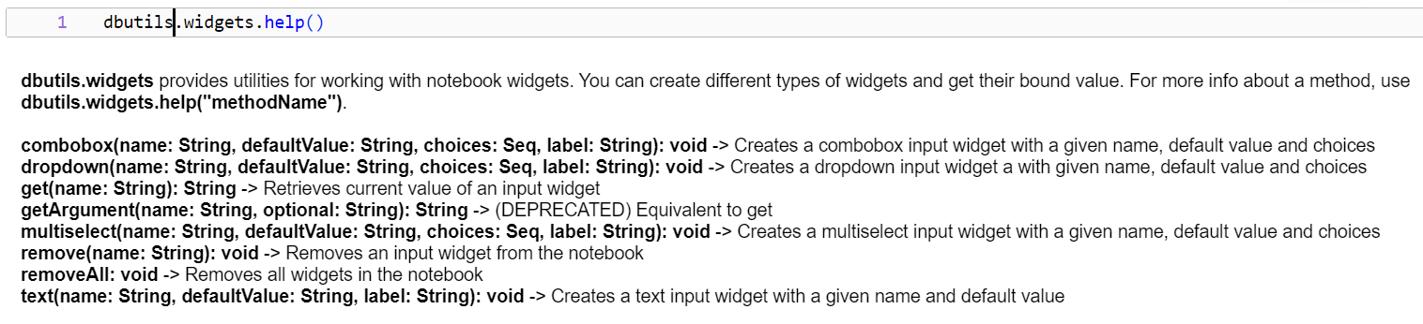
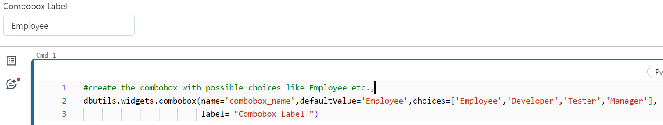

:::continue:::::
B) Widget Utils : Consider widgets are like parameters or placeholders. These are very useful when we want to run our code dynamically . Here are the few examples related to widgets
To remove specific widgets :dbutils.widgets.remove('combobox_name')

Slide 25
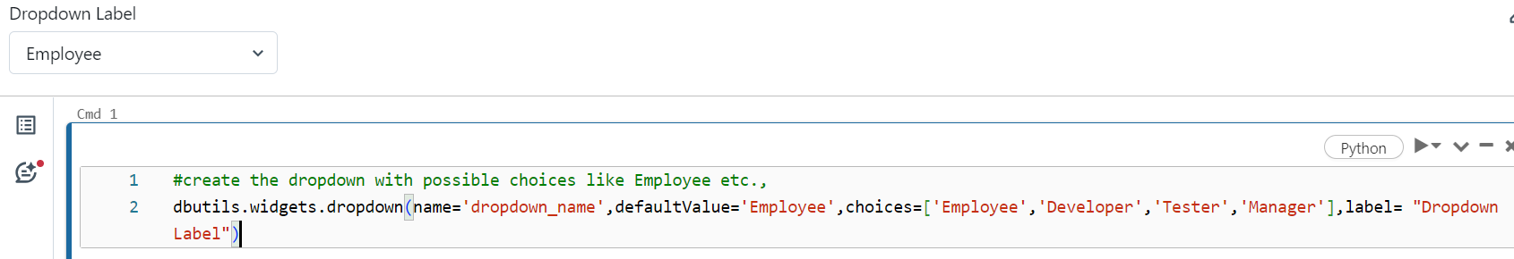
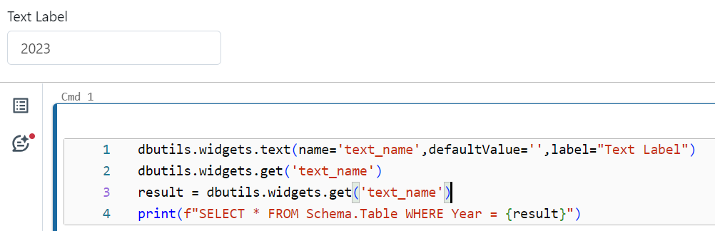
:::continue::::
Useful link : https://drive.google.com/file/d/1FGGlWdDGu1vOlTrecudL-0Yzb7mz5T1X/view?usp=sharing

Slide 26
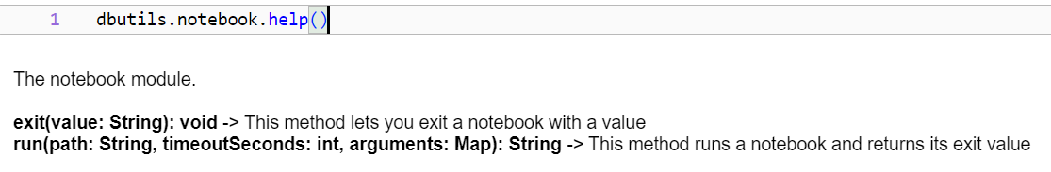
:::continue::::::
Notebook utils : Here are the few examples related to notebook utils .
More examples : https://drive.google.com/file/d/1gFdgi_U38ue2QBcp0bqCRZcd8u67mefu/view?usp=sharing

Slide 27
Magical Commands
DBUTILS
Provide shortcuts for common tasks within notebook cells
Limited to the current notebook cell.
Use magical commands for quick tasks within a cell, like running code snippets or adding markdown
Offer a broader set of utilities for interacting with the Databricks environment
Can access resources and functionalities beyond the notebook cell.
Use DBUtils for more complex interactions, accessing resources outside the notebook cell, or integrating with other Databricks features.

Slide 28
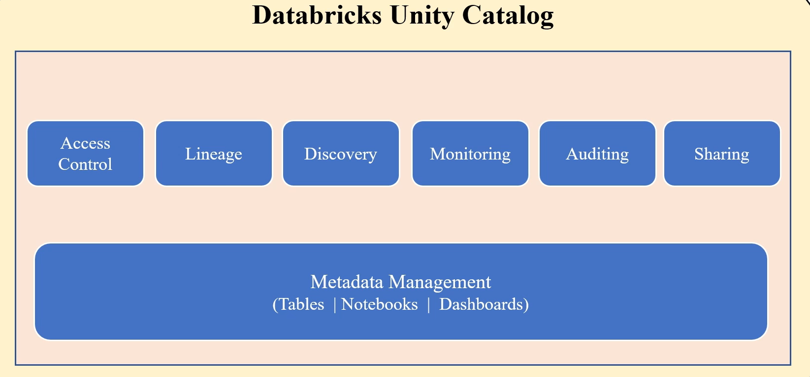
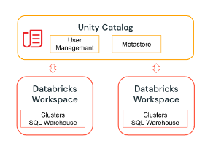
:: Unity Catalog ::
Unity Catalog provides centralized access control, auditing, lineage, and data discovery capabilities across Databricks workspaces.
To wrap up , Unity catalog is a central place where you can control the access of many workspaces, and you can also see who have access to what And you can also control this access management.
Useful link : https://docs.databricks.com/en/data-governance/unity-catalog/index.html

Slide 29
:::continue:::::::::::
Let's understand what problem does Unity Catalog solves and how it is helpful.
Imagine you own a data analytics organization. You got a project where you are making use of Azure Databricks as a solution to complete it. In a typical Databricks service, which is nothing but a Databricks workspace, the one that you will go and you will go to the Azure portal and you will initially create a Azure Databricks workspace . As an organization, you will have many users like developers, leads, managers, etc., where you cannot give developers entire access to the workspace.
To create unrestricted computes or clusters, you need to have a user management where you will define groups and roles, who need to have what level of access. For that, you need to have a user management, So you set up a user management and you define the required groups and roles to work on And you will also have a hive meta store for each workspace which stores the managed tables . Also, you define access controls on tables who need to access what kind of data in storage accounts, You will also have something called user roles, where you can restrict the users to what type of data. Either they can create it, they can read it, or they can delete it, You can define these roles in the storage account. Then, based on the level of access, users can create the clusters and they can work on them.
So , this is fine , But in real time a Databricks will not have only a single workspace. It will have dev workspace, UAT and prod etc., Imagine a situation in real time where you need to create a different workspace for prod environment. So, for again Prod workspace we have define the things what we did before .
Now what if you have multiple projects where you will have multiple workspaces? The solution that you are seeing here requires a lot of tasks to do, and the maintenance is very tough.

Slide 30
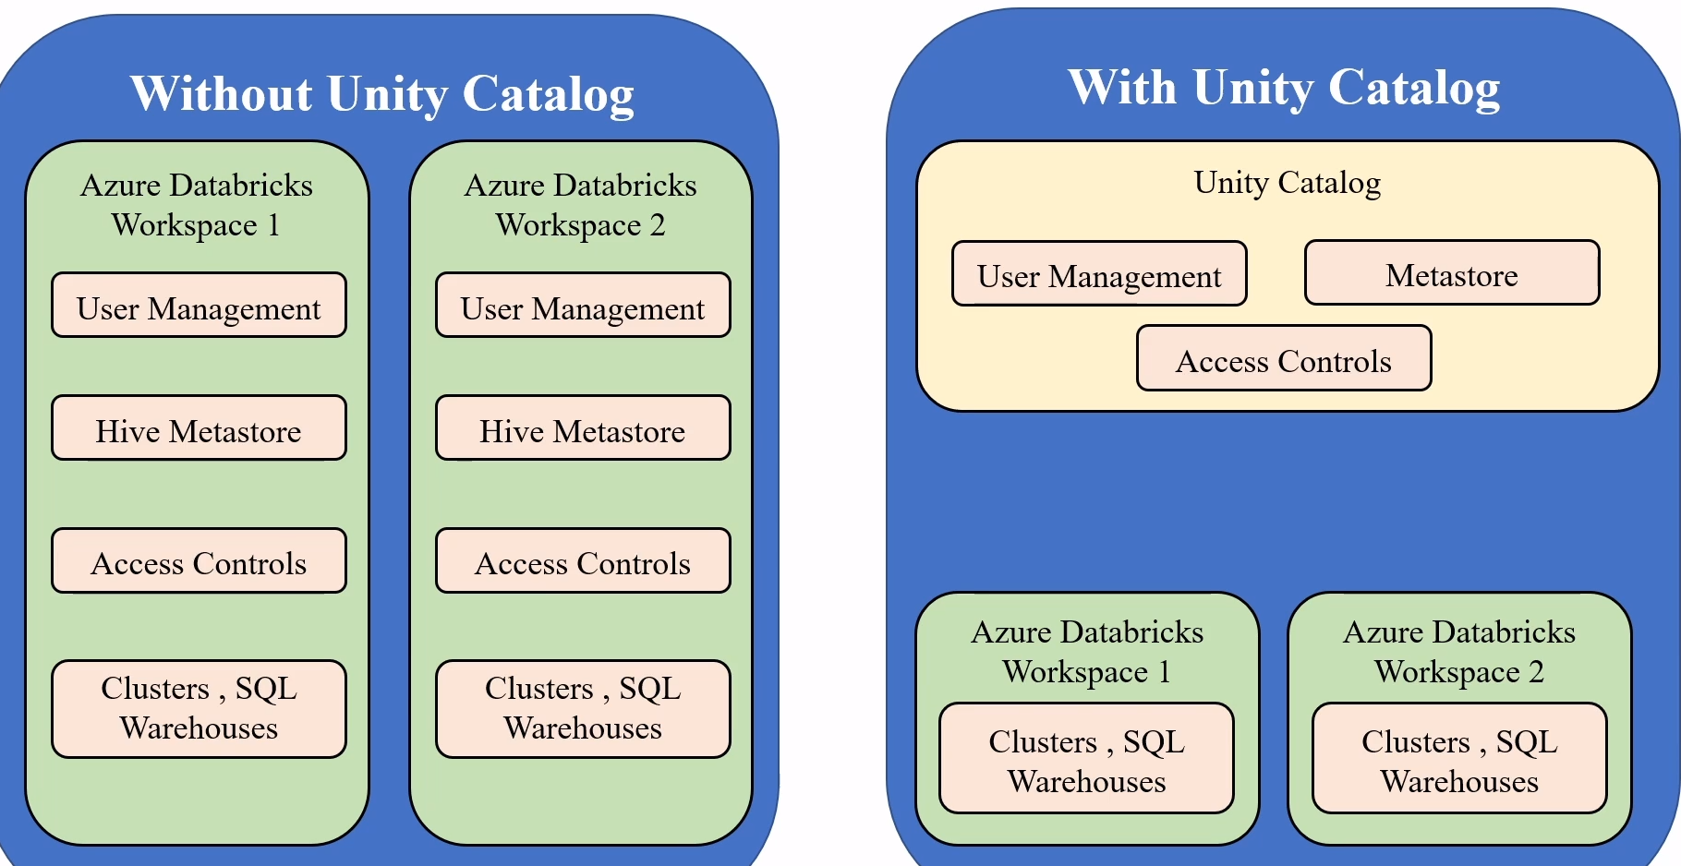
::continue:::
You have no visibility on who is having what level of access in all workspaces. Now there is a need for a centralized location where you can manage users' governance, audit, metadata. Now all these can be solved by a unity catalog. Now we have seen the challenges here and this can be solved by the unity catalog, the unity catalog, the workspaces will only have their compute resources and the rest user management , Metadata management will be taken care by Unity Catalog. Here, Unity Catalog acts as a unified interface for the workspace. You will have a centralized location where you can have the access to user management, where you can control who can have access to what object.
So, you need not to worry about access permission, and you need not to worry about the access level between the workspaces. A single location can have visibility to all workspaces, and you can do the access management by sitting on a single place.

Slide 31
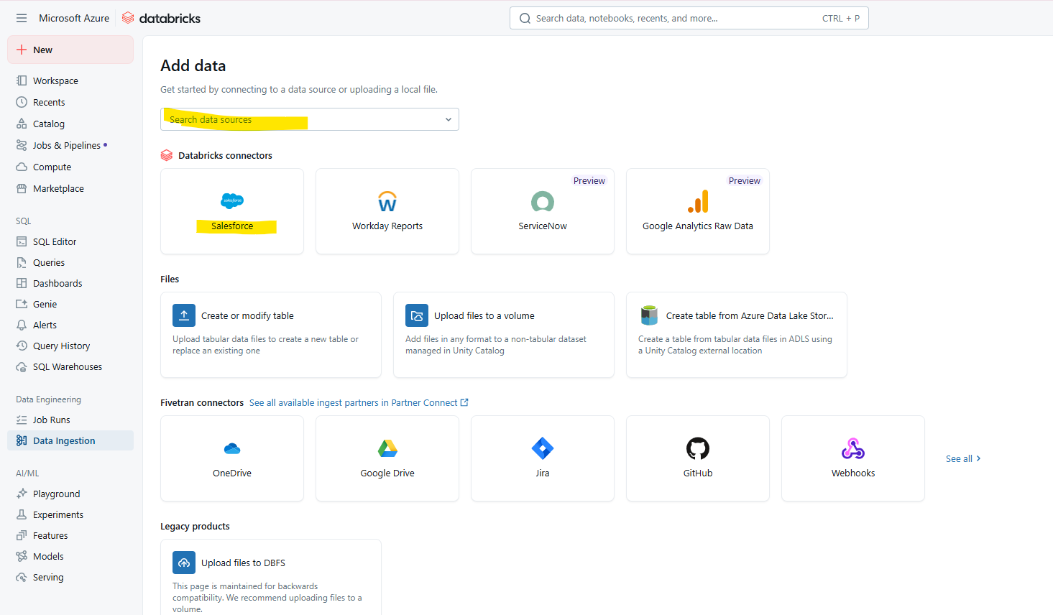
Continue….
https://docs.databricks.com/aws/en/ingestion/lakeflow-connect/salesforce-pipeline

Slide 32
Continue….

