Slide 1
Delta_analysis

Slide 2

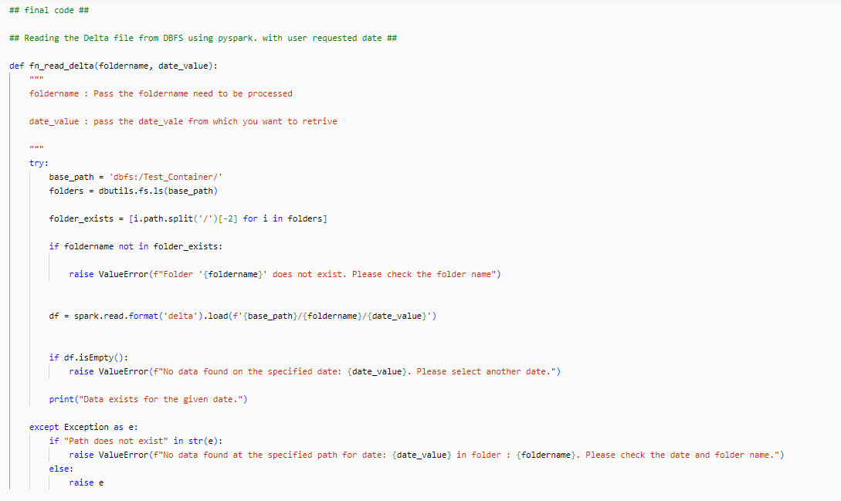
::Pyspark::
Folder structures follows like this in DBFS :

Slide 3
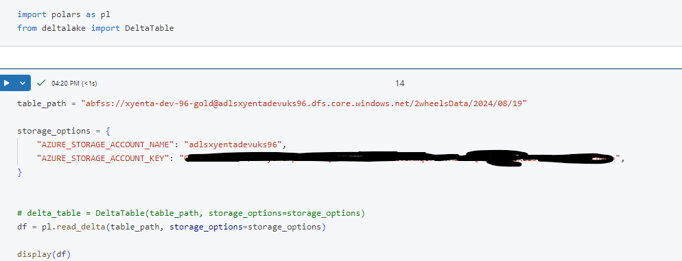
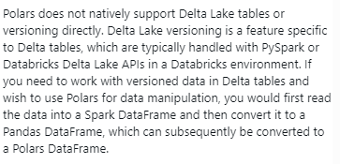
:POLARS:

