Slide 1
Generic Analysis

Slide 2
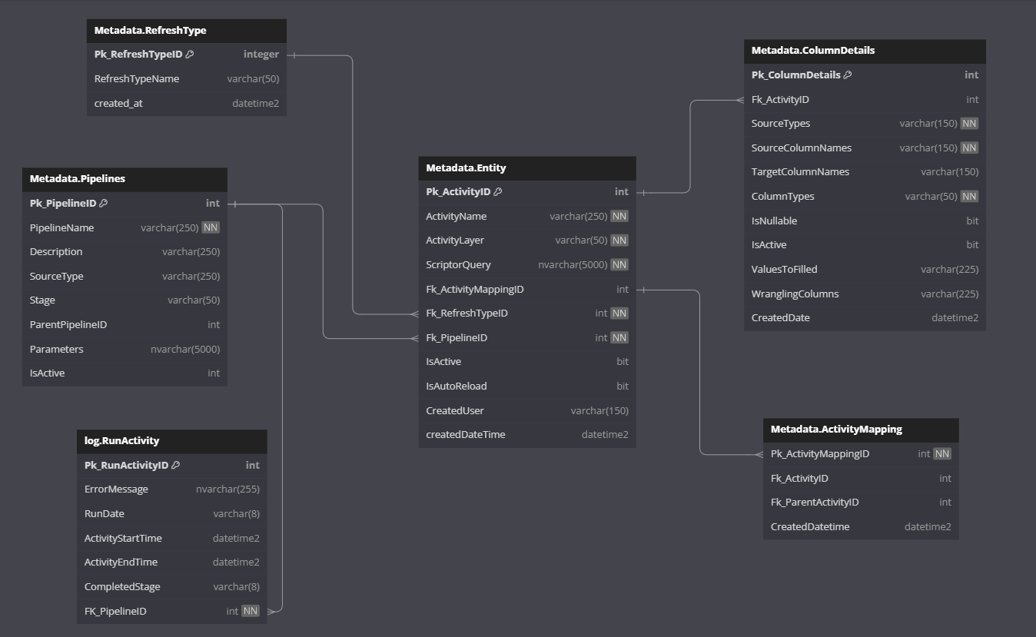
MODEL

Slide 3
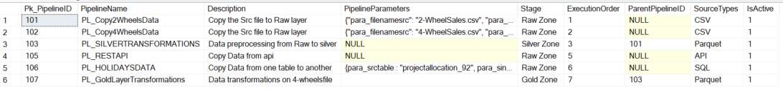

Tables:
Pipelines :
Main view :

Slide 4
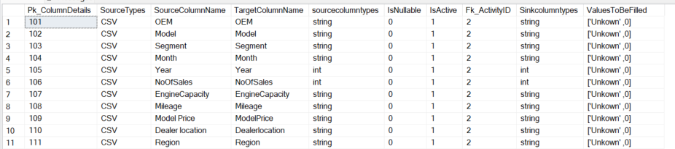
Continue…
Column details Table ::
View_columndetails

Slide 5

Continue….
viewdatacleansing is used in data validation or cleansing part
TConfigIncGeneric : for incremental Loading

Slide 6
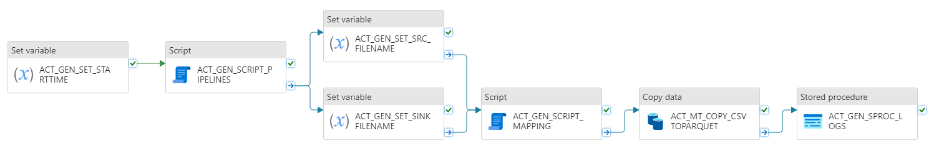
Pipelines Design
Designed the Pipelines which will transfer the Data from source to raw layer
For this I've been designed couple of pipelines called PL_COPY2WHEELSDATA etc.,
The Name of the Pipeline should be same mentioned in the Pipelines Table . So that it’ll pickup the parameters and required values according to the Pipeline Name . Also incorporated the Dynamic schema mapping .

Slide 7
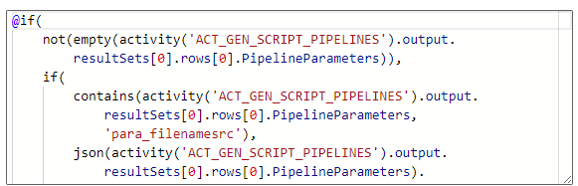


Continue…
Similarly, PL_Copy4WheelsData

Slide 8
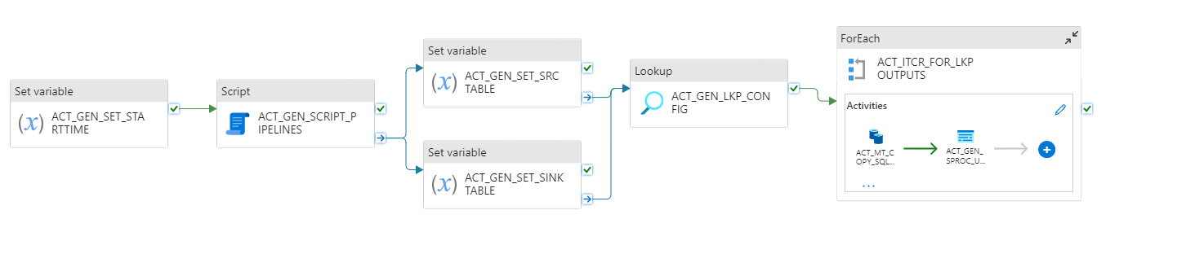

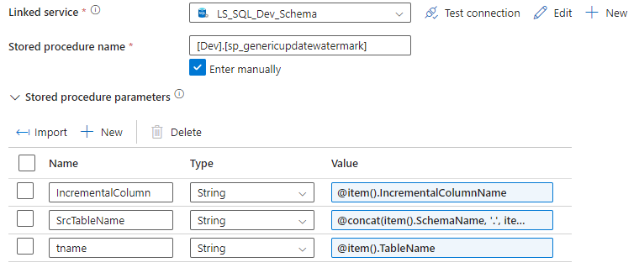
Continue…
Incremental load in SQL Case :

Slide 9
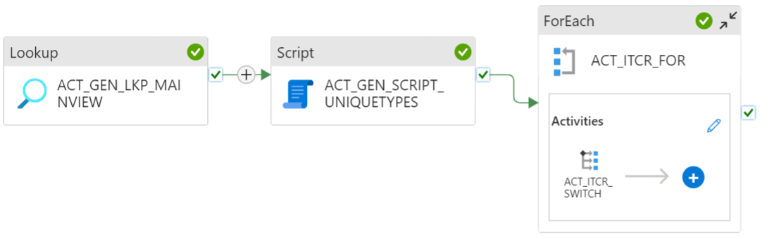
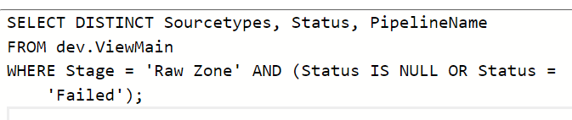
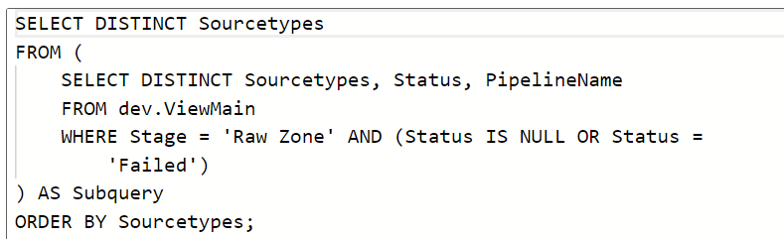
PL_EXECUTE_MASTER RAW
Here is the Master pipeline which is used to execute the pipelines which are in Raw layer according to their types like CSV/SQL/API.
Also used additional script activity , it makes sure get unique types and execute the activities according to the source types only one in switch condition.

Slide 10
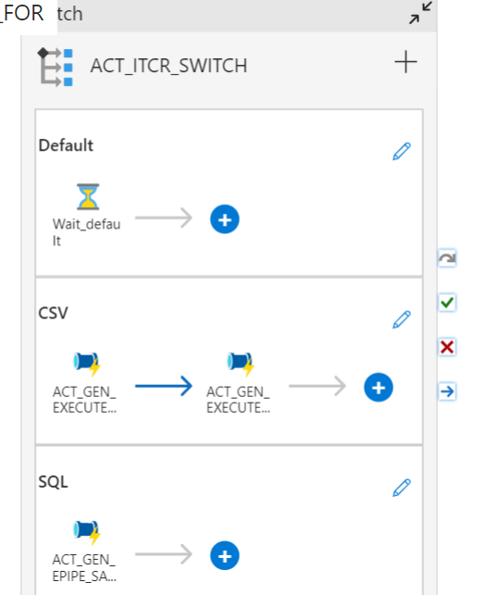
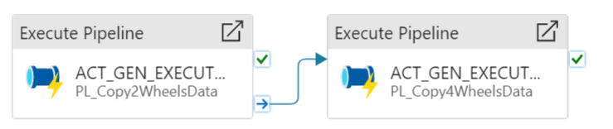
Continue…

Slide 11
Silver Layer Pipelines
Once data landed in the Raw Layer. We are performing couple of Data cleansing process . Here are the List of data cleaning techniques using Pyspark DataBricks are ::
Schema Mapping
Data Wrangling
Null Handling
Drop Duplicate
Assertion Test cases for schema mapping , Data Wrangling, Null Handling and Drop Duplicates
In order to make the above Data cleaning Techniques in a Dynamic way we are going to use ‘viewdatacleansing’ from the database

Slide 12
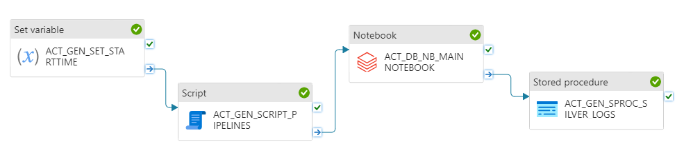
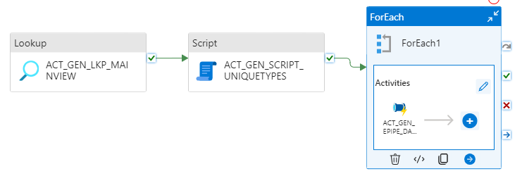
CONTINUE…
PL_SILVERTRANSFORMATIONS:
PL_EXECUTE_MASTER_SILVER:

