Slide 1
External-Storage
Databricks

Slide 2
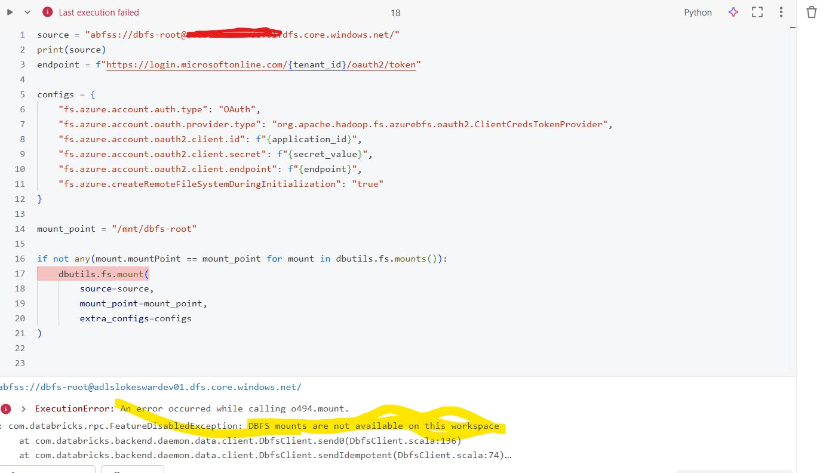
I recently ran into an issue while trying to mount adls gen2 in a databricks Hybrid Workspace using a service principal . Despite everything being configured correctly, Databricks kept throwing error :

Slide 3
Continue…
Hybrid Workspace type(new serverless-first model). DBFS mounts are completely disabled by design. These are mount-less by design.
Databricks strongly recommends migrating away from DBFS mount points and instead using Unity Catalog external locations for modern data governance and access control. New Databricks accounts may not even have access to the legacy mount point features.
An external location is a Secure point to cloud storage (ADLS/S3/GCS). Backed by the Storage Credential. External Location used by UC to govern access to data. Like Databricks Permissioned Gateway to cloud Storage.

Slide 4
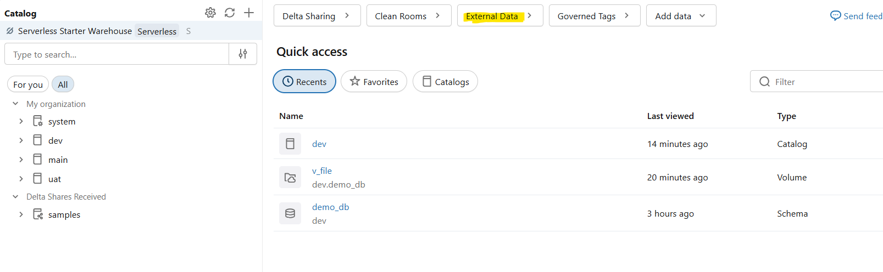
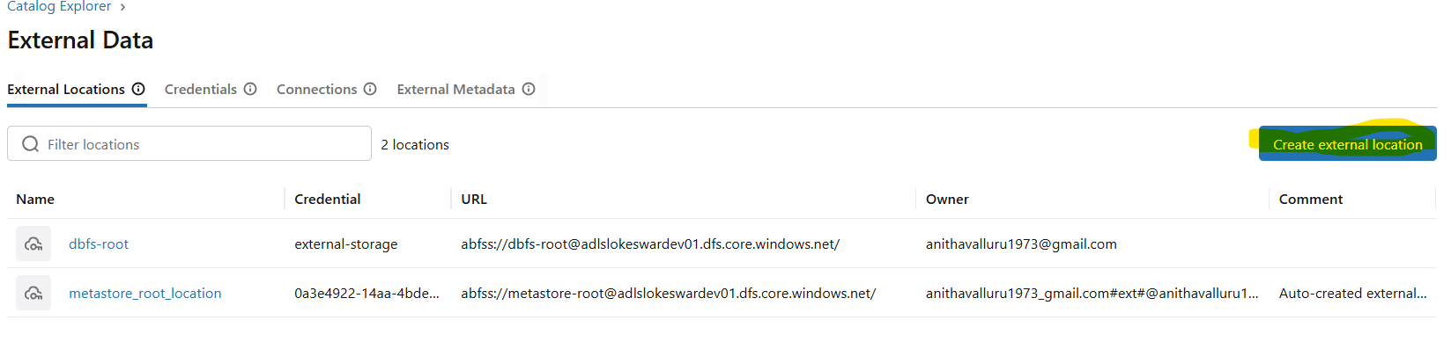
Create external location using UI:
Click on External Data button
Inside of External Data, hit create external Location

Slide 5
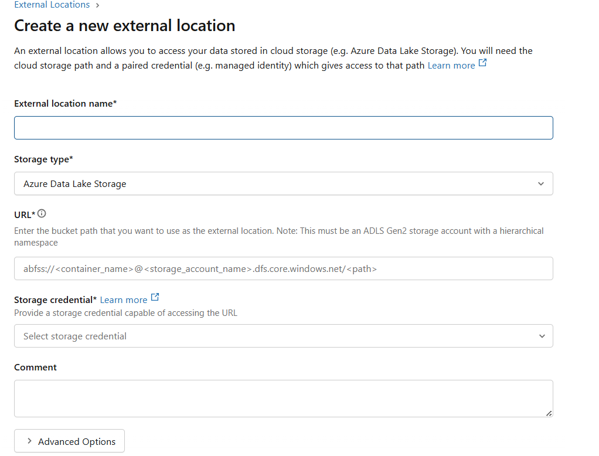
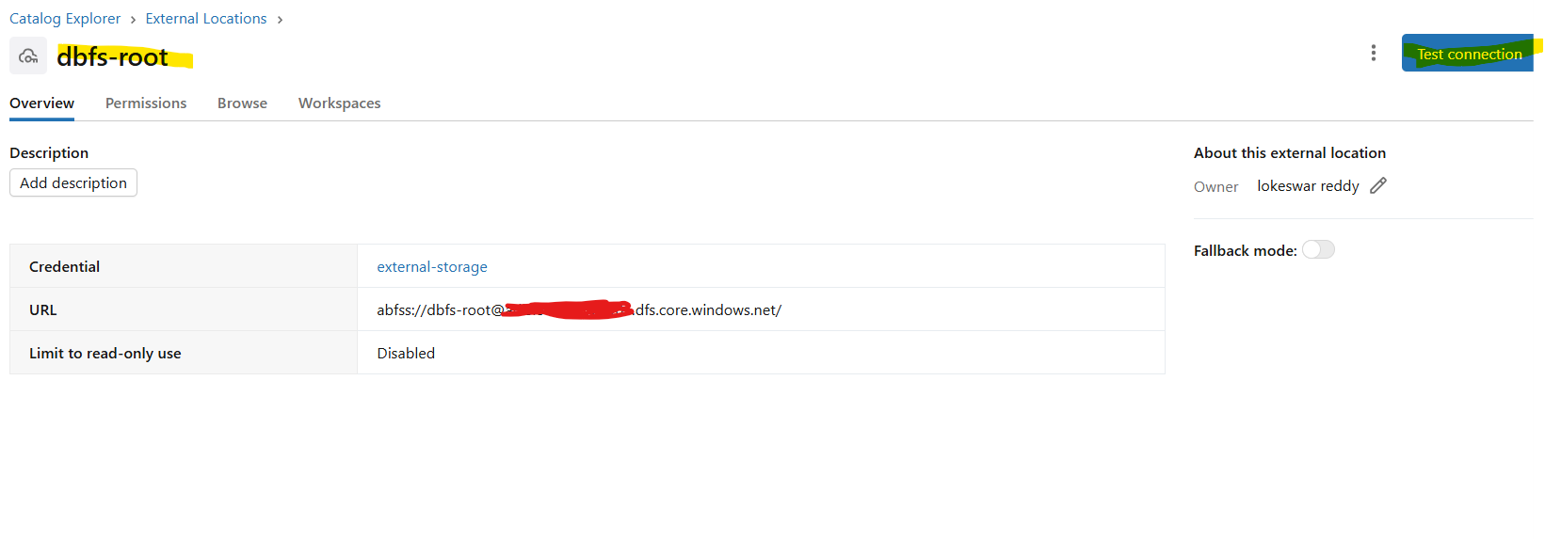
Continue…..
Pass the storage account name, container name and provide the name for the external storage like external-dbfs etc. and click create button.
Click Test Connection

Slide 6
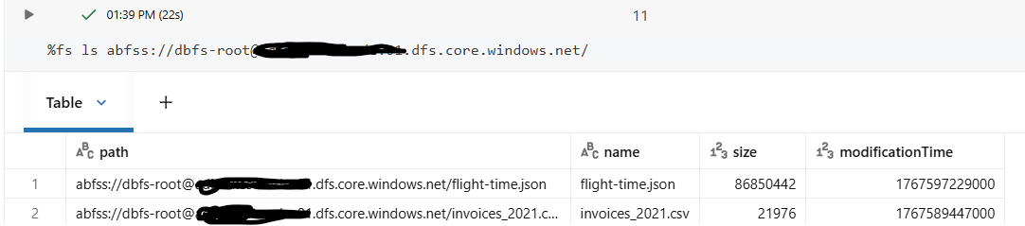
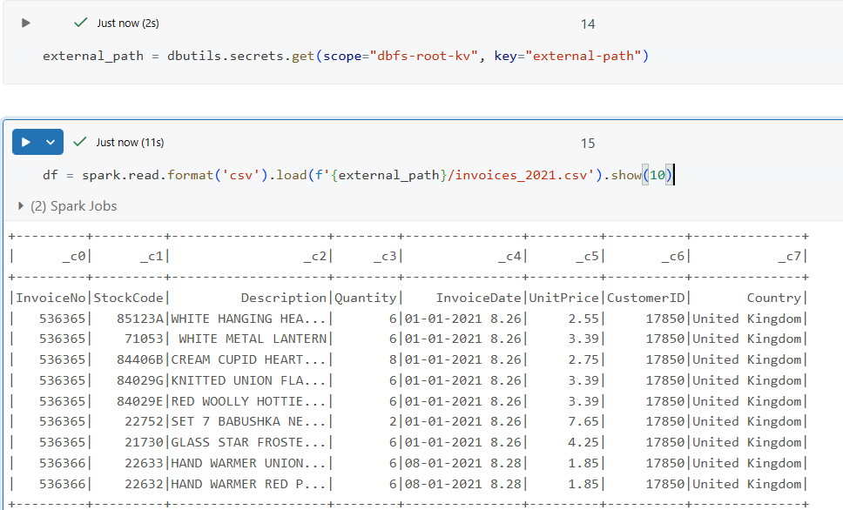
Continue…..
Let’s say Store the url of External storage in Key Vault and access it by using Secret Scope , now read the csv file for instance using External Storage location .
I have uploaded couple of files into the Storage account in adlsgen2
If we are working with Databricks Hybrid/Serverless Workspace: Stop thinking in /mnt. Start thinking in schemas, Tables and External Location

