Slide 1
WEB APP · PYTHON ML · RETAILROCKET
Customer Journey
Intelligence
Smart marketing from online shopping clicks, built as a web app with Python ML on RetailRocket data.

Slide 2
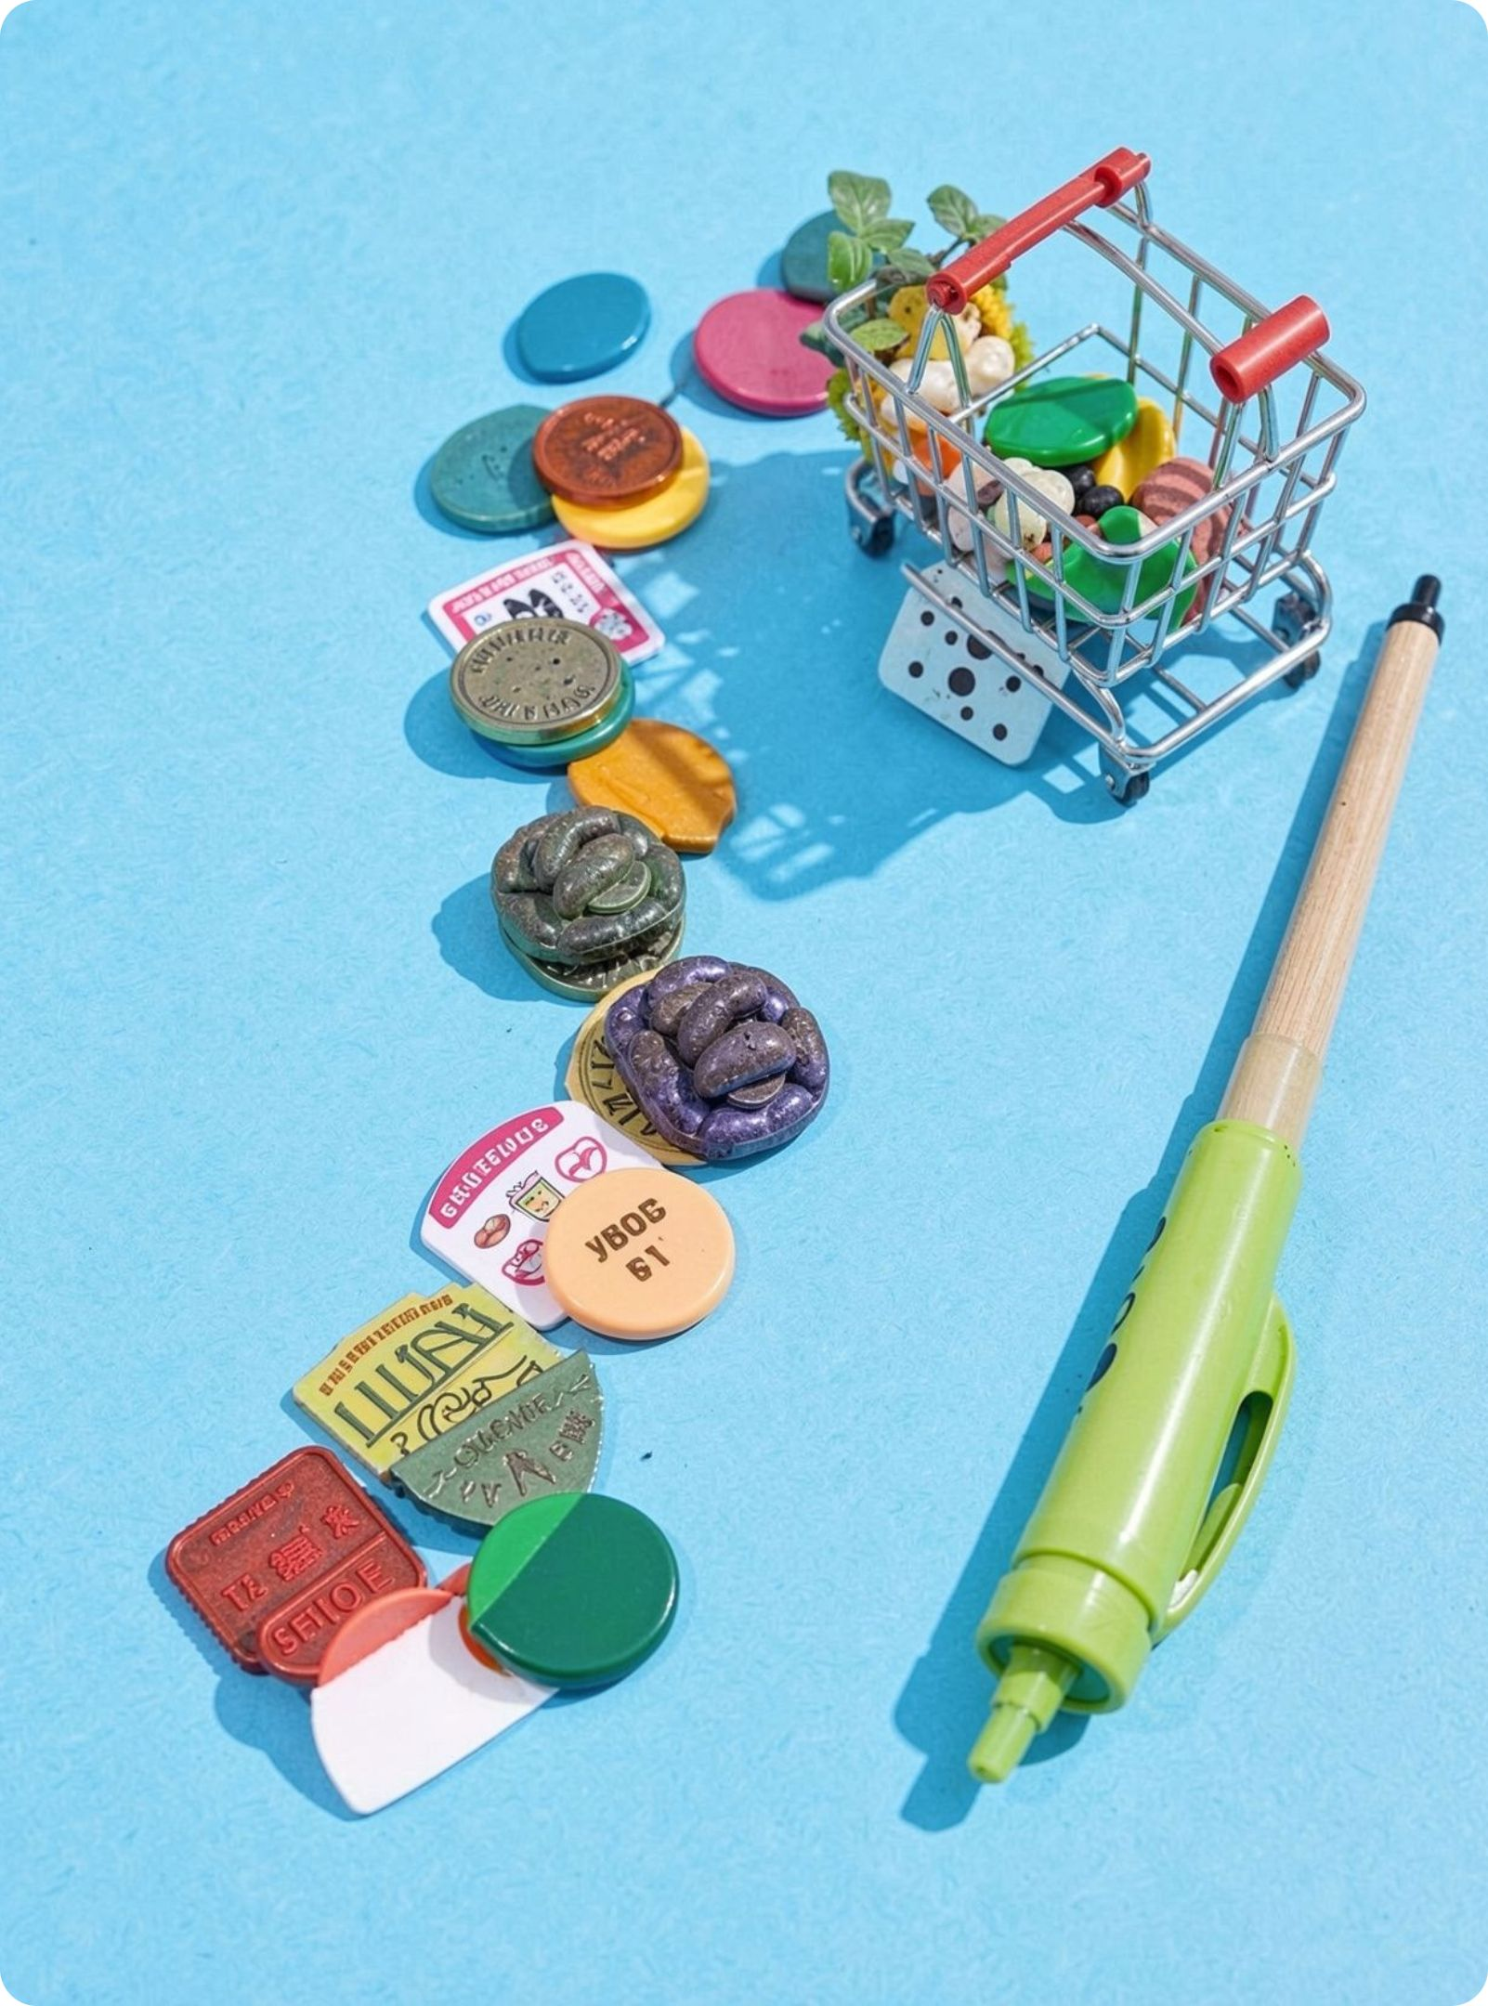
THE PROBLEM
Clicks become useful when they lead to an action
Too many clicks, not enough clarity on who to email and who to leave alone.
Journey intelligence connects journeys to groups, predictions, and the next marketing action.
Success means a working system backed by real numbers from the training run.
02

Slide 3
Customer Journey Intelligence — System Architecture
From raw clicks to journeys, ML scores, and marketing actions
Green = Data (source, pipeline, journey processing) · Purple = Intelligence (ML, NBMA, evaluation) · Orange = Application (API + dashboards) · Grey = Users
1
2
3
Data source: RetailRocket (Kaggle) — events, item properties, category tree → PostgreSQL (raw, processed, results).
Data pipeline (Python): ingest & validate → standardise view / cart / purchase → sessionise (30 min gap).
Journey processing: per-customer timeline → features (recency, frequency, ratios) → journey stage (inactive → engagement → exploration → intent → conversion).
4
5
6
Machine learning: segmentation (rules, RFM, K-Means) | next-event (Markov vs GRU) | propensity (LR, RF, XGBoost).
Decision layer: NBMA (email, reminder, discount, cross-sell, wait, suppress) + recommendations + SHAP / rules for “why this action”.
Evaluation (offline): RQ1–RQ3 metrics (precision, recall, F1, ROC-AUC, PR-AUC) + RQ4 strategy simulation → results stored for the app.
7
8
9
API layer: REST services — journeys, segments, scores, NBMA (diagram: FastAPI / HTTPS JSON).
Presentation layer: React dashboards — executive KPIs, funnel, segments, Customer 360 (timeline + stage + next action).
Users: Admin (data/models) | Marketing analyst (explore) | Marketing manager (act on NBMA).
Data flows top → bottom: store → clean → journey → ML → NBMA → evaluate → API → UI → users
03
Notes:
Walk green → purple → orange in ~45 seconds. ML training is Python batch and the website reads saved results through the API. Hosting names are deployment targets and the same layers run locally with PostgreSQL + React + API.

Slide 4
The test respects time and the rarity of purchase
01
2,756,101 events became 2,755,641 clean events after removing 460 duplicates.
02
Cutoff time τ sits at the 80% point: features come before τ and labels after it.
03
35,000 customers split into 24,500 train, 3,500 validation, and 7,000 test.
04
Future purchase rate is only 0.07% in the cohort.
04

Slide 5




MODEL SYSTEM
The system covers prediction, grouping, explanation, and action
Next event
Groups
Markov, Logistic Regression, Random Forest, XGBoost, and GRU.
K-Means from K=3–8 plus rule-based segments.
Buy chance
Decision layer
Static versus journey-aware features, evaluated with PR-AUC.
SHAP explanations, recommendations, churn score; NBMA actions: email, reminder, discount, wait, or stop marketing.
05

Slide 6
COHORT SHAPE
Most customers never progress beyond browsing
Step | Count | %
All customers | 35,000 | 100%
At least 1 view | 34,913 | 99.8%
At least 1 cart | 928 | 2.7%
At least 1 buy (before cutoff) | 283 | 0.8%
85.7%
of customers are marked Inactive stage.
06

Slide 7
RESEARCH QUESTIONS
Four questions define the evaluation
01
02
Which model?
Do groups separate?
Q1: Which model best predicts the next event: view, cart, or buy?
Q2: Do customer clusters separate well?
03
04
Who will buy?
Which action works?
Q3: Who will buy after the cutoff using static versus journey features?
Q4: Which marketing strategy works best in offline simulation?
07

Slide 8
RESULTS FROM THE TRAINING RUN
Complete results summary
Test metrics from the run; champions are highlighted below.
SETUP · Cohort 35,000 · Train 24,500 · Val 3,500 · Test 7,000 · Q1 test users 382 · Buy-after-cutoff rate 0.07%
Table A — Q1: Next event prediction (train 326 / test 382)
Table D — Q4: Marketing strategies (simulation, test 7,000)
Model | Accuracy | Precision (macro) | Recall (macro) | F1 (macro) | Top-2 acc.
Markov | 0.9869 | 0.3298 | 0.3325 | 0.3311 | 1.0
Logistic Regression | 0.9843 | 0.3298 | 0.3316 | 0.3307 | 0.9843
Random Forest | 0.9843 | 0.3298 | 0.3316 | 0.3307 | 0.9843
XGBoost | 0.9895 | 0.3298 | 0.3333 | 0.3316 | 0.9895
GRU ★ BEST | 0.9921 | 0.664 | 0.4167 | 0.4653 | 1.0
Strategy | Prectarget | Coverage | Unnecessary actions
Wait + Stop | 0.0026 | 1.0 | 71
Generic ★ WINNER | 0.0026 | 1.0 | 0
Segment-based | 0.0026 | 1.0 | 285
Journey + rules | 0.0023 | 0.3333 | 149
Journey + rules produced 4,391 wait/stop outcomes; generic email-all wins hit rate in this simulation.
Table B — Q2: Segmentation
Table C — Q3: Will they buy after cutoff? (test n=7,000)
Method | Score / detail
K-Means K=3 | Silhouette 0.5531
K-Means K=4 ★ BEST | Silhouette 0.5606
K-Means K=5 | Silhouette 0.5537
K-Means K=6 | Silhouette 0.5215
K-Means K=7 | Silhouette 0.5099
K-Means K=8 | Silhouette 0.5120
RFM K-Means (K=4) | Silhouette 0.5528
Rule-based segments
Static features
Journey-aware features
Segment | Count
At-Risk / Inactive | 23894
Recent Browsers | 10058
Cart Abandoners | 672
Champions & High Value | 283
High Intent Cohort | 93
Model | Accuracy / Precision / Recall / F1 / ROC-AUC / PR-AUC
Logistic Regression ★ BEST | 0.8164 / 0.0055 / 0.3889 / 0.0108 / 0.5677 / 0.1483
Random Forest | 0.9973 / 0.0 / 0.0 / 0.0 / 0.6331 / 0.0148
XGBoost | 0.9974 / 0.0 / 0.0 / 0.0 / 0.7473 / 0.0528
GRU | 0.3077 / 0.0008 / 0.2222 / 0.0016 / 0.1598 / 0.0017
Model | Accuracy / Precision / Recall / F1 / ROC-AUC / PR-AUC
Logistic Regression | 0.5274 / 0.003 / 0.5556 / 0.006 / 0.6274 / 0.105
Random Forest | 0.9961 / 0.0 / 0.0 / 0.0 / 0.7408 / 0.0407
XGBoost | 0.9961 / 0.0 / 0.0 / 0.0 / 0.7269 / 0.0322
GRU | 0.9969 / 0.0 / 0.0 / 0.0 / 0.3674 / 0.0024
★ Best on test by PR-AUC: Static Logistic Regression. SHAP top drivers for the journey model: stage_code 2.73, total_events 0.13, recency_days 0.03.
CHAMPIONS · Next event — GRU (F1 0.465) · Customer groups — K-Means K=4 (silhouette 0.561) · Purchase chance — Static Logistic Regression (PR-AUC 0.148) · Strategy simulation — Generic email all (Prectarget 0.0026)
Precision around 0.33 in Q1 is macro-average across three event types, not buy precision.
08

Slide 9
HOW TO READ THE RUN
Accuracy is not the answer when the positive class is rare
The right metric changes with the question.
Q1
Q3
Trust F1, not accuracy; GRU wins.
Trust PR-AUC; with buys at 0.07%, 99% accuracy can still be useless.
Q4
Demo
Email-all wins hit rate here, while journey rules reduce 4,391 wait/stop outcomes.
Models and Research pages in the app; regenerate with python ml/train_models.py.
09

Slide 10
NEXT TEST
The platform is ready for a bigger, more realistic test
2.76M
Built a full journey intelligence platform on 2.76M clean events.
Used a time-based split with no peeking at the future.
Clear winners emerged for next-event prediction, segmentation, purchase chance, and the strategy simulation.
Limits: small future-buy count, offline simulation rather than a live A/B test, and a 35k-customer cap.
Next: run on more data, tune thresholds, and test in a real store.
clean events
Thank you — Questions?
10

