Slide 1


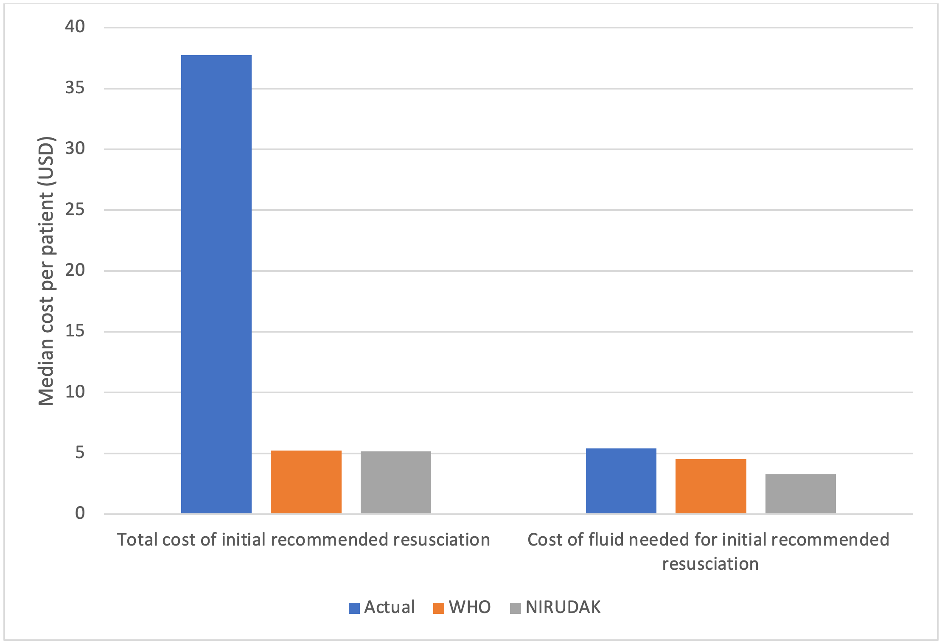
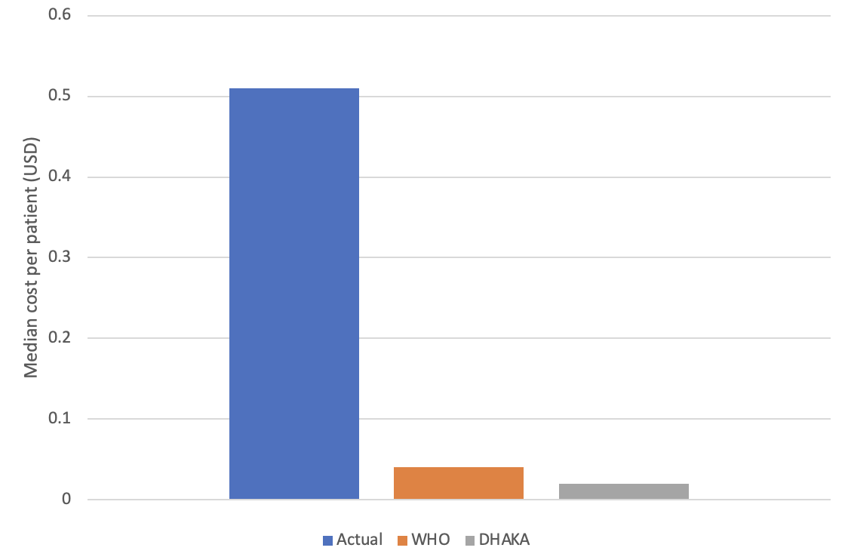
Cost analysis of the NIRUDAK & DHAKA clinical diagnostic model for volume deficit in patients with acute diarrhea
Anagha Lokhande BA¹, Monique Gainey MS MPH², Stephanie C. Garbern MD MPH¹, Sabiha Nasrin MBBS MPH³,
Nur H. Alam MD MBBS PhD³, Adam C. Levine MD MPH¹
¹ Alpert Medical School, Brown University, Providence, RI, USA
² Rhode Island Hospital, Providence, RI, USA
³ International Centre for Diarrhoeal Disease Research, Bangladesh (icddr,b), Dhaka, Bangladesh
Background
Results
Results cont. & Conclusion
With over 6.5 billion cases and 1.4 million deaths in 2019, diarrheal diseases are a major cause of morbidity and mortality and place a heavy burden on healthcare systems worldwide
This study aims to compare simulated treatment costs of acute diarrhea management using the World Health Organization (WHO) guidelinesª or the recently developed NIRUDAK^{b} and DHAKA models^{c} to the actual cost of care at the International Centre for Diarrhoeal Disease Research (icddr,b)
The NIRUDAK model predicts fluid resuscitation requirements for patients over 5 years of age
The DHAKA model predicts fluid resuscitation requirements for patients under 5 years of age
NIRUDAK model, median total cost per patient: $5.18 (IQR: 0 – 25.56)
WHO: $5.23 (IQR: 5.09 – 22.17)
Actual (at icddr,b): $37.75 (IQR: 15.69 – 45.00)
NIRUDAK model, initial fluid resuscitation median cost per patient: $3.27 (IQR: 0 – 4.27)
WHO: $4.55 (IQR: 0 – 5.76)
Actual: $5.43 (IQR: 4.16 – 5.43)
DHAKA model, total fluid cost: $0.02 (IQR: 0 - 0.97)
WHO: $0.04 (IQR: 0.03 - 1.24)
Actual: $0.51 (IQR: 0.45 - 1.71)
Implementing the most cost-effective approach to diarrhea management will help optimize allocation of resources
Especially critical in low resource settings
Measuring the societal cost savings (e.g., of hospital beds, physician and nurse labor, transportation to healthcare facilities, etc.) is beyond the scope of this analysis
However, more accurately diagnosing patient dehydration levels can
free up hospital beds and resources for the most severely ill patients
saving moderately ill patients the costs of in-patient care
Thus, the NIRUDAK and DHAKA models may also provide positive externalities unable to be captured here
Methods
Figure 1. Summary of cost comparisons — NIRUDAK model
Cost of care for each patient presenting to icddr,b’s Dhaka Hospital between March 2019 – March 2020 represents the summed costs of
fluid administered
hospital fees
equipment (e.g. IV tubing and needles)
NIRUDAK model: total costs of resuscitation & cost of fluid required for initial resuscitation (within first 6 hours of admission) were calculated and reported as median and interquartile range (IQR) in USD
DHAKA model: due to data limitations, total costs of fluid were calculated and reported as median and IQR in USD
References
a World Health Organization (WHO). IMAI District Clinician Manual: Hospital Care for Adolescents and Adults. World Heal Organ [Internet]. 2011; 2:780. Available from: http://apps.who.int/iris/bitstream/ 10665/77751/3/9789241548290_Vol2_eng.pdf?ua=1
b Levine AC, Barry MA, Gainey M, Nasrin S, Qu K, Schmid CH, et al. (2021) Derivation of the first clinical diagnostic models for dehydration severity in patients over five years with acute diarrhea. PLoS Negl Trop Dis 15(3): e0009266. https://doi.org/10.1371/journal.pntd.0009266
c Levine, A. C., Glavis-Bloom, J., Modi, P., Nasrin, S., Rege, S., Chu, C., Schmid, C. H., & Alam, N. H. (2015). Empirically Derived Dehydration Scoring and Decision Tree Models for Children With Diarrhea: Assessment and Internal Validation in a Prospective Cohort Study in Dhaka, Bangladesh. Global health, science and practice, 3(3), 405–418. https://doi.org/10.9745/GHSP-D-15-00097
Disclosures
Figure 2. Total cost of fluid — DHAKA model
The authors report no external funding source nor any conflicts of interest for this study.

