Slide 1
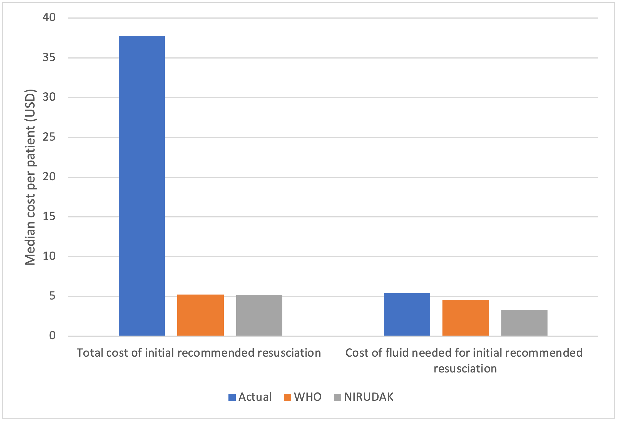
Cost analysis of the NIRUDAK clinical diagnostic model for volume deficit in patients with acute diarrhea
Anagha Lokhande BA¹, Monique Gainey MS MPH², Stephanie C. Garbern MD MPH¹, Sabiha Nasrin MBBS MPH³, Nur H. Alam MD MBBS PhD³, Adam C. Levine MD MPH¹
1 Alpert Medical School, Brown University, Providence, RI, USA; 2 Rhode Island Hospital, Providence, RI, USA; 3 International Centre for Diarrhoeal Disease Research, Bangladesh (icddr,b), Dhaka, Bangladesh
Background and Objectives
Methods
With over 6.5 billion cases and 1.4 million deaths in 2019, diarrheal diseases are a major cause of morbidity and mortality and place a heavy burden on healthcare systems worldwide
This study aims to compare simulated treatment costs of acute diarrhea management using the World Health Organization (WHO) guidelinesª or the recently developed NIRUDAK model^{b} to the actual cost of care in patients over 5 years old
Cost of care for each patient included fluid administered, hospital costs, and equipment for patients presenting to icddr,b’s Dhaka Hospital between March 2019 – March 2020
Total costs of resuscitation along with cost of fluid required for initial resuscitation (within first 6 hours of admission) were calculated and reported as median and interquartile range (IQR) in USD
Results and Conclusion
Using the NIRUDAK model, patients had a median projected total cost of $5.18 (IQR: 0 – 25.56)
Median projected total costs using the WHO guidelines were $5.23 (IQR: 5.09 – 22.17)
Actual total cost of care was $37.75 (IQR: 15.69 – 45.00)
When isolating costs for initial fluid resuscitation, the median projected cost per patient was $3.27 (IQR: 0 – 4.27) using the NIRUDAK model
Median projected fluid cost was $4.55 (IQR: 0 – 5.76) using the WHO guidelines
Actual costs of fluid were $5.43 (IQR: 4.16 – 5.43)
Implementing the most cost-effective approach to diarrhea management will help optimize allocation of resources, which is especially critical in low resource settings
References
a World Health Organization (WHO). IMAI District Clinician Manual: Hospital Care for Adolescents and Adults. World Heal Organ [Internet]. 2011; 2:780. Available from: http://apps.who.int/iris/bitstream/ 10665/77751/3/9789241548290_Vol2_eng.pdf?ua=1
b Levine AC, Barry MA, Gainey M, Nasrin S, Qu K, Schmid CH, et al. (2021) Derivation of the first clinical diagnostic models for dehydration severity in patients over five years with acute diarrhea. PLoS Negl Trop Dis 15(3): e0009266. https://doi.org/10.1371/journal.pntd.0009266

