Slide 1
Theory of high Tc nickelate superconductors &
Possible upper limit of Tc for unconventional superconductivity
Yi-feng Yang
Institute of Physics, Chinese Academy of Sciences
Collaborators:
Qiong Qin, Jiangfan Wang, Yingying Cao
Guang-Ming Zhang, Fu-Chun Zhang
Refs: npj Quantum Mater. 10, 13 (2025); The Innov. Mater. 2, 100102 (2024); CPL 42, 017301 (2025).
PRB 108, L140504 (2023);108, L201108(2023); 109, L081105 (2024); 110, 104507 (2024); 111, 014512 (2025).

Slide 2
Key questions on high Tc nickelates
q What is the minimal effective model?
q What is the pairing mechanism & pairing symmetry?
q What determines the maximum Tc?
q Why is Tc reduced from bilayer to trilayer nickelates?
q How to explain the non-Fermi liquid normal state?
q What can we learn from nickelates?

Slide 3
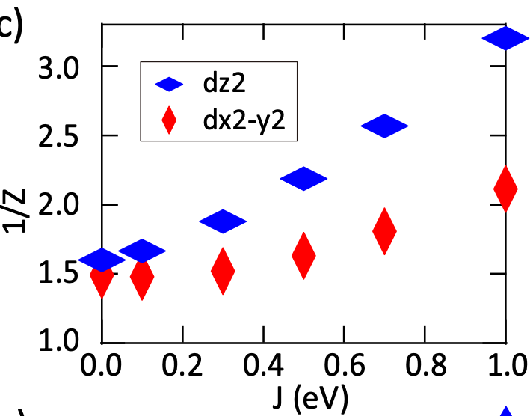
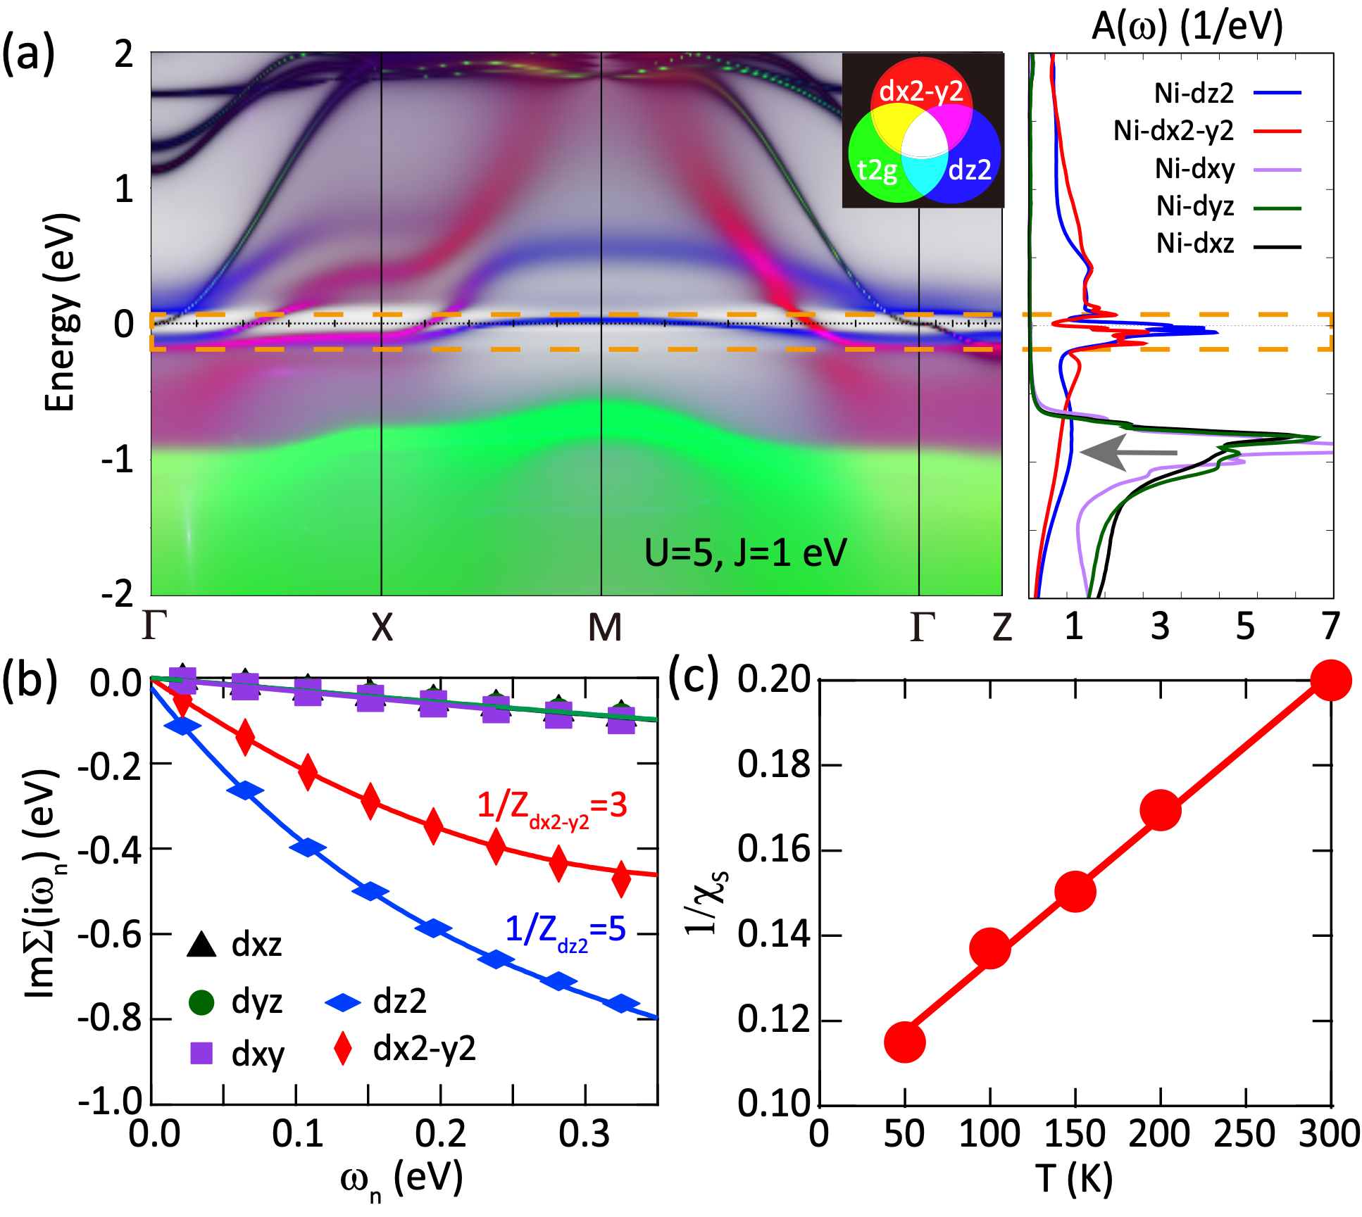
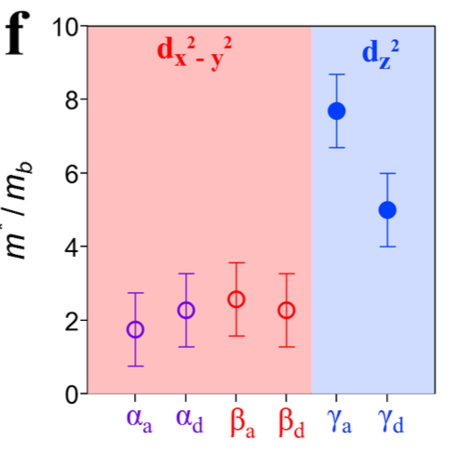
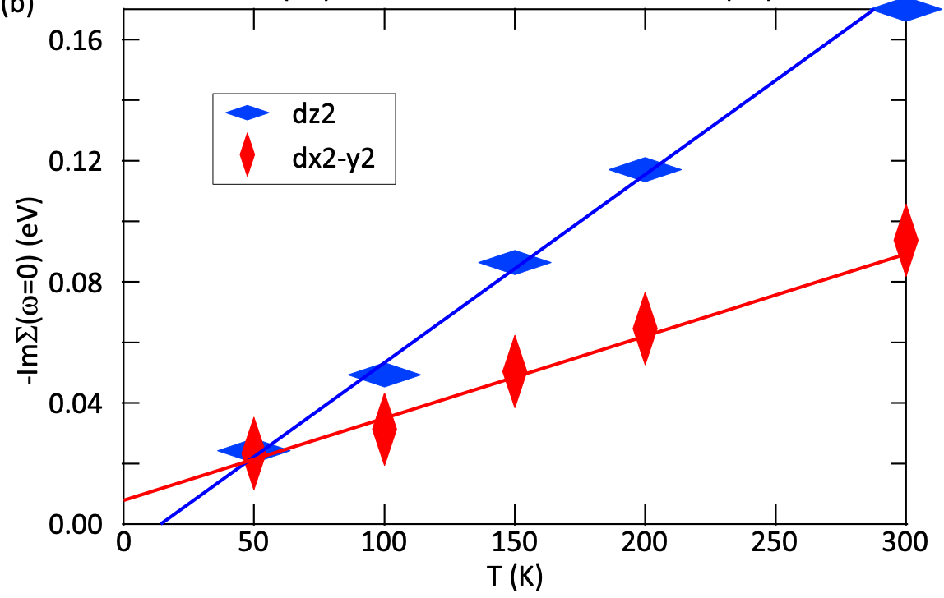
DFT+DMFT: Flat bands promoted by Hund coupling
Y. Cao & YF, PRB 109, L081105 (2024); arXiv:2307.06806
Orbital-dependent mass enhancement due to Hund
Flat dz2 bands (hybridized with) dispersive dx2-y2 bands
Local dz2 moment with strong interlayer superexchange
Interlayer valence bonds & hybridization & Hund physics
XJ Zhou et al.

Slide 4
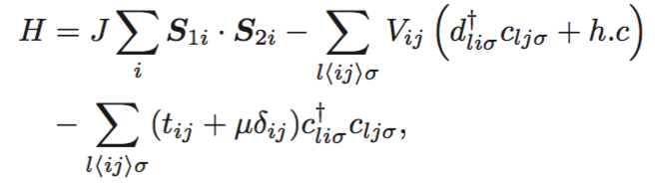
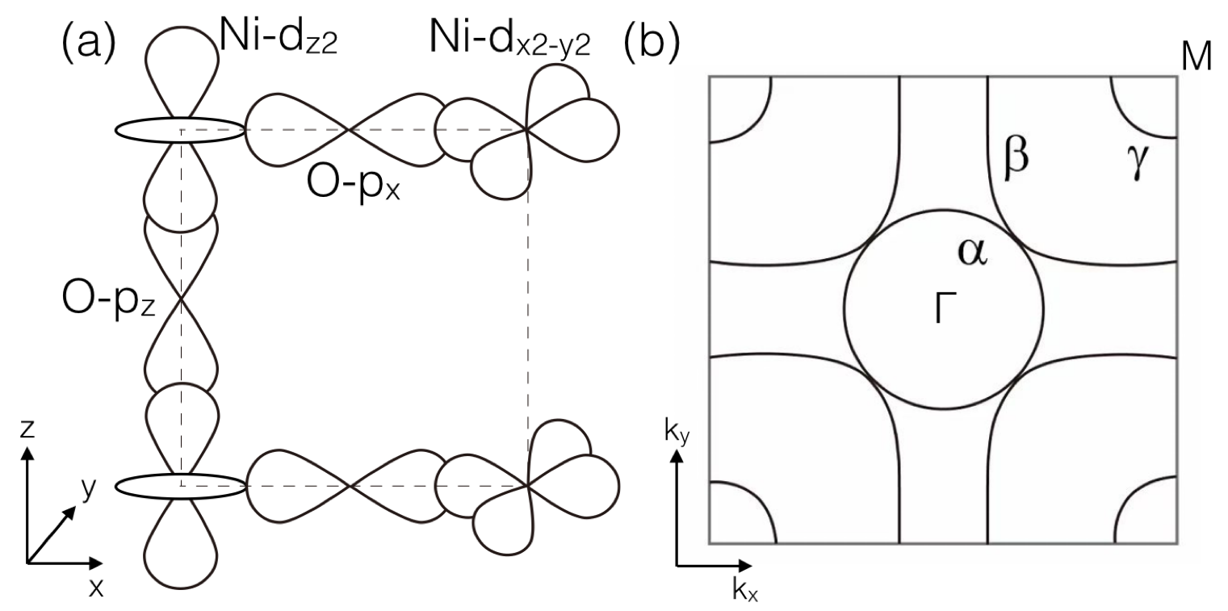
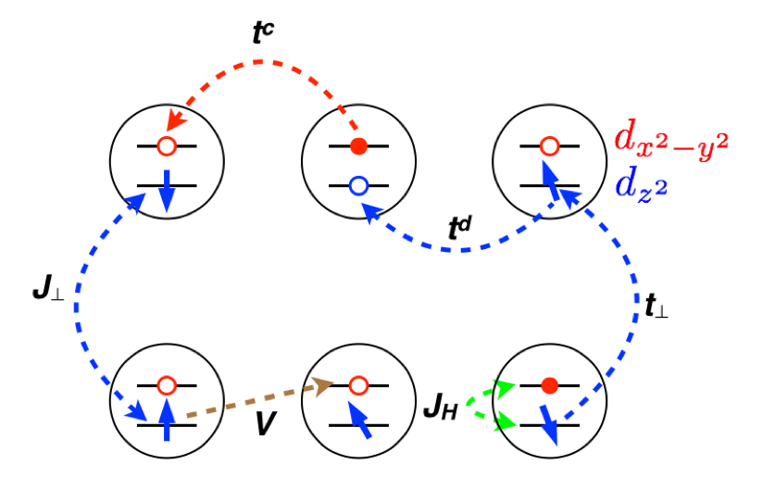
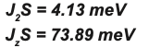
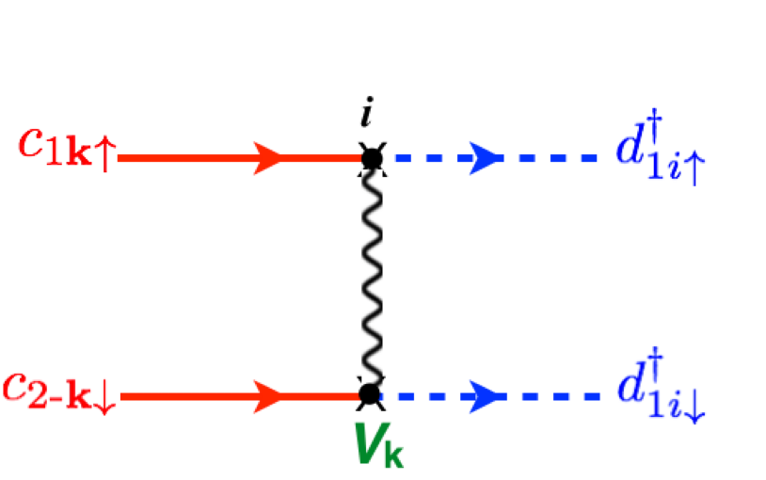
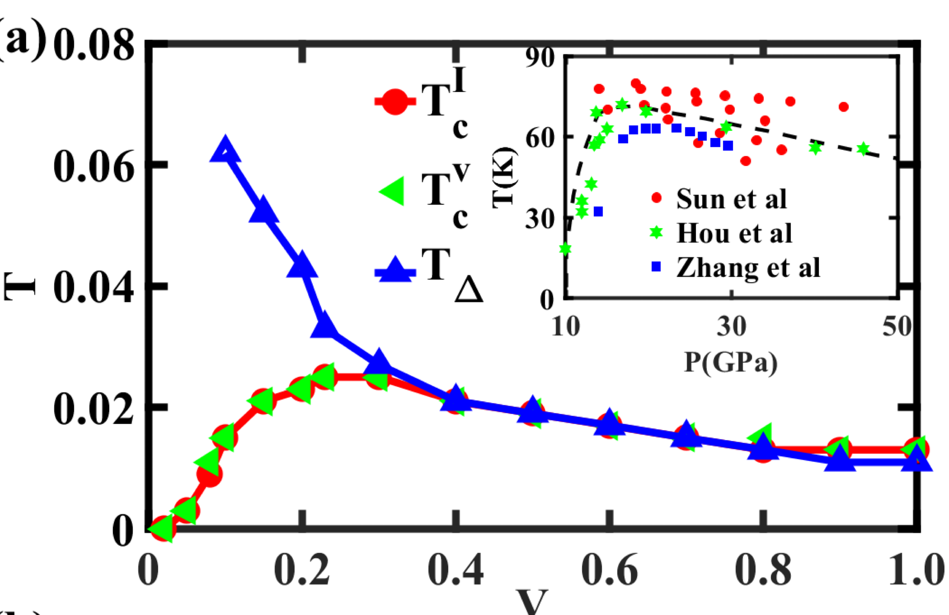

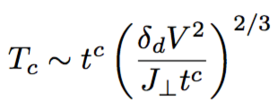

Minimal t-V-J model, two-component theory of SC, and maximum Tc
Minimal t-V-J model
YF, G-M Zhang, F-C Zhang, PRB 108, L201108 (2023)
Two-component composite pairing
Auxiliary-field MC simulations
(Moderate U, no 𝛄 pocket)
dz2 for pairing interaction, dx2-y2 for phase coherence
s⁺⁻ gap with nodes or minima along zone diagonal on 𝜶/𝜷
Maximum Tc≈0.04-0.05J gives 70-90 K for J~150 meV (RIXS/INS); promoted by uniaxial pressure
Reduced Tc in thin films, possibly due to the reduced J
Q. Qin & YF, PRB 108, L140504 (2023)

Slide 5
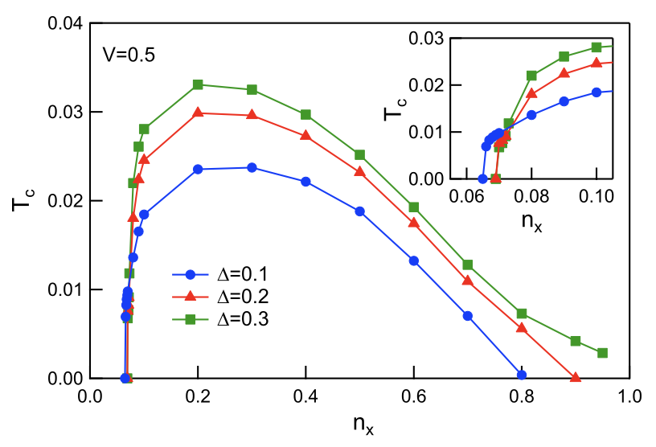
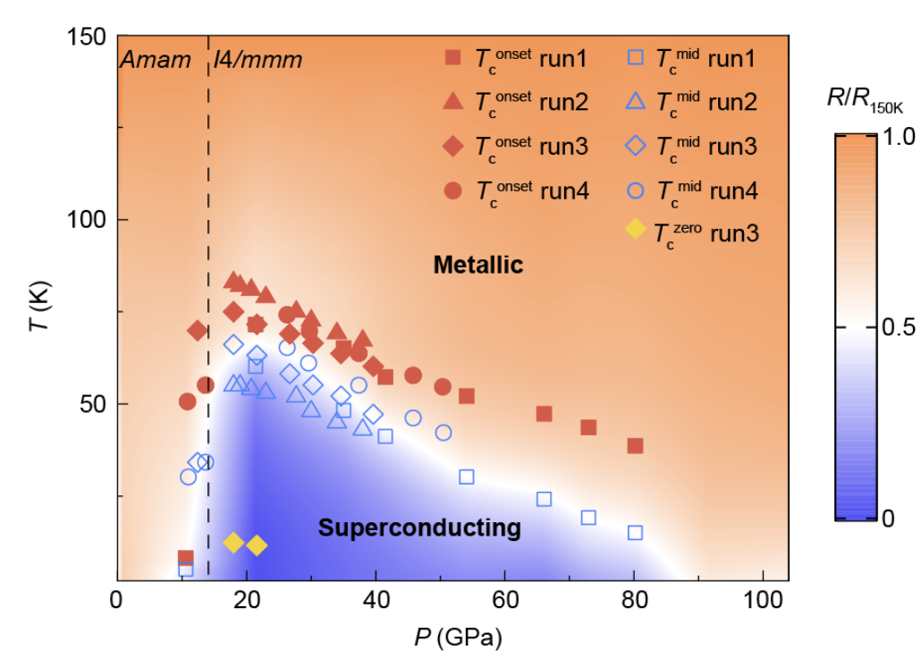
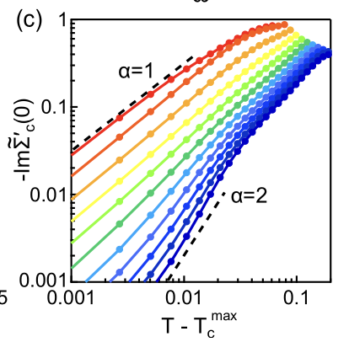
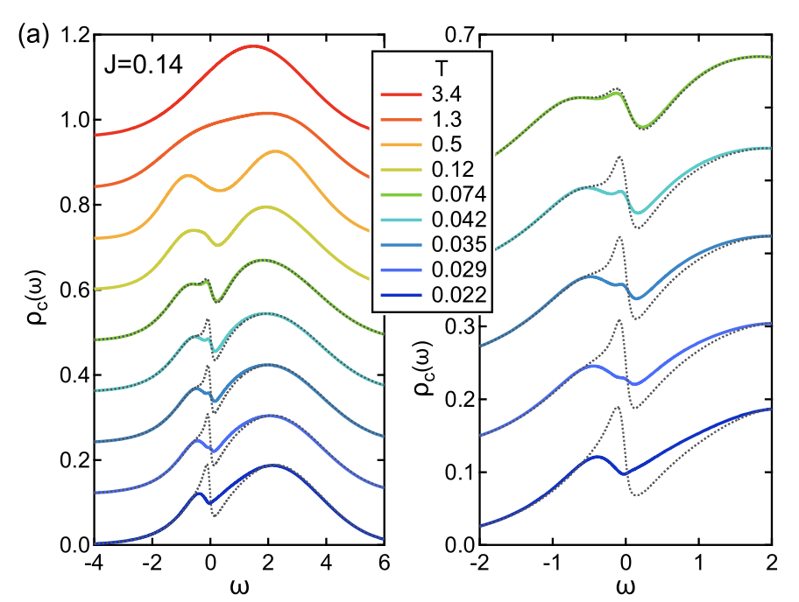
Highly asymmetric Tc curve and non-Fermi liquid upon hole doping
J. Wang & YF, PRB 111, 014512 (2025).
Schwinger boson approach to treat both SC and interlayer valence bonds (large U)
M Wang et al.
Critical hole doping (large U) & highly asymmetric Tc curve
Pseudogap & strange metallicity also obtained above Tc
How about moderate U? (work in progress)

Slide 6
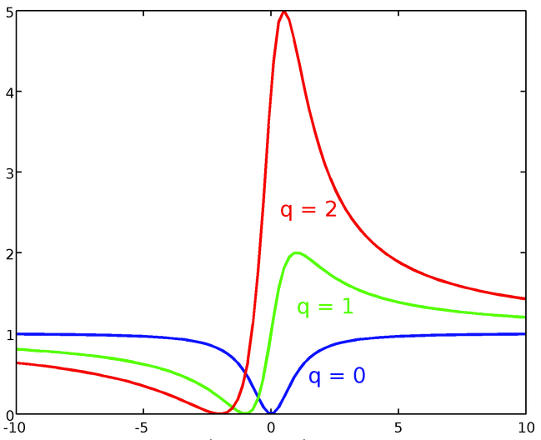
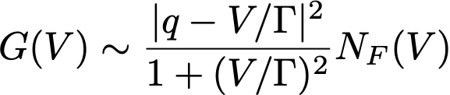
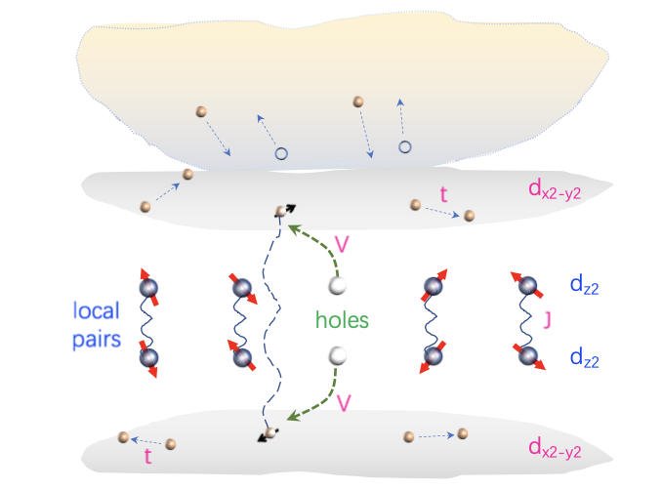

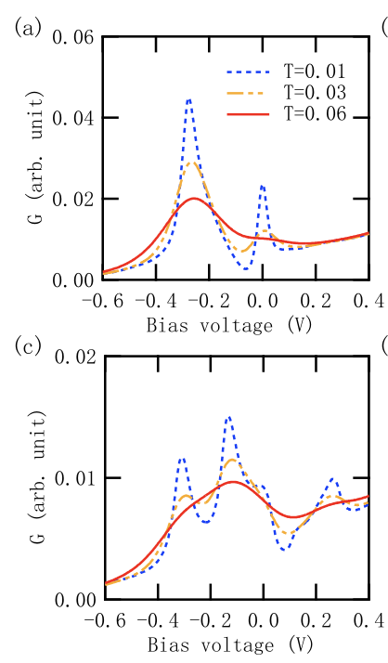
Kondo effect and Fano interference
like in heavy fermion systems
YF, Phys. Rev. B 79, 241107(R) (2009)
dz2
narrow bands
dx2-y2
broad bands
YF, CPL 42, 017301 (2025).
Possible Fano interfore in quasiparticle tunneling

Slide 7
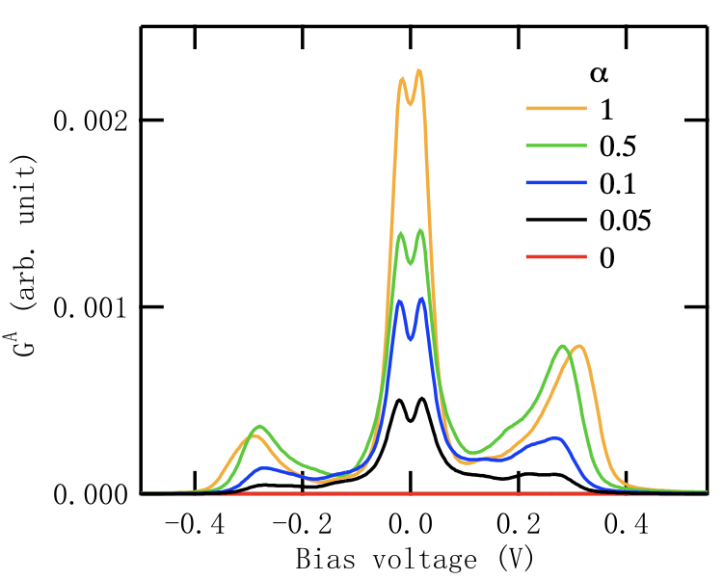
Suppressed Andreev reflection
YF, CPL 42, 017301 (2025).
Interlayer hopping scaling factor
𝜸: full gap (+);
𝜶(+)/𝜷(-): s-wave gap with nodes/minima along zone diagonal
for small t⊥ self-doped hoels on dz2
∝
Andreev reflection is suppressed for weak interlayer hopping due to Gutzwiller constraint
Systematic evolution under pressure or doping tuning
How to compare with experiments by HH Wen et al. & HQ Yuan et al.?

Slide 8

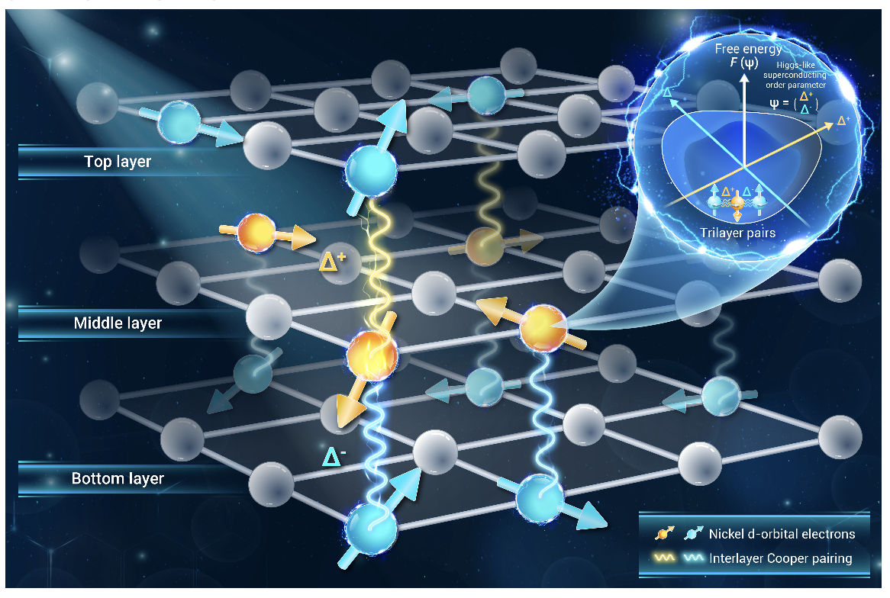

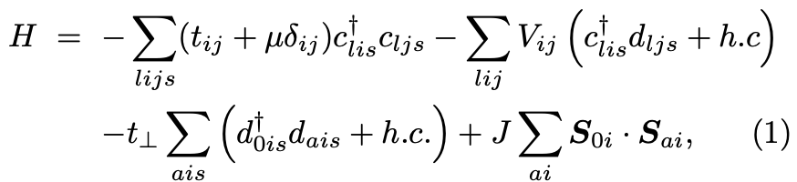




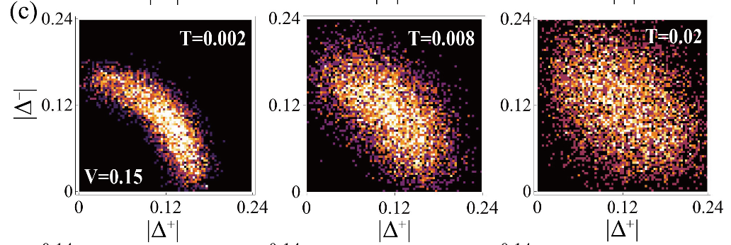
Frustrated superconductivity in trilayer nickelate
Bilayer La3Ni2O7:
Q. Qin, J. Wang, & YF, The Innov. Mater. 2, 100102 (2024)
Trilayer La4Ni3O10:
Monte Carlo simulations of the pairing fields
Strong interlayer SC fluctuations
s± wave pairing with gap nodes or minima
along the zone diagonal direction

Slide 9
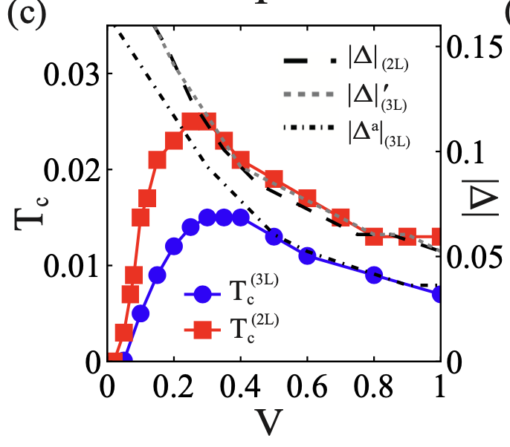

Intrinsic reduction of the maximum Tc
Q. Qin, J. Wang, & YF, The Innov. Mater. 2, 100102 (2024)
Maximum Tc/J ~ 0.04-0.05 for bilayer
Maximum Tc/J ~ 0.02-0.03 for trilayer
Contrary to cuprates where Tc is of record high in trilayer structures.
bilayer: max Tc～70-90 K vs 80 K
trilayer: max Tc～30-50 K vs 30 (39?) K
RIXS & INS
Taking J～150 meV ?
DL Feng et al.
M Wang et al.
Maybe further reduced by layer imbalance & smaller J?

Slide 10

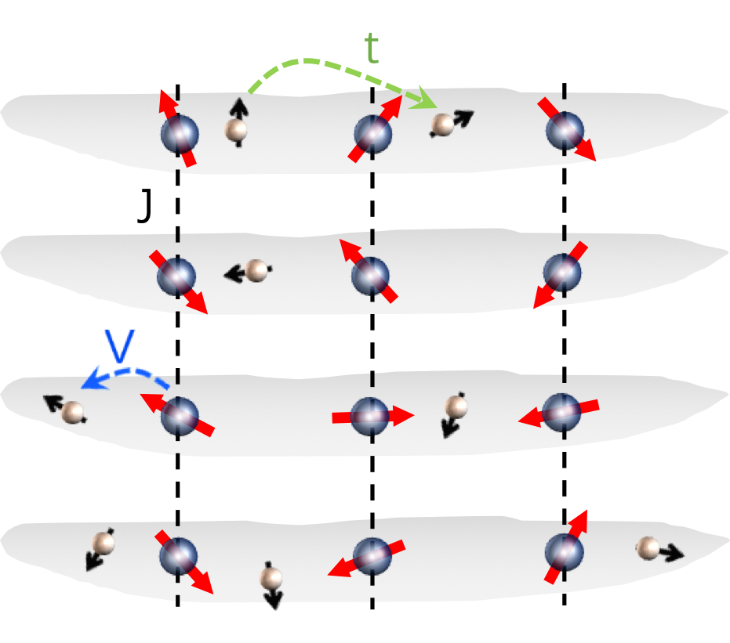
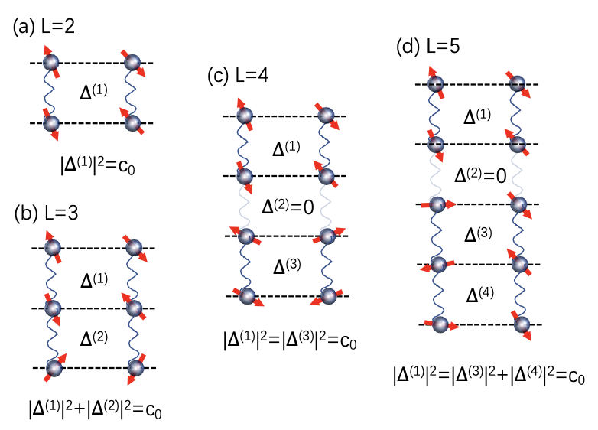
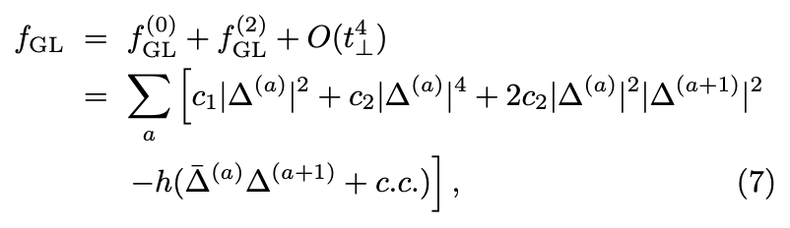
Decomposition of interlayer pairing superconductivity (L≥4)
Multilayer t-V-J model:
To minimize the free energy
Decompose into bilayer blocks (plus one trilayer for odd L)
Maximum Tc possibly determined by the blayer blocks
Possible high Tc under valence tuning
YF, Phys. Rev. B 110, 104507 (2024)

Slide 11
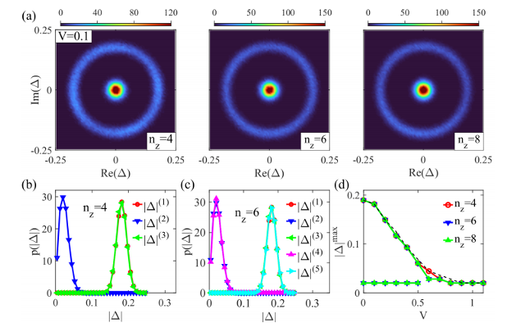
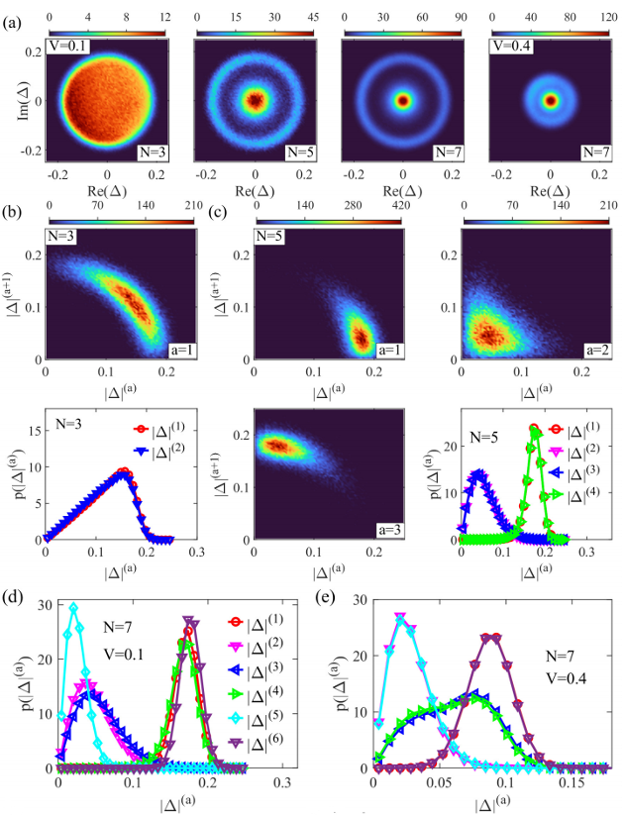
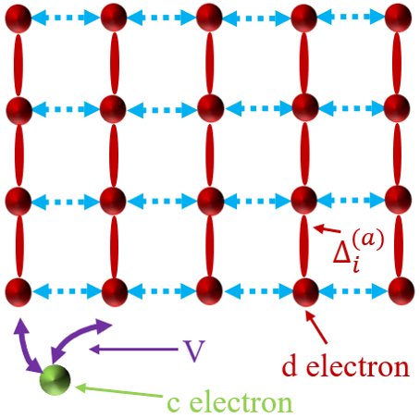
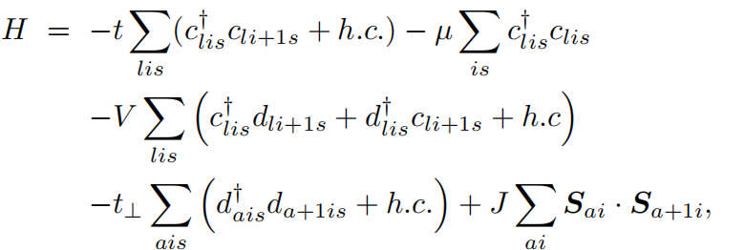
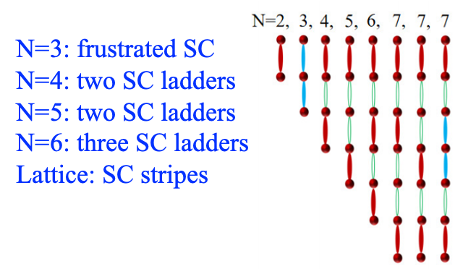
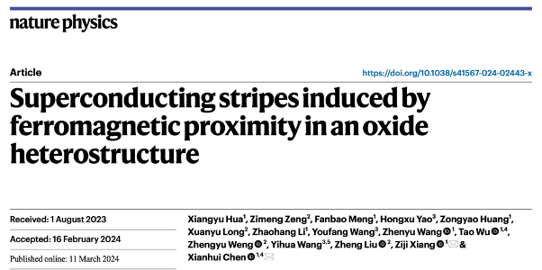
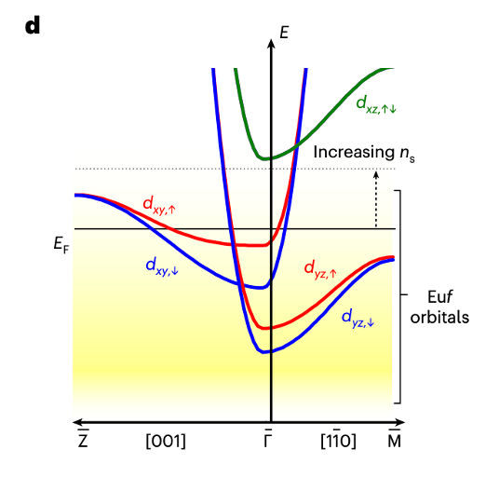
Emergent superconducting stripes in two-orbital superconductors
Q. Qin & YF, arXiv:2508.14632 (2025)

Slide 12
What can we learn from nickelates?

Slide 13
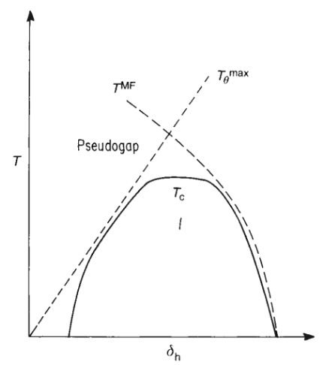
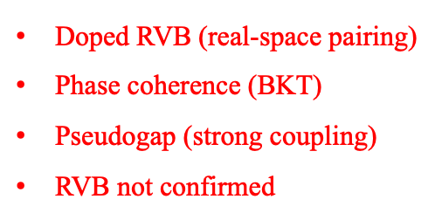
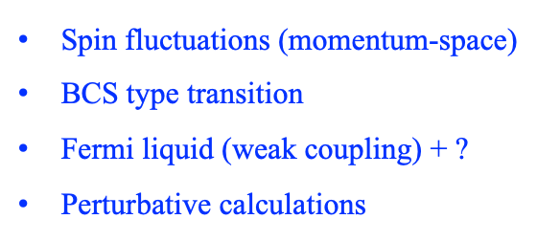
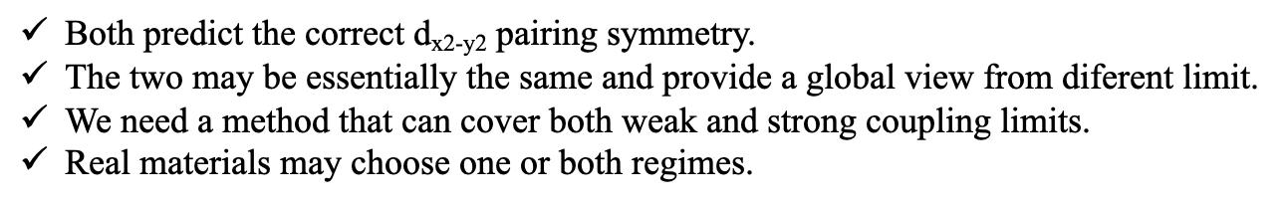
Momentum-space vs. real-space pairing

Slide 14
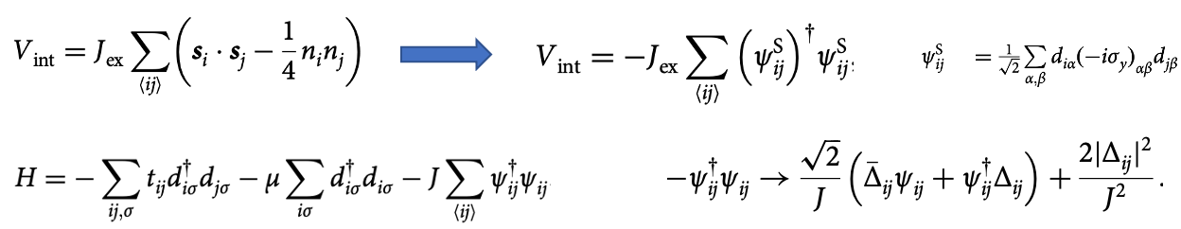
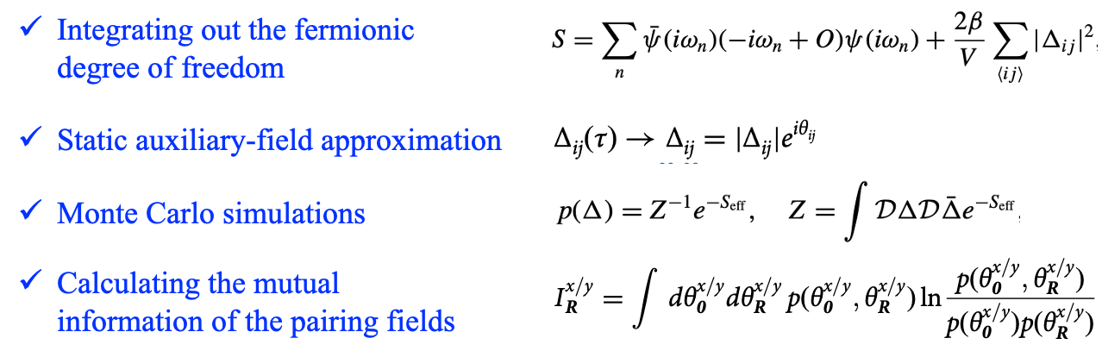
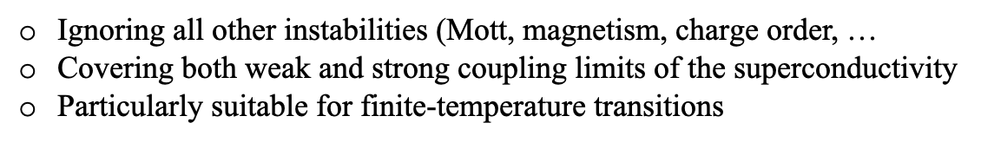

Static auxiliary-field Monte Carlo

Slide 15
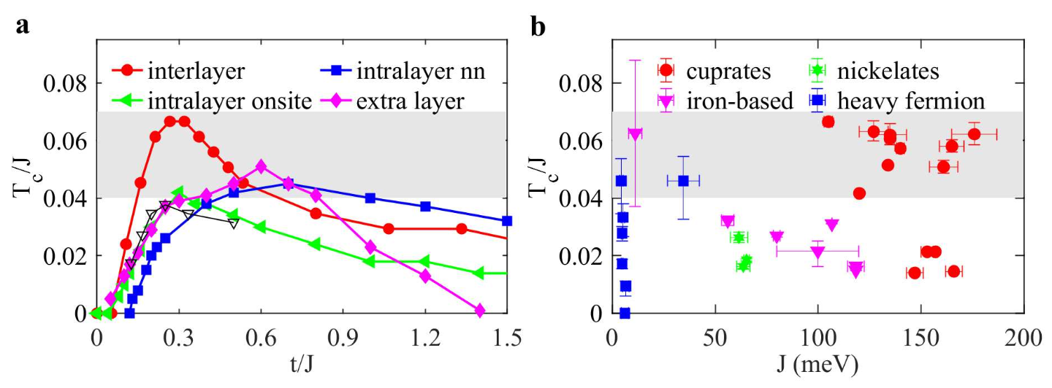

Can we further improve the maximum Tc?
Infinite-layer nickelates could host higher Tc ? (new 40 K samples? or pressure tuning?)
Most iron-based SC (except 11 & 1111) also has low ratios, why?
X
X
La3Ni2O7 ?
RNiO2
maximum Tc ~ 0.04-0.07 J
Tc=300 K requires J > 400-700 meV (@ optimal t/J)
Q. Qin & YF, npj Quantum Mater. 10, 13 (2025)

Slide 16
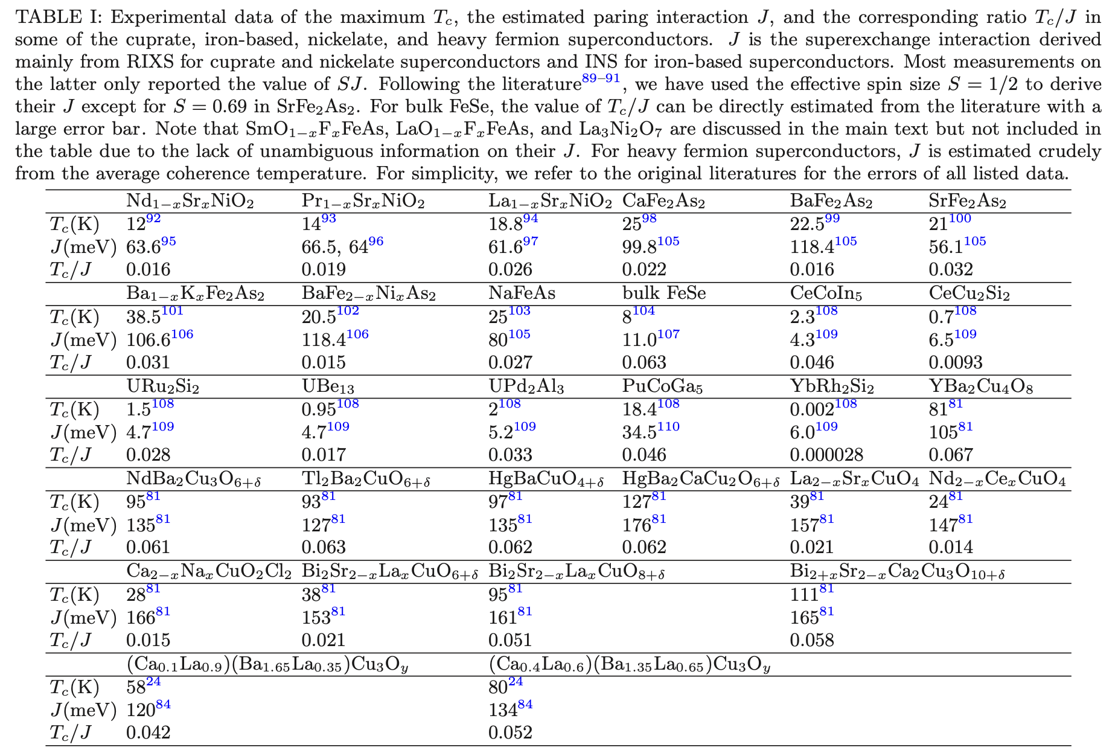

Slide 17
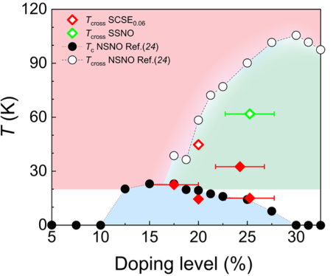
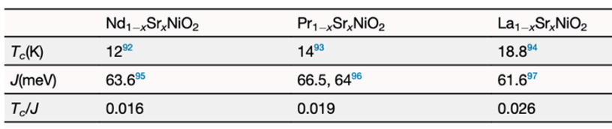
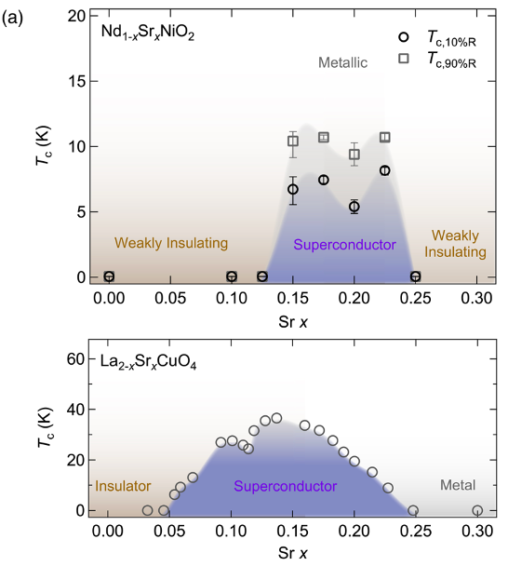
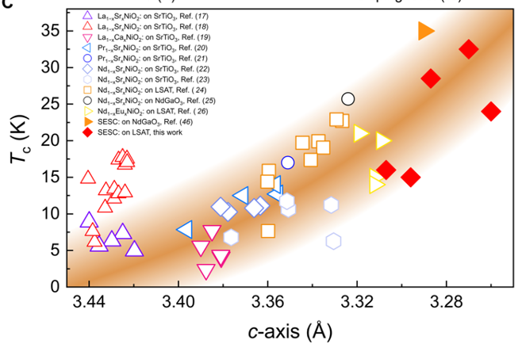



Revisit the infinite-layer nickelates

Slide 18
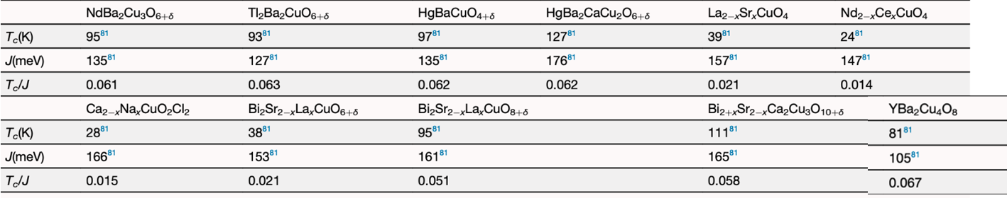
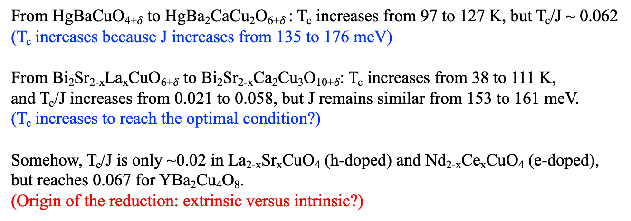
Revisit the cuprate superconductors
Q. Qin & YF, npj Quantum Mater. 10, 13 (2025)

Slide 19
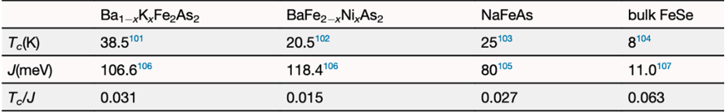


Revisit the iron-based superconductors
Q. Qin & YF, npj Quantum Mater. 10, 13 (2025)

Slide 20





Can we achieve the room-temperature SC?

Slide 21




Materials design from real-space pairing

Slide 22
Summary
q The minimal effective model: Two-orbital t-V-J model
q Hund: important for flatband
q Pairing: Two-component theory, anisotropic s±-wave
q Maximum Tc: ~0.04-0.05 J (bilayer); 0.02-0.03 J (trilayer)
q Non-Fermi liquid normal state: Near optimal doping
q dz2 metallization: crucial (Jiangfan Wang’s talk)
Maximum Tc ~ 0.04-0.07 J
Real-space route for materials design of more high-Tc superconductors

