Slide 1
Software Development Project
Dashboard for ROS-based System
January 16, 2020

Slide 2
Team Members
1. Lokesh Veeramacheneni
2. Zuha Karim
3. Anargh Viswanath

Slide 3
Problem Setting
In ROS-based system running on a robot and being controlled remotely - several
processes being carried-out simultaneously.
• Serious problem ! Some process stops eg.Nodes! Application Failure.
• Need for efficient and real-time monitoring for remedial measures.

Slide 4
Project Objective
Developing a Dashboard UI for monitoring the ROS system running on a robot remotely through a computer system via web services.

Slide 5
Client and Requirements
Client: Deebul Nair
It is intended to be used by RoboCup @work lab.
Requirements:
1. Should be implemented inside Cockpit - open web-based interface for servers.
2. Smooth monitoring of ROS and Robot’s system metrics.
3. Effortless visualization of ROS Nodes.
4. Start and kill the ROS nodes(if possible).

Slide 6
Main Components of Software
1. Cockpit - Integrated open web-based interface for GNU/Linux server.
Features of Cockpit:
Monitor and administer several servers at the same time.
Uses the system’s normal user logins and privileges by
default.
Network login supported.
When inactive, no extra load on the server.

Slide 7
Main Components of Software
Inbuilt packages show the status of the system.
Embedded terminal present within interface.
2. ROS Kinetic - Installed on the robot which has to be monitored.

Slide 8
Coding standards
1. Python
PEP8
2. Javascript / HTML
Google JavaScript Style Guide
Software Development Project - Dashboard for ROS-based System 6/1
3. Bash Script

Slide 9
Organization of Work
Project development, management and release carried out through Git hub
• Each member has a separate branch for development.
• Master branch has reviewed components merged from branches.
• Issues, Sprints and progress also being placed.
• Link to Github Repository

Slide 10
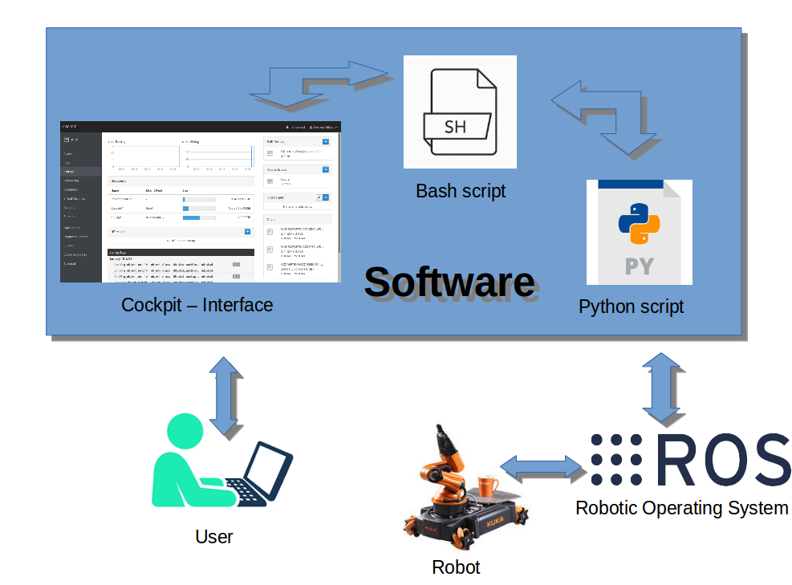
Project Implementation
Figure 1: Working of Software

Slide 11
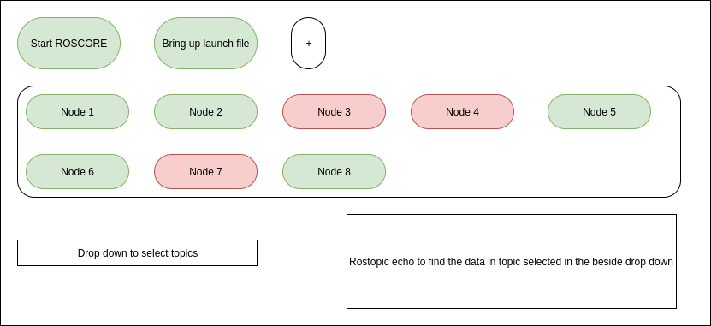
Dashboard Layout
Figure 2: Layout of Dashboard

Slide 12
Problems occurred during development
• Creating packages inside ROS.
• Connecting Cockpit to ROS.

Slide 13
Module I
Start and Kill Rosmaster. Selecting Launch file Description.

Slide 14
Module 2
Getting the node status from launcher and display.

Slide 15
Module 3
Getting the rostopics and diplaying details.

Slide 16
Development Status - Capabilities
• Easy installation of Cockpit and Dashboard inside system.
• The Dashboard can start and kill ROS master.
• Display the status of ROS nodes inside selected launch file.
• Display information about the ROS topics.

Slide 17
Development Status - Limitations
• Certain GUI based nodes not launched from Dashboard.
• The feature for starting and killing nodes not developed.

Slide 18
Development Status - Wish List
• Small wish - Incorporating the feature for starting and killing nodes for
better usage.
• Big Dream - Dashboard able to control all aspects of ROS.

Slide 19
Demonstration
Demonstration of the system

Slide 20
Summary
• Implemented Software-development practices for developing a Dashboard for
monitoring ROS-based system via web services.
• Completed the basic package for the client’s initial requirements.
• The software can be extended and improved through further work.

