Slide 1

AUTOMATING BIRTHDAY WISHES: CREATING A WHATSAPP BOT WITH PYTHON

Slide 2

INTRODUCTION
Welcome to the world of automating birthday wishes using Python. In this presentation, we will explore the process of creating a WhatsApp bot to send personalized birthday wishes automatically.

Slide 3

WHY AUTOMATE BIRTHDAY WISHES?
Automating birthday wishes saves time, ensures no birthdays are missed, and adds a personal touch. With a WhatsApp bot powered by Python, you can streamline the process and make it more e cient.

Slide 4

UNDERSTANDING WHATSAPP API
The WhatsApp API allows interaction with the messaging platform. Through Python, we can utilize this API to send automated birthday wishes.
Understanding this API is crucial for building our WhatsApp bot.

Slide 5

SETTING UP PYTHON ENVIRONMENT
To build the WhatsApp bot, we need to set up a Python environment with the necessary packages such as twilio and ﬂask. These packages will enable us to connect with the WhatsApp API and create a bot.

Slide 6

CREATING THE BIRTHDAY WISHES DATABASE
We will create a database of birthday wishes using Python and SǪLite. This database will store personalized messages for di erent contacts, allowing our WhatsApp bot to send unique wishes to each recipient.

Slide 7
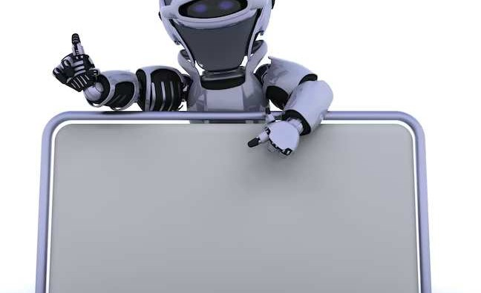
BUILDING THE WHATSAPP BOT
Using Python and the twilio package, we will build the WhatsApp bot. This bot will fetch birthday data from the database and send automated wishes to contacts at the speciﬁed time, making the process seamless and e cient.

Slide 8
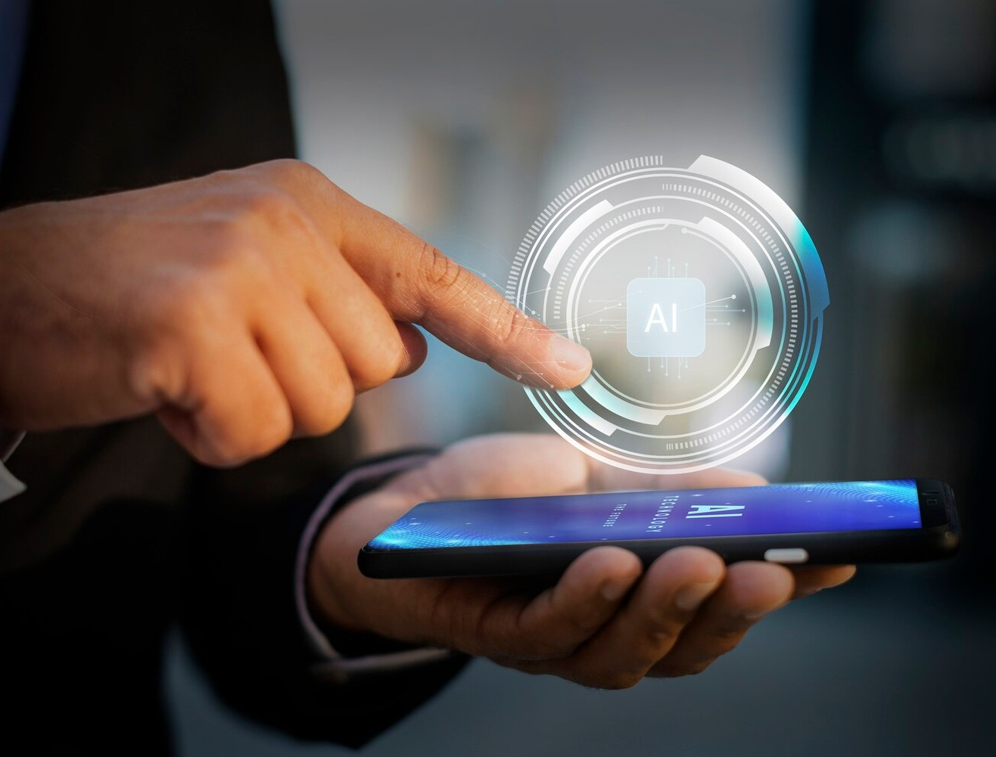
TESTING AND DEPLOYMENT
Before deployment, thorough testing of the WhatsApp bot is essential to ensure it functions as intended. We will explore best practices for testing and then discuss deployment options to make the bot operational.

Slide 9
CONCLUSION
In conclusion, automating birthday wishes with a WhatsApp bot using Python is an e ective way to streamline the process and add a personal touch to each message. By leveraging the WhatsApp API and Python's capabilities, we can make the process e cient and enjoyable.

Slide 10




Thanks!
Do you have any questions? youremail@email.com
+91 620 421 838
www.yourwebsite.com @yourusername

