Slide 1
Aspect-Based Sentiment Analysis for Automated Product Review Analysis Using Natural Language Processing
Project presentation

Slide 2
The problem
The screen is gorgeous and the keyboard feels great, but the battery life is terrible.
• Traditional sentiment analysis: one label for the whole review
• What a seller needs: screen positive, keyboard positive, battery life negative
• Reading every review by hand does not scale

Slide 3
Objectives
1. Extract product aspects with a learnt model, with no hard-coded aspect list
2. Classify the sentiment towards each aspect
3. Measure both on a standard benchmark and against a non-neural baseline
4. Deliver a working web application

Slide 4
Dataset: SemEval-2014 Task 4
• Laptop and restaurant review sentences, annotated by people
• Aspect terms with character offsets and polarity
• Official gold test set used unchanged; duplicates and train/test overlaps removed
Domain | Training | Validation | Test
laptops | 2723 | 303 | 800
restaurants | 2726 | 303 | 800

Slide 5
Method: two stages
review -> clean, split, tokenise
-> BERT token classifier (BIO tags: which words are aspects?)
-> BERT sentence-pair model ([CLS] sentence [SEP] aspect [SEP] -> sentiment)
-> aspect-sentiment map + overall sentiment
• Both start from bert-base-uncased, fine-tuned end to end
• A third model gives the traditional single label, for comparison

Slide 6
Why BIO tags
The battery life is great but the screen is dim
O B-ASPECT I-ASPECT O O O O B-ASPECT O O
• Multi-word aspects are one unit
• Adjacent aspects stay separate
• No stop-word removal: BERT needs "not" and "but"

Slide 7
System
React + TypeScript -> FastAPI -> ABSA pipeline (3 BERT models)
-> SQLite (review history)
• Analyzer, batch CSV analysis, history, dashboard
• Every metric and document is regenerated by script
• Automated tests for backend and frontend

Slide 8
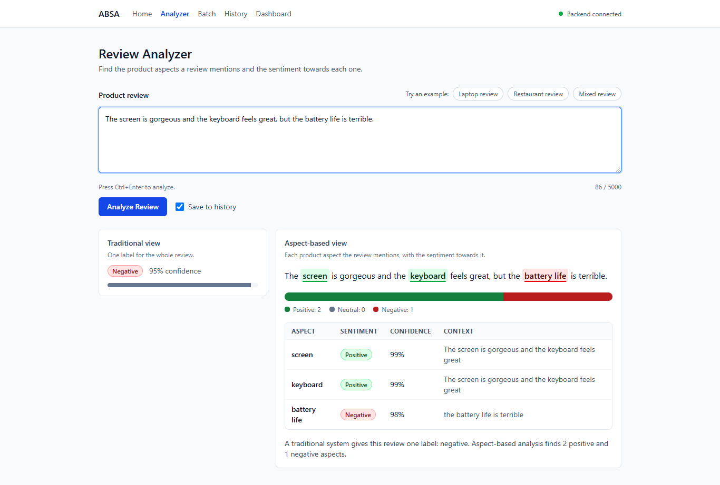
Application: analyzing one review

Slide 9
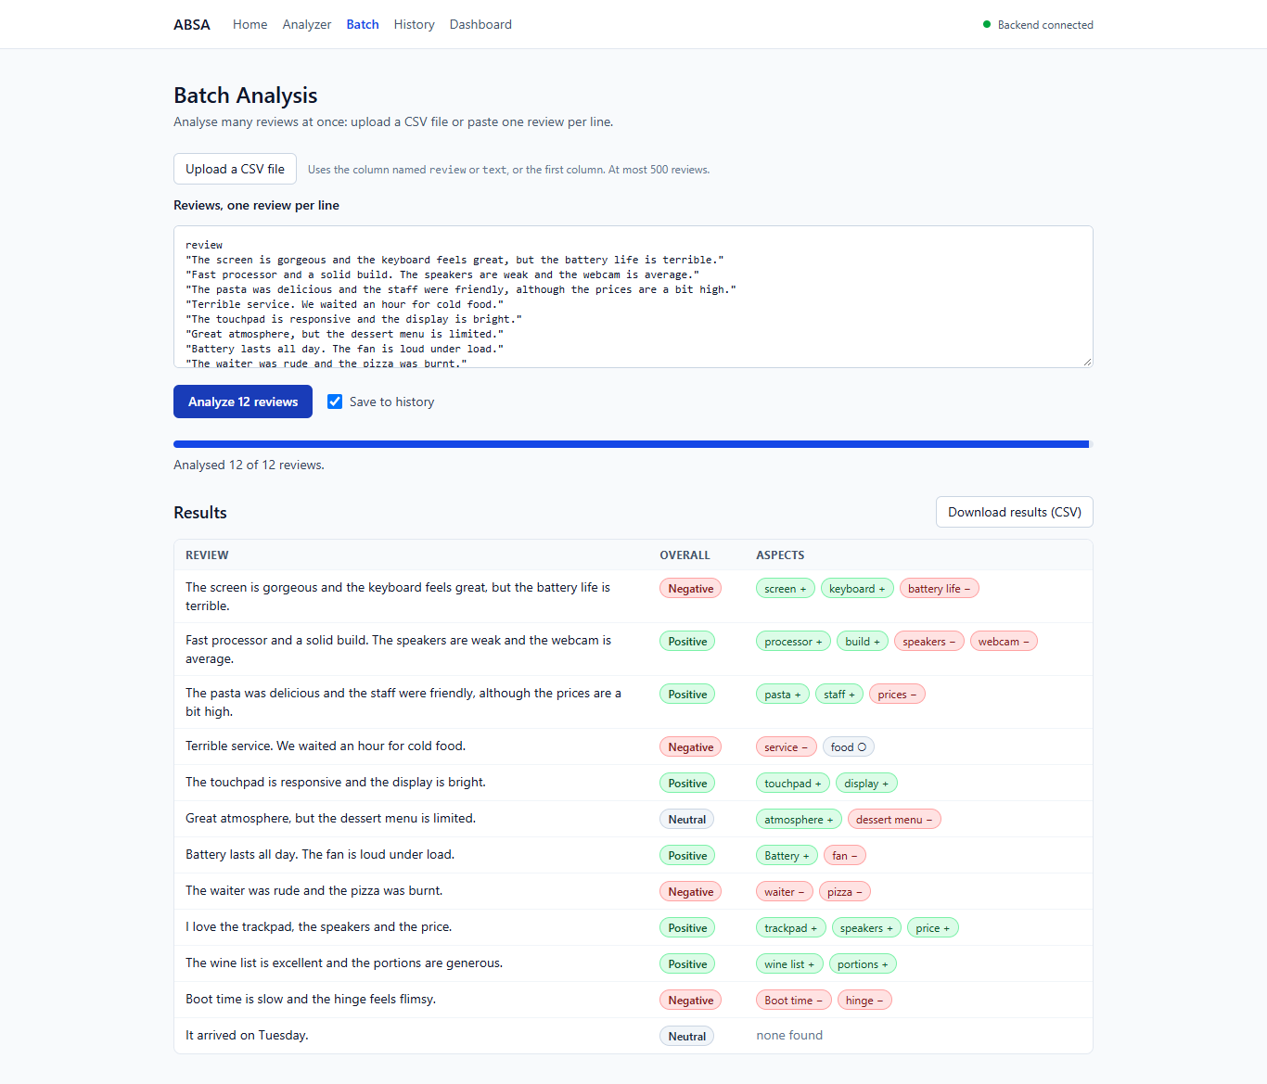
Application: batch analysis of a CSV file

Slide 10
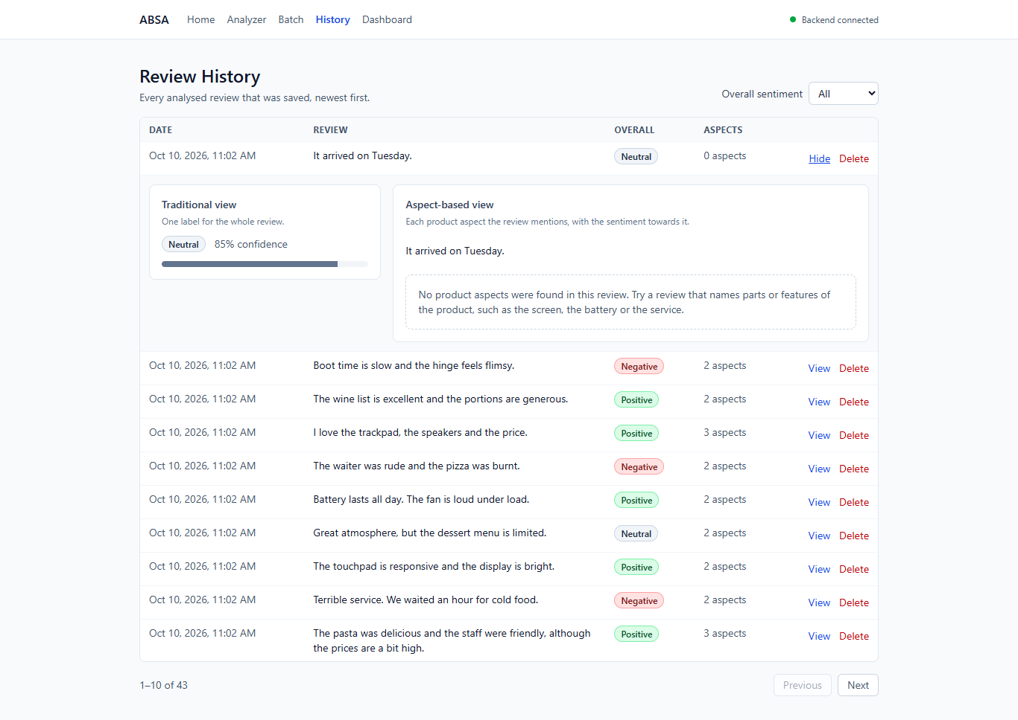
Application: review history

Slide 11
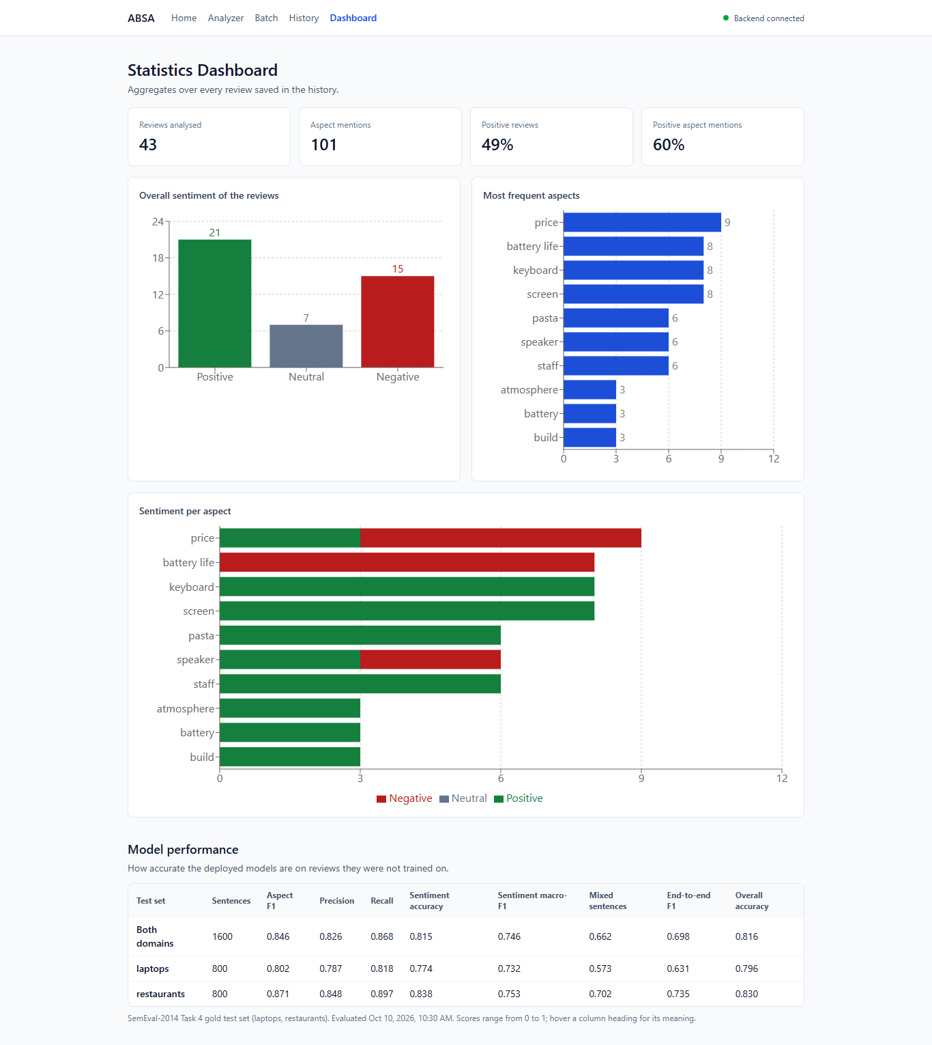
Application: dashboard and model performance

Slide 12
Results on the test sets
Metric | Both domains | Laptops | Restaurants
Aspect extraction F1 | 0.846 | 0.802 | 0.871
Aspect sentiment accuracy | 0.815 | 0.774 | 0.838
Aspect sentiment macro-F1 | 0.746 | 0.732 | 0.753
End-to-end F1 | 0.698 | 0.631 | 0.735
Exact span match; end-to-end requires aspect and sentiment both right.

Slide 13
What BERT adds
Baseline: noun phrases as aspects, opinion-word lexicon for sentiment. Same data, same metrics.
Metric | Baseline | BERT
Aspect extraction F1 | 0.376 | 0.846
Aspect sentiment accuracy | 0.663 | 0.815
Aspect sentiment macro-F1 | 0.616 | 0.746
End-to-end F1 | 0.253 | 0.698

Slide 14
Transfer to an unseen domain
Restaurant test set: an aspect extractor trained on laptops only against the one trained on both domains.
Metric | Trained on laptops only | Trained on both
Aspect extraction precision | 0.892 | 0.848
Aspect extraction recall | 0.234 | 0.897
Aspect extraction F1 | 0.370 | 0.871

Slide 15
Where it still fails
• Aspects in sentences with one sentiment: accuracy 0.851
• Aspects in sentences that mix sentiments: accuracy 0.662
• Negative class F1: 0.749
• Neutral class F1: 0.581
• Positive class F1: 0.906
• Only explicit aspects are found

Slide 16
Limitations
• Training data: two domains, from 2014
• One training run, one seed, no confidence intervals
• Overall-sentiment labels are derived, not annotated
• Confidence values are not calibrated

Slide 17
Demo
1. Analyze a laptop review and a restaurant review
2. A review with no aspect
3. Batch: upload a CSV, export the results
4. History and dashboard
Script: docs/demo.md

Slide 18
Conclusion and future work
• A complete, tested ABSA system with reproducible evaluation
• Next: more data with contrasting aspects, aspect position in the input, several seeds, implicit aspects, more product categories
Thank you. Questions?

